Slide 1

Global Project Management
Lecture 5
Everyone’s Smart
University
PMG 661
Global Project Structure

Slide 2

Global Project Structure
International projects can be structured in different ways, depending on the project size, complexity, types, organizational structures and the creation of work packages according to functional or regional criteria. The maturity level of the organization on global project management and the level of experience of the project manager, project coordinators and team members on global projects are also key factors when choosing between the different project structures.

Slide 3
Global Project Structure
This lecture shows some examples of these basic structures, keeping in mind that experienced project managers will often apply a combination of them according to the organizational culture and the availability of resources. Some organisations may prefer to have mainly collocated teams and opt for the structures with local coordinators, while others prefer to employ virtual teams and can opt for the centralised structure.

Slide 4
Global Project Structure
The first group of organisations can have difficulty in finding resources available in the right location, and can use expatriation and temporary assignments to fill their requirements . The second group will employ the right resources in any possible company location, and need to have a high maturity in project management and worldwide adoption of the Global Project Management Framework.

Slide 5
Centralized project management
In the first form of project structure , Figure below all team members report directly to the project manager, who performs most of the coordination and control tasks using collaborative tools . The projects can have a centralized form when the level of complexity of the coordination activities is relatively low, or when other forms are not applicable. Some examples:

Slide 6
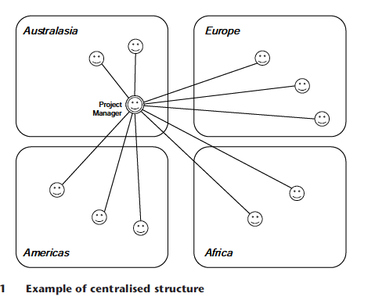
Centralized project management

Slide 7
Centralized project management
When the size and complexity of the project are small enough to allow effective coordination over distance.
When the dispersion degree is high among team members and the size of each local team does not justify assigning local coordinators.

Slide 8
Centralized project management
When the team members working in different locations are familiar with collaborative tools and different cultures, and like to work independently – having a proven record of delivering their tasks on time without close coordination.
When the use of other structures is not possible because local coordinators are not available.

Slide 9
Centralized project management
Some recommendations to project managers working with centralised project teams are:
to train all team members on the collaborative tools, cultural differences and all other areas discussed in this book;
to study and apply the good practices on global team leadership and the other topics.

Slide 10
Centralized project management
to identify team members with good communication and coordination skills, who can work as local coordinators on future projects (allowing the use of the project structures described in the next sections).

Slide 11
Distributed project management, with local coordinators
This is the recommended structure for most global projects. All or most of the team members report to local coordinators, who are responsible for the planning and execution of sub-projects or work packages, depending on the project complexity Figure below.

Slide 12
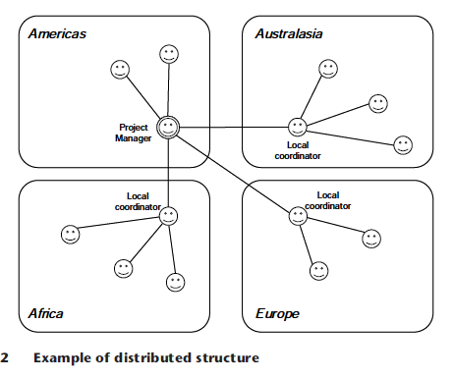
Distributed project management, with local coordinators

Slide 13
Distributed project management, with local coordinators
In other situations, each local team receives a detailed definition of their scope of work and performs their tasks autonomously. Key team members can be involved in a detailed definition of the interfaces between tasks performed by different teams, and between the deliverables produced by different teams.

Slide 14
Distributed project management, with local coordinators
The need for communication over distance may be reduced to the monitoring and control performed by the project manager, and to the follow-up meetings among all local coordinators. This avoids misunderstandings and reduces the amount of work outside office hours when the teams work in different time zones. Some situations when global projects can benefit from distributed structures are:

Slide 15
Distributed project management, with local coordinators
when the international companies are organized using local competence centers, and most work packages group the activities from a functional perspective;
when competencies are distributed and every location can develop a complete component of the final product;
when a cultural or geographical proximity to the final customers is important.

Slide 16
Distributed project management, with local coordinators
Project managers with distributed teams will need to perform coaching, training and organize meetings over distance with a limited number of local coordinators, while these will manage their own teams without the barriers created by different languages, time zones, cultures and distance.

Slide 17
Distributed project management, with local coordinators
All knowledge and practices for global project management will be implemented and employed by the project manager and local coordinators. The local team members will learn these practices by participating in the meetings, using the project collaboration devices and attending the cultural workshops.

Slide 18
Distributed project management, with functional coordinators
This is the recommended structure when the complexity or size of the work packages demands a group of knowledgeable people coordinated by experienced or specialised coordinators, all in different locations Figure below.

Slide 19
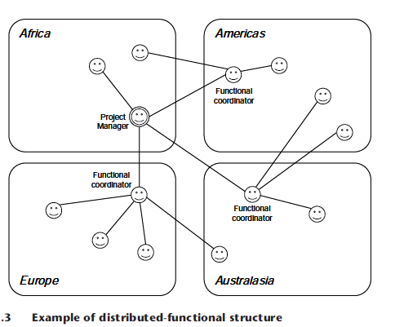
Distributed project management, with functional coordinators

Slide 20
Distributed project management, with functional coordinators
Some examples are:
when organisations allocate people to projects based on their knowledge and availability, not their location;
when companies are organized on functional competence centres, and each work package includes many cross-functional activities;

Slide 21
Distributed project management, with functional coordinators
when competencies are distributed across locations, and the project work packages are grouped on a functional perspective;
when the project team must include team members close to the customers or key stakeholders.

Slide 22
Distributed project management, with functional coordinators
There is an important difference between the two distributed structures. The functional coordinators working with team members in different countries must receive training and coaching in global communication and collaboration tools, and transfer this knowledge to all distributed team members.

Slide 23
Distributed project management, with functional coordinators
Most meetings happen over distance and must avoid the barriers created by the different languages, time zones, cultures and distance. The project manager, local coordinators and most team members must learn and employ the knowledge and practices in the Global Project Management Framework.

Slide 24
Round-the-clock project management
Organisations with a high level of maturity on their processes can deploy specialized teams strategically located around the globe to reduce the time to complete the deliverables, or to implement them in customers dispersed geographically.

Slide 25
Round-the-clock project management
The communication methods among the different teams and project managers must be clearly defined and understood by all parties, the level of integration and teamwork must be extremely high, usually with a global work authorization system in place.

Slide 26
Round-the-clock project management
The benefits achieved by global organisations are often worth the effort in setting up this structure, which is very similar to distributed project management. The main difference is the high degree of independence of the project managers, which makes them share the responsibilities of updating the project records, preparing presentations to the stakeholders and taking strategic decisions Figure below.

Slide 27
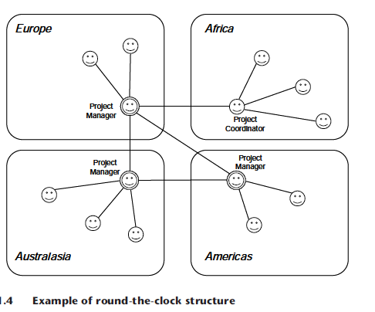
Round-the-clock project management

Slide 28
Project management global network
This is another variant of distributed project management, when the local coordinators work for different organisations. This is the usual structure of projects that employ outsourcing, offshoring and out-tasking strategies for the execution of certain work packages or activities in Figure below .

Slide 29

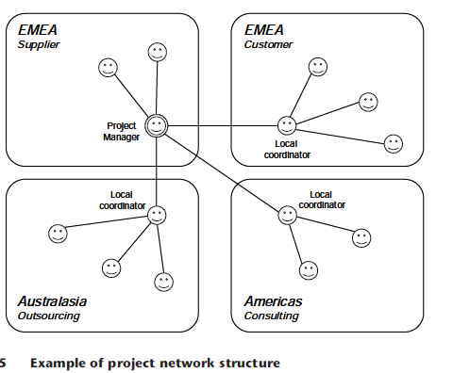
Project management global network

Slide 30
Project management global network
The added challenge of this structure is the need for the project manager to understand and synchronize different organizational cultures and country cultures in the same project. This type of project organization is very common, and often the main reason for project failures involving different companies around the globe.

Slide 31
Resources:
Global Project Management
Communication, Collaboration and Management Across Borders
© Jean Binder 2007
Chapter 11

