Slide 1



Supply Chain
Management
Prepared by Dr. Tarek Mohamed
MGM 660
Orientation Show

Slide 2


Course Agenda
1-Introduction about the professor of the course.
2-Introduction to the course.
3-Primary goal of this course.
4-Learning outcomes.
5-Learning resources.
6-Units of course contents.
7-Assessment method.
8-Academic calendar.
www.midocean.ae

Slide 3
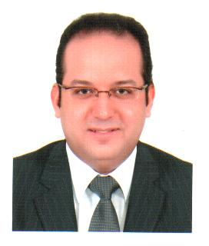
Who Am I ?
Dr. Tarek Mohamed
Doctorate degree in Business Administration- Cairo University.
Master degree in Business Administration- Arab Academy for Science & Technology and Maritime Transport .
Executive Management Diploma- The American University in Cairo.
Senior Lecturer at Post-Graduate Studies and Research Department - Faculty of Commerce -Cairo University.
Supply Chain Consultant & Certified Trainer in manufacturing and service fields.
Professional Consultant of applying Value Chain framework analysis at manufacturing companies.
www.midocean.ae

Slide 4
How to reach me ?
By Email : tarek.mohamed @ esu.ac.ae
Pls include“ Supply Chain Management ” in the subject line.
Via Moodle messages.
Zoom Meeting.
Discussion time at Tuesday ( 9-10 PM ) Every Week.
www.midocean.ae

Slide 5

What is Supply Chain Management
All stages involved, directly or indirectly, in fulfilling a customer request.
Includes manufacturers, suppliers, transporters, warehouses, retailers, and customers.
Within each company, the supply chain includes all functions involved in fulfilling a customer request (product development, marketing, operations, distribution, finance, customer service).
www.midocean.ae

Slide 6

What is Supply Chain Management
All parties involved directly/indirectly in fulfilling customer needs/demands.
All facilities, functions, activities, associated with flow and transformation of goods and services from raw materials to customer, as well as the associated information flows.
An integrated group of processes to “Plan,” “Source,” “Make,” and “deliver” products to customers.
www.midocean.ae

Slide 7


Supply Chain Structure
www.midocean.ae

Slide 8

Primary Goal of this Course
Explaining how to build a strategic framework to analyze supply chains.
Identifying how to manage cross-functional drivers in a supply chain.
Describing the designing process of the supply chain network.
Identifying the planning and coordinating demand and supply in the supply chain.
Understanding how to plan and manage inventories in the supply chain.
Explaining the designing and planning of transportation networks in the supply chain.
www.midocean.ae

Slide 9

Learning Outcomes
At the end of the course, the students will be able to understand :
The important role of supply chains in today’s business and economy.
A wide scope of functions and concepts in supply chains.
The main components of supply chains.
The key drivers of good supply chain management to create a competitive advantage.
Apply conceptual decision-support to supply chain related decision problems.
The unique characteristics and issues of supply chains.
How to utilize the strategic framework concepts used in this text to achieve significant increases in performance.
www.midocean.ae

Slide 10


Learning Resources
TITLE OF SLIDE
Credit Hours: 3 Credit Hours.
Required Textbook :
Supply Chain Management-Strategy, Planning and Operation, Sixth Edition, Sunil Chopra and Peter Meindl,Pearson Education Limited.
Essential References :
The main material and reference for each course will be the textbook mentioned in the course specifications,lecture notes and slides are additional resources that are prepared by the professor.
www.midocean.ae

Slide 11

Units of Course contents
TITLE OF SLIDE
Course Unit | No.of. Weeks | Contact Hours
Part I Building a Strategic Framework to Analyze Supply Chains
Lecture 1- Understanding the Supply Chain | 1st | 3
Lecture 2- Supply Chain Performance: Achieving Strategic Fit and Scope | 2nd | 3
Lecture 3- Supply Chain Drivers and Metrics | 3rd | 3
Part II Designing the Supply Chain Network
Lecture 4- Designing distribution network in the Supply Chain | 4th | 3
Lecture 5- Network design in the Supply Chain | 5th | 3
Part III Planning and Coordinating Demand and Supply in a Supply Chain
Lecture 6- Demand forecasting in a supply chain | 6th | 3
Lecture 7- Aggregate planning in a supply chain | 7th | 3
Part IV Planning and Managing Inventories in a Supply Chain
Lecture 8 -Managing economies of scale in a supply chain: Cycle Inventory | 8th | 3
Part V Designing and Planning Transportation Networks
Lecture 9 -Transportation in a Supply Chain | 9th | 3
Part VI Managing Cross-Functional Drivers in a Supply Chain
Lecture 10- Sourcing decisions in a supply chain | 10th | 3
www.midocean.ae

Slide 12

Assessment Method
TITLE OF SLIDE
Short Exam:
80% marks
Count of short Exam 10 ( Weekly)
8 Marks for each of the short Exam.
20% Final Exam
www.midocean.ae

Slide 13
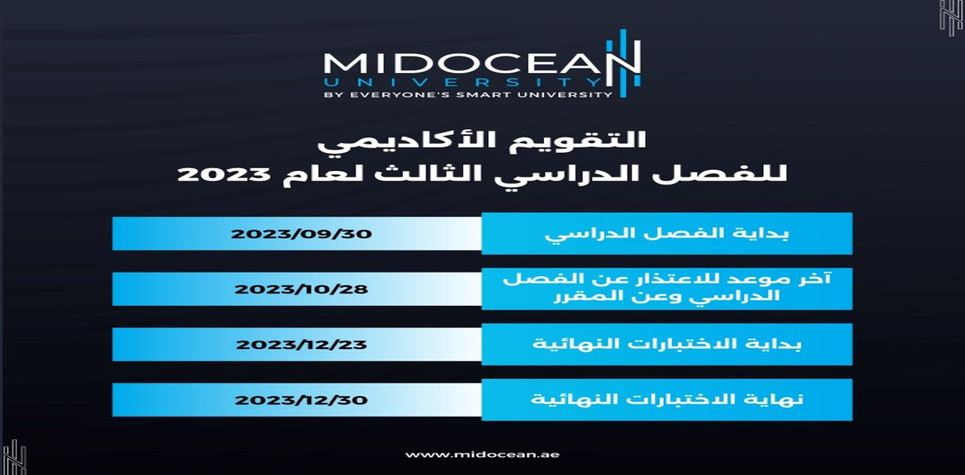
Academic Calendar
TITLE OF SLIDE

Slide 14
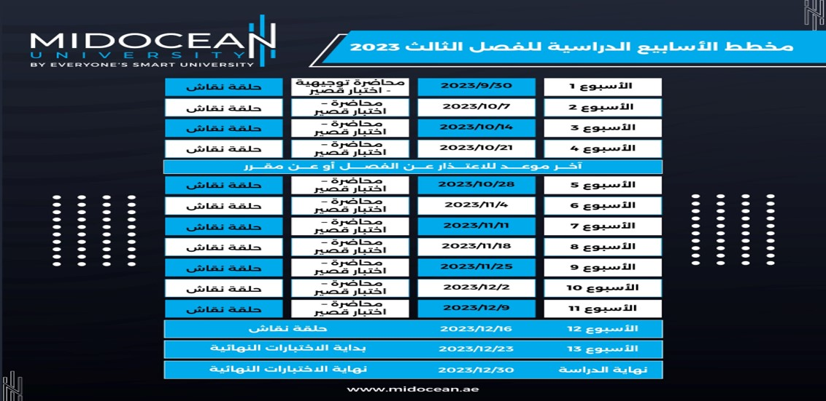
Academic Weeks Agenda for the Third Trimester 2023
TITLE OF SLIDE

Slide 15


Slide 16



Thank You

