Slide 1


College of Humanities
Master of Financial
Technology-
FinTech
Business Analysis
FNT613
Second Lecture
Prepared By:
Dr. Abeir Moussa

Slide 2



Strategy Analysis
2nd Lecture
FNT613
Prepared By:
Dr. Abeir Moussa
www.midocean.ae

Slide 3


Strategy Analysis
Week3
Chapter2
www.midocean.ae

Slide 4

Learning objectives
Understanding what strategy is and why it is important;
Exploring some ideas about how strategy is developed;
Understand the Implementing of strategy;
Understand the challenges of developing and implementing strategy
Exploring the tools for analyzing the external environment
Exploring how can organizations assess their internal resources and capabilities
Understand the role of strategic leadership in executing strategy
Working out what all of this means for business analysts.
www.midocean.ae

Slide 5
Chapter outline
Introduction
The Context for Strategy
What is strategy?
Strategy Development
External Environment Analysis
Internal Environment Analysis
SWOT Analysis
Executing Strategy
www.midocean.ae

Slide 6
INTRODUCTION
Strategy analysis is the process of evaluating an organization's strategy to assess its effectiveness and identify areas for improvement. It involves examining various aspects of the strategy, such as its alignment with the organization's goals, competitive advantage, market conditions, and resource allocation. Here are some key steps involved in strategy analysis:
www.midocean.ae

Slide 7
INTRODUCTION
The key steps involved in strategy analysis:
Understand the organization's goals and objectives
Assess the external environment
Evaluate internal capabilities
Analyze the current strategy
Identify strategic options
Conduct a risk analysis
Make recommendations
www.midocean.ae

Slide 8
1. THE CONTEXT FOR STRATEGY
Most of people would probably support the idea that business is becoming increasingly unpredictable and changes are more turbulent, with international mergers and acquisitions once again becoming regular features of business life as economies come out of the post-banking crisis recession.
The information revolution and the digital economy have caused much of this dramatic change and barriers between previously separate businesses are falling like dominoes.
www.midocean.ae

Slide 9
1. THE CONTEXT FOR STRATEGY
There are some big changes that organizations face and that strategy development tries to moderate: there are the changes to the ways that businesses are employed.
The growth of knowledge-based industries and the continuous change experienced by organizations means that individual employees, consultants or contractors – permanent, full-time or part-time – have become valuable assets.
www.midocean.ae

Slide 10
1. THE CONTEXT FOR STRATEGY
This is more than ever the case as organizations everywhere, in both Government and commercial sectors, flatten their organization structures, decentralize decision-making and give more freedom to individuals to make decisions, deal with customers and resolve problems.
Freedom of information legislation means that individuals have access to evidence and decisions taken by government that were previously hidden
www.midocean.ae

Slide 11
1. THE CONTEXT FOR STRATEGY
Our attitudes to change, direction, reorganization and other people knowing better than we do have shifted and the development and implementation of new strategies need to take this into account.
Organizations are responding to these changes by doing everything they can to increase their flexibility and responsiveness.
Developing strategy is seen as a ‘hard’ discipline like finance and technology but the creativity and change skills that make strategy work are the ‘soft’ skills.
www.midocean.ae

Slide 12
1. THE CONTEXT FOR STRATEGY
Therefore, How can anyone create, formulate or build a strategy if the future is inherently unknowable and unpredictable, and how can it be implemented in a coherent way in decentralized structures with delegated authorities and an ever-changing environment?
This makes it appear very difficult for a business analyst to understand the nature and permanence – or impermanence – of the business strategies against which IS strategies are to be built.
www.midocean.ae

Slide 13
2. WHAT IS STRATEGY?
The concept of strategy begins in a military context and the word strategy is derived from the Greek word ‘strategia’ which means ‘generalship’.
It has a ‘getting ready for battle’ sense to it and the deployment of troops, weapons, aircraft and ships before engagement with the enemy begins.
The transfer of these ideas into business is easy to make, therefore, and we expect to deal with.
www.midocean.ae

Slide 14
2. WHAT IS STRATEGY?
The goal or mission of the business. In strategy terms this is often referred to as the direction.
The time frame. Strategy is about the long term. The problem here is that it differs widely across industries, with petrochemicals and pharmaceuticals at the really long end and domestic financial services products at the short end.
www.midocean.ae

Slide 15
2. WHAT IS STRATEGY?
A popular definition appears in Johnson, Scholes and Whittington (2008):
Strategy is the direction and scope of an organization over the long term, which achieves advantage in a changing environment through its configuration of resources and competences with the aim of fulfilling stakeholder expectations.
However, writers and gurus have offered their own definitions for at least the last 40 years including George Steiner (1979) who did not so much define it as paint a picture of it by saying that strategy is:
What top management does;
About direction;
The process that sets in motion the important actions necessary to achieve these directions;
What the organization should be doing.
www.midocean.ae

Slide 16
2. WHAT IS STRATEGY?
But finally, Johnson, Scholes and Whittington (2008) provide a helpful definition of the issues to be considered during strategy analysis as follow;
The long-term direction of an organization;
The scope of an organization's activities;
Advantage for the organization over competition;
Strategic fit with the business environment;
The organization's resources and competences;
The values and expectations of powerful actors.
www.midocean.ae

Slide 17
2. WHAT IS STRATEGY?
levels of strategy
Strategies exist at different levels in an organization ranging from corporate strategies at the top level affecting the complete organization down to the operational strategies for product/services offerings. Typical levels of strategy could be:
Corporate Strategy
Business Unit Strategy (BUS)
Operational Strategy
www.midocean.ae

Slide 18
2. WHAT IS STRATEGY?
Corporate Strategy that is concerned with the overall purpose and scope of the business. Strategies at this level are influenced by investors, governments and global competition, and by the context set out earlier in this chapter. It is the basis of all other strategies and strategic decisions.
Business Unit Strategy. Below the corporate level are the strategic business units (SBUs). These are organizational units for which there are distinct external markets that are different from those of other SBUs. SBU strategies address choice of products, pricing, customer satisfaction, and competitive advantage.
Operational Strategy- focuses on the delivery of the corporate and SBU strategies through the effective organization and development of resources, processes and people.
www.midocean.ae

Slide 19
3. STRATEGY DEVELOPMENT
There are many different drivers for strategy development and strategy may be formulated in different ways.
Where a business is already established but needs a new direction, a new CEO may brought in to change the strategy in order to move the organization forward.
Alternatively, strategy may develop from the experiences and views of internal managers.
www.midocean.ae

Slide 20
3. STRATEGY DEVELOPMENT
Groups of managers may meet regularly to review trends in the market and their own business progress; they plan new actions and try them out.
Strategy then evolves in an incremental, negotiated way. Another possibility is to enable the generation of innovative ideas from within the organization so that the strategy emerges from the people who do the work.
www.midocean.ae

Slide 21
3. STRATEGY DEVELOPMENT
It is also possible to formulate strategy by adopting a formal, carefully planned, design process.
Different interest groups form around different strategic ideas or issues and compete for resources and the support of stakeholders to achieve the dominance of their ideas.
On this basis, strategic direction is not achieved through a universally accepted, rational analysis but through the promotion of specific ideas of the most powerful – and usually highly political – groups. This power comes from five main sources:
www.midocean.ae

Slide 22
3. STRATEGY DEVELOPMENT
The main five sources of power in strategic development
Dependency- The power of the human resources (HR) department increases if all new staff requisitions have to be authorized by HR.
Financial resources – where are the funds to invest in the development of new ideas, product or services?
What financial frameworks constrain or give freedom to different groups?
Position – where do the actors live in the organization structure and how does their work affect the organization's performance?
Uniqueness – no other part of the organization can do what the powerful group does.
Uncertainty – power resides with people and groups can cope with the unpredictable effects of the environment and protect others from its impact.
www.midocean.ae

Slide 23
3. STRATEGY DEVELOPMENT
Whichever approach is adopted and whatever the internal politics, the development of strategy always needs to incorporate some external analysis, for instance ‘what is happening out there?’, some internal analysis, such as ‘where do we fit in to what’s happening out there?’, plus some consideration of how new strategies could be executed.
www.midocean.ae

Slide 24
3. STRATEGY DEVELOPMENT
Once a strategy has been developed, it is important to provide a written statement of the strategy. This written statement is needed for many reasons:
It provides a focus for the organization and enables all parts of it to understand the reasons behind top-level decisions and how each part can contribute to its achievement;
It provides a framework for a practical allocation of investment and other resources;
It provides a guide to innovation, where new products, services or systems are needed;
It enables appropriate performance measures to be put in place that measure the key indicators of our success in achieving the strategy;
It tells the outside world, especially the outside stakeholders and market analysts, about the businesses and develops the expectations that they hold.
www.midocean.ae

Slide 25
4. EXTERNAL ENVIRONMENT ANALYSIS
Most organizations face a complex and changing external environment of increasing unpredictability.
With a little thought it would have been possible to identify the environmental trends but many of the more dramatic changes have come from surprising places. For example, the Sarbanes–Oxley Act of 2002 (SOX) was introduced in response to a number of major corporate and accounting scandals, most notably at Enron and Tyco International. Although it was clear that something had to be done, critics have claimed that SOX places US firms at a disadvantage compared to overseas competitors and imposes high additional costs on business.
www.midocean.ae

Slide 26
4. EXTERNAL ENVIRONMENT ANALYSIS
The External Environment Analysis is conducted using two models as follows;
PESTLE analysis
Porter’s Five Forces model
www.midocean.ae

Slide 27
4. EXTERNAL ENVIRONMENT ANALYSIS
PESTLE analysis
It is a framework to help organizations assess their broad environment. It is the PESTLE analysis – sometimes called as PEST analysis – it is an examination of the political, economic, socio-cultural, technological, legal, and environmental issues in the external business environment. Some of the influences which may be identified in these categories are shown below:
Political influences:
The stability of the government or political situation
Government policies – such as on social welfare
Trade regulations and tariffs
www.midocean.ae

Slide 28
4. EXTERNAL ENVIRONMENT ANALYSIS
2. Economic influences
Interest rates
Money supply
Inflation
Unemployment
Disposable income
Availability and cost of energy
The internationalization of business
Taken together these economic factors determine how easy – or not – it is to be profitable because they affect demand.
www.midocean.ae

Slide 29
4. EXTERNAL ENVIRONMENT ANALYSIS
3. Socio-cultural influences
Demographics – such as an ageing population in Europe
Social mobility – will people move to find work or stay unemployed where they are and rely on state support? This may also be seen as a political issue with an enlarged Europe enabling a freer movement of labor across the community
Lifestyle changes – such as changes in the retirement age and general changes in people’s views about work/life balance
4. Technological influences
Technological developments
Government spending on research, the quality of academic research, the ‘brain drain’
The focus on technology; demand for invention and innovation
The pace of technological change, the creation of technology enabled industries.
www.midocean.ae

Slide 30
4. EXTERNAL ENVIRONMENT ANALYSIS
5. Legal influences
Legislation about trade practices and competition
Employment law – employment protection, discrimination etc
Health and safety legislation
Company law
Financial regulation
www.midocean.ae

Slide 31
4. EXTERNAL ENVIRONMENT ANALYSIS
6. Environmental influences
Global warming and climate change
Animal welfare
Waste, such as unnecessary packaging
Environmental protection legislation such as new laws on recycling and waste disposal industries
It is important that we do not view PESTLE analysis as a set of checklists as these are not of themselves useful in making a strategic assessment.
The key tasks are to identify those few factors that will really affect the organization and to develop a real understanding of how they might evolve in the future.
www.midocean.ae

Slide 32
4. EXTERNAL ENVIRONMENT ANALYSIS
Porter’s Five Forces model
Few businesses have no competition, even those in the not-for-profit sector, and most seek to develop and keep a competitive advantage over their rivals.
Michael Porter’s Five Forces model (Porter 1980) is an analysis tool that helps to evaluate an industry’s profitability and hence its attractiveness.
In the centre is the competitive battleground where rivals compete and where competitive strategies are developed.
Additionally, they will be in a stronger position if they understand the interplay of the five forces and can develop defenses against the threats they pose.
www.midocean.ae

Slide 33
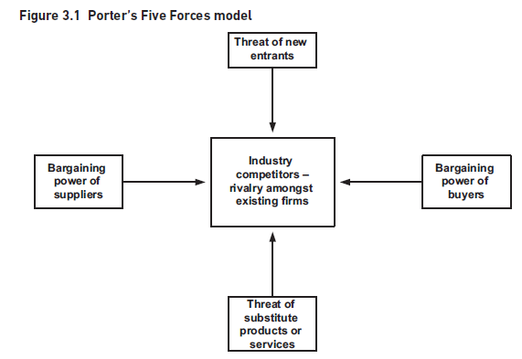
4. EXTERNAL ENVIRONMENT ANALYSIS
www.midocean.ae

Slide 34
4. EXTERNAL ENVIRONMENT ANALYSIS
Porter’s Five Forces model
New entrance:
New entrants may want to move into the market if it looks attractive and if the barriers to entry are low. Globalization and deregulation both give new entrants this opportunity but there are barriers to entry that organizations build. These include:
Economies of scale. This may be difficult to achieve for a new entrant.
Substantial investment required. A new entrant may have difficulty in obtaining sufficient funds for investment.
www.midocean.ae

Slide 35
4. EXTERNAL ENVIRONMENT ANALYSIS
Product differentiation. If existing products and services are seen to have strong identities, which are supported by high expenditure or branding, then new entrants may be deterred from entry.
Access to distribution channels. Existing distribution channels may be booked by existing suppliers requiring new entrants to find new and different distribution channels.
The existence of patented processes.
The need for regulatory approval, for example, in the financial and defense sectors.
www.midocean.ae

Slide 36
4. EXTERNAL ENVIRONMENT ANALYSIS
2. Supplier power limits the opportunity for cost reductions when:
There is a concentration of suppliers and when supplying businesses are bigger than the many customers they supply;
The costs of switching from one supplier to another are high. This may be because of clauses in supply contracts, interacting IT systems between the organization and its suppliers, supply logistics or the inability of other suppliers to delivery;
The supplier brand is powerful, for example, the power of ‘Intel Inside’.
www.midocean.ae

Slide 37
4. EXTERNAL ENVIRONMENT ANALYSIS
3. The bargaining power of buyers (customers) is high when:
There are many small organizations on the supply side. For example, in the supply of food products to supermarkets;
Alternative sources of supply are available and easy to find;
The cost of the product or service is high encouraging the buyer to search out alternatives;
Switching costs are low.
4. The threat from substitute products or service is high when:
Product substitution from new technologies is more convenient;
The need for the product may be replaced by meeting a different need;
It is possible to decide to ‘do without it’!
www.midocean.ae

Slide 38
4. EXTERNAL ENVIRONMENT ANALYSIS
5. All of these forces affect the competitive battleground in some way;
There are many competing firms;
Buyers can easily switch from one firm to another;
The market is growing only slowly or not growing at all;
The industry has high fixed costs and responding to price pressure is difficult;
Products are not well differentiated or are commoditized so there is little brand loyalty;
The costs of leaving the industry are high.
Porter’s framework is simple to use and understand and it helps to identify the key competitive forces affecting a business. It is widely used in the development of strategies.
www.midocean.ae

Slide 39
4. EXTERNAL ENVIRONMENT ANALYSIS
PESTLE and Porter are used to analyze the external environment, and they provide much useful data about the external conditions the organization may face.
However, there is a high level of uncertainty and some different approaches are needed to understand potential future impacts.
Next, the future scenarios these factors could construct are considered, possibly by looking at the possible steps and asking ‘what if?’ questions.
By doing this, predetermined events are concerned such as predicted demographic changes, key uncertainties – often political and economic, including regulation and world trade – and driving forces such as technology and education.
www.midocean.ae

Slide 40
5. INTERNAL ENVIRONMENT ANALYSIS
Successful strategies depend on something else as well; it is the capability of the organization to perform.
Can an organization continue to change its capability so that it constantly fits the environment in which it operates?
Two techniques that help in the analysis of the internal organization:
The MOST analysis technique.
The resource audit and portfolio analysis using the Boston Matrix.
www.midocean.ae

Slide 41
5. INTERNAL ENVIRONMENT ANALYSIS
1. MOST analysis Technique
MOST analysis examines the current mission, objectives, strategy and tactics and considers whether or not these are clearly-defined and supported within the organization.
Mission- A statement declaring what business the organization is in and what it is intending to achieve.
Objectives- The specific goals against which the organization's achievements can be measured.
Strategy- The medium to long-term approach that is going to be taken by the organization in order to achieve the objectives and mission.
Tactics- The detailed means by which the strategy will be executed.
www.midocean.ae

Slide 42
5. INTERNAL ENVIRONMENT ANALYSIS
clear mission driving the organization forward, a set of measurable objectives and a coherent strategy will enhance the capability of the organization and be a source of strength.
On the other hand, where there is a lack of direction, unclear objectives and an ill-defined strategy the internal capability is less effective which is a source of weakness.
When considering the MOST analysis as a means of identifying strengths and weaknesses, it is useful to think about the following aspects:
www.midocean.ae

Slide 43
5. INTERNAL ENVIRONMENT ANALYSIS
Is the MOST clearly defined? For example, are the objectives well-formed and SMART (Specific, Measurable, Achievable, Relevant and Time framed)?
Is there congruence between elements of the SWOT (strengths, weaknesses, opportunities, threats)- For example, is the strategy aligned with the objectives?
Has the MOST been communicated to the managers and staff of the organization?
www.midocean.ae

Slide 44
5. INTERNAL ENVIRONMENT ANALYSIS
The Resource Audit
Reflecting on core competences starts the strategy process from inside the organization so it is an ‘inside/out’ approach based on the belief that competitiveness comes from an ability to create new and unexpected products and services from a set of core competences.
The Resource Audit can help in identifying the core competences or may highlight where there is a lack of competence that could undermine any competitive moves.
There are five key areas to examine, the first three being sets of tangible resource:
www.midocean.ae

Slide 45
5. INTERNAL ENVIRONMENT ANALYSIS
The Resource Audit
Tangible resource:
The physical resources that the organization owns or has access to and includes features such as buildings, plant and equipment, land and so on. These may be modern and cost-effective or old-fashioned, unreliable and incur high maintenance costs.
The financial resources that determine the organization's financial stability, capacity to invest in new resources and ability to weather business fluctuations and changes.
The human resources and their expertise, adaptability, commitment, etc.
www.midocean.ae

Slide 46
5. INTERNAL ENVIRONMENT ANALYSIS
The Intangible Resources
The know-how of the organization- such as patents or trademarks, but this may also be derived from the use made of resources such as information and technology; many organizations hold a large amount of information but it is not available when required or not in a format that can be used easily.
The reputation of the organization, such as the brand recognition and the belief that is held about the quality of the brand, and the goodwill – or antipathy that this produces.
An analysis of the organization's resources will identify where these provide a source of competence – strengths, or where there is a lack of capability – weaknesses.
www.midocean.ae

Slide 47
5. INTERNAL ENVIRONMENT ANALYSIS
2. The Boston Box
The portfolio of business units, each offering their own products and services, may also be a source of strength or weakness for an organization.
Organizations need to review their portfolio on a regular basis in order to take decisions about the resources to be invested into each business unit or even each product or service.
The original portfolio matrix – the Boston Box – was developed by the Boston Consulting Group and provides a means of conducting portfolio analysis.
A company’s strategic business units (SBUs) – parts of an organization for which there is a distinct and separate external market – are identified and the relationship between the SBU’s current or future revenue potential is modelled against the current share of the market.
Figure 3.2, show the Boston Box
www.midocean.ae

Slide 48
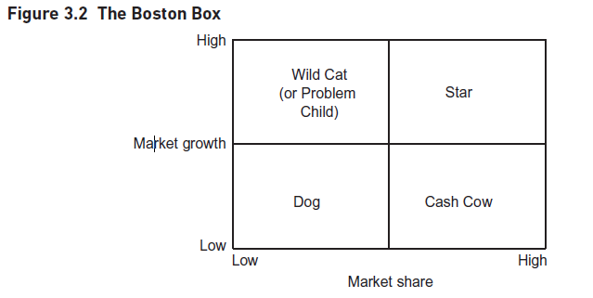
5. INTERNAL ENVIRONMENT ANALYSIS
www.midocean.ae

Slide 49
5. INTERNAL ENVIRONMENT ANALYSIS
The Boston Box shows that the cows are milked, the dogs are buried, the stars get the gold, and the wild cats are carefully examined until they behave themselves or join the dogs and die.
A successful product or SBU starts as a Wild Cat and goes clockwise round the model until it dies or is revitalized as a new product or service or SBU.
The Wild Cats (or Problem Children) are unprofitable but are investments for the future;
The Stars strengthen their position in a growth industry until they become the big profit earners.
The Cash Cows are the mature products or services, in markets with little, if any, growth.
The Stars and Cash Cows provide the funding for the other segments of the matrix. The Dogs have low market share in markets with low growth and are often the areas that are removed or allowed to wither away.
www.midocean.ae

Slide 50
6. SWOT ANALYSIS?
The SWOT (strengths, weaknesses, opportunities, threats) analysis is often used to pull together the results of an analysis of the external and internal environments.
This approach often is used as the first analytical tool before enough preparatory analysis has been done. However, when this approach is adopted the results are usually weak.
A more robust approach is to use the techniques described earlier as they help identify the major factors, both internal and external to the organization, that the business strategy needs to take into account.
www.midocean.ae

Slide 51
6. SWOT ANALYSIS?
Hence, the SWOT analysis is where the key strengths, weaknesses, opportunities, and threats are summaries in order to carry out an overall audit of the strategic position of a business and its environment.
A SWOT analysis is often represented as a two-by-two matrix as shown in Figure 3.3.
www.midocean.ae

Slide 52
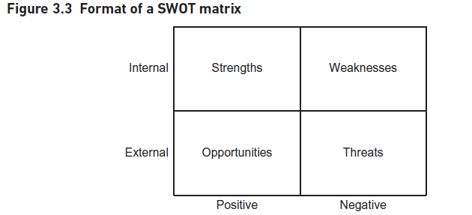
6. SWOT ANALYSIS
www.midocean.ae

Slide 53
6. SWOT ANALYSIS
Some examples – not for the same organization – could be:
Strengths- Strong product branding – market research shows a high awareness of our brands compared with the competition. We secure ‘best space’ in all branches of the top five retailers.
Weakness- the company has poor cash flow. Against industry benchmarks we are in the bottom quartile. We exceed our overdraft limits on 19 days every quarter.
Opportunity- Demographic change in Europe and the US will provide a greater market for our products.
Threat- Low market growth will see increased concentration of business through acquisition. The poorest performing businesses will fail.
www.midocean.ae

Slide 54

A key point that emerges from these examples is that strengths and weaknesses are found within the organization (and hence discovered via the resource audit or the Boston Matrix) whereas opportunities and threats arise from outside the organization (and hence can be found using PESTLE or the Five Forces model).
6. SWOT ANALYSIS
www.midocean.ae

Slide 55
7. EXECUTING STRATEGY
Executing new strategies implies risk because it involves change. There are three particular aspects of implementing strategy –
The context for the strategy,
The role of the leader, and
The two tools that could be used –
The Balanced Business Scorecard, and
The McKinsey 7-S Model.
www.midocean.ae

Slide 56
7. EXECUTING STRATEGY
There are five contextual issues should be considered in executing strategies:
Time – how quickly does the new strategy need to be implemented? What pace of change is needed?
Scope – how big is the change? Is the new strategic direction transformational or incremental?
Capability – does the organization have the required resources for the change? is the organization adaptable and able to change? Are the experiences of change positive or negative?
Readiness – is the whole organization, or the part of it to be affected, ready to make the change?
Strategic leadership – is there a strategic leader for the change?
www.midocean.ae

Slide 57
7. EXECUTING STRATEGY
Here, the strategic leader will have the key role. Typically, the strategic leaders does not have to be delivered from the top management.
The strategic leader key characteristics:
Challenges the status quo all the time and sets new and demanding targets, never being prepared to tolerate unsatisfactory behavior or performance.
Establishes and communicates a clear vision of the direction to be taken, why it has to be taken, and how the journey will be made.
‘Models the way’ or ‘Walks the walk’. He or she demonstrates through their behavior how everyone else should behave and act in order to deliver the strategy.
Empowers people to deliver their part of the strategic change within the vision, values, and mission that have been set out.
Celebrates success with those who achieve it.
www.midocean.ae

Slide 58
Two tools that help in the execution of strategy;
The McKinsey 7-S Model shown in Figure 3.4, and
The Balanced Business Scorecard shown in Figure 3.5.
7. EXECUTING STRATEGY
www.midocean.ae

Slide 59
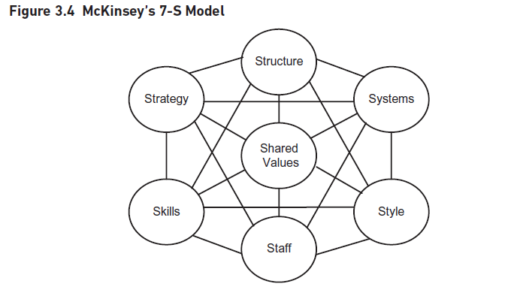
7. EXECUTING STRATEGY
www.midocean.ae

Slide 60
7. EXECUTING STRATEGY
The 7-S model supposes that all organizations are made up of seven components.
Three are often described as ‘hard’ components – strategy, structure and systems, and Four as ‘soft’ – shared values, style, staff, and skills.
Hard components
strategy, means that all of the others have to change as well.
The structure – the basis for building the organization will change to reflect new needs for specialization and coordination resulting from the new strategic direction.
Formal and informal systems that supported the old system must change.
www.midocean.ae

Slide 61
7. EXECUTING STRATEGY
b. Soft components
The style or culture of the organization will be affected by a new strategic direction. Values, beliefs and norms, which developed over time, may be revised or even swept away.
The way staff are recruited, developed and rewarded may change. New strategies may mean relocating people or making them redundant.
Skills – competences acquired in the past may be of less use now. The new strategy may call for new skills.
Shared values are the guiding concepts of the organization, the fundamental ideas that are the basis of the organization. Moving from an ‘engineering first’ company to a ‘customer service first’ company would change the shared values.
www.midocean.ae

Slide 62
As important as the individual elements of the 7-S model, are the connections between them. The execution of strategy will be flawed if, for example, there is a disconnect between the style adopted by management and the shared values of the organization.
7. EXECUTING STRATEGY
www.midocean.ae

Slide 63
7. EXECUTING STRATEGY
The Balanced Business Scorecard
The Balanced Business Scorecard (BBS) can be thought of as the strategic balance sheet for an organization as it captures the means of assessing the financial and non-financial components of a strategy. It therefore shows how the strategy execution is working and the effectiveness with which the levers for change are being used. The BBS supplements financial measures with three other perspectives of organizational performance – customers, learning and growth, and internal business processes.
Vision and strategy connect with each of these as shown in Figure 3.5.
www.midocean.ae

Slide 64
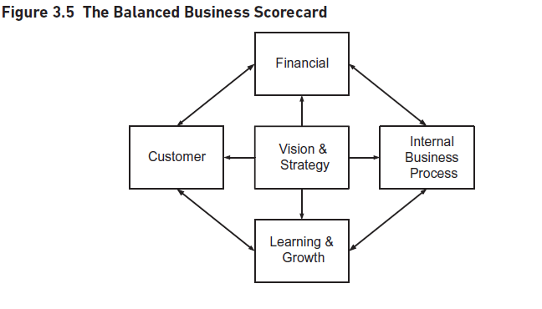
7. EXECUTING STRATEGY
www.midocean.ae

Slide 65
7. EXECUTING STRATEGY
The emphasis of the scorecard is to measure aspects of performance in a balanced way. In the past, managers have perhaps paid more attention to the financial measures but the BBS shows it is important to consider all of the four aspects.
Each perspective answers questions like these:
Financial – what level of income has been generated? How profitable is the business?
Customer – how will we assess our customer satisfaction?
Learning and Growth – how will we measure our ability to change and improve so that we constantly keep ahead of the competition?
Internal Business Processes – how effective are the business processes that we must excel at to deliver customer value?
www.midocean.ae

Slide 66
The BBS helps in the definition of two components which are vital to assess business performance;
Critical Success Factors (CSFs), and
Key Performance Indicators (KPIs).
7. EXECUTING STRATEGY
www.midocean.ae

Slide 67
7. EXECUTING STRATEGY
1. The concept of CSFs was initially developed in the late 1970s when they were defined as ‘the few key areas where “things must go right” for the business to flourish and for a manager’s goals to be attained.
Not every activity is a key area; they are fewer in number than people think and success with them is critical but the CSFs mean that there are some goals that must be reached.
KPIs measure specific areas of performance so also limit the amount of data that managers have to consider and act upon.
www.midocean.ae

Slide 68
7. EXECUTING STRATEGY
CSF such as strict cost control on the purchases of material and of treatment equipment.
So, we would set financial KPIs to monitor and control the prescription of material and treatments; each KPI would have a set target which, in this case, could be a defined budget for expenditure of material and treatments each year.
It’s important that KPIs are defined such that they are SMART and that they are monitored regularly. If the material budget is exceeded within the first few months, what action will be taken to bring it back to budget before the overspend becomes too difficult to manage?
www.midocean.ae

Slide 69
Other parts of the BBS can also generate CSFs so long as they are critical; for any business it is tempting to regard customer satisfaction as a critical success factor.
It is an excellent discipline to ensure that only those that are critical are identified; it is not possible to monitor too many factors at one time.
7. EXECUTING STRATEGY
www.midocean.ae

Slide 70
CONCLUSION
This chapter explored the complexity of strategy analysis process and offered ideas about how strategies are developed taking account of entrepreneurial approaches and formal planning.
The chapter has also described the external factors influencing strategy – the outside/in approach – and an internal analysis approach – the inside/out
www.midocean.ae

Slide 71
CONCLUSION
In conclusion, strategy analysis and business analysis are closely related disciplines that work together to drive organizational success. While strategy analysis focuses on developing the overall strategic direction and identifying opportunities and threats, business analysis provides the detailed insights and recommendations to support the implementation of the chosen strategy. By leveraging the strengths of both disciplines, organizations can make informed decisions, optimize their operations, and achieve their strategic goals.
www.midocean.ae

Slide 72
REFERENCES
Required Reference:
Debra Paul and James Cadle, et al, (2020). “Business Analysis”. BCS, 4th Edition. ISBN:978-1-78017-5102
Recommended Reading
James Cadle, Debra Paul, Jonathan Hunsley, Adrian Reed, David Beckham, Paul Turner (2021). “Business Analysis Techniques” 3rd Edition, BCS. ISBN: 978-1-78017-5690
www.midocean.ae

Slide 73


The End of Lecture
Thank You

