Slide 1


Procurement and Supply Chain
Prepared by Dr. Tarek Mohamed
MGM 431
Lecture 3

Slide 2


The scope and influence of procurement
Lecture 3
PMG 431
Prepared by
Dr. Tarek Mohamed
www.midocean.km

Slide 3

Course Agenda
Chapter
1-How to define procurement.
2-How to define supply chain management.
3-Strategic roles of procurement.
4-The strategic scope of procurement.
5-Integrated supply chain management.
6-The status of procurement and supply management.
www.midocean.km

Slide 4
The Scope of Procurement
Procurement is the business management function that ensures identification, sourcing, access and management of the external resources that an organization needs or may need to fulfil its strategic objectives.
Procurement exists to explore supply market opportunities and to implement resourcing strategies that deliver the best possible supply outcome to the organization, its stakeholders and customers.
Procurement applies the science and art of external resource and supply management through a body of knowledge interpreted by competent practitioners and professionals.
www.midocean.km

Slide 5
Strategic roles of procurement
The strategic ability and contribution of procurement. Boeing, in developing its 787 Dreamliner, expanded the role of procurement from outsourcing parts to outsourcing entire subsections.
It has been estimated that nearly all of the jet’s design and fabrication, along with some 40 per cent of the estimated $8 billion in development costs, is being outsourced to subcontractors.
www.midocean.km

Slide 6
Due diligence
Due diligence
Due diligence is a structured methodology to help determine that a supplier has the necessary qualities to become a partner of the buying organization. The term ‘due diligence’ is more usually associated with financial reviews in takeover situations. Within a procurement context it includes consideration of the supplier’s:
Financial robustness, including working capital
Competence and availability of key personnel resources
Reliance and extent of sub-contracting
History of legal disputes and litigious actions
Experience of partnering relationships
Existence of a robust 5-year business plan
History of insurance claims
System robustness
www.midocean.km

Slide 7
Risk management of the supply chain
Identifying supply chain risks and developing acceptable risk mitigation strategies is a hallmark of a strategically focused procurement operation.
All supply chain risks fall into one of three categories:
1 -Those risks that only the supplier can manage
2 -Those risks that only the buying organization can manage
3-Those risks that must be jointly managed by the supplier and the buying
organization.
www.midocean.km

Slide 8
Risk management of the supply chain
Examples of risks that fall into category 1 are:
Having a robust business continuity plan
Ability to match resource planning to programme deliverables
Contractual relationships with sub-contractors
Design, inspection and testing
Having available sufficient working capital
Through-life product support.
www.midocean.km

Slide 9
Relationship management
The adversarial way of business life is an outdated concept, a fact that some procurement operations need to realize. The skill of managing relationships with key strategic suppliers necessitates attention to,
for example:
Conducting regular blame free reviews of contracts
a joint commitment to continuous improvement
Sharing long-term business goals
Active involvement of senior people at both organizations
Negotiations based on genuine business objectives
The provision of accurate and timely business and contract management data.
www.midocean.km

Slide 10
Continuous improvement of supplier performance
All sectors of the economy have competitive challenges, sometimes from off-shore organizations.
The procurement community have a strategic role to motivate suppliers to continually improve their performance. The performance on long-term contracts can be incentivized to reward the supplier’s investment and initiatives.
The contract can require continuous improvement as an obligation. In some situations, the buying organization may jointly invest in new technology, providing the supplier agrees to appropriate ownership of intellectual property and perhaps licensing upon payment of a royalty on sales.
www.midocean.km

Slide 11
The supplier’s investment in ‘right first time’
An organization's reputation for quality is a prime business consideration.
The law courts regularly try cases where non-compliance with the specification is at issue. Suppliers have expert knowledge, or should have, of the goods or services they provide.
The supplier can add value to a procurement by ensuring that the specified quality can be satisfied or exceeded. The supplier can also advise on through-life costs, maintenance support, inspection and testing and continuous improvement.
When the procurement specialist is engaged in pre-qualification processes there should be a penetrating analysis of the bidder’s quality management attributes.
www.midocean.km

Slide 12
The supplier’s investment in procurement expertise
It is a strange phenomenon that when buyers visit potential suppliers, they often fail to probe the supplier’s investment in procurement expertise.
When the author engages with clients engaged in a tendering exercise and the supplier makes a presentation, it is most unlikely that there will be a procurement specialist on their team.
Why? It can only be concluded that their procurement operation is not seen as contributing to a competitive edge.
www.midocean.km

Slide 13
The relationship between procurement,
supplier management and purchasing
SUPPLIER MANAGEMENT
Mainly strategic activities including:
Strategic bottleneck and leverage items
Make/buy/outsourcing decisions
Sourcing and appraising suppliers including global suppliers
Rationalizing the supplier base
Developing supplier potential
Early supplier involvement
Negotiation
Supplier relationships including partnerships
Capital equipment purchasing
Benchmarking &Monitoring supplier performance
Ethical and environmental issues
www.midocean.km

Slide 14
The relationship between procurement,
supplier management and purchasing
PURCHASING
Mainly transactional and commercial activities including:
Non-critical (low-profit impact, low-supply risk) items
Ordering or calling o suppliers/services
Expediting
Maintaining inventory
Receipt and storage of supplies
Arranging payment
www.midocean.km

Slide 15
Integrated supply chain management
Procurement and supply chain management reflects a growing emphasis concerning the strategic business importance of suppliers.
Supplier relationships are gradually shifting from an adversarial approach to a more cooperative approach with selected suppliers.
The activities that the modern procurement organization must undertake require a different mindset than that traditionally adopted.
Supplier development, partnering, supplier–design involvement, the use of full-service suppliers, lifecycle costing, long-term supplier contracts and relationships, strategic cost management and integrated Internet linkages and shared databases are now seen as ways to create new value within the supply chain.
www.midocean.km

Slide 16
The increasing trend to outsource manufacture and services
There has been a rapidly growing trend to outsource a wide range of manufacturing and service delivery.
This trend of outsourcing has challenged procurement departments to improve their management of tender processes, due diligence, negotiation with different cultures, managing outsourced contracts and applying open book methodologies.
Procurement as a function is not immune from outsourcing actions.
www.midocean.km

Slide 17
The recognition that procurement is a significant
contributor to corporate efficiency
Enlightened organizations have recognized that procurement can contribute to corporate efficiency.
An example is long-range business planning which requires input on long-range costs, availability of strategic materials and supplies, supply chain developments and trends in service delivery; for example, voice recognition technology as an anti-fraud measure.
www.midocean.km

Slide 18
Purchasing and Procurement
Procurement:
The responsibility for acquiring the goods and services upon the organization needs:
Purchasing:
Implies the monetary transaction.
  Goods:
    Raw materials
    Production parts
    Maintenance, repair and operating supplies (MRO)
  Services:
    Consulting services
    Utilities
    Workers health care benefits.
www.midocean.km

Slide 19
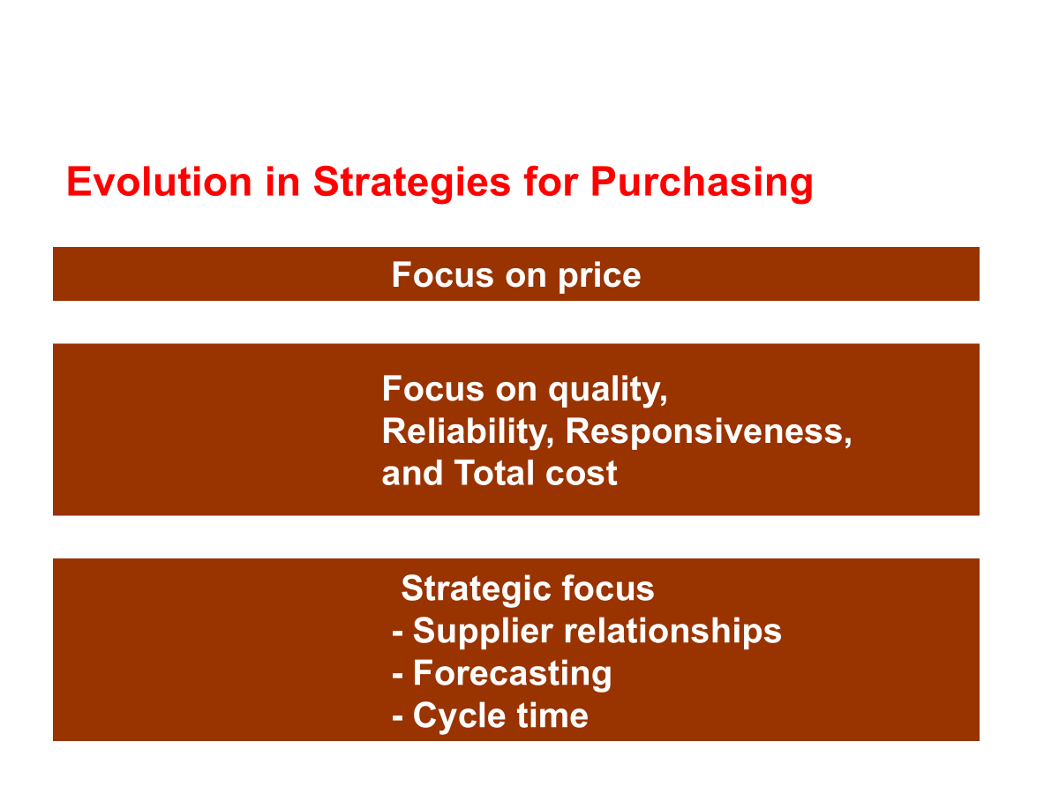
Purchasing and Procurement
www.midocean.km

Slide 20
The Procurement Process
The Procurement Process:
  Preparation:
    Identify needs, such as dependability, long term availability.
    Evaluate user requirements to ensure suitability of purchase.
    Forecast when and how purchase will be needed.
    Identify and select suppliers.
    Develop an efficient ordering system for control.
  Negotiation:
    Bidding processes.
    Contracts.
www.midocean.km

Slide 21
The Procurement Process
Order placing via appropriate channels (i.e. authorized purchase order).
Receiving including adjustments for damages, short or over-shipping and incorrect costs.
Monitoring supplier performance.
www.midocean.km

Slide 22

Types of Purchased Items
Classifications of Goods and Services:
Raw Materials : petroleum, coal, lumber
Semi finished Products and Components: subassemblies, semi finished products
Finished Products: a complete, saleable product
MRO: maintenance, repair and operating items (normally found in manufacturing overhead)
www.midocean.km

Slide 23
Types of Purchased Items
Classifications of Goods and Services:
Production Support Items: packaging materials, tapes, glues, etc.
Services: payroll services, lawn care, snow removal, design, construction
Capital Equipment: production machinery, new manufacturing facilities
Transportation and Third Party Purchasing: logistics services, management of inbound and outbound materials.
www.midocean.km

Slide 24
Purchasing Objectives
Objective 1: Support Operational Requirements
  Uninterrupted flow of high-quality material.
Objective 2: Manage the Purchasing Process Efficiently and Effectively
  Limited resources necessitate best use of resources.
Objective 3: Supply Base Management
  Develop reliable, high-quality sources of supply.
www.midocean.km

Slide 25
Purchasing Objectives
Objective 4: Develop Strong Relationships with Other Functional Groups
  Strong cross-functional relationships must exist internally.
Objective 5: Support Organizational Goals and Objectives.
  Purchasing must follow organizational directives.
Objective 6: Develop Integrated Purchasing Strategies That Support Organizational Strategies.
  Purchasing’s goals must be aligned with company’s goals
www.midocean.km

Slide 26
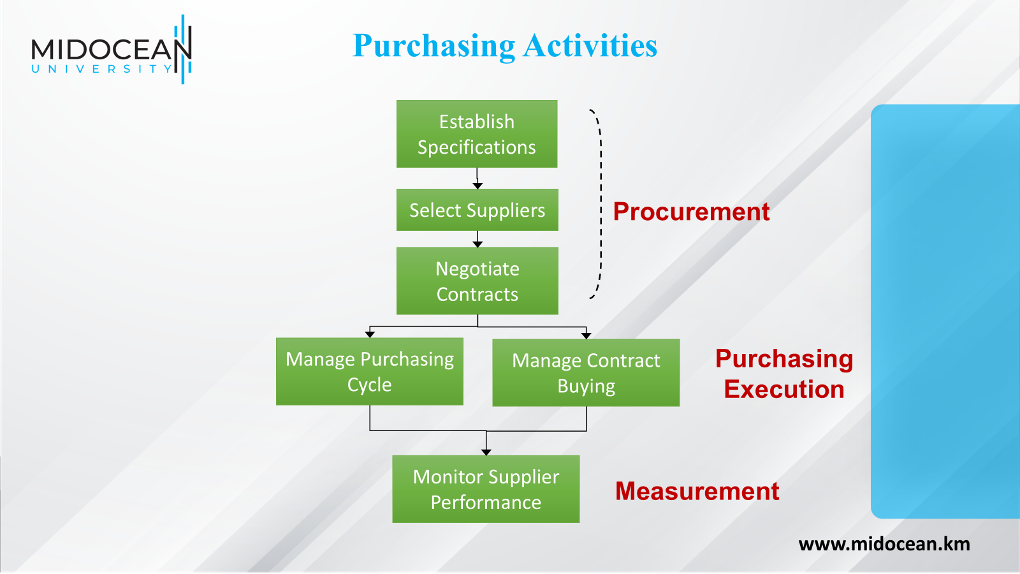

Slide 27
Example of a traditional purchasing process.
1-Requisition Received
2-Source Suppliers.
3-Tender Process.
4-Purchase approved.
5-Purchase order sent to the supplier.
6-Expediting.
7-Suppliers invoice paid.
www.midocean.km

Slide 28
Supply Uncertainty
Elements of supply uncertainty:
  Lead time to supply.
  Quantity supplied.
  Quality of supply.
  Data accuracy on products supplied and prices.
www.midocean.km

Slide 29
Selecting a Supplier
  In selecting a supplier, a number of factors must be analyzed:
  Price
  Quality
  Reliability
  Credit terms
  Shipping costs.
  Look at the whole transaction cost of dealing with a supplier (not just the cheapest price).
www.midocean.km

Slide 30
Positive Trends
Positive trends in purchasing and procurement include:
Reduced number of suppliers.
Long-term relationships with supplier.
Suppliers located close to customers for improved access.
Integrated information infrastructure: EDI, electronic catalogs.
Suppliers considered to be an essential part of the business
Suppliers involved in future product development programs.
www.midocean.km

Slide 31
Purchasing Analysis
Key considerations in analyzing the purchasing process:
  Annual sales
  Annual purchases
  Number of suppliers
  Number of supplier alliances
  Total number of purchased products or parts
  Short and long-term cost-effective purchasing
  Efficient business management of the purchasing process.
www.midocean.km

Slide 32
Suggestions
Analyze what the suppliers' requirements are for:
Goods and services: lot sizes, packaging, delivery frequency, and responsiveness.
Information: how much and when?
financing arrangements and costs.
Compare your needs and abilities against these requirements.
www.midocean.km

Slide 33
Purchasing Span of Control
What decisions does Purchasing have legitimate authority to make?
  Evaluate and Select Suppliers
  Negotiate with Suppliers
  Review Specifications
  Act as the Primary Contact with Suppliers
  Determine the Method of Awarding Purchase Orders and Contracts.
  Determine the appropriate Type of Contract.
www.midocean.km

Slide 34
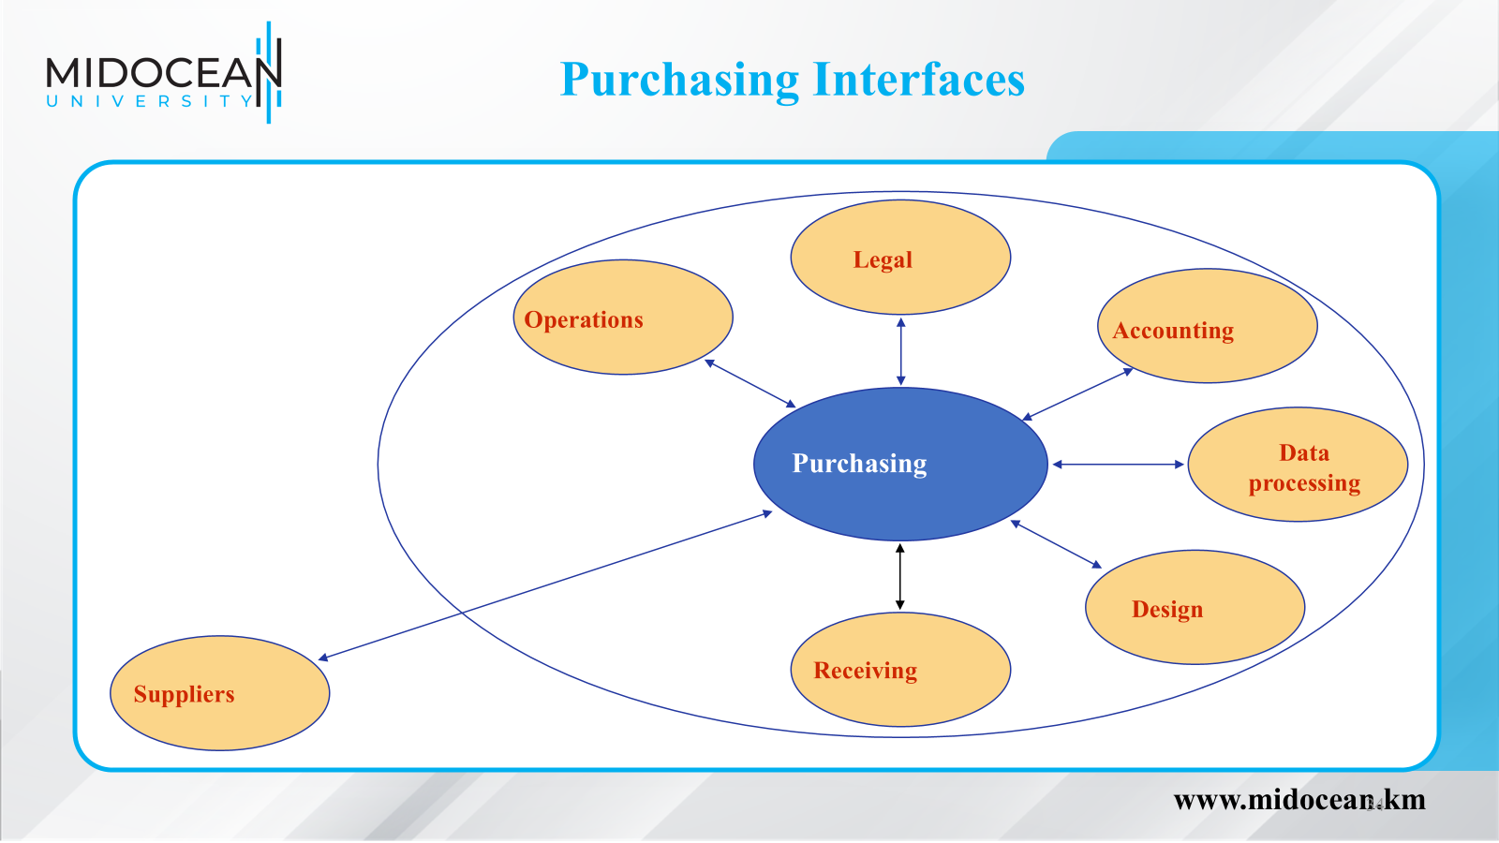

Slide 35
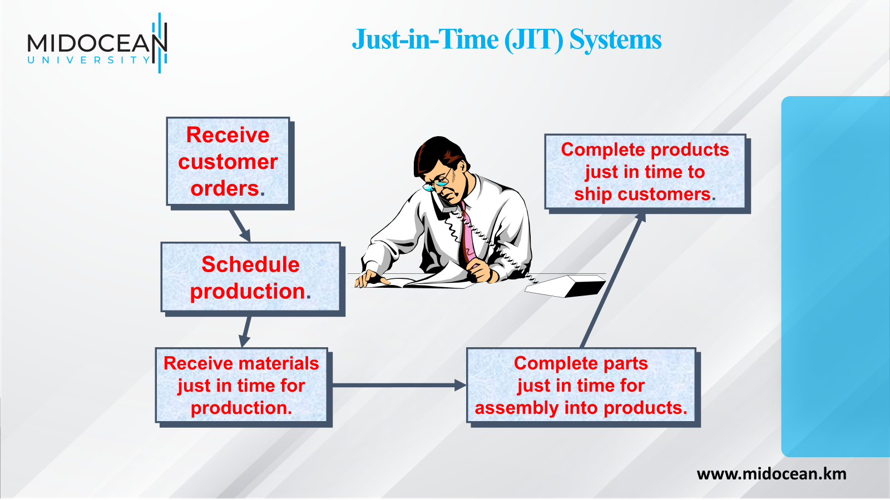

Slide 36
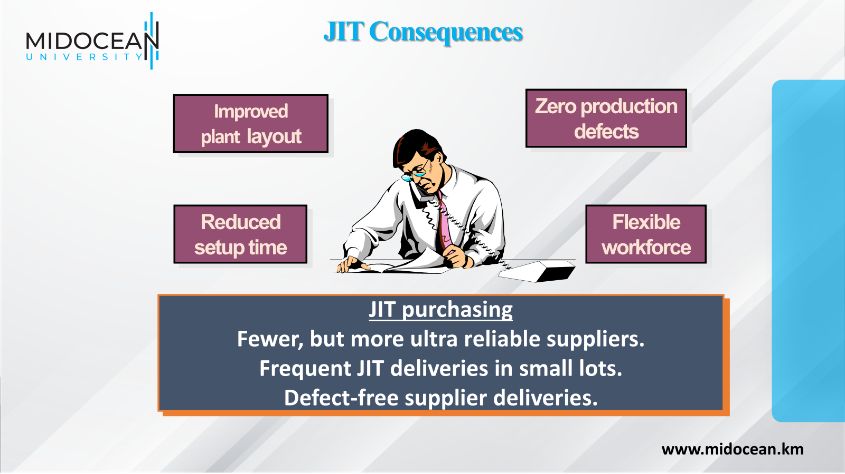

Slide 37
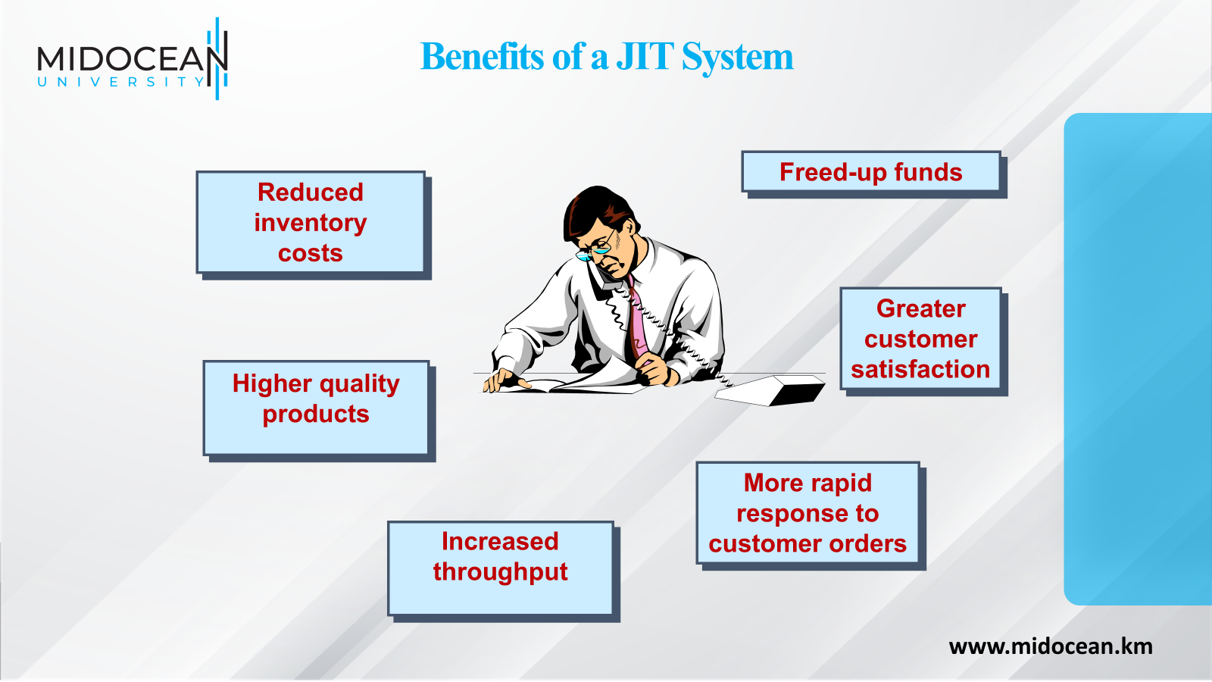

Slide 38
Summary of Learning Objectives
01
1-How to define procurement.
2-How to define supply chain management.
3-Strategic roles of procurement.
4-The strategic scope of procurement.
5-Integrated supply chain management.
6-The status of procurement and supply management.
www.midocean.km

Slide 39
Essential Reference
Morris, P. W., & Pinto, J. K. (Eds.). (2007). The Wiley guide to project technology, supply chain, and procurement management (Vol. 4). John Wiley & Sons.
Schwalbe, K. (2015). Information technology project management. Cengage Learning.
Supply Chain Council
www.midocean.km

Slide 40


Thank You

