Slide 1




"AI-Based Predictive Model for Optimal Gas Station Location Selection"
A Thesis Submitted to
Master of Science in Artificial Intelligence
Under the Supervision of Dr. Yasser Abdelhamid

Slide 2

Abstract
This project aims to develop a predictive model to determine the best locations for establishing gas stations in residential and commercial areas. The model seeks to address the current randomness in station site selection and reduce the risks associated with proximity to schools and homes, as well as alleviate traffic congestion. It also enables investors to choose optimal locations for higher investment returns. Furthermore, the project contributes to improving urban planning for new neighborhoods by strategically placing gas stations in locations that meet the required specifications and standards.

Slide 3




MethodologyObjectives
Build a Predictive Model
Design a Predictive Model
Analyze data based on population density, location details, and traffic patterns to determine optimal locations.
Provide analytical reports showing the best locations based on input data and relevant factors.
Provide Analytical Results
Develop an Interactive Platform
Identify the key factors influencing gas station site selection, such as population density, traffic flow, and main roads.
Create a platform based on spatial maps to identify the best locations for gas stations within a specific urban area.

Slide 4
Methodology
Used
Data Collection
This included population density, current gas station locations, main roads, and approved urban plans.
Data Processing
Spatial analysis tools such as GIS were used to organize and segment the data.
Model Selection
Various models were used, such as neural networks and machine learning models like (logistic regression, decision trees, random forests, SVM, KNN, Naive Bayes).
Testing and Evaluation:
A portion of the data was used on these models and trained to select the most accurate model to be used in the system

Slide 5
Project
Timeline
No. | Task | Start Date | End Date
1 | Requirements Analysis | 2024-10-20 | 2024-10-23
2 | Data Collection and Refinement | 2024-10-24 | 2024-11-02
3 | Web Page Development and GIS Maps | 2024-11-03 | 2024-11-08
4 | Predictive Model Development | 2024-11-09 | 2024-11-19
5 | Model Training | 2024-11-20 | 2024-11-22
6 | Model Testing | 2024-11-23 | 2024-11-25
7 | Report Preparation and Final Submission | 2024-11-26 | 2024-12-03

Slide 6
Expected Project
Outcomes
based on the project's expected objectives, the anticipated outcomes can be outlined as follows:
Improved Site Selection Efficiency:
Identifying strategic locations that reduce randomness and contribute to achieving the highest level of benefit and effectiveness for gas stations.
Enhanced Investment Decisions:
Enabling investors to make informed decisions based on accurate data and analysis, leading to higher financial returns.
Reduced Negative Environmental and Social Impact:
Selecting locations that minimize risks associated with proximity to residential areas and schools, improving the quality of life in surrounding areas.
Alleviating Traffic Congestion:
Optimizing the distribution of gas stations to reduce their impact on traffic flow in crowded areas.
Supporting Urban Planning:
Providing a useful tool for urban planners to identify gas station locations within city development plans, contributing to better organization of new neighborhoods.
Creating an Effective Digital Tool:
Developing an interactive platform that facilitates geographic data analysis and optimal site identification, saving time and effort for the concerned authorities.

Slide 7
Study
Area
Al-Kharj Governorate is located in the Riyadh region of the Kingdom of Saudi Arabia. It is one of the most important governorates in the central region due to its strategic location and significant economic and agricultural importance. The population of Al-Kharj is approximately 373,177 people, and its area is about 1,020 square kilometers.

Slide 8
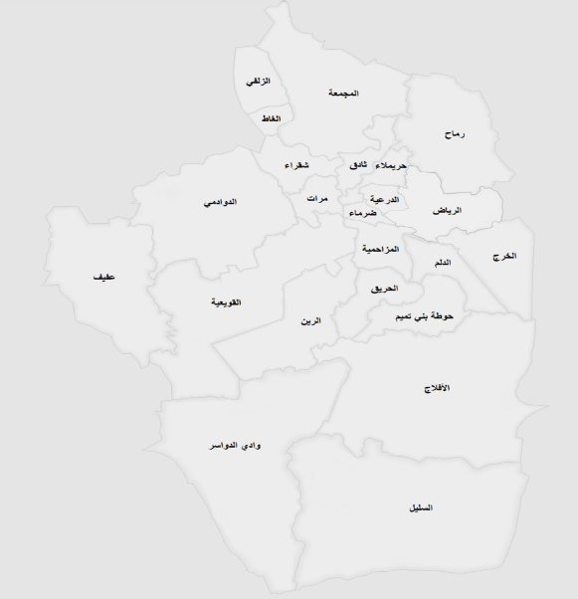
Study
Area
Figure (1)
The location of the governorate relative to Riyadh and neighboring provinces, highlighting its economic importance.

Slide 9
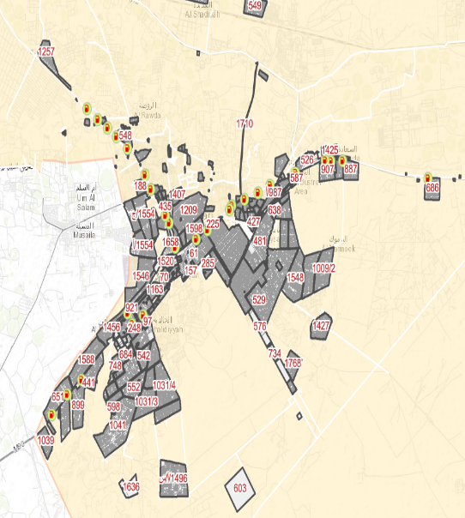
Study
Area
Figure (2)
the study area.

Slide 10
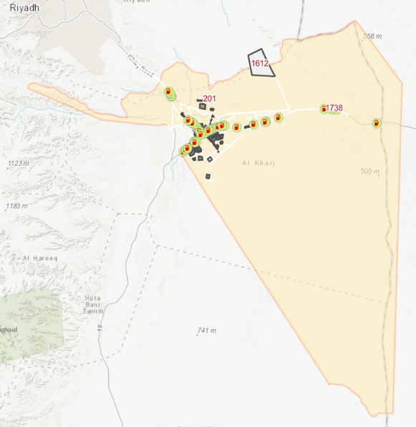
Study
Area
Figure (3)
Population distribution in the city and locations of current gas stations.

Slide 11
The Importance of GIS in Artificial Intelligence and Optimal Gas Station Site Selection
Geographic Information Systems (GIS) play a crucial role in achieving the project’s objectives, and their importance can be summarized as follows:
Spatial Data Analysis:
GIS enables the analysis and visualization of geographic data, helping to understand the factors influencing gas station site selection, such as population density and traffic flow.
Designing Interactive Maps:
GIS provides interactive maps that display potential gas station locations based on a set of input criteria, making it easier for users to explore optimal options.
Identifying Spatial Relationships:
GIS helps in identifying relationships between different elements, such as the proximity of sites to main roads or residential and commercial areas, improving the decision-making process.

Slide 12
The Importance of GIS in Artificial Intelligence and Optimal Gas Station Site Selection
Supporting Urban Planning:
GIS aids in developing effective urban planning strategies by offering spatial insights based on accurate geographic data analysis.
Saving Time and Effort:
Thanks to GIS's ability to process large amounts of data quickly and accurately, the time and effort required to determine suitable locations can be significantly reduced.
Performing Advanced Analyses:
GIS supports advanced analyses, such as traffic flow analysis, identifying underserved areas, and calculating optimal distances, enhancing the accuracy of predictions.
Integration with Other Systems:
GIS can be integrated with web platforms and other analytical software, providing a comprehensive interface to analyze and present results.

Slide 13
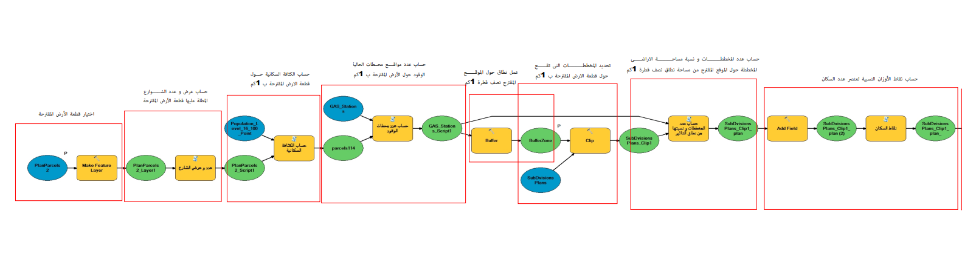
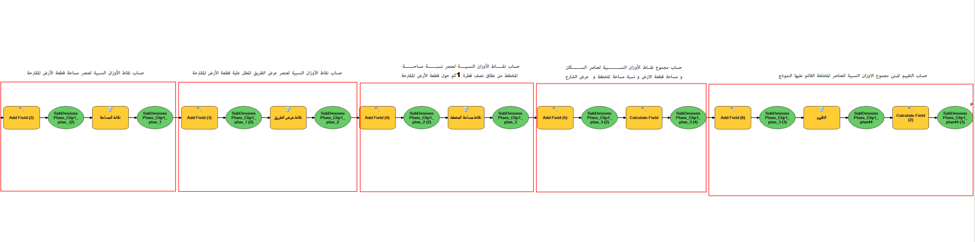
A model in (GIS)
Figure
A model in (GIS) to determine the best location for stations and to compare between more than one location to choose the best. This model can also choose the appropriate place throughout the city automatically.

Slide 14
Data
Sources
The data used in this project was collected from several reliable and diverse sources, while considering the privacy and confidentiality of certain information, which posed one of the biggest challenges we faced. However, the available data is real and sourced from the relevant authorities, as follows:
Urban Plans:
Obtained from the Planning Department, which is responsible for approving the plans.
Gas Stations:
Data on gas stations was provided by the Licensing Department, responsible for issuing gas station licenses.
Population Data:
The data was sourced from the General Authority for Statistics, which is authorized to collect and publish these statistics.
Roads Data:
Data related to roads was collected from two main sources:
Ministry of Transport
Roads Department at the Municipality
Municipal Boundaries:
Data on the municipal boundaries of the study area was obtained from the Department of Municipal Affairs.

Slide 15
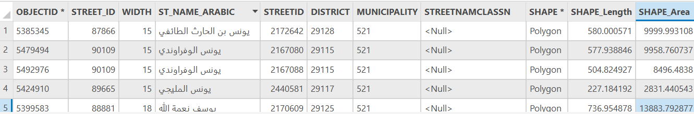
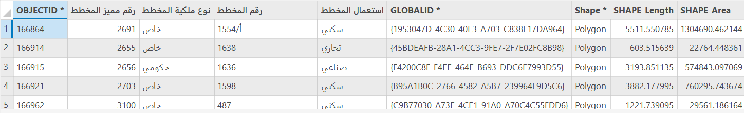
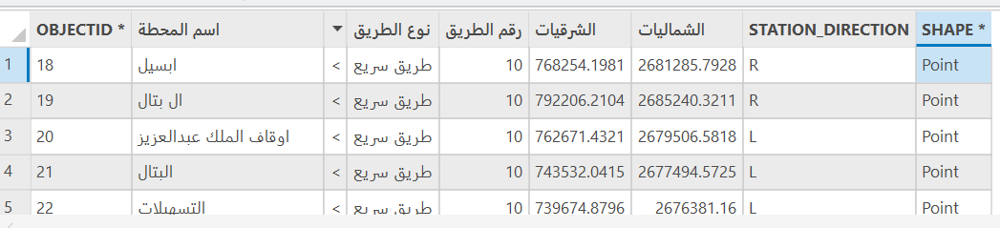
The tables used

Slide 16
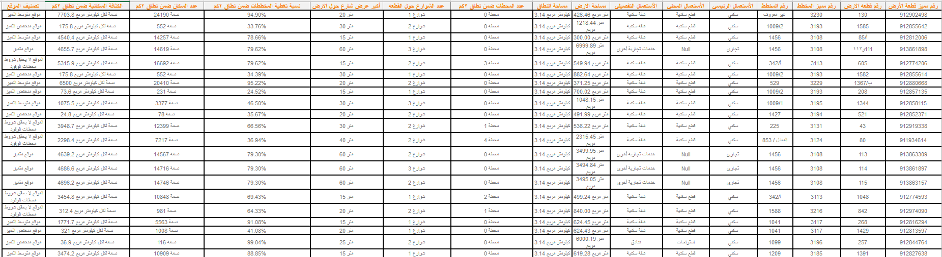
The tables used
Data Collections from multi tables

Slide 17
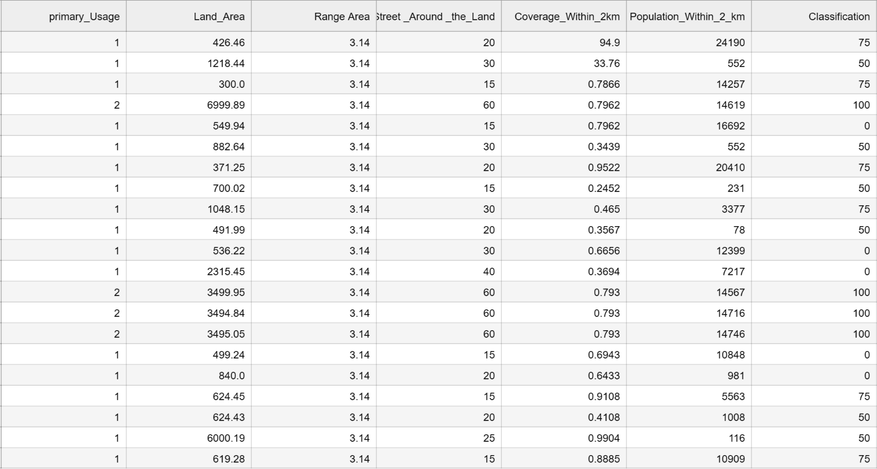
The tables used
Data Cleaned

Slide 18
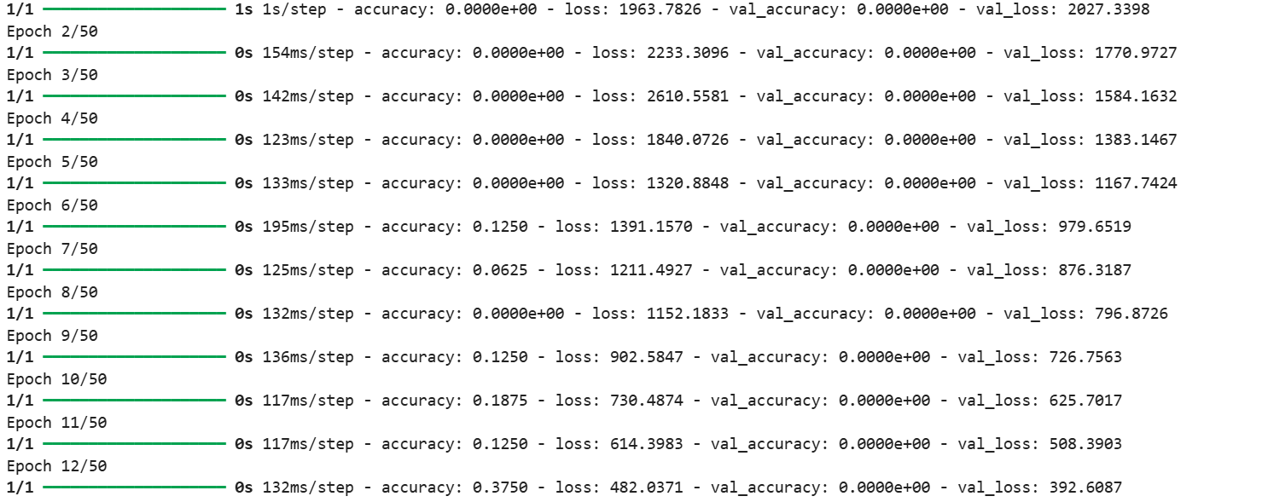
Neural Network Model Results

Slide 19
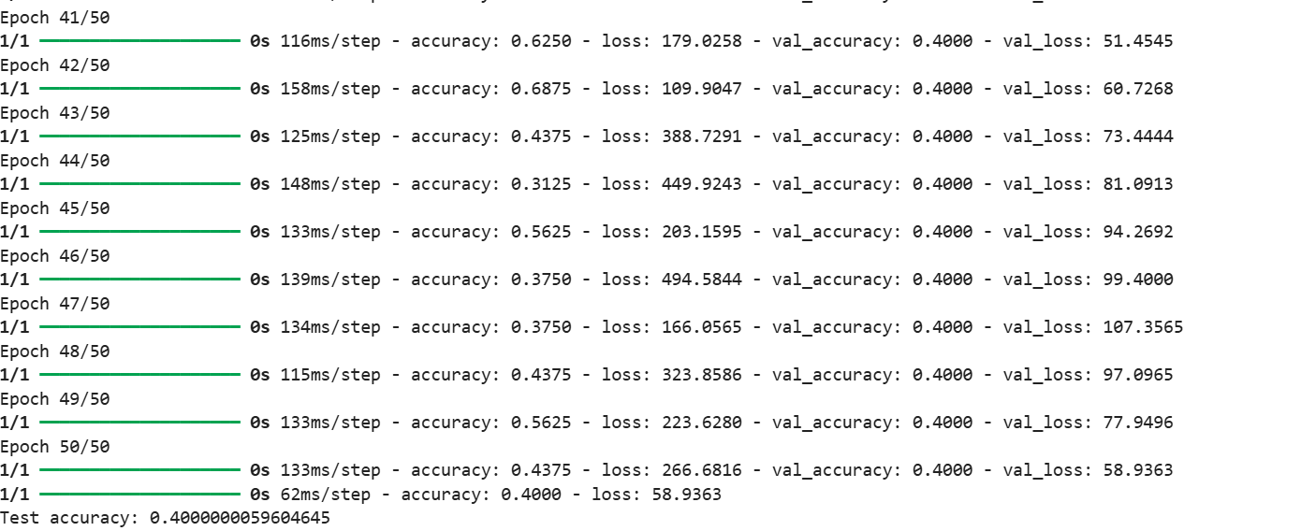
Neural Network Model Results

Slide 20
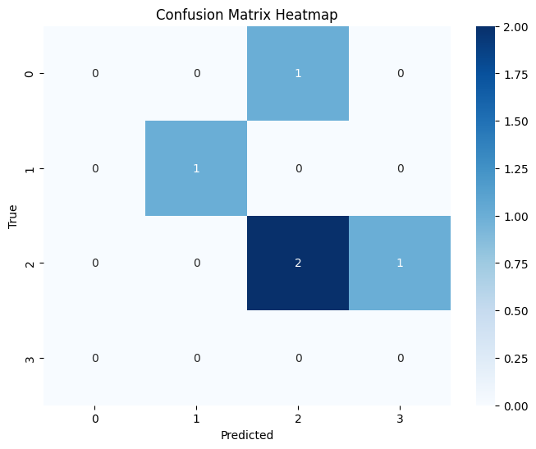
Heatmap of the Results Showing Data Accuracy

Slide 21
Data
Accuracy
Training Logistic Regression...
Best parameters for LogisticRegression: {'C': 1}
Training Decision Tree...
Best parameters for DecisionTree: {'max_depth': 7}
Training Random Forest...
Best parameters for RandomForest: {'max_depth': 10, 'n_estimators': 50}
Training SVM...
Best parameters for SVM: {'C': 1, 'kernel': 'linear'}
Training KNN...
Best parameters for KNN: {'n_neighbors': 3}
Training Naïve Bayes...
Best parameters for NaiveBayes: {}

Slide 22
Data
Accuracy
Logistic Regression Accuracy: 0.6000
Random Forest Accuracy: 0.8000
 | Precision | Recall | f1-score | Support
0 | 1.00 | 1.00 | 1.00 | 1
50 | 0.00 | 0.00 | 0.00 | 1
75 | 0.67 | 0.67 | 0.67 | 3
accuracy |  |  | 0.60 | 5
macro avg | 0.56 | 0.56 | 0.56 | 5
weighted avg | 0.60 | 0.60 | 0.60 | 5
 | Precision | Recall | f1-score | Support
0 | 1.00 | 1.00 | 1.00 | 1
50 | 0.50 | 1.00 | 0.67 | 1
75 | 1.00 | 0.67 | 0.80 | 3
accuracy |  |  | 0.80 | 5
macro avg | 0.83 | 0.89 | 0.82 | 5
weighted avg | 0.90 | 0.80 | 0.81 | 5
Decision Tree Accuracy: 0.8000
SVM Accuracy: 0.6000
 | Precision | Recall | f1-score | Support
0 | 1.00 | 1.00 | 1.00 | 1
50 | 0.50 | 1.00 | 0.67 | 1
75 | 1.00 | 0.67 | 0.80 | 3
accuracy |  |  | 0.80 | 5
macro avg | 0.83 | 0.89 | 0.82 | 5
weighted avg | 0.90 | 0.80 | 0.81 | 5
 | Precision | Recall | f1-score | Support
0 | 1.00 | 1.00 | 1.00 | 1
50 | 0.00 | 0.00 | 0.00 | 1
75 | 0.67 | 0.67 | 0.67 | 3
accuracy |  |  | 0.60 | 5
macro avg | 0.56 | 0.56 | 0.56 | 5
weighted avg | 0.60 | 0.60 | 0.60 | 5

Slide 23
Data
Accuracy
KNN Accuracy: 0.4000
 | Precision | Recall | f1-score | Support
0 | 0.00 | 0.00 | 0.00 | 1
50 | 0.00 | 0.00 | 0.00 | 1
75 | 0.50 | 0.67 | 0.57 | 3
accuracy |  |  | 0.40 | 5
macro avg | 0.17 | 0.22 | 0.19 | 5
weighted avg | 0.30 | 0.40 | 0.34 | 5
Feature Selection
Selected features using SelectKBest: [0 1 3 4 6]
Selected features using RFE: [0 1 3 4 5]
Evaluating Logistic Regression on SelectKBest features:
Accuracy on selected features: 0.4000
Evaluating Logistic Regression on RFE features:
Accuracy on selected features: 0.4000
Evaluating Decision Tree on Select Best features:
Accuracy on selected features: 0.6000
Evaluating Decision Tree on RFE features:
Accuracy on selected features: 0.4000
Naïve Bayes Accuracy: 0.4000
 | Precision | Recall | f1-score | Support
0 | 0.00 | 0.00 | 0.00 | 1
50 | 0.50 | 1.00 | 0.67 | 1
75 | 0.50 | 0.33 | 0.40 | 3
accuracy |  |  | 0.40 | 5
macro avg | 0.33 | 0.44 | 0.36 | 5
weighted avg | 0.40 | 0.40 | 0.37 | 5

Slide 24
Data
Accuracy
Evaluating Random Forest on Select Best features:
Accuracy on selected features: 0.4000
Evaluating Random Forest on RFE features:
Accuracy on selected features: 0.4000
Evaluating SVM on Select Best features:
Accuracy on selected features: 0.6000
Evaluating SVM on RFE features:
Accuracy on selected features: 0.6000
Evaluating KNN on Select Best features:
Accuracy on selected features: 0.4000
Evaluating KNN on RFE features:
Accuracy on selected features: 0.4000
Evaluating Naïve Bayes on Select Best features:
Accuracy on selected features: 0.4000
Evaluating Naïve Bayes on RFE features:
Accuracy on selected features: 0.4000

Slide 25
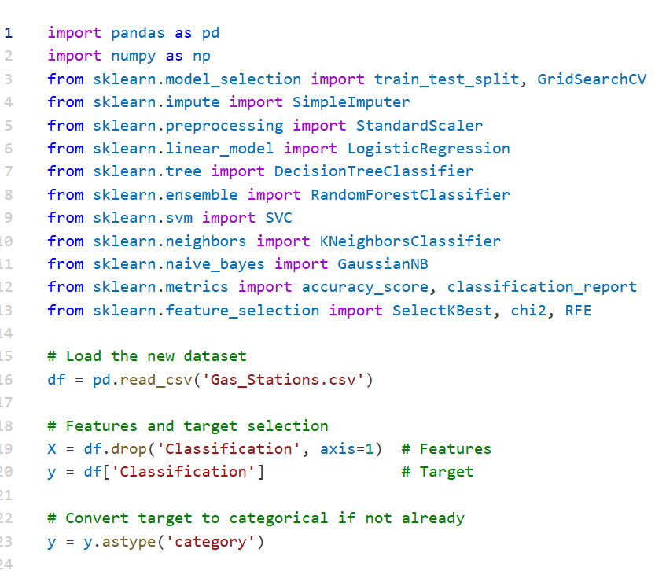
Code
Used

Slide 26
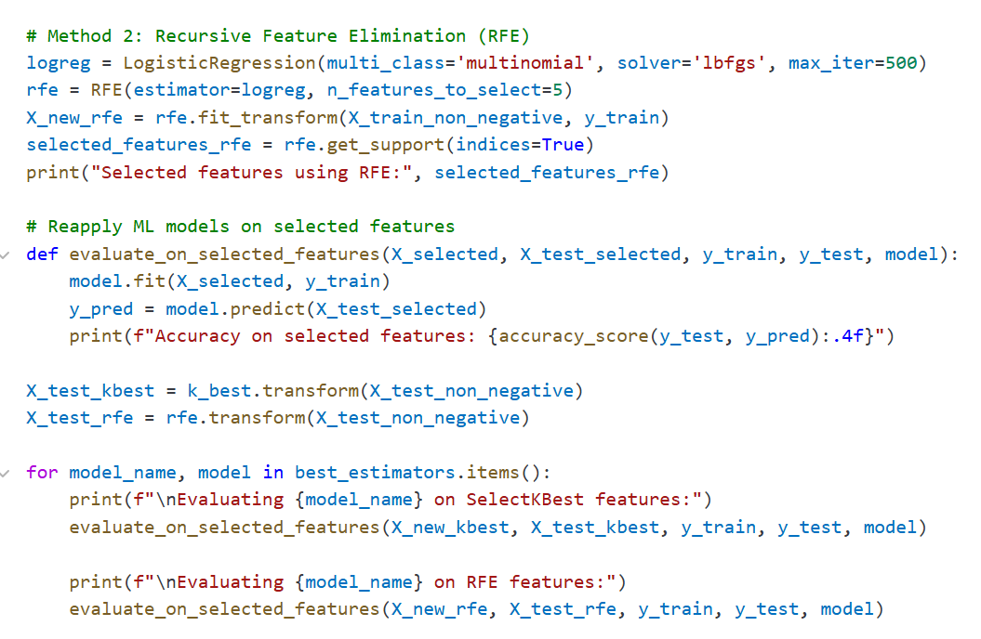
Code
Used

Slide 27
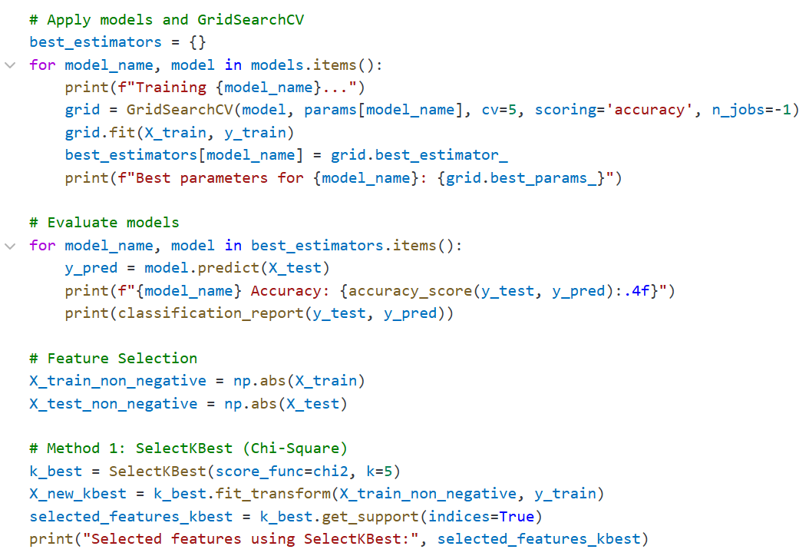
Code
Used

Slide 28
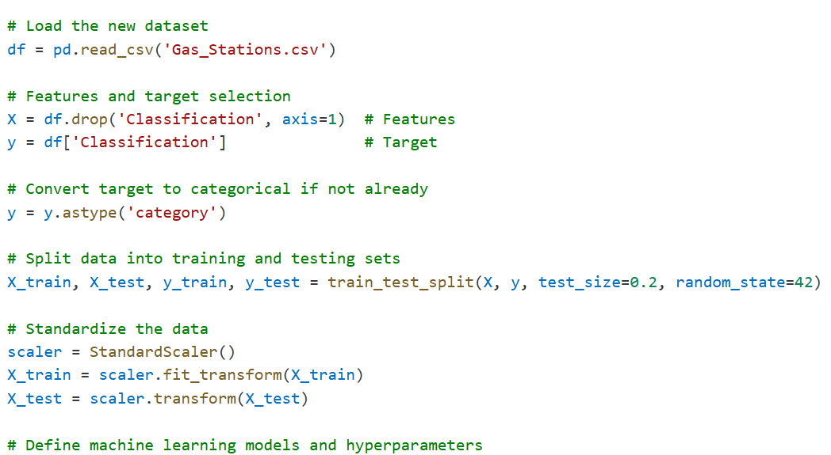
Code
Used

Slide 29
Challenges
We faced several challenges during the data collection process, including:
Ensuring data privacy and confidentiality.
Difficulty in accessing data in a timely manner.
Diversity of data sources, leading to a large number of outliers and missing values.
Difficulty in adapting the data to apply artificial intelligence models.
Adapting to the new work environment (Pro version).
Despite these challenges, we were able, with gratitude, to overcome them successfully.

Slide 30
General Idea of the Interactive Platform
This platform was developed using artificial intelligence and machine learning models to predict optimal locations, presenting the results through interactive maps that assist in making better investment decisions. The system utilizes Python and ArcGIS maps in developing the model on the interactive platform

Slide 31
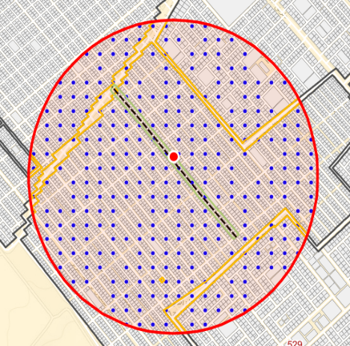
Description of the
Figure
This figure illustrates the proposed gas station site, surrounding streets, and population density in the area under study. It provides a clear visual representation of the location of the suggested gas station, highlighting key elements such as nearby roads and the population distribution in the vicinity, which are crucial for determining the site's suitability and potential for success.

Slide 32

Description of the
Figure
The location was evaluated as medium income based on the defined criteria and the system's predictions. This evaluation suggests that the location offers good potential in terms of expected revenue, but with some limitations or challenges compared to sites classified as high income. This evaluation may result from factors such as medium population density, moderate traffic flow, or proximity to other gas stations, which affect the overall expected revenue.

Slide 33
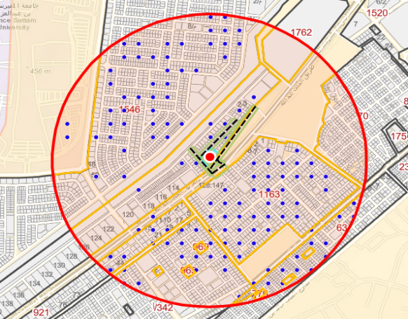
Description of the
Figure
The location was evaluated as high income based on the defined criteria and the system's predictions. This evaluation indicates that the location has high potential for generating revenue, due to factors such as high population density, heavy traffic flow, or proximity to key areas, making it an ideal site for gas stations in terms of expected financial returns.

Slide 34

Description of the
Figure

Slide 35

Description of the
Figure
This figure shows that the location does not meet the required conditions for gas stations. It highlights the factors or limitations that prevent the site from complying with the necessary regulations or criteria for establishing a gas station, such as proximity to residential areas, insufficient space, or other regulatory constraints.

Slide 36

Conclusion
In conclusion, this research contributes to enriching the scientific literature on site selection for commercial establishments. It provides a practical framework that can be applied in other commercial fields that require decisions regarding optimal location identification. This framework not only aids in enhancing decision-making processes but also offers valuable insights that can be used in a variety of contexts to improve strategic planning and operational efficiency.
  Thank You
Gas Station

