Slide 1


Slide 2

Outline

Slide 3

About me

Slide 4
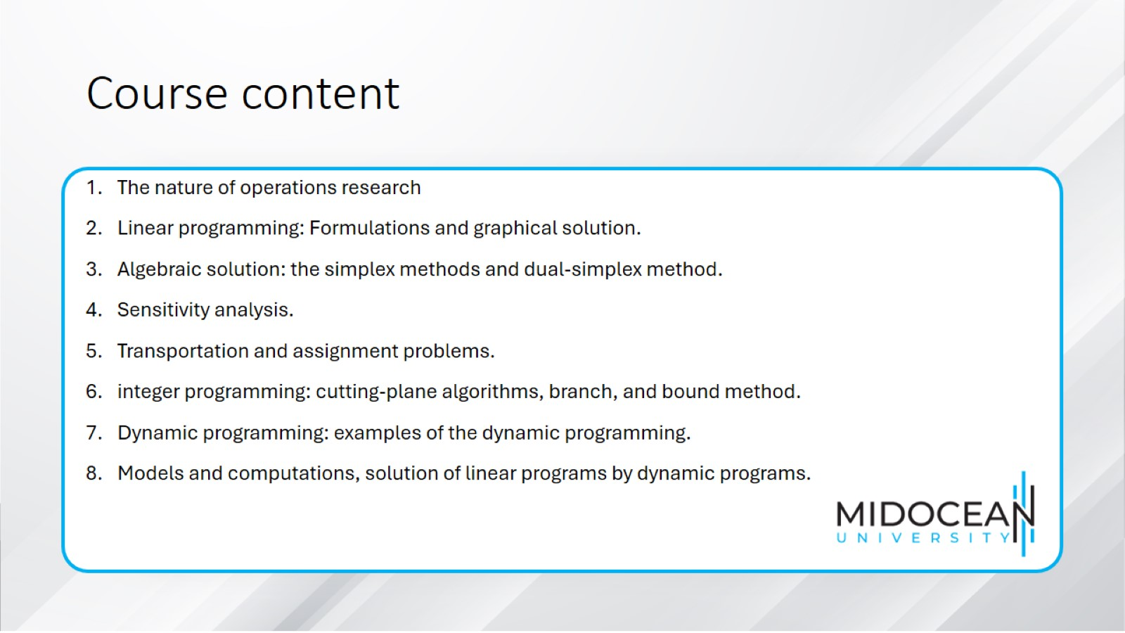
Course content

Slide 5
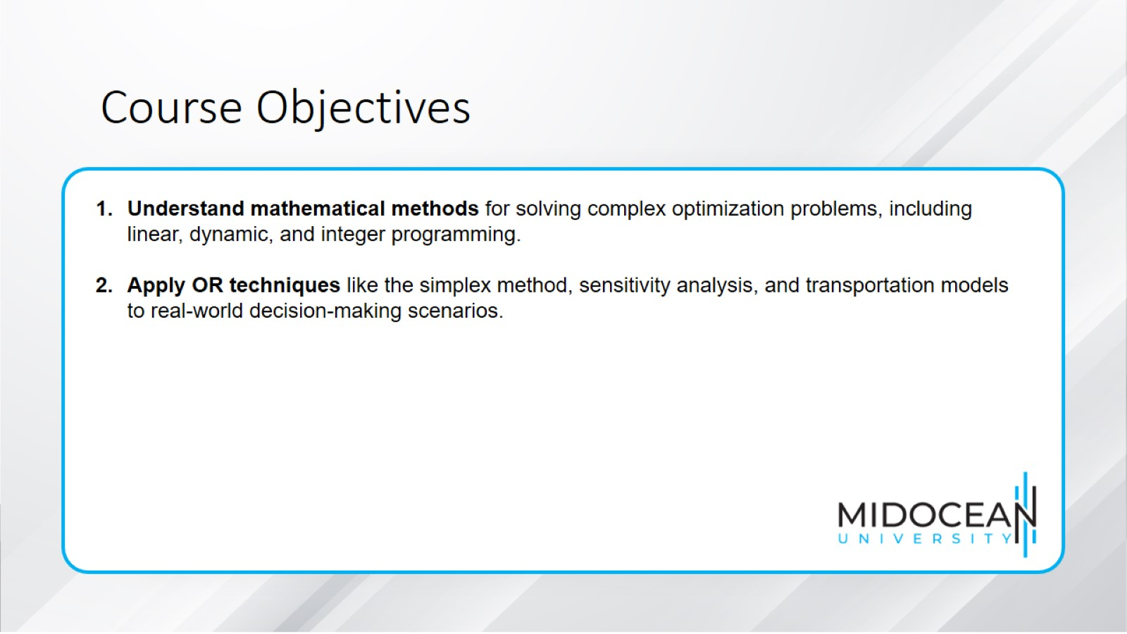

Slide 6

References

Slide 7


