Slide 1


Prepared by Dr. Wesam Ahmed
IT402
Internet of Things
Lecture 8

Slide 2



IoT Cloud Computing
Lecture 8
IT402‎
Internet of Things
Prepared by
Dr. Wesam Ahmed

Slide 3

08
Learning Objectives:
1.1 Describe the cloud computing
1.2 Describe the integration of IoT and cloud
1.3 Describe the cloud computing advantages and challenges

Slide 4
08
Cloud Analytics for IOT Applications
Understand the Importance of Business Intelligence
Cloud analytics for IoT applications refers to the use of cloud computing platforms and data analytics techniques to process, analyze, and gain insights from the vast amount of data generated by Internet of Things (IoT) devices.
This data, often referred to as IoT data or sensor data, can be structured or unstructured and is typically generated in real time or near real time. Cloud analytics provides the infrastructure and tools to effectively manage and analyze this data, extracting valuable information and enabling intelligent decision-making.
The evolution of computing technology can be traced back to the 1940s and 1950s, with the advent of the first commercial computer. The evolution of cloud computing since then has been illustrated in Figure 8.1.

Slide 5
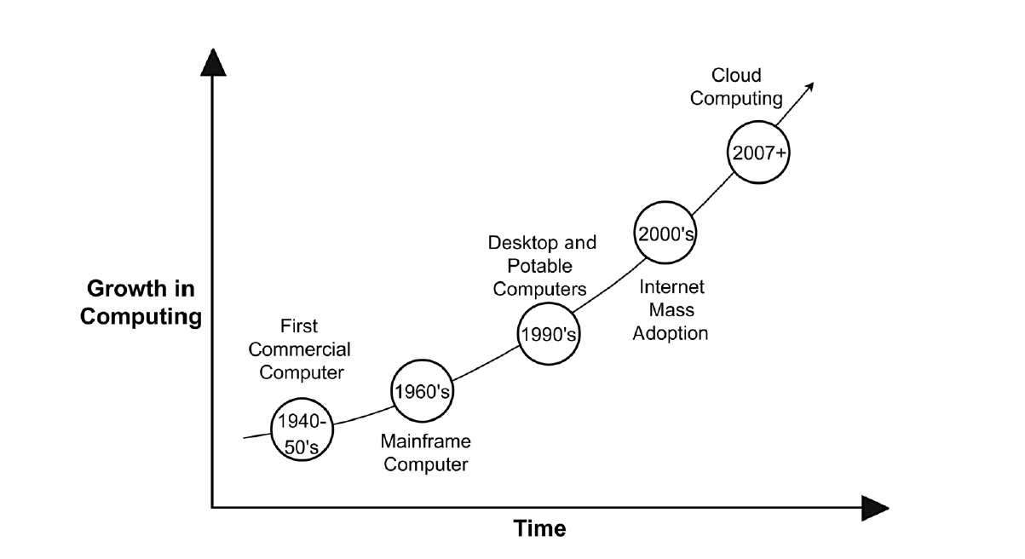
08
Cloud Analytics for IOT Applications
Understand the Importance of Business Intelligence
Figure 8.1: Evolution of cloud computing

Slide 6
08
Introduction to Cloud Computing
Understand the Importance of Business Intelligence
Cloud computing is a technological advancement that enables the distribution of computing services via the internet, encompassing servers, storage, databases, networking, software, analytics, and intelligence, among other resources .It essentially provides computing resources as a service, whereby third-party providers possess and operate the resources for the benefit of the end-users.
This eliminates the need for end-users to worry about the hardware and software infrastructure and their locations, as the resources are accessible through the internet via a metaphorical “cloud.”
The flexibility and scalability of cloud computing have made it an attractive option for individuals and organizations alike, allowing them to focus on their core activities while leaving the complexities of IT infrastructure to cloud providers.

Slide 7
08
Introduction to Cloud Computing
Understand the Importance of Business Intelligence
These are two major advantages:
Flexibility
Users can quickly:
Add more storage
Increase computing power
Install new software
Expand to new regions
All without purchasing new equipment.
Scalability
Cloud resources automatically adjust depending on user demand:
High demand → more resources automatically assigned
Low demand → resources scale down to avoid extra cost
This is essential for organizations whose workloads vary over time.

Slide 8
08
Introduction to Cloud Computing
Understand the Importance of Business Intelligence
The advent of cloud computing has resulted in a shift from on-premises software and hardware to a networked, remote resource, freeing companies from the need to invest in labor, expertise, or capital for the maintenance of such resources.
Traditionally, organizations used on-premises infrastructure. This means:
Servers were physically located inside the company.
The organization purchased and owned all hardware.
The IT team installed and maintained operating systems, applications, security, and networking.
Companies spent a lot of money, time, and expertise on managing their own data centers.
With the arrival of cloud computing, this model changed completely.
This shift freed organizations from:
Buying expensive hardware
Maintaining servers and storage
Hiring specialized IT staff
Managing daily operations (cooling, electricity, security, updates)

Slide 9
08
Introduction to Cloud Computing
Understand the Importance of Business Intelligence
The emergence of cloud computing has led to the rise of various cloud providers, including major players like AWS and Microsoft Azure . These providers operate huge global data centers and rent their computing resources to customers on a pay-as-you-use basis.
Cloud computing offers an alternative to on-premises data centers, which require users to manage everything, from hardware and virtualization to installing operating systems, applications, and configuring network and storage (Figure 8.2) .
In contrast, cloud vendors are responsible for purchasing and maintaining hardware, and they offer a range of software and platform services that can be rented based on usage. The cloud infrastructure provides an internet-based platform that makes it easy for users to manage computing, storage, networking, and application resources.

Slide 10
08
Introduction to Cloud Computing
Understand the Importance of Business Intelligence
Cloud Services Are “Rented” Based on Use : Cloud computing uses a model similar to utilities (electricity, water).
You only pay for what you use.
For example:
Rent storage by the GB
Rent a virtual machine by the hour
Pay based on database queries
Pay for bandwidth consumed

Slide 11
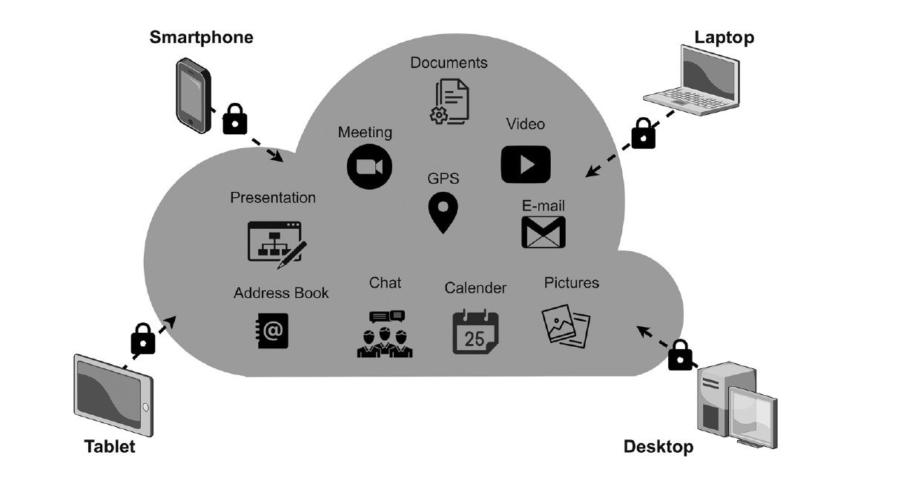
08
Introduction to Cloud Computing
Understand the Importance of Business Intelligence
Figure 8.2 : Application of the cloud

Slide 12
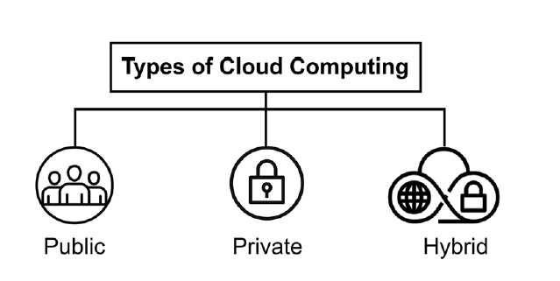
08
Introduction to Cloud Computing
Understand the Importance of Business Intelligence
Cloud computing technology can be broadly categorized into three types: public cloud, private cloud, and hybrid cloud . The distinguishing characteristics of each type are as follows.

Slide 13
08
Introduction to Cloud Computing
Understand the Importance of Business Intelligence
Public Cloud: Public clouds refer to cloud resources that are owned and operated by a third-party cloud service provider. These providers include companies like:
Amazon Web Services (AWS)
Microsoft Azure
Google Cloud Platform (GCP)
How it works
The cloud provider owns all the hardware (servers, storage, networking).
Users access these resources over the internet.
Public clouds are open to multiple users and are usually priced according to usage.
Multiple customers share the same physical infrastructure .

Slide 14
08
Introduction to Cloud Computing
Understand the Importance of Business Intelligence
Private Cloud: Private clouds are exclusive to a single business or organization.
These resources may be located on-site (inside the organization’s data center) or hosted by a third-party but still exclusive to one company (e.g., IBM Cloud Private).
Private clouds are typically more secure than public clouds, as Only authorized users within the organization can access the resources.
Private clouds are best for:
Banks
Government agencies
Hospitals

Slide 15
08
Introduction to Cloud Computing
Understand the Importance of Business Intelligence
Hybrid Cloud: Hybrid clouds are a combination of public and private clouds.
Data and applications are shared between the two, allowing for greater flexibility and deployment options.
How it works
Sensitive data is stored in the private cloud.
Less sensitive applications or workloads run in the public cloud.
Both environments communicate using encrypted links, APIs, or hybrid cloud platforms.
Hybrid cloud provides organizations with the best of both worlds:
✔ Public cloud: scalability, cost reduction
✔ Private cloud: security, control
Example scenario:
A hospital might:
Store patient medical records in a private cloud (for privacy and compliance).
Run its website or appointment system in a public cloud.
Use public cloud analytics tools to analyze non-sensitive data.

Slide 16
08
Introduction to Cloud Computing
Understand the Importance of Business Intelligence
Cloud computing and fog computing are two important computing paradigms that support modern technologies such as IoT, smart cities, and distributed systems.
Although both approaches help organizations manage data and communication efficiently, they operate at different levels of the network and serve different purposes.
Fog computing—commonly called fogging—was introduced as an extension of cloud computing to address its limitations, particularly latency, bandwidth usage, and the need for real-time processing.
Fog architecture brings computing power closer to the users and devices by enabling processing at edge nodes, which are physical devices located near data sources.

Slide 17
08
Introduction to Cloud Computing
Understand the Importance of Business Intelligence
Fog computing creates a middle layer between cloud data centers and end devices, allowing IoT devices to process data locally instead of sending everything to the centralized cloud.
This makes fog computing critical for applications that require immediate responses, such as autonomous vehicles, industrial automation, real-time monitoring, and smart healthcare.
The key contrasts between cloud computing and fog computing are explained in the following :
Architecture: Cloud Computing Architecture (Centralized)
Cloud systems rely on large, centralized data centers hosted by providers like AWS and Azure.
All data from user devices must travel across the internet to reach these data centers.
The structure is based on a central location where storage, processing, and management occur.
Example:
A wearable health device sends data to a distant cloud server for analysis.

Slide 18
08
Introduction to Cloud Computing
Understand the Importance of Business Intelligence
The key contrasts between cloud computing and fog computing are explained in the following :
Architecture:
Fog Computing Architecture (Decentralized)
Fog computing distributes processing across multiple local nodes, such as routers, gateways, or micro-servers.
Instead of a single central location, fog nodes operate close to the data source (edge devices).
This architecture reduces dependency on faraway data centers.
Example:
A smart traffic light processes vehicle data on a nearby fog node to adjust signals instantly.

Slide 19
08
Introduction to Cloud Computing
Understand the Importance of Business Intelligence
The key contrasts between cloud computing and fog computing are explained in the following :
Use Cases:
Cloud Computing Best For:
Large-scale data storage
Big data analysis
Machine learning model training
Applications requiring huge computational power
Fog Computing Best For:
Applications requiring:
  Low latency
  Real-time processing
  Immediate analytics
  Proximity to data sources

Slide 20
08
Introduction to Cloud Computing
Understand the Importance of Business Intelligence
The key contrasts between cloud computing and fog computing are explained in the following :
Processing:
Cloud Processing
Data is transmitted to remote cloud servers where computation happens.
Fog Processing
Data is processed locally on fog nodes before being sent to the cloud (if needed).
Reduces the load on the cloud.
Example:
A factory machine detects an anomaly and processes data locally to shut down instantly—no need to wait for cloud analysis.

Slide 21
08
Introduction to Cloud Computing
Understand the Importance of Business Intelligence
Latency:
Cloud Latency (Higher)
Data must travel long distances to remote data centers.
This can result in delays—unacceptable for real-time applications.
Scenario:
A self-driving car cannot wait milliseconds for a cloud server response to detect obstacles.
Fog Latency (Lower)
Fog nodes are located close to IoT devices.
Local processing minimizes delay, enabling immediate response.
Scenario:
Smart grid systems adjust electricity distribution instantly using fog processing.

Slide 22
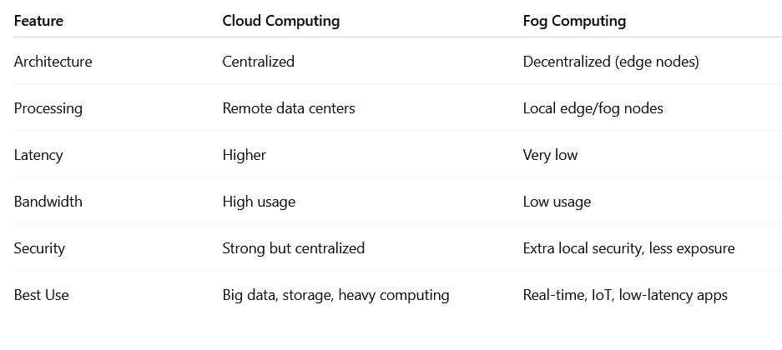
08
Introduction to Cloud Computing
Understand the Importance of Business Intelligence

Slide 23
08
Introduction to Cloud Computing
Advantages of Cloud Computing: Cloud computing offers various benefits to organizations, including the following:
Cost Effectiveness: Cloud computing eliminates the need for organizations to invest heavily in physical hardware, software licenses, and data center infrastructure. Instead, they pay only for the resources they use through a pay-as-you-go or subscription model, which significantly reduces capital expenditure.
Speed: Cloud platforms allow businesses to deploy servers, databases, applications, and services within minutes. This instant availability removes delays caused by purchasing, installing, and configuring physical systems.
Security: Most cloud vendors offer strong security frameworks, including data encryption, access management, and advanced monitoring systems, which protect the stored data .
Understand the Importance of Business Intelligence

Slide 24
08
Introduction to Cloud Computing
Cloud computing has progressed from its fundamental notion of supplying computing resources on-demand through the internet, to more advanced services that address diverse business requirements. The next evolution of cloud computing centers around delivering software, platforms, and infrastructure as services.
Over time, cloud computing grew into a sophisticated ecosystem offering different layers of services that address various business needs. These layers are known as:
Software as a Service (SaaS)
Platform as a Service (PaaS)
Infrastructure as a Service (IaaS)
These models represent different levels of control, responsibility, and flexibility for the user.
Understand the Importance of Business Intelligence

Slide 25
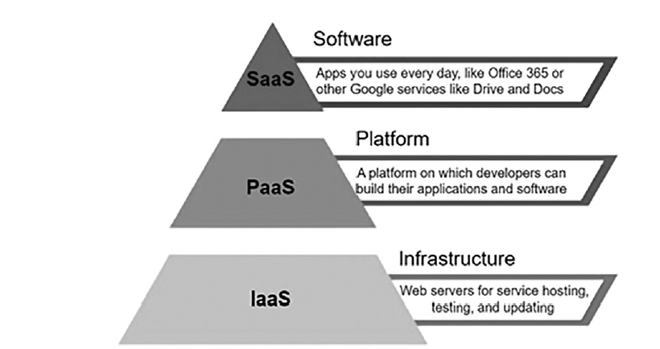
08
Introduction to Cloud Computing
Understand the Importance of Business Intelligence
Development of cloud computing

Slide 26
08
Introduction to Cloud Computing
Software-as-a-Service (SaaS): is a cloud model where the provider hosts a complete software application and makes it accessible to users via the internet.
Users do not install anything on their computer.
The cloud provider manages everything: software updates, security, servers, and storage.
Users only need a web browser or a thin client to access the application.
It reduces maintenance effort and cost for businesses.
Examples
Gmail, Outlook (email services)
Google Workspace, Microsoft 365 (office applications)
Understand the Importance of Business Intelligence

Slide 27
08
Introduction to Cloud Computing
Platform-as-a-Service (PaaS): PaaS provides a cloud-based environment for building, testing, and deploying applications without worrying about the underlying hardware or operating systems.
What the provider manages
Infrastructure (servers, storage, networking)
Operating systems
Databases
What the customer manages
Application code
Application deployment
Application data
Examples
Microsoft Azure App Services
Understand the Importance of Business Intelligence

Slide 28
08
Introduction to Cloud Computing
Understand the Importance of Business Intelligence
Infrastructure-as-a-Service (IaaS): IaaS provides virtualized computing resources over the internet, such as:
Virtual machines
Storage
Network components
Organizations can build any type of IT environment they want using these virtual resources.
Examples
Amazon Web Services (AWS)
Microsoft Azure

Slide 29
08
The Role of Cloud Computing in IoT
Understand the Importance of Business Intelligence
The “cloud” refers to a centralized infrastructure where data, files, and applications are stored, processed, and managed in remote data centers connected through the internet.
IoT devices generate huge volumes of data every second—far more than a device can store or process on its own. Because of this: The IoT depends on cloud computing for:
Storage: Sensors send data to the cloud instead of storing it locally.
Processing power: Cloud servers analyze large datasets efficiently.
Accessibility: Data is accessible from anywhere, anytime.
Integration: Cloud applications can communicate with multiple devices.
Security & backups: Cloud ensures reliable, secured, and backed-up data.
Thus, the integration of cloud and IoT forms the backbone of many modern smart systems.

Slide 30
08
The Role of Cloud Computing in IoT
Understand the Importance of Business Intelligence
Benefits and Functions of IoT Cloud: The combination of IoT and cloud computing offers numerous benefits and functions :
Multiple Connectivity Options and Wide Network Access: IoT–cloud computing offers high accessibility and rich connectivity features because:
Cloud resources can be accessed from any device connected to the internet (laptops, tablets, smartphones, etc.).
IoT cloud services work as on-demand web services, meaning anyone with internet access can use the service instantly.
Developers do not need special permissions or physical hardware; they can build and deploy IoT applications online. This wide network access promotes mobility, remote access, and seamless device connectivity.

Slide 31
08
The Role of Cloud Computing in IoT
Understand the Importance of Business Intelligence
Benefits and Functions of IoT Cloud: The combination of IoT and cloud computing offers numerous benefits and functions :
High Scalability: IoT devices generate increasing amounts of data as the system grows. Cloud computing supports this growth through:
Scalable storage: Users can add more storage instantly as data increases.
Scalable processing power: Cloud computing can handle larger workloads when more IoT data streams are generated.
Scalable user access: More users or devices can be added without disrupting system performance.
This scalability ensures that IoT systems can expand to thousands or millions of devices without crashing.

Slide 32
08
The Role of Cloud Computing in IoT
Understand the Importance of Business Intelligence
Benefits and Functions of IoT Cloud: The combination of IoT and cloud computing offers numerous benefits and functions :
Resource Pooling and Collaboration: Cloud computing brings together shared computing resources such as:
Storage
Networks
Servers
Applications
These resources are pooled and shared among multiple users, which:
Enhances collaboration
Supports teamwork
Improves communication between devices and users
Allows multiple applications or devices to utilize the same infrastructure

Slide 33
08
The Role of Cloud Computing in IoT
Understand the Importance of Business Intelligence
Benefits and Functions of IoT Cloud: The combination of IoT and cloud computing offers numerous benefits and functions :
Cost Effectiveness:
IoT cloud computing saves money because:
Users pay only for the services and resources they consume.
No need to buy expensive hardware or maintain large data centers.
Service providers measure resource usage (storage, CPU usage, bandwidth) so billing is precise and fair.
Businesses can start small and expand later without major upfront costs.
This makes IoT solutions affordable even for small companies and startups.

Slide 34
08
The Role of Cloud Computing in IoT
Understand the Importance of Business Intelligence
Benefits and Functions of IoT Cloud: The combination of IoT and cloud computing offers numerous benefits and functions :
Enhanced Security Through Cloud-Based Protection:
As IoT grows, so do security risks such as unauthorized access, data breaches, and cyberattacks. Cloud computing improves security through:
Authentication: Ensuring only authorized users/devices can access the system.
Encryption: Protecting data during transmission and storage using cryptographic techniques.
Continuous monitoring: Detecting threats in real time.
Standardized security frameworks followed by major cloud providers.
This strengthens the security posture of IoT applications and ensures safe data exchange.

Slide 35
08
The Role of Cloud Computing in IoT
Understand the Importance of Business Intelligence
How IoT and Cloud Will Transform Information Management:
The integration of cloud computing and IoT is reshaping the way information is:
Collected (through smart sensors and devices)
Stored (in scalable cloud data centers)
Analyzed (using cloud-based analytics tools)
Accessed (from anywhere, at any time)
Cloud computing is the ideal platform for IoT because it provides:
Computing power → to process massive sensor data
Reliability → through backup, redundancy, and high availability
Connectivity → allowing devices to interact seamlessly over the internet
As hybrid cloud adoption grows, businesses benefit from combining private and public cloud flexibility. This trend will continue, enabling new IoT solutions in smart homes, smart cities, healthcare, agriculture, and industry.

Slide 36
08
The Role of Cloud Computing in IoT
Understand the Importance of Business Intelligence
How IoT and Cloud Will Transform Information Management:
The integration of cloud computing and IoT is reshaping the way information is:
Collected (through smart sensors and devices)
Stored (in scalable cloud data centers)
Analyzed (using cloud-based analytics tools)
Accessed (from anywhere, at any time)
Cloud computing is the ideal platform for IoT because it provides:
Computing power → to process massive sensor data
Reliability → through backup, redundancy, and high availability
Connectivity → allowing devices to interact seamlessly over the internet
As hybrid cloud adoption grows, businesses benefit from combining private and public cloud flexibility. This trend will continue, enabling new IoT solutions in smart homes, smart cities, healthcare, agriculture, and industry.

Slide 37
08
Challenges in the Integration of IoT with Cloud
Understand the Importance of Business Intelligence
The integration of cloud computing and IoT has the potential to accelerate the growth of the internet. However, implementing this integration poses several challenges, ranging from handling large amounts of data to managing network communication protocols and sensor networks, as described in the following.
Handling Large Amounts of Data: IoT devices generate massive volumes of data every second. This leads to several issues:
Millions of sensors produce continuous data streams (temperature, speed, humidity, location, video, etc.).
Storage requirements increase rapidly.
Processing real-time data becomes difficult as the system scales.
Bandwidth usage increases, causing delays or bottlenecks.
Impact:
Application performance may slow down.
Real-time analytics may become unreliable.
System overload or downtime may occur if data is not managed efficiently.

Slide 38
08
Challenges in the Integration of IoT with Cloud
Network and Communication Protocol Challenges
Network and Communication Protocol Challenges:
IoT devices use various communication technologies and protocols (e.g., Zigbee, LoRaWAN, Wi-Fi, Bluetooth, MQTT, CoAP). Integrating them into a single cloud system is difficult.
M2M (machine-to-machine) communication requires devices with different protocols to “talk” to each other.
Many IoT systems are built using incompatible standards or proprietary technologies.
Non-mobile IoT devices (industrial, agricultural, environmental) often struggle with standardized protocol transitions.
Ensuring seamless communication between heterogeneous devices is complex.
Impact:
Devices may fail to communicate with the cloud.
Data may not synchronize properly.
Mobility becomes limited—devices may work only in certain environments.

Slide 39
Summary
08
Gorry and Scott-Morton (1971) proposed a framework that is a 3-by-3 matrix
IoT and Cloud
Advantages and challenges

Slide 40


Thank You

