Slide 1


Project Quality
Management
Prepared by Dr. Ehab Mahmoud
PMG 354
Quality Fundamentals and Concepts
Lecture 01

Slide 2



Project Quality
Management
Lecture 1
PMG354
Quality Fundamentals and Concepts
Prepared by
Dr. Ehab Mahmoud

Slide 3

Lecture
Objectives
01
At the end of this lecture, we expect to acquire a knowledge about the different meaning and concepts of quality to be considered when planning and executing projects in order to achieve the intended outcome.

Slide 4

Lecture
Contents
01
What does quality mean ?
Quality grade & Quality class
Characteristics of quality
Quality Cost
Responsibility for quality
Benefits of quality
Management of quality
Evolution of quality-related thinking
Quality Assurance and Quality Control

Slide 5

Lecture
What does quality mean ?
01
“Quality is not an Act…
it is a Habit.”
- Aristotle

Slide 6


Quality may be defined as :
The degree to which a set of inherent characteristics fulfills requirements
“Conformance to customer requirements (including laws, rules, procedures, policies and standards).”

Slide 7
Lecture
Quality may be defined as :
01
A degree of excellence
Fitness for use
Conformance to requirements
People have found many ways to describe quality.
Some of the most popular definitions for quality
Fitness for purpose
Conformance to specifications
A predictable degree of uniformity and dependability, at low cost and suited to the market
Totality of characteristics which act to satisfy a need
Freedom from defects

Slide 8
Lecture
Quality meaning in different areas of society
01
Airlines
On-time, comfortable, low-cost service
Health Care
Correct diagnosis, minimum wait time, lower cost, security
Food Services
Good product, fast delivery, good environment
Postal Services
Fast delivery, correct delivery, cost containment
Academia
Proper preparation for future, on-time knowledge delivery
Insurance
Payoff on time, reasonable cost
Automotive
Defect-free

Slide 9
Lecture
01
Quality
Is
“All about Customer Satisfaction”

Slide 10
Who is the customer?
Who contracts with the organization for specific purposes
Who is witness on the quality of products and services

Slide 11
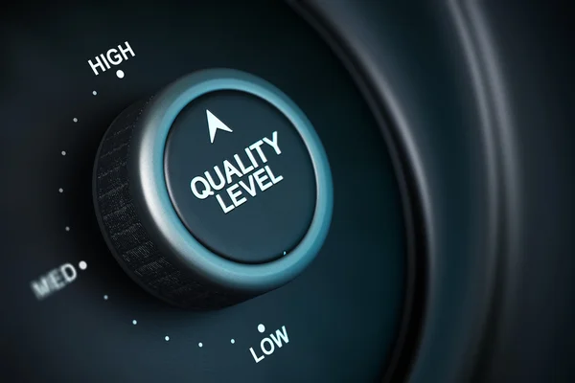
Lecture
01
Quality Grade and Quality Class

Slide 12
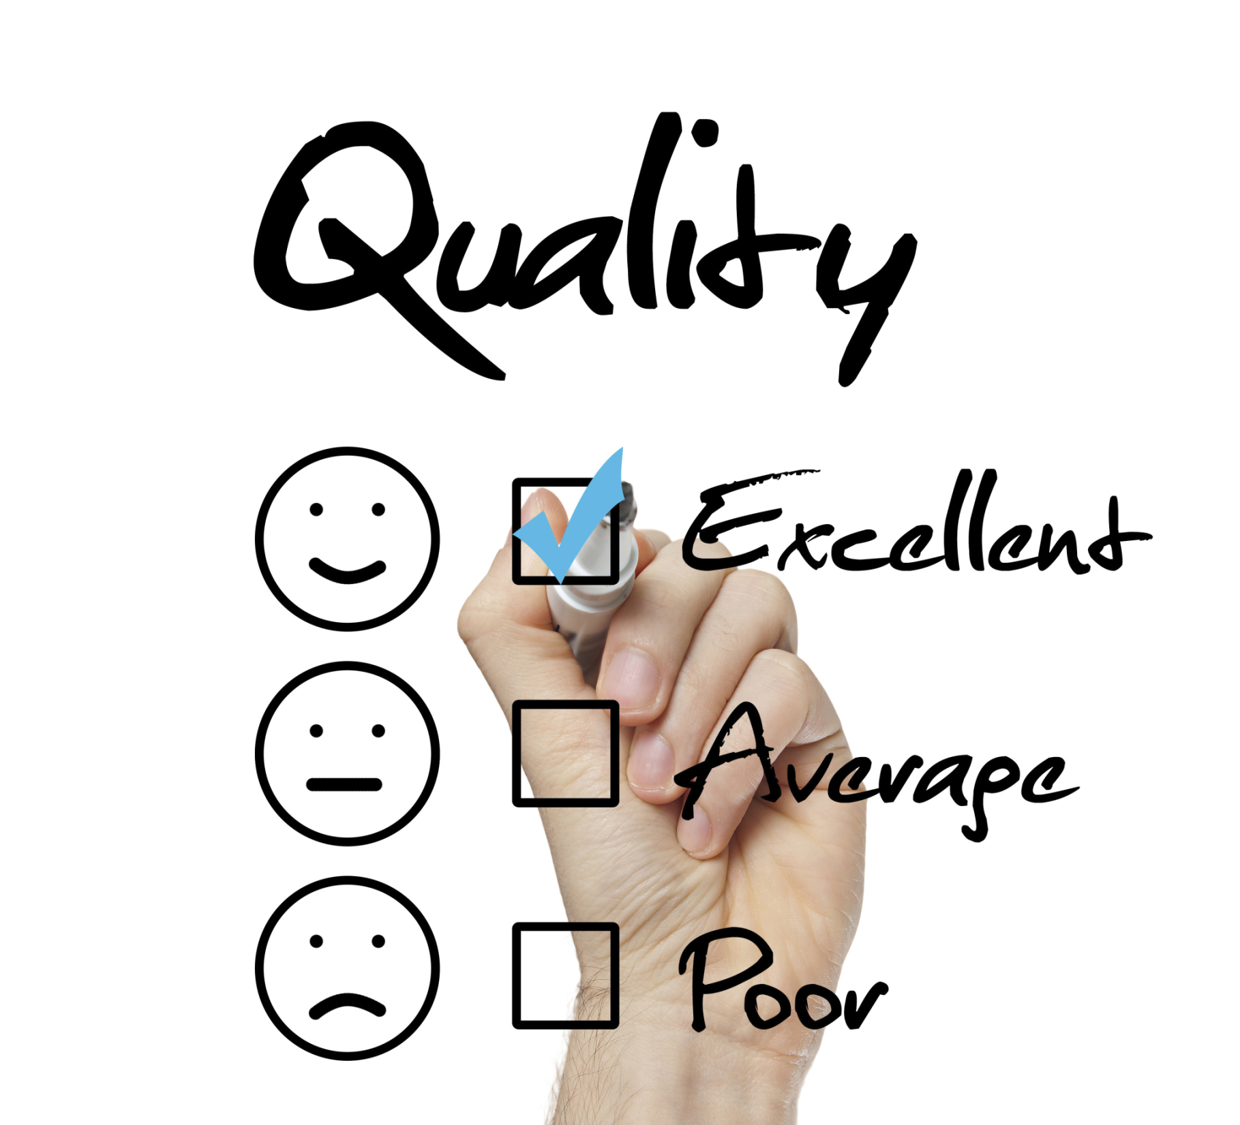
Lecture
01
Quality Class
Quality Grade
The type of product that fulfill the customer requirement
Differences in product or service performance

Slide 13

Lecture
01
Characteristics of Quality

Slide 14
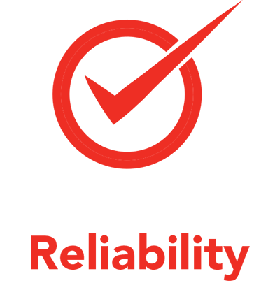








Lecture
01
Reliability
الأعتمادية
Conformance
المطابقة
Quality of Product
Features
المميزات
Durability
المتانة
Performance
الأداء
Aesthetics
Serviceability
المظهر الجمالى
الصيانة

Slide 15
Lecture
01
Criteria for Quality Product
Refers to the propensity for product to perform consistently
over its useful design life.
Reliability
Measuring product quality characteristics is absolutely crucial , but there are some techniques and metrics for measuring quality.
Conformance
Does the product meet the standards?
Aesthetics
Style , materials and visual of product appear

Slide 16

Lecture
01
What is the ease of fixing or repairing the product if it fails ?
Serviceability
Criteria for Quality Product
Are attributes of a product that supplement the product's basic
performance
Features
Measuring product quality characteristics is absolutely crucial , but there are some techniques and metrics for measuring quality.
This criterion defines how much the consumer will benefit from the product service before it starts to lose its quality?
Durability
Refers to the effectiveness with a product achieves its intended
purpose.
Performance

Slide 17




Lecture
01
Quality of Service
Reliability
الأعتمادية
Responsiveness
الأستجابة
Assurance
Tangible
التوكيد
ملموسة

Slide 18
Lecture
01
It relates to the ability of the service provider to perform the
promised service accurately
Reliability
Criteria for Quality Service
The ability to deal effectively with complaints and promptness of the service
Responsiveness
Measuring service quality is absolutely crucial , but there are some techniques and metrics for measuring quality.
Assurance
Refers to the knowledge of employees and their
ability to inspire trust and confidence
Tangibles
The state of facilitating goods; physical condition of the buildings and the environment; appearance of personnel; and condition of equipment

Slide 19
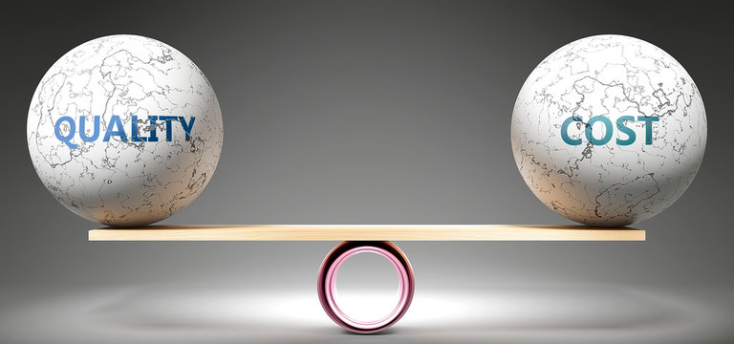
Lecture
01
Quality Cost

Slide 20
Lecture
01
The quality cost is generally classified into two main categories
COPQ
Internal cost
Cost associated with defects found before the customer receives the product or service
External cost
Cost associated with defects found after the customer receives the product or service
COQ
Inspection cost
Cost incurred to determine the degree of conformance to quality requirements
Prevention cost
Cost incurred to Prevent poor quality

Slide 21

Lecture
01
Who Is Responsible for Quality ?

Slide 22

Lecture
01
Who Is Responsible for Quality ?

Slide 23

Lecture
01
Benefits of Quality

Slide 24
Lecture
Benefits of Quality
01
Internal Benefits
External Benefits
Customer gets accurate product or service.
Correct specifications.
Customer satisfaction.
Reduces costs
Increases dependability
Increases customer retention
Quality Benefits

Slide 25

Lecture
01
Management of
Quality

Slide 26
Lecture
Management of Quality
01
01
First Step : Plan Quality
What is quality and how will we ensure it?
02
Second Step : perform Quality Control
Are we meeting the quality standards?
03
Third Step : perform Quality Assurance
Are we Following the quality standards?

Slide 27
Lecture
01
Evolution of quality

Slide 28

The challenge that companies face in the 21st Century is to succeed in a global economy where competition is huge and where customers are becoming Increasingly demanding of quality.
It is realized that the survival of business comes from the strong relationships between the organization itself and its interested parties to satisfy their needs and expectations.
Lecture
01
Evolution of quality-related thinking
In delivery of products or services, three aspects have to be considered - price, quality and delivery

Slide 29
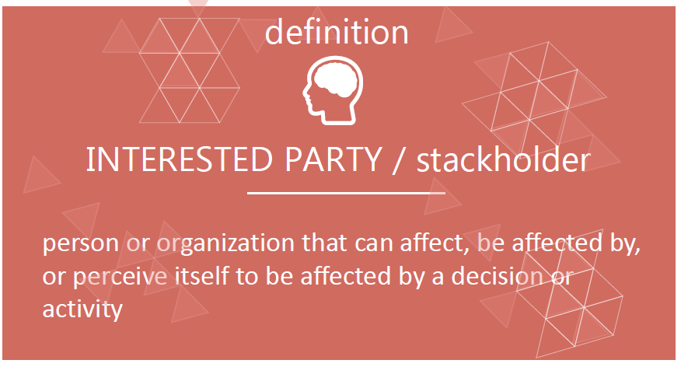
Lecture
01

Slide 30
Lecture
Interested parties
01
Employees
Labors
Shareholders
Internal interested parties
Security
Sector heads
Department heads

Slide 31
Lecture
Interested parties
01
Customers
Suppliers
Contractor
External interested parties
Neighbors
Legal parties
Visitors

Slide 32
Lecture
Interested parties
01
Comfortable working environment
Ease to access to requirements
Fair compensation system
Internal interested parties needs and expectations
Fair appraisal system
Training needs
Appropriate and safe transportation

Slide 33
Lecture
Interested parties
01
Clear and effective communication
Clear requirements
Short administrative cycle
External interested parties' needs and expectations
Conformed products
Products on time

Slide 34
Lecture
Quality is….
01
So………… What Is Quality?

Slide 35
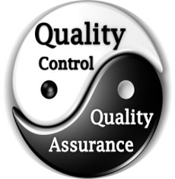
Lecture
Quality assurance vs. quality control
01
Differences Between
Quality Assurance and Quality Control

Slide 36
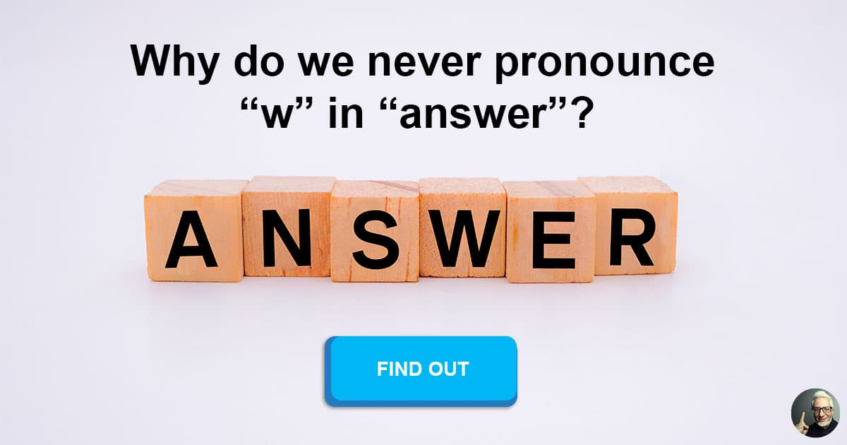
Lecture
Quality assurance vs. quality control
01
Both QC and QA personnel.
Control is defined as
“To check, test, or verify by evidence or experiments”
Assurance is defined as
“Confidence of mind or manner.”

Slide 37
Lecture
Quality assurance vs. quality control
01
Quality Assurance (QA)
Quality Control (QC)
QA is a set of activities for ensuring quality in the processes by which products are developed
QC is a set of activities for ensuring quality in products – services.
The activities focus on identifying defects in the actual products produced.
Definition
QA aims to prevent defects with a focus on the process used to make the product. It is a proactive quality process.
QC aims to identify (and correct) defects in the finished product. Quality control, therefore, is a reactive process.
Focus on
The goal of QA is to improve development and test processes so that defects do not arise when the product is being developed.
The goal of QC is to identify defects after a product is developed and before it's released.
Goal
Establish a good quality management system and the assessment of its adequacy.
Periodic conformance audits of the operations of the system.
Finding & eliminating sources of quality problems through tools & equipment so that customer's requirements are continually met.
How?

Slide 38
Lecture
Quality assurance vs. quality control
01
Quality Assurance (QA)
Quality Control (QC)
Process
Product- Service
Proactive
Reactive
Staff function
Individual function
Prevent defects
Find defects
Defining process
Testing

Slide 39
Lecture
QA and QC responsibilities
01
Quality Assurance (QA)
Quality Control (QC)
Everyone on the team involved in developing the process is responsible for quality assurance
Quality control is usually the responsibility of a specific team that tests the product for defects
Verify the accuracy of the data in order to provide confidence in the results.
QC personnel perform the testing and compare the results to the specification requirements.
Responsible for controlling the quality of the work performed.

Slide 40



Thank You

