Slide 1

Interaction Design (DGM 729)
Prepared by
Dr. Mohamed Owies
Lecture 8
Interaction Design(DGM 729)

Slide 2

Chapter 8
Testing and Validation Methods
Interaction Design

Slide 3
Lecture 8
Content
lecture 8 includes the following points:
Method 19
Paper and Interactive Prototypes
Method 20
Black Hat Session
Method 21
Quick-and-Dirty Usability Test
Method 22
Five-Second Test
Method 23
UX Health Check
If You Only Do One Thing…

Slide 4
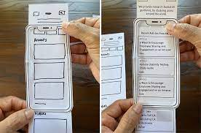
Lecture 8
Method 19 Paper and Interactive Prototypes
Does it work and feel as intended?
Prototypes are semi-functional models of a product that help you test how it will work and feel. Prototypes can vary widely from the crudest paper-based explorations to highly realistic, functional models.
This basic approach—idea first, then prototype, and then further improvement based on what you learn—is a powerful and time- endorsed method for any type of new product development. And it’s an excellent practice for you to get into as a team of one because people expect UX practitioners to drastically improve the product design.

Slide 5
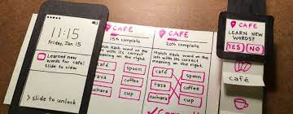
Lecture 8
Method 19 Paper and Interactive Prototypes
Some skilled UX practitioners just naturally know how to do that, but if you’re (like me) not always exactly sure of what needs to happen to make a killer design, prototyping and iterating give you a method where you can comfortably trust your gut and still give yourself space to learn and improve as you go.
Use When: You want to validate the direction prior to investing the time and resources to make it fully real. Often, you’ll discover that an idea doesn’t work quite as well as you originally imagined. Discovering this information early on enables you to modify your design in a relatively cheap and efficient way, and to evolve the design with real-time feedback.

Slide 6

Lecture 8
Method 19 Paper and Interactive Prototypes
Try It Out
1. Think about the purpose of the prototype.
Different points in the process argue for different types of prototypes. Ask yourself what type of validation you are trying to do and select the appropriate tool. Here are some different forms a prototype might take, depending on your goal:
To validate early concepts, a paper prototype (just static pictures or sketches representing a few select screens or moments in the product) should be enough.

Slide 7
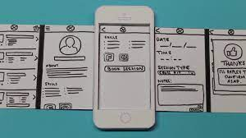
Lecture 8
Method 19 Paper and Interactive Prototypes
To get a sense of how a sequence of screens or moments flow together, a dummy clickable prototype usually suffices to illustrate how a discrete experience will unfold. A “dummy” clickable prototype includes the bare minimum of interactivity.
To simulate intended interactions as realistically as possible more robust prototyping tools may be needed. You may need prototyping tools that enable you to integrate basic conditional logic. Popular tools for this include Balsamiq, Axure, iRise, Flash Catalyst (from Adobe), and good old-fashioned HTML. If you have technical knowledge, you can also prototype directly in whatever the target technology is, which is arguably the most efficient because you may be able to repurpose the prototype into production code.

Slide 8
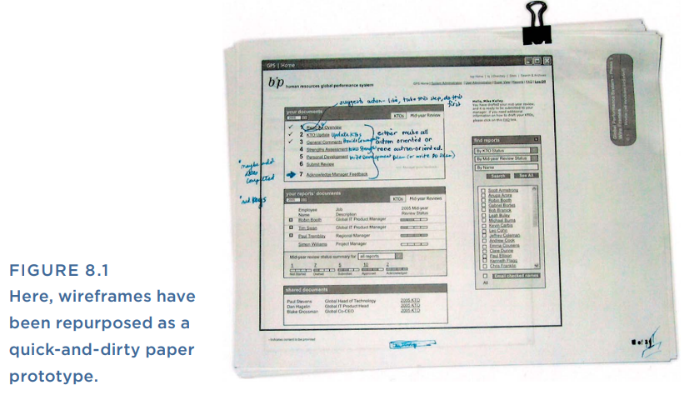
Lecture 8
Method 19 Paper and Interactive Prototypes
2. Make your prototype.
This is the fun part. Depending on your prototype fidelity and tool, this may be as simple as cleaning up some wireframes and printing them out, like the paper prototype in Figure 8.1, or it may require more time for writing code or setting up software to behave as you intend.

Slide 9
Lecture 8
Method 19 Paper and Interactive Prototypes
Typically, a prototype shows a sequential experience. There is a beginning, middle, and end that correspond to how somebody would (ideally) move through the product. To structure your prototype, plan out your beginning, middle, and end on paper, and think about the states or screens that make up this sequence.
A design is the content and information within it, so it’s great if you can test the comprehensibility and usefulness of the information—the content, the data, and so on—just as much as you’re assessing the flow and functionality. Put a little thought into the placeholder content you’ll be including in your prototype.

Slide 10
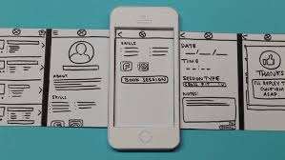
Lecture 8
Method 19 Paper and Interactive Prototypes
3. Validate the prototype with yourself and others.
Use the prototype to observe how someone would really interact with the design if unaided and left to his own devices. To do this, put the prototype in front of a volunteer or a representative user and give him a task. Start at the beginning of the experience that you’ve prototyped and ask him to show you what he would do in order to complete the task. What would he interact with? What would he touch or click on to complete his task? Remind him that his only goal is to complete the task you’ve given him. Ask him to explain what he thinks he is seeing at each step along the way.

Slide 11

Lecture 8
Method 20 Black Hat Session
What areas of the design could be improved?
Black Hat sessions are inspired by Edward DeBono’s Six Thinking Hats. “Six thinking hats” is a facilitative framework where teams adopt deliberate mental attitudes in order to make group work more dynamic and directed. With a group discussion using six thinking hats, each individual figuratively puts on a hat of a certain color. Each color signifies a particular point of view.
For example, there’s a hat for optimism (the yellow hat), one for emotion (the red hat), one for creativity (the green hat), etc. There’s also a hat for judgment, negativity, and skepticism, and that is the black hat. A person wearing the black hat is obliged to point out weaknesses or risks, and to be frank about what’s confusing or seems like it could be further improved.

Slide 12
Lecture 8
Method 20 Black Hat Session
All of the hats are interesting, but for the purposes of design critique, the black hat is especially powerful. It’s a quick framework that can put your teammates in a state of mind that enables candid and productive feedback on designs. This is valuable for several reasons:
People don’t necessarily know how to give critical design feedback: This can be even truer for your non-UX partners. When presented with a set of wireframes, it can often be hard to know where to start in evaluating them. For someone who is unaccustomed to the experience design process, it may be difficult to know if what you’re looking at has issues or not. A Black Hat session gives a group of people permission to call things as they see them, which can release them from any worry about whether their feedback is relevant or even correct.

Slide 13
Lecture 8
Method 20 Black Hat Session
Because a Black Hat session is all about pointing out the hard things, it does a few very important things. First, it gives anyone who is unhappy with certain aspects of the design a constructive forum for sharing his concerns and instills confidence that he is being heard. Second, it creates a safe place where people who are less comfortable giving negative feedback can express their concerns as well. Third, it puts all of these data points into a format that you can see, track, manage, and take charge of.
By running a Black Hat session, you show that you are not protective and defensive about the designs that you are creating and that you are serious about doing what needs to be done to make a great product. It also shows that you are the driver of a process where designs get better and better through continuous input and iterative improvement.

Slide 14
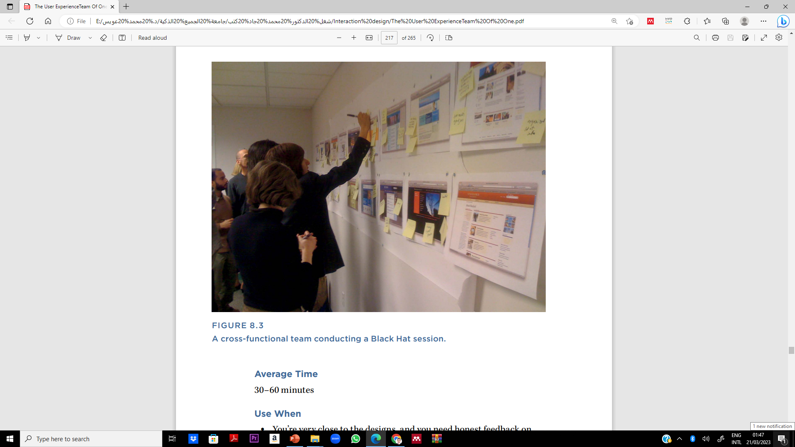
Lecture 8
Method 20 Black Hat Session
Figure 8.3 shows what a typical Black Hat session looks

Slide 15
Lecture 8
Method 20 Black Hat Session
Use When
You’re very close to the designs, and you need honest feedback on what’s working and what isn’t.
You sense that the team is holding back or not fully engaging in design reviews.
You want to do targeted reviews with subject matter experts (for example, technical feasibility reviews with the engineering team).

Slide 16
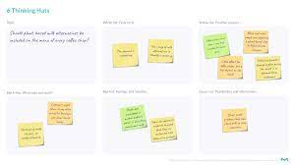
Lecture 8
Method 20 Black Hat Session
Try It Out
1. Make time for a group work session.
Once you have designs in a shareable form, schedule a Black Hat session. Block off an hour on the calendar, find a room or area with large, usable wall space, and assemble a group of people to help you critique the designs. It’s ideal if this group is actually the cross-functional team that works on the product together, but barring that, even a group of friends or uninvolved colleagues should be able to provide feedback on potential stumbling blocks from an end-user perspective.

Slide 17
Lecture 8
Method 20 Black Hat Session
2. Explain the rules.
With the group assembled, tape to the wall any designs you want to critique. Explain the rules of the Black Hat session. Everyone has one job and one job only: to assume the most critical, judgmental perspective they can muster, and look at the designs from that point of view. Ask participants to write down every problem or issue they see on a sticky note (one issue per sticky note) and place the note on the designs near where they spotted the problem. One easy way to “put on” the black hat is to pretend that you are a grumpy and skeptical user who is short on time and trying to do four different things simultaneously. Or pretend that you’re a tough and very senior leader who will be approving these designs before they are considered final.

Slide 18

Lecture 8
Method 20 Black Hat Session
3. Start the clock.
Give the group 15 to 20 minutes to walk through all of the designs, reflect on what they notice, and write their sticky notes. You can have participants do this as a silent exercise, or you can invite them to discuss what they’re seeing as a group. You can participate as well, writing your own sticky notes. Either way, make sure that everyone is writing lots of sticky notes. If they seem hesitant, you can give them some guidance as they go. Ask them things like:
When you look at each screen or step, do you understand its fundamental purpose?
What jumps out at you? Is it what should jump out at you?

Slide 19
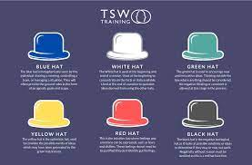
Lecture 8
Method 20 Black Hat Session
4. Review and look for themes.
After all the sticky notes have been written, invite the team to step back and look at other people’s sticky notes, looking for themes and issues they might have missed.
5. Discuss and synthesize.
Now, engage the group in a discussion about the big themes that emerged. You may find that the issues identified run the gamut from language, flow, and ease-of-use, all the way to core assumptions about the design concept. That’s great. You’ve just gotten a lot of help to make the design even better. During the group discussion, record the points on a flipchart or whiteboard. That list effectively becomes the synthesis of all the individual sticky notes. Close with a discussion about what’s most successful in the designs, in order to end the session on a positive note.

Slide 20
Lecture 8
Method 20 Black Hat Session
6. Update the designs.
After the meeting, revisit the designs to address the issues that the group identified. Some may be simple, quick fixes. Some may require more thought and rework to the designs.
Tips and Tricks for Black Hat Sessions
Use them whenever, wherever. Black Hat sessions don’t require a lot of prep and material—just some people, some designs, some Post-it notes, and a little bit of time. That makes a Black Hat session a durable and self-contained pop-up exercise that you can use whenever and wherever it’s helpful.

Slide 21
Lecture 8
Method 20 Black Hat Session
Tips and Tricks for Black Hat Sessions
Focus feedback. Black Hat sessions can be general, as described above, but they can also be focused on specific topics. A Black Hat session that focuses on, say, technical feasibility can be a great way to quickly involve engineering and identify designs that may prove problematic from an implementation perspective.
If you work remotely… Giving critical feedback can be uncomfortable. So can receiving it (even if you’re the one requesting it). For that reason, it’s far preferable to do this sort of activity in person. The in-person dynamic makes it easier for you to read non-verbal cues, diffuse any awkwardness, and encourage your colleagues to be open and honest.

Slide 22
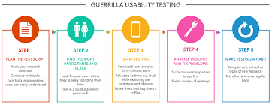
Lecture 8
Method 21 Quick-and-Dirty Usability Test
Can people use this product as intended?
A quick-and-dirty usability test is a natural output to many of the design methods described in Chapter 7, “Design Methods.” The essence of the quick-and-dirty usability test is that you do it quickly—like the name says. With this method, you’ll forego rigor and perfectionism to make it possible to get rapid feedback on designs. You’ll let go of recruiting and scheduling time with real users and just test the designs with anyone who’s available. Think of it as putting the design in front of the first person you find (who is unfamiliar with the product) and seeing if they can make sense of it.

Slide 23
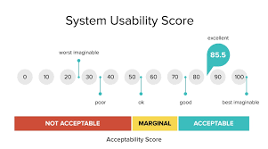
Lecture 8
Method 21 Quick-and-Dirty Usability Test
Of course, ideally you should test designs with people who truly represent the intended end-user, and if you have the time and team support, you should go that route. But if you’re just trying to get a gut check on whether a design direction works or doesn’t, a fresh pair of eyes can help you see things from a new perspective and settle wavering questions.
Use When
At any point during the design process when you want to do a quality check on the designs.
As often as possible to check your work along the way.

Slide 24
Lecture 8
Method 21 Quick-and-Dirty Usability Test
Try It Out
1. Find someone, anyone.
As you’re working on a design, when you want to see if it makes sense to others, print out the design or grab your laptop and wander over to anyone who hasn’t seen it yet. This could be someone who sits in the desk next to yours, someone you encounter walking down the hall or in the cafeteria, or if you truly work alone, a friend or family member.

Slide 25
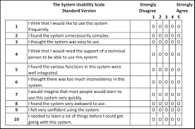
Lecture 8
Method 21 Quick-and-Dirty Usability Test
2. Ask them what they’re seeing and how they think it works.
Think about the purpose of the page, screen, or section of the design that you’re working on. What are the main things people should be able to use it for? With this list of primary tasks in mind, show your design to your volunteer. Ask her how she thinks she could interact with this design to accomplish a particular task. If there are multiple screens or steps that you’re designing, proceed through each screen, asking her to explain what she’s seeing and what she would do to advance to the next step. That may only take 5 minutes, or it might take 20.

Slide 26
Lecture 8
Method 21 Quick-and-Dirty Usability Test
3. Find a few more volunteers.
Once you’ve shown your design to one person, try to find a few more people to run through the same process. Your colleagues may enjoy getting involved, since it’s a break from their normal routine and shows that you value their perspective.
4. Iterate the designs.
If you identify anything that’s especially confusing to people or that they interpreted differently than you had intended, go back and revise the design.

Slide 27
Lecture 8
Method 21 Quick-and-Dirty Usability Test
Tips and Tricks for Quick-and-Dirty Usability Tests
Not for expert users. Quick-and-dirty usability tests are preferable for products that don’t have a highly technical purpose or audience (where the average person has a better chance of being a reasonable stand-in for your actual users). If you do have a very technical product and you’re trying to run a quick-and-dirty usability test, you should try to find someone who is a good stand-in for a typical user. At a minimum, you may need to spend a few minutes up front explaining some concepts and terminology.
•Be willing to stop and fix things. If you discover after your first few conversations that something in the new design is just not working for people, stop and fix the design before continuing.
Ultimately, it’s more productive to test three different designs of progressively improving quality with two people each than to test one bad design with six people.

Slide 28
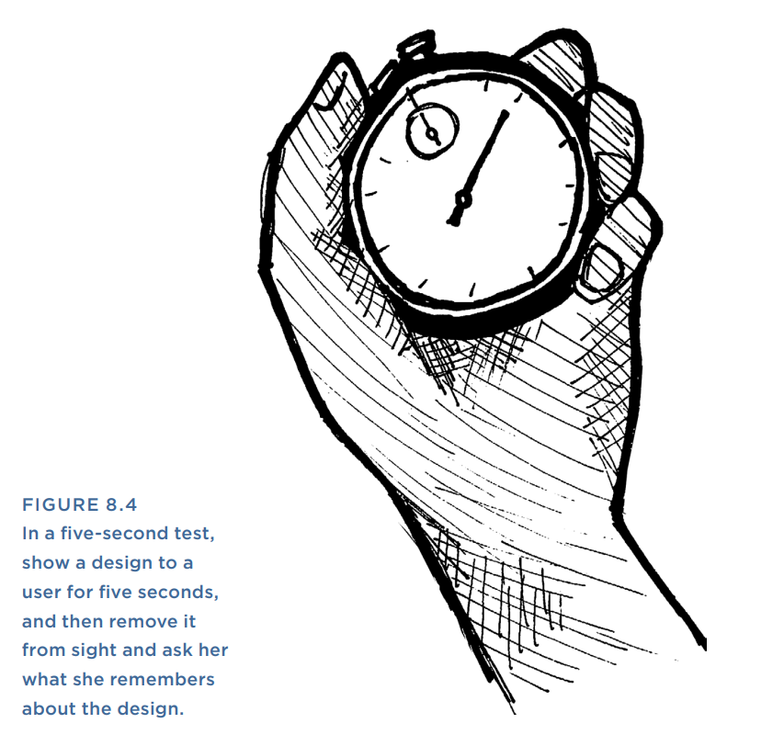
Lecture 8
Method 22 Five-Second Test
What impression is created by a specific screen, step, or moment within the product? First popularized by Christine Perfetti at User Interface Engineering, a five-second test is a lightning-fast but surprisingly insightful method to quickly assess the information hierarchy in a product. Read more at www.uie.com/articles/five_second_test/. A five-second test helps you see how clear and memorable a given moment in the product or service is to users (see Figure 8.4).
Like a quick-and-dirty usability test, a five-second test can and should be done regularly to check your work as you progress through the design process. You can even combine a quick-and-dirty usability test with a five-second test for a rapid but rich round of validation.

Slide 29
Lecture 8
Method 22 Five-Second Test
In a five-second test, you basically expose the user to a screen or moment in a product, ask her to look at it for five seconds, and then remove the screen from view. Once the screen has been removed, ask her what she remembers seeing, and what she thought the overall purpose of the page or screen was. Considering that people often use products in a distracted, multitasking state, the five-second test is actually a pretty good indicator for how people really experience your products.
Use When
You want to test the information hierarchy of a page, screen, or state.
As often as possible to check your work along the way.

Slide 30
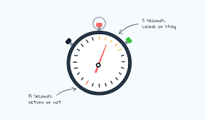
Lecture 8
Method 22 Five-Second Test
Try It Out
1. Find a volunteer.
Find someone to test your designs on. This can be anyone who is handy (as in the quick-and-dirty usability test) or representative users. Explain that you are going to show your volunteer a screen in a product, but only for five seconds, after which you’ll take it away and ask her some questions about it.
2. Commence the five-second countdown.
Show your participant the design that you are testing and silently count off five seconds. You can do this in person by showing her a printout or a design on the screen of your computer, mobile device, or tablet. If you’re doing this remotely, you can do it through screen sharing software, such as WebEx, Skype, or Adobe Connect.

Slide 31
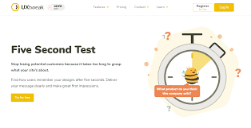
Lecture 8
Method 22 Five-Second Test
3. Ask the volunteer what she remembers.
After five seconds have passed, remove the picture from view. Now ask your research participant what she remembers seeing on the page or screen. Also ask her what she thinks the purpose of the page was, and, if she is unfamiliar with your product, what she thinks the product was.
4. Did she get it right?
Did she notice the most important messages or information that you’re trying to convey in that moment? If not, your information hierarchy may be off. Did she correctly interpret the purpose of the product and the screen? If not, the balance of messaging and basic affordances (or, what it looks like you can do with that page) may need more work. Could she correctly identify the type of product this is? If not, you may need to think about navigation, branding, or messaging.

Slide 32
Lecture 8
Method 22 Five-Second Test
5. Repeat regularly.
Repeat as many times as needed to vet key screens or moments in the product.
Tips and Tricks for Five-Test a variety of screens.
This is a great way to validate important parts of a product, like the start screen or the home page. But people sometimes enter products through the back door, too. They poke around online; they save bookmarks; they follow links in emails. To test that the product design is robust at all levels, consider running five-second tests on random lower-level pages as well.
If you work remotely… Online tools for this sort of testing are getting more sophisticated all the time. Check out FiveSecondTest (http://fivesecondtest.com/), Verify (http://verifyapp.com/), or Clue (www.clueapp.com/

Slide 33
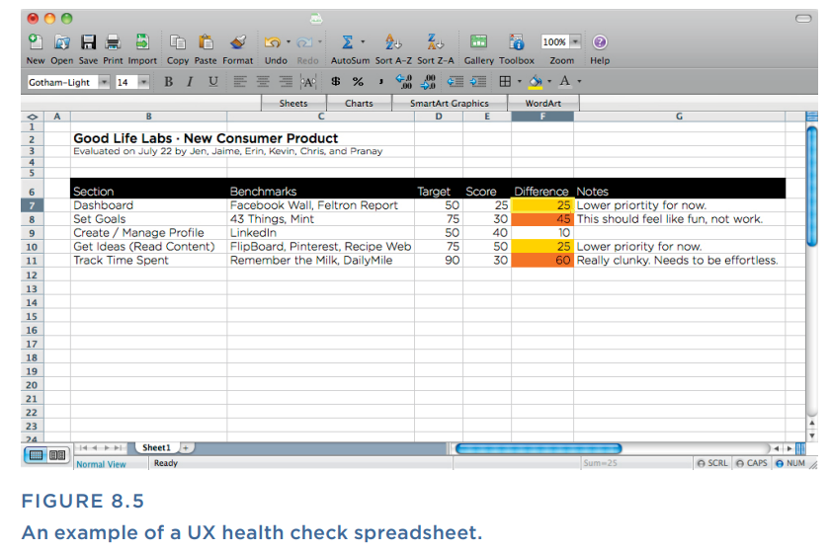
Lecture 8
Method 23 UX Health Check
A UX health check measures baseline quality of a user experience and assesses changes in quality over time.
In a UX health check, you regularly assemble a cross-functional team to do an audit on the quality of the product’s user experience. This technique was developed by Livia Labate and Austin Govella while at Comcast. It’s a way to quickly figure out how well the team feels the product is currently measuring up against user experience expectations (see Figure 8.5).
This is a quick, rather unscientific method, but it has the benefit of inclusivity; you are establishing and measuring this baseline with the help of your colleagues. If you conduct this process regularly, it enables you to demonstrate and agree collectively on changes in quality over time.

Slide 34
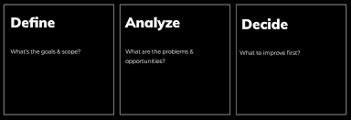
Lecture 8
Method 23 UX Health Check
Use When
You want to start tracking the quality of UX over time and don’t have other formal measures in place.
Try It Out
1. Designate a team.
Identify a cross-functional group of people to be the health check team, and set up a recurring meeting: monthly, quarterly, weekly, or whatever duration makes sense for your product. Ideally, this is the team who is responsible for the product on a day-to-day basis.

Slide 35
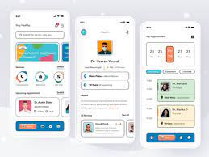
Lecture 8
Method 23 UX Health Check
2. Break the product into sections.
Looking at your overall offering, break it down into sections or areas of focus. This could correspond to the sections of the product from a navigational perspective (for example, registration, account, homepage, etc.). Or, alternately, this could be layers of the experience (content, brand, interactivity, cross-channel consistency, etc.)
3. Set competitive benchmarks.
For each section or area of focus, pick a relevant competitive benchmark to serve as an inspiration. For example, you want your product suggestions to be as good as Amazon’s. Or you want your crosschannel consistency to be as good as Apple’s, and so on.

Slide 36
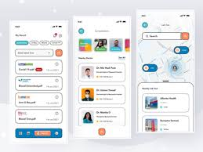
Lecture 8
Method 23 UX Health Check
4. Set a target.
Next, for each of those sections, decide how good your product actually needs to be, compared to its competitive benchmark. You may not be able to make your cross-channel consistency 100% as good as Apple’s, but maybe 50% as good would be pretty great. As a team, assign a target percentage for each section and its benchmark. As you discuss why you’ve chosen the target percentage that you have, note and document your rationale. This is so that you and the team can remember your thought process in the future and explain it if anyone asks

Slide 37
Lecture 8
Method 23 UX Health Check
5. Measure yourself against the benchmarks.
Now, for each of these sections, give the product a rating. You might want to be 50% as good as Apple, but after discussion, you decide that you are presently only 25% as good. Discuss how well each section measures up against its competitive benchmark, and give each section a percentage number that reflects where you think you are today. The team may need to have a bit of discussion to arrive at a number that everyone can agree on. That’s good! The discussion is the most valuable part.

Slide 38
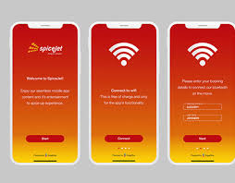
Lecture 8
Method 23 UX Health Check
6. Spot the biggest opportunities for improvement.
Once you’ve agreed on your rankings, identify the biggest gaps between your target and where you stand today, and then discuss how you’re going to improve it.
7. Repeat regularly.
As you continue to evolve the product, keep checking back and measuring yourself against your benchmark. Where your product is improving, congratulate yourselves. Where your product is underperforming relative to your baseline, focus on your next round of improvements.

Slide 39
Lecture 8
UX Design Methods & AI Integration
Method 19: Paper and Interactive Prototypes
Used to visualize ideas early in the design process.
AI Role: AI tools (like Figma plugins or AI-assisted wireframing) speed up prototype creation, predict user flows, and suggest design improvements.
Method 20: Black Hat Session
Critical evaluation of a product’s flaws.
AI Role: Sentiment analysis tools and AI-based risk detection can simulate “black hat” thinking to uncover design weaknesses.
Method 21: Quick-and-Dirty Usability Test
Fast feedback from real users using minimal resources.
AI Role: AI-driven testing platforms can automate the analysis of user behavior, identify usability issues quickly, and offer instant reports.

Slide 40
Lecture 8
UX Testing Enhanced by AI
Method 22: Five-Second Test
Evaluates users’ first impressions of a design.
AI Role: Eye-tracking AI can simulate and analyze user attention in the first 5 seconds, enhancing precision in design evaluation.
Method 23: UX Health Check
Assesses overall usability and performance of a system.
AI Role: AI analytics tools monitor system health continuously, detect UX pain points, and recommend data-driven improvements.

Slide 41
Lecture 8
Method 23 UX Health Check
If You Only Do One Thing…
Falling in love with your own ideas is an ever-present risk in design. Being proud of your work is great, but you never want it to prevent you from seeing that designs can evolve, simplify, and improve. This chapter offers a variety of methods for assessing how well a design is working—quickly, and with minimal overhead. The spirit of this chapter is simple: always be more curious about what isn’t working than what is.
So if you only have time to try one thing from this chapter, focus on the “Black Hat Session.” Of all the methods in this chapter, the Black Hat session is the fastest and most blunt instrument for satisfying your curiosity about what isn’t working. Black Hat sessions clear away all the niceties and expose bad or unworkable designs with striking efficiency.

Slide 42
Lecture 8
Thank You

