Slide 1


IELTS Preparation
Mini-Course
Lecture 2
Prepared by
Ahmed Soliman

Slide 2
Mastering the IELTS Speaking Test (Parts 1–3)

Slide 3
🎯 Objectives
By the end of the lesson, students will be able to:
Identify the structure and timing of the IELTS Speaking test.
Recognize the assessment criteria (Fluency, Lexical Resource, Grammar, Pronunciation).
Respond confidently to Part 1, 2, and 3 familiar-topic questions..

Slide 4
Lead-in
What do you already know about the Speaking test?
How many parts?
How long in total?
Is it face-to-face or on a computer?

Slide 5
Test Structure
Part | Focus | Duration | Type of Questions | Example Topic
1 | Introduction & Interview | 4–5 min | Personal / Familiar | Work, studies, hobbies
2 | Long Turn (Cue Card) | 3–4 min | Description + Details | Describe a book / trip / person
3 | Discussion | 4–5 min | Abstract / Opinion | Education, environment, culture

Slide 6
The Band Descriptors (simplified):
Fluency & Coherence: speak smoothly, logical ideas.
Lexical Resource: wide vocabulary, natural expressions.
Grammatical Range & Accuracy: variety of structures.
Pronunciation: clear and natural sound.

Slide 7
Part 1 Practice — Interview
Model Q&A:
What do you do?
Do you enjoy your work/studies? Why?
What kind of music do you like?
How often do you spend time with friends?
Notes:
  Give full answers (✓)
  Use linking words (✓)
  Clear pronunciation (✓)

Slide 8
Common topics for Task 1
[ Work, study, Hometown, Home, Art, Birthdays, Childhood, Clothe, Computer, Daily Routine, Dictionaries, Evenings, Family, Friends, Flowers, Food, Going out, Happiness, hobbies, Internet, Leisure/free time, Music, Neighbors and Neighborhoods, Newspapers, Pets, Reading, Shopping, Sports, Transport, Weather]
It is a good idea to have these topics prepared in advance.

Slide 9
Focus on ICC (idioms + connectors + complex)
Focus on the use of the following complex sentences:
- If I talk about….
- When it comes to…
- If you want my honest opinion, I can say that…
- It’s believed that….
- It’s crystal clear that…
- As far as I know,
- As far as I recall
- If my memory serves me,
- As far as I’m concerned

Slide 10
IELTS Part 1 Speaking: Answer Formation Process
Understand the Question (1-2 seconds):
  Listen carefully to the keywords and the tense.
  Identify the core topic.
Formulate a Direct Answer (1 second):
  Give a clear, concise "Yes/No" or direct statement.
  Example Question: "Do you enjoy cooking?"
  Direct Answer Thought: "Yes, I do."
Provide a Reason/Explanation (2-3 seconds):
  Briefly explain why your direct answer is true.
  Think: "Because..." or "The reason is..."
  Connecting Thought: "...because I find it very relaxing and creative."

Slide 11
4. Add an Example or Elaboration (3-4 seconds):
  Give a specific example, a brief detail, or expand slightly on your reason.
  Think: "For instance...", "One reason is...", "A good example is..."
  Elaboration Thought: "I especially love trying out new recipes from different cuisines."
5. Refine and Conclude (1 second - optional):
  Optionally, add a very short concluding thought or a natural linking phrase to transition if more ideas come to mind.
  Overall Answer (2-4 sentences): "Yes, I do enjoy cooking. I find it very relaxing and creative, especially when I get to try out new recipes from different cuisines."

Slide 12
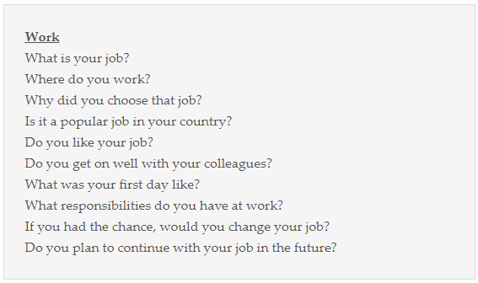
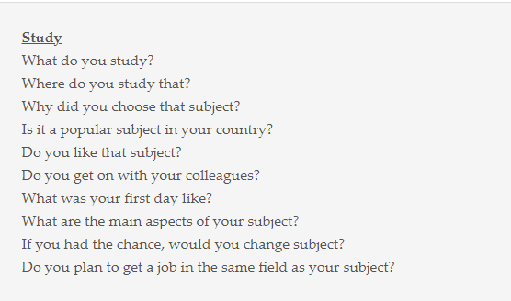
Examples of task 1
Speaking Prompt that the examiner uses with transcript.
Examples of most common topics in IELTS speaking task 1 with questions.

Slide 13
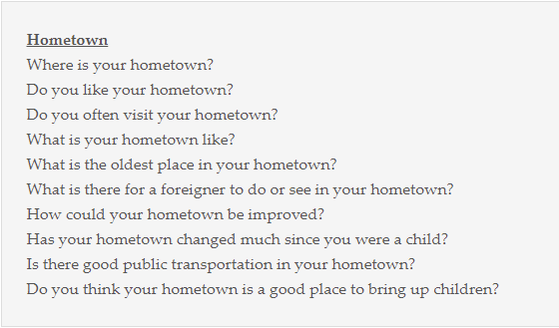
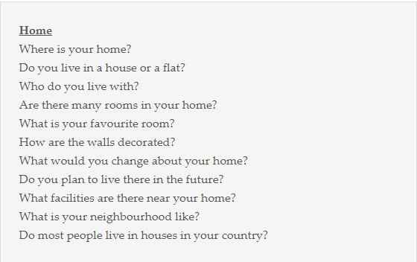

Slide 14
🗣️ Part 2 – Long Turn (Cue Card)
1 min to prepare → 1–2 min to speak.
Make quick notes (who, where, when, why, feelings).
Structure answer: Introduction → Description → Details → Opinion.
Cue Card Example:
Describe a book you recently read.
You should say:
– what book it was
– why you decided to read it
– what you learned from it
and explain why you would (or would not) recommend it.

Slide 15
1- You will be given a small piece of paper with a topic and some points, an empty piece of paper and a pen. You will have one minute to prepare the topic and the points.
2- After that, you will be asked to talk about the topic for two minutes – with a timer – the examiner might ask you a question during that time to help you continue. You should use the points written on the paper. They are also very helpful for new ideas.
This part is made to assess your ability to speak at length on a specific topic. Using accurate language while staying organized is very important.

Slide 16
Examples of task 2
Speaking Prompt that the examiner uses with transcript.

Slide 17
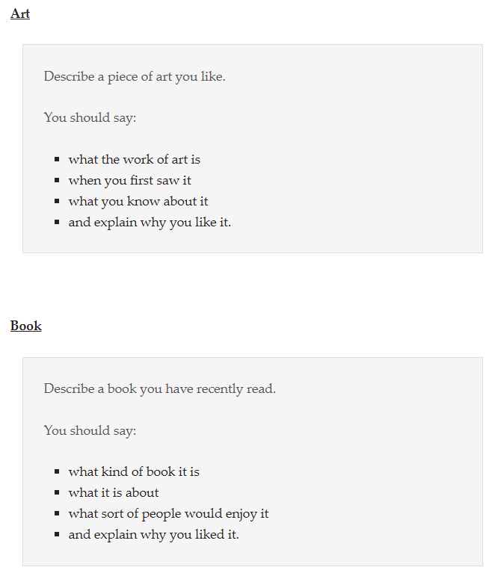
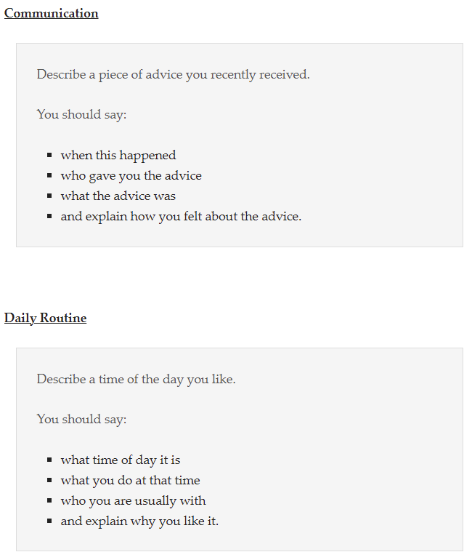
Examples of task 2

Slide 18
Part 3 – Discussion
Questions become more abstract and require reasoning/opinion.
Examiner may interrupt or ask “Why?” / “Do you think … ?”
Sample Topic: Reading and Education
Do you think people read less nowadays?
How can schools encourage students to read more?
Do you believe reading habits will change in the future?

Slide 19
You will be asked more questions related to part 2, and you will be asked to explain, analyze, discuss, speculate justify, and express your opinion.
In this part the examiner will speak with you and ask you questions.
This part is made to assess your ability to express ,justify your opinion and discuses and speculate issues related to general topics.

Slide 20
IELTS Part 3: Simple Answer Formation
Part 3 is for discussing bigger ideas and opinions. Think "big picture."
State Your Main Idea: Give your direct opinion or the main point.
  Example: "Why do people live in big cities?" → "I think the main reason is career opportunities."
Explain It: Tell us how or why your idea is true.
  Example: "...because cities have more jobs and better chances for promotion."
Give an Example/Detail: Provide a general illustration or a specific, brief example.
  Example: "For instance, most large companies are based in urban areas."
Add Another Side (Optional, but good): Briefly mention an opposite view or another consideration.
  Example: "However, the high cost of living can be a problem too."
Result (4-6 sentences): "I think the main reason people live in big cities is career opportunities. This is because cities generally have more jobs and better chances for promotion compared to smaller towns. For instance, most large companies are based in urban areas. However, it's also true that the high cost of living can be a major problem for many."
Key Idea: Main Idea + Explain + Example (+ Other Side).

Slide 21
Examples of task 3
Speaking Prompt that the examiner uses with transcript.

Slide 22
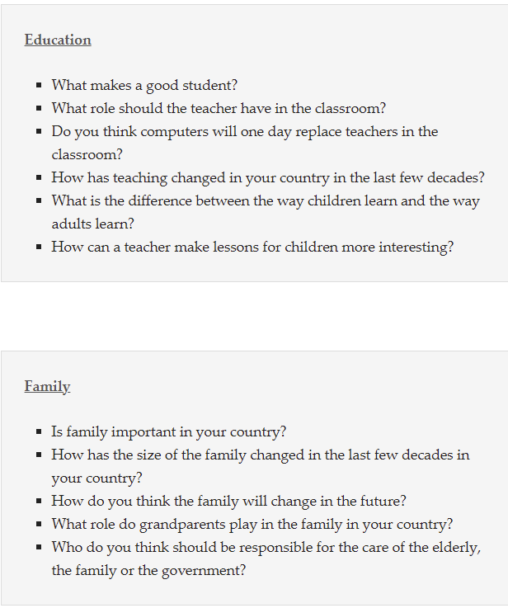
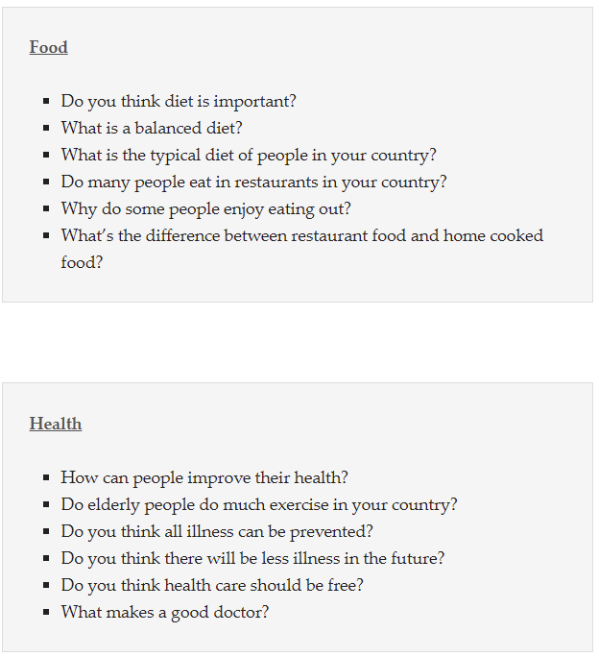
Examples of task 3

Slide 23
General tips
Use connectors and linking
Examples of connectors and linking for speaking
Organizing your thoughts
[ Firstly, Secondly/ Lastly, Finally / The former, the latter ]
Adding more information
Informal [What’s more, Plus, besides, and, also]
Giving examples
[ For example, for instance, Namely, Such as, Like]
Summarizing :
Informal : [ In a nutshell. To sum up]
Time Phrase :
[ Now, At the moment, Currently, right now, these days, nowadays, in the past, before, then, at the time, years ago, When I was younger]

Slide 24
General tips
Expressing ideas:
[ I think one important thing is, I guess one difference is, I suppose the main difference between …. And …. Is ]
Causes and Solutions
[ guess it’s because, The main reason is, It was caused by, Because, I suppose the best way to deal with this problem is, I reckon the only answer is to, The best way to solve this is]
Contrasting and concessions
[ But, yet, while, whereas, on the other hand, even though ]
Cause
[ Because, for this, due to, therefor, that is why]
Effect
[ For this, that is why, so]

Slide 25
How to study Speaking at home alone

Slide 26
How to study Speaking alone
1- Learn how to develop ideas for them. Be able to make at least six questions for any topic you hear using question heads.
for example, if the topic is transportation in your country
What transportation do we use?
When do we use transportation/busiest hour of the day?
What kind of transportation do we have?
where
How
Why
who
Is / Are
Do / Does
etc.
2- Learn different topics related vocabulary [ Cold, chilly, freezing]

Slide 27
3- Record yourself when you answer speaking, and check
- Fluency [ Worth 25% of speaking ]
How long are your answers?
Are your ideas organized?
Are you doing a lot of uh, ah?
Are you taking pauses?
- Pronunciation [ Worth 25% of speaking ]
Are you pronouncing words and sounds right [o,p,th,j]? check dictionaries/
Are you using contractions?
Are you sounding flat ?
- Vocabulary [ Worth 25% of speaking ]
How many different words are you using?
Are you repeating the same words over and over or are you paraphrasing it?,
Are you using the wrong words,
Write it and put it on Grammarly

Slide 28
General tips
- Grammar [ Worth 25% of speaking ]
How many different tense are you using ?
Are you using model verbs or not? Are your sentences only simple?
Example: “we wear a lot of light colored clothe because The weather is normally very hot in Egypt, especially last month, it was scorching sometime it feels like you might melt”

Slide 29
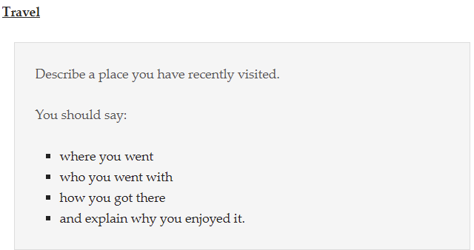
Assignment
1- Record a 2-minute response to the following cue card:
2- Write 3 Part 3 questions about “Travel and Tourism.”

Slide 30


Thank You

