Slide 1


Project Quality
Management
Prepared by Dr. Ehab Mahmoud
PMG 354
Orientation lecture
Lecture 0

Slide 2



Project Quality
Management
Lecture 0
PMG 354
Orientation Lecture
Prepared by
Dr. Ehab Mahmoud

Slide 3

Chapter
Contents
0
Academic Agenda
Course Description
Online Lecture
Course Objectives
Learning Outcomes
Course Topics
Areas of Discussion
Reference

Slide 4

Chapter
Academic Agenda
0

Slide 5

Chapter
Course Description
0
Credit Hours: 3 Credit Hours
The materials and reference for this course will be:
Textbook, Project Quality Management, Second Edition: Why, What and How by Kenneth Rose
Lecture notes and slides

Slide 6
Chapter
Online Lecture
0
Answer your questions/inquiries
Solve different issues/problems
Discuss your opinions with the instructor/classmates
Trigger activities related to previous session topics

Slide 7
Chapter
Course Objectives
0
Introducing the foundations and concepts of quality in general
Introducing the main tools for quality assurance and quality control of the project
Identifying the main milestones of the project from start to end
Identifying the project charter.
Identifying the main elements of Quality Management plan to make sure the project will deliver the intended outcome.

Slide 8
Chapter
Learning Outcomes
0
At the end of this subject, each student will be able to:
Evaluate the core quality processes and explain the role of each process in planning and managing projects.
Given a project scenario with a well‐defined goal and scope, construct a comprehensive quality plan that addresses the stakeholders’ needs.
Apply appropriate quality‐control tools and techniques to a given scenario where improvement is warranted as a result of the project’s quality‐control data.

Slide 9
Chapter
Course Topics
0
Quality fundamentals and concepts
Quality auditing
Ishikawa basic seven tools
Statistical quality control – part 1
Statistical quality control – part 2

Slide 10
Chapter
Course Topics
Course Topics
0
Project philosophy
Initiating the project
Developing the project schedule – part 1
Developing the project schedule – part 2
Developing a quality management plan

Slide 11
Chapter
Areas of Discussion
0
What does Quality mean?
Characteristics of quality
The difference between quality assurance and quality control
The main stages of Audit
What are the common quality control used?
What are the main stages of the project?
How can we create a comprehensive project charter?

Slide 12
Chapter
Areas of Discussion
Areas of Discussion
0
What are the responsibilities of project manager?
How can we create the quality management plan to make sure that the project delivers the intended outcome?
Open discussion on what are the main barrier that the project team may face during the execution of project and how can be overcome.

Slide 13
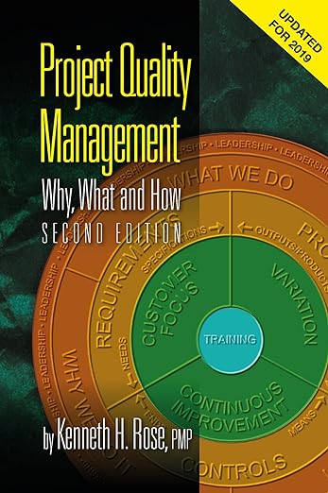
Chapter
Reference
0

Slide 14



Thank You

