Slide 1

RHSA (Admin 1) Red Hat Enterprise Linux 8 Essentials
Prepared by Eng. Taghreed Elsayed
Lecture 6
CONTROLLING SERVICES AND DAEMONS

Slide 2

Chapter
08
CONTROLLING SERVICES AND DAEMONS
DENTIFYING AUTOMATICALLY STARTED SYSTEM PROCESSES
Daemons are processes that wait or run in the background performing various tasks.
Generally, daemons start automatically at boot time and continue to run until shutdown or until they are manually stopped. By convention, the names of many daemon programs end in the letter "d“.
A service often refers to one or more daemons, but starting or stopping a service may instead make a one-time change to the state of the system, which does not involve leaving a daemon process running afterward (called oneshot).
systemctl and systemd units The systemctl command is used to manage different types of systemd objects, called units. A list of available unit types can be displayed with systemctl -t help.

Slide 3
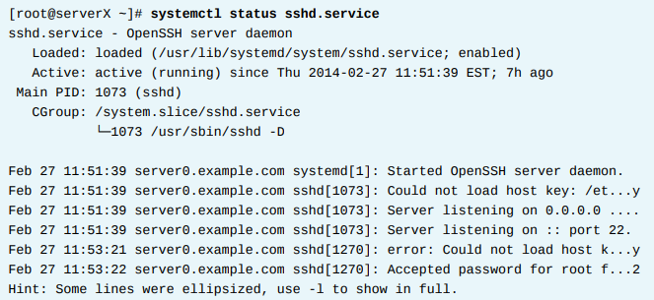
Chapter
08
CONTROLLING SERVICES AND DAEMONS
Service states
The status of a service can be viewed with systemctl status name.type.
If the unit type is not provided, systemctl will show the status of a service unit, if one exists.

Slide 4
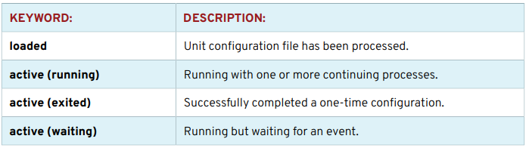
Chapter
08
CONTROLLING SERVICES AND DAEMONS
Several keywords indicating the state of the service can be found in the status output:

Slide 5
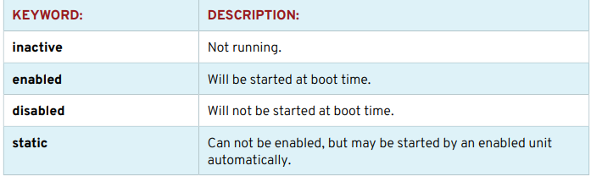
Chapter
08
CONTROLLING SERVICES AND DAEMONS
LISTING UNIT FILES WITH systemctl :
NOTE Notice that the systemctl command will automatically paginate the output with less.

Slide 6


Chapter
08
CONTROLLING SERVICES AND DAEMONS
1.List all service units on the system
2.List all socket units, active and inactive, on the system.
3.Explore the status of the chronyd service. This service is used for network time synchronization (NTP).
3.1. Display the status of the chronyd service. Note the process ID of any active daemons.

Slide 7



Chapter
08
CONTROLLING SERVICES AND DAEMONS
3.2. Confirm that the listed daemons are running.
4.Explore the status of the sshd service. This service is used for secure encrypted communication between systems.
4.1. Determine if the sshd service is enabled to start at system boot.

Slide 8



Chapter
08
CONTROLLING SERVICES AND DAEMONS
4.2. Determine if the sshd service is active without displaying all of the status information.
4.3. Display the status of the sshd service.
5. List the enabled or disabled states of all service units.

Slide 9

Chapter
08
CONTROLLING SERVICES AND DAEMONS
CONTROLLING SYSTEM SERVICES
To control system daemons and network services using systemctl.
STARTING AND STOPPING SYSTEM DAEMONS ON A RUNNING SYSTEM
→Changes to a configuration file or other updates to a service may require that the service be restarted. A service that is no longer used may be stopped before removing the software. A service that is not frequently used may be manually started by an administrator only when it is needed.
Managing services on a running system.
1. View the status of a service.

Slide 10


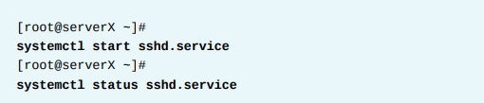
Chapter
08
CONTROLLING SERVICES AND DAEMONS
2. Verify that the process is running.
3. Stop the service and verify the status.
4. Start the service and view the status. The process ID has changed.

Slide 11

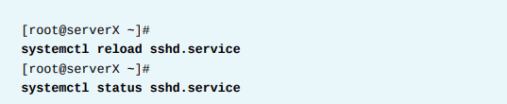
Chapter
08
CONTROLLING SERVICES AND DAEMONS
5. Stop, then start, the service in a single command
6. Issue instructions for a service to read and reload its configuration file without a complete stop and start. The process ID will not change.

Slide 12

Chapter
08
CONTROLLING SERVICES AND DAEMONS
Unit dependencies
For example, a file placed into the print spool directory will cause the cups print service to be started if it is not running.
To completely stop printing services on a system, stop all three units. Disabling the service will disable the dependencies.
The systemctl list-dependencies UNIT command can be used to print out a tree of what other units must be started if the specified unit is started.
Depending on the exact dependency, the other unit may need to be running before or after the specified unit starts.
The --reverse option to this command will show what units need to have the specified unit started in order to run.

Slide 13

Chapter
08
CONTROLLING SERVICES AND DAEMONS
ENABLING SYSTEM DAEMONS TO START OR STOP AT BOOT
Starting a service on a running system does not guarantee that the service will be started when the system reboots.
Similarly, stopping a service on a running system will not keep it from starting again when the system reboots.
Services are started at boot time when links are created in the appropriate systemd configuration directories.
These links are created and removed with systemctl commands.
Enabling and disabling services.
1. View the status of a service.

Slide 14


Chapter
08
CONTROLLING SERVICES AND DAEMONS
2. Disable the service and verify the status. Note that disabling a service does not stop the service.
3. Enable the service and verify the status.

Slide 15
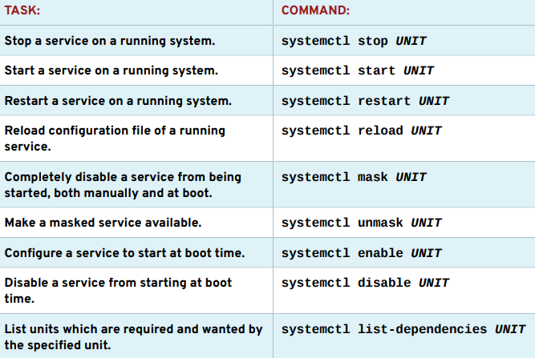
Chapter
08
CONTROLLING SERVICES AND DAEMONS
SUMMARY OF systemctl COMMANDS

Slide 16


Chapter
08
CONTROLLING SERVICES AND DAEMONS
USING systemctl TO MANAGE SERVICES
The chronyd service is disabled and no longer running on the system.
Observe the results of systemctl restart and systemctl reload commands.
1.1. Display the status of the sshd service. Note the process ID of the daemon
1.2. Restart the sshd service and view the status. The process ID of the daemon has changed.

Slide 17



Chapter
08
CONTROLLING SERVICES AND DAEMONS
2. Verify that the chronyd service is running.
3. Stop the chronyd service and view the status.
4. Determine if the chronyd service is enabled to start at system boot.

Slide 18


Chapter
08
CONTROLLING SERVICES AND DAEMONS
5. Reboot the system, then view the status of the chronyd service.
6. Disable the chronyd service so that it does not start at system boot, then view the status of the service.

Slide 19

Chapter
08
CONTROLLING SERVICES AND DAEMONS
7. Reboot the system, then view the status of the chronyd service.

