Slide 1


Cybersecurity
Concepts
Prepared by Dr. Diaa Salama
FNT625
Advanced Encryption Standard (AES)
Lecture 8

Slide 2




Cybersecurity
Concepts
Lecture 8
FNT625
Advanced Encryption Standard (AES)
Prepared by
Dr. Diaa Salama
www.midocean.ae

Slide 3





Slide 4

Lecture
Lets Start the Eighth Lecture
08
Advanced Encryption Standard (AES)
www.midocean.ae

Slide 5


Advanced Encryption Standard
Simplified Advanced Encryption Standard (AES)
www.midocean.ae

Slide 6
Advanced Encryption Standard (AES)
Simplified Advanced Encryption Standard
www.midocean.ae

Slide 7
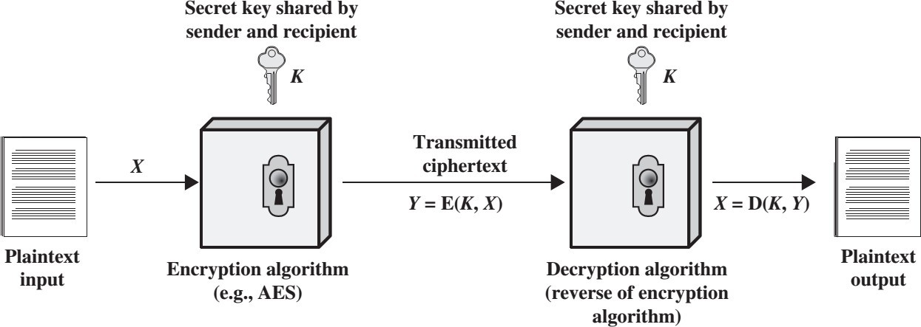
Cryptography and Network Security
Lecture
08
Advanced Encryption Standard (AES)
www.midocean.ae

Slide 8
Lecture
08
Origin of AES
1999: NIST indicates that DES should be replaced as a standard
  have theoretical attacks that can break it
  have demonstrated exhaustive key search attacks
Triple-DES should be used before a new standard is approved
  3DES has 168-bit key: brute-force attack is infeasible
  Same engine as for DES is running – software/hardware can be reused
  Confident that no effective attack exists: DES has been around for a long time
  As far as security is concerned, 3DES is ideal to replace DES
Drawbacks of 3DES
  Relatively slow software implementations – DES was designed for 1970’s hardware
  DES and 3DES use 64-bit blocks: for efficiency and security, larger blocks should be used
www.midocean.ae

Slide 9
Lecture
08
Origin of AES
US NIST issued call for ciphers in 1997
  15 candidates accepted in Jun 98
  5 were shortlisted in Aug-99
  Rijndael was selected as the AES in Oct-2000
  issued as FIPS PUB 197 standard in Nov-2001
www.midocean.ae

Slide 10
Lecture
08
Requirements for the new standard
Private key symmetric block cipher
128-bit data, 128/192/256-bit keys
Stronger and faster than 3DES
Active life of 20-30 years (+ archival use)
Provide full specification and design details
Both C and Java implementations
NIST have released all submissions & unclassified analyses
www.midocean.ae

Slide 11
Lecture
08
AES Evaluation Criteria
Initial criteria:
  security – effort to practically cryptanalyze
  cost – computational efficiency, so as to be used in high-speed applications, such as broadband links
  algorithm and implementation characteristics: should be suitable for a variety of soft/hard implementations, simple enough to make analysis straightforward
www.midocean.ae

Slide 12
Lecture
08
AES Evaluation Criteria
Final criteria:
  general security: this was conducted by the public (academic) cryptographic community: people published various attacks and weaknesses of the candidates
  software and hardware implementation ease: execution speed, performance on various platforms, variation of speed with key size
  Attacks on implementation: timing attacks and power analysis
  Multiplication consumes more power and takes more time than addition
  Writing 1s consumes more power and takes more time than writing 0s
  Flexibility (in encryption/decryption, key change, other factors)
www.midocean.ae

Slide 13
Lecture
08
AES Shortlist
After testing and evaluation, shortlist in Aug-99:
    MARS (IBM) - complex, fast, high security margin
    RC6 (USA) - v. simple, v. fast, low security margin
    Rijndael (Belgium) - clean, fast, good security margin
    Serpent (Euro) - slow, clean, v. high security margin
    Twofish (USA) - complex, v. fast, high security margin
  Then subject to further analysis & comment
  Analysed contrast between algorithms with
    few complex rounds vs. many simple rounds
    which refined existing ciphers vs. new proposals
www.midocean.ae

Slide 14
Lecture
08
The AES Cipher – Rijndael
Designed by Rijmen-Daemen in Belgium
128/192/256-bit keys, 128 bit data
Does not have the structure of a classical feistel cipher
  treats data in 4 groups of 4 bytes
  operates an entire block in every round
Designed to be:
  resistant against known attacks
  speed and code compactness on many platforms
  design simplicity
Decryption algorithm different than the encryption
www.midocean.ae

Slide 15
Lecture
08
Rijndael
Processes data as 4 groups of 4 bytes – 128-bit block
Input block copied into State array, modified at each stage of encryption or decryption and copied to the output matrix after the final round
has 9/11/13 rounds (depending on which variant is used) in which State
undergoes:
  byte substitution (one S-box used on every byte)
  shift rows: a simple permutation
  mix columns: substitution using arithmetic in GF(2⁸)
  add round key (XOR State with the round key)
initial XOR of the plaintext with a round key
There is an incomplete last round (the 10th/12th/14th)
Note: all operations can be combined into XOR and table lookups - hence very fast and efficient
www.midocean.ae

Slide 16
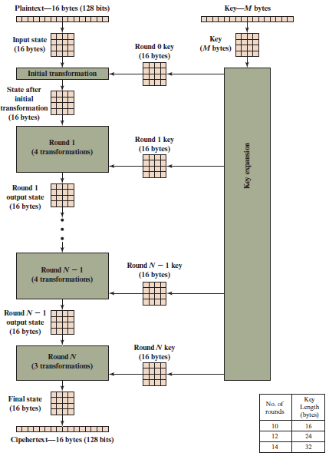
Figure 6.1 A E S Encryption Process
Notes:
Figure 6.1 shows the overall structure of the AES encryption process. The cipher takes a plaintext block size of 128 bits, or 16 bytes. The key length can be 16, 24, or 32 bytes (128, 192, or 256 bits). The algorithm is referred to as AES-128, AES-192, or AES-256, depending on the key length.

Slide 17
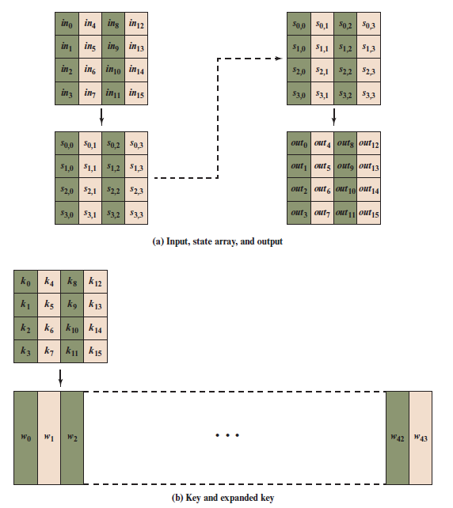
Lecture
07
Rijndael data structures
www.midocean.ae

Slide 18
Table 6.1 A E S Parameters
Key Size (words/bytes/bits) | 4/16/128 | 6/24/192 | 8/32/256
Plaintext Block Size (words/bytes/bits) | 4/16/128 | 4/16/128 | 4/16/128
Number of Rounds | 10 | 12 | 14
Round Key Size (words/bytes/bits) | 4/16/128 | 4/16/128 | 4/16/128
Expanded Key Size (words/bytes) | 44/176 | 52/208 | 60/240
Notes:
The cipher consists of N rounds, where the number of rounds depends on the key length: 10 rounds for a 16-byte key, 12 rounds for a 24-byte key, and 14 rounds for a 32-byte key (Table 6.1). The first N - 1 rounds consist of four distinct transformation functions: SubBytes, ShiftRows, MixColumns, and AddRoundKey, which are described subsequently. The final round contains only three transformations, and
there is a initial single transformation (AddRoundKey) before the first round, which can be considered Round 0. Each transformation takes one or more 4 * 4 matrices as input and produces a 4 * 4 matrix as output. Figure 6.1 shows that the output of each round is a 4 * 4 matrix, with the output of the final round being the ciphertext. Also, the key expansion function generates N + 1 round keys, each of which is a distinct 4 * 4 matrix. Each round key serves as one of the inputs to the AddRoundKey transformation in each round.

Slide 19
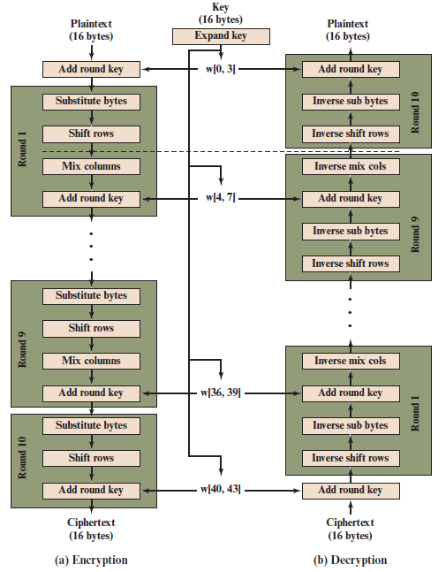
Lecture
08
Rijndael
Figure 6.3 A E S Encryption and Decryption
www.midocean.ae

Slide 20
Detailed Structure (1 of 2)
Processes the entire data block as a single matrix during each round using substitutions and permutation
The key that is provided as input is expanded into an array of forty-four 32-bit words, w[i]
Four different stages are used:
  Substitute bytes – uses an S-box to perform a byte-by-byte substitution of the block
  ShiftRows – a simple permutation
  MixColumns – a substitution that makes use of arithmetic over GF(2⁸)
  AddRoundKey – a simple bitwise X O R of the current block with a portion of the expanded key
Notes:
Before delving into details, we can make several comments about the overall AES structure.
1. One noteworthy feature of this structure is that it is not a Feistel structure. Recall that, in the classic Feistel structure, half of the data block is used to modify the other half of the data block and then the halves are swapped. AES instead processes the entire data block as a single matrix during each round using substitutions and permutation.
2. The key that is provided as input is expanded into an array of forty-four 32-bit words, w [i ]. Four distinct words (128 bits) serve as a round key for each round; these are indicated in Figure 6.3.
3. Four different stages are used, one of permutation and three of substitution:
• Substitute bytes: Uses an S-box to perform a byte-by-byte substitution of the block
• ShiftRows: A simple permutation
• MixColumns: A substitution that makes use of arithmetic over GF(2⁸ )
• AddRoundKey: A simple bitwise XOR of the current block with a portion of the expanded key
4. The structure is quite simple. For both encryption and decryption, the cipher begins with an AddRoundKey stage, followed by nine rounds that each includes all four stages, followed by a tenth round of three stages.
5. Only the AddRoundKey stage makes use of the key. For this reason, the cipher begins and ends with an AddRoundKey stage. Any other stage, applied at the beginning or end, is reversible without knowledge of the key and so would add no security.
6. The AddRoundKey stage is, in effect, a form of Vernam cipher and by itself would not be formidable. The other three stages together provide confusion, diffusion, and nonlinearity, but by themselves would provide no security because they do not use the key. We can view the cipher as alternating operations of XOR encryption (AddRoundKey) of a block, followed by scrambling of the block (the other three stages), followed by XOR encryption, and so on. This scheme is both efficient and highly secure.
7. Each stage is easily reversible. For the Substitute Byte, ShiftRows, and MixColumns stages, an inverse function is used in the decryption algorithm. For the AddRoundKey stage, the inverse is achieved by XORing the same round key to the block.
8. As with most block ciphers, the decryption algorithm makes use of the expanded key in reverse order. However, the decryption algorithm is not identical to the encryption algorithm. This is a consequence of the particular structure of AES.
9. Once it is established that all four stages are reversible, it is easy to verify that decryption does recover the plaintext. Figure 6.3 lays out encryption and decryption going in opposite vertical directions. At each horizontal point (e.g., the dashed line in the figure), State is the same for both encryption and decryption.
10. The final round of both encryption and decryption consists of only three stages. Again, this is a consequence of the particular structure of AES and is required to make the cipher reversible.

Slide 21
Lecture
08
Rijndael – the structure
Discuss each of the four stages in each round
For each stage, describe the encryption and decryption algorithms
Describe the rationale of each stage
Describe key expansion
Each stage operates on the 128-bit State, i.e., 16 bytes – these will be treated as a 4x4 matrix of bytes
  The first four bytes are on the first column, the following 4 on the second column, etc.
In this description we assume key length of 128
  Details are only slightly different for longer keys
  The 128-bit key is also shown as a matrix of 4x4 bytes (each byte is a number from 0 to 255): first 4 bytes on the first column, following 4 on the 2nd columns, etc.
  The key is expanded in an array of 44 words – each word has 4 bytes; these key words are used throughout the rounds: in each XOR are involved 4 words
www.midocean.ae

Slide 22
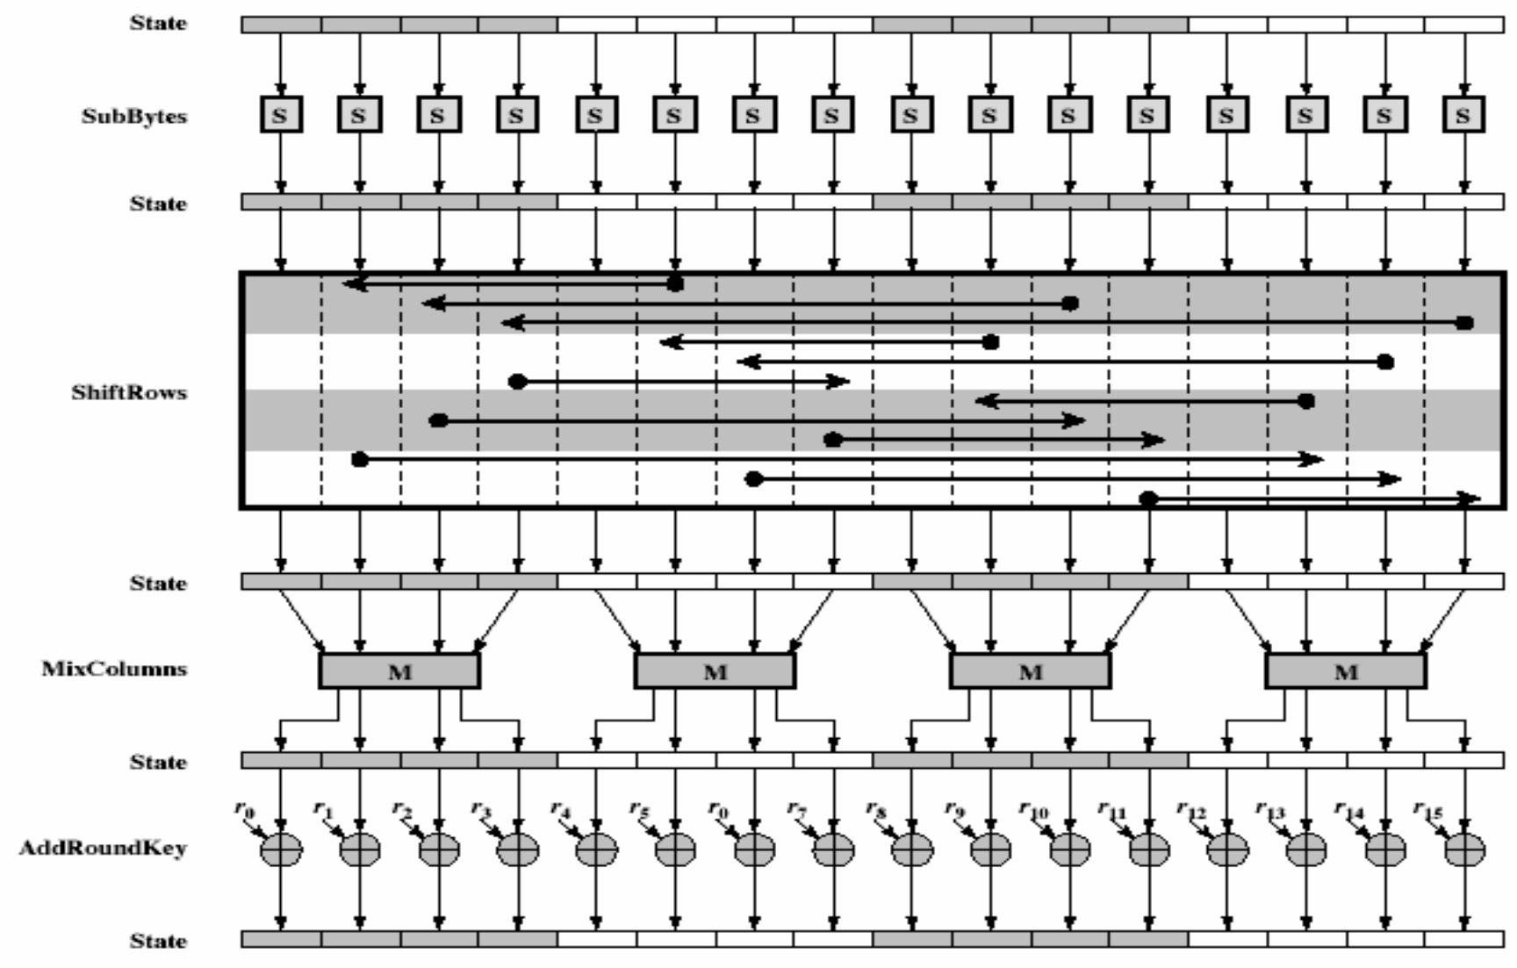
Lecture
08
Implementation: one AES Ecryption Round
www.midocean.ae

Slide 23
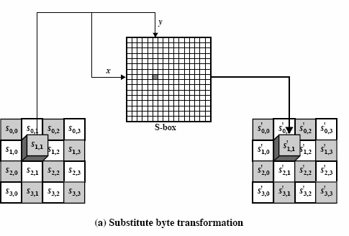
Lecture
08
Substitute bytes transformation using The S-box
www.midocean.ae

Slide 24
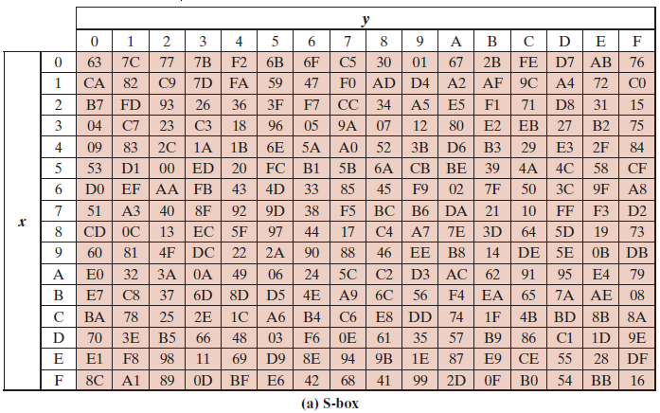
Lecture
08
AES S-boxes
www.midocean.ae

Slide 25
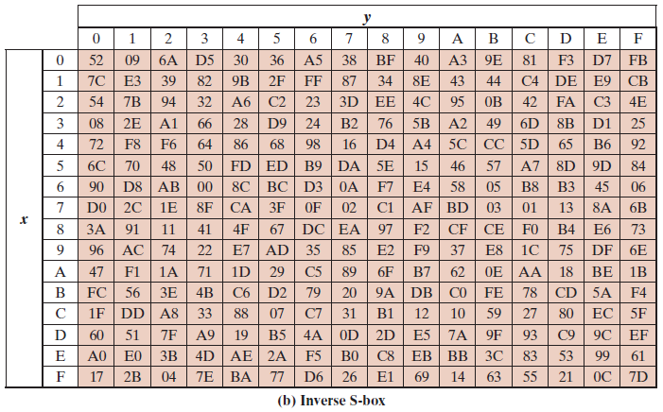
Lecture
08
AES S-boxes
www.midocean.ae

Slide 26
Lecture
08
Substitute bytes transformation
Note: we will denote hexadecimal numbers in parenthesis: {45}, {A6},
{CF}
SubBytes is a simple table lookup (see next slide)
  table of 16x16 bytes containing a permutation of all 256 8-bit values
Each byte of state is replaced by a byte in the table
  The row is given by the leftmost 4-bits of the byte
  The column is given by the rightmost 4-bits of the byte
  Example: byte {95} (in hexa) is replaced by the byte on row 9, column 5:
{2A} (see next slide)
For decryption, use the inverse S-box
www.midocean.ae

Slide 27
Lecture
08
Shift Row Transformations
For encryption, circular byte shift in each row
  1st row is unchanged
  2nd row does 1 byte circular shift to left
  3rd row does 2 byte circular shift to left
  4th row does 3 byte circular shift to left
For decryption, all shifts are done to right
Why this particular shift?
  Since state is processed by columns, this step permutes bytes between the columns
  The 4 bytes of one column are spread out to 4 different columns
This step provides “permutation” of the data, whereas the other steps provide substitutions (recall Shannon’s S-P networks)
www.midocean.ae

Slide 28
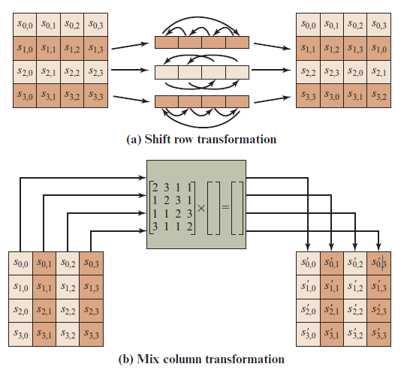
Lecture
08
A E S Row and Column Operations
www.midocean.ae

Slide 29
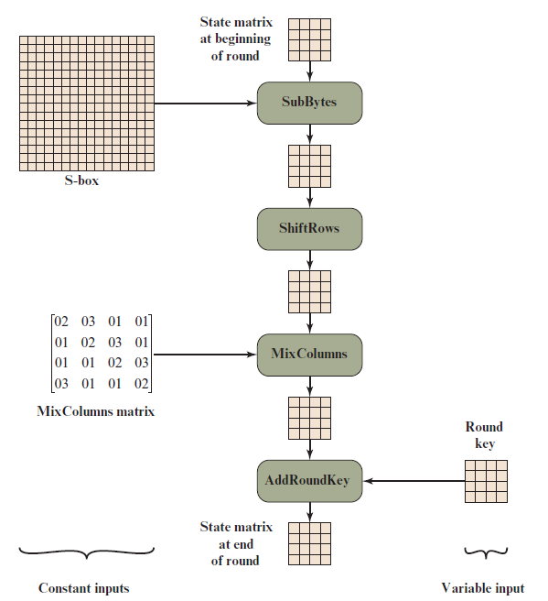
Lecture
08
Inputs for Single A E S Round
www.midocean.ae

Slide 30
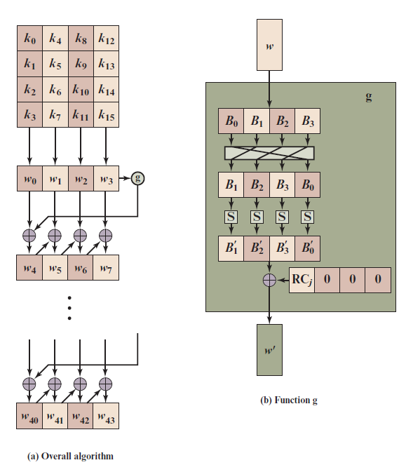
Lecture
08
A E S Key Expansion
www.midocean.ae

Slide 31
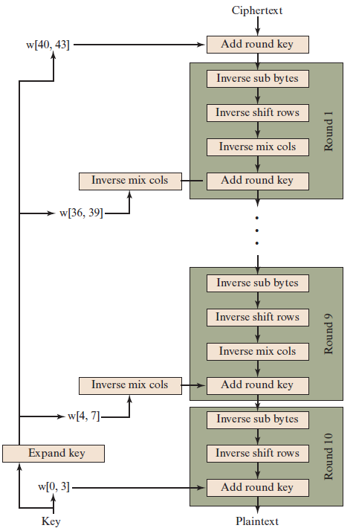
Lecture
08
Equivalent Inverse Cipher
www.midocean.ae

Slide 32
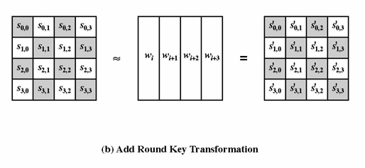
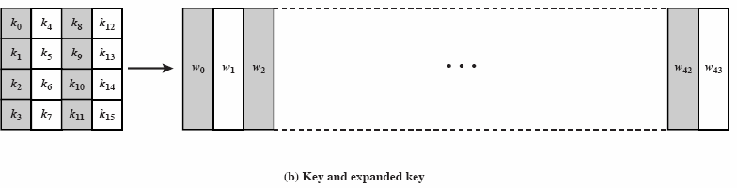
Lecture
08
Add Round Key
XOR state with 128-bits of the round key
Same in the decryption – use the round keys in reverse order
⊕
www.midocean.ae

Slide 33
Lecture
08
AES Key Expansion
Takes 128-bit (16-byte) key and expands into an array of 44 32-bit words (each word has 4 bytes)
www.midocean.ae

Slide 34
Lecture
08
AES Decryption
AES decryption is not identical to encryption since steps must be performed in reverse
  This is a disadvantage because different software is needed for encryption and decryption
  Encryption is an interation of SubBytes, ShiftRows, MixColumns, AddRoundKey
  Decryption is an interation of InvShiftRows, InvSubBytes, AddRoundKey, InvMixColumns
Decryption can be modified to use the encryption software (switch the order of the first two operations and the order of the last two operations in each round), provided we operate a small change in the key expansion
  Before we apply AddRoundKey in each round, we apply InvMixColumns to the matrix formed by the 4 words participating in the current round
www.midocean.ae

Slide 35

Lecture
08
AES Decryption
Implementation aspects: AES Round with State seen as an array with 16 bytes rather than as a 4x4 matrix
www.midocean.ae

Slide 36
Lecture
08
Implementation Aspects
Can efficiently implement on 8-bit CPU
  byte substitution works on bytes using a table of 256 entries
  shift rows is simple byte shifting
  add round key works on byte XORs
  mix columns requires matrix multiply in GF(2⁸) which works on byte values, can be simplified to use a table lookup
www.midocean.ae

Slide 37
Lecture
08
Implementation Aspects
Can efficiently implement on 32-bit CPU
  redefine steps to use 32-bit words
  can precompute 4 tables of 256-words
  then each column in each round can be computed using 4 table lookups
+ 4 XORs
  at a cost of 16Kb to store tables
Designers believe this very efficient implementation was a key factor in its selection as the AES cipher
www.midocean.ae

Slide 38
Advanced Encryption Standard
Simplified Advanced Encryption Standard (AES)
www.midocean.ae

Slide 39








Simplified Advanced Encryption Standard
S-AES Encryption and Decryption S-AES Key Generation
S-AES Encryption
S-AES Decryption

Slide 40
Simplified Advanced Encryption Standard
S-AES Encryption and Decryption
S-AES Key Generation S-AES Encryption
S-AES Decryption

Slide 41
Simplified AES (S-AES) was developed Schaefer of Santa Clara University in 2003
by Professor Edward
its purpose is educational, since its key and block size are very small 16bits
it is possible for students to encrypt or decrypt a block doing all operations by hand
it easier for students to understand the structure AES

Slide 42
Simplified Advanced Encryption Standard
S-AES Encryption and Decryption
S-AES Key Generation
S-AES Encryption S-AES Decryption

Slide 43












16-bit Plain text
16-bit Key
16-bit Plain text
Add Round Key
^{𝒘}𝟎,𝟏
Add Round Key
Nibble Substitution
Expand Key
Inverse Nibble Substitution
Shift Row
Round 1
Round 2
Inverse Shift Row
Mix Columns
Inverse Mix Columns
Add Round Key
^{𝒘}𝟐,𝟑
Add Round Key
Nibble Substitution
Expand Key
Inverse Nibble Substitution
Shift Row
Round 2
Round 1
Inverse Shift Row
Add Round Key
^{𝒘}𝟒,𝟓
Add Round Key
16-bit Cipher text
16-bit Cipher text

Slide 44

16-bit Plaintext, P= D7 28
=1101 0111 0010 1000
16-bit Key, K= 4A F5
=0100 1010 1111 0101

Slide 45

Simplified Advanced Encryption Standard
S-AES Encryption and Decryption
S-AES Key Generation
S-AES Encryption
S-AES Decryption

Slide 46

16-bit Key
^{𝒘}𝟎,𝟏
Expand Key
^{𝒘}𝟐,𝟑
Expand Key
^{𝒘}𝟒,𝟓

Slide 47
16-bit Key
^{𝒘}𝟎,𝟏
Expand Key
^{𝒘}𝟐,𝟑
Expand Key
^{𝒘}𝟒,𝟓

Slide 48


K= 4A F5
= 0100 1010 1111 0101
The input key, K, is split into 2 words, w0 and w1:
w0 = 0100 1010
w1 = 1111 0101

Slide 49
16-bit Key
^{𝒘}𝟎,𝟏
Expand Key
^{𝒘}𝟐,𝟑
Expand Key
^{𝒘}𝟒,𝟓

Slide 50
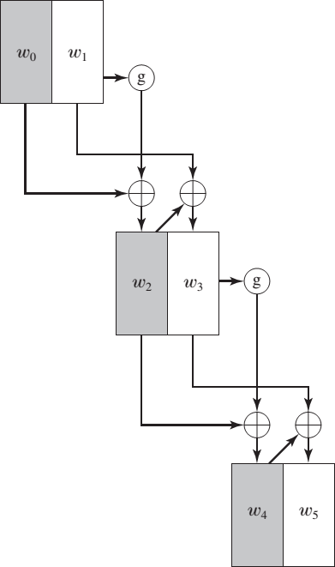
S-AES Key Expansion

Slide 51
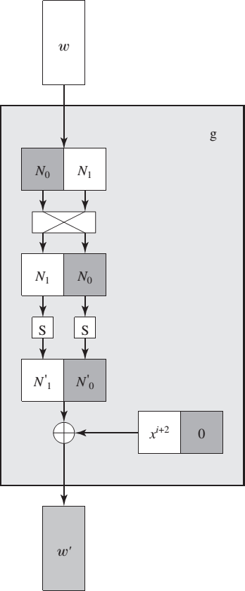
Function g

Slide 52
16-bit Key
^{𝒘}𝟎,𝟏
Expand Key
^{𝒘}𝟐,𝟑
Expand Key
^{𝒘}𝟒,𝟓

Slide 53
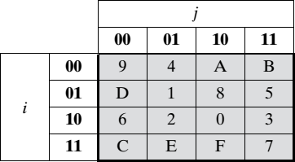
w0 = 0100 1010, w1 = 1111 0101
w2 = w0 ⊕ Rcon(1) ⊕ SubNib( RotNib(w1))
RotNib() is “rotate the nibbles”, which is equivalent to swapping the nibbles , Rcon is a round constant
SubNib() is “apply S-Box substitution on nibbles using encryption S-Box”
RotNib(w1) = 0101 1111
SubNib(0101 1111) = 0001 0111
Rcon(1) = 10000000
S-Box

Slide 54
w0 = 0100 1010, w1 = 1111 0101
w2 = w0 ⊕ Rcon(1) ⊕ SubNib( RotNib(w1))
= 0100 1010 ⊕ 1000 0000 ⊕ 0001 0111
= 0100 1010 ⊕ 1001 0111=1101 1101
w2 =1101 1101
w3 = w2 ⊕ w1 = 1101 1101 ⊕ 1111 0101= 0010 1000
w3 = 0010 1000

Slide 55
16-bit Key
^{𝒘}𝟎,𝟏
Expand Key
^{𝒘}𝟐,𝟑
Expand Key
^{𝒘}𝟒,𝟓

Slide 56
w2 = 1101 1101, w3 = 0010 1000
w4 = w2 ⊕ Rcon(2) ⊕ SubNib( RotNib(w3) )
= 1101 1101 ⊕ 0011 0000 ⊕ SubNib( 1000 0010 )
= 1101 1101 ⊕ 0011 0000 ⊕ 0110 1010
= 1101 1101 ⊕ 0101 1010
= 1000 0111
w5 = w4 ⊕ w3
= 1000 0111 ⊕ 0010 1000
= 1010 1111
S-Box

Slide 57
16-bit Key
^{𝒘}𝟎,𝟏
Expand Key
^{𝒘}𝟐,𝟑
Expand Key
^{𝒘}𝟒,𝟓

Slide 58
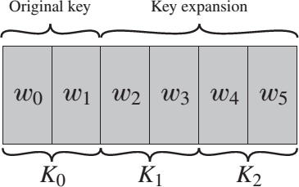
Key
Key0 = w0w1
= 0100 1010 1111 0101
Key1 = w2w3
= 1101 1101 0010 1000
Key2 = w4w5
= 1000 0111 1010 1111

Slide 59



Thank You

