Slide 1



Discrete Mathematics
Dr. Shahira Ahmed
IT241
Lecture 6

Slide 2



Discrete Mathematics
Lecture 6
Counting
www.midocean.ae

Slide 3

Learning outcomes
Solve counting problems by applying elementary counting techniques using the sum and product rules, permutations, combinations and pigeonhole principle.
Apply the ideas of Permutations and Combinations, Combinatorial number theory in various real-life situations.
www.midocean.ae

Slide 4
Lecture Outline
The Basics of Counting
The Pigeonhole Principle
Permutations and Combinations
www.midocean.ae

Slide 5
The Basics of Counting

Slide 6
Motivation
Suppose that a password on a computer system consists of six, seven, or eight characters. Each of these characters must be a digit or a letter of the alphabet. Each password must contain at least one digit. How many such passwords are there?
Counting problems arise throughout mathematics and computer science. For example, we must count the successful outcomes of experiments and all the possible outcomes of these experiments to determine probabilities of discrete events.
We need to count the number of operations used by an algorithm to study its time complexity.

Slide 7
Basic Counting Principles: The Product Rule
The Product Rule:
A procedure can be broken down into a sequence of two tasks. There are n₁ ways to do the first task and n₂ ways to do the second task. Then there are n_{1*}n₂ ways to do the procedure.

Slide 8
Basic Counting Principles: The Product Rule
How many Student code for 2 digit number?
How many Student code for 2 bit number?
Solution:
10*10=100
2*2=4

Slide 9
Basic Counting Principles: The Product Rule
How many bit strings of length seven are there?
Solution:
Since each of the seven bits is either a 0 or a 1,
= 2*2*2*2*2*2*2
= 2⁷
= 128.

Slide 10
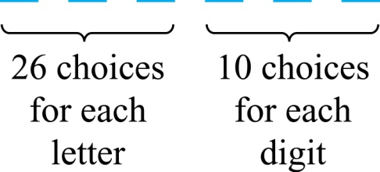
The Product Rule
How many different license plates can be made if each plate contains a sequence of three uppercase English letters followed by three digits?
Solution: By the product rule,
there are 26 ∙ 26 ∙ 26 ∙ 10 ∙ 10 ∙ 10 = 17,576,000 different possible license plates.

Slide 11
Telephone Numbering Plan
A telephone number consists of 10 digits
  three-digit area code
  a three-digit office code
  and a four-digit station code.
  Let X denote a digit from 0 through 9.
  Let N denote a digit from 2 through 9.
  Let Y denote a digit that is 0 or 1.
How many different telephone numbers are possible under the old plan and under the new plan?
                NYX-NNX-XXXX.
    NXX-NXX-XXXX.

Slide 12
Telephone Numbering Plan
Solution: Use the Product Rule.
  There are 8 ∙2 ∙10 = 160 area codes with the format NYX.
  There are 8 ∙8 ∙10 = 640 office codes with the format NNX.
  There are 10 ∙10 ∙10 ∙10 = 10,000 station codes with the format XXXX.
  Number of old plan telephone numbers: 160 ∙640 ∙10,000 = 1,024,000,000.
                NXX-NXX-XXXX.
  Let X denote a digit from 0 through 9.
  Let N denote a digit from 2 through 9.
  Let Y denote a digit that is 0 or 1.

Slide 13
Telephone Numbering Plan
Solution: Use the Product Rule.
  There are 8 ∙10 ∙10 = 800 area codes with the format NXX.
  There are 10 ∙10 ∙10 ∙10 = 10,000 station codes with the format XXXX.
  Number of new plan telephone numbers: 800 ∙800 ∙10,000 = 6,400,000,000.
  Number of old plan telephone numbers: 160 ∙640 ∙10,000 = 1,024,000,000.
                NXX-NXX-XXXX
  Let X denote a digit from 0 through 9.
  Let N denote a digit from 2 through 9.
  Let Y denote a digit that is 0 or 1.

Slide 14
Basic Counting Principles: The Sum Rule
The Sum Rule: If a task can be done either in one of n₁ ways or in one of n₂, where none of the set of n₁ ways is the same as any of the n₂ ways, then there are n₁ + n₂ ways to do the task.

Slide 15
Combining the Sum and Product Rule
A student can choose a computer project from one of three lists. The three lists contain 23, 15, and 19 possible projects, respectively. No project is on more than one list. How many possible projects are there to choose from?
Solution
23 + 15 + 19 = 57 ways to choose a project.

Slide 16
The Sum Rule vs The Product Rule
There are 37 faculty member and 83 Student.
In how many ways can one representatives be picked who is a either faculty member or a student?
In how many ways can two representatives be picked so that one is a faculty member, and the other is a student?
Solution:
By the sum rule it follows that there 37 + 83 = 120 possible ways to pick a representative.
By the product rule it follows that there 37 * 83 = 3071 possible ways to pick a representative.

Slide 17
Combining the Sum and Product Rule
Suppose statement Variable name in a programming language can be either a single letter or a letter followed by a digit. Find the number of possible labels. →Letters is upper case
Solution: Use the product rule.
26 + 26 ∙ 10 = 286

Slide 18
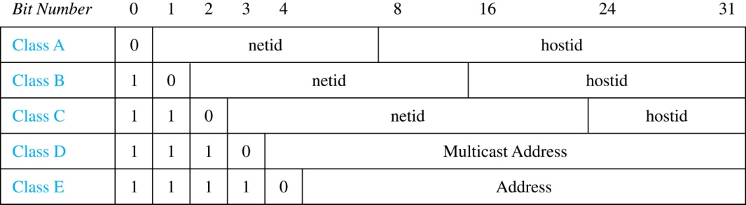
Internet Addresses
Version 4 of the Internet Protocol (IPv4) uses 32 bits.
How many different IPv4 addresses are available for computers on the internet?

Slide 19
Internet Addresses
Class A addresses, used for the largest networks, consist of 0, followed by a 7-bit netid and a 24-bit hosted
Note :netid 1111111 is unavailable, hostids consisting of all 0s and all 1s are unavailable
  2⁷ − 1 = 127 netids.
  2²⁴ − 2 = 16,777,214 hostids.
  IP= 127∙ 16,777,214 = 2,130,706,178.

Slide 20
Internet Addresses
Class B addresses, used for medium-sized networks, consist of 10, followed by a 14-bit netid and a 16-bit hostid.
Note :hostids consisting of all 0s and all 1s are unavailable
  2¹⁴ = 16,384 netids
  2¹⁶ − 2 = 16,534 hostids.
  IP = 16,384 ∙ 16, 534 = 1,073,709,056.

Slide 21
Internet Addresses
Class C addresses, used for the smallest networks, a 110,followed by a 21-bit netid and a 8-bit hostid.
Note :hostids consisting of all 0s and all 1s are unavailable
  2²¹ = 2,097,152 netids.
  2⁸ − 2 = 254 hostids.
  IP= 2,097,152 ∙ 254 = 532,676,608.

Slide 22
Internet Addresses
Version 4 of the Internet Protocol (IPv4) uses 32 bits.
  Neither Class D nor Class E addresses are assigned as the address of a computer on the internet. Only Classes A, B, and C are available.
  How many different IPv4 addresses are available for computers on the internet?
  x = x_{A} + x_{B} + x_{C}
  = 2,130,706,178 + 1,073,709,056 + 532,676,608
  = 3, 737,091,842

Slide 23
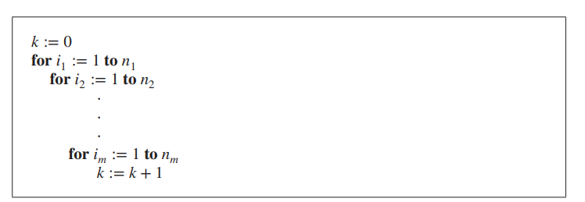
Quiz
What is the value of k after the following code, where n₁, n₂, … , n_{m} are positive integers, has been executed?
n₁*n₂*⋯ *n_{m}

Slide 24
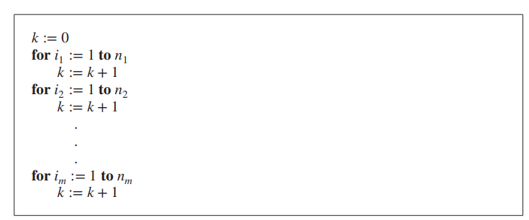
Quiz
What is the value of k after the following code, where n₁ ,n₂ ,n_{m} are positive integers, has been executed?
n₁₊n₂₊⋯ +n_{m}

Slide 25
Basic Counting Principles: Subtraction Rule
Subtraction Rule: If a task can be done either in one of n₁ ways or in one of n₂ ways, then the total number of ways to do the task is n₁ + n₂ minus the number of ways to do the task that are common to the two different ways.
Also known as, the principle of inclusion-exclusion:

Slide 26
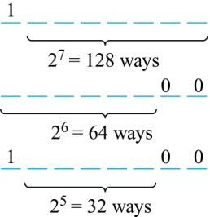
Quiz
How many bit strings of length eight either start with a 1 bit or end with the two bits 00?
Solution: Use the subtraction rule.
Number of bit strings of length eight that start with a 1 bit: 2⁷ = 128
Number of bit strings of length eight that end with bits 00: 2⁶ = 64
Number of bit strings of length eight that start with a 1 bit and end with bits 00 : 2⁵ = 32
the number is 128 + 64 − 32 = 160

Slide 27
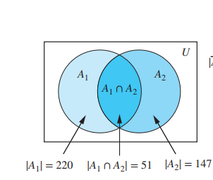
Quiz
Job applications.
  220 computer science
  147 business
  51 computer science and in business,
How many applicants?
  Solution
  220+147-51=316

Slide 28
Basic Counting Principles: Division Rule
Division Rule: There are n/d ways to do a task if it can be done using a procedure that can be carried out in n ways, and for every way w, exactly d of the n ways correspond to way w.
Suppose 100 cookies are distributed equally to a group of kids. Each kid receives 4 cookies. How many kids are there?
Solution 100/4=25
The total degree of undirected graph is 58, how many edges does it have?
    Solution: we count each edge twice, so there are 58/2=29 edges in the graph

Slide 29
Basic Counting Principles: Division Rule
Suppose that an automated system has been developed that counts the legs of cows in a pasture. Suppose that this system has determined that
  in a farmer’s pasture there are exactly 572 legs.
  How many cows are there is this pasture, assuming that each cow has four legs and that there are no other animals present?
Solution:
  Let n be the number of cow legs counted in a pasture. Because each cow has four legs, by the division rule we know that the pasture contains n∕4 cows.
  the pasture with 572 cow legs has 572∕4 = 143 cows in it.

Slide 30
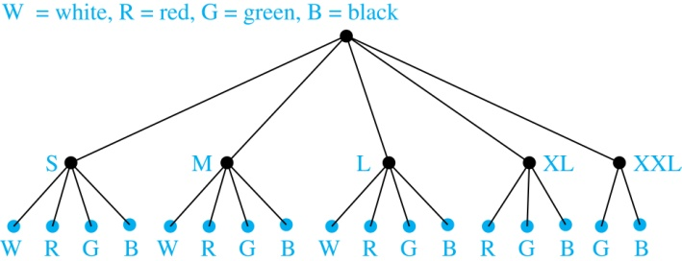
Tree Diagrams
Tree Diagrams: We can solve many counting problems through the use of tree diagrams, where a branch represents a possible choice and the leaves represent possible outcomes.
Example: Suppose that “I Love Discrete Math” T-shirts come in five different sizes: S,M,L,XL, and XXL. Each size comes in four colors (white, red, green, and black), except XL, which comes only in red, green, and black, and XXL, which comes only in green and black. What is the minimum number of shirts that the campus book store needs to stock to have one of each size and color available?
Solution: Draw the tree diagram.
The store must stock 17 T-shirts.

Slide 31
The Pigeonhole Principle

Slide 32
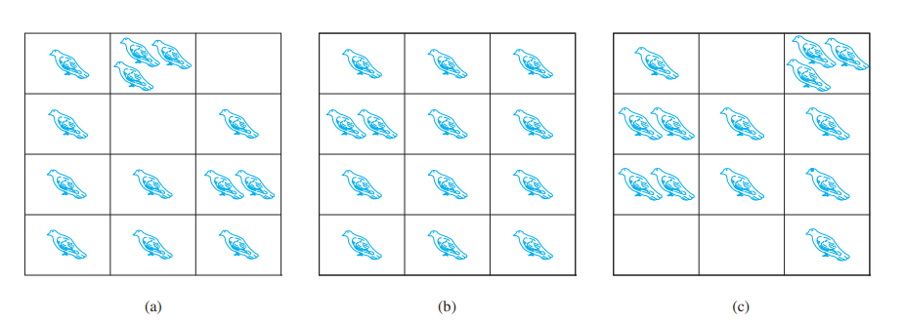
The Pigeonhole Principle
If a flock of 20 pigeons roosts in a set of 19 pigeonholes, one of the pigeonholes must have more than 1 pigeon.
Pigeonhole Principle: If k is a positive integer and k + 1 objects are placed into k boxes, then at least one box contains two or more objects.

Slide 33
Pigeonhole Principle
Among any group of 367 people, there must be at least two with the same birthday, because there are only 366 possible birthdays.
In any group of 27 English words, there must be at least two that begin with the same letter.
How many students must be in a class to guarantee that at least two students receive the same score on the final exam, if the exam is graded on a scale from 0 to 100 points?
Solution: There are 101 possible scores on the final.

Slide 34
Quiz
What is the minimum number of students required in a discrete mathematics class to be sure that at least one will receive the same grade, if there are five possible grades, A, B, C, D, and F?
Solution:6.

Slide 35
The Generalized Pigeonhole Principle
The Generalized Pigeonhole Principle: If N objects are placed into k boxes, then there is at least one box containing at least ⌈N/k⌉ objects.
  Ten children are in an elevator.at least ----------- of them were born on the same day of the week.
  Seventeen children are in an elevator. at least -----------of them were same day of the week
Solution
    2
    3

Slide 36
Permutations and Combinations

Slide 37
Permutations
Definition: A permutation of a set of distinct objects is an ordered arrangement of these objects. An ordered arrangement of r elements of a set is called an r-permuation.

Slide 38
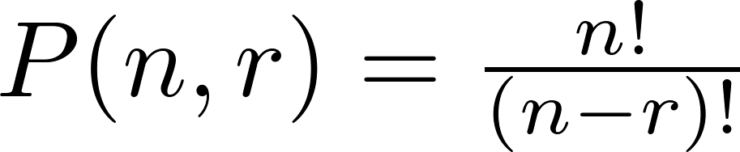
Permutations
Example: Let S = {1,2,3}.
  The ordered arrangement 3,2 is a 2-permutation of S.
The number of r-permuatations of a set with n elements is denoted by P(n,r).
  The 2-permutations of S = {1,2,3} are 1,2; 1,3; 2,1; 2,3; 3,1; and 3,2.
  P(3,2) = 6.

Slide 39
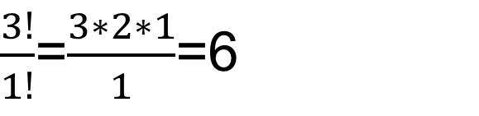
Permutations
Example: Let S = {1,2,3}.
  The ordered arrangement 3,2 is a 2-permutation of S.
$\frac{3!}{1!}$=$\frac{3∗2∗1}{1}$=6

Slide 40
Solving Counting Problems by Counting Permutations
Example: How many ways are there to select a first-prize winner, a second prize winner, and a third-prize winner from 100 different people who have entered a contest?
Solution:
P(100,3) = 100 ∙ 99 ∙ 98 = 970,200

Slide 41
Solving Counting Problems by Counting Permutations (continued)
Example: Suppose that a saleswoman has to visit eight different cities. She must begin her trip in a specified city, but she can visit the other seven cities in any order she wishes. How many possible orders can the saleswoman use when visiting these cities?
Solution: The first city is chosen, and the rest are ordered arbitrarily. Hence the orders are:
7! = 7 ∙ 6 ∙ 5 ∙ 4 ∙ 3 ∙ 2 ∙ 1 = 5040

Slide 42
Solving Counting Problems by Counting Permutations (continued)
Example: How many permutations of the letters ABCDEFGH contain the string ABC ?
Solution: We solve this problem by counting the permutations of six objects, ABC, D, E, F, G, and H.
6! = 6 ∙ 5 ∙ 4 ∙ 3 ∙ 2 ∙ 1 = 720

Slide 43

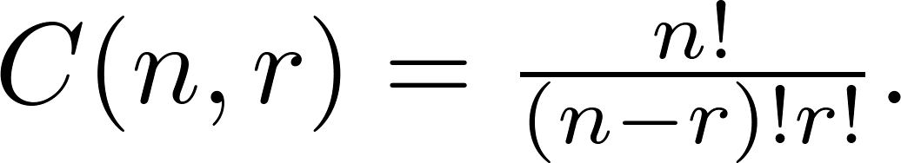
Combinations
Definition: An r-combination of elements of a set is an unordered selection of r elements from the set.
The number of r-combinations of a set with n distinct elements is denoted by C(n, r). The notation is also used and is called a binomial coefficient.
The number of r-combinations of a set with n elements, where n ≥ r ≥ 0, equals

Slide 44
Combinations
Example: Let S be the set {a, b, c, d}. Then {a, c, d} is a 3-combination from S. It is the same as {d, c, a} since the order listed does not matter.
C(4,2) = 6 because the 2-combinations of {a, b, c, d} are the six subsets {a, b}, {a, c}, {a, d}, {b, c}, {b, d}, and {c, d}.

Slide 45
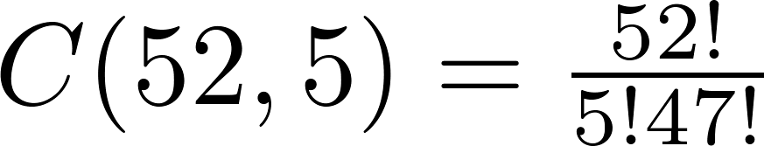
Combinations
How many poker hands of five cards from a standard deck of 52 cards?
Solution:
Since the order in which the cards are dealt does not matter, the number of
five card hands is:
This is a special case of a general result. →

Slide 46
Combinations
How many poker hands of five cards from a standard deck of 52 cards?
How many ways are there to select 47 cards from a deck of 52 cards?
Solution:
Since the order in which the cards are dealt does not matter, the number of five card hands is:
2. The different ways to select 47 cards from 52 is
This is a special case of a general result. →

Slide 47
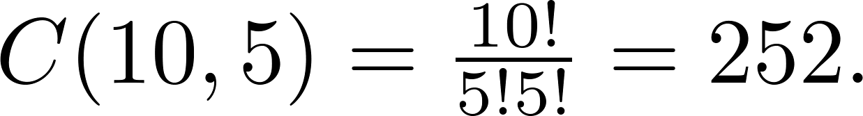
Quiz
How many ways are there to select five players from a 10-member tennis team to make a trip to a match at another school.
Solution:
A group of 30 people. How many ways are there to select six people?
Solution:

Slide 48
Permutations with Repetition
The number of r-permutations of a set of n objects with repetition allowed is n^{r}.
Example: How many strings of length r can be formed from the uppercase letters of the English alphabet?
Solution: The number of such strings is 26^{r}, which is the number of r-permutations of a set with 26 elements.

Slide 49
Combinations with Repetition
The number 0f r-combinations from a set with n elements when repetition of elements is allowed is
C(n + r – 1,r) = C(n + r – 1, n –1).

Slide 50
Combinations with Repetition
Suppose that a cookie shop has four different kinds of cookies. How many different ways can six cookies be chosen?
Solution: The number of ways to choose six cookies is the number of 6-combinations of a set with four elements. By Theorem 2
is the number of ways to choose six cookies from the four kinds.

Slide 51
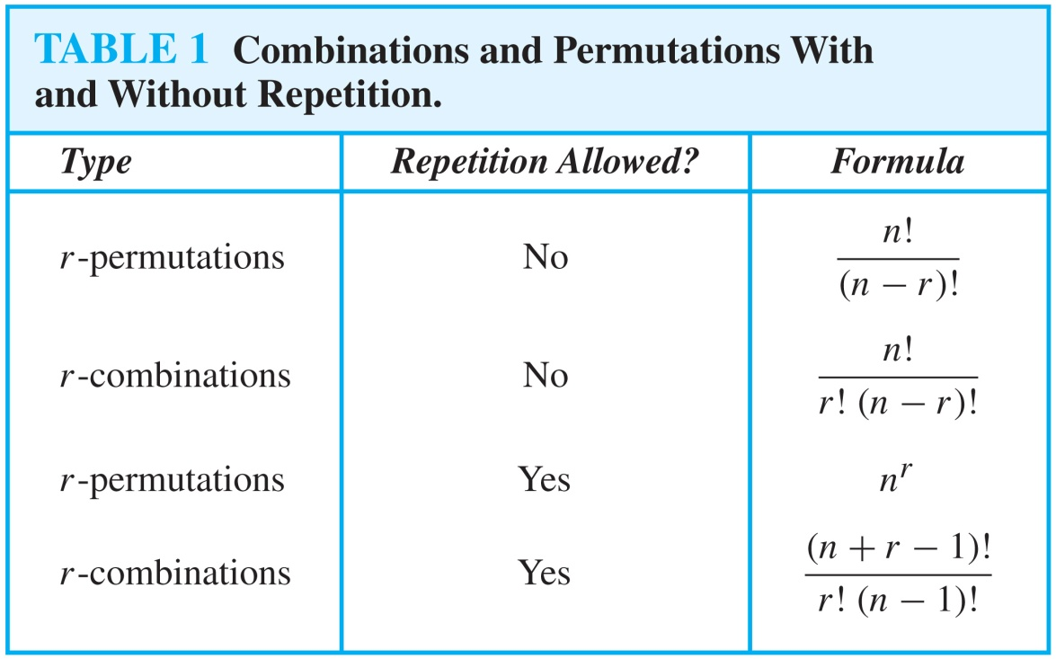
Summarizing the Formulas for Counting Permutations and Combinations with and without Repetition

Slide 52
Recap

Slide 53
Quiz
There are 18 mathematics majors and 325 computer science majors at a college.
a) In how many ways can two representatives be picked so that one is a mathematics major and the other is a computer science major?
b) In how many ways can one representative be picked who is either a mathematics major or a computer science major?
Solution
a) 325*18= 5850
b) 325+18=343

Slide 54
Quiz
If a student has an infinite number of red, blue, yellow, and black socks in a drawer, what is the minimum number of socks that the student must pull out of the drawer to guarantee they have a pair?
Solution 5

Slide 55
Quiz
A drawer contains a dozen brown socks and a dozen black socks, all unmatched. A man takes socks out at random in the dark.
a) How many socks must he take out to be sure that he has at least two socks of the same color?
Solution
a) 3

Slide 56

Quiz
How many ways are there to select five players from a 10-member tennis team
Solution

Slide 57
Quiz
The chairs of an auditorium are to be labeled with an uppercase English letter followed by a positive integer not exceeding 100. What is the largest number of chairs that can be labeled differently?
Solution:
  The procedure of labeling a chair consists of two tasks, namely, assigning to the seat one of the 26 uppercase English letters, and then assigning to it one of the 100 possible integers.
  26 ⋅ 100 = 2600

Slide 58
Quiz
Your wardrobe consists of 5 shirts, 3 pairs of pants, and 17 bow ties. How many different outfits can you make?
Solution
  There are 255 outfits. Use the multiplicative principle.

Slide 59
Quiz
How many strings of six letters (English-uppercase)are there?
Solution: 26^6
How many ways are there to assign three jobs to five employees if each employee can be given more than one job?
Solution: 5^3

Slide 60
Quiz
How that in any set of _________ classes, each meeting regularly once a week on a particular day of the week, there must be two that meet on the same day
Show that if there are ______ students in a class, then at least two have last names that begin with the same letter.
Solution 8,27

Slide 61
Quiz
How many possible Student code for 3 digit number?
How many possible Student code for 3 bit number?
Solution: 10^3,2^3

Slide 62
Lecture Summary
The Product Rule
The Sum Rule
The Subtraction Rule
The Division Rule
Tree Diagrams
Permutations with Repetition
Combinations with Repetition
Permutations without Repetition
Combinations without Repetition
Pigeonhole principle

