Slide 1
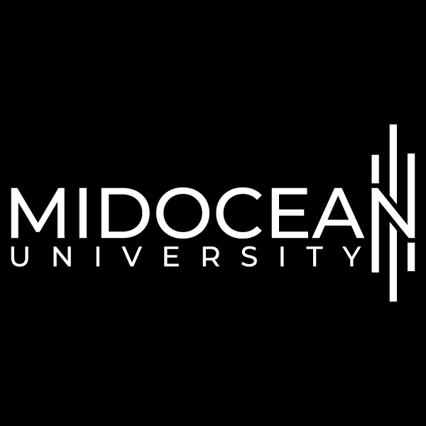



HCIA-AI Huawei
Eng.Eman Elgallad
Lecture 4- Supervised Learning

Slide 2


Lecture
Content
04
Supervised Learning
Regression
  Linear Regression
Classification
  Logistic Regression
  KNN
  SVM
  Decision Tree
  Ensemble Learning
  Naïve Bayes
HCIA-AI Huawei
Lecture 04 – Supervised Learning
Eng. Eman Elgalad

Slide 3
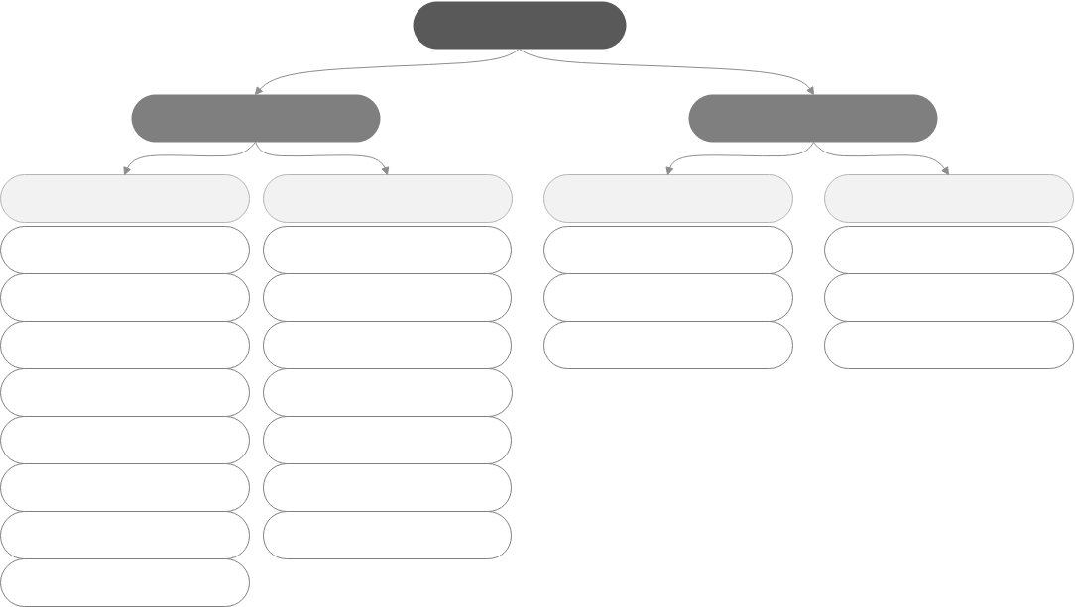
Machine Learning Algorithm Overview
Lecture
04
Machine learning
Supervised learning
Unsupervised learning
Classification
Regression
Clustering
Other
Logistic regression
Linear regression
k-means clustering
Association rule
SVM
SVM
Hierarchical clustering
Principal component analysis
Neural network
Neural network
Density-based clustering
Gaussian mixture modeling
Decision tree
Decision tree
Random forest
Random forest
Gradient boosted decision tree (GBDT)
GBDT
k-NN
k-NN
Naive Bayes

Slide 4
Types of Machine Learning
Lecture
04
Supervised learning: The program takes a known set of samples and trains an optimal model to generate predictions. Then, the trained model maps all inputs to outputs and performs simple judgment on the outputs. In this way, unknown data is classified.
Unsupervised learning: The program builds a model based on unlabeled input data. For example, a clustering model groups objects based on similarities. Unsupervised learning algorithms model the highly similar samples, calculate the similarity between new and existing samples, and classify new samples by similarity.
Semi-supervised learning: The program trains a model through a combination of a small amount of labeled data and a large amount of unlabeled data.
Reinforcement learning: The learning systems learn behavior from the environment to maximize the value of reward (reinforcement) signal function. Reinforcement learning differs from supervised learning of connectionism in that, instead of telling the system the correct action, the environment provides scalar reinforcement signals to evaluate its actions.
Machine learning evolution is producing new machine learning types, for example, self-supervised learning, contrastive learning, generative learning.
Notes:
Supervised learning: We give a computer a bunch of choice questions (training samples) and provide standard answers. The computer tries to adjust its model parameters to make their predictions close to standard answers. In this way, the computer learns how to deal with this type of problem. Then the computer can help us reply to choice questions whose answers are not given (test samples).
Unsupervised learning: We give a computer a bunch of choice questions (training samples), but do not provide standard answers. The computer tries to analyze the relationships between these questions and classify them. It does not know the answers to these questions, but it thinks that the answers to the questions in the same category should be the same.
Semi-supervised learning: Traditional supervised learning uses a large number of labeled training samples to create a model for predicting the labels of new samples. For example, in a classification task, a label indicates the category of a sample while in a regression task, a label is a real-value output of the sample. As data storage capabilities are developing, we can easily obtain a large amount of unlabeled data from many tasks. However, labeling the data is labor-consuming and time-consuming. For example, for web page recommendation, users need to label web pages they like, but only a few users are willing to spend a lot of time doing this. Then we get limited labeled web page data and a large amount of unlabeled web page data.

Slide 5
Supervised Learning
Lecture
04
Data features
Labels
Feature 1
······
Feature n
Target
Supervised learning algorithm
Feature 1
······
Feature n
Target
Feature 1
······
Feature n
Target
Weather | Temperature | Wind Speed
Sunny | High | High
Rainy | Low | Medium
Sunny | Low | Low
Suitable for Exercise
Yes
No
Yes

Slide 6
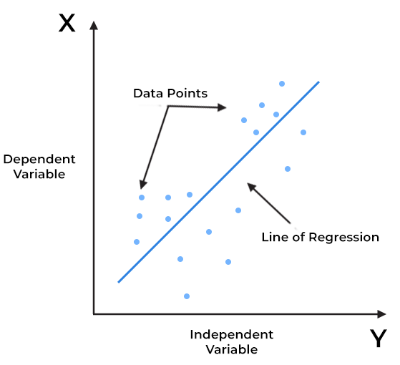
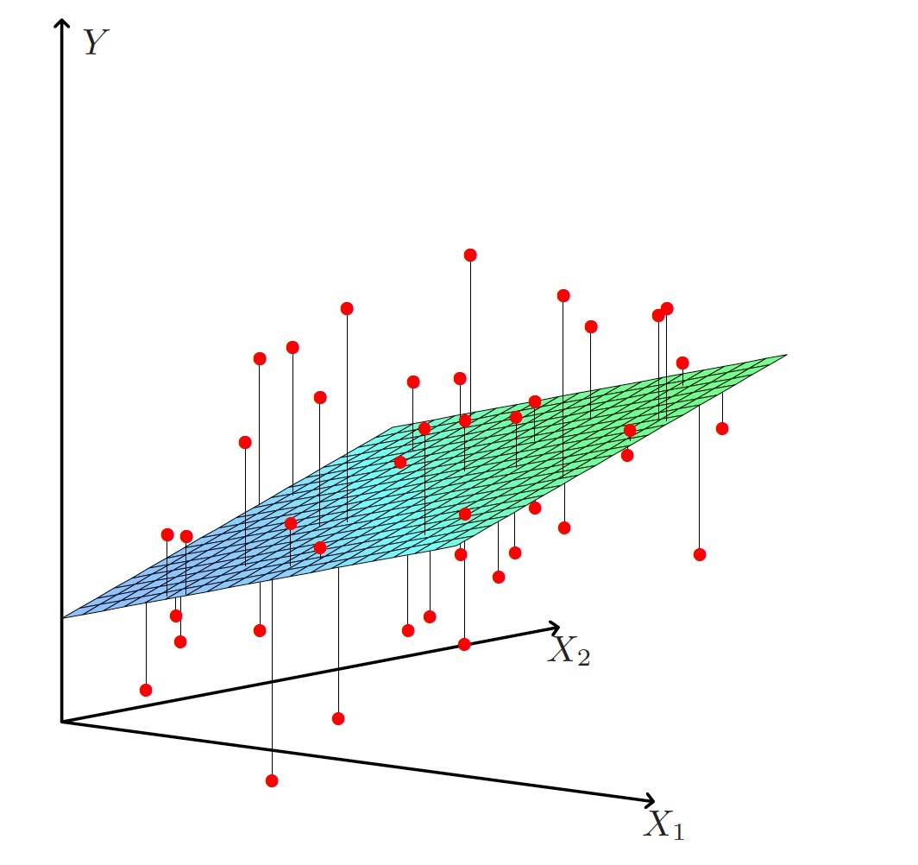
Lecture
04
Linear Regression
Linear regression uses the regression analysis of mathematical statistics to determine the quantitative relationship between two or more variables.
X-axis = Independent variable
Y-axis = Output / dependent variable
Line of regression = Best fit line for a model
Simple linear regression
Multiple linear regression

Slide 7
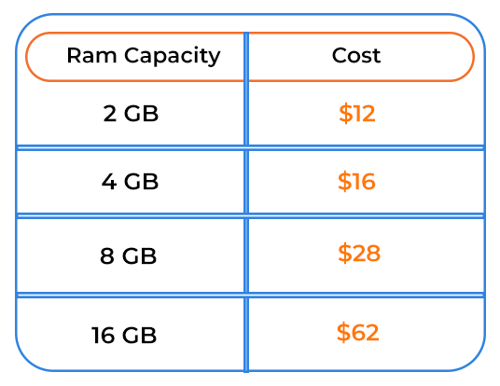
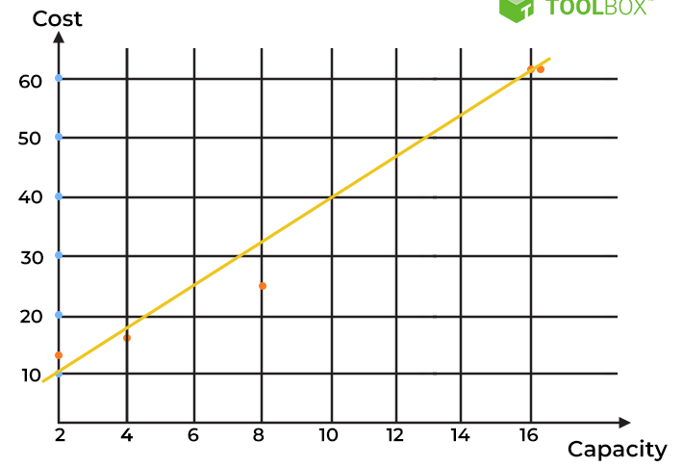
Lecture
04
Linear Regression
Mathematically these slant lines follow the following equation,
Y = m*X + b
Where X = dependent variable (target)
Y = independent variable
m = slope of the line (slope is defined as the ‘rise’ over the ‘run’)

Slide 8
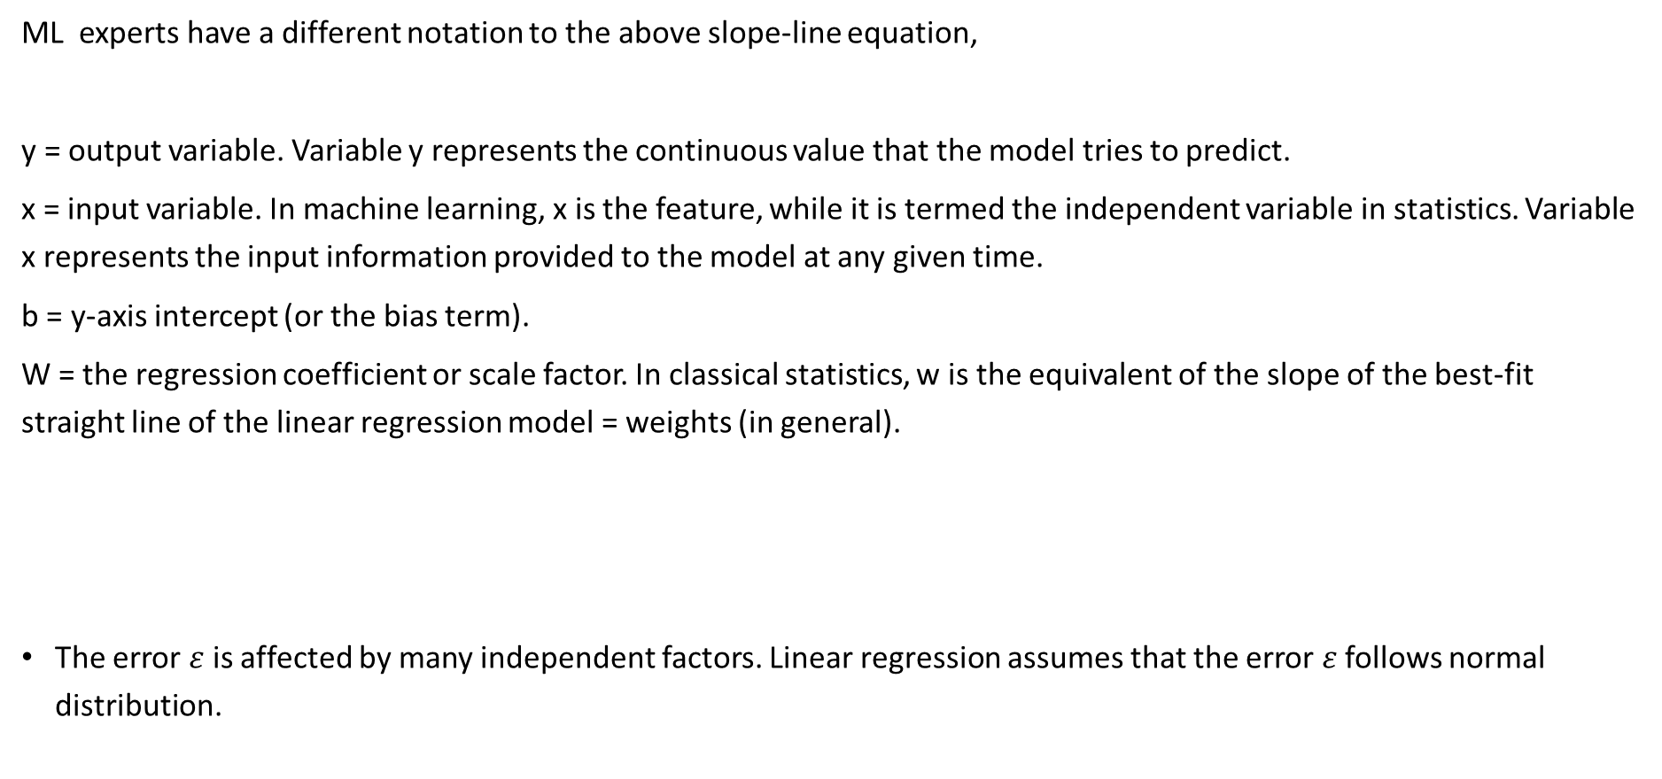
Lecture
04
Linear Regression
ML experts have a different notation to the above slope-line equation,
y = output variable. Variable y represents the continuous value that the model tries to predict.
x = input variable. In machine learning, x is the feature, while it is termed the independent variable in statistics. Variable x represents the input information provided to the model at any given time.
b = y-axis intercept (or the bias term).
W = the regression coefficient or scale factor. In classical statistics, w is the equivalent of the slope of the best-fit straight line of the linear regression model = weights (in general).
The error $ε$ is affected by many independent factors. Linear regression assumes that the error $ε$ follows normal distribution.

Slide 9
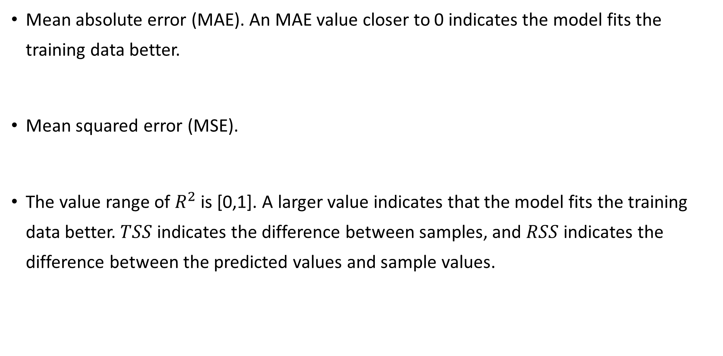
Lecture
04
Performance Evaluation of Machine Learning - Regression
Mean absolute error (MAE). An MAE value closer to 0 indicates the model fits the training data better.
Mean squared error (MSE).
The value range of $R^{2}$ is [0,1]. A larger value indicates that the model fits the training data better. $TSS$ indicates the difference between samples, and $RSS$ indicates the difference between the predicted values and sample values.

Slide 10
Lecture
04
Classification:
Classification is a supervised machine learning method where the model tries to predict the correct label of a given input data. In classification, the model is fully trained using the training data, and then it is evaluated on test data before being used to perform prediction on new unseen data.
There are four main classification tasks in Machine learning:
-binary
-multi-class
-multi-label
-imbalanced classifications.
Lecture 04 – Supervised Learning
Eng. Eman Elgallad

Slide 11
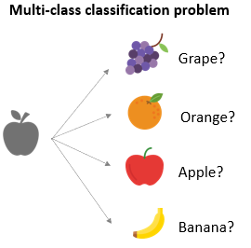
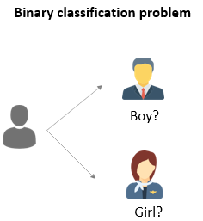
Lecture
04
In a binary classification task, the goal is to classify the input data into two mutually exclusive categories. For example: true and false; positive and negative; O and 1; spam and not spam, etc.
The multi-class classification, on the other hand, has at least two mutually exclusive class labels, where the goal is to predict to which class a given input example belongs to.
Lecture 04 – Supervised Learning

Slide 12
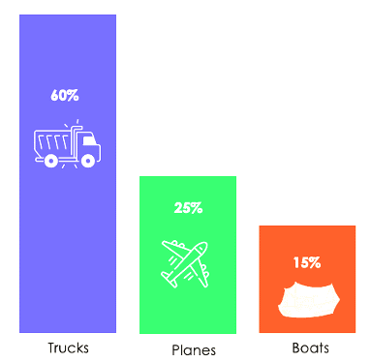
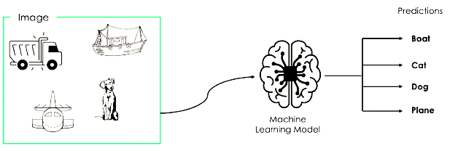
Lecture
04
Imbalanced Classification
the number of examples is unevenly distributed in each class. Let’s consider the following 3-class classification scenario where the training data contains: 60% of trucks, 25% of planes, and 15% of boats.
Multi-Label Classification
In multi-label classification tasks, we try to predict 0 or more classes for each input example. In this case, there is no mutual exclusion because the input example can have more than one label.

Slide 13
Lecture
04
Most of the binary classification algorithms can be also used for multi-class classification. These algorithms include but are not limited to:
Logistic Regression.
Random Forest
Naive Bayes.
K-Nearest Neighbors.
Gradient Boosting .
SVM.
SVM and Logistic Regression do not support multi-class classification by default?
→ That’s correct. However, we can apply binary transformation approaches such as one-versus-one and one-versus-all to adapt native binary classification algorithms for multi-class classification tasks.
HCIA-AI Huawei

Slide 14
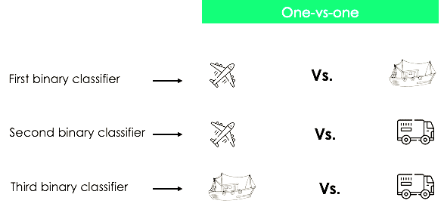
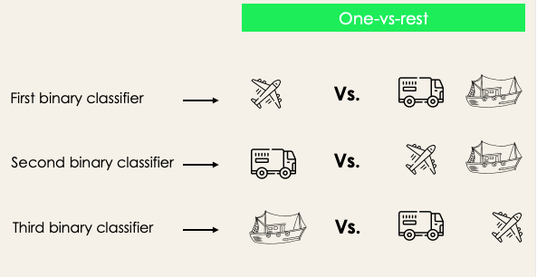
Lecture
04
One-versus-one: this strategy trains as many classifiers as there are pairs of labels. If we have a 3-class classification, we will have three pairs of labels, thus three classifiers, as shown below.
One-versus-rest: at this stage, we start by considering each label as an independent label and consider the rest combined as only one label. With 3-classes, we will have three classifiers.
In general, for N labels, we will have N binary classifiers.

Slide 15
Lecture
04
Logistic Regression:
The logistic regression model is based on the logistic function, which transforms any continuous value into a value between 0 and 1.
This allows the model to output the probability of belonging to a certain class. In other words, logistic regression is used to predict the probability of an event occurring, such as whether a customer will buy a product or not, based on a set of independent variables such as age, gender, income, etc.
The logistic regression model estimates the probability of the dependent variable (i.e., the event occurring) based on the independent variables. The model then assigns the observation to the class with the highest probability.
For example, if the probability of a customer buying a product is estimated to be 0.8, the model would predict that the customer is likely to buy the product.

Slide 16
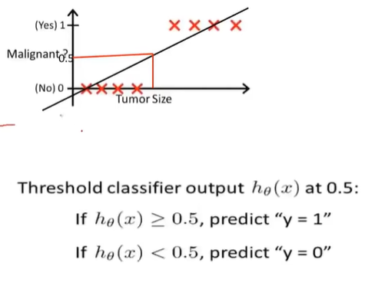
Lecture
04
Logistic Regression:
Why regression ? Because its equation based on regression rule
But according to this graph we would have two problems if we worked with Linear Regression:
-The output will be continuous values
-The MSE will be so big between points of each class

Slide 17
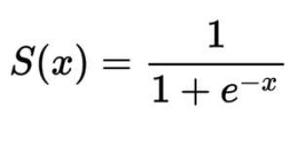
Lecture
Lecture
How Logistic Regression Works for binary Classification(Sigmoid)
04
Logistic regression works by estimating the probability of a binary dependent variable (y) based on one or more independent variables (x1, x2, …, xn).
The logistic regression model uses the logistic function, also known as the sigmoid function, to map any continuous value to a value between 0 and 1. The sigmoid function has an S-shaped curve, and it is given by the equation:
p = 1 / (1 + e^(-z))
Where:
• p is the probability of the dependent variable taking the value 1 (i.e., success or positive outcome)
• e is the mathematical constant approximately equal to 2.71828
• z is the linear combination of the independent variables, and their coefficients (β0, β1, …, βn), which are estimated by the model. z = β0 + β1x1 + β2x2 + … + βnxn.

Slide 18
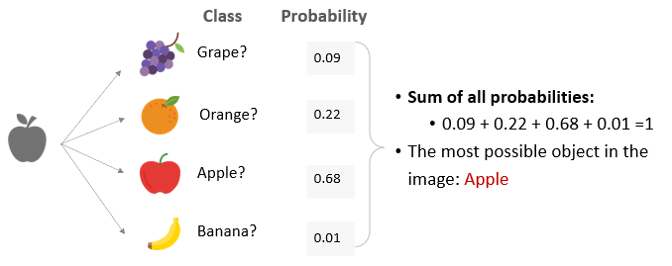
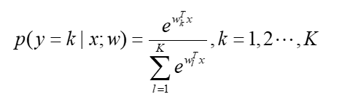
Lecture
Lecture
How Logistic Regression Works for Multiclassification Classification
(SoftMax)
04
SoftMax regression: SoftMax regression, also known as multiclass logistic regression, is a generalization of logistic regression that can handle multiple classes directly.
It assigns a probability value to each class in a multi-class classification problem. The sum of all the probabilities is 1.
  SoftMax may present the generated classes as follows:

Slide 19
Lecture
Logistic Regression:
04
Strengths of Logistic Regression:
• LR is a simple and easy-to-implement model that does not require extensive computational resources.
• LR is a linear model, which makes it interpretable and allows for easy identification of important predictors.
• LR can handle both continuous and categorical predictors.
• LR can produce probability estimates of the target class, which can be useful for decision-making and ranking.
• LR can handle missing data by excluding observations with missing values from the analysis.
Weaknesses of Logistic Regression:
• LR assumes that the relationship between the predictors and the target variable is linear. This may not always be the case, and non-linear relationships may be missed.
• LR assumes that the predictors are not highly correlated with each other.
• LR may not perform well when the classes are imbalanced or when the decision boundary is non-linear.
• LR may not capture complex interactions between predictors or higher order relationships

Slide 20
Lecture
KNN:
04
K-Nearest Neighbors is one of the simplest Machine Learning algorithms based on Supervised Learning technique.
It is a non-parametric and lazy learning algorithm, meaning that it does not make any assumptions about the distribution of the data and does not require training prior to making predictions.
The KNN algorithm works in the following steps:
Calculate the distance between the new data point and all points in the training set.
Sort the distances in ascending order and select the K nearest neighbors.
Assign a class label or numerical value to the new data point based on the most common class label or the average of the values of the K nearest neighbors.

Slide 21
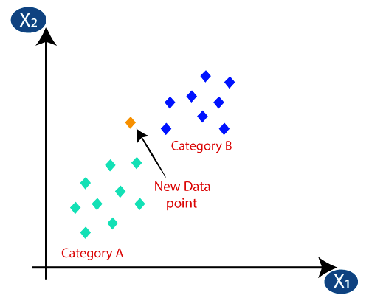
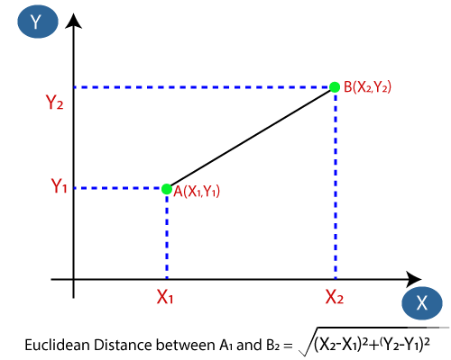
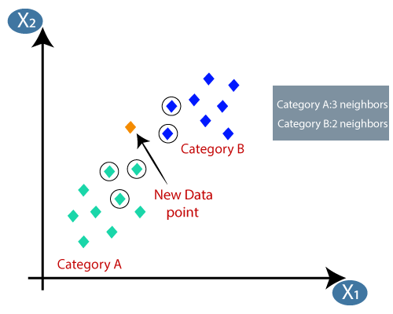
Lecture
04
How does KNN work?

Slide 22
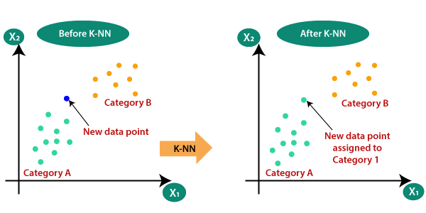
Lecture
04
Output:

Slide 23
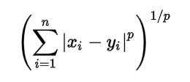
Distance Measures
Lecture
04
Minkowski distance: The formula for Minkowski distance is in generalized form and we can manipulate it to get different distance metrices.
The p value in the formula can be manipulated to give us different distances like:
    p = 1, when p is set to 1 we get Manhattan distance
    p = 2, when p is set to 2 we get Euclidean distance
Euclidean distance
  d = √[ (x22 – x11)² + (y22 – y11)²]
Manhattan distance
  sum for i to N sum || X1i – X2i ||
Lecture 04 – Supervised Learning
Eng. Eman Elgallad

Slide 24
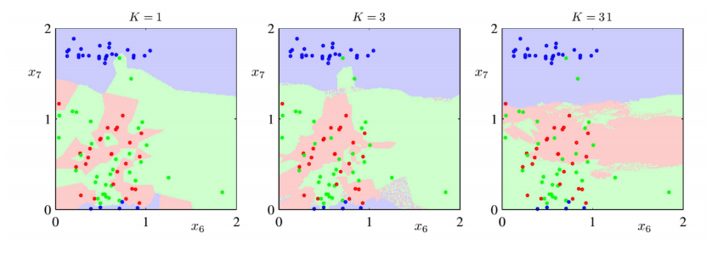
Lecture
04
KNN Overfitting and Underfitting.
Overfitting
Underfitting
The value of k in the KNN algorithm is related to the error rate of the model.
A small value of k could lead to overfitting as well as a big value of k can lead to underfitting.

Slide 25
Strengths and Weaknesses of KNN
Lecture
04
Strengths:
Simple and easy to understand.
Can work well on small datasets with low dimensions.
Can handle both classification and regression tasks.
Weaknesses:
Can be computationally expensive on large datasets or high-dimensional data.
The choice of the hyperparameter K can have a significant impact on performance.
Requires a lot of memory to store the training set.

Slide 26
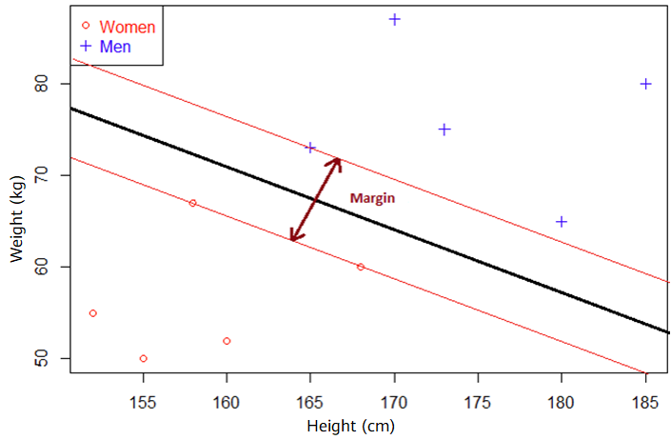
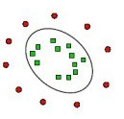
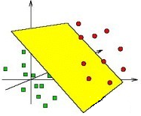
Support Vector Machine
Lecture
04
Support vector machines (SVMs) are binary classification models.
Their basic model is the linear classifier that maximizes the width of the gap between the two categories in the feature space. SVMs also have a kernel trick, which makes it a non-linear classifier.
Mapping
Difficult to split in a low-dimensional space.
Easy to split in a high-dimensional space.
Notes:
The main ideas of SVMs are:
In the case of linear inseparability, non-linear mapping algorithms are used to convert the linearly inseparable samples of low-dimensional input space into samples of high-dimensional feature space. In this way, samples become linearly separable. Then the linear algorithm can be used to analyze the non-linear features of samples.
Based on the structural risk minimization principle, an optimal hyperplane is constructed in the feature space, so that the learner is optimized globally, and the expectation of the whole sample space satisfies an upper boundary with a certain probability.

Slide 27
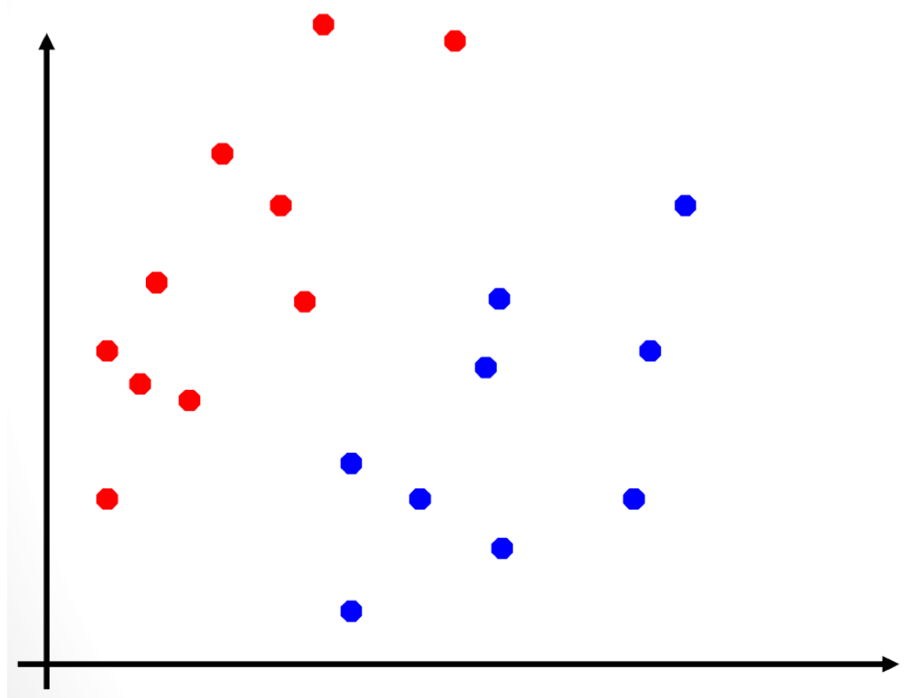
Linear SVM (1)
Lecture
04
How can we divide the red and blue data points with just one line?
or
Two-dimensional data set with two sample categories
Both the division methods on the left and right can divide data. But which is correct?

Slide 28
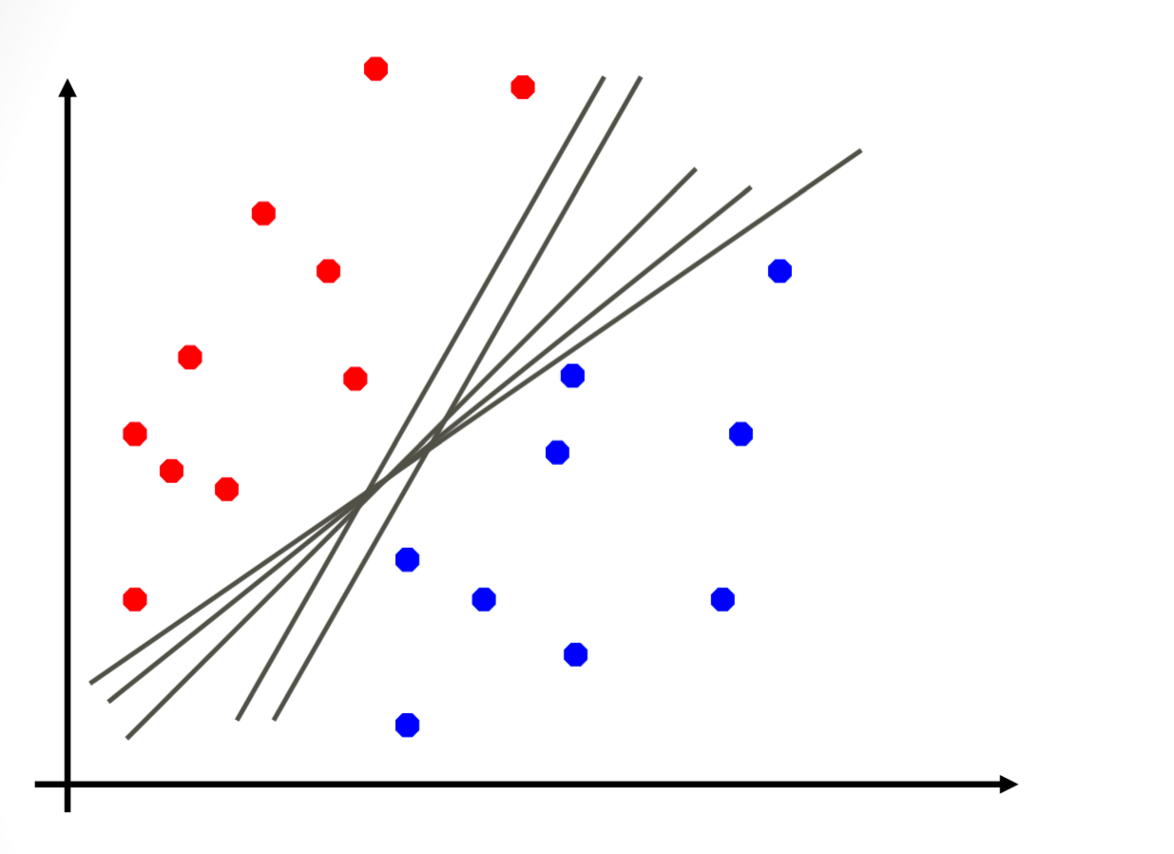
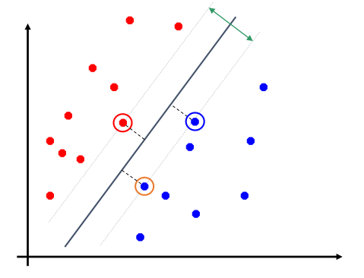
Linear SVM (2)
Lecture
04
We can use different straight lines to divide data into different categories. SVMs find a straight line and keep the most nearby points as far from the line as possible. This gives the model a strong generalization capability. These most nearby points are called support vectors.
In the two-dimensional space, a straight line is used for division; in the high-dimensional space, a hyperplane is used for division.
Maximize the distance from each support vector to the line

Slide 29
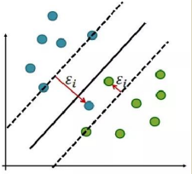
Linear SVM (3)
Lecture
04
How SVM be controlled to deal with outliers ?
As shown with the data given that there are some outliers that would make the linear separation has some sort of errors.
In this case the SVM wouldn't work with their hard maximum margin classifier concept, so a soft margin was developed called soft margin classifier (AKA Support vector classifier) which allow for some misclassification and attempted to maximize margin or in other words make a balance between the error and the margin. This method is the realistic method used as it is hard to find data that is completely linearly separable with no error at all (hard classifiers)

Slide 30
Non-linear SVM (1)
Lecture
04
How can we divide a linear inseparable data set?
Linear SVM works well on a linear separable data set.
A non-linear data set cannot be divided using a straight line.

Slide 31
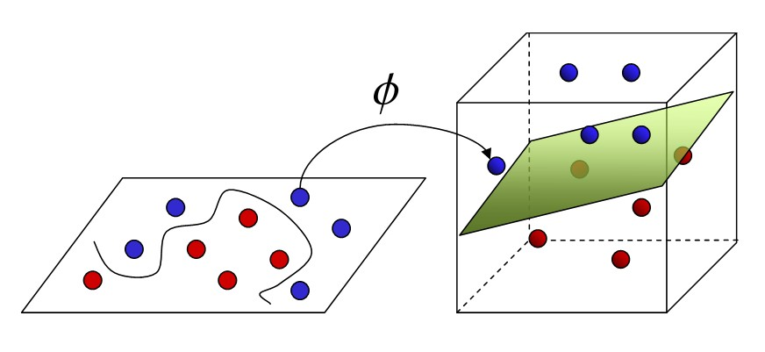
Non-linear SVM (2)
Lecture
04
Kernel functions can be used to create non-linear SVMs.
Kernel functions allow algorithms to fit a maximum-margin hyperplane in a transformed high-dimensional feature space.
Common kernel functions
Linear kernel
Polynomial kernel
Gaussian kernel
Sigmoid kernel
Input space
High-dimensional feature space
Notes:
The Gaussian kernel function is the most frequently used.

Slide 32
Decision Tree
Lecture
04
Each non-leaf node of the decision tree denotes a test on an attribute; each branch represents the output of a test; and each leaf (or terminal) node holds a class label. The algorithm starts at the root node (topmost node in the tree), tests the selected attributes on the intermediate (internal) nodes, and generates branches according to the output of the tests. Then, it saves the class labels on the leaf nodes as the decision results.
Root node
Small
Large
Does not squeak
Short-necked
Long-necked
Squeaks
Short-nosed
Long-nosed
It could be a squirrel.
It could be a rat.
It could be a giraffe.
Stays on land
Stays in water
It could be an elephant.
It could be a rhino.
It could be a hippo.
Notes:
How to construct a decision tree is very important. We should determine the topological structure of feature attributes based on attribute selection measures. The key step is to split attributes. That is, different branches are constructed based on the differences of a feature attribute on a node.
The common learning algorithms used to generate a decision tree include ID3, C4.5, and CART.

Slide 33
Structure of a Decision Tree
Lecture
04
Root node
Subnode
Subnode
Leaf node
Leaf node
Subnode
Leaf node
Leaf node
Leaf node
Leaf node
Notes:
All nodes except the root node are called leaf nodes.

Slide 34
Decision Tree Construction Process
Lecture
04
Feature selection: Select one of the features of the training data as the split standard of the current node. (Different standards distinguish different decision tree algorithms.)
Decision tree generation: Generate sub nodes from top down based on the selected feature and stop until the dataset can no longer be split.
Pruning: The decision tree may easily become overfitting unless necessary pruning is performed to reduce the tree size and optimize its node structure. Pruning reduces the size of decision trees by removing parts of the tree that do not provide power to classify instances.

Slide 35
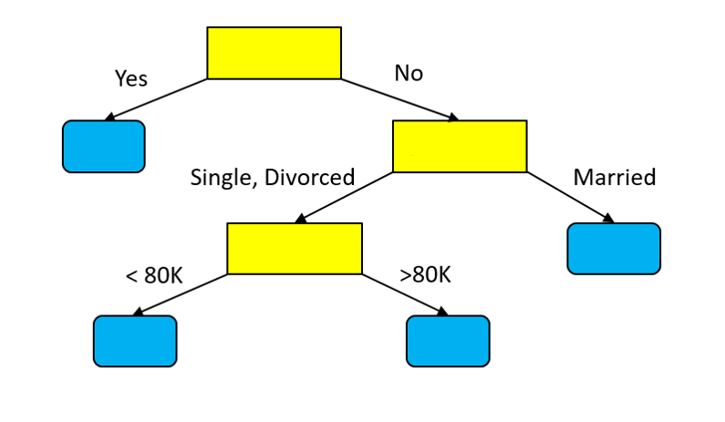
Decision Tree Example
Lecture
04
The following figure shows a decision tree for a classification problem. The classification result is affected by three attributes: refund, marital status, and taxable income.
TID | Refund | Marital Status | Taxable Income | Cheat
1 | Yes | Single | 125K | No
2 | No | Married | 100K | No
3 | No | Single | 70K | No
4 | Yes | Married | 120K | No
5 | No | Divorced | 95K | Yes
6 | No | Married | 60K | No
7 | Yes | Divorced | 220K | No
8 | No | Single | 85K | Yes
9 | No | Married | 75K | No
10 | No | Single | 90K | Yes
Refund
No
Marital Status
Taxable
Income
No
No
Yes

Slide 36
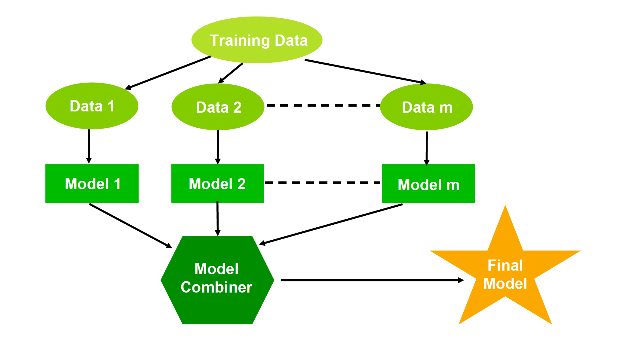
Ensemble Learning
Lecture
04
Ensemble learning is a machine learning paradigm in which multiple learners are trained and combined to resolve an issue. When multiple learners are used, the generalization capability of the ensemble can be much stronger than that of a single learner.
For example, If you ask thousands of people at random a complex question and then summarize their answers, the summarized answer is more accurate than an expert's answer in most cases. This is the wisdom of the crowd.
Training set
Dataset 1
Dataset 2
Dataset m
Model 1
Model 2
Model m
Ensemble
Large model

Slide 37
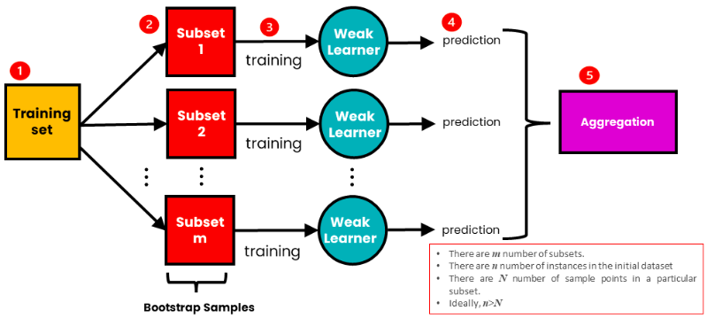
Types of Ensemble Learning-Bagging
Lecture
04
We use bagging for combining weak learners of high variance. Bagging aims to produce a model with lower variance than the individual weak models. These weak learners are homogenous, meaning they are of the same type. Bagging is also known as Bootstrap aggregating. It consists of two steps: bootstrapping and aggregation.
Bootstrapping
Involves resampling subsets of data with replacement from an initial dataset. In other words, subsets of data are taken from the initial dataset. These subsets of data are called bootstrapped datasets or, simply, bootstraps. Resampled ‘with replacement’ means an individual data point can be sampled multiple times. Each bootstrap dataset is used to train a weak learner.
Bagging

Slide 38
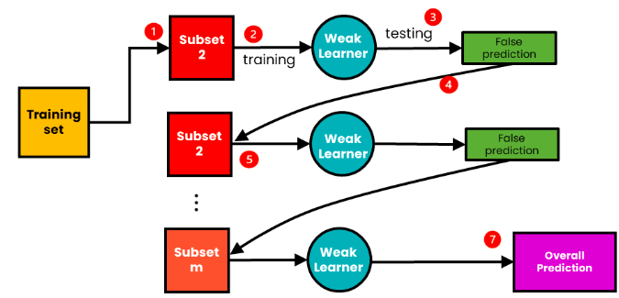
Types of Ensemble Learning-Boosting
Lecture
04
We use boosting for combining weak learners with high bias. Boosting aims to produce a model with a lower bias than that of the individual models. Like in bagging, the weak learners are homogeneous.
Boosting involves sequentially training weak learners. Here, each subsequent learner improves the errors of previous learners in the sequence. A sample of data is first taken from the initial dataset. This sample is used to train the first model, and the model makes its prediction. The samples can either be correctly or incorrectly predicted. The samples that are wrongly predicted are reused for training the next model. In this way, subsequent models can improve on the errors of previous models
Bagging

Slide 39
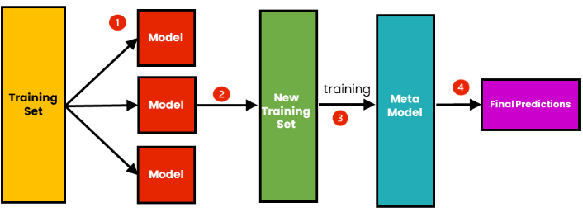
Types of Ensemble Learning-Stacking
Lecture
04
We use stacking to improve the prediction accuracy of strong learners. Stacking aims to create a single robust model from multiple heterogeneous strong learners.
Stacking differs from bagging and boosting in that:
It combines strong learners
It combines heterogeneous models
It consists of creating a Metamodel.
A metamodel is a model created using a new dataset.
Individual heterogeneous models are trained using an initial dataset. These models make predictions and form a single new dataset using those predictions. This new data set is used to train the metamodel, which makes the final prediction. The prediction is combined using weighted averaging.
Bagging

Slide 40
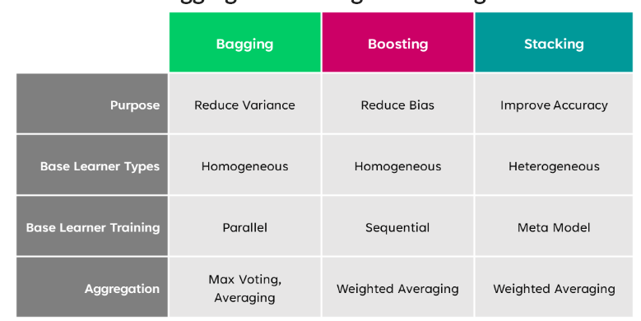
When to use Bagging vs Boosting vs Stacking?
Lecture
04
Bagging

Slide 41
Ensemble Learning - Random Forest
Lecture
04
Random forest = Bagging + Classification and regression tree (CART)
Random forest builds multiple decision trees and aggregates their results to make prediction more accurate and stable.
  The random forest algorithm can be used for classification and regression problems.
Bootstrap sampling
Build trees
Aggregate results
Subset 1
Prediction 1
Subset 2
Prediction 2
Classification: majority voting
All training data
Final prediction
Prediction
Regression: mean value
Subset n
Prediction n
Notes:
Bootstrap bagging is based on sampling with replacement.

Slide 42
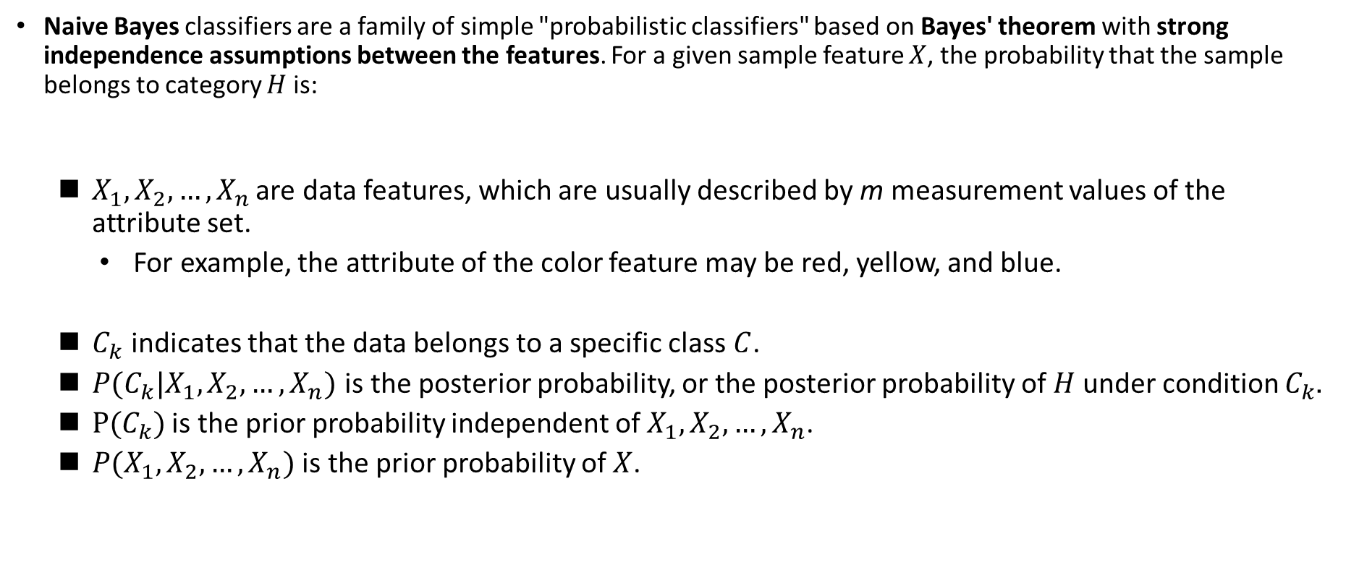
Naive Bayes
Lecture
04
Naive Bayes classifiers are a family of simple "probabilistic classifiers" based on Bayes' theorem with strong independence assumptions between the features. For a given sample feature $X$, the probability that the sample belongs to category $H$ is:
  $X_{1},X_{2},…,X_{n}$ are data features, which are usually described by m measurement values of the attribute set.
    For example, the attribute of the color feature may be red, yellow, and blue.
  $C_{k}$ indicates that the data belongs to a specific class $C$.
  $P(C_{k}|X_{1},X_{2},…,X_{n})$ is the posterior probability, or the posterior probability of $H$ under condition $C_{k}$.
  $P(C_{k})$ is the prior probability independent of $X_{1},X_{2},…,X_{n}$.
  $P(X_{1},X_{2},…,X_{n})$ is the prior probability of $X$.
Notes:
Class conditional independence: The Bayes classifier assumes that the effect of an attribute value on a given class is independent of the values of other attributes. This assumption is made to simplify the calculation and becomes "naive" in this sense.
Bayes classifiers show high accuracy and speed when applied to large databases.

Slide 43

Naive Bayes
Lecture
04
Feature independent hypothesis example:
  If a fruit is red, round, and about 10 cm in diameter, it can be considered an apple.
  A Naive Bayes classifier believes that each of these features independently contributes to the probability of the fruit being an apple, regardless of any possible correlation between color, roundness, and diameter features.

Slide 44
Performance Evaluation of Classification
Lecture
04
Terms:
  $P$: positive, indicating the number of real positive cases in the data.
  $N$: negative, indicating the number of real negative cases in the data.
  $TP$: true positive, indicating the number of positive cases that are correctly classified.
  $TN$: true negative, indicating the number of negative cases that are correctly classified.
  $FP$: false positive, indicating the number of positive cases that are incorrectly classified.
  $FN$: false negative, indicating the number of negative cases that are incorrectly classified.
Predicted
 | $$\text{Y}\text{es}$$ | $$\text{N}\text{o}$$ | Total
Yes | $$TP$$ | $$FN$$ | $$P$$
No | $$FP$$ | $$TN$$ | $$N$$
Total | $$P^{′}$$ | $$N^{′}$$ | $$P+N$$
Actual
Confusion matrix
The confusion matrix is an $m×m$ table at minimum. The entry $CM_{i,j}$ in the first $m$ rows and $m$ columns indicates the number of cases that belong to class $i$ but are labeled as $j$.
  For classifiers with high accuracy, most of the cases should be represented by entries on the diagonal of the confusion matrix from $CM_{1,1}$ to $CM_{m,m}$, while other entries are 0 or close to 0. That is, $FP$ and $FN$ are close to 0.

Slide 45
Performance Evaluation of Classification (2)
Lecture
04
Measurement | Formula
Accuracy, recognition rate | $$\frac{TP+TN}{P+N}$$
Error rate, misclassification rate | $$\frac{FP+FN}{P+N}$$
True positive rate, sensitivity, recall | $$\frac{TP}{P}$$
True negative rate, specificity | $$\frac{TN}{N}$$
Precision | $$\frac{TP}{TP+FP}$$
$F_{1}$ value, harmonic mean of precision and recall | $$\frac{2×precision×recall}{precision+recall}$$
$F_{β}$ value, where $β$ is a non-negative real number | $$\frac{(1+β^{2})×precision×recall}{β^{2}×precision+recall}$$

Slide 46
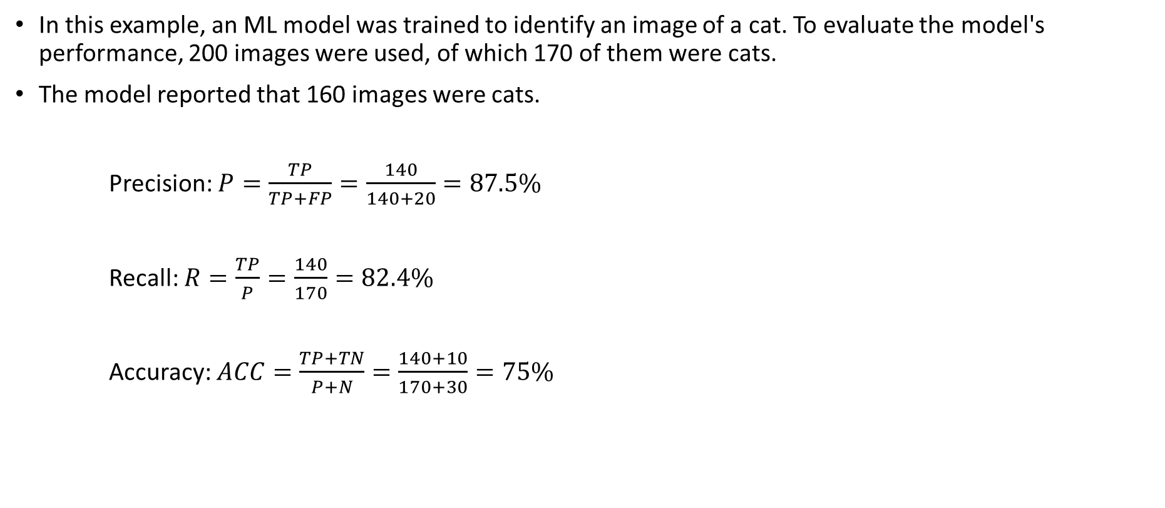
Performance Evaluation of Classification Example
Lecture
04
In this example, an ML model was trained to identify an image of a cat. To evaluate the model's performance, 200 images were used, of which 170 of them were cats.
The model reported that 160 images were cats.
Precision: $P=\frac{TP}{TP+FP}=\frac{140}{140+20}=87.5\%$
Recall: $R=\frac{TP}{P}=\frac{140}{170}=82.4\%$
Accuracy: $ACC=\frac{TP+TN}{P+N}=\frac{140+10}{170+30}=75\%$
Predicted
 | $$yes$$ | $$no$$ | Total
$$yes$$ | 140 | 30 | 170
$$no$$ | 20 | 10 | 30
Total | 160 | 40 | 200
Actual

Slide 47


