Slide 1


Research Methods
(RSC 701)
Prepared by Dr. Mahitab ELrafii
Lecture Intro

Slide 2


Lecture
Lecture Content
0

Slide 3
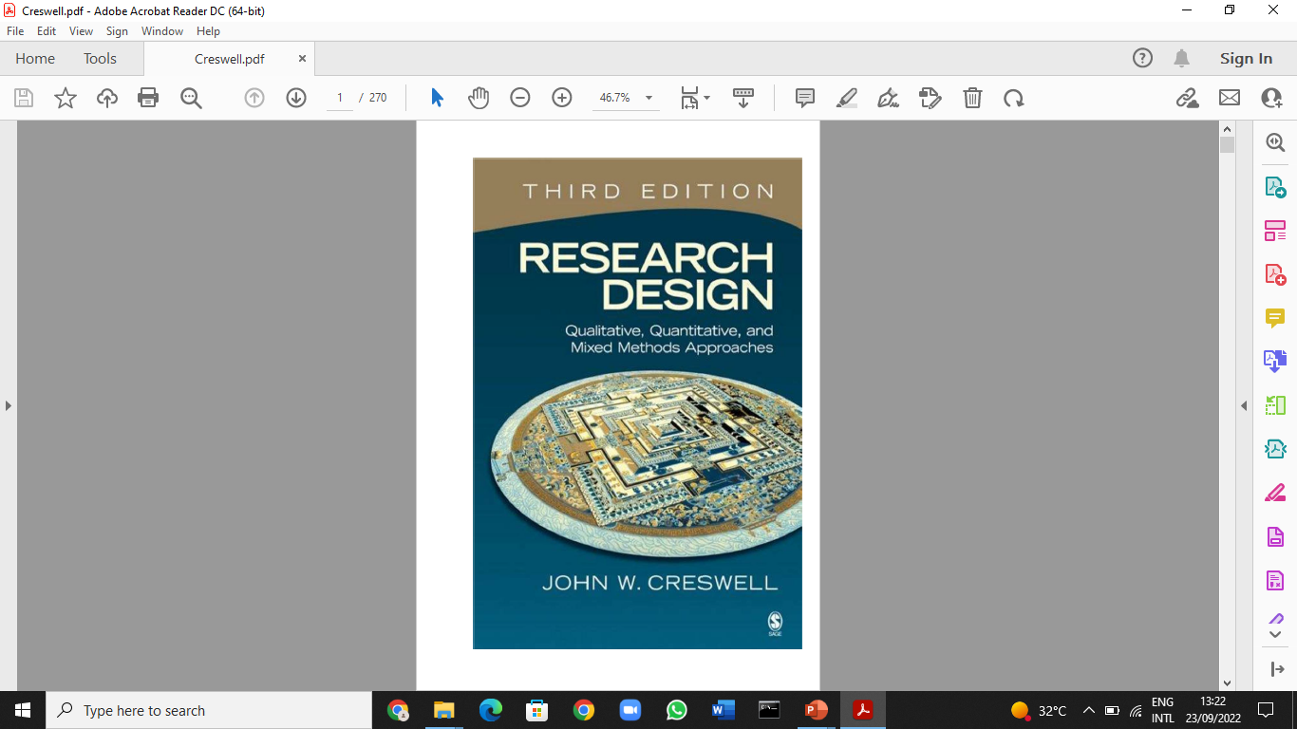
Recommended Reference

Slide 4

Course Description
This course will provide an opportunity for participants to establish or advance their understanding of research through critical exploration of research language, ethics, and approaches. The course introduces the language of research, ethical principles and challenges, and the elements of the research process within quantitative, qualitative, and mixed methods approaches. Participants will use these theoretical underpinnings to begin to critically review literature relevant to their field or interests and determine how research findings are useful in forming their understanding of their work, social, local and global environment.

Slide 5
Learning outcomes
1.Understand research terminology.
2. Be aware of the ethical principles of research, ethical challenges and approval processes.
3.Describe quantitative, qualitative and mixed methods approaches to research.
4.Identify the components of a literature review process.
5.Critically analyze published research.

Slide 6
Course topics
Module 1: Foundations
Lesson 1: Definition and Purposes of Research
Lesson 2: Research Ethics
Lesson 3: Sources of Knowledge

Slide 7
Course topics
Module 2: Quantitative Research
Lesson 4: Classification of Quantitative Research.
Lesson 5: Analysis and Interpretation

Slide 8
Course topics
Module 3: Qualitative Research
Lesson 6: Introduction to Qualitative Research, Study Designs and Methods.
Lesson7: What is the Research Proposal of Quantitative Data.

Slide 9
Course topics
Module 4: Mixed Methods Research
Lesson 8: Introduction to Mixed Methods Research, Study Designs and Methods
Lesson 9: Analysis and Interpretation of Mixed Methods Data
Lesson 10:Writing a Scientific Report

Slide 10
Definition and Purposes of Research
Scientific research defined :
People have long strived to come to grips with their environment and to understand the nature of the phenomena it presents to their senses.
One of the means by which they set out to achieve these ends is research.
Scientific research adheres to a set of strict protocols and long-established structures.

Slide 11
Definition and Purposes of Research
Research is defined as human activity based on intellectual.
application in the investigation of matter. In other words, research is the systematic process of collecting and analyzing information to increase our understanding of the phenomenon under study.

Slide 12
The function of the researcher
Contribute to the understanding of the phenomenon and to communicate that understanding to others. It may be said that the general aims of research are to observe and describe, to predict, to determine causes and explain.

Slide 13
Research outcomes
Empirical - putting beliefs, ideas, or assumptions to a test.
Critical - many truths are tentative and are subject to change as a result of subsequent research.

Slide 14
Characteristics of Scientific Research
As mentioned above research has been considered as an impartial, objective, empirical and logical analysis and recording of controlled observations that may lead to the development of generalizations, principles or theories, resulting, to some extent, in prediction and control of events that may be causes or consequences of specific phenomena. We can summarize the main.

Slide 15
Characteristics of research as follows :
Is directed toward the solution of a problem.
Is based upon observable experience or empirical evidence.
Demands accurate observation and description.

Slide 16
Characteristics of research as follows:
Involves gathering new data from primary or first-hand sources or using existing data for a new purpose;
Is characterized by carefully designed procedures, always applying rigorous analysis. However, it is sometimes somewhat random and unsystematic

Slide 17
Characteristics of research as follows:
Requires expertise.
Is characterized by patient and unhurried activity.
Is carefully recorded and reported.

Slide 18
Goals of Scientific Research:
The purpose of scientific research is problem solving. The problem could be of an immediate and practical value, or they could be of theoretical nature. That is, research focuses on answering various.
questions and acquiring new knowledge. It is the primary tool used in virtually all areas of science to expand the frontiers of knowledge. In addition, by conducting research, researchers attempt to reduce the complexity of problems, discover the relationship between seemingly unrelated events, and ultimately improve the way we live.

Slide 19
Seeking solutions to practical or theoretical problems involves doing the following important tasks.
Describing phenomena.
Explaining phenomena.
Predicting phenomena.
Controlling phenomena.
Comparing phenomena.

Slide 20
Description
Description represents efforts exerted to give pictorial account of the phenomenon being studied. It is actually the first step in research since it provides the basis for further exploration about the phenomenon under consideration.
In description, the researcher attempts to find answers to the questions “what,” “who,” and “where?”

Slide 21
Explanation
In explanation, the researcher is interested in exploring the reasons or the causes of the occurrence of certain behavior or event. It involves understanding the cause – and – effect relationship between phenomena. Attempts have been made to answer the question “why?”

Slide 22
Prediction
In research, generalization is made not only to explain the past but also to predict what will happen in the future. A widely based conceptual framework or theory will be used to make prediction about the variable of interest.

Slide 23
Control
Researchers are also interested in influencing or changing a particular event or condition for different purposes. Therefore, the description, explanation, and or prediction of events which result from any research undertaking are not casual or without aim. It is to explore and allow possibilities of control – to intervene and subsequently observe an expected result.

Slide 24
Comparison
The researcher may also be interested in comparing two or more groups on a certain behavior. The purpose here is to explore whether two or more groups are similar or different with respect to the occurrence of certain event. Comparison may take different forms. Instead of comparing groups on one behavior, the researcher.

Slide 25
The Difference between Research Method and Research Methodology
Methodology describes “the theory of how inquiry should proceed” that “involves analysis of the principles and procedures in a particular field of inquiry.
A method is a particular research technique or way to gather evidence about a phenomenon. Therefore, methods are the specific research tools we use in research projects to gain fuller understanding of phenomena.

Slide 26



Thank You

