Slide 1

Financial Accounting
Prepared by Dr. Mohamed Hamouda
Lecture 4
Inventory

Slide 2
Financial Accounting
Prepared by Dr. Mohamed Hamouda
Lecture 4
Inventory

Slide 3
Financial Accounting
Prepared by Dr. Mohamed Hamouda
Lecture 4
Inventory

Slide 4
Inventories
Classifying Inventory
Determining Inventory Quantities
Inventory Costing
Inventory Errors
Statement Presentation and Analysis
Finished goods
Work in process
Raw materials
Taking a physical inventory
Determining ownership of goods
Specific identification
Cost flow assumptions
Financial statement and tax effects
Consistent use
Lower-of-cost-or-net realizable value
Income statement effects
Statement of financial position effects
Presentation
Analysis using inventory turnover

Slide 5
Classifying Inventory
Merchandising Company
Manufacturing Company
One Classification:
Merchandise Inventory
Three Classifications:
Raw Materials
Work in Process
Finished Goods
Regardless of the classification, companies report all inventories under Current Assets on the statement of financial position.

Slide 6
Determining Inventory Quantities
Physical Inventory taken for two reasons:
Perpetual System
Check accuracy of inventory records.
Determine amount of inventory lost (wasted raw materials, shoplifting, or employee theft).
Periodic System
Determine the inventory on hand
Determine the cost of goods sold for the period.
SO 1 Describe the steps in determining inventory quantities.

Slide 7
Determining Inventory Quantities
Taking a Physical Inventory
Involves counting, weighing, or measuring each kind of inventory on hand.
Taken,
  when the business is closed or when business is slow.
  at end of the accounting period.
SO 1 Describe the steps in determining inventory quantities.

Slide 8
Determining Inventory Quantities
Determining Ownership of Goods
Goods in Transit
  Purchased goods not yet received.
  Sold goods not yet delivered.
Goods in transit should be included in the inventory of the company that has legal title to the goods. Legal title is determined by the terms of sale.
SO 1 Describe the steps in determining inventory quantities.

Slide 9
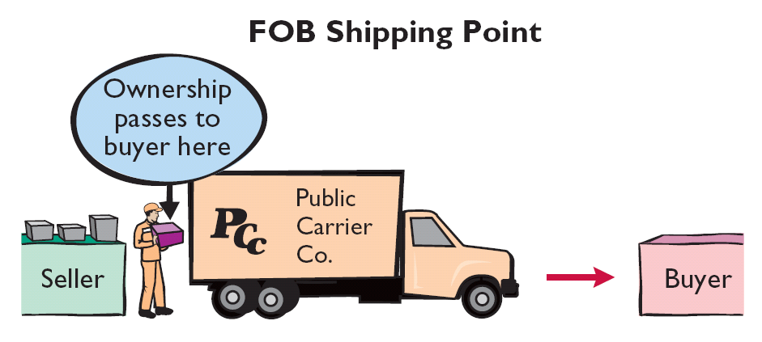
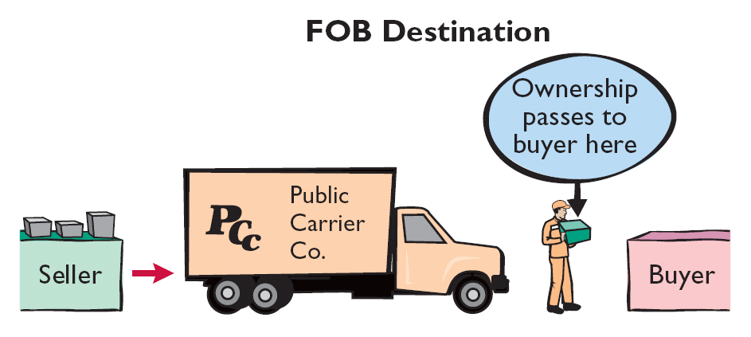
Determining Inventory Quantities
Goods in Transit
Illustration 6-1
Ownership of the goods passes to the buyer when the public carrier accepts the goods from the seller.
Ownership of the goods remains with the seller until the goods reach the buyer.
SO 1 Describe the steps in determining inventory quantities.

Slide 10
Determining Inventory Quantities
Review Question
Goods in transit should be included in the inventory of the buyer when the:
  public carrier accepts the goods from the seller.
  goods reach the buyer.
  terms of sale are FOB destination.
  terms of sale are FOB shipping point.
SO 1 Describe the steps in determining inventory quantities.

Slide 11
Determining Inventory Quantities
Determining Ownership of Goods
Consigned Goods
  In some lines of business, it is common to hold the goods of other parties and try to sell the goods for them for a fee, but without taking ownership of goods.
  These are called consigned goods.
SO 1 Describe the steps in determining inventory quantities.

Slide 12
Inventory Costing
Unit costs can be applied to quantities on hand using the following costing methods:
  Specific Identification
  First-in, first-out (FIFO)
  Average-cost
Cost Flow Assumptions
SO 2 Explain the accounting for inventories and apply the inventory cost flow methods.

Slide 13
Inventory Costing
Specific Identification Method
An actual physical flow costing method in which items still in inventory are specifically costed to arrive at the total cost of the ending inventory.
  Practice is relatively rare.
  Most companies make assumptions (Cost Flow Assumptions) about which units were sold.
SO 2 Explain the accounting for inventories and apply the inventory cost flow methods.

Slide 14
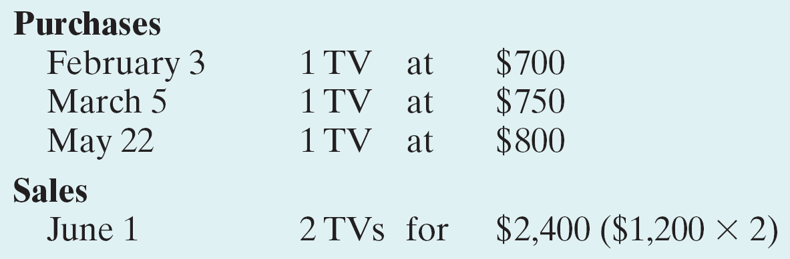
Inventory Costing
Illustration: Assume that Crivitz TV Company purchases three identical 46-inch TVs on different dates at costs of $700, $750, and $800. During the year Crivitz sold two sets at $1,200 each.
Illustration 6-2
SO 2 Explain the accounting for inventories and apply the inventory cost flow methods.

Slide 15
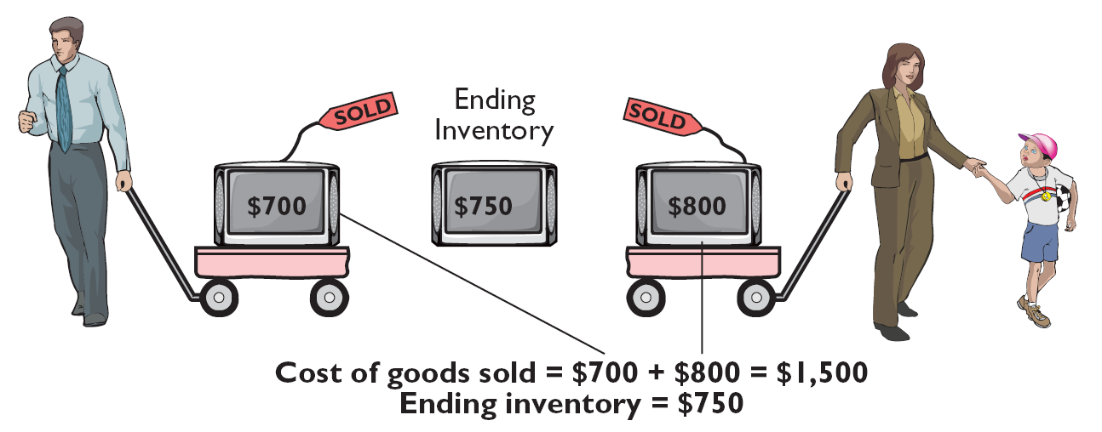
Inventory Costing
Illustration: If Crivitz sold the TVs it purchased on February 3 and May 22, then its cost of goods sold is $1,500 ($700 $800), and its ending inventory is $750.
Illustration 6-3
SO 2 Explain the accounting for inventories and apply the inventory cost flow methods.

Slide 16
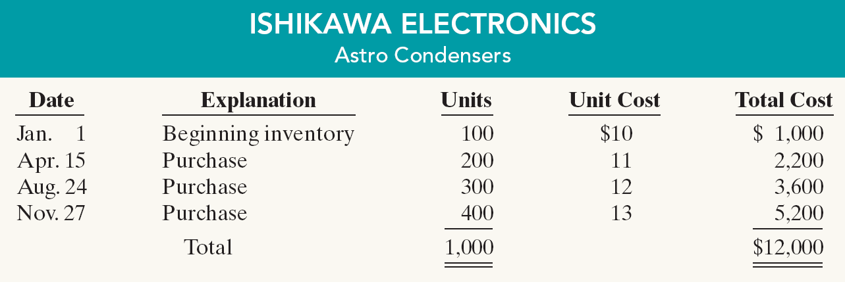
Inventory Costing
Cost Flow Assumptions
Illustration 6-4
Ishikawa uses a periodic inventory system.
Physical inventory determined that Ishikawa sold 550 units and had 450 units in inventory at December 31.
SO 2 Explain the accounting for inventories and apply the inventory cost flow methods.

Slide 17
Inventory Costing
“First-In-First-Out (FIFO)”
  Earliest goods purchased are first to be sold.
  Often parallels actual physical flow of merchandise.
  Generally good business practice to sell oldest units first.
SO 2 Explain the accounting for inventories and apply the inventory cost flow methods.

Slide 18
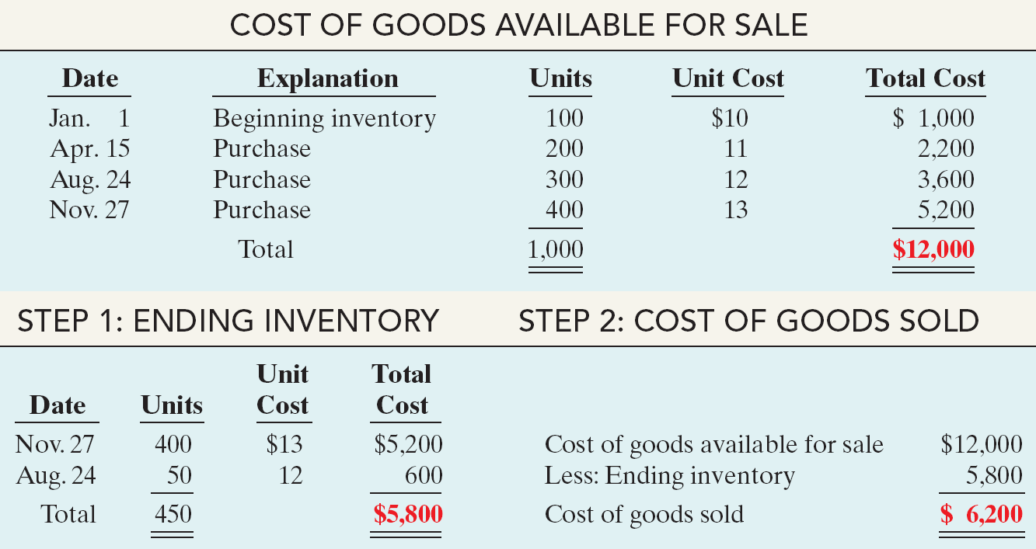
Inventory Costing
“First-In-First-Out (FIFO)”
Illustration 6-5
Answer on notes page
SO 2 Explain the accounting for inventories and apply the inventory cost flow methods.

Slide 19
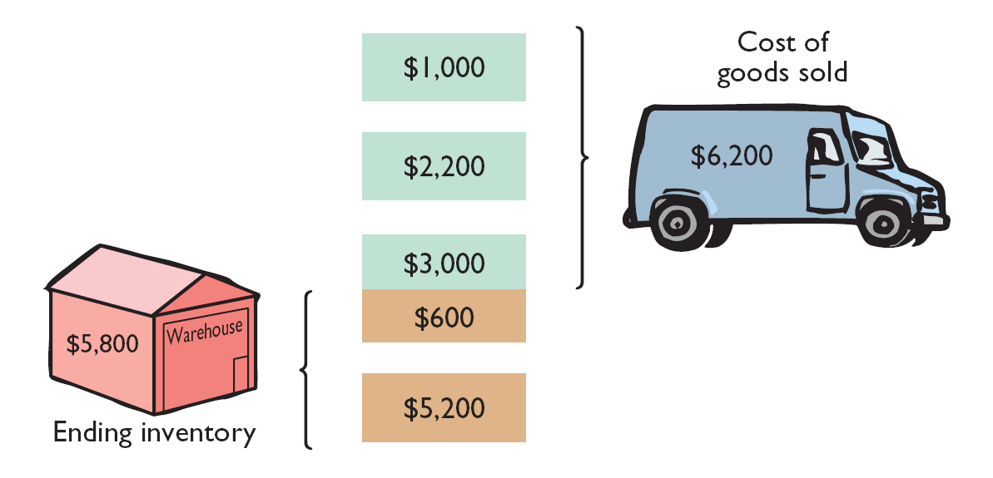
Inventory Costing
“First-In-First-Out (FIFO)”
Illustration 6-5
SO 2 Explain the accounting for inventories and apply the inventory cost flow methods.

Slide 20
Inventory Costing
“Average-Cost”
  Allocates cost of goods available for sale on the basis of weighted average unit cost incurred.
  Assumes goods are similar in nature.
  Applies weighted average unit cost to the units on hand to determine cost of the ending inventory.
SO 2 Explain the accounting for inventories and apply the inventory cost flow methods.

Slide 21
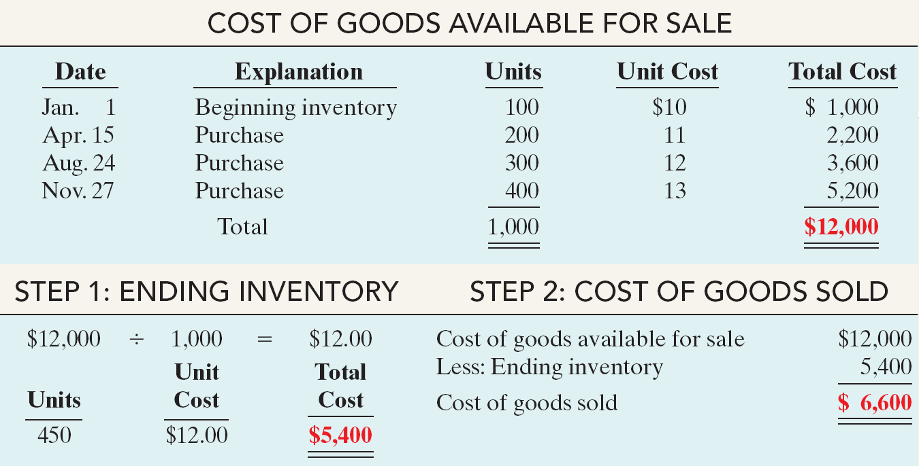
Inventory Costing
“Average Cost”
Illustration 6-8
Answer on notes page
SO 2 Explain the accounting for inventories and apply the inventory cost flow methods.

Slide 22
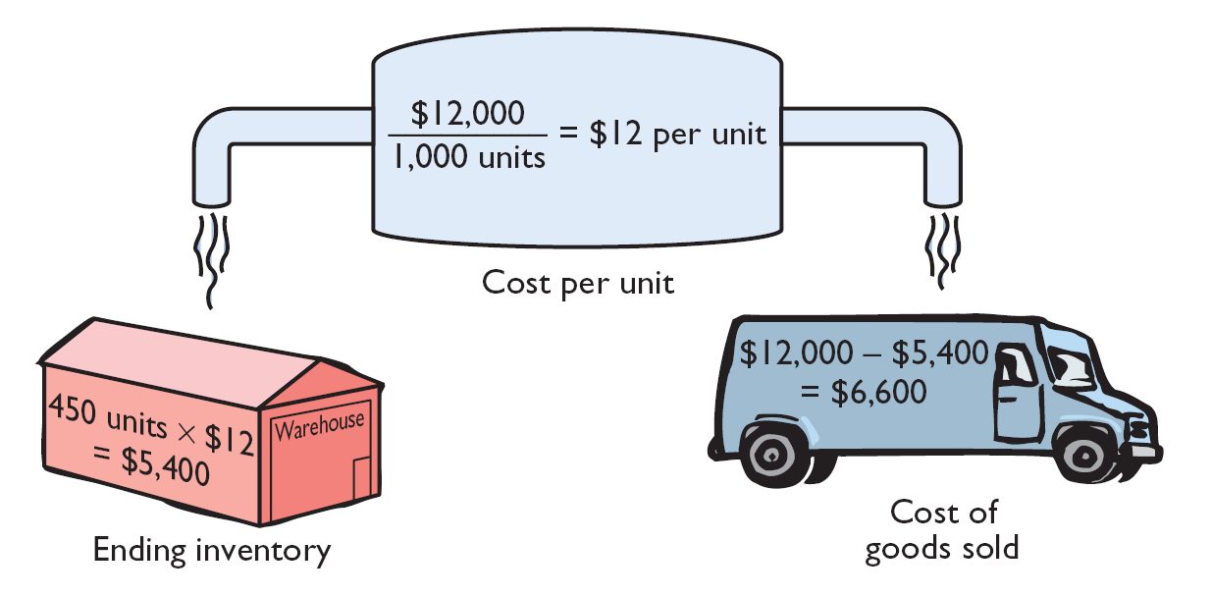
Inventory Costing
“Average Cost”
Illustration 6-8
SO 2 Explain the accounting for inventories and apply the inventory cost flow methods.

Slide 23
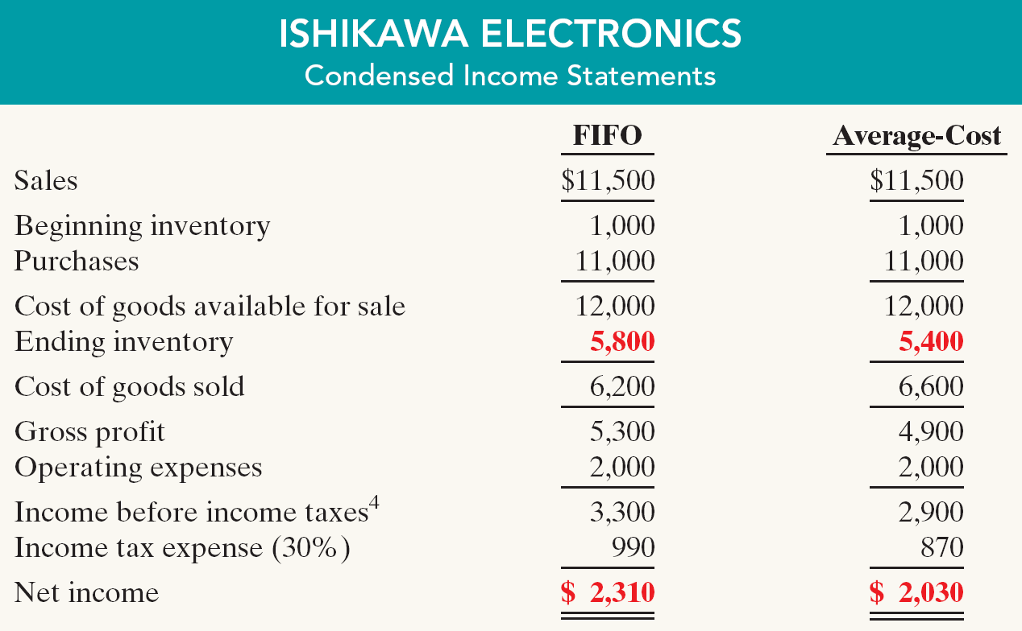
Inventory Costing
Financial Statement and Tax Effects
Illustration 6-9
Income Statement Effects
SO 3 Explain the financial effects of the inventory cost flow assumptions.

Slide 24
Inventory Costing
Statement of Financial Statement Effects
A major advantage of the FIFO method is that in a period of inflation, the costs allocated to ending inventory will approximate their current cost.
A shortcoming of the average-cost method is that in a period of inflation, the costs allocated to ending inventory may be understated in terms of current cost.
SO 3 Explain the financial effects of the inventory cost flow assumptions.

Slide 25
Inventory Costing
Tax Effects
In a period of inflation:
  FIFO - inventory and net income higher.
  AVERAGE Cost - lower income taxes.
SO 3 Explain the financial effects of the inventory cost flow assumptions.

Slide 26
Inventory Costing
Review Question
In a period of rising prices, average cost will produce:
  higher net income than FIFO.
  the same net income as FIFO.
  lower net income than FIFO.
  net income is equal to the specific identification method.
SO 3 Explain the financial effects of the inventory cost flow assumptions.

Slide 27
Inventory Costing
Using Cost Flow Methods Consistently
  Method should be used consistently, enhances comparability.
  Although consistency is preferred, a company may change its inventory costing method.
SO 3 Explain the financial effects of the inventory cost flow assumptions.

Slide 28
Inventory Costing
Lower-of-Cost-or-Net Realizable Value
When the value of inventory is lower than its cost
  Companies can “write down” the inventory to its net realizable value in the period in which the price decline occurs.
  Net realizable value refers to the net amount that a company expects to realize (receive) from the sale of inventory.
SO 4 Explain the lower-of-cost-or-net realizable value basis of accounting for inventories.

Slide 29
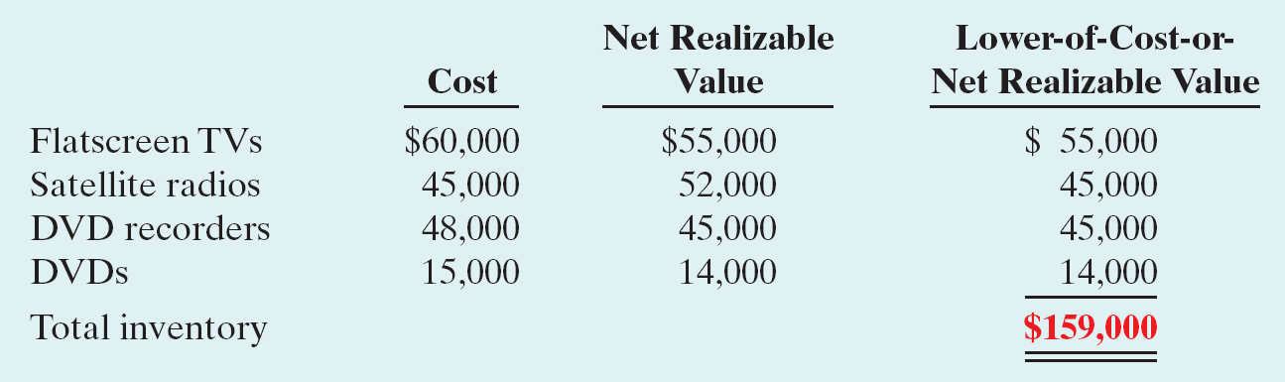
Inventory Costing
Lower-of-Cost-or-Net Realizable Value
Illustration: Assume that Ken Tuckie TV has the following lines of merchandise with costs and market values as indicated.
Illustration 6-10
SO 4 Explain the lower-of-cost-or-net realizable value basis of accounting for inventories.

Slide 30
Inventory Errors
Common Cause:
  Failure to count or price inventory correctly.
  Not properly recognizing the transfer of legal title to goods in transit.
  Errors affect both the income statement and statement of financial position.
SO 5 Indicate the effects of inventory errors on the financial statements.

Slide 31
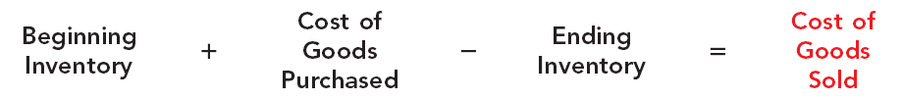
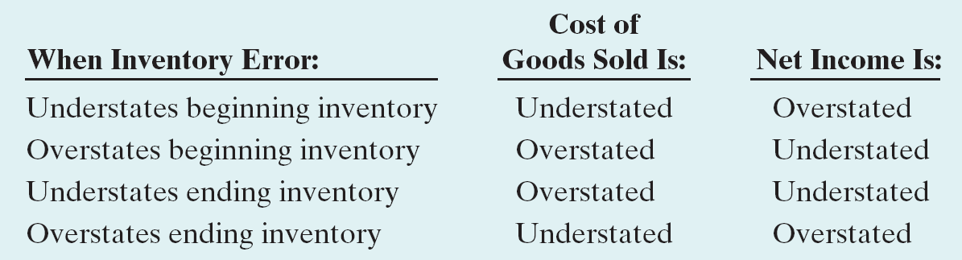
Inventory Errors
Income Statement Effects
Inventory errors affect the computation of cost of goods sold and net income.
Illustration 6-11
Illustration 6-12
SO 5 Indicate the effects of inventory errors on the financial statements.

Slide 32
Inventory Errors
Income Statement Effects
Inventory errors affect the computation of cost of goods sold and net income in two periods.
  An error in ending inventory of the current period will have a reverse effect on net income of the next accounting period.
  Over the two years, the total net income is correct because the errors offset each other.
  The ending inventory depends entirely on the accuracy of taking and costing the inventory.
SO 5 Indicate the effects of inventory errors on the financial statements.

Slide 33
Inventory Errors
Illustration 6-13
Combined income for 2-year period is correct.
($3,000)
Net Income understated
$3,000
Net Income overstated
SO 5 Indicate the effects of inventory errors on the financial statements.

Slide 34
Inventory Errors
Review Question
Understating ending inventory will overstate:
  assets.
  cost of goods sold.
  net income.
  equity.
SO 5 Indicate the effects of inventory errors on the financial statements.

Slide 35
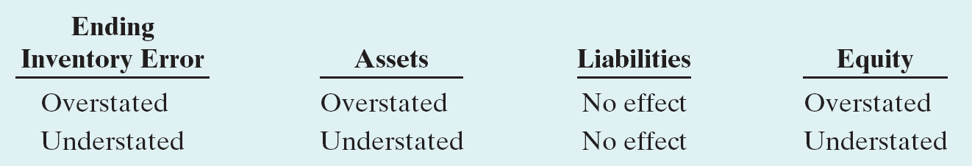
Inventory Errors
Statement of Financial Position Effects
Effect of inventory errors on the statement of financial position is determined by using the accounting equation:
Illustration 6-11
Illustration 6-14
SO 5 Indicate the effects of inventory errors on the financial statements.

Slide 36
Statement Presentation and Analysis
Presentation
Statement of Financial Position - Inventory classified as current asset.
Income Statement - Cost of goods sold.
There also should be disclosure of
  major inventory classifications,
  basis of accounting (cost, or lower-of-cost-or-net realizable value), and
  Cost method (specific identification, FIFO, or average-cost).

Slide 37
Statement Presentation and Analysis
Analysis Using Inventory Turnover
Inventory management is a double-edged sword
High Inventory Levels - may incur high carrying costs (e.g., investment, storage, insurance, obsolescence, and damage).
Low Inventory Levels – may lead to stockouts and lost sales.
SO 6 Compute and interpret the inventory turnover ratio.

Slide 38
Statement Presentation and Analysis
Inventory turnover measures the number of times on average the inventory is sold during the period.
Cost of Goods Sold
Inventory Turnover
=
Average Inventory
Days in inventory measures the average number of days inventory is held.
Days in Year (365)
Days in Inventory
=
Inventory Turnover
SO 6 Compute and interpret the inventory turnover ratio.

Slide 39
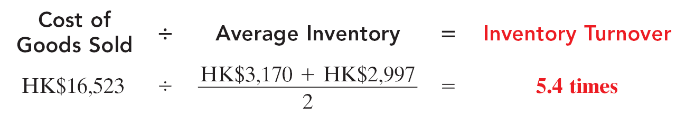
Statement Presentation and Analysis
Illustration: Esprit Holdings reported in its 2009 annual report a beginning inventory of HK$3,170 million, an ending inventory of HK$2,997 million, and cost of goods sold for the year ended June 30, 2009, of HK$16,523 million. The inventory turnover formula and computation for Esprit Holdings are shown below.
Illustration 6-16
Days in Inventory: Inventory turnover of 5.4 times divided into 365 is approximately 68 days. This is the approximate time that it takes a company to sell the inventory.
Answer on notes page
SO 6 Compute and interpret the inventory turnover ratio.

Slide 40
Understanding U.S. GAAP
Key Differences
Inventories
  Both GAAP and IFRS permit the specific identification method where appropriate. IFRS requires that the specific identification method must be used where the inventory items are not interchangeable (i.e., can be specifically identified). If the inventory items are not specifically identifiable, a cost flow assumption is used. GAAP does not specify situations that require its use.
  GAAP permits the use of the last-in, first-out (LIFO) cost flow assumption for inventory valuation. IFRS prohibits its use. LIFO is frequently used by U.S. companies for tax purposes. U.S. regulations require that if LIFO is used for taxes, it must also be used for financial reporting. (See Appendix 6C.)

Slide 41
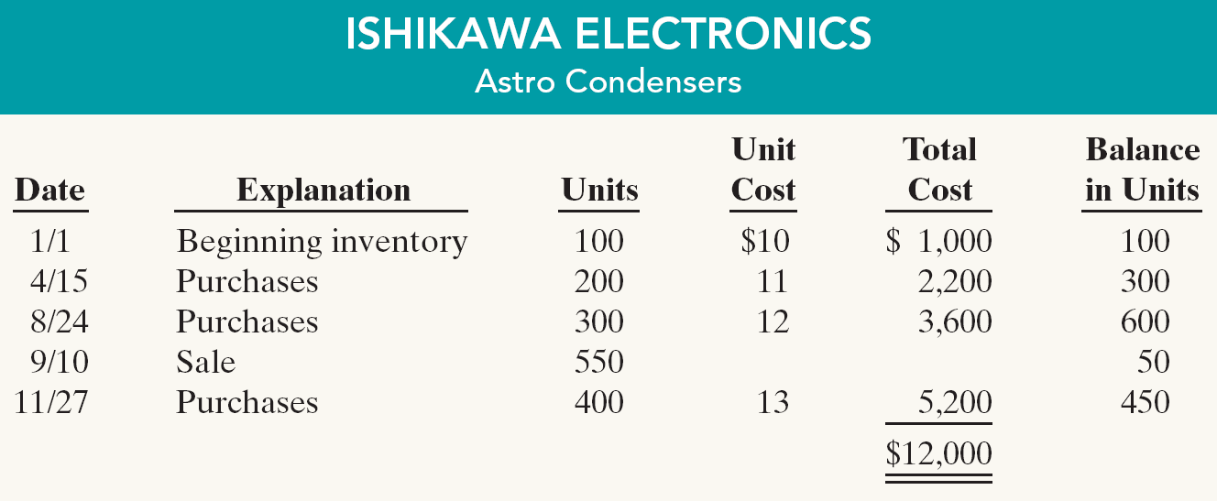
Cost Flow Methods in Perpetual Systems
Appendix 6A
Illustration 6A-1
Assuming the Perpetual Inventory System, compute Cost of Goods Sold and Ending Inventory under FIFO and Average cost.
SO 7 Apply the inventory cost flow methods to perpetual inventory records.

Slide 42
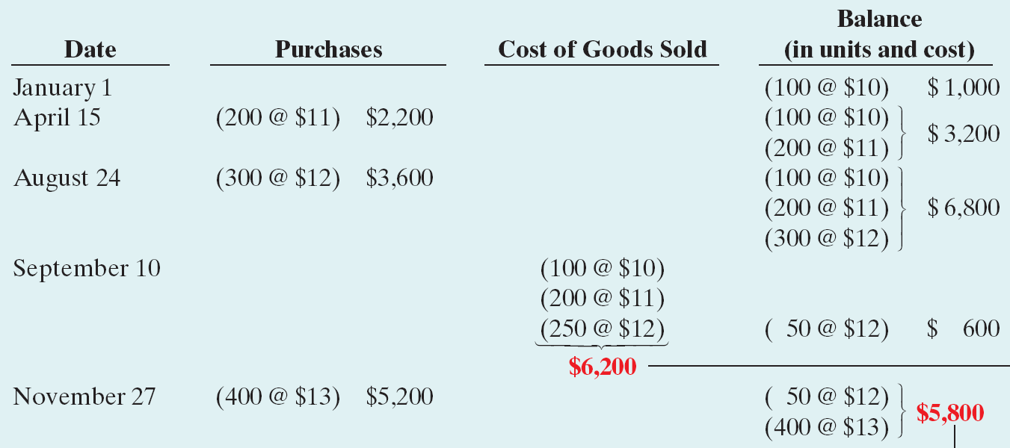
Cost Flow Methods in Perpetual Systems
“First-In-First-Out (FIFO)”
Illustration 6A-2
Cost of Goods Sold
Answer on notes page
Ending Inventory
SO 7 Apply the inventory cost flow methods to perpetual inventory records.

Slide 43
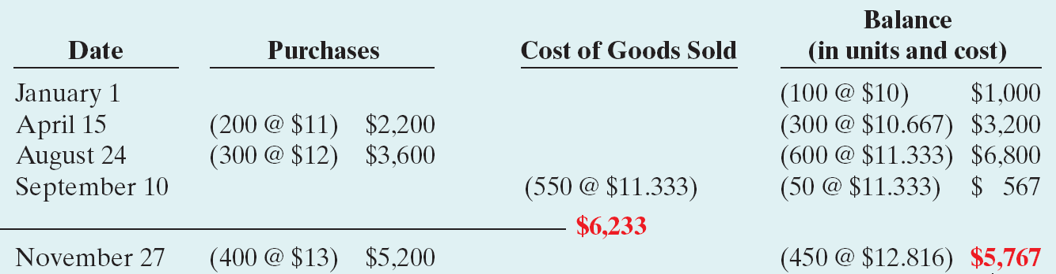
Cost Flow Methods in Perpetual Systems
“Average Cost” (Moving-Average System)
Illustration 6A-3
Cost of Goods Sold
Ending Inventory
Answer on notes page
SO 7 Apply the inventory cost flow methods to perpetual inventory records.

Slide 44
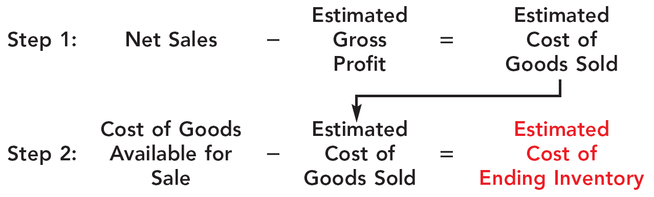
Estimating Inventories
Appendix 6B
Gross Profit Method
The gross profit method estimates the cost of ending inventory by applying a gross profit rate to net sales.
Illustration 6B-1
SO 8 Describe the two methods of estimating inventories.

Slide 45
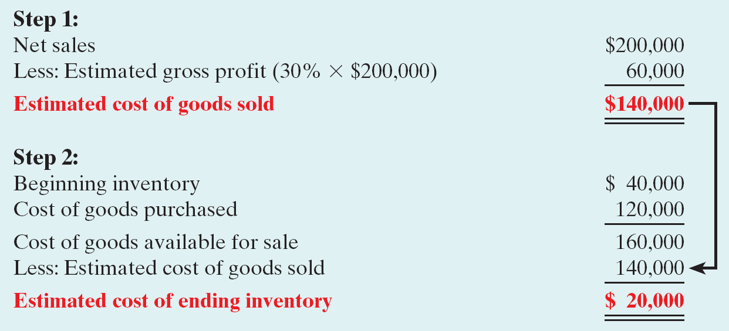
Estimating Inventories
Illustration: Kishwaukee Company’s records for January show net sales of $200,000, beginning inventory $40,000, and cost of goods purchased $120,000. The company expects to earn a 30% gross profit rate. Compute the estimated cost of the ending inventory at January 31 under the gross profit method.
Illustration 6B-2
SO 8 Describe the two methods of estimating inventories.

Slide 46
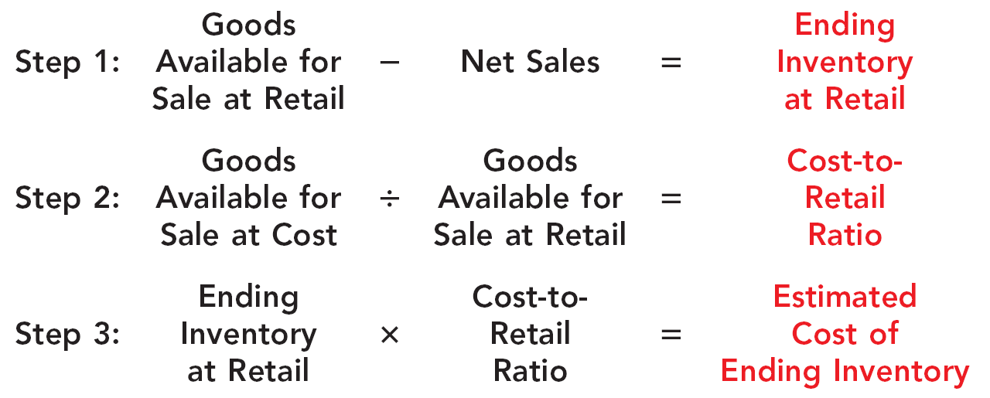
Estimating Inventories
Retail Inventory Method
Company applies the cost-to-retail percentage to ending inventory at retail prices to determine inventory at cost.
Illustration 6B-3
SO 8 Describe the two methods of estimating inventories.

Slide 47
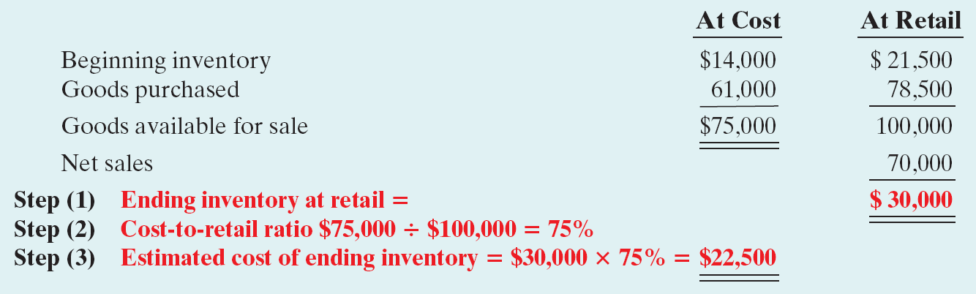
Estimating Inventories
Illustration:
Illustration 6B-4
Note that it is not necessary to take a physical inventory to determine the estimated cost of goods on hand at any given time.
SO 8 Describe the two methods of estimating inventories.

Slide 48
LIFO Inventory Method
Appendix 6C
“Last-In-First-Out (LIFO)”
  Latest goods purchased are first to be sold.
  Seldom coincides with actual physical flow of merchandise.
  Exceptions include goods stored in piles, such as coal or hay.
  Under IFRS, LIFO is not permitted for financial reporting purposes.
SO 9 Apply the LIFO inventory costing method.

Slide 49
LIFO Inventory Method
Illustration
Illustration 6-4
Ishikawa uses a periodic inventory system.
Physical inventory determined that Ishikawa sold 550 units and had 450 units in inventory at December 31.
SO 9 Apply the LIFO inventory costing method.

Slide 50
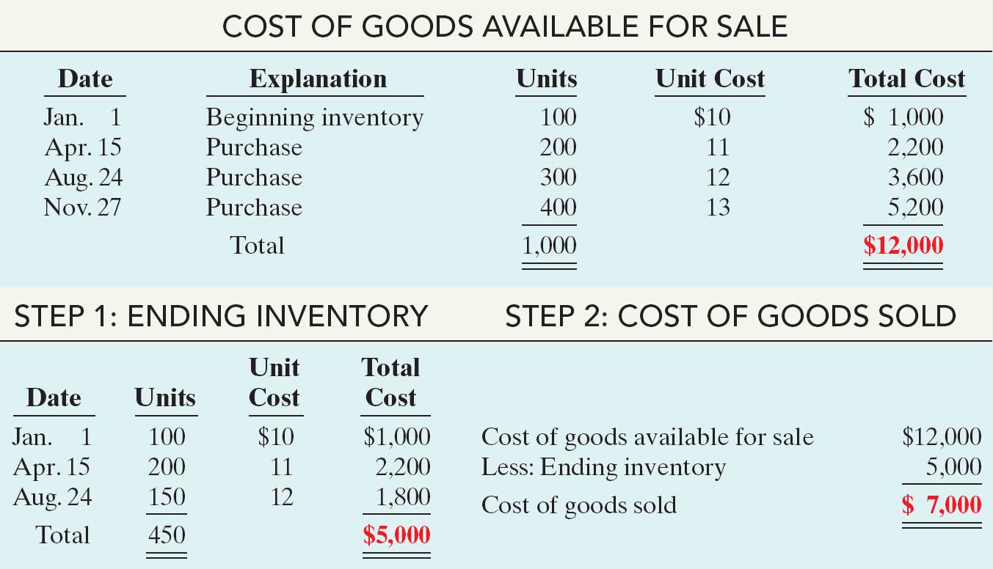
LIFO Inventory Method
“Last-In-First-Out (LIFO)”
Illustration 6C-1
Solution on notes page
SO 9 Apply the LIFO inventory costing method.

Slide 51
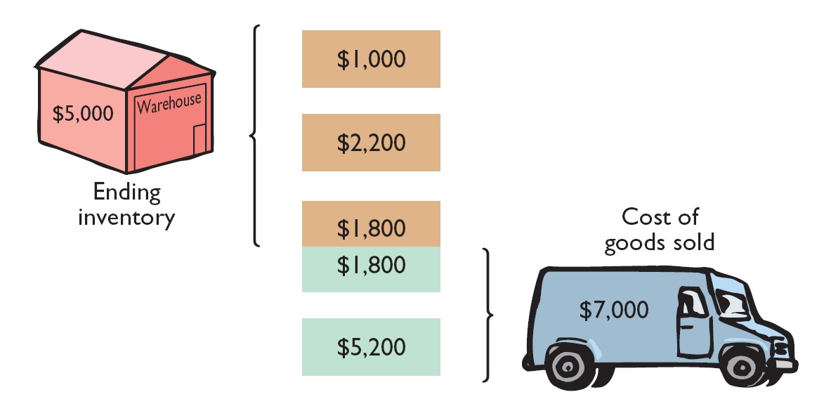
LIFO Inventory Method
“Last-In-First-Out (LIFO)”
Illustration 6C-1
SO 9 Apply the LIFO inventory costing method.

