Slide 1


System Administration (2)
IT401
Prepared by
Dr. Ahmed El-Douh
Lecture 3

Slide 2



System Administration 2
Lecture 3
IT401
Access the command line & Manage files from the command line
Prepared by
Dr. Ahmed El-Douh

Slide 3
Objectives
Upon completion of this lecture, you will be able to:
  Access and use local help systems in Red Hat Enterprise Linux to troubleshoot and resolve system issues.
  Create, view, and edit text files using command-line tools and text editors.
  Manage file content and command output effectively to support system configuration and task automation.
  Maintain a smooth workflow while working with system-level tasks in a Linux environment.

Slide 4
Chapter
Outlines
03
Part 1: Access the command line
  • Log into a Linux system
  • run simple commands using the shell.
Part 2: Manage Files from the Command Line
  • Copy, move, create, delete, and organize files while working from the bash shell.

Slide 5


Chapter
03
Access the command line

Slide 6
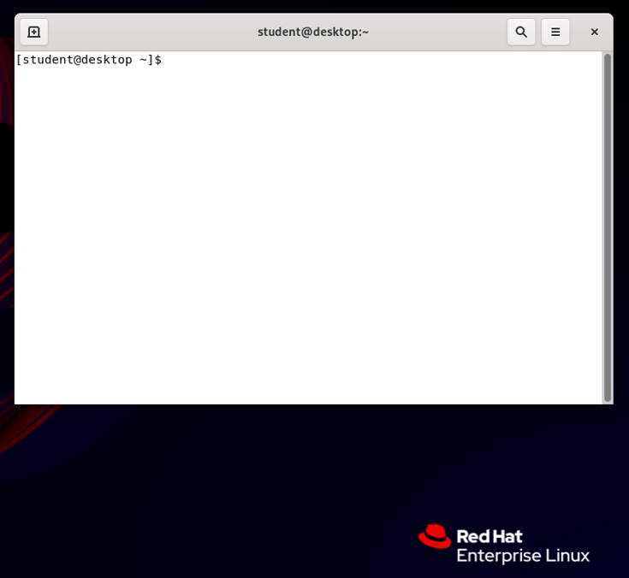
Linux Terminal
The Shell Prompt
When you open a terminal, you'll see a line of text where you can start typing. This is called the shell prompt. It tells you that the system is ready for your commands.

Slide 7
Access the Command Line
The Bash SHELL A command line is: a text-based interface which can be used to input instructions to a computer system.
The Linux command line is provided by a program called the shell.
The default shell for users in Red Hat Enterprise Linux is the GNU Bourne-Again Shell (bash).
Bash is an improved version of one of the most successful shells used on UNIX-like systems, the Bourne Shell (sh).
This is called the shell prompt. When a regular user starts a shell, the default prompt ends with a $ character.
The $ is replaced by a # if the shell is running as the super user, root. This makes it more obvious that it is a super user shell, which helps to avoid accidents and mistakes in the privileged account.

Slide 8
Access the Command Line
# Using bash to execute commands can be powerful.
The bash shell provides a scripting language that can support automation of tasks.
The shell has additional capabilities that can simplify or make possible operations that are hard to accomplish efficiently with graphical tools.
VIRTUAL CONSOLES Users access the bash shell through a terminal. A terminal provides a keyboard for user input and a display for output.
On text-based installations, this can be the Linux machine's physical console, the hardware keyboard and display. Terminal access can also be configured through serial ports.
Another way to access a shell is from a virtual console.
A Linux machine's physical console supports multiple virtual consoles which act like separate terminals. Each virtual console supports an independent login session.

Slide 9
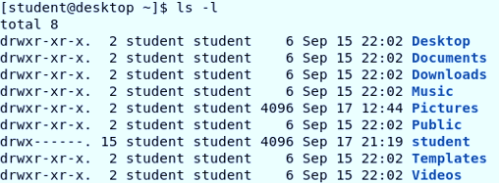


Access the Command Line
SHELL BASICS Commands entered at the shell prompt have three basic parts:
Command to run.
Options to adjust the behavior of the command.
Arguments, which are typically targets of the command The command is the name of the program to run.
It may be followed by one or more options, which adjust the behavior of the command or what it will do. Options normally start with one or two dashes (-a or --all, for example) to distinguish them from arguments.
Commands may also be followed by one or more arguments, which often indicate a target that the command should operate on. For example, the command line usermod -L morgan has a command (usermod), an option (-L), and an argument (morgan).

Slide 10
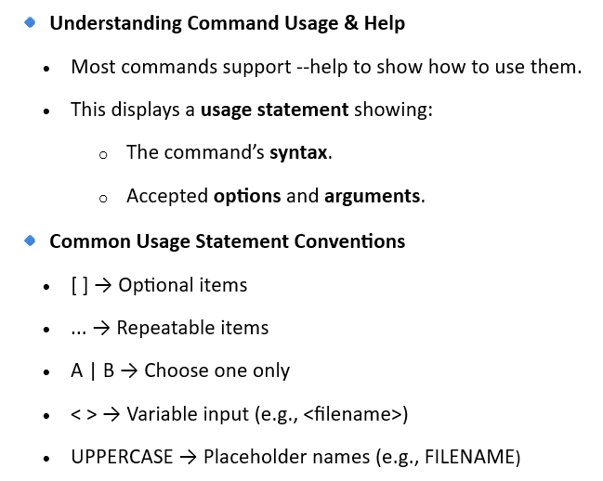
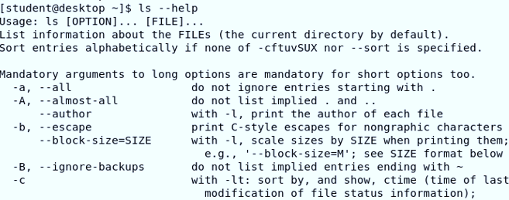
Access the Command Line

Slide 11

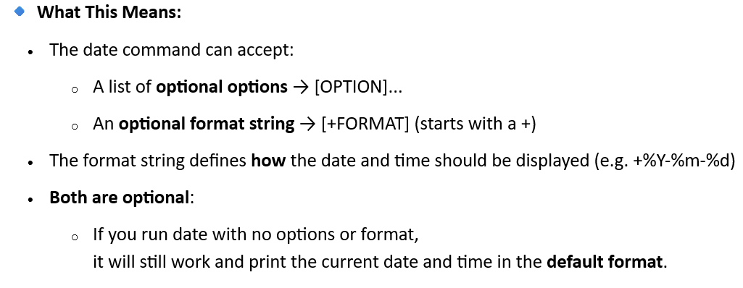

Access the Command Line

Slide 12
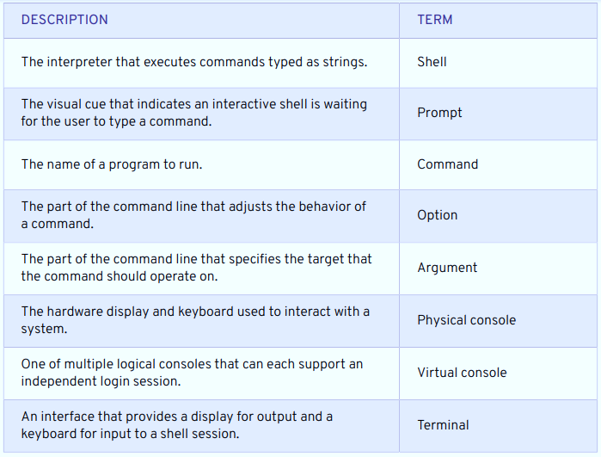
Access the Command Line: LOCAL CONSOLE ACCESS TERMS

Slide 13
Access the Command Line: EXECUTING COMMANDS USING THE BASH SHELL
Each word typed into the shell is separated from each other with spaces. Commands are the names of programs that are installed on the system. Each command has its own options and arguments.
The Enter key is pressed when a user is ready to execute a command. Each command is typed on a separate line and the output from each command displays before the shell displays a prompt.
If a user wants to type more than one command on a single line, a semicolon, ; , can be used as a command separator. A semicolon is a member of a class of characters called meta characters that has special meanings for bash.

Slide 14
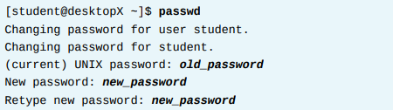
Access the Command Line: EXECUTING COMMANDS USING THE BASH SHELL
The password command changes a user's own password. The original password for the account must be specified before a change will be allowed. By default, password is configured to require a strong password, consisting of lowercase letters, uppercase letters, numbers, and symbols, and is not based on a dictionary word.
The super user can use the password command to change other users' passwords.
Password: all authentication tokens updated successfully.
Linux does not require file name extensions to classify files by type. The file command scans the beginning of a file's contents and displays what type it is. The files to be classified are passed as arguments to the command.

Slide 15
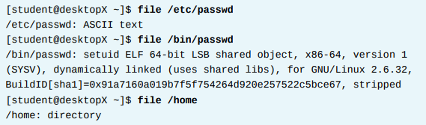
Access the Command Line: EXECUTING COMMANDS USING THE BASH SHELL
The head and tail commands display the beginning and end of a file respectively.
By default, these commands display 10 lines, but they both have a -n option that allows a different number of lines to be specified. The file to display is passed as an argument to these commands.

Slide 16
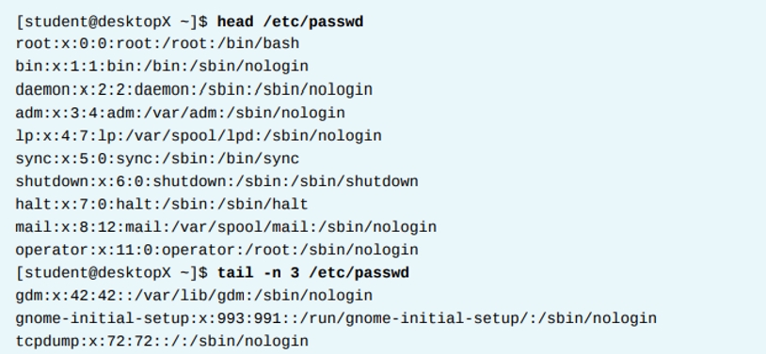
Access the Command Line: EXECUTING COMMANDS USING THE BASH SHELL

Slide 17
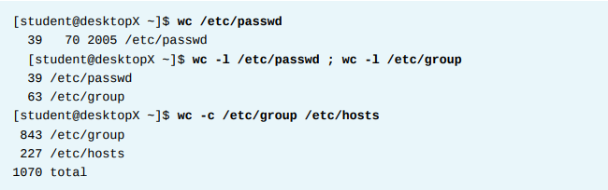
Access the Command Line: EXECUTING COMMANDS USING THE BASH SHELL

Slide 18
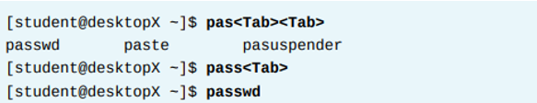
Access the Command Line: TAB COMPLETION
Tab completion allows a user to quickly complete commands or file names once they have typed enough at the prompt to make it unique. If the characters typed are not unique, pressing the Tab key twice displays all commands that begin with the characters already typed.

Slide 19
Access the Command Line: TAB COMPLETION
Tab completion allows a user to quickly complete commands or file names once they have typed enough at the prompt to make it unique. If the characters typed are not unique, pressing the Tab key twice displays all commands that begin with the characters already typed.
Tab completion helps in quickly finding and completing file names or paths

Slide 20
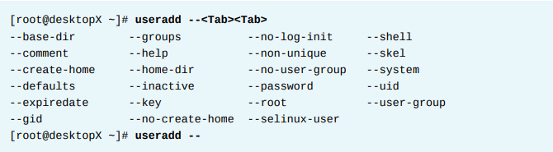
Access the Command Line: TAB COMPLETION
Arguments and options can be matched with tab completion for many commands. The useradd command is used by the superuser, root, to create additional users on the system. It has many options that can be used to control how that command behaves. Tab completion following a partial option can be used to complete the option without a lot of typing.

Slide 21
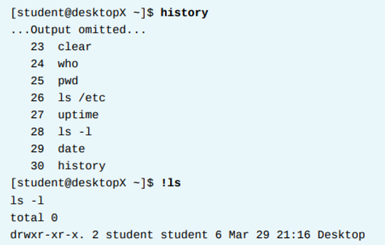
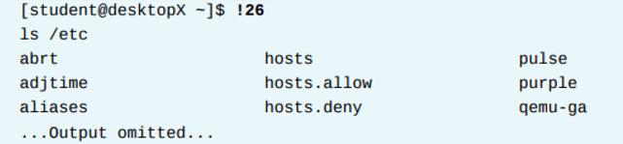
Access the Command Line: COMMAND HISTORY
The history command displays a list of previously executed commands prefixed with a command number.
The exclamation point character, !, is a metacharacter that is used to expand previous commands without having to retype them.
!string expands to the most recent command that begins with the string specified.
!number expands to the command matching the number specified.

Slide 22
Access the Command Line: Editing Command Line
The arrow keys can be used to navigate through previous command lines in the shell's history.
Up Arrow edits the previous command in the history list.
Down Arrow edits the next command in the history list. Use this key when the Up Arrow has been pressed too many times. Left Arrow and Right Arrow move the cursor left and right in the current command line being edited.
The Esc+. key combination causes the shell to copy the last word of the previous command on the current command line where the cursor is. If used repeatedly, it will continue to go through earlier commands.
EDITING THE COMMAND LINE When used interactively, bash has a command line-editing feature. This allows the user to use text editor commands to move around within and modify the current command being typed.
Using the arrow keys to move within the current command and to step through the command history was introduced earlier in this session. More powerful editing commands are introduced in the following table.

Slide 23
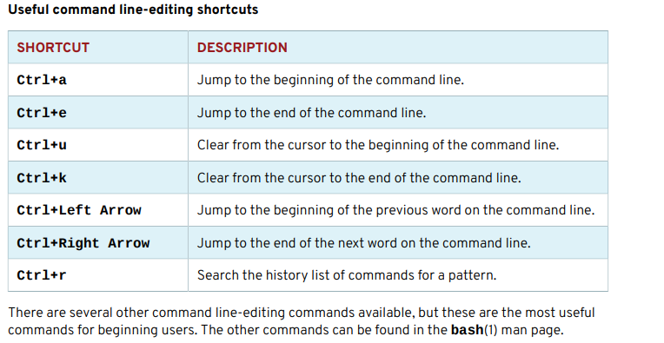
Access the Command Line: Editing Command Line

Slide 24
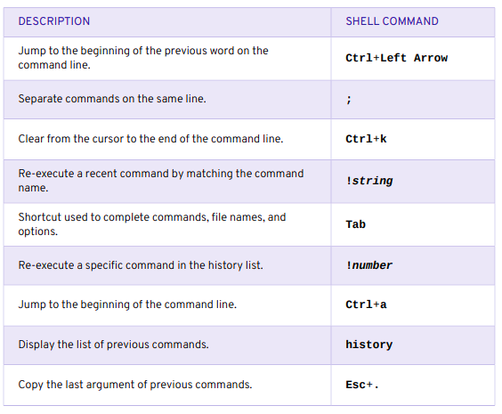
BASH COMMANDS AND KEYBOARD SHORTCUTS

Slide 25
Chapter
03
Manage Files from the Command Line

Slide 26
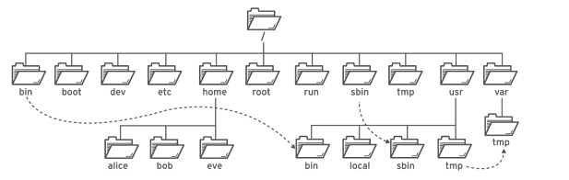
Managing Files from the Command Line
THE FILE SYSTEM HIERARCHY:
All files on a Linux system are stored on file systems which are organized into a single inverted tree of directories, known as a file system hierarchy.
This tree is inverted because the root of the tree is said to be at the top of the hierarchy, and the branches of directories and subdirectories stretch below the root.
Significant file system directories in Red Hat

Slide 27
Managing Files from the Command Line
The directory / is the root directory at the top of the file system hierarchy.
The / character is also used as a directory separator in file names. For example, if etc is a subdirectory of the / directory, we could call that directory /etc.
Likewise, if the /etc directory contained a file named issue, we could refer to that file as / etc/issue.
Subdirectories of / are used for standardized purposes to organize files by type and purpose. This makes it easier to find files. For example, in the root directory, the subdirectory /boot is used for storing files needed to boot the system.

Slide 28
Linux File System Hierarchy: Benefits
Key Benefits:
Ensures consistency across different Linux distributions
Provides predictability for software developers and system administrators
Facilitates interoperability between different Unix-like systems
Standardizes locations of important files and directories

Slide 29
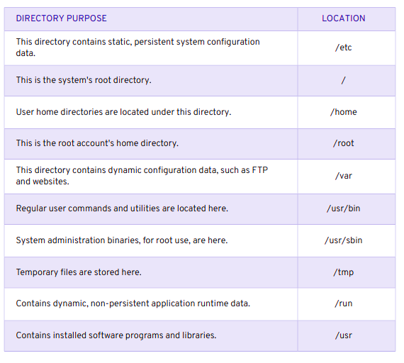
File System Hierarchy

Slide 30
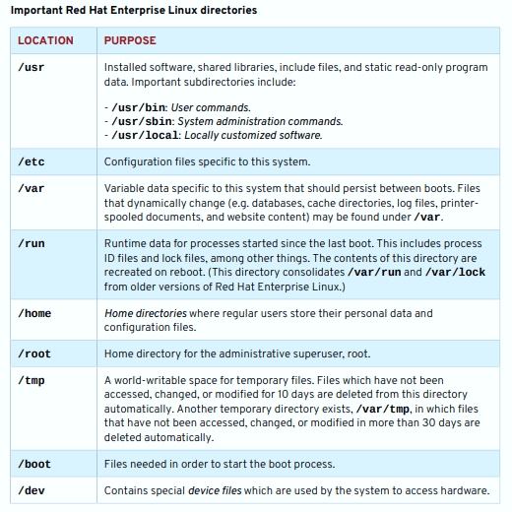
Managing Files from the Command Line

Slide 31
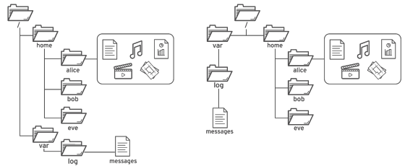
LOCATING FILES BY NAME
ABSOLUTE PATHS AND RELATIVE PATHS
The path of a file or directory specifies its unique file system location.
Following a file path traverses one or more named subdirectories, delimited by a forward slash (/), until the destination is reached.
Standard file behavior definitions apply to directories (also called folders) the same as other file types.
The common file browser view (left) is equivalent to the top-down view (right)

Slide 32
Managing Files from the Command Line: Absolute Path
Absolute paths : An absolute path is a fully qualified name, beginning at the root (/) directory and specifying each subdirectory traversed to reach and uniquely represent a single file.
Every file in a file system has a unique absolute path name, recognized with a simple rule: A path name with a forward slash (/) as the first character is an absolute path name.
For example, the absolute path name for the system message log file is /var/log/messages. Absolute path names can be long to type, so files may also be located relatively (relative paths).
When a user logs in and opens a command window, the initial location is normally the user's home directory. System processes also have an initial directory.
Users and processes navigate to other directories as needed; the terms working directory or current working directory refer to their current location.

Slide 33
Absolute Path vs. Relative Path
An absolute path specifies the complete location of a file or directory from the root directory (/). It always starts with a forward slash.
A relative path specifies the location of a file or directory relative to your current working directory. It does NOT start with a forward slash.

Slide 34

Managing Files from the Command Line: NAVIGATING PATHS
NAVIGATING PATHS The pwd command displays the full path name of the current location, which helps determine appropriate syntax for reaching files using relative path names.
The ls command lists directory contents for the specified directory or, if no directory is given, for the current directory.

Slide 35

Managing Files from the Command Line: NAVIGATING PATHS
The cd command stands for "Change Directory" and is used to navigate between directories in the Linux file system.
cd # Takes you to your home directory
cd ~ # Same as above (~ represents home)
cd / #Go to the root directory
cd .. # Go up one directory level
cd - # Go back to previous directory
cd /path/to/directory # Go to specific directory

Slide 36

Managing Files from the Command Line
The touch command is used to create empty files and update file timestamps in Linux.
If the file already exists, touch updates its access and modification times to the current time
This is useful for creating empty files, which can be used for practice, since "touching" a file name that does not exist causes the file to be created. Using touch, practice file are created in the Documents subdirectory.

Slide 37
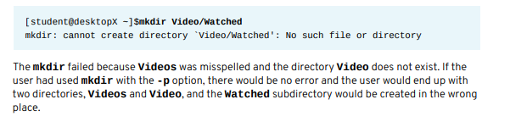
Managing Files from the Command Line
Create directories The mkdir command
creates one or more directories or subdirectories, generating errors if the file name already exists or when attempting to create a directory in a parent directory that doesn't exist.
The -p parent option creates missing parent directories for the requested destination. Be cautious when using mkdir -p, since accidental spelling mistakes create unintended directories without generating error messages.
In the following example, a user attempts to use mkdir to create a subdirectory named Watched in the existing Videos directory but mistypes the directory name.
mkdir directory_name # Create single directory
mkdir dir1 dir2 dir3 # Create multiple directories
mkdir -p dir3/dir4 # This will create all missing directories i.e. dir3 and dir4

Slide 38
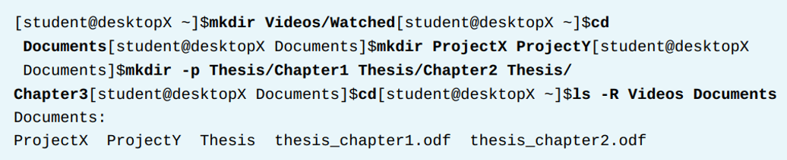
Managing Files from the Command Line
The provided Figure demonstrates a sequence of commands in the command line for organizing files. It begins with creating a subdirectory Watched inside Videos using mkdir, then changes the directory to Documents with cd to create new folders (ProjectX, ProjectY, and Thesis) using mkdir with the -p option. The process concludes by using the ls -R command to display the entire directory structure, confirming the successful creation of all the folders.

Slide 39
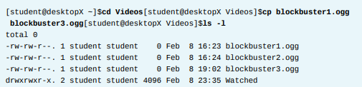
Managing Files from the Command Line
Copy files
The cp command copies one or more files to become new, independent files. Syntax allows copying an existing file to a new file in the current or another directory or copying multiple files into another directory.
In any destination, new file names must be unique. If the new file name is not unique, the copy command will overwrite the existing file.

Slide 40
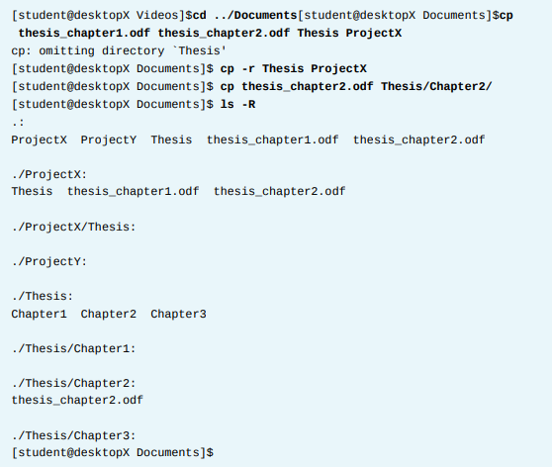
Managing Files from the Command Line
To protect users from accidentally overwriting directories with contents, multiple file cp commands ignore directories specified as a source.
Copying non-empty directories, with contents, requires the -r recursive option.

Slide 41
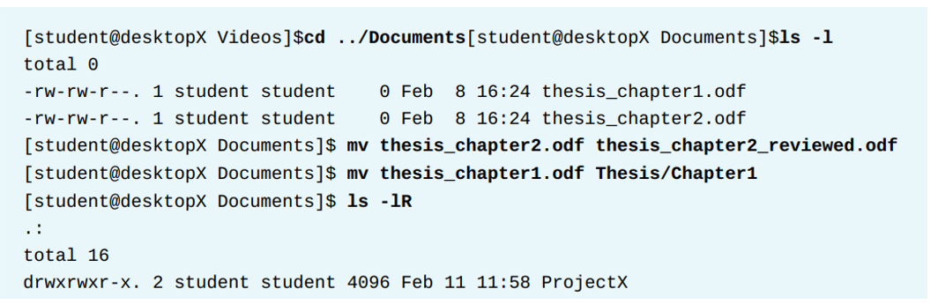
Managing Files from the Command Line
Move files
The mv command renames files in the same directory or relocates files to a new directory.
File contents remain unchanged. Files moved to a different file system require creating a new file by copying the source file, then deleting the source file. Although normally transparent to the user, large files may take noticeably longer to move.

Slide 42
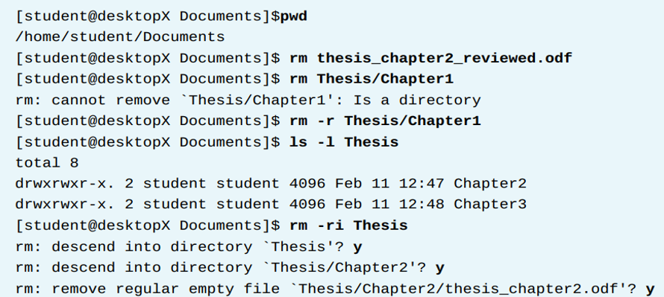
Managing Files from the Command Line
Remove files
Remove files and directories Default syntax for rm deletes files, but not directories. Deleting a directory, and potentially many subdirectories and files below it, requires the -r recursive option. There is no command-line undelete feature, nor a trash bin from which to restore.

Slide 43
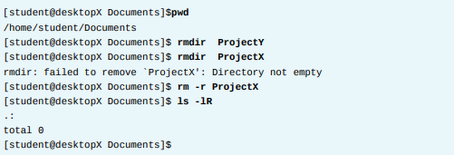
Managing Files from the Command Line
Remove files
After rm failed to delete directory, the -r recursive option succeeded. The last rm command parsed into each subdirectory first, individually deleting contained files before removing each now-empty directory. Using -i will interactively prompt for each deletion.
This is essentially the opposite of -f which will force the deletion without prompting the user. The rmdir command deletes directories only if empty. Removed directories cannot be undeleted.

Slide 44



Thank You

