Slide 1


Human Resources Management
Robert L. Mathis ⏐ John H. Jackson
Prepared by Dr. Samah Abdelfatah
MGM 243
Lecture 10

Slide 2



Part 4:Compensating Human Resources
Managing Employee Benefits
Chapter
14
Lecture 10
MGM 243
Prepared by
Dr. Samah Abdelfatah

Slide 3

Chapter
Learning Outcomes
14
After you have read this chapter, you should be able to:
Define a benefit and identify four strategic benefits considerations.
Summarize why benefits management and communications efforts are important.
Discuss the retirement plans from defined-benefit to defined-contribution and cash balance programs.
Discuss other types of benefits.
Define health, safety, and security and discuss some related issues

Slide 4
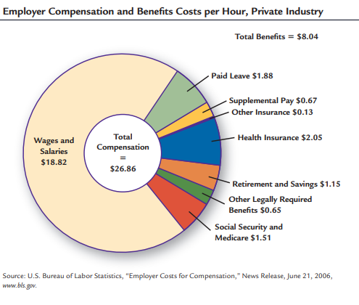

BENEFIT
Chapter
14
Benefit :Indirect reward given to an employee or a group of employees for organizational membership.
Figure 14-1

Slide 5
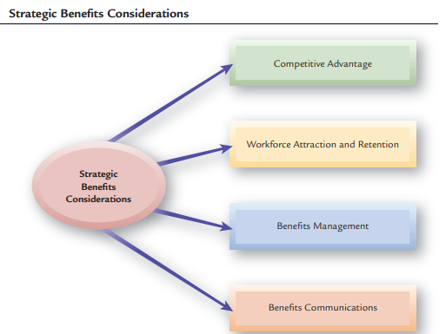
BENEFITS AND HR STRATEGY
Figure 14-2

Slide 6

Chapter
Benefits as Competitive Advantage
14
Employers may offer benefits in order to
Aid recruiting and retention, impact organizational performance, and meet legal requirements.
Reinforcing the company philosophy of social and corporate citizenship.
To be viewed positively within a community and the industry by customers, civic leaders, current employees, and workers in other firms. Conversely, cutting benefits, or taking advantage of workers may be viewed more negatively.

Slide 7


Chapter
Benefits for Workforce Attraction and Retention
14
It is well-established that benefits influence employees’ decisions about which particular employer to work for, whether to stay with or leave an employer, and when to retire.
Some companies are beginning to brand their own versions of Benefits—a type of ‘‘internal branding’’ that seems the next move in this field
  Dominos pizza encourages employees to get their ‘‘piece of the pie,’’
  Starbucks has branded its total rewards concept as ‘‘your special blend,’’

Slide 8
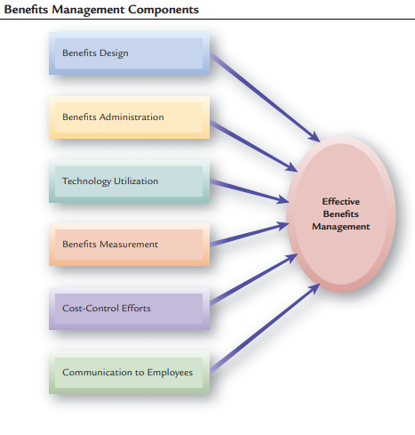
BENEFITS MANAGEMENT COMPONENTS
Figure 14-3

Slide 9
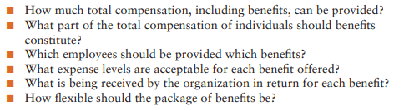
BENEFITS MANAGEMENT COMPONENT
1. Benefits Design
Chapter
14
A number of key decisions are part of benefits design:

Slide 10
1. Benefits Design Cont.
Chapter
14
Part-Time Employee Benefits
Research indicate that providing benefits for par timers positively affects ability to attract and retain part-time workers in tight labor markets.
Flexible benefits plan
Program that allows employees to select the benefits they prefer from groups of benefits established by the employer.
Adverse selection
Situation in which only higher-risk employees select and use certain benefits.

Slide 11
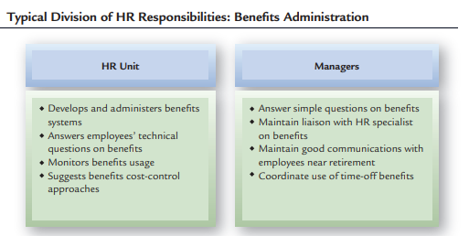
2. HR and Benefits Administration

Slide 12

Chapter
3. HR Technology and Benefits
14
Internet-based systems are being used to communicate benefits information, conduct employee benefit.
Information technology also allows employees to change their benefits choices, track their benefits balances, and submit questions to HR staff members and external benefits providers.

Slide 13
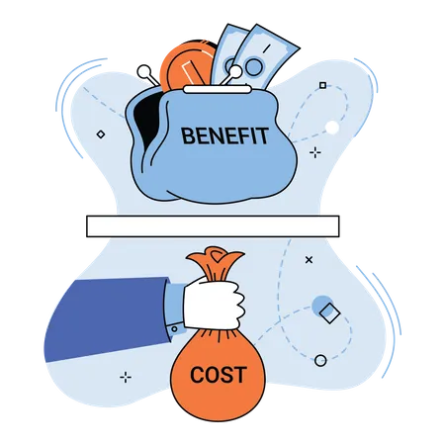
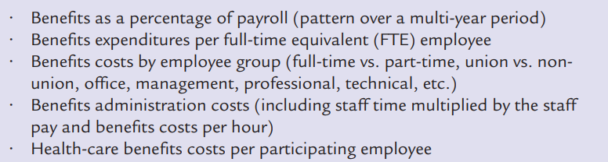
4. Benefits Measurement

Slide 14
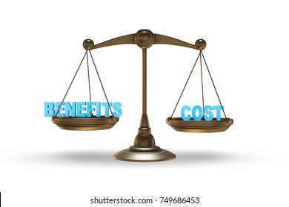
5. Benefits Cost Control
The most common means of benefits cost control is cost sharing, which refers to having employees pay more of their benefits costs.
Almost 60% of firms use this means.
Chapter
14

Slide 15


Chapter
Benefits Communication
14
Research shows that employees do not understand the value of benefits.
Benefits communication and satisfaction of employees with their benefits are linked.
Consequently, many employers have instituted special benefits communication systems to inform employees about the value of the benefits they provide.
Employers can use various means, including videos, electronic alerts, newsletters, and employee meetings. All these efforts are done to ensure that employees are knowledgeable about their benefits.

Slide 16
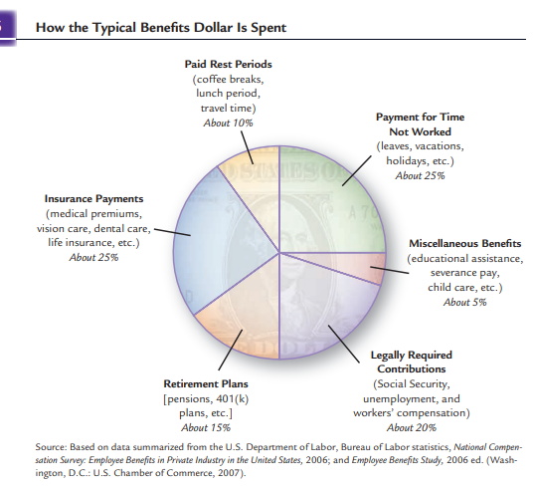
TYPES OF BENEFITS
1. Government-Mandated Benefits
Figure 14-4

Slide 17

Chapter
2. SECURITY BENEFITS
14
Workers’ compensation Security benefits provided to persons injured on the job.
Unemployment Compensation: Officially known as the Emergency Subsidy, establishes a fund to compensate workers/employees whose wages are suspended due to firm closure or downsizing.
Severance pay Security benefit voluntarily offered by employers to individuals whose jobs are eliminated or who leave by mutual agreement with their employers.

Slide 18
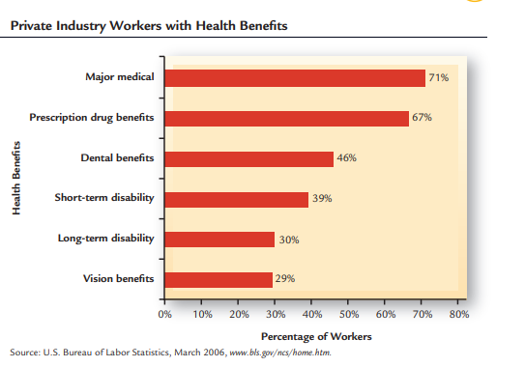
3. HEALTH-CARE BENEFITS
Figure 14-5

Slide 19
Chapter
4. RETIREMENT BENEFITS
14
Pension plan Retirement program established and funded by the employer and employees.
  Defined-Benefit Pension Plans A “traditional” pension plan, in which the employer makes the contributions and the employee will get a defined amount each month upon retirement, is no longer the norm in the private sector.
  Defined-contribution plan Retirement program in which the employer makes an annual payment to an employee’s pension account.
  Cash balance plan Retirement program in which benefits are based on an accumulation of annual company contributions plus interest credited each year.

Slide 20
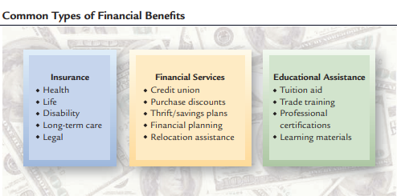
5. FINANCIAL BENEFITS
Figure 14-6

Slide 21

Chapter
6. FAMILY-ORIENTED BENEFITS
14
Family and Medical Leave Act

Slide 22
Chapter
6. FAMILY-ORIENTED BENEFITS CONT.
14
2. Family-Care Benefits
Adoption Benefits Many employers provide maternity and paternity benefits to employees who give birth to children.
Child-Care Assistance Balancing work and family responsibilities is a major challenge for many workers.
Elder-Care Assistance Another family issue of importance is caring for elderly relatives.

Slide 23
OTHER BENEFITS
Paid-Time-Off
Time-off benefits represent a significant portion of total benefits costs.
Employers give employees paid time off for a variety of circumstances.
Paid lunch breaks and rest periods, holidays, and vacations are common.

Slide 24

Chapter
Paid-Time-Off Cont.
14
Well-pay Extra pay for not taking sick leave.
Well-pay Extra pay for not taking sick leave.
Paid-time-off (PTO) plans that combine all sick leave, vacation time, and holidays into a total number of hours or days that employees can take off with pay.

Slide 25

Chapter
SICK LEAVES
14
An employee whose sickness is established and determined by the concerned medical responsible is entitled to sick leave, and shall be compensated according to the Social Insurance Law for example, as follows
1 + - month fully paid every 3 years
3 + - month 75 + -% paid of the wage
8 + - months unpaid

Slide 26
Other Benefits
NON STATUARY BENEFITS
Chapter
14
Business Travel
Car Allowance
Housing
Club Membership
Company Cars
Company Gym
Company Loans
Company Picnics or Social Events
Compassionate days off
Education Allowance
Education assistance to employees
Fuel allowance for private car usage
Furniture Allowance (expatriates)
Gymnasium membership
Non-statutory benefit programs should always be developed in alignment with the company culture, structure, budget, strategy, philosophy, mission, vision and values.
Upon deciding which benefits are to be used, the next step is to combine them with the compensation structure to generate the final compensation and benefits model.

Slide 27

Chapter
Miscellaneous Benefits
14
Employers offer a wide variety of miscellaneous benefits.
Some of the benefits are voluntary, meaning that employees can participate in them and pay for the costs themselves, often at group discount rates.
Various types of voluntary insurance programs are the most common offered.

Slide 28

Chapter
HEALTH, SAFETY, AND SECURITY
14
Health
  A general state of physical, mental, and emotional well-being.
Safety
  A condition in which the physical well-being of people is protected.
Security
  The protection of employees and organizational facilities.

Slide 29
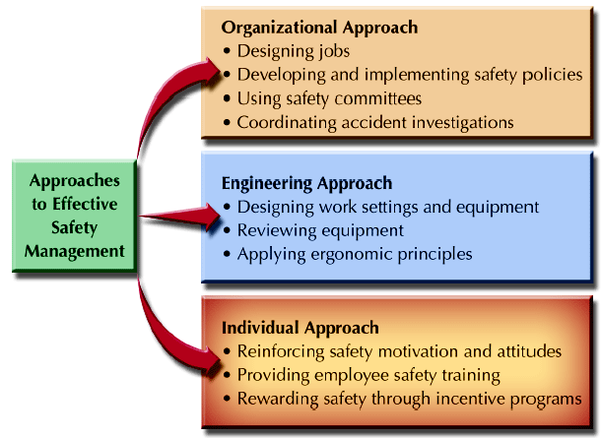
Approaches to Effective Safety Management
Figure 14-7

Slide 30

OTHER SAFETY ISSUES
Safety Policies
and Discipline
Safety
Committees
Employee
Motivation
and Incentives
Safety Training
and
Communications

Slide 31

Phases of Accident Investigation
Figure 14-8

Slide 32

Workplace Health issues
Smoking
at Work
Emotional/
Mental Health Concerns
Workplace
Air Quality

Slide 33
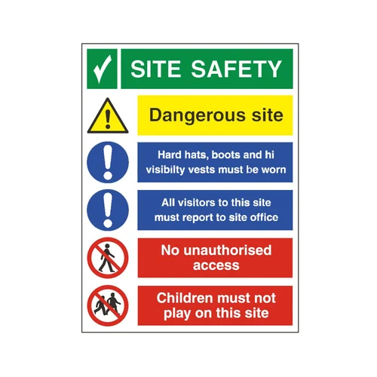

Slide 34
Workplace Violence
Domestic
Causes
Management Responses
Workplace
Violence
Issues
Training in Detection and Prevention

Slide 35
Chapter
SECURITY
14
Top Eight Security Concerns at Work:
  Workplace violence
  Internet/intranet security
  Business interruption/disaster recovery
  Fraud/white collar crime
  Employee selection/screening concerns
  General employee theft
  Unethical business conduct
  Computer hardware/software theft

Slide 36
SECURITY MANAGEMENT
Security
Audit
Controlled Access
Workplace
Security
Computer
Security

Slide 37
Chapter
Balancing Employer Security Concerns & Employee Rights
14
Right to Privacy
  Defined in legal terms for individuals as the freedom from unauthorized and unreasonable intrusion into their personal affairs.
Privacy Rights and HR Records:
  Access to personal information held by employer
  Response to unfavorable information in records
  Correction of erroneous information
  Notification when information is given to a third party

Slide 38

Chapter
Employee Records
14
HR Records’ Security
  Restrict access to all HR records
  Utilize confidential passwords to HRIS databases
  Place sensitive information in separate files and restricted databases
  Inform employees of types of data to retain
  Purge outdated data from records
  Release information only with employee’s consent

Slide 39
Chapter
SUMMARY
14
BENEFIT
BENEFITS AND HR STRATEGY
  Competitive Advantage
  Workforce Attraction and Retention
  Benefits management components
  Benefits Communication
TYPES OF BENEFITS
HEALTH, SAFETY, AND SECURITY
APPROACHES TO EFFECTIVE SAFETY MANAGEMENT
WORKPLACE HEALTH ISSUES
WORKPLACE VIOLENCE
SECURITY MANAGEMENT

Slide 40



Thank You

