Slide 1


Hybrid
LSTM–XGBoost Model for Gold Price Forecasting
Raed Abdalnaser Tattan
MSC in Artificial Intelligence – Midocean University
Supervisor: Dr. Wessam Ahmed
Notes:
This thesis proposes a hybrid AI framework for gold price forecasting.

Slide 2
Agenda
Introduction & Background
Research Contribution
Related Work
Methodology
Data, Hardware & Software
Results & Analysis
Conclusion & Future Work
References
Notes:
Brief overview of the presentation structure.

Slide 3
introduction
Gold price forecasting is critical for investors and policymakers
Gold markets exhibit high volatility and non-linear dynamics
Recent AI developments support hybrid forecasting models
Notes:
Brief overview of the presentation structure.

Slide 4
Background
Traditional statistical models
(e.g., ARIMA, GARCH) struggle to handle
gold price volatility and non-linearity
Machine learning and deep learning models
improve prediction accuracy but often face
limitations when used independently
Recent research highlights the need for
hybrid and explainable AI approaches
for robust gold price forecasting
Notes:
Brief overview of the presentation structure.

Slide 5
Problem Statement
Traditional ML ignores long-term temporal dependencies
Standalone DL models often suffer from instability in volatile markets
Single-model approaches are insufficient
Notes:
Each approach solves part of the problem, not all of it.

Slide 6
Research Challenge
Gold prices change a lot and are hard to predict
Traditional ML models do not capture time patterns well
Deep learning models alone can be unstable
Using a single model is often not enough
Many AI models are hard to explain
Notes:
Each approach solves part of the problem, not all of it.

Slide 7
Objectives
Develop a hybrid AI model
Improve prediction accuracy and stability
Capture both trends and sudden market changes
Compare hybrid model with single models
Notes:
Focus on robustness rather than only minimizing error.

Slide 8
Key Contributions
Hybrid LSTM–XGBoost (Residual Learning)
Comparison of ML, DL, and Hybrid models
Notes:
The novelty lies in residual-based hybridization.

Slide 9
Related Work
Study (Author, Year) | Model | Dataset | Labeling | Key Findings | Limitations
Cohen & Aiche (2023) | XGBoost, RF, GBRT | Gold price + 38 stock indices, bonds, VIX | Gold price (USD) | XGBoost achieved best numerical accuracy | Ignores long-term temporal dependencies
Jabeur et al. (2024) | XGBoost + SHAP | Gold price + macro-financial indicators | Gold price (USD) | Strong prediction with model interpretability | Focused on feature importance, not temporal modeling
Varshini et al. (2024) | ML vs DL models | Gold & metal price time series | Gold price (USD) | Nonlinear models outperform linear regressions | No hybrid residual modeling
Amini & Kalantari (2024) | CNN–BiLSTM | Historical gold prices | Gold price (USD) | DL models capture complex temporal patterns | High complexity and instability under volatility
Yurtsever (2021) | LSTM, BiLSTM, GRU | Historical gold prices | Gold price (USD) | DL outperforms traditional ML models | Requires long historical windows

Slide 10
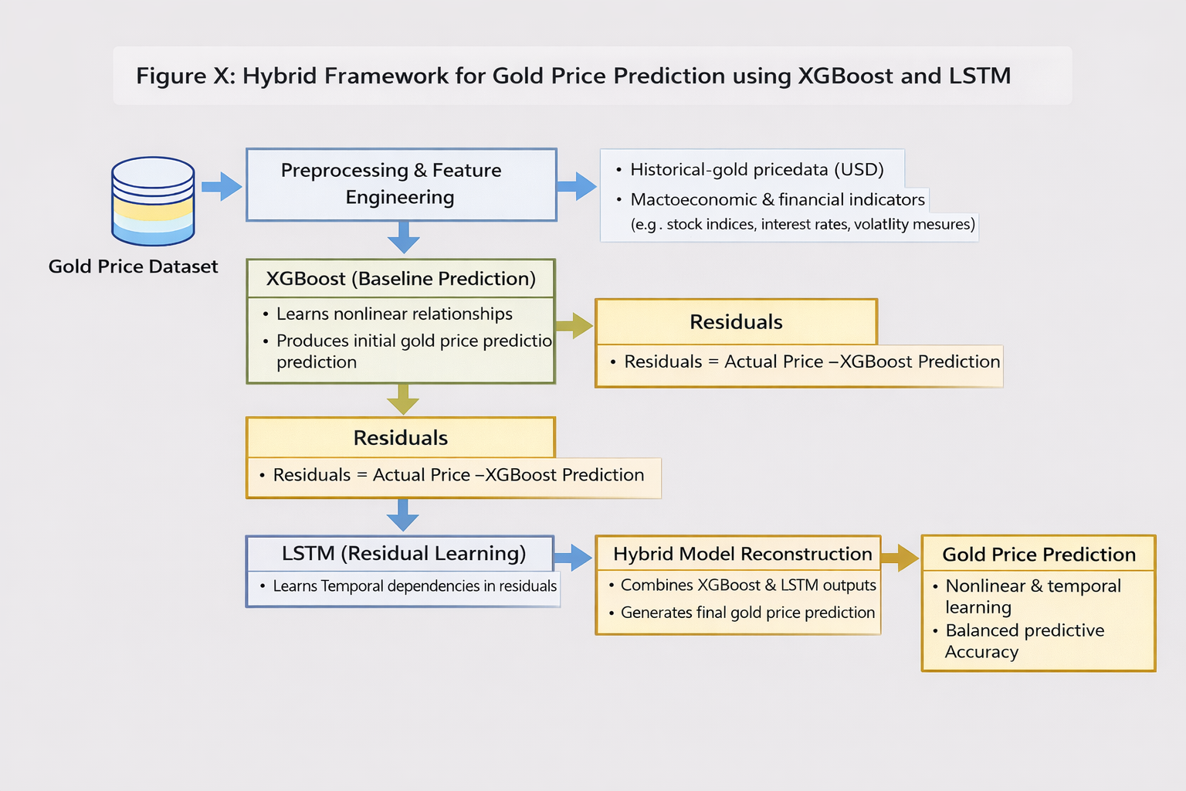
Methodology
Notes:
Sequential hybrid design.

Slide 11
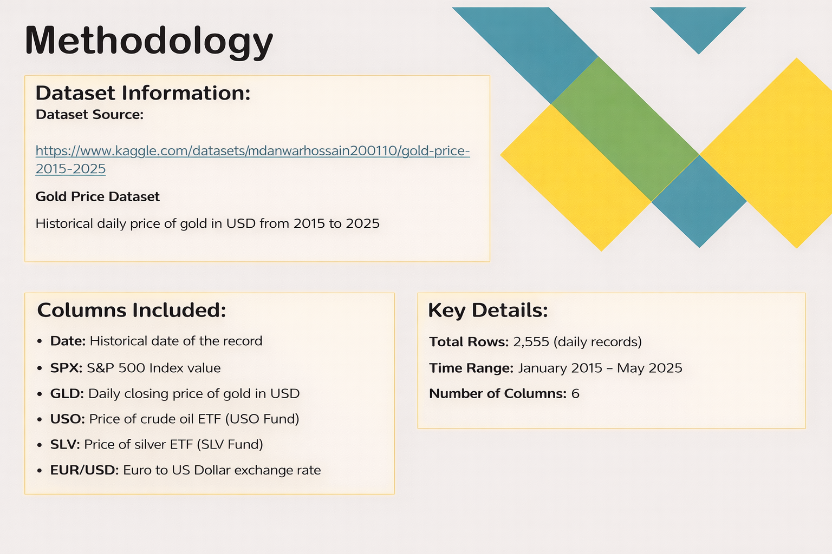
Notes:
Sequential hybrid design.

Slide 12
Hardware and Software
Hardware :
  Computing Environment: Jupyter Notebook (Anaconda)
Software :
  Python Libraries: pandas, numpy
  Data Visualization: matplotlib, seaborn
  Machine Learning: scikit-learn, xgboost
  Deep Learning (LSTM): tensorflow, keras
Notes:
Sequential hybrid design.

Slide 13
Dataset Split used in Experiments
Dataset Split | Time Period | Number of Samples
Training | 2015 – 2021 | 1697
Validation | 2022 – 2023 | 501
Testing | 2024 – 2025 | 405
Notes:
Each model plays a complementary role.

Slide 14
Regression Models Performance (RMSE / MAE)
Model | RMSE | MAE
XGBoost | 0.3723 | 0.1261
LSTM | 2.8100 | 2.1000
Hybrid Residual (XGB + LSTM) | 0.3800 | 0.1350
Target-Oriented Model Strength (Directional Accuracy)
Model | Directional Accuracy (%)
XGBoost | 98.66
LSTM | 47.00
Hybrid Residual (XGB + LSTM) | 98.66
Notes:
Each model plays a complementary role.

Slide 15
CONCLUSION AND FUTURE WORK
Conclusion
  Hybrid LSTM–XGBoost improved gold price forecasting accuracy
  Captured temporal patterns and nonlinear relationships
  Outperformed individual models in accuracy and direction
Future Work
  Include macroeconomic and sentiment features
  Explore transformer-based models
  Apply the framework to other markets
Notes:
No single model dominates all metrics.

Slide 16
References
[1] Chen, T., & Guestrin, C. (2016). XGBoost: A scalable tree boosting system. Proceedings of the 22nd ACM SIGKDD International Conference on Knowledge Discovery and Data Mining, 785–794.
[2] Hochreiter, S., & Schmidhuber, J. (1997). Long short-term memory. Neural Computation, 9(8), 1735–1780.
[3] Hajirahimi, Z., & Khashei, M. (2019). Hybrid structures in time series modeling and forecasting: A review. Engineering Applications of Artificial Intelligence, 86, 83–106.
[4] Chai, T., & Draxler, R. R. (2014). Root mean square error (RMSE) or mean absolute error (MAE)? Geoscientific Model Development, 7(3), 1247–1250.
Notes:
A simplified comparison highlighting strengths of each model.

