Slide 1



Artificial Intelligence
by Samara Jasim
LAW614
Lecture 3

Slide 2




Lecture
Artificial Intelligence
03
What do we mean by Artificial Intelligence?
AI is a term used for a computer-based algorithm that can analyze, strategize, and draw conclusions to complete tasks typically performed by humans.

Slide 3

Lecture
INTRODUCTION TO AI IN DIGITAL LAW
03
a. OVERVIEW
The age of artificial intelligence is dawning, and its influence is already widespread across various domains. From medical diagnosis to driving directions, stock trading to social networking, and even policing, AI is making its presence felt.
While the exact shape of the AI-influenced future remains uncertain, there is a widespread assumption that its impacts will be profound. As stated by the European Commission in 2018, "The way we approach AI will define the world we live in."

Slide 4
Lecture
INTRODUCTION TO AI IN DIGITAL LAW
03
a. OVERVIEW
AI brings forth numerous profound implications, challenging existing laws, corporate and government policies, and ethical considerations. Courts are grappling with the task of applying traditional legal doctrines to complex and seemingly unexplainable systems. Policymakers face the decision of whether to modify existing regulations specifically to address AI.

Slide 5
Lecture
INTRODUCTION TO AI IN DIGITAL LAW
03
a. OVERVIEW
In order to determine the necessary policies, officials at all levels and branches of government must have access to technical expertise in AI. They require translators who can effectively explain the underlying technology of AI.

Slide 6
Lecture
INTRODUCTION TO AI IN DIGITAL LAW
03
a. OVERVIEW
While AI poses significant legal issues, it is crucial to recognize that many traditional doctrines and general statutes could address these issues or serve as a starting point for response.
Rather than creating technology-specific rules, it is generally more effective to develop sound rules first and then apply them to computer innovations.

Slide 7
Lecture
INTRODUCTION TO AI IN DIGITAL LAW
03
a. OVERVIEW
AI can be loosely defined as a computerized system that exhibits behavior commonly associated with intelligence. It can solve complex problems in a rational manner and take appropriate actions to achieve its goals, regardless of real-world circumstances.
Artificial intelligence refers to systems that display intelligent behavior by analyzing their environment and autonomously taking actions to achieve specific goals.

Slide 8

Lecture
INTRODUCTION TO AI IN DIGITAL LAW
03
a. OVERVIEW
Narrow AI is already pervasive in various areas:
Wall Street relies on AI for trades, credit scoring, resume evaluation, and interpreting x-rays.
AI is being integrated into policing and the criminal justice system.
Self-driving cars, robotic surgical equipment, and medical diagnostic systems prominently feature AI.
Your phone employs AI to provide word prompts while composing texts and uses it in navigational software to determine the fastest route home.

Slide 9
Lecture
INTRODUCTION TO AI IN DIGITAL LAW
03
a. OVERVIEW
Online chat bots, which interpret users' questions and provide answers akin to human customer service representatives, are powered by AI.
Google search and Facebook's content recommendation algorithm rely on AI, while Amazon suggests books, Netflix recommends movies, and Spotify creates playlists using AI.
Google's search engine incorporates AI-based language translation, and this technology is widely available in other services.

Slide 10

Lecture
INTRODUCTION TO AI IN DIGITAL LAW
03
b. IMPORTANCE & APPLICATION OF AI IN LEGAL FIELD
The realm of digital legal tools has progressed far beyond the pioneering days of Westlaw and LexisNexis, as artificial intelligence (AI) now introduces new instruments that not only enhance efficiency but also catalyze a transformative leap within the legal profession.
Presently, the most advanced AI tools on the market primarily rely on two distinct technologies, either individually or in combination: Natural Language Processing (NLP) and Automation.

Slide 11
Lecture
INTRODUCTION TO AI IN DIGITAL LAW
03
b. IMPORTANCE & APPLICATION OF AI IN LEGAL FIELD
Natural Language Processing involves the ability to comprehend language in its natural form, be it a legal contract or a spoken question. Recent advancements in computer power have enabled cutting-edge machine learning tools to utilize statistical pattern recognition techniques and generate their own rules, known as "predictive algorithms," through vast amounts of examples.

Slide 12

Lecture
INTRODUCTION TO AI IN DIGITAL LAW
03
b. IMPORTANCE & APPLICATION OF AI IN LEGAL FIELD
For instance, a system exposed to a collection of documents and their translations into another language can discern statistical patterns between them, allowing for translation without necessitating an understanding of individual word meanings or underlying grammar rules. Within the legal profession, NLP is employed to extract key information from extensive document sets or for contract review.

Slide 13
Lecture
INTRODUCTION TO AI IN DIGITAL LAW
03
b. IMPORTANCE & APPLICATION OF AI IN LEGAL FIELD
Automation, on the other hand, revolves around technologies that execute tasks based on predefined rules. Many of these systems utilize decision trees, which are flowcharts featuring a series of questions. The answers to these questions determine the subsequent branches followed, ultimately leading to a conclusion or decision. Decision trees can be crafted by lawyers or algorithmically derived by computers based on training data. Such systems typically offer advice in specific matters or aid in document drafting.

Slide 14
Lecture
INTRODUCTION TO AI IN DIGITAL LAW
03
b. IMPORTANCE & APPLICATION OF AI IN LEGAL FIELD
Conversational interfaces and bots represent another stride in AI development. By combining natural language processing tools with automation tools, systems capable of understanding questions, extracting relevant information, navigating decision trees, and even generating initial drafts of required documents can be created. There is considerable emphasis in this domain on developing bots to address access to justice challenges or chatbot applications for dispensing simple advice.

Slide 15
Lecture
INTRODUCTION TO AI IN DIGITAL LAW
03
b. IMPORTANCE & APPLICATION OF AI IN LEGAL FIELD
It is important to note that AI is not meant to replace lawyers, but rather serves as a potent and indispensable complement to augment their effectiveness and enhance the quality of their work. However, for this complementary relationship to yield positive and successful outcomes, a shift in mentality, modifications to the existing model, and a review of internal and external interactions within the legal realm are necessary.

Slide 16
Lecture
INTRODUCTION TO AI IN DIGITAL LAW
03
b. IMPORTANCE & APPLICATION OF AI IN LEGAL FIELD
AI and Law Firms, Courts, and In-House Lawyers:
AI and Law Firms
International law firms are leading the way in embracing AI and advanced technology tools to enhance their service delivery to clients. They have been utilizing e-discovery software for document review and employing contract/documents review tools to search for specific information or clauses within documents.

Slide 17
Lecture
INTRODUCTION TO AI IN DIGITAL LAW
03
b. IMPORTANCE & APPLICATION OF AI IN LEGAL FIELD
AI and Law Firms, Courts, and In-House Lawyers:
AI and Law Firms
The use of automated drafting tools is also on the rise, enabling clients to generate tailor-made, house-styled documents quickly and independently through direct platform access. Furthermore, in highly regulated sectors, automated advice systems are being employed to provide preliminary guidance, utilizing decision tree technology to process large amounts of data and present weighted options for lawyers to make informed decisions.

Slide 18
Lecture
INTRODUCTION TO AI IN DIGITAL LAW
03
b. IMPORTANCE & APPLICATION OF AI IN LEGAL FIELD
AI and Law Firms, Courts, and In-House Lawyers:
AI and Courts
In the realm of courts, the application of AI-powered legal technology tools has the potential to significantly impact how judicial services are managed and delivered. However, it is crucial that judges using these tools have a clear understanding of their functioning, limitations, and potential errors, and receive appropriate instructions for their proper usage. When applied correctly, AI can expedite and enhance the processing of the judicial workload, making it more efficient.

Slide 19
Lecture
INTRODUCTION TO AI IN DIGITAL LAW
03
b. IMPORTANCE & APPLICATION OF AI IN LEGAL FIELD
AI and Law Firms, Courts, and In-House Lawyers:
AI and In-House Lawyers
The implementation of AI and digital tools is an ongoing process that companies are progressively exploring. Although there is still a long way to go, many companies, at present, may not be fully capitalizing on the benefits that AI can bring. These tools are essential for in-house legal teams to increase efficiency and improve quality.

Slide 20
Lecture
INTRODUCTION TO AI IN DIGITAL LAW
03
b. IMPORTANCE & APPLICATION OF AI IN LEGAL FIELD
AI and Law Firms, Courts, and In-House Lawyers:
AI and In-House Lawyers
For large international companies like Enel or Vodafone, AI holds the potential to facilitate collaboration among teams across different countries, fostering a global perspective within the legal domain.

Slide 21
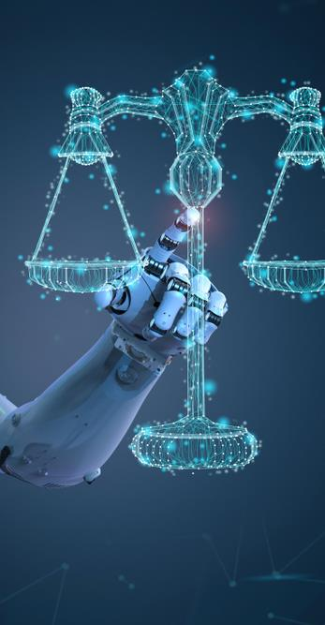
Lecture
INTRODUCTION TO AI IN DIGITAL LAW
03
BENEFITS OF AI IN THE LEGAL FIELD
AI has emerged as a valuable asset in the legal field, empowering lawyers to perform their tasks with increased efficiency, enhanced insights into the legal domain, and reduced costs. While current AI technology has its limitations, its potential in the legal industry is virtually limitless.
In the realm of in-house legal departments, AI is still in its early stages, yet it has already proven its worth in various areas, such as legal research and contract development, with many more applications on the horizon.

Slide 22
Lecture
INTRODUCTION TO AI IN DIGITAL LAW
03
BENEFITS OF AI IN THE LEGAL FIELD
The incorporation of AI into legal practice brings forth numerous advantages. It significantly saves time by automating repetitive tasks, allowing for earlier and more accurate risk assessments. AI's capabilities in providing in-depth analysis and identifying patterns that may elude human counterparts result in higher quality work.
Furthermore, AI tools contribute to improving the organizational structure within legal departments by streamlining processes and enhancing overall efficiency.

Slide 23
Lecture
INTRODUCTION TO AI IN DIGITAL LAW
03
BENEFITS OF AI IN THE LEGAL FIELD
By taking over routine tasks, AI enables legal professionals to focus on more creative and analytical aspects of their work, fostering innovation and strategic thinking. Additionally, AI helps mitigate the risk of burnout by alleviating the burden of time-consuming administrative duties.

Slide 24
Lecture
INTRODUCTION TO AI IN DIGITAL LAW
03
BENEFITS OF AI IN THE LEGAL FIELD
As AI technology continues to advance, its potential to revolutionize the legal field becomes increasingly evident. Its capacity to enhance speed, accuracy, and quality presents promising opportunities for lawyers and legal departments to optimize their performance and deliver greater value to their clients. The ongoing development of AI holds the key to unlocking new levels of productivity, efficiency, and innovation within the legal profession.

Slide 25
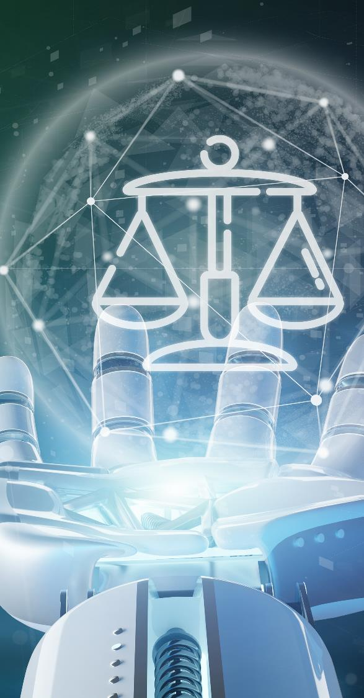
Lecture
INTRODUCTION TO AI IN DIGITAL LAW
03
RISKS OF AI IN THE LEGAL FIELD
While AI has proven to be valuable in the legal field, human supervision remains essential, and critical questions need to be raised before deciding to adopt an AI application. It is crucial to understand how the tool operates, be aware of potential errors, and consider the costs associated with such errors.

Slide 26
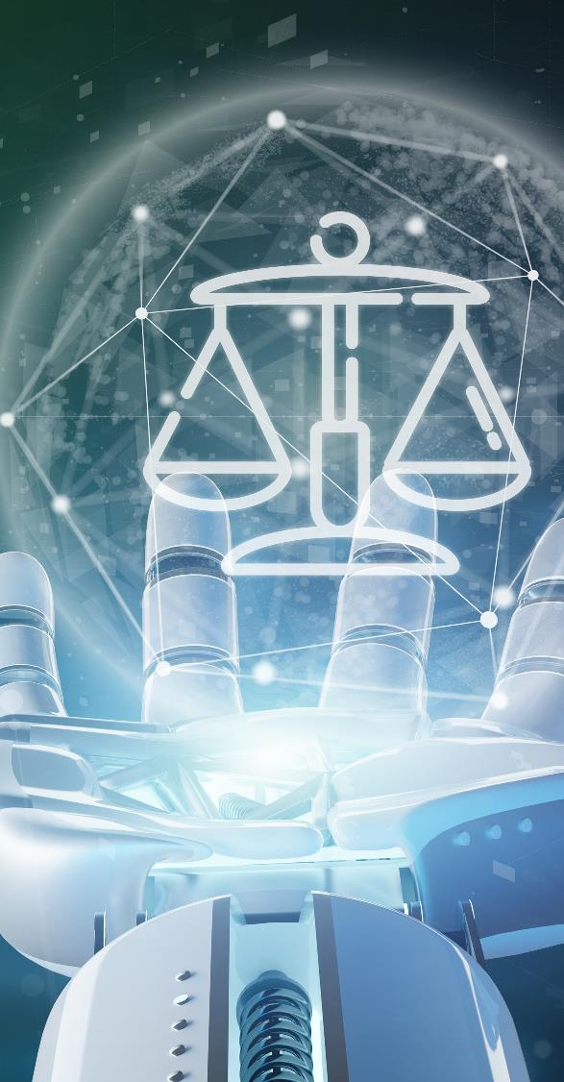
Lecture
INTRODUCTION TO AI IN DIGITAL LAW
03
RISKS OF AI IN THE LEGAL FIELD
There are several risks that have been identified in relation to AI implementation in the legal domain. These risks include job displacement, susceptibility to cyber-attacks, economic constraints, the need for trained lawyers to effectively use AI tools, concerns regarding intellectual property rights, privacy and data protection, as well as ethical considerations.
However, the European Union has adopted a human-centric approach to AI, as reflected in forthcoming legislation. This approach aims to deploy AI in a manner that enhances human capabilities rather than replacing humans.

Slide 27
Lecture
INTRODUCTION TO AI IN DIGITAL LAW
03
RISKS OF AI IN THE LEGAL FIELD
By prioritizing human-centric deployment, the EU seeks to strike a balance between leveraging the benefits of AI and addressing potential risks. It recognizes the importance of upholding human involvement, expertise, and ethical considerations in AI-driven processes. This approach aligns with the goal of deploying AI technologies as tools to support and augment human capabilities, rather than undermining the role of humans in legal practice.

Slide 28
Lecture
INTRODUCTION TO AI IN DIGITAL LAW
03
RISKS OF AI IN THE LEGAL FIELD
While challenges and risks exist, careful consideration, regulation, and a human-centric approach can help mitigate these concerns and ensure that AI technology is harnessed effectively and ethically to enhance the legal profession.

Slide 29
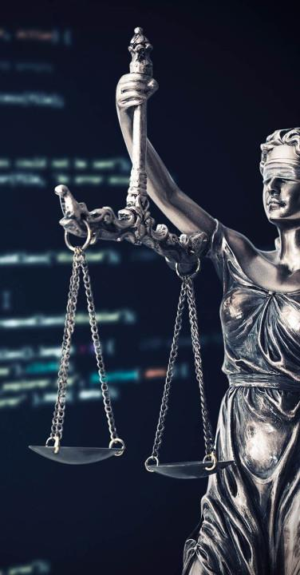
Lecture
INTRODUCTION TO AI IN DIGITAL LAW
03
CURRENT REGULATORY LANDSCAPE FOR AI IN DIFFERENT JURISDICTIONS
The EU's proposed regulatory framework for AI is influencing other jurisdictions as they consider their own approaches to AI governance. This influence is particularly notable in jurisdictions like Singapore, where similar core principles and approaches are already in place, emphasizing transparency, accuracy, human oversight, and a risk-sensitive approach.

Slide 30
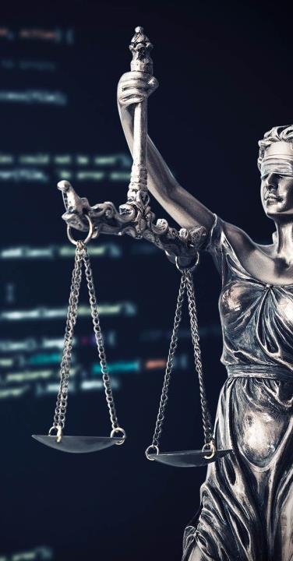
Lecture
INTRODUCTION TO AI IN DIGITAL LAW
03
CURRENT REGULATORY LANDSCAPE FOR AI IN DIFFERENT JURISDICTIONS
Regarding the United Kingdom, its position on AI matters post-Brexit is still evolving. However, the UK has expressed its ambition to be a global leader in AI. The UK House of Lords has cautioned against relying solely on self-regulation, where organizations develop their own ethical AI codes of conduct, as this approach may lack uniformity and enforceability.

Slide 31
Lecture
INTRODUCTION TO AI IN DIGITAL LAW
03
CURRENT REGULATORY LANDSCAPE FOR AI IN DIFFERENT JURISDICTIONS
In the United States, the Federal Trade Commission (FTC), which oversees general consumer protection, is closely monitoring companies' use of AI. The FTC has specifically expressed concerns regarding AI systems that may lead to discrimination against protected classes, such as based on race or gender. In line with principles outlined in the EU AI Act, the FTC has provided guidance for businesses to follow when deploying AI, emphasizing transparency and monitoring. Additionally, US banking regulators are seeking feedback on the use of AI by financial institutions, suggesting that further guidance may be forthcoming in this sector.

Slide 32
Lecture
INTRODUCTION TO AI IN DIGITAL LAW
03
CURRENT REGULATORY LANDSCAPE FOR AI IN DIFFERENT JURISDICTIONS
Overall, the EU's proposed AI regulatory framework is creating a ripple effect in other jurisdictions, shaping discussions and influencing the development of regulatory regimes for AI. As countries grapple with the challenges and opportunities presented by AI, they are looking to the EU and other leaders in the field for guidance and best practices in ensuring responsible and beneficial AI deployment.

Slide 33

Lecture
INTRODUCTION TO AI IN DIGITAL LAW
03
ACCOUNTABILITY, LIABILITY, AND RESPONSIBILITY IN AI SYSTEMS
Currently, there is no universal consensus on ethical issues in AI. The perspective on ethical considerations often varies depending on the specific use case of AI and the stakeholders involved, such as customers and regulators. Over the years, numerous sectorial papers on ethics and AI have been published by various stakeholders at the national, European, and international levels.

Slide 34

Lecture
INTRODUCTION TO AI IN DIGITAL LAW
03
ACCOUNTABILITY, LIABILITY, AND RESPONSIBILITY IN AI SYSTEMS
The guidelines emphasize the importance of developing and deploying AI systems that are human-centric and adhere to key ethical requirements. These requirements include:
1. Human agency and oversight: To ensure fundamental rights are not compromised, a fundamental rights impact assessment should be conducted before developing an AI system. Mechanisms should also be established to allow external feedback on any potential infringement of fundamental rights.

Slide 35

Lecture
INTRODUCTION TO AI IN DIGITAL LAW
03
ACCOUNTABILITY, LIABILITY, AND RESPONSIBILITY IN AI SYSTEMS
User interaction with AI systems should be sufficiently understandable and meaningful, and individuals should not be subject to decisions based solely on automated processing. Additionally, human oversight should always be in place, allowing humans the ultimate authority to override decisions made by AI systems. AI developers should consider implementing technical measures to ensure human oversight when designing their products or services.

Slide 36

Lecture
INTRODUCTION TO AI IN DIGITAL LAW
03
ACCOUNTABILITY, LIABILITY, AND RESPONSIBILITY IN AI SYSTEMS
2. Transparency: Transparency is crucial for preventing bias in AI systems. Lack of transparency, coupled with the absence of traceability, can lead to loss of control and consent in data usage. When data are accessed or shared, they move outside the control of the original data holder, limiting their ability to control how the data are reused. To address this, AI guidelines should introduce measures to ensure transparency in the AI industry.

Slide 37
Lecture
INTRODUCTION TO AI IN DIGITAL LAW
03
ACCOUNTABILITY, LIABILITY, AND RESPONSIBILITY IN AI SYSTEMS
3. Diversity, non-discrimination, and fairness: While AI surpasses human capabilities in terms of speed and processing capacity, it cannot always be trusted to be fair and unbiased. The filters used during algorithm development, along with the data employed, can potentially introduce discriminatory elements

Slide 38
Lecture
INTRODUCTION TO AI IN DIGITAL LAW
03
ACCOUNTABILITY, LIABILITY, AND RESPONSIBILITY IN AI SYSTEMS
AI developers should strive to design algorithms that are unbiased and consult and involve stakeholders who may be directly or indirectly affected by AI systems. AI systems should be inclusive, considering a wide range of human abilities, skills, and requirements, and ensuring accessibility for individuals with disabilities.

Slide 39
Lecture
INTRODUCTION TO AI IN DIGITAL LAW
03
ACCOUNTABILITY, LIABILITY, AND RESPONSIBILITY IN AI SYSTEMS
The lack of legislation addressing artificial intelligence is a global concern. Regulators worldwide are recognizing the risks associated with the absence of a legal framework in this field. Consequently, regulatory authorities are actively developing legislation and ethical regulations to govern AI. The proposed EU AI Act is a groundbreaking initiative, aiming to establish harmonized rules for AI systems in the EU. It seeks to strike a balance between promoting innovation and reaping the benefits of AI while addressing the risks and concerns associated with it. The EU AI Act adopts a risk-based approach and takes into account sector-specific considerations to address the key challenges posed by AI.

Slide 40

Lecture
INTRODUCTION TO AI IN DIGITAL LAW
03
CONCLUSION
In conclusion, the implementation of AI in the legal field presents numerous benefits for all parties involved. However, it is crucial to conduct a thorough analysis of internal processes and the specific needs of the company to determine where AI can be effectively utilized, to what extent, and through which specific tools.

Slide 41
Lecture
INTRODUCTION TO AI IN DIGITAL LAW
03
CONCLUSION
This analysis is necessary to identify and address bottlenecks, as well as to reduce time spent on non-value-added tasks. It is important to note that there is no one-size-fits-all solution, and each decision to invest in AI must be tailored to the unique circumstances of each organization. Not all companies are the same, and their level of digitalization may vary, making it essential to adapt AI implementation strategies accordingly for optimal usefulness and effectiveness.

Slide 42




Thank You

