Slide 1


Entrepreneurship
Prepared by Dr. Thana Ahmed
Lecture 3
Inside the Entrepreneurial Mind:
From Ideas to Reality

Slide 2
Chapter
03
Learning Objectives
Describe the process of conducting an idea assessment.
1
Explain the elements of a feasibility analysis.
2
Describe the six forces in the macro environment of an industry.
3
Understand how Porter’s Five Forces Model assesses the competitive environment.
4

Slide 3
Learning Objectives
Describe the various methods of conducting primary and secondary market research.
1
Understand the four major elements of a financial feasibility analysis.
2
Describe the process assessing entrepreneur feasibility.
3
Describe the nine elements of a business model.
4
5
6
7
8

Slide 4

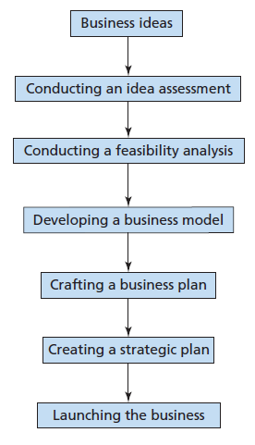
New Business Planning Process

Slide 5

Idea Assessment
Idea assessment: The process of examining a particular need in the market, developing a solution for that need, and determining the entrepreneur’s ability to successfully turn the idea into a business.

Slide 6
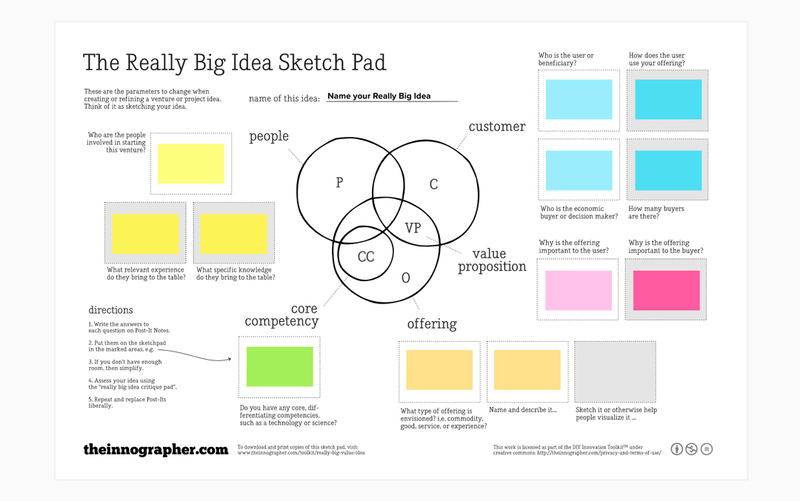
Idea Assessment
Idea sketch pad =
effective tool used to help assess ideas
It helps entrepreneurs assess ideas in a relatively short period of time

Slide 7
Idea Assessment
Use an idea sketch pad to ask key questions about:
  Customers
  Offering
  Value proposition
  Core competencies
  People

Slide 8

Idea sketch pad
Customers.
  Start with a group of customers who have a clear need that is not being addressed: this may be a need that no business is currently addressing, or it may be a need that no business is fully or adequately meeting for these customers.
  The entrepreneur assesses the customers by answering basic questions about the potential users of the product or service and the potential buyers if they are different than the users.
    Specifically who would be the users of the offering?
    How would they use the offering?
    How many potential customers are there?

Slide 10
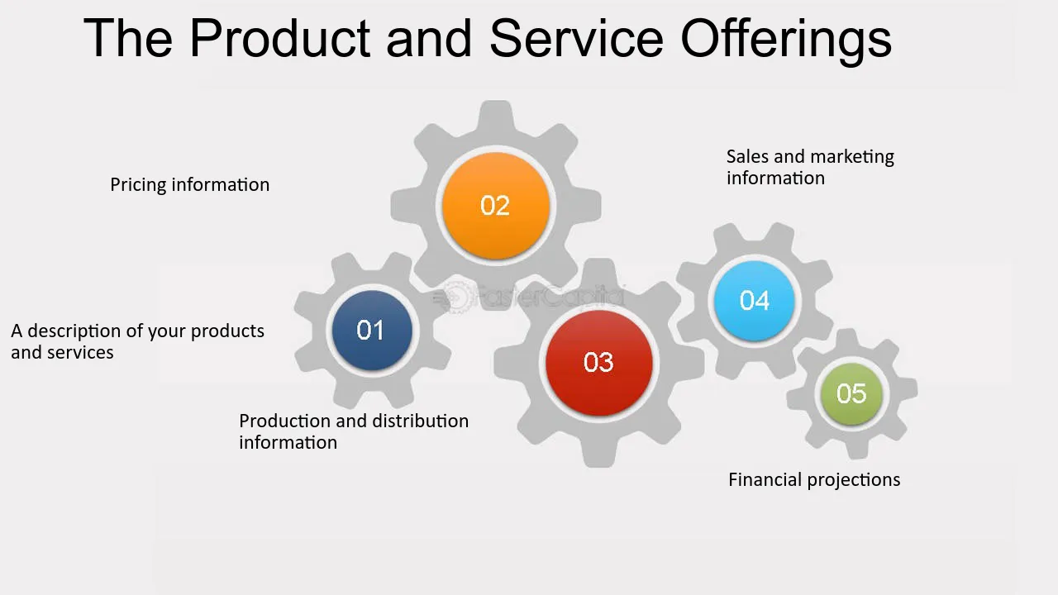
Idea sketch pad
Offering.
  Describe your idea for a product or service to offer the customers. Are you offering a product, a service, an experience, or a combination of one or more of these? What are its key features? Describe it in detail and sketch out an image of it if you can.

Slide 11
Idea sketch pad
Value proposition.
  Explain why your product or service will be important to the customers.
  Why would your offering be valuable to the user and/or buyer?
  How does it address the need these customers currently have that is not being met?

Slide 12
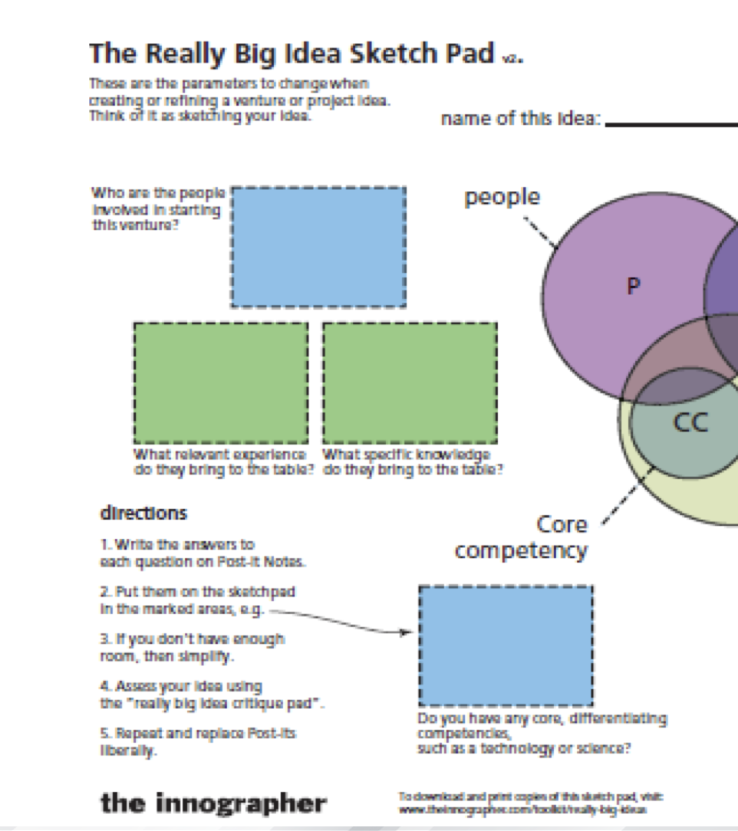
Idea sketch pad
Core competencies.
  Does your offering include any technologies or unique features that will help differentiate it from competitors? Is it based on intellectual property that you can protect?

Slide 13
Idea sketch pad
People.
  Identify the key people on the team who will launch this business.
  Who are the founding entrepreneurs of this venture?
  Do they have the skills and knowledge needed to successfully turn the idea into a start-up venture?
  Can they attract key team members who will fill in any gaps in knowledge, skills, and experience?

Slide 15
New Business Planning Process

Slide 16
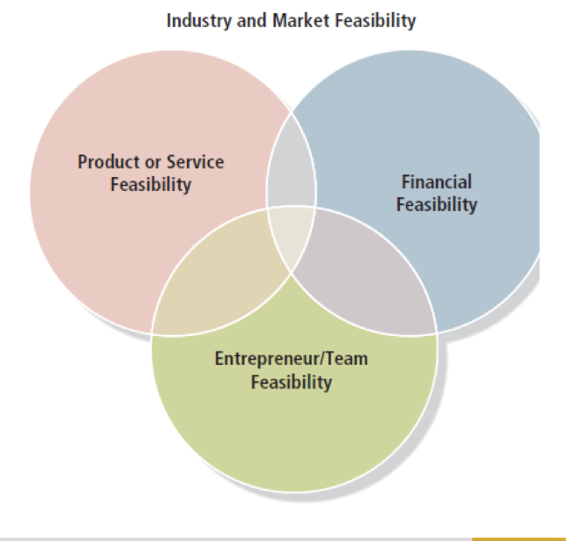
Feasibility Analysis
An analysis of the viability of a business idea that includes four interrelated components:
  An industry and market analysis,
  The product or service analysis,
  A financial analysis, and
  An entrepreneur analysis.

Slide 17

Feasibility Analysis
Is a particular idea a viable foundation for creating a successful business?
Feasibility study addresses the question: “Should we proceed with this business idea?”

Slide 18
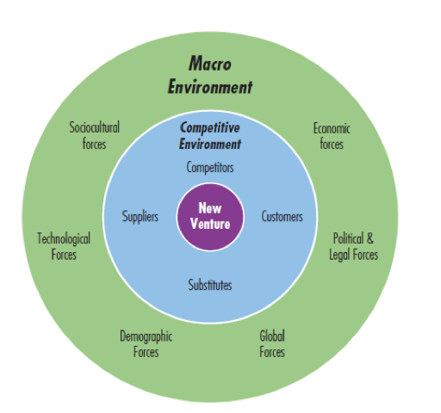
Environmental Forces and New Ventures
The first step in assessing industry attractiveness is to paint a picture of the industry in broad strokes, assessing it from a “macro” level.
Most opportunities for new businesses within an industry are due to changes taking place in that industry.

Slide 19
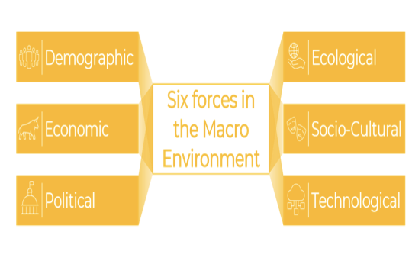
Industry and Market Feasibility Analysis
Assess industry attractiveness using six macro forces:
    Sociocultural
    Technological
    Demographic
    Economic
    Political and legal
    Global / Ecological

Slide 20
Industry and Market Feasibility Analysis
What threats does the industry face?
What opportunities does the industry face?
How crowded is the industry?
How intense is the level of competition in the industry?
Is the industry young, mature, or somewhere in between?
  How large is the industry?
  How fast is it growing?
  Is the industry as a whole profitable?
  Is the industry characterized by high profit margins or razor-thin margins?
  How essential are its products or services to customers?
  What trends are shaping the industry’s future?

Slide 21
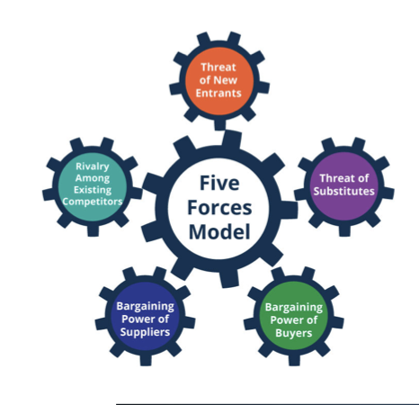
Porter’s Five Forces Model
Five forces interact with one another to determine the setting in which companies compete and, hence, the attractiveness of the industry:
    Rivalry among companies in the industry
    Bargaining power of suppliers
    Bargaining power of buyers
    Threat of new entrants
    Threat of substitute products or services

Slide 22
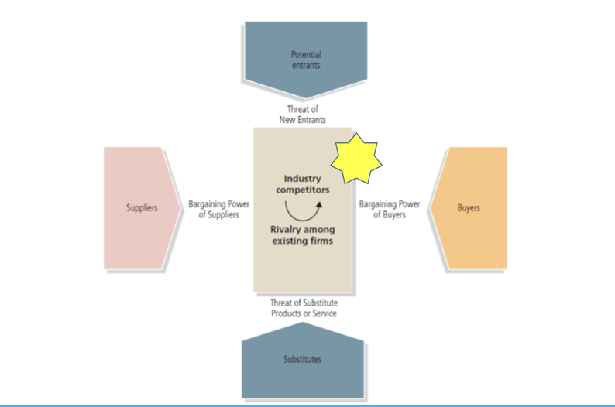
FIVE FORCES MODEL

Slide 23

Rivalry Among Companies
Strongest of the five forces
Industry is more attractive when:
  Number of competitors is large, or, at the other extreme, quite small
  Competitors are not similar in size or capacity
  Industry is growing fast
  Opportunity to sell a differentiated product or service exists

Slide 24
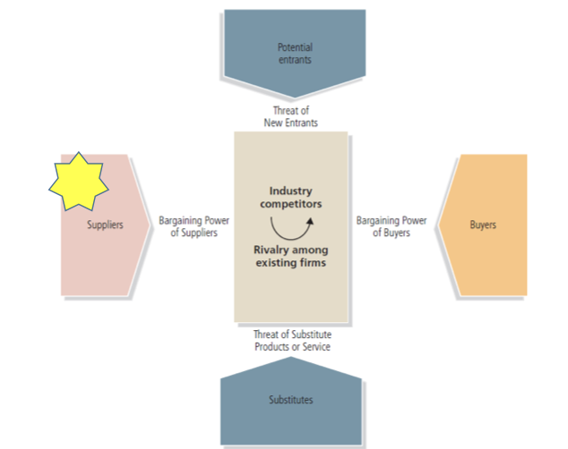
FIVE FORCES MODEL

Slide 25

Bargaining Power of Suppliers
The greater the leverage of suppliers, the less attractive the industry.
Industry is more attractive when:
  Many suppliers sell a commodity product
  Substitutes are available
  Switching costs are low
  Items account for a small portion of the cost of finished products

Slide 26
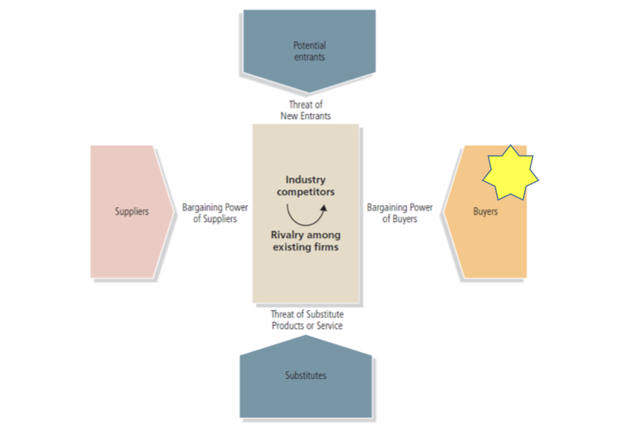
FIVE FORCES MODEL

Slide 27

Bargaining Power of Buyers
Buyers’ influence is high when number of customers is small and cost of switching to a competitor’s product is low.
Industry is more attractive when:
  Customers’ switching costs are high
  Number of buyers is large
  Customers want differentiated products
  Customers find it difficult to collect information for comparing suppliers
  Items account for a small portion of customers’ finished products

Slide 28
FIVE FORCES MODEL

Slide 29

Threat of New Entrants
The larger the pool of potential new entrants, the less attractive an industry is.
Industry is more attractive to new entrants when:
  Advantages of economies of scale are absent
  Capital requirements to enter are low
  Cost advantages are not related to company size
  Buyers are not loyal to existing brands
  Government does not restrict the entrance of new companies

Slide 30
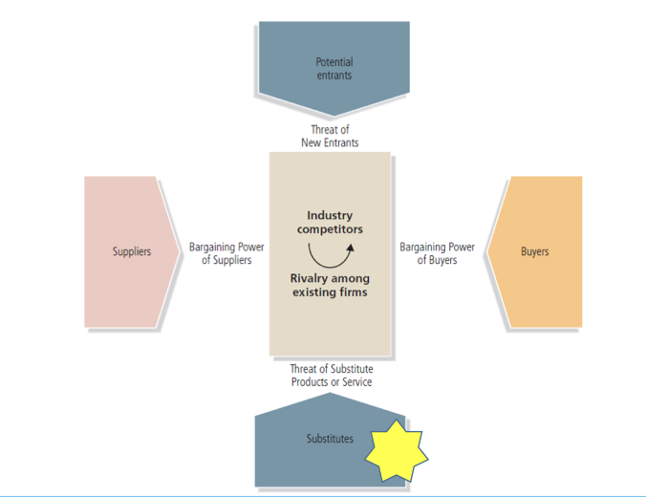
FIVE FORCES MODEL

Slide 32
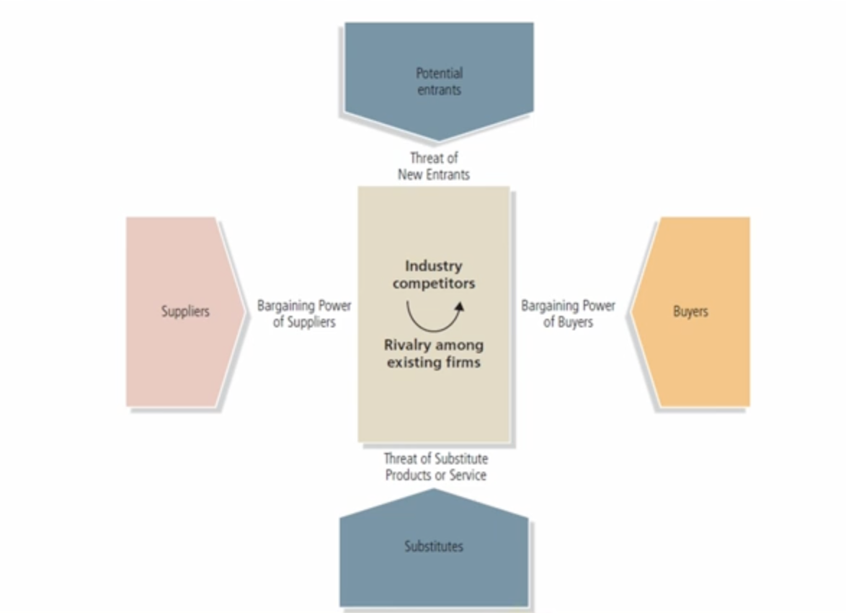
FIVE FORCES MODEL

Slide 33
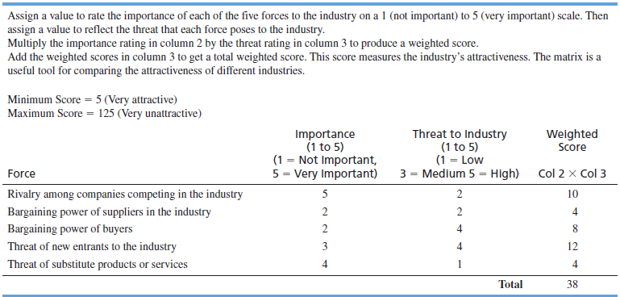
Five Forces Matrix

Slide 34
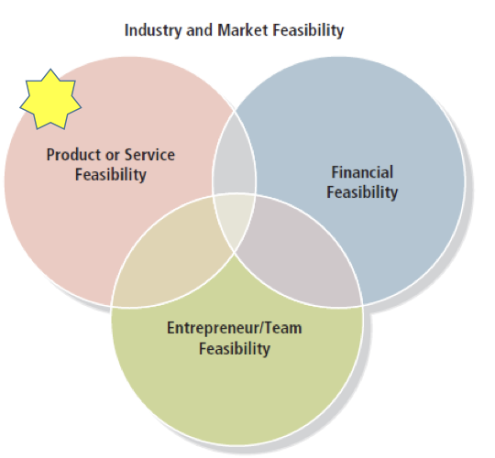
ELEMENTS OF FEASIBILITY ANALYSIS

Slide 35

Product or Service Feasibility Analysis
Determines the degree to which a product or service idea appeals to potential customers and identifies the resources necessary to produce it.
Two questions:
  Are customers willing to purchase our product or service?
  Can we provide the product or
  service to customers at a profit?

Slide 36
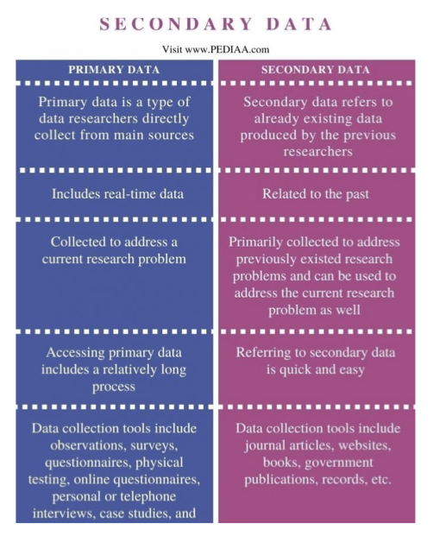
Product or Service Feasibility Analysis
Primary research:
  Collect data firsthand and analyze it.
Secondary research:
  Gather data that already has been compiled and analyze it.

Slide 37
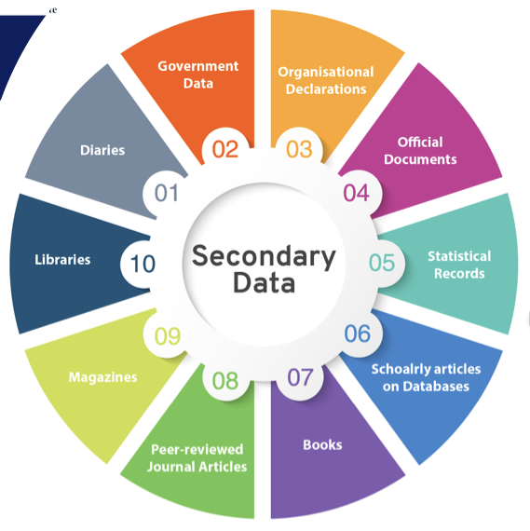
Secondary data
It searches usually start by getting a secondary data
the sources of secondary data can be:
  the company's internal database
  companies can buy secondary data from outside suppliers like research agencies
  use commercial online databases
  Use Internet search engines …
Secondary data can usually be obtained more quickly and at lower cost than primary data
Secondary sources can sometimes provide data and individual company cannot collect on its own.
The researcher must evaluate secondary information carefully to make certain it is relevant, accurate, current and impartial.

Slide 38

Primary Research Techniques
Customer surveys and questionnaires
Focus groups
Prototypes
In-home trials (consumer visits to observe consumers use of product/service)
“Windshield” research (observe customers interacting with existing businesses within an industry).
Trade associations and business directorie
...

Slide 39
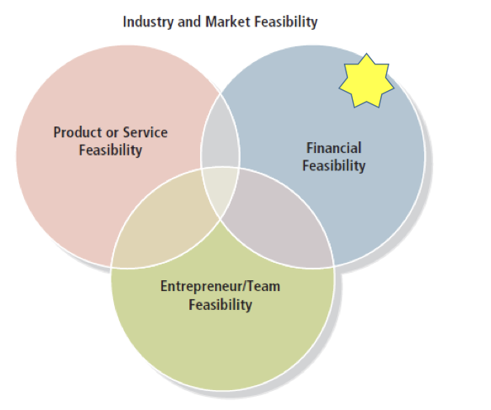
ELEMENTS OF FEASIBILITY ANALYSIS

Slide 40

Financial Feasibility Analysis
Capital requirements: an estimate of how much start-up capital is required to launch the business.
Estimated earnings: forecasted income statements.
Time out of cash: the total cash it will take to sustain the business until the business achieves break-even cash flow.
Return on investment: combining the previous two estimates to determine how much investors can expect their investments to return.

Slide 41
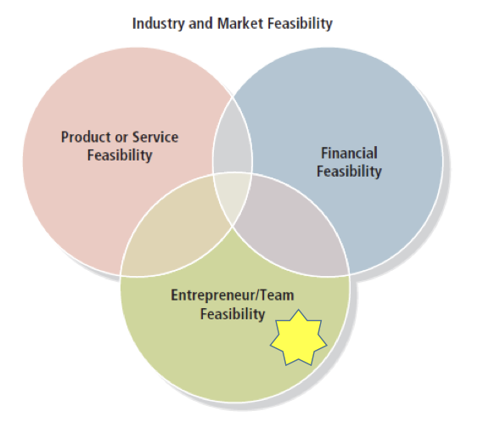
ELEMENTS OF FEASIBILITY ANALYSIS

Slide 42

Entrepreneur Feasibility
Is this idea right for me?
  Assess entrepreneurial readiness: knowledge, experience, and skills necessary for entrepreneurs to be successful.
  Assess whether the business will be able to generate enough profit to support everyone’s income needs.

Slide 43
Developing and Testing a Business Model
Key questions to address:
  What value does the business offer customers?
  Who is my target market?
  What do they expect of me as my customers?
  How do I get information to them, and how do they want to get the product?
  What are the key activities to make all this come together, and what will they cost?
  What resources do I need to make this happen, including money?
  Who are the key partners I will need to attract to be successful?

Slide 44
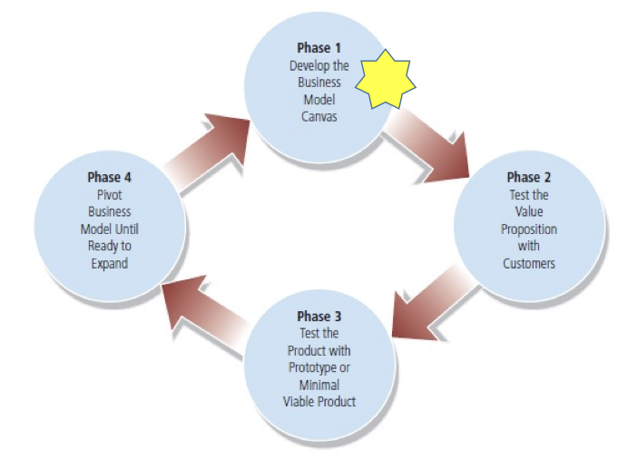
The Business Modeling Process

Slide 45
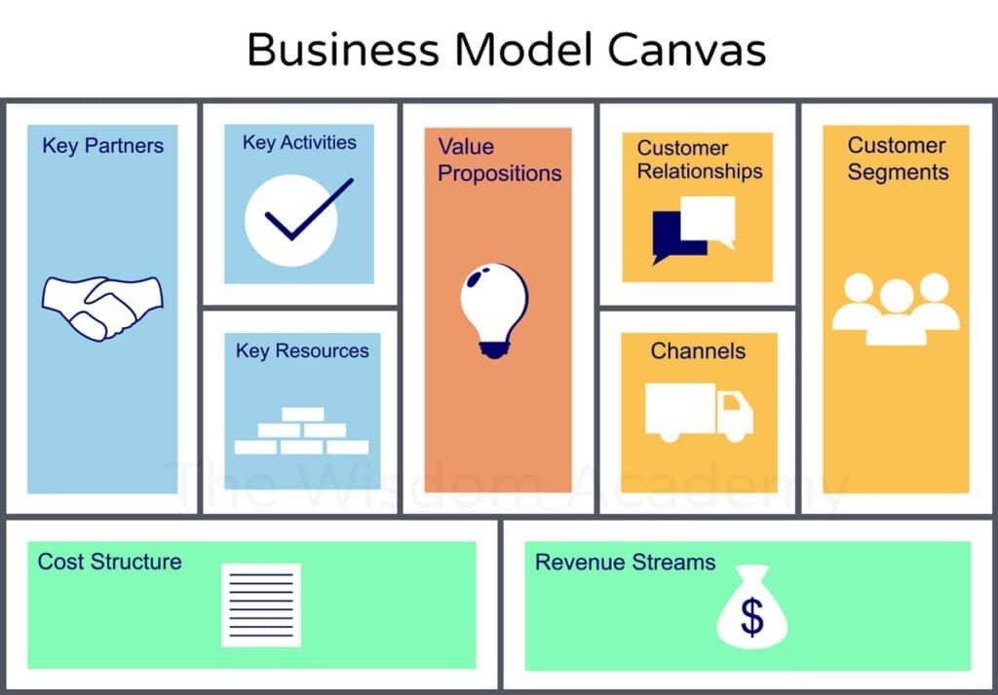


Slide 46
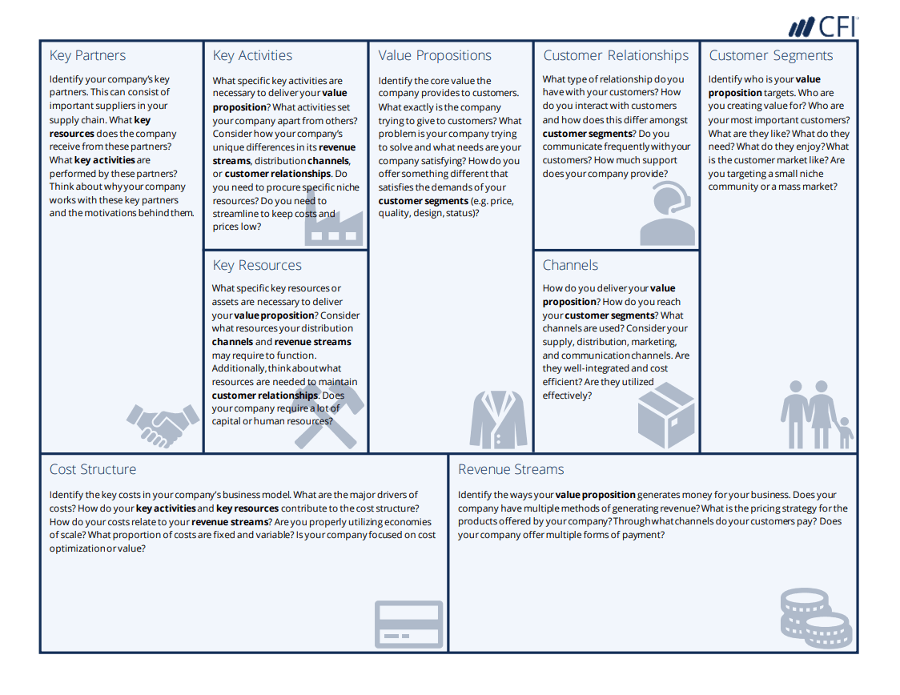
THE BUSINESS MODEL CANVA

Slide 48
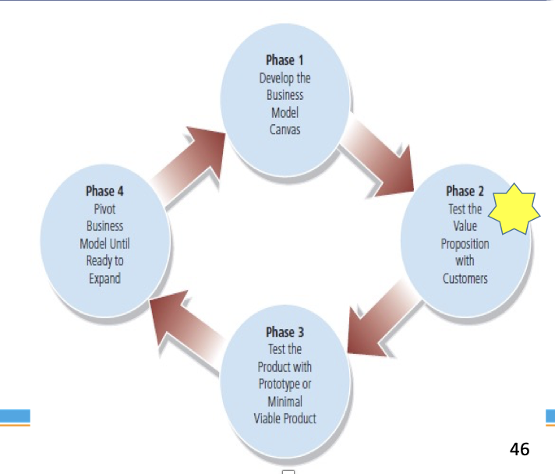
The Business Modeling Process

Slide 49

Test the Value Proposition
Ask customers:
  Do we really understand the customer problem the business model is trying to address?
  Do these customers care enough about this problem to spend their hard-earned money on our product?
  Do these customers care enough about our product to help us by telling others through word-of-mouth?

Slide 50
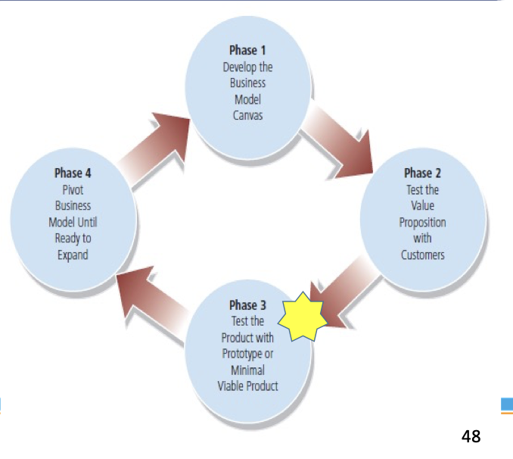
The Business Modeling Process

Slide 52

Business Prototyping
Test early versions of a product or service using a lean start-up: a process of rapidly developing simple prototypes to test key assumptions by engaging real customers.
Begin the lean start-up process using a minimal viable product: the simplest version of a product or service with which an entrepreneur can create a sustainable business.

Slide 53
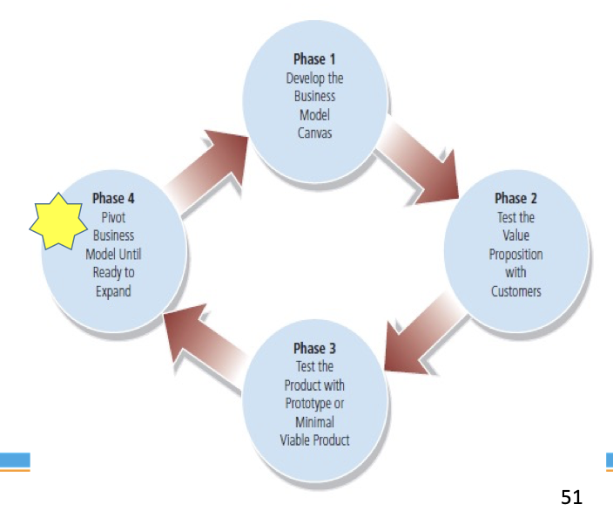
The Business Modeling Process

Slide 54

Pivots
Pivots: the process of making changes and adjustments in the business model on the basis of the feedback a company receives from customers.
  Product pivot
  Customer pivot
  Revenue model pivot

Slide 55

Conclusion
The best business ideas start with a common problem or need.
The ideas assessment process helps an entrepreneur more efficiently and effectively examine multiple ideas to identify the solution with the most potential.
A feasibility analysis helps the entrepreneur determine whether an idea can be transformed into a viable business.
Developing a business model helps the entrepreneur better understand all that will be required to launch and build a business.
Once the entrepreneur completes the idea assessment, feasibility study, and business model, he or she is ready to develop the business plan.

Slide 56


