Slide 1


Fundamentals of Organizational Communication
Prepared by
Dr. Walid El Leithy
Chapter 1

Slide 2



Chapter 1
www.midocean.ae

Slide 3

Chapter
Learning Objectives
1
1.1 Examine the factors that have changed organizations and the way people work​
1.2 Recognize communication to be fundamental to the process of organizing​
1.3 Describe communication in the information- rich world​
1.4 Recognize communication as a key to organizational excellence​
1.5 Report communication competency as a personal and organizational need​
1.6 Describe the human communication process​
1.7 Develop awareness of our personal communication competencies​

Slide 4
Chapter
Learning Objectives
1
1.8 Distinguish among interpersonal, small-group, and organizational communication​
1.9 Identify descriptions of organizations​
1.10 Definitions of organizational communication​
1.11 Assess personal development needs​
​

Slide 5
Chapter
What is Organizational Communication?​
1
Organizational communication is a field of study and a practice that involves the exchange of verbal and nonverbal messages in the context of a formal organization¹². It describes the structure and style of interaction among individuals within an organization and with external stakeholders³⁴. It also refers to the way an organization gives information about its aims and activities to the public and its employees⁵.

Slide 6

Chapter
The Changing Nature of Organizations and Work​
1
Objective 1.1 Examine the factors that have changed organizations and the way people work​

Slide 7
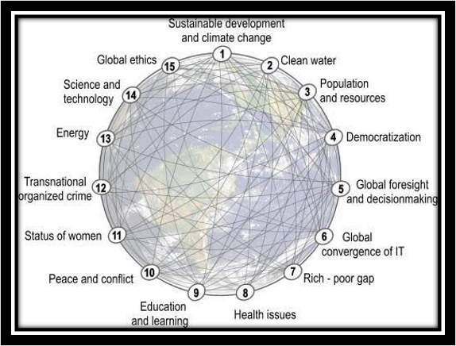
Chapter
1.1 The Changing Nature of Organizations and Work​
1

Slide 8
Chapter
1.1 The Changing Nature of Organizations and Work Cont. ​
1
Turbulent period​
Contemporary organizations​
​Point 1 – Turbulent period​
One of the more turbulent periods of history​
Unprecedented opportunities and unprecedented problems​
Uncertainty and change have become the norm​
Creativity and innovation are more important than ever​
Point 2 – Contemporary organization​
New relationships between organizations and employees​
Old social contract replaced by frequent employment shifts​

Slide 9

Chapter
Challenges for Individuals and Organizations​
1
Objective 1.2 Recognize communication to be fundamental to the process of organizing​

Slide 10
Chapter
1.2 Challenges for Individuals and Organizations​
1
Organizational and individual environments​
Organizational and individual challenges​
Point 1 – Organizational and individual environments​
Complex, fragile, turbulent, and uncertain environments​
Enormous opportunities for innovation and change​
Point 2 – Organizational and individual challenges​
Problems of sharing our planet, our humanity, and a global rule book ​
Requirement to continually learn and build new competencies ​

Slide 11

Chapter
The Communications Era​
1
Objective 1.3 Describe communication in the information- rich world​

Slide 12
Chapter
1.3 The Communications Era​
1
Complex communications environments​
Postindustrial information society and conceptual age​
Point 1 – Complex communications environments​
World more interconnected than ever​
Globalization and nature of innovation​
Point 2 – Postindustrial information society and conceptual age​
Rapid change associated with mass production of information​

Slide 13

Chapter
Communication: The Key to Organizational Excellence​
1
Objective 1.4 Recognize communication as a key to organizational excellence​

Slide 14

Chapter
1.4 Communication: The Key to Organizational Excellence​
1
Communication excellence​
Future employees​
Point 1 – Communication excellence​
Key to organizational excellence​
More than just efficient management of large volumes of facts​
Point 2 – Future employees​
Competent communicators at all organizational levels​
Excellence depends on the abilities, commitment, and creativity of all organizational​
members​

Slide 15
Chapter
Excellence in Communication: Communication Competency​
1
Communication competency​
- Components of communication competency​
Components of communication competency​
​
Competency arises out of four basic components: process understanding, interpersonal sensitivity, communication skills, and ethical responsibility​
Competence comes from the interaction of three primary elements: theory, practice, and analysis​

Slide 16

Chapter
Organizational Communication: A Competency-​
Based Approach​
1
Objective 1.6 Report communication competency as a personal and organizational need​

Slide 17
Chapter
1.6 Organizational Communication: A Competency-Based Approach​
1
Point 1 – Knowledge​
Learning of theory and principles​
Exploration of the interactive process nature of human communication​
Point 2 – Sensitivity​
Ability and willingness to understand what others feel and do​
Examination of our personal “theories-in-use” about communication and organizations​
Point 3 – Skills​
Developing important analytical capabilities​
Ability to communicate effectively in a variety of settings​
Applying knowledge and sensitivity to case studies and individual experiences​
Point 4 – Values​
Taking personal responsibility for effective communication​
Developing values through discussion of personal responsibility ​
www.midocean.ae

Slide 18

Chapter
Understanding Human Communication​
1
Objective 1.7 Describe the human communication process​
www.midocean.ae

Slide 19

Chapter
1.7 Understanding Human Communication​
1
Defining Communication ​
- Human communication​
Shared realities​
Defining Communication ​
Point 1 – Human communication​
Constituting experience of working together and making sense of what ​
it means​
Use of symbols or words to attempt to create mutual understanding​
Point 2 – Shared realities​
Communication is an attempt to construct shared realities​
Create present reality through sharing realities​
www.midocean.ae

Slide 20

Chapter
Human Communication: Messages and Constitutive Processes​
1
Objective 1.8 Develop awareness of our personal communication competencies​
www.midocean.ae

Slide 21
Chapter
1
1.8 Human Communication: Messages and ​
Constitutive Processes (1 of 5)​
Source/Receiver​
Point 1 – Sending messages​
Individual in a communication is both sender and receiver​
Talk to send messages​
Point 2 – Receiving messages​
Monitor nonverbal reactions of others ​
Use of technology to rapidly exchange messages​
www.midocean.ae

Slide 22
Chapter
1.8 Human Communication: Messages and ​
Constitutive Processes (1 of 5)​
1
Encoding/Decoding​
Point 1 – Encoding​
Process of formulating messages, choosing content and symbols to ​
convey meaning​
Determining what we want to be understood​
Determining how we believe that it can best be presented​
Point 2 – Decoding​
Process of assigning meaning to message symbols received ​
Taking what we see and hear and interpreting it ​
www.midocean.ae

Slide 23

Chapter
Please compose a communication ​
message using below symbols ​
1
www.midocean.ae

Slide 24
Chapter
1.8 Human Communication: Messages​
and Constitutive Processes (2 of 5)​
1
Message​
Point 1 – Source​
Sends messages in any combination of the five senses​
Intent of the message​
Point 2 – Meaning​
Decoding of messages​
Messages serve as symbols for meaning​
​
Channel​
Point 1 – Medium​
Link between source and receiver​
Includes the five senses and technology​
Channels used in combination​
Point 2 – Distortion of messages​
Message distortion in reception – technological and sensory​
Selection of channel is a message in itself​
​
www.midocean.ae

Slide 25
Chapter
1.8 Human Communication: Messages and ​
Constitutive Processes (3 of 5)​
1
Noise​
Point 1 – Types of noises​
cInterference contributing to discrepancies in deoding​
Physical distractions, channel interference, communicative competence, etc​
Point 2 – Presence of noise​
Always present in some form​
Type of noise contributes to the meanings assigned​
​
Competence​
Point 1 – Impression of competence​
Ability to generate shared realities contributes to the impression of our own competence​
We continually evaluate and form impressions about others’ competence​
Point 2 – Encoding/decoding messages​
Impressions contribute to encoding/decoding messages​
Contributes to communication effects and evaluation of the effectiveness of interactions ​
www.midocean.ae

Slide 26
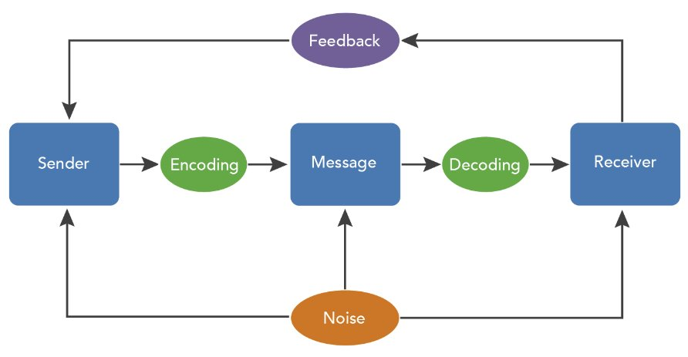
Chapter
Messages and Constitutive Processes Model
1
www.midocean.ae

Slide 27
Chapter
1.8 Human Communication: Messages ​
and Constitutive Processes (4 of 5)​
1
Field of Experience​
Point 1 – Familiarity​
What we do depends on our experiences​
Behavior depends on familiarity to situations​
Point 2 – Situation specific​
May relate to evaluations of self-competence​
Common fields of experience enable easier communication​
​
Communication Context​
Point 1 – Communication interaction environment​
Includes the specific time and place of the interaction​
Includes roles, relationships, and status of participants​
Point 2 – Communication intentions​
Context contributes to our intentions ​
​
www.midocean.ae

Slide 28
Chapter
1.8 Human Communication: Messages​
and Constitutive Processes (5 of 5)​
1
Realities and Effects​
- Communication realities​
Ethics​
Realities and Effects​
Point 1 – Communication realities​
Result, consequence, or outcome of the communication exchange​
Effect can be immediate or delayed​
Point 2 – Ethics​
Evaluation of ethics influence future interactions​
Ethical perceptions of past interactions influence perceptions of future communication​
www.midocean.ae

Slide 29

Chapter
Communication as Constitutive of Shared Realities​
1
Objective 1.9 Distinguish among interpersonal, small-group, and organizational communication​
www.midocean.ae

Slide 30
Chapter
1.9 Communication as Constitutive of ​
Shared Realities​
1
- Shared realities​
- Types of communications​
Point 1 – Shared realities​
Communication is the attempt to construct shared realities​
Culture and context influence communication ​
Communication is dynamic and ever-changing​
Point 2 – Types of communications​
Interpersonal​
Group​
Public​
Organizational​
www.midocean.ae

Slide 31
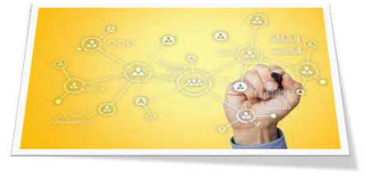
Chapter
Twenty-First Century Concepts of Organizations​
1
Objective 1.10 Identify descriptions of organizations​
www.midocean.ae

Slide 32
Chapter
1.10 Twenty-First Century Concepts of Organizations​
1
- Organizing​
Types of organizations
Point 1 – Organizing​
Purposeful activities as a result of communication behaviors​
Communication seeks to bring order out of chaos​
Five features of all organizations​
Point 2 – Types of organizations​
Family-owned, social justice, and volunteer organizations​
Partnerships, entrepreneurial opportunities, home-based work, and global ventures​
Temporary, local, regional, or global organizations​
​
​
www.midocean.ae

Slide 33

Chapter
Definitions of Organizational Communication​
1
Objective 1.11 Survey definitions of organizational communication
www.midocean.ae

Slide 34
Chapter
1
1.11 Definitions of Organizational Communication (1 of 3)​
Organizational Communication as Process​
Point 1 – Process​
Ongoing​
Ever changing​
Evolutionary​
Culturally dependent​
Point 2 – Process occurrence​
Occurs in developing strategy, planning, decision making, and executing the work of the organization​
Occurs during unexpected crises, changes in the external environment, encounters with competitors​
​
www.midocean.ae

Slide 35
Chapter
1.11 Definitions of Organizational Communication (1 of 3)​
1
Organizational Communication as People​
Point 1 – Organizational communication​
Contributes to creating relationships​
Assists in achieving diverse purposes​
Point 2 – Organizational communication occurrence​
Occurs between people who share work and interpersonal relationships​
Occurs between people who are geographically separated ​
Occurs across networks of people with a variety of objectives​
​
www.midocean.ae

Slide 36
Chapter
1.11 Definitions of Organizational Communication (2 of 3)​
1
Organizational Communication as Messages​
Point 1 – Message creation​
Transmission of verbal and nonverbal behaviors​
Sharing of information​
Communicators are linked together by channels​
Point 2 – Message description​
Frequency​
Amount​
Type​
Fidelity​
​
www.midocean.ae

Slide 37
Chapter
1.11 Definitions of Organizational Communication (2 of 3)​
1
Organizational Communication as Meaning​
Point 1 – Role taking​
Occurs as individuals interact in the ever-changing organizational context​
Organizational communication is the symbolic behavior which affects all organizational activities​
Point 2 – Multiple meanings​
Does not create a singular set of meanings​
Interactions of ever-changing behaviors create multiple perceptions of events and multiple realities​
www.midocean.ae

Slide 38
Chapter
1.11 Definitions of Organizational Communication (3 of 3)​
1
Organizational Communication as Constitutive of Organizations​
​
Point 1 – Context Definition​
Organizing, decision making, planning, controlling, and coordinating​
Seeks to reduce environmental uncertainty​
People, messages, and meaning​
Intentional and unintentional messages​
Reflects the purpose of the organization​
Process through which individuals and organizations attempt goal-oriented behavior​
Point 2 – Competencies​
Interpersonal abilities​
Effectiveness in complex and changing environments​
www.midocean.ae

Slide 39

Chapter
Self-Assessment of Personal Development Needs: ​
Your Personal Workbook​
1
Objective 1.12 Assess personal development needs​
www.midocean.ae

Slide 40
Chapter
1.12 Self-Assessment of Personal Development Needs: Your Personal Workbook​
1
- Self-development exercises​
- Self-analysis for career planning​
- Influences on career choices​
- Achievements, skills, and values​
- Current status of career planning​
- Resume development​
​
www.midocean.ae

Slide 41




Thank You

