Slide 1

CYB670
Malware and Attacks Type
Cybersecurity Fundamentals
Prepared by Dr. Redhwan M. A. Saad
Lecture # 4
Notes:
‏الامن السيبراني: هو الامن الذي يتعلق بالحماية من المخاطر الخارجية المحتملة والخاصة بحيث يعمل مختصو الامن السيبراني على حماية الحواسيب والهواتف من اي نوع من الهجمات والاختراقات والتهديدات التي تحدث عن طريق السيرفرات
‏امن المعلومات :يهتم بحماية كل ما يتعلق بالمعلومات من الحاسوب او خارجه
يركز امن المعلومات على ثلاثة مبادئ اساسية
1-السرية
2-السلامة
3-التوافرية
‏ايه الفايدة والاهمية منهم؟
الامن السيبراني:
حماية الشبكات والبيانات والمعلومات.
تحسين مستوى الحماية والأمان.
ضمان استمرارية الأعمال.
امن المعلومات:
تحديد الجهات المخولة بالوصول إلى المعلومات.
حماية المعلومات من السرقة والاختراق.
تقليل الخسائر المحتملة
اهم وظائف الامن السيبراني
1- مستشار امن سيبراني
2- مدير امن سيبراني
3- محلل امن سيبراني
4- مدقق امن سيبراني
5- مهندس امن سيبراني
6- محلل ادارة مخاطر

Slide 2

Module 02
Lecture 04
Outline
    It includes:
    Introduction
    Cyber-Attacks and Vulnerabilities,
    Malware threats, Sniffing, Gaining Access, Escalating Privileges, Executing Applications, Hiding Files, Covering Tracks, Worms, Trojans, Viruses, Backdoors.
Cybersecurity Fundamentals, Dr. Redhwan M. A. Saad

Slide 3
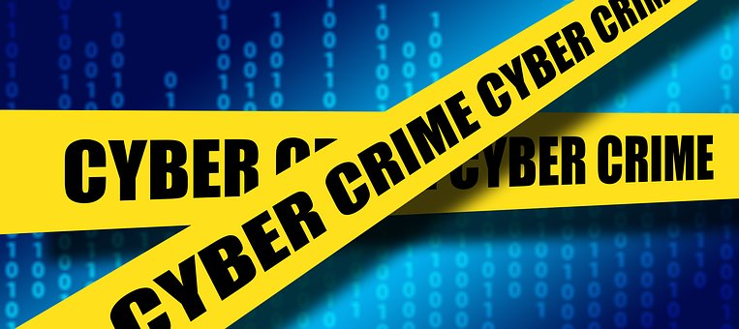
Module 02
Lecture 04
Introduction
The malware is a computer software program maliciously developed to install on the computers without any consent of the users.
The main objective of malware programs is to either establish the access to the targeted computers without any permission of the user or to install the program to create annoyance for the users.
The annoyance can include pranks, data theft, data damage, computer malfunction, service blockage, and spying on the users.
In most of the cases, the malwares are installed on the targeted computers to achieve different types of goals, which may include getting financial favor, knowing the business strategies, sabotaging the governmental system, and many others.
Cybersecurity Fundamentals, Dr. Redhwan M. A. Saad

Slide 4
Module 02
Lecture 04
Introduction
Hackers normally consistently create different types of malicious software program that are used via internet.
All these programs are given certain names by the hackers.
In certain cases, those programs are detected and named by the cyber security companies.
But all those programs fall under the major categories, which are very well known in the field of computer security.
Cybersecurity Fundamentals, Dr. Redhwan M. A. Saad

Slide 5
Module 02
Lecture 04
Malwares and attack Types
Malware, also called malicious code, is software designed to:
gain access to targeted computer systems,
steal information or
disrupt computer operations.
Malware and malicious files inside a computer system can:
Deny access to the critical components of the network
Obtain information by retrieving data from the hard drive
Disrupt the system or even render it inoperable
Cybersecurity Fundamentals, Dr. Redhwan M. A. Saad

Slide 6
Module 02
Lecture 04
Malwares and attack Types
The main types of malware software programs are explained below:
  Viruses
  Trojan Horse
  Rootkit
  Spywares
  Worms
  Adware
  Scareware
  Browser Hijacker
Cybersecurity Fundamentals, Dr. Redhwan M. A. Saad

Slide 7
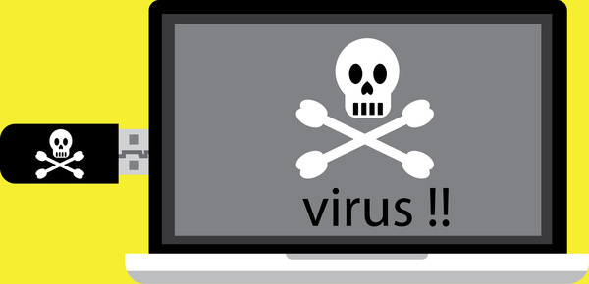
Module 02
Lecture 04
Viruses
There are several types of malware, the most important are as fellows:
common types of malware include:
Viruses:- A computer virus is a piece of code that can replicate itself and spread from one computer to another. It requires intervention or execution to replicate and/or cause damage.
A computer virus is a malicious computer program, which is designed to alter the computer functions, slow down the computer performance, and to damage the valuable files on the computer drive.
The virus are executable files when run on any machine by mistake or through any trick, it will activate and will start altering the computer configurations and the process, which are used for the smooth operation of the computers.
The virus programs have the capability to copy into multiple files and thus, overwhelm the computer processes and data storage.
Cybersecurity Fundamentals, Dr. Redhwan M. A. Saad

Slide 8
Module 02
Lecture 04
Viruses
The main sources of virus propagation include:
  Copying on hard drive
  Data copying through flash
  Emails attachments
  Short text messages
  Scam websites
  Scam social media links
  Infected file downloading from internet
  Visiting infected websites
Cybersecurity Fundamentals, Dr. Redhwan M. A. Saad

Slide 9
Module 02
Lecture 04
Viruses
The viruses are just programs in the form of executable files. They don’t activate without running those executable files on your computers.
If you got a virus program on your computer, but it has not been executed on your computer, your computer is not infected as yet.
As soon as you execute that file by either clicking or running some legitimate programs on which, the virus files are attached, the virus becomes active, and it will start doing its designed job.
Cybersecurity Fundamentals, Dr. Redhwan M. A. Saad

Slide 10
Module 02
Lecture 04
Viruses
The objectives of spreading a virus many include:
  Amusement, fun and prank
  Altering computer functioning
  Corrupting data files on computer
  Stealing credentials
  Sending spamming emails from your computer
  Erasing valuable data
  Damaging hard drives
Cybersecurity Fundamentals, Dr. Redhwan M. A. Saad

Slide 11
Module 02
Lecture 04
Viruses
In the modern world, the creation of computer virus is motivated by gaining some financial benefits on the internet.
That may include stealing data and selling it to the third party, or even using that data for malicious financial transactions.
Cybersecurity Fundamentals, Dr. Redhwan M. A. Saad

Slide 12
Module 02
Lecture 04
Viruses
The main symptoms of a virus infected computer may include the following:
  Frequent appearance of pop ups and other annoyance
  Changes in the home screen and other settings
  Redirecting your online surfing to certain websites
  Large scale incoming and outgoing emails
  Slowing down of the performance of your computer
  Running of unknown programs on your computer
  Changes in your passwords, especially the admin passwords
  System start crashing frequently
  Restarting of your computer unexpectedly
Cybersecurity Fundamentals, Dr. Redhwan M. A. Saad

Slide 13
Module 02
Lecture 04
Viruses
The solution to the menace of computer virus is use updated antivirus software from well-known antivirus software companies.
It is very important to note that antivirus programs should be regularly updated to cope with increasing threat of computer viruses.
Cybersecurity Fundamentals, Dr. Redhwan M. A. Saad

Slide 14
Module 02
Lecture 04
Viruses
We can save our computers from the attack of nasty viruses by taking the following measures:
Avoid using unsecure websites
Don’t open fake websites that allure you for some free incentives
Always keep your antivirus software up-dated
Always keep operating system of your computer updated
Turn on the security firewall settings
Always configure your browser for high level of security
Free and insecure plugins should not be installed on your browsers
Cybersecurity Fundamentals, Dr. Redhwan M. A. Saad

Slide 15
Module 02
Lecture 04
Viruses
We can save our computers from the attack of nasty viruses by taking the following measures:
Don’t use your credit cards on the websites that don’t comply with the Payment Card Industry Data Security Standard (PCI-DSS) guidelines for secure transactions.
Never insert flash cards or other storage devices to your computer without scanning and knowing about the type of data.
Never open emails and their attachments from unknown people.
By following the above mentioned rules of thumb, you can save your computer from the effect of computer viruses.
Cybersecurity Fundamentals, Dr. Redhwan M. A. Saad

Slide 16
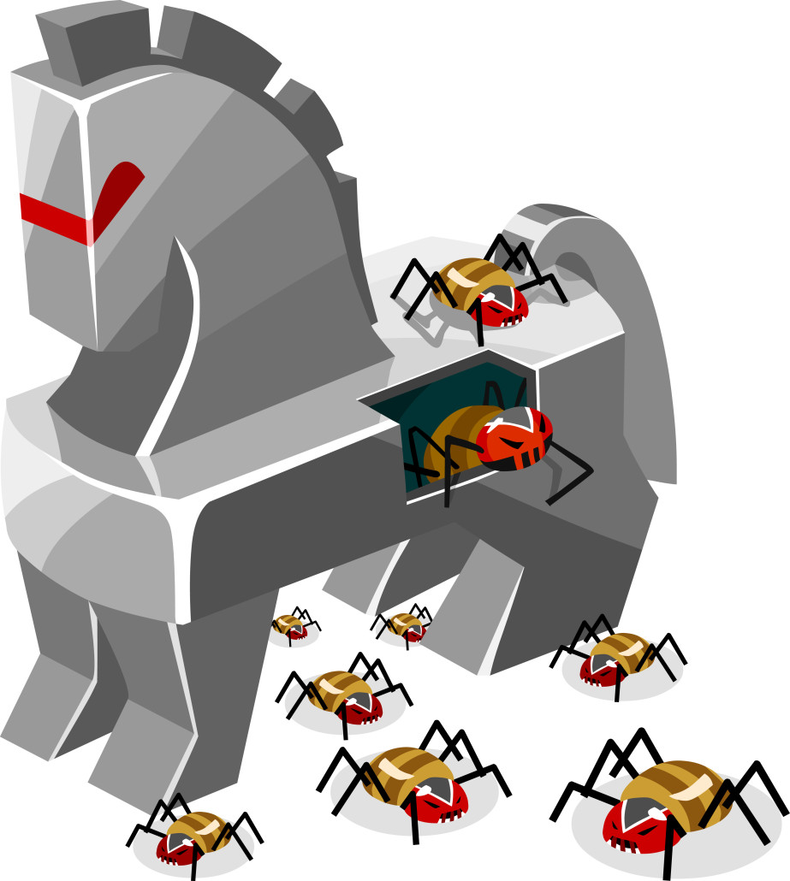
Module 02
Lecture 04
Trojan Horses
There are several types of malware, the most important are as fellows:
common types of malware include:
Trojan horses:- A further category of malware is the Trojan horse, which is a piece of malware that gains access to a targeted system by hiding within a genuine application. Trojan horses are often broken down into categories reflecting their purposes.
Trojan horse is also a malicious computer program that may look very meek and harmless, but it can pave the way for a bigger attack on your computer and valuable data.
Cybersecurity Fundamentals, Dr. Redhwan M. A. Saad

Slide 17
Module 02
Lecture 04
Trojan Horses
It collects the information about the user behavior, credentials and other activities on the computer silently and sends them to its command and control center from where the other malicious attacks can originate.
Hackers use Trojan to open the backdoor on your computer to access your computer and establish control on your machine.
The concept of the Trojan horse in the modern computer terminology resembles 100% with the story of Trojan horse in the Greek mythology.
According to the old mythology, Greek developed a wooden Trojan horse, which would house many soldiers inside the wooden compartment of the Trojan horse.
The people of the Troy city would pull the Trojan to the city and the soldiers hidden inside the Trojan horse would come out in the night and would open the gates of the cities.
They would call their fellow soldiers to come in and overrun the city to conquer.
Cybersecurity Fundamentals, Dr. Redhwan M. A. Saad

Slide 18
Module 02
Lecture 04
Trojan Horses
The concept of Trojan horse in computer security is also same.
A Trojan horse comes in through a social engineering tactics such as emails, disguised links and other sources.
They would sit on the computers and start spying, making changes in credentials and doing other such malicious activities.
The main objectives of Trojan horse are to spy on the user activities and send back to its master control.
Based on the information backdoor access on the computer is created to get control over the computer for malicious activities.
Cybersecurity Fundamentals, Dr. Redhwan M. A. Saad

Slide 19
Module 02
Lecture 04
Trojan Horses
The Trojan horses cannot replicate as the virus or computer worms can do.
They are silent spies working silently on your computers to accomplish their malicious acts for which the Trojan horses are designed and propagated.
Cybersecurity Fundamentals, Dr. Redhwan M. A. Saad

Slide 20
Module 02
Lecture 04
Trojan Horses
Generally recognized activities of a Trojan horse on an infected computer include:
  Collecting data and sending to command and control center
  Copying the files and credential information
  Blocking of the data
  Altering the useful data
  Reducing the performance of computer
  Deleting some useful data files
Cybersecurity Fundamentals, Dr. Redhwan M. A. Saad

Slide 21
Module 02
Lecture 04
Trojan Horses
There are numerous types of Trojan horses used in the modern cybercrimes.
A few very important ones are mentioned below:
Trojan Spy
Trojan Mail Finder
Trojan Proxy
Trojan Clicker
Trojan Ransom
Trojan SMS
Trojan Dropper
Trojan Fake AV
Trojan Game Theft
Trojan Backdoor
Trojan DDoS
Cybersecurity Fundamentals, Dr. Redhwan M. A. Saad

Slide 22
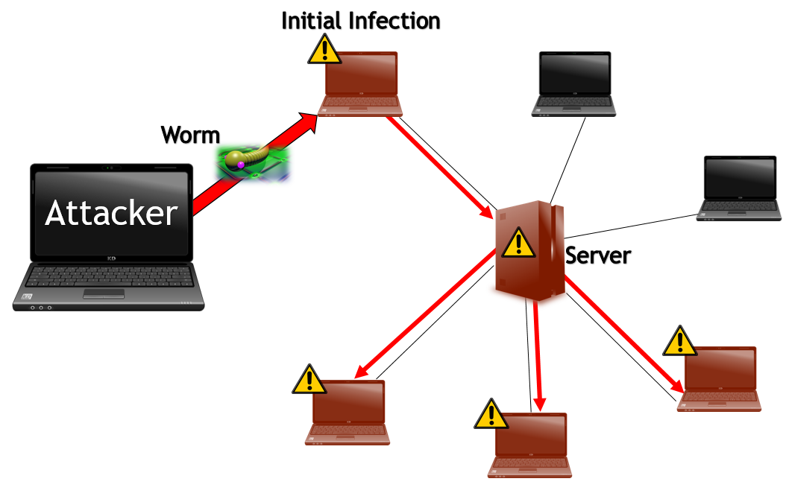
Module 02
Lecture 04
Network Worm
There are several types of malware, the most important are as fellows:
common types of malware include:
Network Worm:- A variant of the computer virus, which is essentially a piece of self-replicating code designed to spread itself across computer networks. It does not require intervention or execution to replicate.
The main feature of a computer worms and viruses is that they replicate themselves in order to spread to other computers on the network or through other data transmission mediums.
Cybersecurity Fundamentals, Dr. Redhwan M. A. Saad

Slide 23
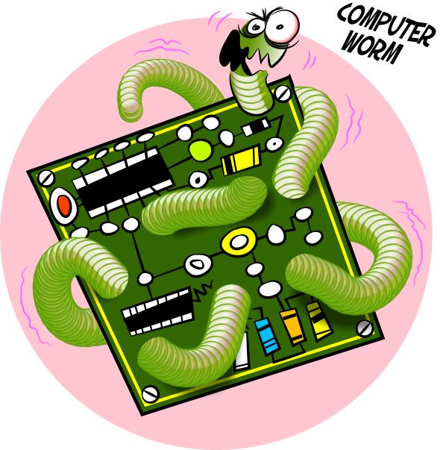
Module 02
Lecture 04
Network Worm
Computer worms are the types of malware software programs that replicate on the computers to consume the majority portions of the computer resources like bandwidth, hard disk, and memory.
The basic objective of a worm is to spread on the computers in a network by exploiting the vulnerabilities in the computer operating system and other vulnerabilities in the computer networks.
They are considered to be harmless without payloads. The worms without any payloads or payload-free worms just consume the resource of the computer and do no other harms.
Cybersecurity Fundamentals, Dr. Redhwan M. A. Saad

Slide 24
Module 02
Lecture 04
Network Worm
The history of creating computer worms is very interesting. The first worm code named as “tapeworm” to replicate on 100 different nodes for a communication was created at Xerox Palo Alto Research Center by John Shoch.
The purpose of that code was to analyze traffic patterns of a communication network based on Ethernet.
This worm was created to save the time of code creation on every single machine individually. So that worm code replicated on all machines on the network. It was not a maliciously intended code.
Cybersecurity Fundamentals, Dr. Redhwan M. A. Saad

Slide 25
Module 02
Lecture 04
Network Worm
So, the ratio of the servers that went down due to Morris worm was about 10% of the entire internet.
The estimated cost of that worm attack was between $0.1 million and $10 million.
After that worm attack many other worms were released on the internet through different sources. A few very important worms are listed below:
Blaster worm
My Doom worms
Code Red worm
I LOVE YOU worm
CIH worm
Cybersecurity Fundamentals, Dr. Redhwan M. A. Saad

Slide 26
Module 02
Lecture 04
Network Worm
The main points of a worm can be summarized as below:
It replicates and spreads
Exploits communication protocol vulnerabilities on networks
Exploits operating systems on the computers
They are harmless in nature without any payloads
Payloads on the worms can be harmful like virus or other malicious attacks
They infect the computers without any interaction from the user
Bandwidth, storage space, memory can be consumed with uncontrolled replication
Cybersecurity Fundamentals, Dr. Redhwan M. A. Saad

Slide 27
Module 02
Lecture 04
Network Worm
A worm infected computer can be recognized by certain symptoms. Those symptoms are listed below:
Some errors related to the operating system and system files appear
The modified files disappear or don’t open
Firewall warnings may popup in certain cases
Strange icons or files appear on the desktop
Computer generates unknown errors in sounds, messages or even in images
The performance of computers slows down
Sometimes computer may hang or freeze
In extreme conditions system may crash frequently
In extreme cases, you will find emails sent to your contacts without your knowledge.
Cybersecurity Fundamentals, Dr. Redhwan M. A. Saad

Slide 28
Module 02
Lecture 04
Network Worm
The worms can be prevented by using taking the following measures and guidelines:
Always keep operating system updated with software patches
Always take care in opening emails and its attachments from unknown source
Activate the security firewall
Use anti-spyware and antivirus software
Always keep antivirus software updated
Use packet filters on the network
Implement ACL, and null route configuration on switches and routers
Cybersecurity Fundamentals, Dr. Redhwan M. A. Saad

Slide 29

Module 02
Lecture 04
Spyware
There are several types of malware, the most important are as fellows:
A number of further terms are also used to describe more specific types of malware, characterized by their purposes. They include:
Spyware (Sniffing):- A class of malware that gathers information about a person or organization without the knowledge of that person or organization.
Cybersecurity Fundamentals, Dr. Redhwan M. A. Saad

Slide 30

Module 02
Lecture 04
Spyware
Spyware is a software code or program, which is installed on the computers without letting the user know about it.
The main objective of this program is to monitor online activities, computer using habits and personal interests.
A spyware snoops the way user uses the internet.
In most cases the spywares are used to learn the habits of the computer users so that proper and focused digital marketing campaign through emails and other online sources can be implemented.
In the present-day modern world, the importance of privacy has become very critical.
Cybersecurity Fundamentals, Dr. Redhwan M. A. Saad

Slide 31
Module 02
Lecture 04
Spyware
A few years back the NSA data snooping jolted the entire world.
In that security surveillance the privacy of the online people all over the world was compromised.
The tougher laws and regulations were brought into force all over the world to maintain the security and privacy of the online users.
Thus, the privacy has not become matter of individuals only, but also a big concern for all businesses and enterprises all over the world.
At the initial stages, the attack of spyware is not even noticed, but slowly and gradually the impact of the spyware unleashes on your system as well as personally on you.
Cybersecurity Fundamentals, Dr. Redhwan M. A. Saad

Slide 32
Module 02
Lecture 04
Spyware
The symptoms of a spyware attack on your computer may include the following:
System performs slows down
Any spyware stops working properly
Many changes in browser tools bar and plugins appear
Advertisements appear on your screen incessantly
Internet bandwidth chokes
Cybersecurity Fundamentals, Dr. Redhwan M. A. Saad

Slide 33
Module 02
Lecture 04
Spyware
A few important measures to reduce the impact of spyware are listed below.
Always close the advertisement popup windows by clicking on “X” red button or ALT+F4 shortcut key
Don’t click the OK, NO, YES, or any other link on the popup window
Be very careful while visiting new websites or redirected websites
Don’t download free software tools
Don’t be lured by the tempting offers
Don’t open emails and their attachments form unknown senders
Don’t rely on free help for removing anti-spyware links; they are normally spyware themselves in many cases
Keep your operating system up to date
Install a genuine spyware software from renowned companies
Keep your anti-spyware up to date
Activate firewall settings
Increase the security level of your browser to high
Cybersecurity Fundamentals, Dr. Redhwan M. A. Saad

Slide 34

Module 02
Lecture 04
Adware
Adware (Spam):- Designed to present advertisements (generally unwanted) to users
According to the Statista information, the total spending on digital advertisement in 2018 was more than $266 billion, which will increase to over $517 by 2023.
Different tactics are used by the marketers to make their digital marketing campaigns effective.
One of those tactics is the use of adware to make their marketing strategies more focused and effective.
As the name ‘Ad-ware’ implies; it is a computer program that forces the internet users to visit a particular web page, pop-up window, or an on-page advertisement to watch.
Cybersecurity Fundamentals, Dr. Redhwan M. A. Saad

Slide 35
Module 02
Lecture 04
Adware
Adware has become a very popular tool for digital marketing teams to draw attention of the users to a particular product or service.
The adware code uses different ways to propagate and find the suitable targets so that the focused audience is figured out for a particular product.
You might have come across some annoying links and pages while browsing the internet. When you click on those pages or links you are redirected to another page that promotes a particular product or service.
In some cases, pop-ups windows appear with promotional content for a particular product.
This is all done with the help of adware programs.
Cybersecurity Fundamentals, Dr. Redhwan M. A. Saad

Slide 36
Module 02
Lecture 04
Adware
A few very important symptoms of your computer to have been affected by the adware include the following:
Frequent redirects
Huge number of spam emails
Frequent popup windows of offers
Bombardment of product ads in browser
Heavy outgoing and incoming traffic
Slowdown of internet connection
Cybersecurity Fundamentals, Dr. Redhwan M. A. Saad

Slide 37
Module 02
Lecture 04
Adware
So, an adware is a software code that is used to force the users to see a particular advertisement or promotional content on any website, popup window or a commercial advertisement.
The adware software programs are created by the hired programmers for a particular company, which pays the programmers for such codes.
This is very important to note that adware is normally not so dangerous to damage your computer or valuable data; so, don’t panic at all.
This malware only focuses on your behavior to study and send you the targeted advertisements that you may be interested in.
Cybersecurity Fundamentals, Dr. Redhwan M. A. Saad

Slide 38
Module 02
Lecture 04
Adware
You can avoid adware or reduce them by taking the following measures:
  Activate popup blocker on your browser
  Use your common sense what to click and what not
  Activate the firewall
  Install an anti-adware software
  Update the anti-adware software regularly
  Try to avoid free downloads, they may contain adware codes
Cybersecurity Fundamentals, Dr. Redhwan M. A. Saad

Slide 39
Module 02
Lecture 04
Adware
Hundreds of adware have been detected on the internet, a few very important among those adware codes are listed below:
  DeskAd adware
  SpyTrooper adware
  WebCake adware
  WebSparkle adware
  1ClickDownloader adware
  Aartemis search adware
  AnyWhereMe toolbar adware
  AllSearchApp adware
  GetSavin adware
  Hotspot Shield adware
Cybersecurity Fundamentals, Dr. Redhwan M. A. Saad

Slide 40
Module 02
Lecture 04
Self-Assignment
Q1. What is a computer virus?
Q2. State the main sources of virus propagation?
Q3. What is the main purpose of a spyware?
The End ☺
Cybersecurity Fundamentals, Dr. Redhwan M. A. Saad

Slide 41
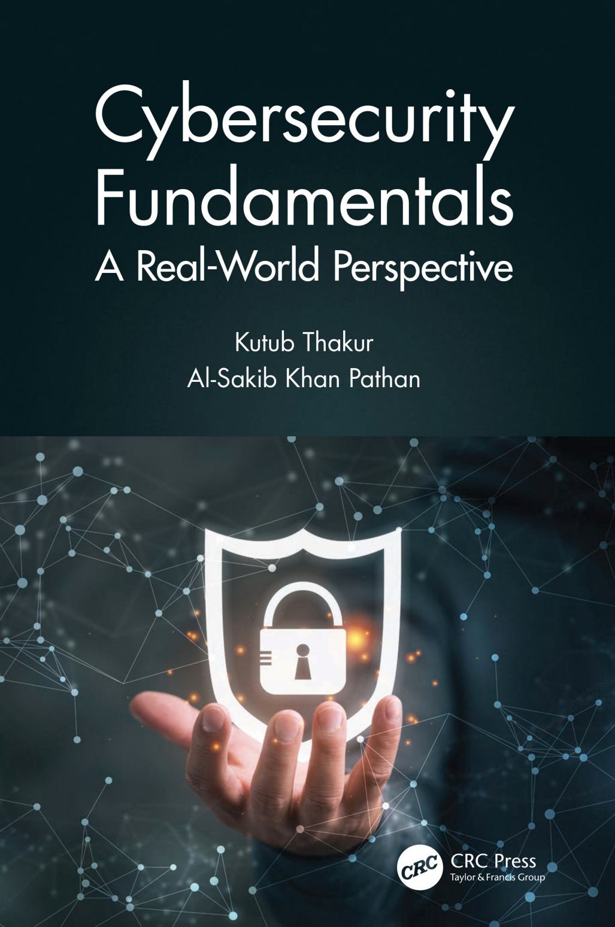
Module 02
Lecture 04
Reference
Thakur, K., & Pathan, A. S. K. (2020). Cybersecurity Fundamentals: A Real-World Perspective. CRC Press.
Cybersecurity Fundamentals, Dr. Redhwan M. A. Saad

