Slide 1

Lecture 8
Scheduling
8.1 BACKGROUND
A schedule is the conversion of a project action plan into an operating timetable. As such, it serves as the basis for monitoring and controlling project activity and, taken together with the plan and budget, is probably the major tool for the management of projects. In a project environment, the scheduling function is more important than it would be in an ongoing operation because projects lack the continuity of day-to-day operations and often present much more complex problems of coordination. Indeed, project scheduling is so important that a detailed schedule is sometimes a customer-specified requirement. In later chapters, we discuss the fact that a properly designed, detailed schedule can also serve as a key input in establishing the monitoring and control systems for the project.
Not all project activities need to be scheduled at the same level of detail. In fact, there may be several schedules (e.g., the master schedule, the development and testing schedule, the assembly schedule). These schedules are typically based on the previously determined action plan and/or work breakdown structure (WBS), and it is good practice to create a schedule for each major task level in the WBS that will cover the work packages.

Slide 2
Lecture 8
Scheduling
8.1 BACKGROUND
. It is rarely necessary, to list all work packages. One can focus mainly on those that need to be monitored for maintaining adequate control over the project. Such packages are usually difficult, expensive, or have a relatively short time frame for their accomplishment
The basic approach of all scheduling techniques is to form a network of activity and event relationships that graphically portrays the sequential relations between the tasks in a project. Tasks that must precede or follow other tasks are then clearly identified, in time as well as function. Such a network is a powerful tool for planning and controlling a project, and has the following benefits:
• It is a consistent framework for planning, scheduling, monitoring, and controlling the project.
• It illustrates the interdependence of all tasks, work packages, and work elements.
• It denotes the times when specific individuals and resources must be available for work on a given task.

Slide 3
Lecture 8
Scheduling
8.1 BACKGROUND
• It aids in ensuring that the proper communications take place between departments and functions.
• It determines an expected project completion date.
• It identifies so-called critical activities that, if delayed, will delay the project completion time.
• It also identifies activities with slack that can be delayed for specified periods without penalty, or from which resources may be temporarily borrowed without harm.
• It determines the dates on which tasks may be started—or must be started if the project is to stay on schedule.
• It illustrates which tasks must be coordinated to avoid resource or timing conflicts.
• It also illustrates which tasks may be run, or must be run, in parallel to achieve the predetermined project completion date.

Slide 4
Lecture 8
Scheduling
8.1 BACKGROUND
• It relieves some interpersonal conflict by clearly showing task dependencies.
• It may, depending on the information used, allow an estimate of the probability of project completion by various dates, or the date corresponding to a particular a priori probability.

Slide 5
Lecture 8
Scheduling
8.2 NETWORK TECHNIQUES: PERT (ADM) AND CPM (PDM)
The most common approach to project scheduling is the use of network techniques such as The Program Evaluation and Review Technique (PERT) and Critical Path Method (CPM).
In application, PERT has primarily been used for R&D projects, though its use is more common on the “development” side of R&D than it is on the “research” side. CPM was designed for construction projects and has been generally embraced by the construction industry. (There are many exceptions to these generalities.) The use of PERT has decreased sharply in recent years because a large majority of project management software generates CPM networks. The two methods are quite similar and are often combined for educational presentation.
In CPM, activities can be “crashed” (expedited) at extra cost to speed up the completion time. Both techniques identified a project critical path with activities that could not be delayed, and also indicated activities with slack (or float) that could be somewhat delayed without lengthening the project completion time.

Slide 6
Lecture 8
Scheduling
8.2 NETWORK TECHNIQUES: PERT (ADM) AND CPM (PDM)
In 2005, renamed PERT as ADM (Arrow Diagram Method) and CPM as PDM (Precedence Diagram Method). In general, we will simply refer to either as a “network,” but if we wish to refer specifically to a PERT (ADM) network where the activities are shown as arrows on the network, we will call it an AOA (activity-on-arrow) network, and if we refer to a CPM (PDM) network where the activities are shown as nodes, we will call it an AON (activity-on-node) network.
Terminology
Activity A specific task or set of tasks that are required by the project, use up resources, and take time to complete.
Event The result of completing one or more activities. An identifiable end state that occurs at a particular time. Events use no resources.

Slide 7
Lecture 8
Scheduling
8.2 NETWORK TECHNIQUES: PERT (ADM) AND CPM (PDM)
Network The arrangement of all activities (and, in some cases, events) in a project arrayed in their logical sequence and represented by arcs and nodes. This arrangement (network) defines the project and the activity precedence relationships. Networks are usually drawn starting on the left and proceeding to the right. Arrowheads placed on the arcs are used to indicate the direction of flow—that is, to show the proper precedences. Before an event can be realized—that is, achieved—all activities that immediately precede it must be completed. These are called its predecessors. Thus, an event represents an instant in time when each and every predecessor activity has been finished.
Path The series of connected activities (or intermediate events) between any two events in a network.
Critical Activities, events, or paths which, if delayed, will delay the completion of the project. A project’s critical path is understood to mean that sequence of critical activities (and critical events) that connects the project’s start event to its finish event and which cannot be delayed without delaying the project.

Slide 8
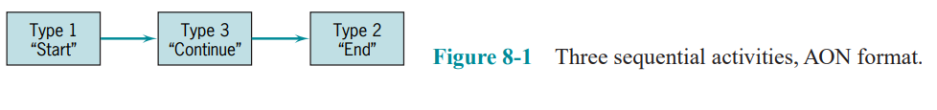
Lecture 8
Scheduling
8.2 NETWORK TECHNIQUES: PERT (ADM) AND CPM (PDM)
To transform a project plan into a network, one must know what activities comprise the project and, for each activity, what its predecessors (or successors) are. An activity can be in any of these conditions: (1) it may have a successor(s) but no predecessor(s); (2) it may have a predecessor(s) but no successor(s); and (3) it may have both predecessor(s) and successor(s). The first of these is an activity that starts a network. The second ends a network. The third is in the middle.
Figure 8-1 shows each of the three types of activities. Activities are represented here by rectangles (one form of what in a network are called “nodes”) with arrows to show the precedence relationships. As noted earlier, this activity-on-node (AON) notation is used for PDM/CPM networks. When there are multiple activities with no predecessors, it is usual to show them all emanating from a single node called “START,”

Slide 9
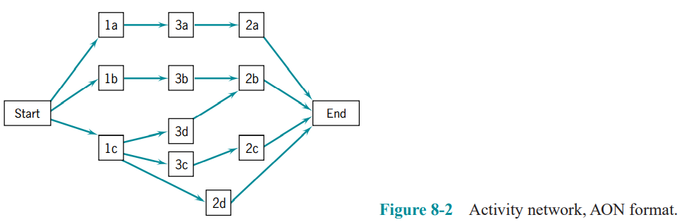
Lecture 8
Scheduling
8.2 NETWORK TECHNIQUES: PERT (ADM) AND CPM (PDM)
as in Figure 8-2. Similarly, when multiple activities have no successors, it is usual to show them connected to a node called “END.”

Slide 10
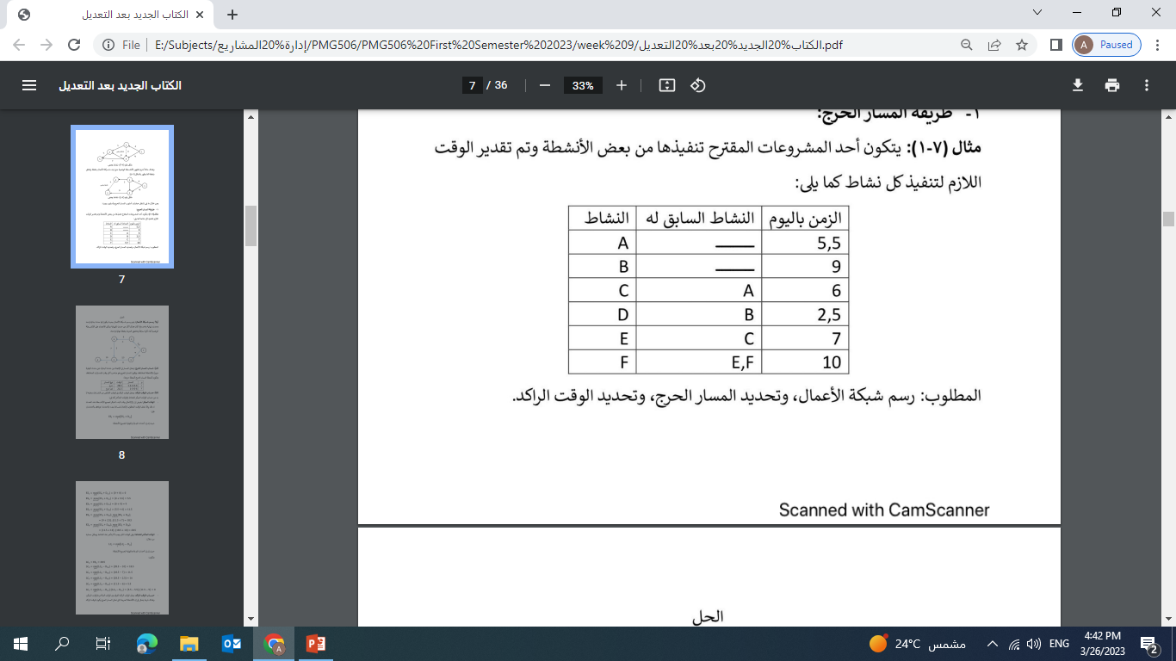
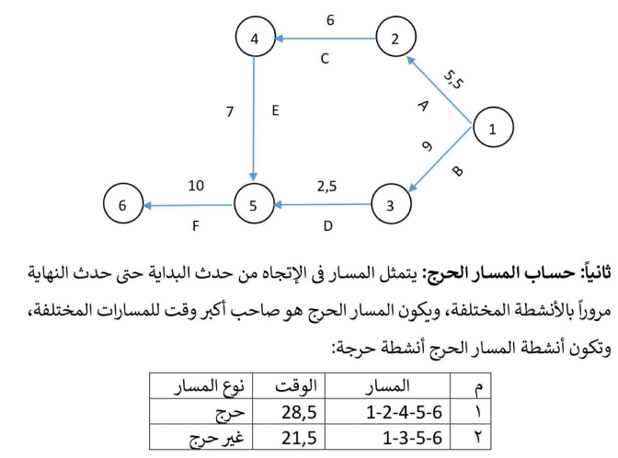

Slide 11
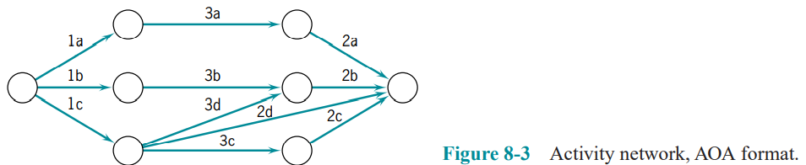
Lecture 8
Scheduling
8.2 NETWORK TECHNIQUES: PERT (ADM) AND CPM (PDM)
In the preceding examples, rectangles (nodes) represented the activities; hence it was called an activity-on-node (AON) network. Another format for drawing networks is AOA (activity-on-arrow), as shown in Figure 8-3. Here, the activities are shown on the arrows and the (circular) nodes represent events. And as noted earlier, this is the standard notation for ADM/PERT networks. If the project begins with multiple activities, they can all be drawn emanating from the initial node and multiple activities can terminate in a single node at the end of the project.

Slide 12
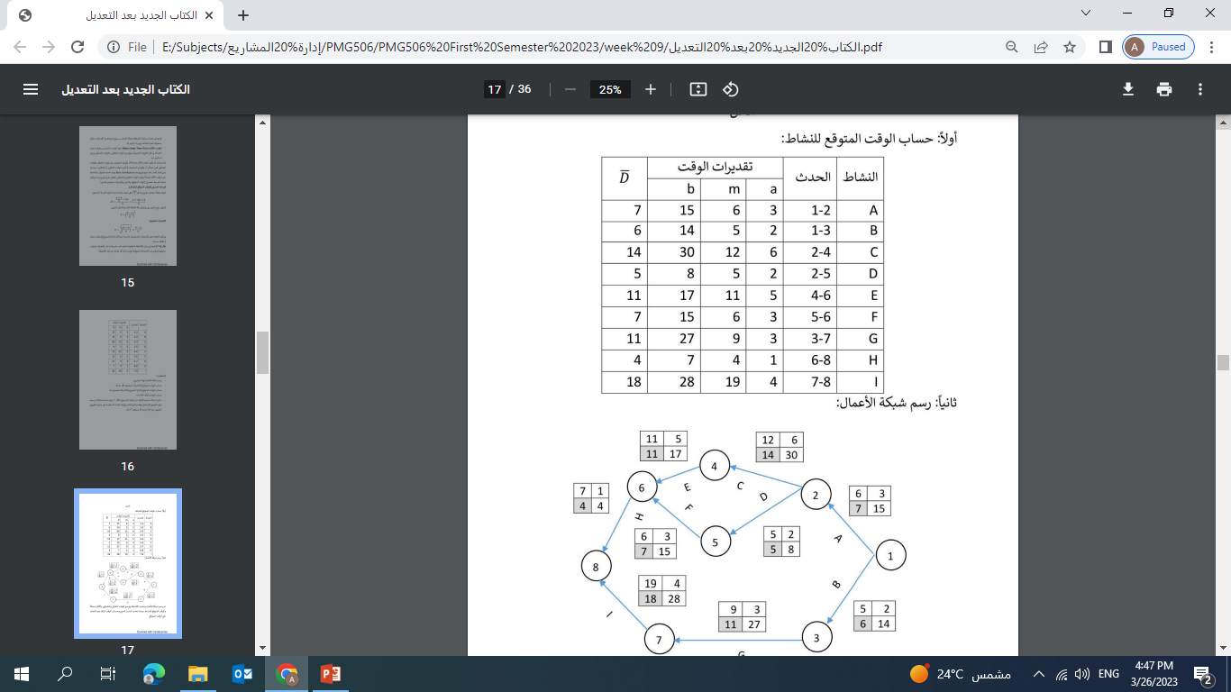
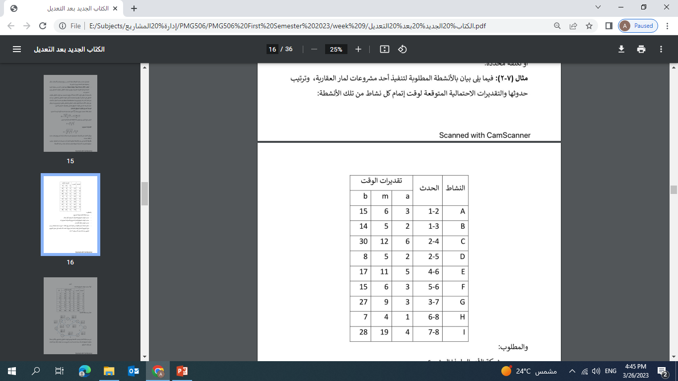
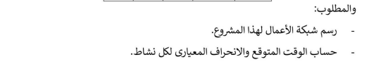
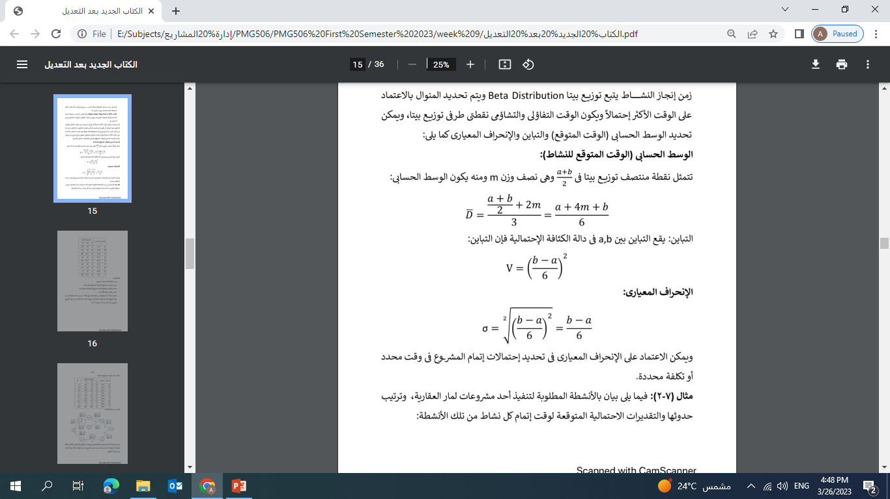

Slide 13
Lecture 8
Scheduling
8.2 NETWORK TECHNIQUES: PERT (ADM) AND CPM (PDM)
Gantt (Bar) Charts and Microsoft Project® (MSP)
One of the oldest but still one of the most useful methods of presenting project schedule information is the Gantt chart. It shows planned and actual progress for a number of tasks displayed as bars against a horizontal time scale. It is a particularly effective and easy-to-read method of indicating the actual current status for each of a set of tasks compared to the planned progress for each item of the set. As a result, the Gantt chart can be helpful in expediting, sequencing, and reallocating resources among tasks, as well as in the valuable but mundane job of keeping track of how things are going. In addition, the charts usually contain a number of special symbols to designate or highlight items of special concern to the situation being charted.

Slide 14


