Slide 1



Research methodology in Computer Science (AI800)
Lecture 1
Introduction to Research methodology
Prepared by
Dr. Mohammed Anbar
www.midocean.ae

Slide 2


Outlines
Overview
Research
Research Questions
Research Questions Characteristics
Computer Science Research
Research Methods
Attributes of Good Research Study
Characteristics of Research
Types Of Research Studies
Research Methods and Methodology
Criteria of A Good Research
Research Gap
Problems in Research
Research Process
www.midocean.ae

Slide 3
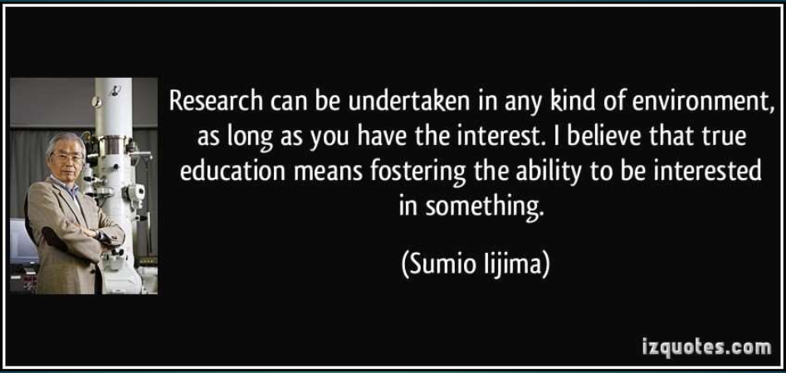
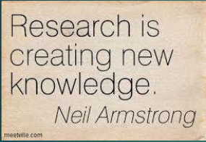

Overview
Research allows me to ask questions and formulate ways to answer them.
www.midocean.ae

Slide 4
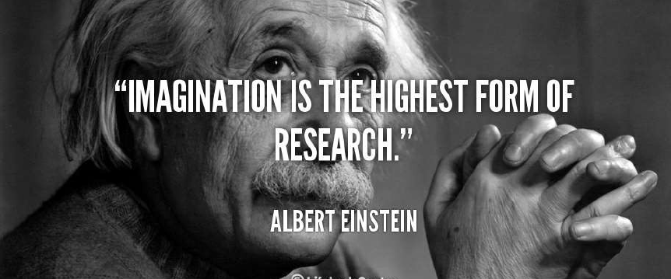
Overview (cont.)
Research is to see what everybody else has seen, and to think what nobody else has thought
www.midocean.ae

Slide 5

Where to Start From?
1. Decide on a general area of interest
  Why does this area interest you?
2. Answer the questions:
    What is the aim?
    What is the hypothesis?
    Does my work have novelty?
    Why does it matter?
3. Discuss your ideas with others
  Supervisors.
  Co-Supervisors.
  Close Colleague working in your domain.
4. Other issues to consider
  Collaboration with Senior Researchers.
  Get your research proposal peer reviewed at every stage from your Supervisor/Co-Supervisor.
www.midocean.ae

Slide 6

What is research?
Research is an art of scientific investigation.
Research is “Search of knowledge”- It is a scientific and systematic search for relevant information on specific topic.
Research is an academic activity which consists of defining and redefining problems, formulating hypothesis or suggested solutions, collecting, organizing and evaluating data, making deductions and reaching conclusions and at last carefully testing the conclusions to determine whether they fit the formulating hypothesis.
Research is an organized set of activities to study and develop a model of procedure technique to find the result of a realistic problem supported by literature and data.
www.midocean.ae

Slide 7

Research Questions
How can machine learning algorithms improve the accuracy of natural language processing tasks?"
"What are the security vulnerabilities associated with Internet of Things (IoT) devices, and how can they be mitigated?"
"What factors influence the adoption of new technology in healthcare settings?
A research question is a clear, concise, and specific inquiry that a researcher seeks to answer through their research study or investigation.
These questions are designed to guide the research process and help focus the study on a particular topic or issue.
Research questions typically address what the researcher wants to explore, understand, or investigate within their study.
Research Questions example
How can machine learning algorithms improve the accuracy of natural language processing tasks?
What are the security vulnerabilities associated with Internet of Things (IoT) devices, and how can they be mitigated?
What factors influence the adoption of new technology in healthcare settings?
www.midocean.ae

Slide 8
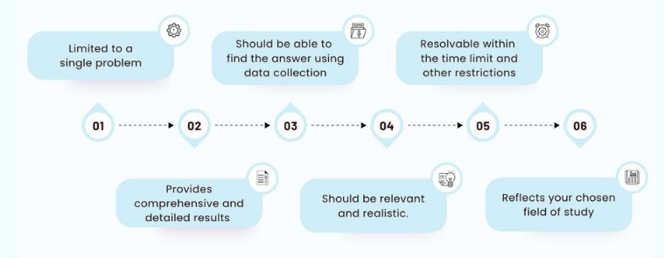
Research Questions Characteristics
www.midocean.ae

Slide 9
What is Computer Science Research?
Computer Science is a systematic study of computing systems and computation. The body of knowledge resulting from this discipline contains theories for understanding:
    computing systems and methods;
    design methodology,
    algorithms, and tools;
    methods for the testing of concepts;
    methods of analysis and verification;
    knowledge representation and implementation.
www.midocean.ae

Slide 10
What is Computer Science Research? (cont. )
  Computer Science Research is a human activity based on the intellectual investigation of aspects of the world related to the discipline of Computer Science to discover new knowledge, interpret existing knowledge, or revise erroneous or incomplete knowledge.
  Normally based on the “Scientific Method”
www.midocean.ae

Slide 11
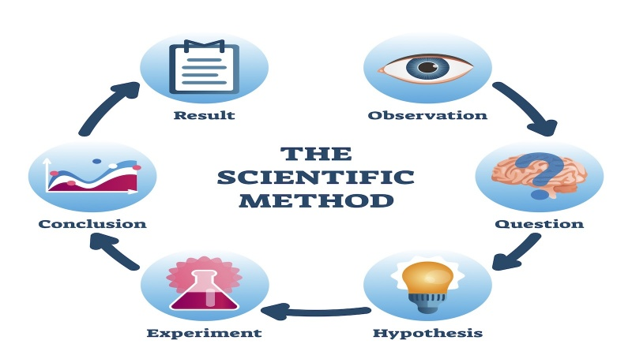
The Scientific Method
Share your findings
Conduct research
Examine your results
Make an observation
Ask the question
Draw a conclusion
Develop your hypothesis
Test your hypothesis with an experiment
www.midocean.ae

Slide 12
Research Methods
Research involves inductive and deductive methods:
Inductive methods analyzes the observation of phenomenon and identify the underlying principles, structures, or processes.
Deductive methods verify the assumed principles through observations.
The purposes are different: one is to develop explanations, and the other is to test the validity of the explanations. i.e., Validation of Simulation work with Experimental work
www.midocean.ae

Slide 13
Objectives of Research
The purpose of research is to discover answers through the application of scientific procedures.
The objectives are:
  To gain familiarity with a phenomenon or to achieve new insights into it- Formulative Research.
  To portray accurately the characteristics of a particular individual, situation or a group -Descriptive Research.
  To determine the frequency with which something occurs or with which it is associated with something else- Diagnostic Research.
  To test a hypothesis of a causal relationship between variables -Hypothesis-Testing Research.
www.midocean.ae

Slide 14
Attributes of Good Research Study
OBJECTIVE: A good research must answer the research question.
CONTROL: A good research must be able to control all variables.
GENERALISABILITY: Generate similar result when used other method.
BIAS FREE: Research should be free from personal bias. It should be based on objective and not on subjective matter.
SYSTEMATIC: A good research study must have various well-planned steps, i.e. all steps must be interrelated, and one step should lead to another step.
www.midocean.ae

Slide 15
Criteria of A Good Research
1. Purpose clearly defined.
2. Research process detailed.
3. Research design thoroughly planned.
4. High ethical standards applied.
5. Limitations frankly revealed.
6. Suitable analysis for decision maker’s needs.
7. Findings presented unambiguously.
8. Conclusions justified.
9. Researcher’s experience reflected.
www.midocean.ae

Slide 16
Types Of Research Studies
Descriptive research: includes surveys and fact-finding enquiries of different kinds. It uses descriptive studies in which researcher seeks to measure characteristics like, shopping behavior, preferences, etc. Generally, survey methods are used for descriptive research.
Analytical research: includes use of facts and information already available and analyze these to make a critical evaluation of the material.
Applied research aims at finding a solution for an immediate problem facing a society or business organization. Marketing research, trend analysis are examples of applied research.
Fundamental research is concerned with generalizations and with the formulation of the theory. Research concerning some natural phenomenon or relating to pure mathematics are examples of fundamental research.
www.midocean.ae

Slide 17
Types Of Research Studies (cont.)
Quantitative research is based on the measurement of quantity or amount. It is applicable to phenomena that can be expressed in terms of quantity. For example, questionnaire survey result.
Qualitative research is concerned with qualitative phenomenon like relating to or involving the reasons or motives for human behavior. For example, word association, tests, sentence completion tests, story completion, etc.
Conceptual research is that related to some abstract ideas or theory. It is generally used by philosophers and thinkers to develop new concepts or to reinterpret the existing one.
Empirical research relies on experience or observation, often with some data-based research. It is necessary to get all facts and information at first hand.
www.midocean.ae

Slide 18
Some other types of research
One-time Research – Research confined to a single time.
Longitudinal Research – Research carried on over several time periods.
Diagnostic Research – It is also called clinical research which aims at identifying the causes of a problem, frequency with which it occurs and the possible solutions for it.
Exploratory Research –It is aimed to gain familiarity with the problem, to generate new ideas or to make a precise formulation of the problem. Hence it is also known as formulative research.
Experimental Research – It is designed to assess the effect of one variable on a phenomenon by keeping the other variables constant or controlled.
www.midocean.ae

Slide 19
Research Methods and Methodology
Research Methods
Research Methodology
Research methods may be understood as all those methods/techniques that are used for conduction of research. It refers to the methods the researcher uses in performing research operations. Research methods can be put into following three groups:
  Concerned with data collection
  Concerned with statistical Techniques
  Concerned with methods of evaluating the accuracy of the results obtained.
Research Methodology is a way to systematically solve the research problem.
It may be understood as a science of studying how research is done scientifically. When we talk of research methodology, we do not only talk of the research methods but also the logic behind the methods we use in the context of our research. Research Methodology has many dimensions and research methods do constitute a part of it.
www.midocean.ae

Slide 20
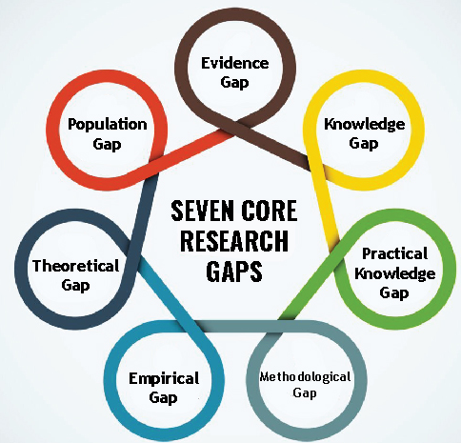
Research Gap
Evidence Gap: When a new study contradicts widely accepted beliefs.
Knowledge Gap: Two main reasons—lack of awareness about related theories and literature in the real-world context, and the possibility of survey findings deviating from expectations.
Practical-Knowledge Gap: This type of gap sparks new research when experts' real-world behavior differs from their recommended behavior.
www.midocean.ae

Slide 21
Research Gap (cont.)
Methodological Gap: Concerns the conflict arising from the influence of research methods on study outcomes.
Empirical Gap: Focuses on shortages in prior research, emphasizing the need for empirical evaluation of research results or proposals.
Theoretical Gap: Involves addressing theoretical shortages in previous research.
Population Gap: Highlights the recurring issue of underserved and under-researched communities in the field of research.
www.midocean.ae

Slide 22
Problems in Research
Uncontrollable variables
Time and money
Lack of computerization
Lack of scientific training in the methodology of research
Insufficient interaction between university research departments and business establishments
Lack of confidence on the part of business units to give information
Lack of code of conduct
www.midocean.ae

Slide 23
Problems in Research(cont.)
Difficulty of adequate and timely secretarial assistance
Poor library management and functioning
Difficulty of timely availability of published data.
Ignorance
www.midocean.ae

Slide 24
Role of Research in Decision Making
Decision-making is the process of selecting the best alternative from the available set of alternatives.
Management is mainly concerned with decision making and its implementation.
These decisions should be based on appropriate studies, evaluations and observations.
Research provides us with knowledge and skills needed to solve the problems and to meet the challenges of a fast-paced decision-making environment.
www.midocean.ae

Slide 25
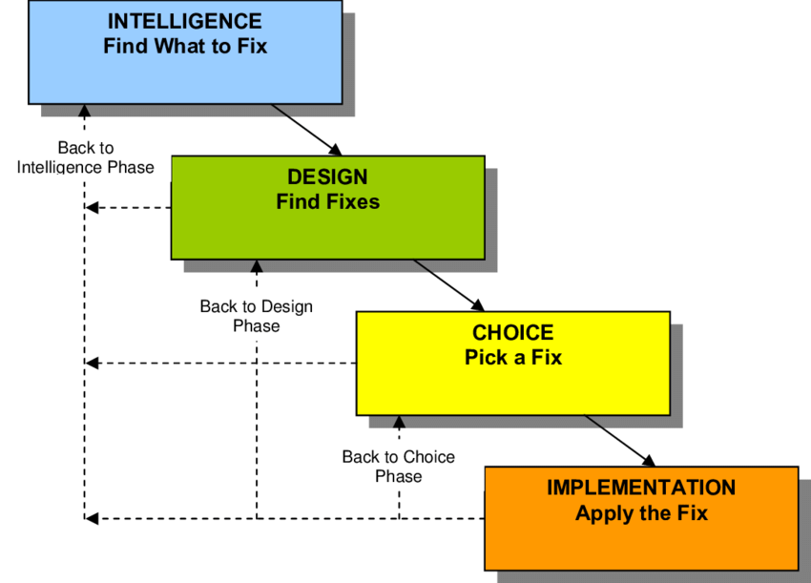
Role of Research in Decision Making (cont.)
According to Herbert A Simon, decision making involves three activities:
Intelligence Activity - scanning the environment for identifying conditions necessary for the decision.
Designing Activity - identifying, developing and analyzing the alternative courses of action.
Choice Activity - choosing the best course of
action from among the alternatives.
www.midocean.ae

Slide 26
Research ‘Musts’
Problem must be clearly recognized
Determine information already available and what further information is required, as well as the best approach for obtaining it
Obtain and assess information objectively to help inform the decision
www.midocean.ae

Slide 27
Research Process
The research process is a systematic and organized series of steps or activities undertaken by researchers to investigate, gather information, analyze data, and generate new knowledge or insights about a specific topic or research question.
It is a structured approach that helps researchers plan, conduct, and report their research effectively.
www.midocean.ae

Slide 28
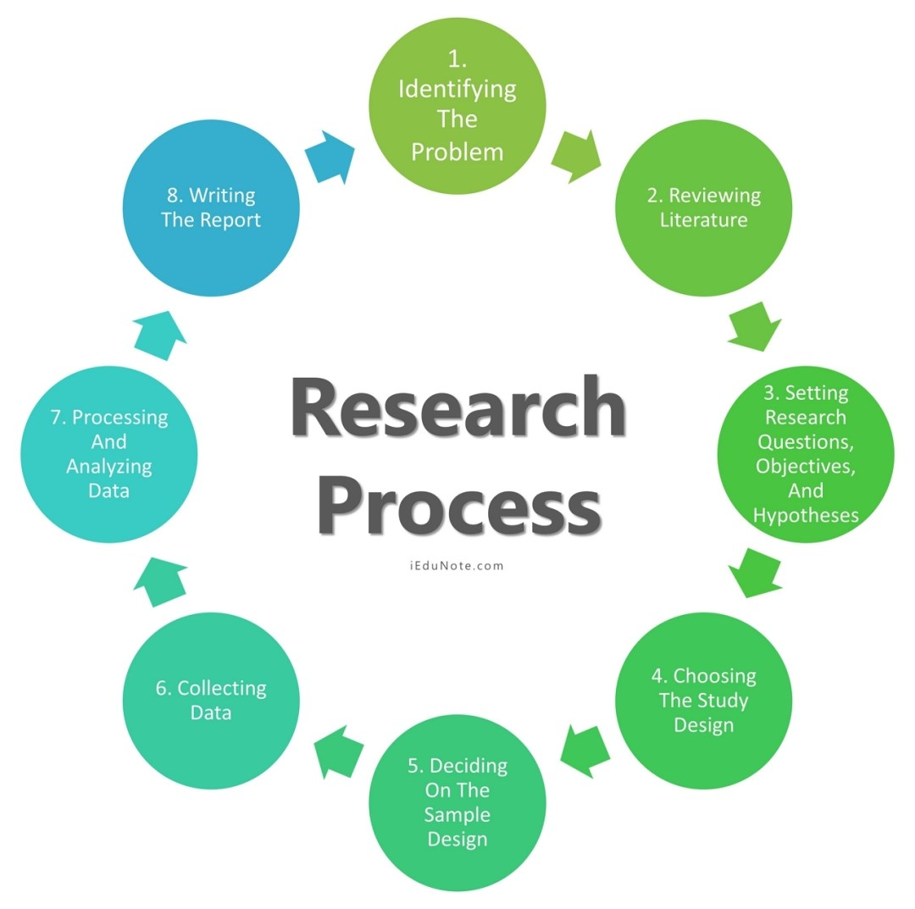
Research Process Steps
Problem Identification and Formulation
Reviewing of Literature
Research Questions, Objectives, and Hypotheses Formulations
Research Design
Deciding on the Sample Design
Collecting Data From The Research Sample
Process and Analyze the Collected Research Data
Writing Research Report – Developing Research Proposal, Writing Report, Disseminating and Utilizing Results
www.midocean.ae

Slide 29
Research Process Steps (cont.)
Problem Identification and Formulation
Finding a research problem is the first and most important step in the entire scientific research
process. Describe the issue or query that needs research:
  The problem you wish to solve or the inquiry you want to answer should be stated clearly.
  Describe your goals and objectives. Describe the goals you have for your research.
A clearly defined problem will help the researcher complete crucial steps in the research process, such as setting objectives and choosing the research methodology.
Researchable issues are those that might be the subject of a thorough verification investigation that considers data analysis and gathering.
www.midocean.ae

Slide 30
Problem Identification and Formulation(cont.)
Researchers need to identify both;
  Non-Research Problems that may hinder the progress of their study, such as lack of funding or limited access to data.
  Research Problem that is the focus of their study, which could be related to a gap in existing knowledge or a specific research question they aim to answer.
      Statement of the Problem
      Justifying the Problem
      Analyzing the Problem
Identifying and defining the research problem is crucial as it sets the foundation for the entire study and helps researchers determine the scope and objectives of their research.
www.midocean.ae

Slide 31

Research Process Steps (cont.)
Reviewing of Literature
Reviewing the literature helps researchers avoid duplicating previous work, learn what others have discovered about the issue, and become familiar with pertinent concepts and theories.
Reviewing pertinent literature aids in problem formulation, background comprehension, methodology selection, and development of coherence between the study's findings and previous findings.
Review relevant papers, articles, books, and other sources to understand the current state of knowledge in interest.
Identify areas where existing knowledge is insufficient or where new approaches can be explored.
www.midocean.ae

Slide 32

Research Process Steps (cont.)
Research Questions, Objectives, & Hypotheses
An aim will clearly state what should be researched, outline the kinds of data that should be gathered, and offer guidelines for the study's scope. The most effective way to state a study purpose is with a well-developed, tested research hypothesis.
A hypothesis is an unverified assertion or claim that can be disproved or confirmed by
empirical evidence.
Hypothetical claims make an assertion about a potential solution to a research question
www.midocean.ae

Slide 33

Research Process Steps (cont.)
Research Design
The research design serves as a guide or framework for achieving goals and responding to research questions.
There are four basic research designs that a researcher can use to conduct their study;
  Experimental design (if applicable): Define the variables, control groups, treatments, and data collection methods for experiments.
  Observational design (if applicable): Determine how data will be collected in non-experimental settings.
  Case study design (if applicable): Specify the case(s) to be studied and the methods for data collection and analysis.
  Survey design (if applicable).
Four factors primarily determine the type of research design to be used:
  The type of problem
  The objectives of the study,
  The existing state of knowledge about the problem that is being studied, and
  The resources are available for the study.
www.midocean.ae

Slide 34

Research Process Steps (cont.)
Collecting Data
Determine where and how to obtain the necessary data (e.g., experiments, surveys, simulations, existing datasets).
There are several methods for collecting data. Some common methods include interviews, questionnaires, and experiments. Additionally, data can also be collected through sources such as existing databases , online platforms and simulators.
Take steps to validate and clean the data to minimize errors and biases.
The goals of the study, the research design, and the availability of resources, including time, money, and personnel, all influence the data collection strategy.
The process for collecting data also varies, depending on whether it will be qualitative or quantitative.
www.midocean.ae

Slide 35

Research Process Steps (cont.)
Data Analysis
Data Processing: Initially, data are edited and coded for uniformity and completeness.
Data Analysis: This phase involves data reduction, summarization, pattern recognition, and the application of statistical methods to answer research questions.
Technique Selection: Choose appropriate statistical or computational methods for data processing.
Interpretation: Analyze findings and draw meaningful conclusions from the data.
Hypothesis Evaluation: Based on the analysis, assess whether the findings align with formulated hypotheses and theories.
www.midocean.ae

Slide 36
Research Process Steps (cont.)
Implementation (if applicable)
Implementation refers to the process of putting into practice or executing a plan, idea, concept, or system. It involves taking theoretical or conceptual designs and turning them into tangible, functional realities.
In various contexts, implementation can refer to the actual construction or development of a product, system, or solution according to established specifications and requirements.
This phase often involves tasks such as coding, building prototypes, testing, and deploying software or hardware. It is a critical step in the project lifecycle as it brings theoretical concepts into the real world, allowing them to be used, evaluated, and refined, as necessary.
This phase is crucial in bridging the gap between theoretical knowledge and real-world applications, allowing for the validation and refinement of research findings.
www.midocean.ae

Slide 37

Research Process Steps (cont.)
Writing Research Report
A research proposal is a formal document that outlines the objectives, methodology, scope, and potential outcomes of a research project. It serves as a detailed plan or blueprint for conducting research, providing a clear framework for the study.
A research proposal must also demonstrate how it will be beneficial. There is always a description of the study's aim (the research objectives) or a statement of the issue.
In a research proposal, the specific research methodology is methodically described, along with the steps taken at each stage of the research process.
www.midocean.ae

Slide 38
Research Process Steps (cont.)
Conclusions
The end goal of a scientific study is to interpret the results and draw conclusions.
After conducting experiments, gathering data, or analyzing information, researchers must carefully interpret their findings and draw meaningful conclusions. This process involves:
  Interpreting Results.
  Contextualizing Findings.
  Analyzing Relationships.
  Addressing Limitations.
  Drawing Conclusions.
  Implications and Applications.
  Suggesting Future Research.
  Communicating Results.
The process of interpreting results and drawing conclusions is crucial for advancing scientific knowledge. It ensures that research is conducted rigorously, and it contributes to the accumulation of reliable, evidence-based information in a given field.
www.midocean.ae

Slide 39
References
LAZAR, Jonathan; FENG, Jinjuan Heidi; HOCHHEISER, Harry. Research methods in human-computer interaction. Morgan Kaufmann, 2017.‏
RICHEY, Rita C.; KLEIN, James D. Design and development research: Methods, strategies, and issues. Routledge, 2014.‏
GODDARD, Wayne; MELVILLE, Stuart. Research methodology: An introduction. Juta and Company Ltd, 2004.‏
www.midocean.ae

Slide 40



Thank You

Slide 41
Characteristics of Research
Research is directed towards the solution of a problem.
Research is based upon observable experience or empirical evidence.
Research demands accurate observation and description.
Research involves gathering new data from primary sources or using existing data for a new purpose.
Research activities are characterized by carefully designed procedures.
Research requires expertise i.e., skill necessary to carryout investigation, search the related literature and to understand and analyze the data gathered.
Research is objective and logical – applying every possible test to validate the data collected and conclusions reached.
Research involves the quest for answers to unsolved problems.
Research requires courage.
Research is characterized by patient and unhurried activity.
Research is carefully recorded and reported.
www.midocean.ae

