Slide 1


Project Governance
Prepared by Dr. Fayez Jrad
PMG 424
Lecture 08

Slide 2



Project Governance
Lecture 08
PMG 424
Governance of Portfolios
Prepared by
Dr. Fayez Jrad

Slide 3
Chapter
Learning Outcomes
08
Clarifying the logic behind developing project portfolios.
Discussing a project portfolio as a governance structure.
Highlighting the types of decisions made in project portfolios.
Understanding the role of portfolio optimization strategies.
Explaining the different measures of project portfolio performance.

Slide 4
The Logic of Portfolios
A project may consist of a larger or smaller number of ongoing projects being run simultaneously.
As these projects typically compete for a finite number of often scarce resources, they need to be governed.
In this case, the focus is on:
Ensuring effectiveness by ‘doing the right projects’.
Ensuring efficiency by ‘doing projects right’.

Slide 5
Whereas Effectiveness Is Achieved Through Project Portfolios, Efficiency Is Achieved Through Project Programs

Slide 6
What is a Project Portfolio
The project portfolio is a grouping of projects and programs by similar skills or resource needs, prioritized by their contribution to corporate strategy and managed together to optimize contribution to strategic objectives.
Project portfolio management is concerned with managing competing needs for scarce skills and resources of the various projects in the portfolio.

Slide 7
Effectiveness and Project Portfolios
Effectiveness is achieved through selection and prioritization of projects (portfolios) that contribute most to corporate strategy.
They create the highest value for the corporation and therefore constitute the most economic use of scarce resources.
This need for effectiveness has led to the development of the project portfolio approach.

Slide 8
Decisions on Portfolios
The board of directors makes the decision on whether and how to use programs and portfolios to implementing the project-based organizational works.
This decision determines the framework for managers to decide on the types of projects in which the organization is going to engage.

Slide 9
Decisions on Portfolios
The project-based part of the organizational works is typically governed by management decisions on:
whether, when and how to share resources across projects;
whether to pursue higher level goals which need to be accomplished through several interlinked projects;
or whether to focus on smaller goals accomplished by individual projects.

Slide 10
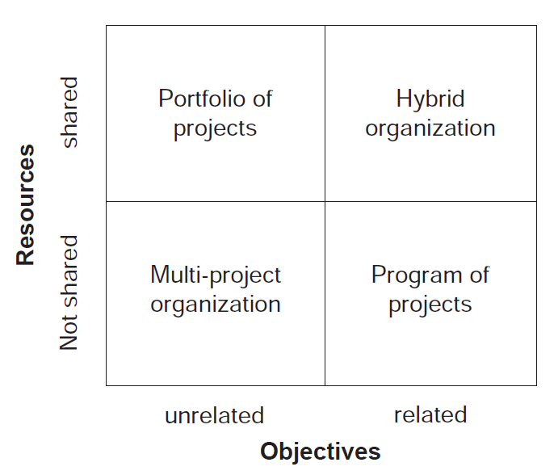
Possible Governance Structures
Previous Management Decisions Lead To Four Possible Governance Structures For Project-based Organizations

Slide 11
Multi-project Organizations
A multi-project organization is meant to maximizing the return on individual projects.
Projects in this type of organization are very diverse and have little or nothing in common, thus there are no synergies of objectives or resource usage.
In such projects, external resources with very specific skill sets may be used for just the duration of a contracted project.

Slide 12
Portfolios of Projects
A portfolio of projects is meant to maximizing the effectiveness by using existing skill sets and contributions to strategic objectives.
Such organizations group their projects based on availability of skill sets and prioritize their projects to maximize their strategic objectives.
The objectives of projects in a portfolio do Not necessarily have to be related to each other; key is commonality of skill sets required.

Slide 13
Programs of Projects
A programs of projects is meant to maximizing efficiency.
Such organizations emphasize synergies stemming from combining several individual project objectives into a larger overall objective.
In this type of organization, skill sets needed may vary significantly between the individual programs.

Slide 14
Hybrid Organizations
A hybrid organization is meant to balancing maximization of effectiveness and efficiency through a combination of program and portfolio approaches.
Such organizations achieve their strategic objectives by combining sharing of skill sets through portfolios and relating project objectives through programs.

Slide 15
Performance of Governance Structures
Corporate performance varies greatly according to the choice of governance structure.
The hybrid organization structure of combining and balancing programs and portfolios is statistically more successful than other three approaches.
The multi-project approach achieves the lowest level of performance, while either the programs or portfolios achieve moderate performance.

Slide 16
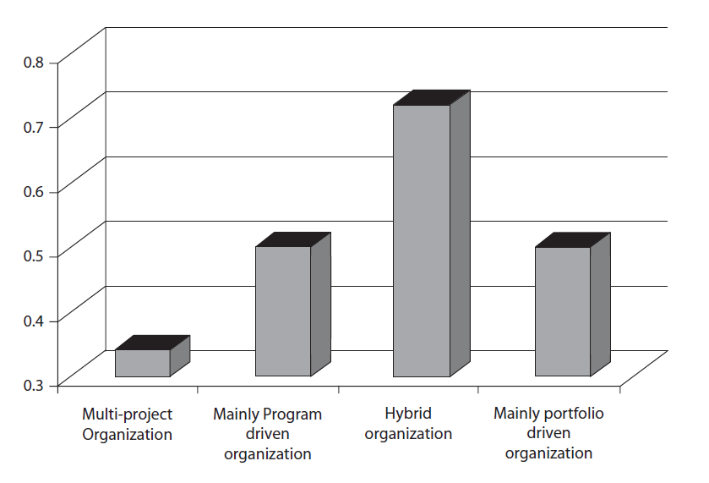
Performance of Governance Structures

Slide 17
The Hybrid Approach Balances Both Efficiency and Effectiveness When Deciding Which Projects To Take On and Which Ones To Drop

Slide 18
Why Portfolios?
The objective of project portfolio governance is to ensure that the best projects are selected; that is, those that will achieve their strategic objectives:
in the shortest possible time; and
within the constraints of available skills and resources.

Slide 19
Why Portfolios?
Projects and programs in any given portfolio are screened, selected, prioritized and scheduled based on getting the highest possible throughput of the ‘best’ projects for the organization.
The term ‘throughput’ implies ensuring the greatest number of the best projects implemented by the organization in the shortest possible amount of time.
The term ‘best’ implies that a large number of good projects might be preferable to a smaller number of excellent projects as the overall throughput will be greater.

Slide 20
Portfolio Management
Effective portfolio management requires a proper communication structure that allows information to flow from portfolios to projects and back again.
Portfolio managers often communicate portfolio decisions to line or middle management, sponsors (and steering groups).
Tactical PMOs collect and aggregate project performance and report to the portfolio level.

Slide 21
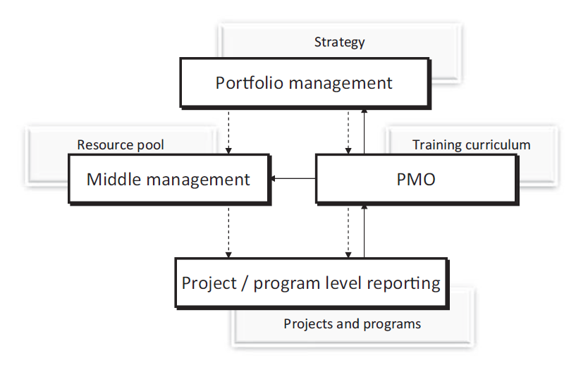
Portfolio Management

Slide 22
Portfolio Management Objectives
An important purpose of project portfolio governance is to achieve the objectives for each portfolio, which should be derived from the organization’s strategy.
These portfolio objectives provide the framework for decision-making within the portfolio.

Slide 23
Portfolio Management Objectives
Portfolio objectives vary depending upon whether the corporation is shareholder- or stakeholder oriented.
Achieving these objectives involves careful selection and prioritization of projects within each portfolio to ensure their alignment with its objectives.

Slide 24
Portfolio Optimization Strategies
There are three most often used portfolio optimization strategies that are either used alone or in combination with each other:
Value Maximization.
Balancing.
Strategic Alignment.

Slide 25
Value Maximization Strategy
In this strategy, projects are selected into the portfolio if they reach a certain threshold value; often financial such as Return on Investment (ROI).
The strategy is criticized as being too numbers focused and for Not factoring in the more qualitative benefits of each project.
Corporations that use this as a standalone strategy are seen to perform the worst in their industry.

Slide 26
Balancing Strategy
Projects are selected into the portfolio based on a balanced weighted measure of several parameters (similar way to an investment fund):
Examples are:
distribution of high versus low-risk projects.
distribution of short-term versus long-term projects.

Slide 27
Balancing Strategy
The balancing matrix uses a number of two-dimensional graphs for each parameter to visualize the relative positions of projects against each other, allowing managers to select the most desirable balance of projects.
The strategy is criticized for lack of guidance on the balancing parameters and weighting criteria.
Corporations that use this as a standalone strategy are seen to be more successful in their industry than those who use Value Maximization as a standalone strategy.

Slide 28
Strategic Alignment Strategy
This strategy assigns a budget value to each strategic objective of the corporation; it is also called the strategic bucket approach.
When a project is considered for the portfolio, it is tested against the objectives of each bucket (that is, the strategic goal).
If the project supports one of the buckets or goals, then it is funded out of the relevant bucket.

Slide 29
Strategic Alignment Strategy
This strategy requires detailed planning, based on a long-term view anticipating future business trends.
This strategy is often criticized for being too hypothetical (requires developing hypothesis on future trends).
Corporations that use this as a standalone strategy are seen to be the most successful in their industry.

Slide 30
Choice of Strategy
The choice of portfolio optimization strategy is related to the orientations of corporations.
While corporations that are shareholder-oriented use the Value Maximization strategy, corporations that are stakeholder-oriented use the Balancing strategy.
Corporations that are both shareholder- and stakeholder-oriented use the Strategic Alignment strategy, as it is contingent on the corporation’s strategy.

Slide 31
Roles and Authorities of Portfolio Managers
Governance of project portfolios also includes deciding on the roles, authorities and decisions on the degree to which the portfolio management process is formalized (or the portfolio manager is engaged).
Roles and authorities assigned to the portfolio managers include:
Business management roles and authorities.
Portfolio decision roles and authorities.
Portfolio maintenance roles and authorities.

Slide 32
Roles and Authorities of Portfolio Managers
Business management roles and authorities:
Participation in corporate business planning.
Special emphasis on contributing to planning for changes in required skill sets and resources.
Procurement of the agreed-upon quantity and quality of skill sets.

Slide 33
Roles and Authorities of Portfolio Managers
Portfolio decision roles and authorities:
Determination of roles.
Naming of individuals with the authority to identify, prioritize and select projects within the portfolio.
Includes responsibility and authority to start, suspend or terminate projects from within a portfolio.

Slide 34
Roles and Authorities of Portfolio Managers
Portfolio maintenance roles and authorities:
Collection and aggregation of reports.
Participation in steering groups and project/program plan reviews.
Identification of bad projects and associated initiation of reviews, handling of issues and so on.
Coaching of project managers.
General improvement of organizational processes.

Slide 35
The Degree To Which the Portfolio Management Process Is Formalized Is Influenced By the Complexity of the Decision-making Process In the Organization

Slide 36
Measuring Portfolio Performance
Portfolio performance is measured using three groups of performance variables:
Achievement of desired portfolio results: these are aggregated project level measures (customer satisfaction, achieved time, cost, quality).
Achievement of project/program purpose: these show how well the projects and programs have fulfilled their purpose (effectiveness of project selection).
Balancing priorities: these are business level measures (resource retention, timely implementation of programs and stakeholder satisfaction).

Slide 37
Roles
The Three Groups of Measures For Portfolio Performance Should Be Assessed At Each Portfolio Reporting Cycle

Slide 38
Conclusions
The project portfolio is a grouping of projects and programs by similar skills or resource needs, aiming to contribute to a strategic objective.
Project portfolio management is concerned with managing competing needs for scarce skills and resources of the various projects in the portfolio.

Slide 39
Conclusions
Whereas efficiency is achieved through project programs, effectiveness is achieved through project portfolios.
Effectiveness is achieved through selection and prioritization of projects (portfolios) that contribute most to corporate strategy.

Slide 40
Conclusions
The board of directors makes the decision on whether and how to use programs and portfolios as an approach to implementing the project-based works.
This decision determines the framework for managers to decide on the types of projects in which the organization is going to engage.

Slide 41
Conclusions
The hybrid approach of combining and balancing programs and portfolios is statistically more successful than other three approaches.
The multi-project approach achieves the lowest level of performance, while either the programs or portfolios achieve moderate performance.

Slide 42
Conclusions
The three portfolio optimization strategies are Value Maximization, Balancing, and Strategic Alignment.
The choice of portfolio optimization strategy is related to the orientations of corporations (shareholder or stakeholder.

Slide 43
Task 1
Find an internationally successful company, and discuss how their portfolio optimization strategies and decisions have contributed to their favourable performance?

Slide 44
Task 2
Find a local company in which the portfolio management process is formalized, and discuss how formalization impacted the roles and authorities of the portfolio manager?

Slide 45

Reference

Slide 46



Thank You

