Slide 1
Lecture three:
The effectiveness of the “Holistic project operations compliance plan “HPJOCP in creating Project Competence-Integration (PCTI), for having project compliance readiness and ensuring successful project management outcomes

Slide 2
The compliance -integration into project management,
It involves ensuring that the project activities, processes, and deliverables meet the prescribed requirements set by external regulatory bodies, industry standards, or internal organizational policies.
Compliance requirements may vary depending on the nature of the project, industry, and geographical location.

Slide 3
The lecture target
This integration not only enhances project performance but also mitigates risks associated with non-compliance, ensuring that projects are executed within legal and regulatory boundaries.
Moreover, the HPJOCP fosters a culture of transparency and accountability, promoting ethical practices and minimizing the likelihood of repetitional damage.

Slide 4

Section 1
The HPJOMS road map
The HPJOCM frame work
The Project success types and HPJOCP compliance integration levels
Section 2 :
The Project success types and HPJOCP compliance integration levels
Section 3
The requirements and challenges of the PCTI

Slide 5
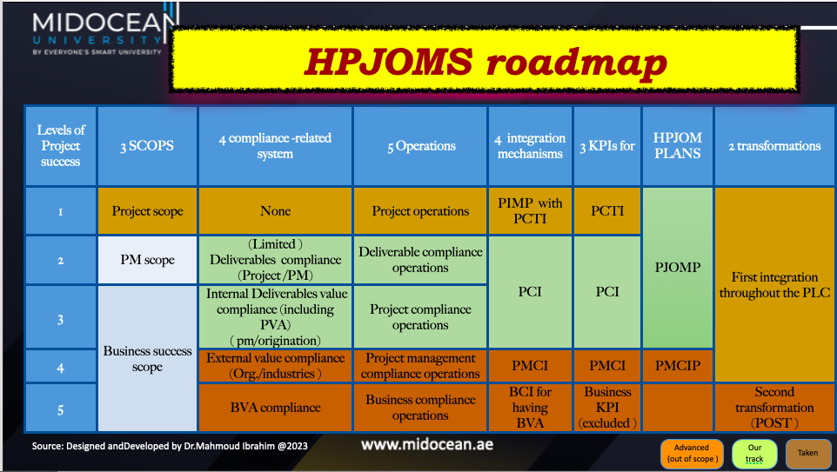

Slide 6
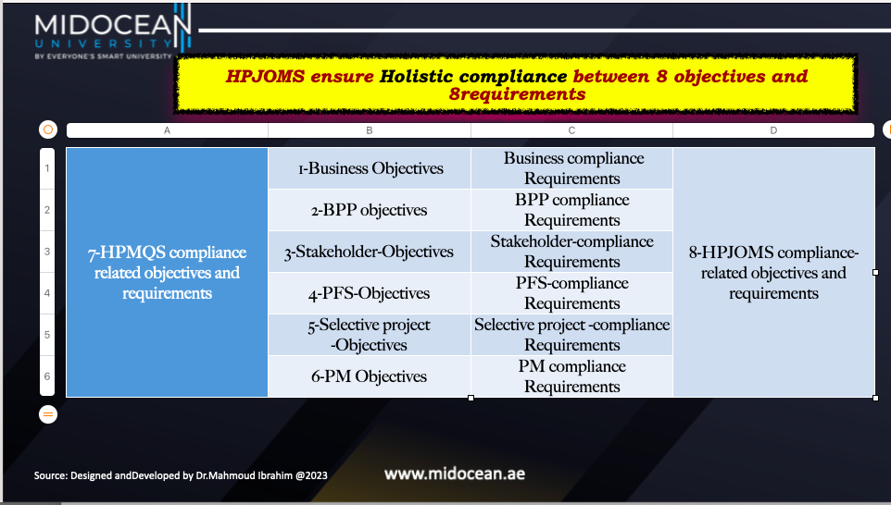

Slide 7
Comments
Achieve the PMBOK 7th edition by shifting from creating deliverables to delivering value added system
Each compliance level has its own objective ,scope and baselines (time,Budget,Resources,Quality standard, risk ,change management, procurement ,acceptance level )

Slide 8

The HPJOCP and its compliance-integration levels …
The role of the HPJOCP in managing the project success

Slide 9
What is Holistic project operations compliance plan “HPJOCP”?
"It is a comprehensive framework that aligns project management operations with business compliance requirements and conforms Project adherence to laws, regulations, policies, and standards throughout the project management operations .This is achieved by:
Identifying and assessing compliance requirements,
Establishing processes to meet compliance requirements,
Identifying potential compliance risks early by discovering any compliance gaps that may lead to non-compliance issues at the project initiation, including compliance-related tasks and activities in the project plan, a
Allocating necessary resources for compliance activities, and
Monitoring compliance performance and progress throughout the project lifecycle.
Taking corrective action if any deviations occur throughout its compliance integration level.
HPJOCP documentation, audits, and inspections are often conducted to ensure adherence.“

Slide 10
The HPJOCP goals
This framework includes regular audits and reviews to ensure ongoing compliance, providing project management with the opportunity to identify and address any potential compliance issues before they escalate.
Additionally, identifying implementation of the HPJOCP not only safeguards the project’s success but also instills confidence in stakeholders, attracting potential investors and clients.

Slide 11
The HPJOCP characteristics

Slide 12
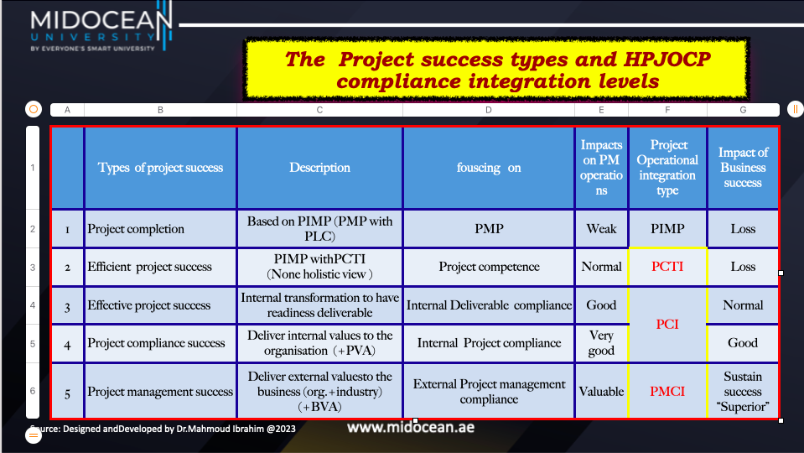

Slide 13
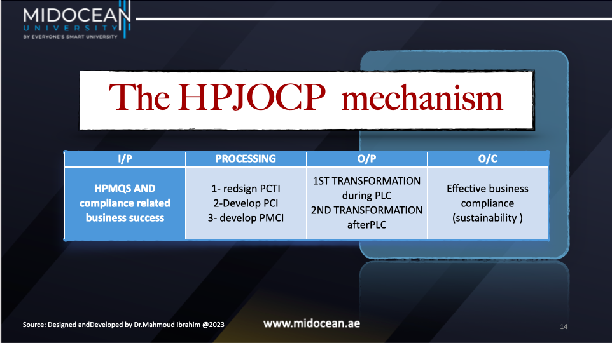

Slide 14
HPJOCP and its impact on efficiency PM
HPJOMP enables effective communication and collaboration among different stakeholders involved in project compliance, including regulatory bodies, auditors, and internal teams.
This streamlined approach promotes:
optimizing workflow transparency and accountability,
a standardized approach to project management,
reduces the chances of errors or misunderstandings that can lead to non-compliance and
minimize any potential setbacks or disruptions
mitigating risks helps to safeguard project outcomes

Slide 15

The first compliance integration of the HPJOCM
(PCTI)
Note :Project integration management plan(PIMP) is for developing the planned deliverables
But project competence integration (PCTI)is the project operations for managing the PIMP to be on track and achieve its goals and deliver PFS (compliance deliverable )
And maximizing the compliance related readiness by developing the project competence integration (PCTI)

Slide 16
Project competence-integration
(PCTI)
As a first project compliance integration level of HPJOCP, It is a systematic process of incorporating and aligning the knowledge, skills, and capabilities of project management team members with the project objectives and compliance requirements. It involves strengthening the expertise and experience of individuals to enhance their project performance and project progress rate .
It focuses on ensuring that the team members possess the necessary competencies to execute their assigned tasks effectively and contribute to the overall project success and to achieve project objectives.

Slide 17


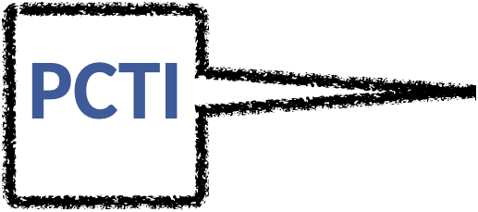
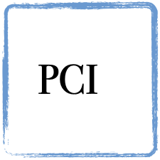

Enhancing
Prerequisite

Slide 18
The aim of the PCTI
PCTIplays a crucial role in ensuring competence related PM that are well-prepared and equipped with the necessary skills and knowledge to adhere to project compliance standards therefore developing PCTI.

Slide 19
HPJOCP and PCTI relationship with the Business Compliance Objectives
Reading The PCTI is the first compliance integration of the HPJOMS ,the HPJOCP guidelines into PCTI's project operations not only ensures compliance and commitment to responsible and lawful business practices, but also can be a competitive advantage in the market.

Slide 20
The PCTI relationship with HPJOCP
it is a symbiotic one, as the implementation of the framework enables PCTI to
1. meet its compliance obligations while also benefiting from optimizing project operations.
2. Allow for continuous improvement and adaptation to changing compliance requirements, ensuring that projects stay up-to-date and compliant throughout their lifecycle.
3. Provide PCTI with access to valuable resources and expertise that can help them overcome complex compliance issues and mitigate risks.
By staying current with HPJOCP, PCTI can enhance PM competence as a trustworthy and reliable partner, attracting more clients and business opportunities.

Slide 21
PCTI impact on PM
Regrading PM :Project management compliance refers to the adherence to established project management methodologies, frameworks, and best practices.
Regarding the PMP: It includes following best practices in areas like scope management, time management, cost management, quality management, risk management, stakeholder management, and communication management.
Regarding the PLC :It focuses on ensuring that projects are planned, executed, and controlled in accordance with recognized project management standards, such as the Project Management Institute's (PMI) Project Management Body of Knowledge (PMBOK)

Slide 22
PCTI impact on the project manager operational decisions
1. By establishing the HPJOCP, the PCTI creates a centralized platform where project managers can assess and address any compliance gaps, ensuring that projects are executed smoothly and efficiently.
2. By integrating PCTI into the PM process, project managers can proactively address these risks and ensure that all compliance requirements are met.
3. Help project managers and stakeholders monitor, track, and report on project performance and compliance-related progress information.

Slide 23
PCTI requirements and challenges
3

Slide 24
Based on PMI's Project Management Body of Knowledge (PMBOK)
It's important to note that the specific requirements for project competence integration and project compliance integration may vary depending on the industry, project type, and organizational context.

Slide 25
PCTI requirements

Slide 26
It is requirements
In project competence integration, the emphasis is on aligning the skills and capabilities of team members with project requirements. This includes:
1. Identifying necessary competencies: Assessing the required skills and knowledge for each role within the project team.
2. Acquiring competent resources: Recruiting or assigning team members who possess the necessary competencies.
3. Developing team capabilities: Offering training and development opportunities to enhance individual and collective competencies.
4. Promoting collaboration: Encouraging effective communication, knowledge sharing, and teamwork among project team members.

Slide 27
Challenges of
project competence integration
The project competence integration is a critical requirement of the PIMP
And success factor for PCI (second integration )

Slide 28
1. Skill and Knowledge Gaps:
Identifying and addressing skill and knowledge gaps within the project team can be challenging. It may require conducting comprehensive skill assessments, providing appropriate training programs, and ensuring the availability of resources with the required competencies.

Slide 29
2. Team Dynamics and Collaboration:
Building effective team dynamics and fostering collaboration among team members can be challenging, especially in large or geographically dispersed teams.
Communication barriers, conflicting work styles, and a lack of trust or cooperation can hinder competence integration efforts.

Slide 30
3. Changing Project Requirements:
Projects often undergo changes in scope, objectives, or technology, which may require acquiring new competencies or adapting existing ones. Managing these changes and aligning the team's competencies with evolving project requirements can be challenging.

Slide 31
4. Resource Constraints:
Limited resources, such as budget or time, can impact the ability to invest in training and development initiatives. Balancing resource allocation between project execution and competence development can be a challenge, particularly in fast-paced or resource-constrained environments.

Slide 32
4. Ensuring Stakeholder Understanding and Commitment:
Obtaining buy-in and commitment from project stakeholders, including team members, clients, and regulatory bodies, can be challenging. Clear communication, education, and engagement efforts are necessary to ensure that all stakeholders understand the importance of compliance and actively support compliance integration initiatives.

Slide 33
5-Limited Training Resources:
Availability of training resources, such as trainers, training materials, or budget, can be a challenge. Organizations may face limitations in terms of capacity, expertise, or financial resources to provide comprehensive training programs. Prioritizing training needs and identifying cost-effective solutions can help mitigate these challenges.

Slide 34
6-Resistance to Change:
Implementing new competence integration practices or introducing changes to existing processes can be met with resistance from team members. Some individuals may be resistant to acquiring new skills or changing their approach, leading to a reluctance to embrace competence development initiatives. Overcoming resistance and fostering a culture of continuous learning can be challenging but is essential for successful competence integration.

Slide 35
8-. Retaining and Transferring Knowledge:
Knowledge retention and transfer can be challenging, particularly in projects with high turnover rates or when team members transition between projects. Capturing and preserving project-specific knowledge, lessons learned, and best practices becomes crucial to ensure knowledge continuity and prevent loss of valuable expertise.

Slide 36
9- Identifying and Assessing Competencies:
One of the initial challenges is accurately identifying the required competencies for each project role. Determining the specific skills, knowledge, and abilities needed can be complex, especially in projects with unique or specialized requirements. Conducting comprehensive competency assessments and aligning them with project goals is crucial but can be time-consuming and resource-intensive.

Slide 37
The three PCTI
Success factors

Slide 38
Assessing the team's collective capabilities
Identifying the required competencies for each project role and ensuring that the right individuals with the appropriate skills are assigned to those roles. This includes assessing the team's collective capabilities and identifying any gaps that need to be addressed through training, hiring, or reassigning resources.
Needs assessment :Providing training and development opportunities to enhance the competencies of team members. This can involve conducting skill assessments, designing training programs, and offering coaching or mentoring to help individuals acquire or improve their skills.

Slide 39
Knowledge Sharing and Project Performance Evaluation:
2-Knowledge Sharing :Facilitating effective communication and collaboration among team members to promote the exchange of knowledge and expertise. This can be achieved through regular team meetings, project documentation, lessons learned sessions, and the use of collaboration tools and platforms.
3- Project Performance Evaluation: Continuously monitoring and evaluating the performance of team members to ensure they are meeting the required competencies and performance standards. This may involve conducting performance appraisals, providing feedback, and addressing any performance gaps through training or corrective actions.

