Slide 1


Project Governance
Prepared by Dr. Fayez Jrad
PMG 424
Lecture 03

Slide 2



Project Governance
Lecture 03
PMG 424
Creating Project-focused Governance Structures
Prepared by
Dr. Fayez Jrad
www.midocean.ae

Slide 3
Chapter
Learning Outcomes
03
Explaining how projects are related to organizational strategy.
Understanding projects as temporary organizations.
Identifying the institutions responsible for project and project management governance.
Highlighting existing guidelines, standards, and principles necessary for the appropriate governance of projects, programs, and portfolios.
www.midocean.ae

Slide 4
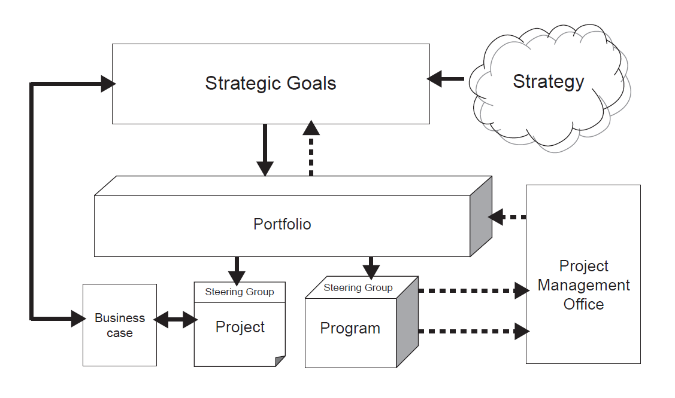
Projects and Strategy
Projects are created to accomplish an organization’s strategy.
Strategy and projects are linked through a delivery cycle and a control cycle.
www.midocean.ae

Slide 5
The Delivery Circle
The delivery cycle is shown by solid arrows.
Strategy determines the strategic goals necessary, which, in turn, determine the goals of the project portfolios, as well as the projects and programs required within the portfolio.
Whereas portfolios are governed by the board of directors, projects and programs are governed by respective steering groups.
These groups own the business case, which stems from the organization’s strategy and determines the scope of individual projects and programs.
The sum of these projects and programs contributes to the achievement of these strategic goals.
www.midocean.ae

Slide 6
The Control Circle
The control cycle is shown by dotted line arrows.
Project Management Offices (PMOs) or similar structures enable control of the alignment between strategy and capabilities via information flow from projects to the various governance levels in the organization.
For example, the PMO aggregates project performance information for the portfolio manager who takes this information into account for future portfolio decisions.
The portfolio manager then reports performance data to senior management enabling them to refine or adjust the strategy as appropriate according to the organization’s capabilities.
www.midocean.ae

Slide 7
Projects as Temporary Organizations
The heart of each project is an endeavour to create an outcome.
This outcome needs to be accomplished by people, within the constraints of time, cost and other constraints.
A project therefore can be considered as a temporary organization of people for the accomplishment of a specific outcome, with a planned start date and end date.
Projects reside within the permanent organization; that is, the corporation itself, a permanent organization with no planned end date.
www.midocean.ae

Slide 8
Projects as Temporary Organizations
Within this perspective, projects can be seen as a production function of the firm.
Here individual projects serve as agencies to manage uncertainties in new undertakings, stimulate change of different kinds and utilize resources.
Within each agency the project manager acts as CEO of this temporary organization.
All these agency functions and agency decisions need to be aligned continuously with the firm’s strategy and its tactical objectives and capabilities.
The need thus arises for governance as a framework for decision making in and for projects.
www.midocean.ae

Slide 9
Why We Need Project Governance
Given the need for governance of temporary organizations, project governance aims to achieve a consistent and predictable delivery of projects and programs in accordance with their planned contribution to corporate strategy and stakeholder expectations.
This is achieved through a consistent and coherent execution of governance roles and responsibilities by the various management levels throughout the organization.
The purpose of governance structures is the alignment of the objectives at the different management levels of the organization to allow for most effective and efficient project planning and execution, within the boundaries of corporate governance.
www.midocean.ae

Slide 10
Objectives of Project Governance
Objectives of project governance include:
  Fostering of an environment allowing projects to be successful.
  Prioritization of projects for best use of resources.
  Identification of projects in trouble.
  Rescue, suspension or termination of these projects as appropriate.
Governance then defines the processes, roles and accountabilities of the managers in the different institutions which perform corporate governance.
www.midocean.ae

Slide 11
Governance Institutions
Institutions responsible for governance of portfolios are:
  Board of directors.
  Portfolio management.
  Sponsors and steering groups.
These institutions are following discussed to clarify their roles, responsibility and type of decisions made.
www.midocean.ae

Slide 12
Board of Directors
This is the highest level of management in the corporation and governance originates at this level.
Directors must find the appropriate balance between governance of projects and governance of project management.
While the former comprises the extent to which the business is run using projects, the latter addresses the capacity of project and program managers needed to execute these projects.
Here the foundation is laid for the governance paradigm to be used throughout the entire organization.
www.midocean.ae

Slide 13
Board of Directors and Projects
Project governance decisions made by the board of directors include strategy formulation, which decides on the types, quantities and scope of the various projects needed to implement the strategy.
For example, a strategy to spend 50% of the annual budget on revenue generating projects, 30% on R&D projects, 10% on quality improvement, and 10% on legally enforced projects.
These numbers give the first indication about the number and type of projects to be expected.
This information is then taken up by the portfolio managers to make decisions on which projects to accept into the portfolio and which to start, suspend, continue or terminate.
www.midocean.ae

Slide 14
Board of Directors and Project Management
Project management governance decisions include fundamental questions on the strategic value of project management to the organization.
Is project management to be done on the side by technical specialists who have little or no training or previous experience of project management, by temporarily contracted external project managers, or by full-time professional project managers employed by the organization?
These decisions are often made on an ad-hoc or unconscious basis. However, these decisions are Project Management Governance decisions and need to be made as part of a conscious overall strategy.
www.midocean.ae

Slide 15
Decisions of the Board of Directors
The Board of Directors make project management governance decisions as part of a conscious overall strategy, which include the quantity and quality of:
  Portfolio management personnel.
  Project and program sponsors including steering groups.
  Program and project managers.
  Possible project/program management office (PMO) functions.
  Communication structures, such as reporting and disclosure at the project.
  Program, PMO and portfolio level.
The governance paradigm established through the board’s decisions on the above items is then filtered down the organization.
www.midocean.ae

Slide 16
Individual Project Governance
Governance of individual projects is done mainly through portfolio managers, sponsors/steering groups and strategic PMOs.
Implementation of the policy and actual governance of project management is mainly undertaken by middle management and tactical PMOs.
Within the given governance paradigm and the decisions made by the board of directors, the project governance institutions decide on the priority of individual projects.
They also decide on the project management processes, techniques, acceptance criteria, type of project management skills and so on needed at the project level.
www.midocean.ae

Slide 17
Portfolio Governance
A portfolio is a grouping of projects around a particular skill set needed for executing these projects.
The projects in any individual portfolio do not necessarily have to be related to each other.
The requisite skills sets (or resources) do have to be.
Large organizations often run several portfolios in parallel.
For example, one portfolio of application development projects for external customers in the banking industry, another for retail solutions for external customers, a third for internal IT projects.
www.midocean.ae

Slide 18
Governance Decisions at the Portfolio Level
Project governance decisions made at the portfolio level are:
  Acceptance of projects into the portfolio, based on the organization’s strategy.
  The portfolio optimization strategy and the organization’s capabilities.
  Prioritizing of projects, including start, end, suspension and termination of projects.
  Allocation of resources to projects based on project priorities.
  Identification of skills bottlenecks or other strategic resources, which risk delays in delivery of projects within the portfolio.
  Possible remedies and mitigation strategies for any risks, issues and so on encountered within the portfolio.
www.midocean.ae

Slide 19
Sponsors
A sponsor is usually a manager whose organization provides funding for the project.
It is anticipated that this organization receives the most benefits from the project outcome; therefore, the sponsor is the person most interested in the success of the project.
This function may be separated into a project owner who receives the benefits of the project outcome and a project sponsor organization which provides the budget for the project.
An example is an international development project where a local government owns a project, and the funding comes from World Bank.
www.midocean.ae

Slide 20
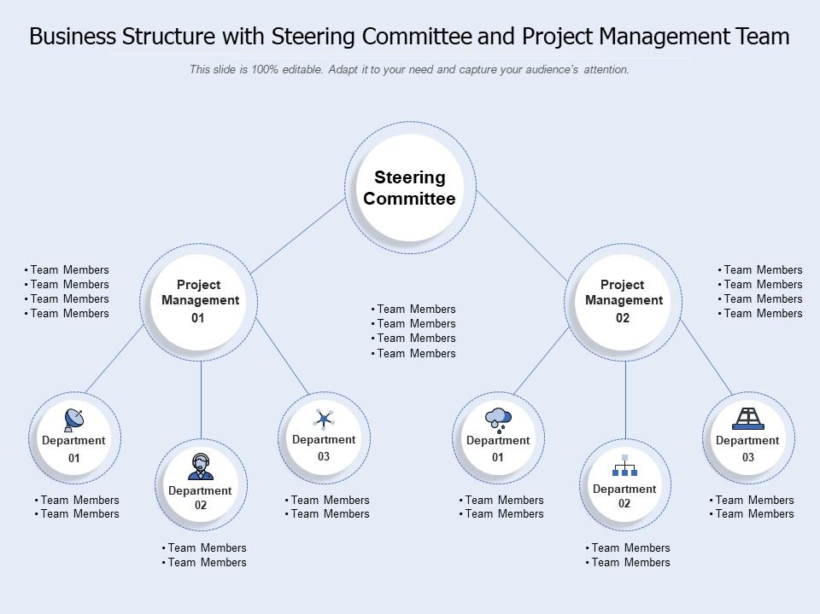
Steering Groups
Steering Groups are committees set up to implement governance of the project.
They are also known as Steering Committees or Project Boards, and are typically chaired by the sponsor.
www.midocean.ae

Slide 21
Minimum Steering Group Members
PRINCE2 suggests that steering groups consist of, as a minimum:
  The project sponsor: the manager who orders the project and gains most of the benefits from the outcome. This is often, but not always, the same manager or organization that provides the funding for the project.
  The project manager: the manager who is given the responsibility for the day-to-day management of the project on behalf of the steering group. The project manager has a role in the steering group and will often attend many steering group meetings, but is not a member of it.
www.midocean.ae

Slide 22
Expanded Steering Group Members
Beyond the minimum, typical additional members of the steering group are:
  Managers representing the users of the project outcome.
  The major suppliers and stakeholder groups.
  Executive management.
  Others on demand; these may often be temporary additions to the core steering group members. In such cases they may have a specific role to play, such as SMEs (Subject Matter Experts) for a particular phase of the project and are no longer required once that particular phase has been completed.
www.midocean.ae

Slide 23
How Things Work
Sponsored projects are selected by portfolio management for execution.
Once selected, either an individual sponsor, or a steering group is formally assigned ownership.
The sponsor then owns the business case for this project and is accountable to senior management for achievement of the business goals associated with it; the sponsor acts mostly as the chairperson of the steering group.
This practice is very common in industrial and technical projects where the sponsor’s role is closely related to the conceptualization and realization of the business benefits.
www.midocean.ae

Slide 24
How Things Work
Steering groups are ultimately responsible for project success and constitute the governance institution closest to project execution.
They appoint the project manager, set the parameters in terms of budget, time, success criteria (for example, quality levels) and define the goals to be achieved within these limits.
The sponsor or steering group then executes governance by providing resources, controlling the project milestones, deliverables and change control and acceptance of project.
They also provide advice and guidance as needed to the project manager.
During the project’s existence the project manager reports to the assigned steering group.
www.midocean.ae

Slide 25
Program Governance
Programs are groupings of projects with a common goal.
Program governance comprises determining the framework for management of the projects within the program.
This includes the methodologies to be used, the change management processes to be followed, the risk management processes to be undertaken and the natureof reporting by each project manager.
Program managers act as sponsors for the projects within their program; they are ultimately responsible for achievement of the objectives of all individual projects within the program.
An additional program board might be established to take on the steering group function for the entire program.
www.midocean.ae

Slide 26
Strategic Project Management Offices
Strategic project management offices are governance institutions that are either explicitly identifiable within the organization or are more implicit in other management roles such as those of Vice Presidents or heads of R&D departments.
Whether explicit or implicit, governance is always done within the organization; someone will decide which projects to accept and which ones to drop.
This is not the case when it comes to Program Management Offices; not all organizations have them, even though they have become very popular in recent years.
A wide variety of different types of PMO exists, from the enterprisewide and strategic to the operational and tactical.
www.midocean.ae

Slide 27
Goals of Strategic Project Management Offices
The Strategic PMO sets the goals to be achieved in terms of project management results.
Typical objectives set by this type of PMO include Corporate Balanced Scorecard measures, such as ‘number of red projects’, or ‘revenue at risk due to red customer delivery projects’.
The classification of projects by colour is typically defined along the following lines:
  Green: overall status OK.
  Yellow: plan deviation, project in need of management attention.
  Red: serious deviation from plan, project in danger of failure.
www.midocean.ae

Slide 28
Tactical Project Management Offices
The means to achieve project goals are provided by a tactical PMO.
Progress control is done by collecting performance data on all projects in a portfolio.
Centralized tools are used for collection of performance data and subsequent classification of projects as red, yellow or green.
This data are aggregated into an overall portfolio report for the portfolio manager, which serves as an input to further portfolio decisions and for measuring the portfolio’s contribution to corporate strategic objectives.
www.midocean.ae

Slide 29
Project Management Governance Institutions
Using the governance paradigm and decisions made by the board of directors, project management governance institutions decides on the project management related skill levels required, the depth to which each is required, and the quantities needed.
These institutions include:
  Middle Management.
  Tactical PMOs.
www.midocean.ae

Slide 30
Middle Management
Middle managers are responsible for the operational implementation of corporate strategy, which is done via ongoing processes and projects.
For projects middle managers need to recruit, train and maintain a pool of project managers with the level of project management skills required to implement the mix of projects.
Decisions made by middle managers include:
  How many different project management skills levels are needed for the projects the manager is responsible for.
  What are the profiles of the different skills sets needed (junior, experienced and senior project managers).
  What are appropriate training and certification programs for these levels.
  How many project managers are needed for each skill level.
www.midocean.ae

Slide 31
Tactical PMOs
Tactical PMOs work with project managers to ensure each project uses the optimal depth and breadth of methodologies, processes, techniques, tools and other management functions.
Tactical PMOs often provide training and consulting services to project managers.
Questions addressed at the level of the tactical PMO include:
  Which methods, tools, techniques should be used for the different projects in the organization?
  Which areas of project management should be improved within the organization?
  How do we ensure use of appropriate methods, tools and techniques in the project management community?
  How do we ensure a seamless information flow among and between the different governance institutions?
www.midocean.ae

Slide 32
Existing Standards and Guidelines
The APM Guide to governance of project management is addressed in relation to four main dimensions:
  Portfolio direction effectiveness and efficiency.
  Project sponsorship effectiveness and efficiency.
  Project management effectiveness and efficiency.
  Disclosure and reporting.
APM defines eleven Governance of Project Management Principles that endure the best implementation of governance within projects, programs, and portfolios.
www.midocean.ae

Slide 33
Existing Standards and Guidelines
APM project management governance principles:
The Steering Group has overall responsibility for governance of projects.
The roles, responsibilities and performance criteria for the governance of projects management are clearly defined.
Disciplined governance arrangements, supported by appropriate methods and controls, are supplied throughout the project life cycle.
A coherent and supportive relationship is demonstrated between the overall business strategy and the project portfolio.
All projects have an approved plan containing authorization points at which the business case is reviewed and approved. Decisions made at authorization points are recorded and communicated.
www.midocean.ae

Slide 34
Existing Standards and Guidelines
APM project management governance principles:
6. Members of delegated authorization bodies have sufficient representation, competence, authority and resources to enable them to make appropriate decisions.
7. The project business case is supported by relevant and realistic information that provides a reliable basis for making authorization decisions.
8. The Steering Group or its delegated agents decide when independent review of projects and project management systems is required and implement such scrutiny accordingly.
9. There are clearly defined criteria for reporting project status and for the escalation of risks and issues to the levels required by the organization.
10. The organization fosters a culture of improvement and of frank internal disclosure of project information.
11. Project stakeholders are engaged at a level appropriate to their importance in the organization and in a manner that fosters trust.
www.midocean.ae

Slide 35
Conclusion
The heart of each project is an endeavour to create an outcome.
Projects are created to accomplish an organization’s strategy.
Strategy determines the strategic goals necessary, which, in turn, determine the goals of the project portfolios, as well as the projects and programs required within the portfolio,
Project Management Offices (PMO) or similar control structures enable control of the alignment between strategy and capabilities via information flow from projects to the various governance levels in the organization.
www.midocean.ae

Slide 36
Conclusion
Project governance in projects as temporary organizations aims to achieve a consistent and predictable delivery of projects and programs in accordance with their planned contribution to corporate strategy and stakeholder expectations.
The purpose of governance structures is the alignment of the objectives within organization to allow for most effective and efficient project planning and execution.
Objectives of project governance include fostering of an environment allowing projects to be successful; prioritization of projects for best use of resources; identification of projects in trouble; and rescue, suspension or termination of these projects as appropriate.
www.midocean.ae

Slide 37
Conclusion
Institutions responsible for governance of portfolios are the board of directors, the portfolio management committee, or the sponsors and steering groups.
Governance of individual projects is done mainly through portfolio managers, sponsors/steering groups and strategic PMOs.
Program managers act as sponsors for the projects within their program; they are ultimately responsible for achievement of the objectives of all individual projects within the program.
An additional program board might be established to take on the steering group function for the entire program.
www.midocean.ae

Slide 38
Task 1
Think of projects as temporary organizations that have their own structures, roles, and responsibilities and try write down what implications this conceptualization has on project management?
www.midocean.ae

Slide 39
Task 2
Try to explore the governance structures of well-known international organizations and map down how project, program, and portfolios governance structures are derived from the parent organizations’ corporate level governance structures?
www.midocean.ae

Slide 40
Task 3
Explore other existing guidelines, standards, and principles necessary for the appropriate governance of projects, programs, and portfolios?
www.midocean.ae

Slide 41

Reference
www.midocean.ae

Slide 42



Thank You

