Slide 1


Capstone Project
(End to End Case for a real dataset)
Prepared by Eng. Ahmed Hussein, MBA, PfMP©, PMP©, CMP APMG
Course: From Data to Decisions using Power BI
Lecture 10

Slide 2



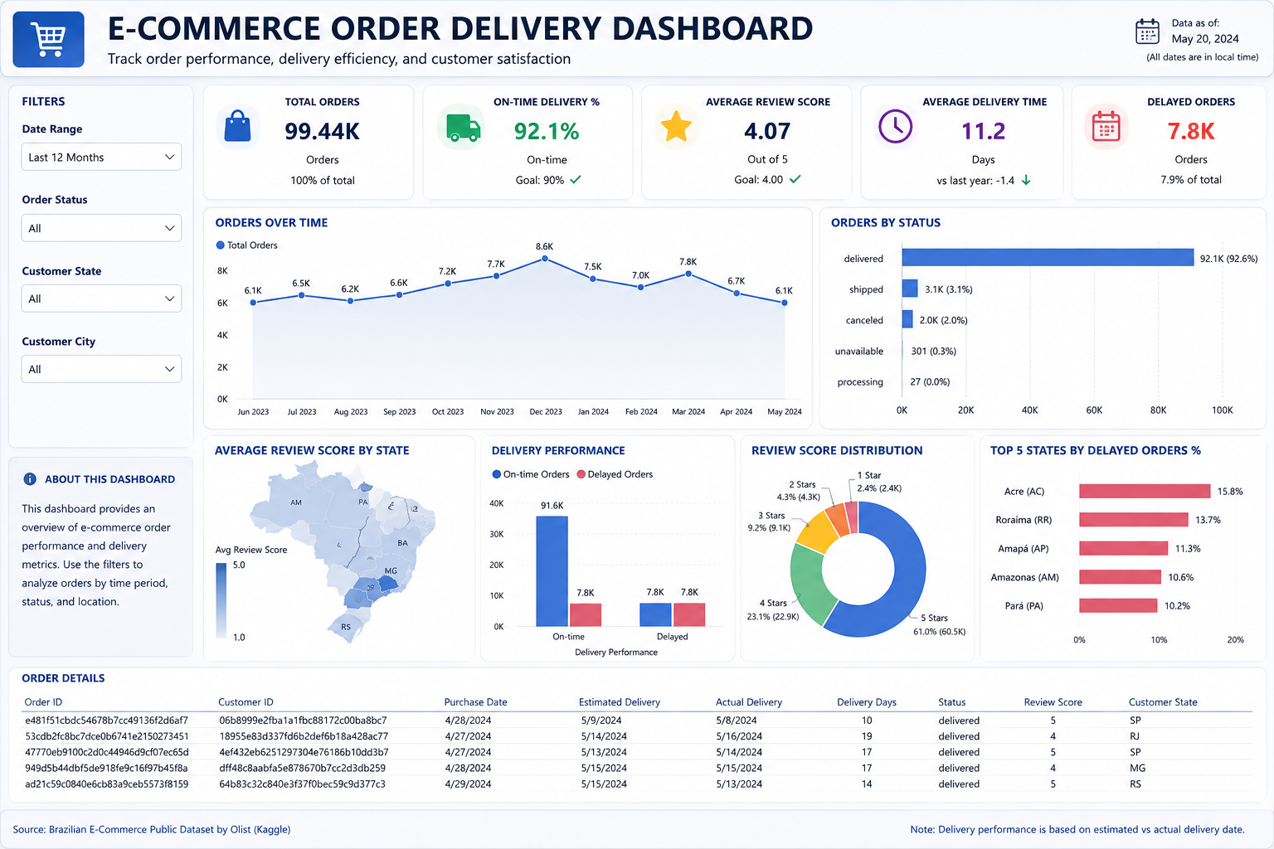
Power BI Capstone Project
E-Commerce Order Delivery Performance Dashboard
Business Scenario
As a Business Intelligence Analyst for a large e-commerce marketplace (Olist), operations management requires an interactive dashboard to monitor order fulfillment, delivery performance, and customer satisfaction to resolve operational bottlenecks.
Learning Objectives
Import & Model: Connect and model multiple e-commerce datasets.
Relationships: Establish star schema data relationships.
DAX Metrics: Develop core delivery and review score measures.
Interactive UI: Build & publish report in Power BI Service.
2

Slide 3

Dataset Overview
Kaggle.com → Login → Datasets → Brazilian E-Commerce (Olist)
Dataset Files Used
About the Dataset
File Name | Contents & Key Fields
Orders | Order lifecycle details: order_id, purchase timestamp, estimated & actual delivery dates, and order status.
Customers | Customer geographic metadata: customer_id, city, state, and regional postal attributes.
Reviews | Customer feedback data: review_id, order_id, review score (1–5), and survey dates.
Public dataset provided by Olist on Kaggle, containing real anonymized transactions from one of Brazil's largest online marketplaces.
Tracks order lifecycles from purchase to delivery, customer geographic locations, and post-delivery review ratings.
3

Slide 4






Business Questions We Will Answer
The Power BI dashboard will solve six primary operational questions required by logistics and customer service leaders:
1. On-Time Delivery
2. Order Volume Trends
3. Order Status Breakdown
Are orders being delivered on time compared to estimated dates?
How has total order volume evolved across different time periods?
Which order statuses occur most frequently (delivered, canceled, etc.)?
4. Regional Delays
5. Customer Satisfaction Impact
6. Operational Priorities
Which states have the highest percentage of delayed deliveries?
Does delivery speed directly influence customer review scores?
Which specific regions require immediate operational intervention?
Strategic Business Value: Enables operations managers to pinpoint fulfillment bottlenecks, optimize partner logistics, safeguard customer ratings, and drive data-backed improvements.
4

Slide 5



Executive Dashboard Components
Dashboard Component | Analytical Purpose & Actionable Insight
Date & Location Slicers | Filter orders by reporting period, state, city, and order status.
KPI Cards Header | Total Orders, On-Time %, Avg Review Score, Avg Delivery Time, Delays.
Order Trend Line Chart | Monitor monthly fulfillment volume trajectories and peak delivery seasons.
Order Status Bar Chart | Compare delivered, shipped, canceled, and in-transit order volumes.
State Performance Map | Geographically map delay hot-spots.
Delivery Performance Chart | Benchmark on-time vs. delayed orders across review scores.
Review Score Distribution | Analyze score breakdowns (1 to 5 stars) against delivery speed.
Detailed Orders Table | Granular drill-down interface to audit specific delayed orders.
Expected Outcome
An interactive executive dashboard connecting logistics metrics with customer review scores for holistic decision-making.
Interactive Drilldown
Slicers and cross-highlighting enable immediate root-cause analysis from national performance down to individual delayed packages.
5

Slide 6




Data Model & DAX Measures
Star Schema Model
Core DAX Measures
DAX Measure Name | Description / Logic
[Total Orders] | Distinct count of order IDs.
[Avg Review Score] | Average score rating across reviews.
[Avg Delivery Time] | Days from purchase to actual delivery date.
[Delayed Orders] | Orders where actual date > estimated date.
[On-Time Delivery %] | Percentage of orders delivered on/before estimate.
[Avg Orders / Month] | Monthly average volume calculation (Optional).
1 : Many
1 : Many
6

Slide 7

Power BI Workflow
(The Analytics Journey)
Lecture
10
Connect Data
Model Data
Create Visualizations
Transform Data
Build Reports/ Dashboards
Publish/ Share
Make Decision
Tables loaded
Connected relationships
Professional Layout
Reliable tables
Charts and KPIs
Decision-ready report
In this hands-on session, we will construct the complete Power BI delivery dashboard through five sequential phases:
7

Slide 8

Live Demo on Power BI
Lecture
09
8

Slide 9
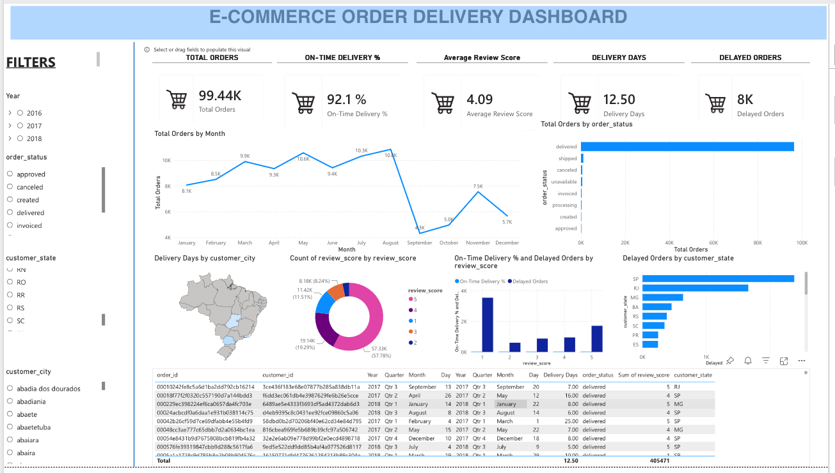
Live Demo Result
We answered all business questions through this one-page report.
1. On-Time Delivery
2. Order Volume Trends
3. Order Status Breakdown
4. Regional Delays
5. Customer Satisfaction Impact
6. Operational Priorities
9

Slide 10
Suggested Improvements:
10

Slide 11




Microsoft Official Certification Pathways
Validate your business intelligence expertise and distinguish your resume with industry-recognized Microsoft credentials:
Power BI Data Analyst Associate
Fabric Analytics Engineer Associate
Designed for analysts who transform raw operational data into actionable dashboards and scalable models.
Tailored for analytics engineers building enterprise-scale data architecture integrating Fabric and Power BI.
Data Preparation: Clean and transform data via Power Query.
Enterprise Architecture: Design Lakehouses & Warehouses.
Data Modeling: Build Star Schemas and DAX measures.
Data Engineering: Dataflows, Pipelines & T-SQL/Notebooks.
Visualization: Design interactive executive dashboards.
Model Optimization: Optimize large semantic models.
Security & Sharing: Manage RLS and Power BI Service assets.
Governance: Manage OneLake data governance.
How to Prepare: Complete Microsoft Learn free learning paths, practice PL-300 assessment exams online, and apply your skills on real capstone projects like the ones built in this course.
11

Slide 12


Keep Building Momentum
4 Steps to Master Power BI & Grow Your Career
1. Build a Standout Portfolio: Publish 3-4 diverse dashboards (e.g., E-commerce, Finance, Healthcare) on Power BI Service & GitHub.
2. Master Advanced DAX: Go beyond basics to master Time-Intelligence, `CALCULATE` context transition, and performance tuning.
3. Engage with the Community: Join the Microsoft Power BI & Fabric Community, attend local User Groups, and share insights.
4. Get PL-300 Certified: Set a target exam date, complete Microsoft practice tests, and earn your official badge.
Pro Tip: Practice data storytelling! The best analysts don't just display numbers—they answer business questions and drive actions.
12

Slide 13




Congratulations & Thank You!
You have successfully completed the Power BI course! You now possess the practical tools to connect data, construct robust data models, formulate DAX calculations, and craft high-impact interactive dashboards.
"Data isn't just numbers—it's the foundation of smarter decision-making. Keep analyzing, keep building, and never stop learning!"
13

Slide 14
Thank You

