Slide 1



Strategic Management
Prepared by Dr. Amira Elfekky
Lecture 10
MGM414

Slide 2

Content
Part One / Analysis
Chapter 1 What Is Strategy?
Chapter 2 Strategic Leadership: Managing the Strategy Process
Chapter 3 External Analysis: Industry Structure, Competitive Forces, and Strategic Groups
Chapter 4 Internal Analysis: Resources, Capabilities, and Core Competencies
Chapter 5 Competitive Advantage, Firm Performance, and Business Models

Slide 3
Content
Part Two/ Formulation
Chapter 6 Business Strategy: Differentiation, Cost Leadership, and Blue Oceans
Chapter 7 Business Strategy: Innovation, Entrepreneurship, and Platforms
Chapter 8 Corporate Strategy: Strategic Alliances, Mergers, and Acquisitions
Chapter 9 Global Strategy: Competing Around the World
Part Three/ Implementation
Chapter 10 Organizational Design: Structure, Culture, and Control

Slide 4


Strategic Management
Strategic management involves developing and implementing plans to help an organization achieve its goals and objectives. This process can include formulating strategy, planning organizational structure and resource allocation, leading change initiatives, and controlling processes and resources.

Slide 5
Agenda Organizational Design: Structure, Culture, and Control
Organizational Design and Competitive Advantage
Organizational Structure
Mechanistic vs. Organic Organizations
Strategy and Structure
Simple Structure
Functional Structure
Multidivisional Structure
Matrix Structure

Slide 6
Agenda Organizational Design: Structure, Culture, and Control
Organizational Design and Competitive Advantage
Organizational Structure
Mechanistic vs. Organic Organizations
Strategy and Structure
Simple Structure
Functional Structure
Multidivisional Structure
Matrix Structure

Slide 7
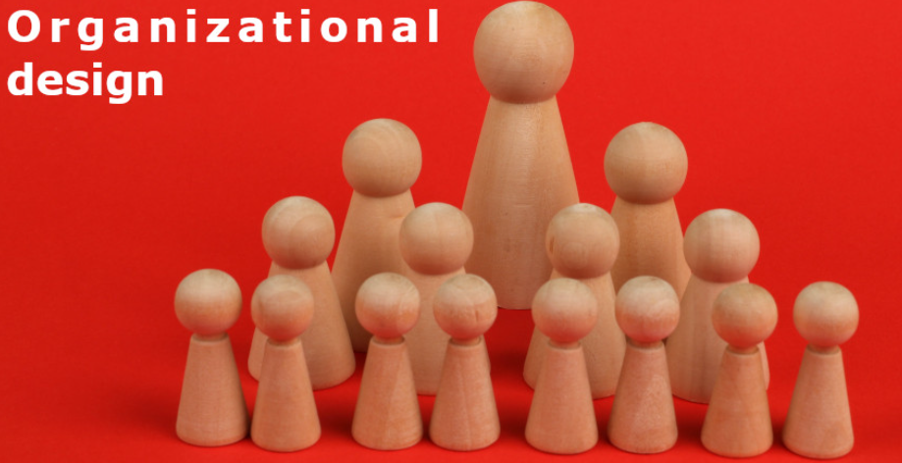
Organizational Design
Define organizational design and list its three components;
1- Organizational design is the process of creating, implementing, monitoring, and modifying the structure, processes, and procedures of an organization.

Slide 8
Organizational Design
Define organizational design and list its three components;
2- The key components of organizational design are structure, culture, and control.

Slide 9
Organizational Design
Define organizational design and list its three components;
3- The goal is to design an organization that allows managers to effectively translate their chosen strategy into a realized one.

Slide 10
Agenda Organizational Design: Structure, Culture, and Control
Organizational Design and Competitive Advantage
Organizational Structure
Mechanistic vs. Organic Organizations
Strategy and Structure
Simple Structure
Functional Structure
Multidivisional Structure
Matrix Structure

Slide 11
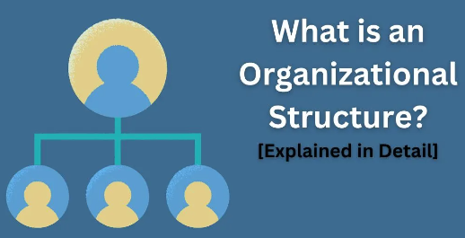
Organizational structure
Organizational structure A key to determining how the work efforts of individuals and teams are orchestrated and how resources are distributed.

Slide 12
Organizational structure
Some of the key decisions managers must make when designing effective organizations pertain to the firm’s organizational structure. That structure determines how the work efforts of individuals and teams are coordinated and how resources are distributed. In particular, an organizational structure defines how jobs and tasks are divided and integrated, Identifies the reporting relationships up and down the hierarchy, defines formal communication channels, and prescribes how individuals and teams coordinate their work efforts.

Slide 13
Organizational structure
The key building blocks of an organizational structure are:
■ Specialization
■ Formalization
■ Centralization
■ Hierarchy

Slide 14
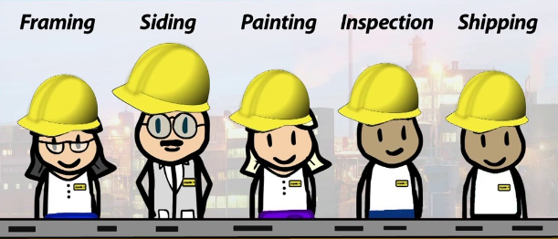
Chapter
Organizational structure
10
1- Specialization
Specialization An organizational element that describes the degree to which a task is divided into separate jobs (i.e., the division of labor).

Slide 15
Chapter
Organizational structure
10
1- Specialization
Specialization describes the degree to which a task is divided into separate jobs—that is, the division of labour. Larger firms, such as Fortune 100 companies, tend to have a high degree of specialization; smaller entrepreneurial ventures tend to have a low degree of specialization.

Slide 16
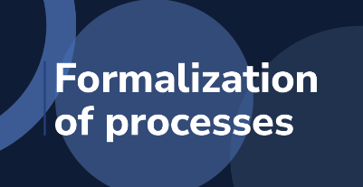
Chapter
Organizational structure
10
2- Formalization
Formalization An organizational element that captures the extent to which employee behavior is steered by explicit and codified rules and procedures.

Slide 17
Chapter
Organizational structure
10
2- Formalization
Formalization captures the extent to which employee behaviour is steered by explicit and codified rules and procedures. Formalized structures are characterized by detailed written rules and policies of what to do in specific situations. These are often codified in employee handbooks. McDonald’s, for example, uses detailed standard operating procedures throughout the world to ensure consistent quality and service.

Slide 18

Chapter
Organizational structure
10
3- Centralization
Centralization An organizational element that refers to the degree to which decision-making is concentrated at the top of the organization.

Slide 19
Chapter
Organizational structure
10
3- Centralization
Centralization refers to the degree to which decision-making is concentrated at the top of the organization. Centralized decision-making often correlates with slow response time and reduced customer satisfaction. In decentralized organizations such as Zappos, decisions are made and problems solved by empowered lower-level employees who are closer to the source of issues.

Slide 20

Chapter
Organizational structure
10
4- Hierarchy
Hierarchy An organizational element that determines the formal, position-based reporting lines and thus stipulates who reports to whom.

Slide 21
Chapter
Organizational structure
10
4- Hierarchy
Hierarchy determines the formal, position-based reporting lines and thus stipulates who reports to whom. Let’s assume two firms of roughly equal size: Firm A and Firm B. If many levels of hierarchy exist between the frontline employee and the CEO in Firm A, it has a tall structure. In contrast, if there are few levels of hierarchy in Firm B, it has a flat structure.

Slide 22
Agenda Organizational Design: Structure, Culture, and Control
Organizational Design and Competitive Advantage
Organizational Structure
Mechanistic vs. Organic Organizations
Strategy and Structure
Simple Structure
Functional Structure
Multidivisional Structure
Matrix Structure

Slide 23
MECHANISTIC VS. ORGANIC ORGANIZATIONS
Several of the building blocks of organizational structure frequently appear together, creating distinct organizational forms—mechanistic or organic organizations.

Slide 24
Mechanistic organizations
Mechanistic organizations are characterized by a high degree of specialization and formalization and by a tall hierarchy that relies on centralized decision-making. The fast food chain McDonald’s fits this description quite well. Each step of every job such as deep-frying fries is documented in minute detail (e.g., what kind of vat, the quantity of oil, how many fries, what temperature, how long, and so on).

Slide 25
Organic organizations
Organic organizations have a low degree of specialization and formalization, a flat organizational structure, and decentralized decision-making.
Organic structures tend to be correlated with the following: a fluid and flexible information flow among employees in both horizontal and vertical directions; faster decision-making; and higher employee motivation, retention, satisfaction, and creativity. Organic organizations also typically exhibit a higher rate of entrepreneurial behaviours and innovation.

Slide 26
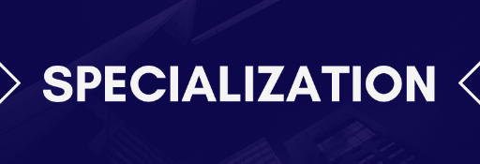
Chapter
Organizational structure
10
Specialization
Mechanistic Organizations
• High degree of specialization
• Rigid division of labor
• Employees focus on narrowly defined tasks

Slide 27
Chapter
Organizational structure
10
Specialization
Organic Organizations
• Low degree of specialization
• Flexible division of labor
• Employees focus on “bigger picture”

Slide 28
Chapter
Organizational structure
10
Formalization
Mechanistic Organizations
• Intimate familiarity with rules, policies, and processes necessary
• Deep expertise in narrowly defined domain
required
• Task-specific knowledge valued

Slide 29
Chapter
Organizational structure
10
Formalization
Organic Organizations
• Clear understanding of organization’s core
competencies and strategic intent
• Domain expertise in different areas
• Generalized knowledge of how to accomplish
strategic goals valued

Slide 30
Chapter
Organizational structure
10
Centralization
Mechanistic Organizations
• Decision power centralized at top
• Vertical (top-down) communication

Slide 31
Chapter
Organizational structure
10
Centralization
Organic Organizations
• Distributed decision making
• Vertical (top-down and bottom-up) as well as
horizontal communication

Slide 32
Chapter
Organizational structure
10
Hierarchy
Mechanistic Organizations
• Tall structures
• Low span of control
• Clear lines of authority
• Command and control

Slide 33
Chapter
Organizational structure
10
Hierarchy
Organic Organizations
• Flat structures
• High span of control
• Horizontal as well as two-way vertical
communication
• Mutual adjustment

Slide 34
Agenda Organizational Design: Structure, Culture, and Control
Organizational Design and Competitive Advantage
Organizational Structure
Mechanistic vs. Organic Organizations
Strategy and Structure
Simple Structure
Functional Structure
Multidivisional Structure
Matrix Structure

Slide 35
Strategy and Structure
The important and interdependent relationship between strategy and structure directly impacts a firm’s performance. Moreover, the relationship is dynamic—changing over time in a somewhat predictable pattern as firms grow in size and complexity.
Different stages in a firm’s growth require different organizational structures;
Simple structure
Functional structure
Multidivisional Structure
Matrix Structure

Slide 36
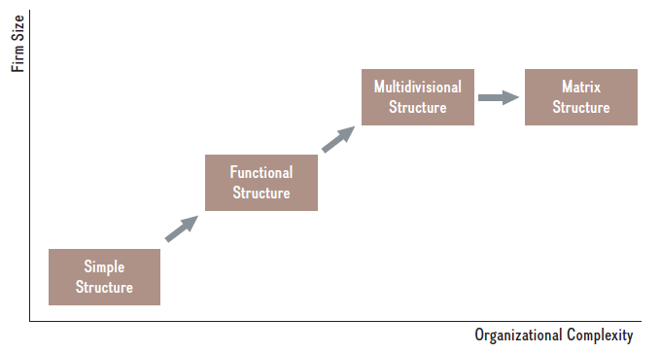
Chapter
Strategy and Structure
10

Slide 37
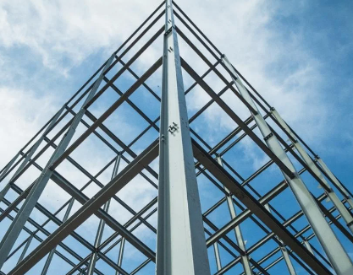
Chapter
Strategy and Structure
10
Simple structure
Organizational structure in which the founders tend to make all the important strategic decisions as well as run the day-to-day operations.

Slide 38
Chapter
Strategy and Structure
10
Simple structure
Advantages
• Fast decision-making
• Intelligent and responsive organization
• Integration of expertise across areas
• Organizations with simple
structures are easily pushed into “crisis mode,”
requiring “all hands on deck” (i.e., everyone
working long hours until project is completed)

Slide 39
Chapter
Strategy and Structure
10
Simple structure
Disadvantages
• CEO overload
• Lack of domain expertise in distinct business
functions (e.g., accounting, finance, marketing,
etc.)
• Unable to accommodate growth
• No separation of strategic and day-to-day
decision making

Slide 40
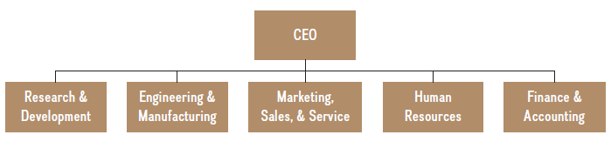
Chapter
Strategy and Structure
10
Functional structure
Organizational structure that groups employees into functional areas based on domain expertise.

Slide 41
Chapter
Strategy and Structure
10
Functional structure
Advantages
• Clear, top-down lines of authority and decision
making
• Deeper domain expertise
• Higher productivity due to specialization and
division of labor
• Responsive organization

Slide 42
Chapter
Strategy and Structure
10
Functional structure
Disadvantages
• No effective communication across different departments.
• Growth is limited
• Employee isolation, especially in startups
that move from simple structure to functional
one

Slide 43
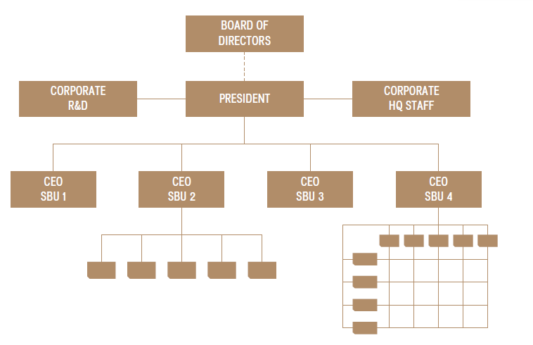
Chapter
Strategy and Structure
10
Multidivisional Structure (M-form)
An organizational structure that consists of several distinct strategic business units (SBUs), each with its own profit-and-loss (P&L) responsibility.

Slide 44
Chapter
Strategy and Structure
10
Multidivisional Structure (M-form)
Advantages
• Accommodates growth (horizontal, vertical, and
geographic)
• Clear profit & loss responsibilities at SBU level,
run by CEO or equivalent
• Efficient processing of information
• Allows for different competitive strategies
at SBU-Ievel, while integration takes place at
corporate level

Slide 45
Chapter
Strategy and Structure
10
Multidivisional Structure (M-form)
Disadvantages
• Additional layer of corporate hierarchy
• SBUs stand in competition to one another
• Political infighting

Slide 46
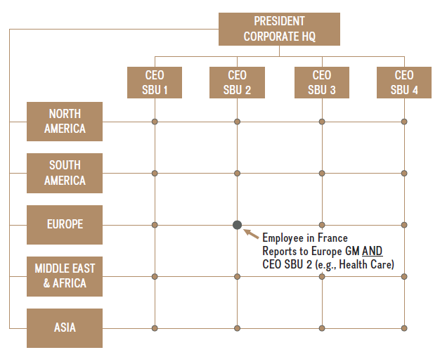
Chapter
Strategy and Structure
10
Matrix Structure
Organizational structure that combines the functional structure with the M-form.

Slide 47
Chapter
Strategy and Structure
10
Matrix Structure
Advantages
• Accommodates growth (horizontal, vertical, and
geographic)
• Combines advantages of functional structure
with M-Form

Slide 48
Chapter
Strategy and Structure
10
Matrix Structure
Disadvantages
• Two layers of organizational structure create
multiple principal–agent relationships
• Slow in decision making
• Potentially inaccurate performance appraisals
• Quite difficult to implement

Slide 49
Thank You

