Slide 1


Financial Management
Prepared by
Dr. Mohamed Hussein
Assistant Professor of Accounting
MGM424
Lecture 7

Slide 2



Financial Management
Lecture 7
MGM424 Cash Flow Estimation and Risk Analysis
Prepared by
Dr. Mohamed Hussein

Slide 3

Chapter
07
Cash Flow Estimation and Risk Analysis

Slide 4

Chapter
07
Cash Flow Estimation and Risk Analysis
Introduction
Concept of Cash Flows
Types of Cash Flows
Conceptual Issues in Cash Flow Estimation.
Estimating Cash Flows
Risk Analysis
Measuring Stand-Alone Risk

Slide 5

Chapter
Introduction
07
Cash Flow Estimation and Risk Analysis are critical components in financial decision-making and investment appraisal.
By estimating expected cash inflows and outflows over a project’s life, firms can evaluate the economic feasibility of projects, forecast financial positions, and make informed investment decisions.
Moreover, understanding and analyzing risk factors helps organizations prepare for uncertainties and develop strategies to mitigate potential negative outcomes.

Slide 6

Chapter
Concept of Cash Flows
07
Concept of Cash Flows
Cash flow is a cornerstone in understanding a firm’s financial health and operational performance. Below is a detailed explanation of what cash flows are and why they are so important.
Definition
A cash flow refers to the net amount of cash that moves in and out of a business during a specific period. This includes:
Cash Inflows (Receipts): Money received by the business from various sources, such as sales revenue, loan proceeds, or investments.

Slide 7
Chapter
Concept of Cash Flows
07
Cash Outflows (Payments): Money paid out by the business for expenses, investments, or other obligations, such as supplier payments, salaries, loan repayments, and taxes.
Cash flow is different from profit (or net income) because of accounting practices like accrual accounting, which can record revenues and expenses when they are earned or incurred rather than when cash is actually received or paid. Consequently, a business might show a profit on its income statement but still have negative cash flow if its actual cash collections lag behind its bills.

Slide 8
Chapter
Concept of Cash Flows
07
Real-World Example
Startup Scenario: A technology startup might show rapid sales growth and positive net income due to strong demand for its product. However, if customers have 90-day payment terms while the startup pays suppliers and employees monthly, the startup’s cash inflows may lag behind its outflows. Despite being “profitable,” the business could face cash shortages and might need short-term financing (like a credit line) to bridge the gap.
Mature Company: A mature manufacturing company may have stable cash inflows from repeat customers and predictable outflows for raw materials and labor. If the company’s operating cash flow is consistently positive, it can use excess cash to invest in new machinery, pay dividends, or reduce debt, reinforcing long-term financial health.

Slide 9
Chapter
Concept of Cash Flows
07
In Summary
Definition: Cash flow is the lifeblood of any business, representing all the actual cash moving in and out.
Project Evaluation: Future cash flow projections help in making smart investment decisions and determining project viability.
Liquidity Assessment: Monitoring and forecasting cash flow helps ensure there is enough liquidity to cover short-term obligations and avoid potential insolvency.
Financial Health: Strong and stable cash flows indicate a healthy, efficient, and potentially growing business—an attractive sign to investors, creditors, and other stakeholders.

Slide 10

Chapter
Types of Cash Flows
07
When analyzing a company’s financial performance and planning for future projects, it is helpful to break down cash flows into distinct categories. Each category sheds light on different aspects of the firm’s operations, investments, and financing strategies.

Slide 11
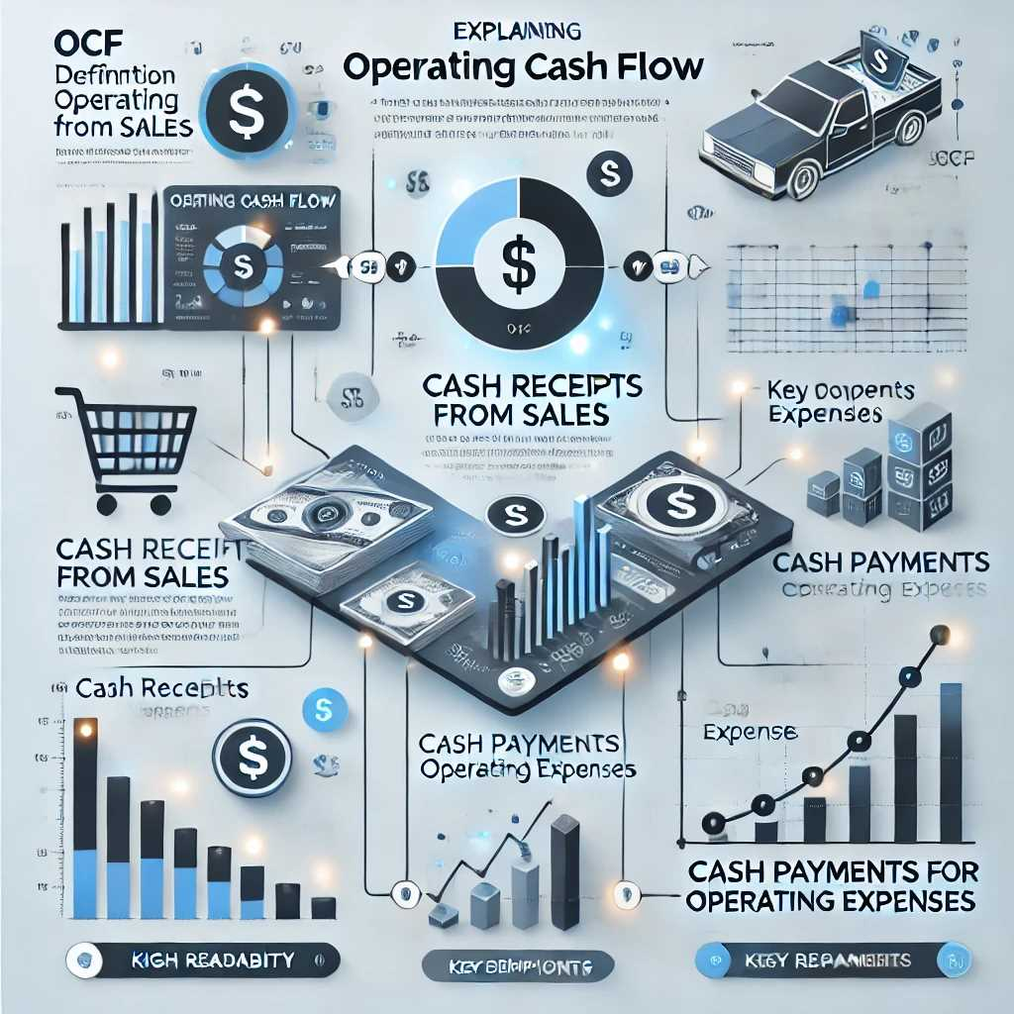
Chapter
Types of Cash Flows
07
Operating Cash Flow (OCF)
Definition
Operating Cash Flow refers to the net cash generated by a company’s core business operations. It typically includes cash received from the sale of goods and services minus the cash paid for operating expenses (such as salaries, rent, and raw materials).
Key Components
  Cash Receipts from Sales: Revenue actually received in cash for products or services sold.
  Cash Payments for Operating Expenses: Cash paid for day-to-day operational costs (e.g., purchasing inventory, paying wages, utilities).

Slide 12

Chapter
Types of Cash Flows
07
Significance
  Indicator of Core Profitability: Positive OCF suggests that the core business model is generating enough cash to cover daily expenses and potentially fund expansions or pay down debt.
  Liquidity Indicator : Lenders and investors closely monitor OCF to determine how easily the company can meet short-term obligations without needing external financing.
Example
  A retail store sells goods worth $100,000 in a month and pays $60,000 for inventory, wages, and other expenses. Its operating cash flow for that month is $40,000 (i.e., $100,000 – $60,000).

Slide 13

Chapter
Types of Cash Flows
07
Investing Cash Flow
Definition
Investing Cash Flow arises from the purchase or sale of long-term assets—such as property, plant, and equipment (PP&E)—or investments in securities (like stocks, bonds, or acquisitions).
Key Components
  Capital Expenditures (CapEx): Cash paid for new machinery, equipment, or property to expand or upgrade existing operations.
  Asset Disposals: Cash received from selling used or surplus assets.
  Investments in Securities: Purchase or sale of stocks, bonds, or stakes in other companies.

Slide 14

Chapter
Types of Cash Flows
07
Significance
  Growth Strategy Indicator: Significant outlays on capital expenditures may signal that the company is investing in growth or modernization.
  Asset Management: Analyzing investing cash flows helps stakeholders assess how effectively the company uses or divests its assets to generate returns.
Example
  A manufacturing company purchases a new production line for $500,000 and sells old equipment for $50,000. The net investing cash flow is –$450,000 (i.e., $50,000 inflow minus $500,000 outflow).

Slide 15
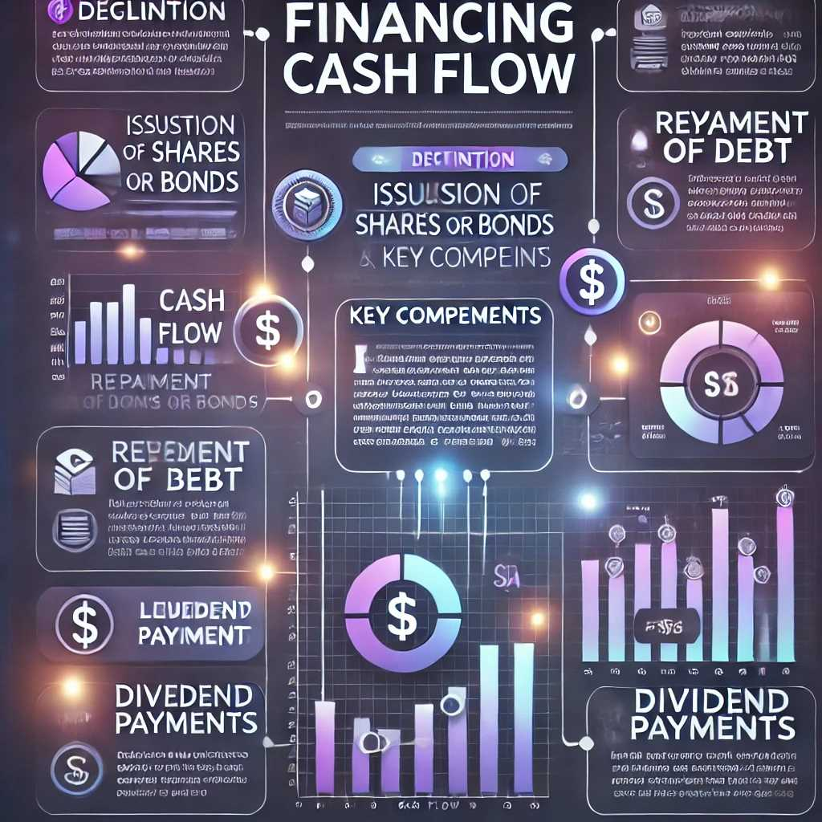
Chapter
Types of Cash Flows
07
Financing Cash Flow
Definition
Financing Cash Flow is derived from activities that change the company’s capital structure, such as issuing or repurchasing equity, borrowing or repaying loans, and distributing dividends to shareholders.
Key Components
  Issuance of Shares or Bonds: Cash inflow from selling new shares of stock or issuing bonds.
  Repayment of Debt: Cash outflow when the company repays principal amounts on loans or bonds.
  Dividend Payments: Cash outflow to shareholders as a return on their equity investment.

Slide 16

Chapter
Types of Cash Flows
07
Significance
  Capital Raising Strategy: Shows how the company funds its operations and investments—whether primarily through equity or debt.
  Shareholder Return Policy: Reflects management’s decisions about distributing profits through dividends or share buybacks versus reinvesting in the business.
Example
  A firm issues shares worth $1 million to raise new capital and uses $300,000 of it to repay a portion of its long-term loan. The net financing cash flow is +$700,000.

Slide 17
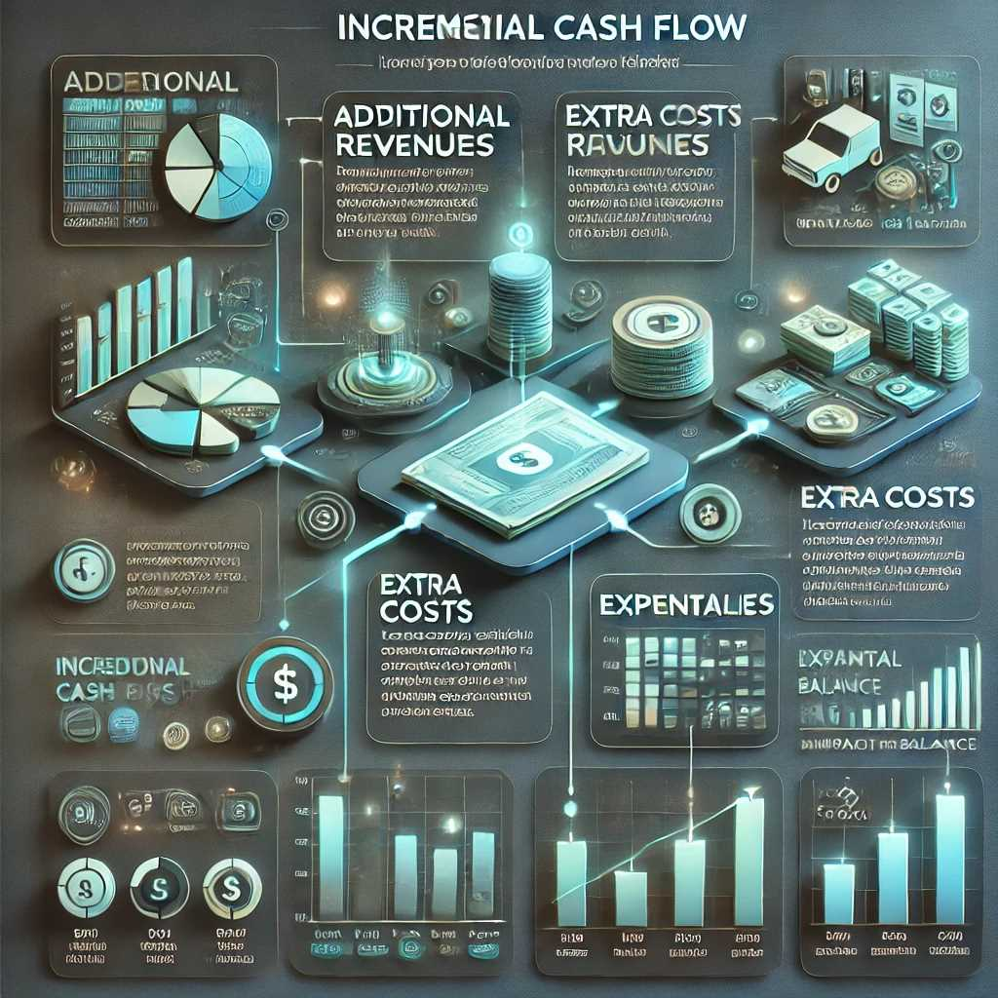
Chapter
Types of Cash Flows
07
Incremental Cash Flows
Definition
Incremental Cash Flows are the additional cash inflows or outflows directly attributable to a specific project or investment decision. They represent the difference in a company’s total cash flows if the project is undertaken versus if it is not.
Key Components
  Additional Revenues: Extra cash inflows expected from new sales due to the project.
  Extra Costs: Incremental operating costs, capital expenditures, or maintenance costs required to sustain the project.
  Externalities: Any positive or negative impact on other parts of the business (e.g., cannibalization of existing sales, complementary product sales).

Slide 18
Chapter
Types of Cash Flows
07
Significance
  Capital Budgeting Accuracy: Focusing on incremental cash flows ensures decision-makers consider only the cash changes directly caused by the project. This prevents irrelevant costs or revenues (e.g., sunk costs) from distorting the analysis.
  Isolates Project Impact: By measuring only the project’s unique contribution, the firm can more accurately forecast viability and compare competing projects.
Example
  A company is considering adding a new product line. The project is expected to generate $200,000 in additional sales, but $50,000 of those sales would otherwise have gone to a similar existing product (cannibalization). Therefore, the real incremental inflow is $150,000. If incremental production costs are $70,000, the net incremental cash flow attributable to the project is +$80,000.

Slide 19
Chapter
Types of Cash Flows
07
Why Classifying Cash Flows Matters
Breaking down cash flows into operating, investing, financing, and incremental categories helps managers, investors, and creditors:
Identify Core Operational Performance (via operating cash flow).
Evaluate Growth and Asset Allocation Strategies (via investing cash flow).
Understand Funding Choices (via financing cash flow).
Make Better Project Decisions (via incremental cash flows in capital budgeting).
These distinctions provide clearer insight into where a company is performing well, where it might face challenges, and how it chooses to finance its long-term plans.

Slide 20
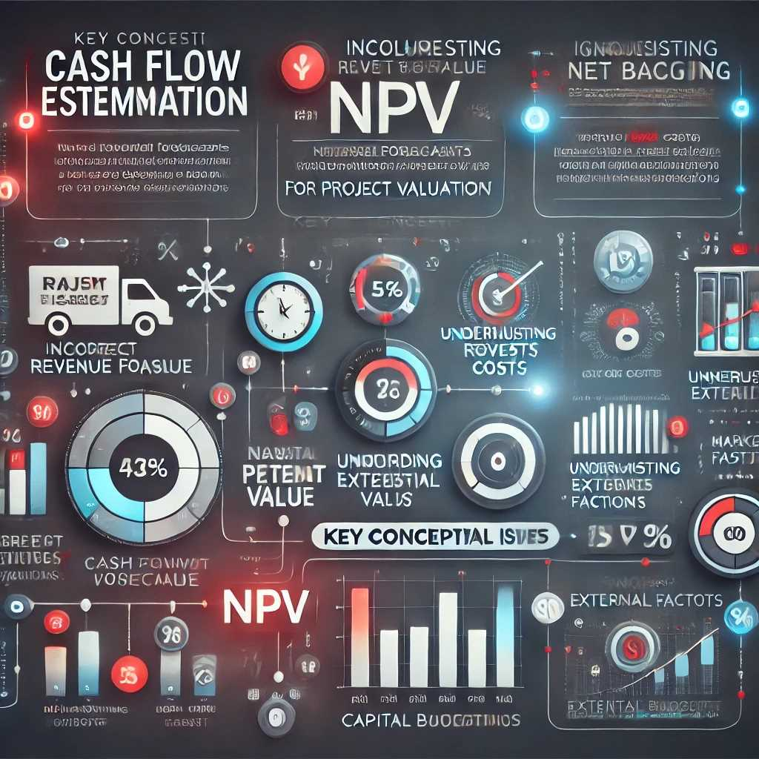
Chapter
Conceptual Issues in Cash Flow Estimation
07
Before the cash flow estimation process is illustrated, we need to discuss several
important conceptual issues. A failure to handle these issues properly can lead
to calculating incorrect project NPVs, which will lead to bad capital budgeting
decisions.

Slide 21

Chapter
Conceptual Issues in Cash Flow Estimation
07
EBIT(1 - T):
  EBIT (Earnings Before Interest and Taxes) adjusted for taxes (T) to reflect after-tax operating profit.
Depreciation and Amortization:
  Non-cash expenses added back since they reduce accounting income but not actual cash flow.
Capital Expenditures (CapEx):
  Cash spent on acquiring or upgrading physical assets like machinery, buildings, or equipment.
Change in Net Operating Working Capital (ΔNOWC):
  Adjustments for changes in current assets (excluding cash) and current liabilities (excluding debt). A positive change means more cash is tied up in operations, reducing FCF.
FREE CASH FLOW VERSUS ACCOUNTING INCOME

Slide 22
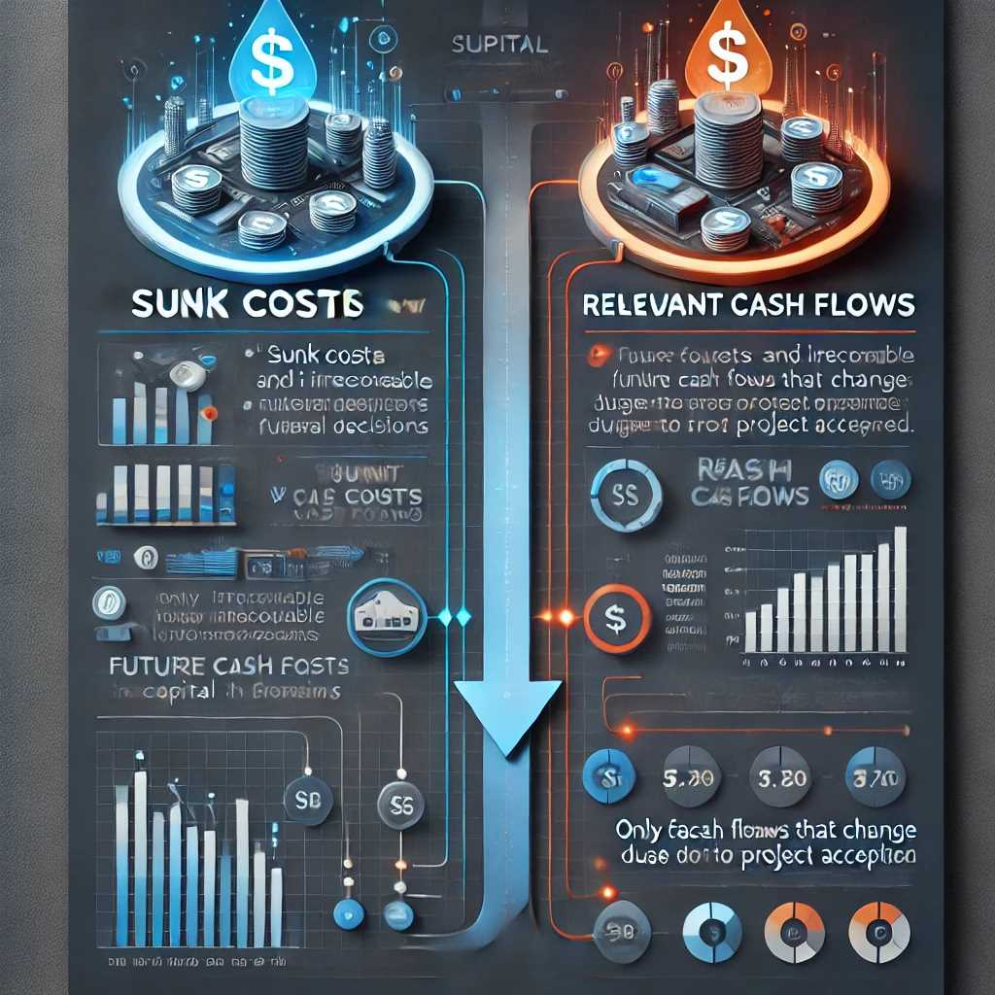
Chapter
Conceptual Issues in Cash Flow Estimation
07
When estimating cash flows for a project or investment, several conceptual considerations ensure that only the most relevant and accurate financial data drive decision-making. Below are the key issues and how they influence the capital budgeting process.
1.Sunk Costs vs. Relevant Cash Flows
Sunk Costs
  Definition: Expenses already incurred in the past that cannot be recovered, regardless of future decisions.
  Impact on Decisions: Sunk costs should be excluded from future project evaluations because they do not change as a result of accepting or rejecting a project.

Slide 23
Chapter
Conceptual Issues in Cash Flow Estimation
07
  Example: If a company spent $50,000 on research for a product but decides not to launch it, that $50,000 is a sunk cost. It should not affect whether the firm proceeds with a new, related project.
Relevant Cash Flows
  Definition: Future incremental cash inflows and outflows that occur only if a project is undertaken.
  Significance: Including only these future inflows/outflows ensures that the analysis focuses on what truly changes with the project decision.
  Example: If launching a new product is expected to generate $200,000 in additional sales and $120,000 in additional costs, then the relevant cash flow is $80,000. Past expenditures are ignored as they do not affect this incremental amount.

Slide 24
Chapter
Conceptual Issues in Cash Flow Estimation
07
2.Opportunity Costs
Definition
  The potential benefit lost by choosing one option over the next best alternative.
  Should be treated as part of a project’s cash flows if it represents a real economic trade-off.
Importance
  Inclusion in Cash Flow Analysis: Even if no explicit cash payment changes hands, an opportunity cost can be a significant real cost to the business.
  Example: If a firm uses a piece of company-owned land for a project instead of selling it for $500,000, the foregone sale proceeds count as an opportunity cost of $500,000. Thus, this amount should be reflected as part of the cash flow calculation for the new project.

Slide 25

Chapter
Conceptual Issues in Cash Flow Estimation
07
3.Externalities and Side Effects
Positive Externalities
  Definition: Benefits to other products or business areas when a new project is introduced.
  Example: A coffee shop launches a new pastry line, which in turn increases coffee sales because customers tend to buy both together. The incremental revenue from coffee should be factored into the project’s cash flow analysis.

Slide 26
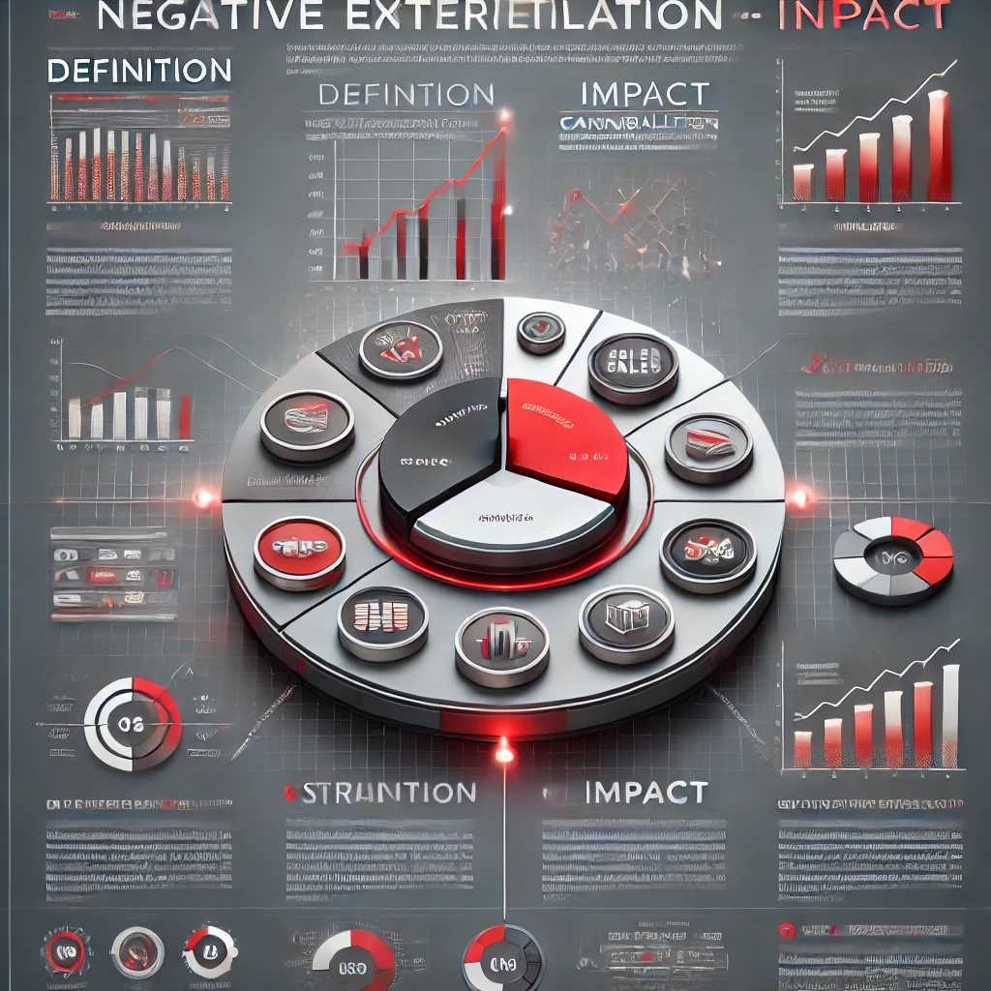
Chapter
Conceptual Issues in Cash Flow Estimation
07
Negative Externalities (Cannibalization)
  Definition: When a new project reduces the sales or revenue of an existing product or business segment.
  Example: A car manufacturer introduces a new model that attracts buyers away from an older, still-produced model. The lost revenue from the older model is a negative externality and must be subtracted from the incremental cash flows of the new project.

Slide 27

Chapter
Conceptual Issues in Cash Flow Estimation
07
4. Inflation and Exchange Rates
Inflation
  Effect on Cash Flows: Over time, prices of goods and services typically rise. This impacts both revenues (sales prices) and costs (labor, materials).
  Adjustment: Projecting nominal (inflated) cash flows requires a nominal discount rate; if using real cash flows (excluding inflation), use a real discount rate. Inconsistent treatment leads to inaccurate results.

Slide 28

Chapter
Conceptual Issues in Cash Flow Estimation
07
Exchange Rates
  Relevance for International Projects: When operating in multiple currencies, future cash flow estimates must account for potential currency fluctuations.
  Risk Factor: Exchange rate volatility can significantly alter the home-currency value of cash flows, necessitating hedging strategies or sensitivity analysis.

Slide 29
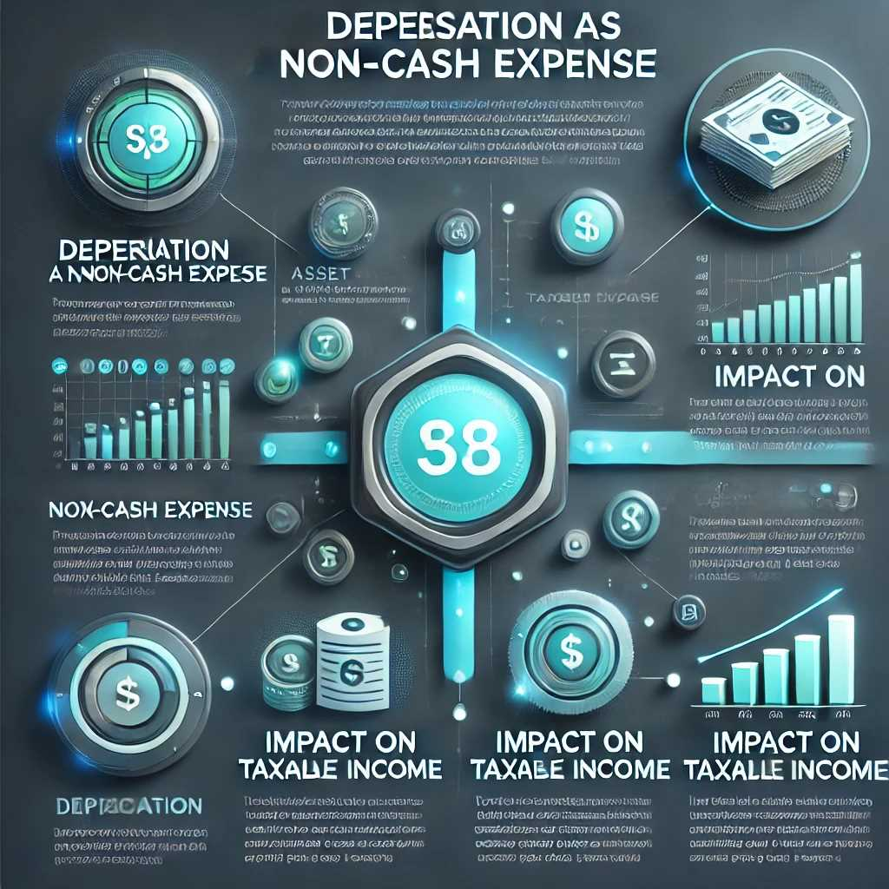
Chapter
Conceptual Issues in Cash Flow Estimation
07
5. Depreciation and Tax Implications
Depreciation as a Non-Cash Expense
  Definition: Allocation of an asset’s cost over its useful life, recognized for accounting and tax purposes.
  Impact on Taxable Income: Although depreciation does not require a cash outflow, it lowers taxable income, thus increasing after-tax cash flow (via the “depreciation tax shield”).

Slide 30
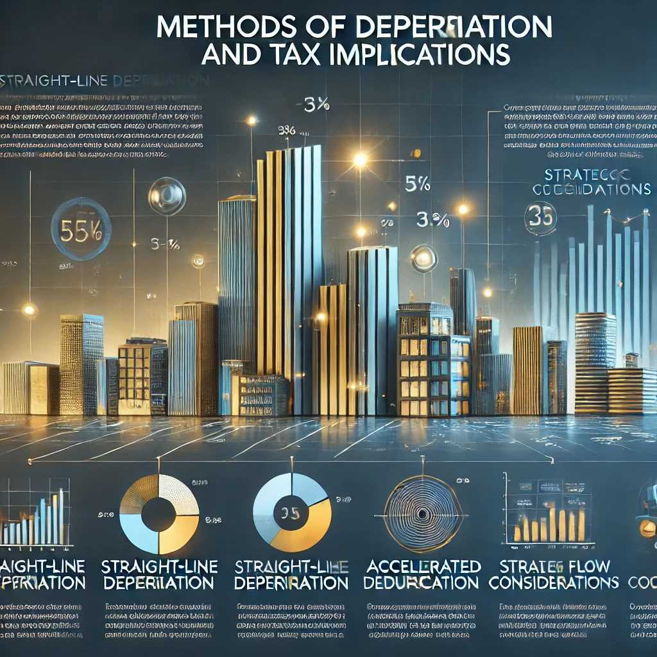
Chapter
Conceptual Issues in Cash Flow Estimation
07
5. Depreciation and Tax Implications
Methods of Depreciation
  Straight-Line vs. Accelerated: Different methods yield different annual depreciation amounts and, therefore, different tax effects in each year of the project’s life.
  Strategic Considerations: Companies may choose a depreciation method that accelerates write-offs if they value higher early-year cash flows.

Slide 31

Chapter
Conceptual Issues in Cash Flow Estimation
07
6. Working Capital Adjustments
Definition of Working Capital
  Working Capital (WC): Current assets (like cash, accounts receivable, inventory) minus current liabilities (like accounts payable, short-term debt).
  Changes in WC: Often reflect how much cash is tied up in daily operations.

Slide 32
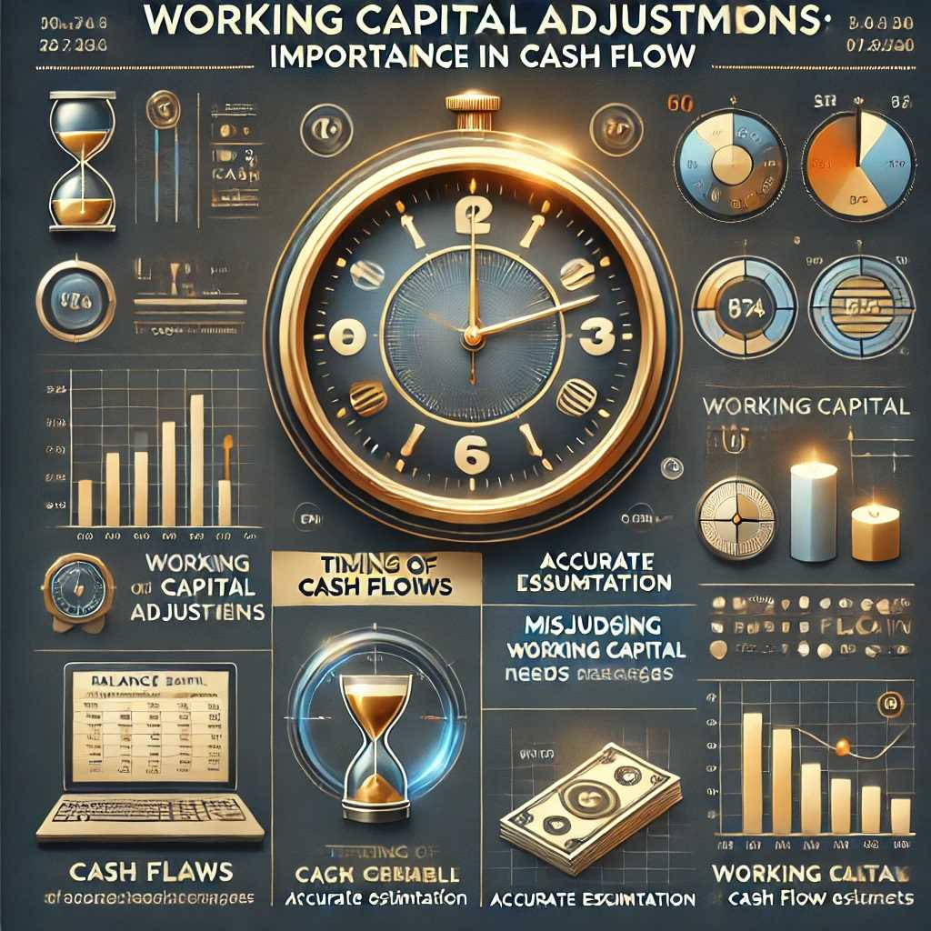
Chapter
Conceptual Issues in Cash Flow Estimation
07
6. Working Capital Adjustments
Importance in Cash Flow
  Timing of Cash Flows: Increases in accounts receivable or inventory delay the conversion of sales into cash, whereas increases in payables may provide temporary financing.
  Accurate Estimation: Misjudging working capital needs can overstate or understate a project’s cash flow. For instance, a spike in inventory requirements at the project’s onset represents a cash outflow, which must be reversed (i.e., recaptured) at project closure.

Slide 33
Chapter
Conceptual Issues in Cash Flow Estimation
07
Final Thoughts
Accurate cash flow estimation goes beyond simply forecasting sales and expenses. It requires identifying which costs are incremental, which are sunk, and whether there are opportunity costs or externalities influencing the bottom line. Depreciation, tax rules, inflation, currency movements, and working capital dynamics each play a crucial role in shaping a project’s true cash flow picture.
By carefully addressing these conceptual issues, decision-makers can avoid common pitfalls, thereby ensuring that the capital budgeting process yields the most reliable and relevant estimates. This rigor ultimately helps firms allocate resources more effectively and improve their long-term financial performance.

Slide 34

Chapter
Estimating Cash Flows
07
When conducting a capital budgeting exercise or assessing a project’s financial viability, accurate cash flow estimation is crucial. Below are the key steps and considerations in estimating these flows:
1. Forecasting Sales and Revenues
Market Analysis
  Demand Estimation: Analyze market size, customer segments, and historical trends to project future sales volumes.
  Price Trends: Consider how changes in market conditions, competition, or regulations might affect pricing power.

Slide 35
Chapter
Estimating Cash Flows
07
Data Sources and Techniques
  Historical Sales Data: Use past sales performance as a baseline, adjusting for trends (growth, seasonal patterns).
  Economic Indicators: Factor in broader economic variables such as GDP growth rates, consumer confidence, and interest rates.
  Competitive Environment: Examine competitor actions (e.g., product introductions, price cuts) that could influence market share.
Growth Scenarios
  Conservative, Most Likely, and Aggressive Estimates: Prepare multiple scenarios to capture the uncertainty surrounding future sales.
  Sensitivity Analysis: Assess how changes in volume or price assumptions will impact projected revenues.

Slide 36
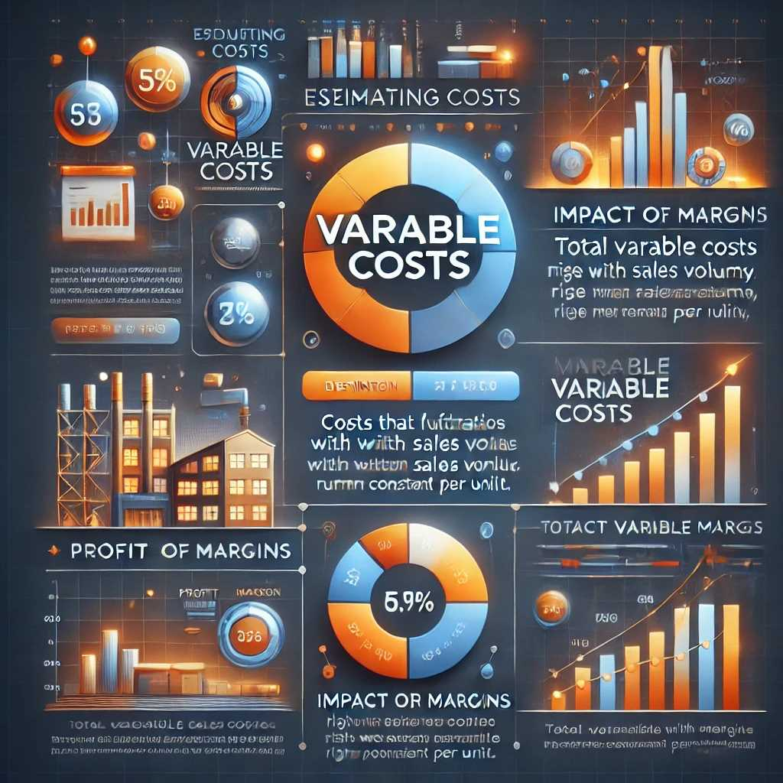
Chapter
Estimating Cash Flows
07
2. Estimating Costs
Variable Costs
  Definition: Costs that vary directly with production or sales volume (e.g., raw materials, packaging).
  Impact on Margins: As sales increase, total variable costs rise, but they remain constant per unit produced.
  Example: If each unit requires $5 in raw materials and you expect to sell 10,000 units, total variable cost is $50,000.

Slide 37
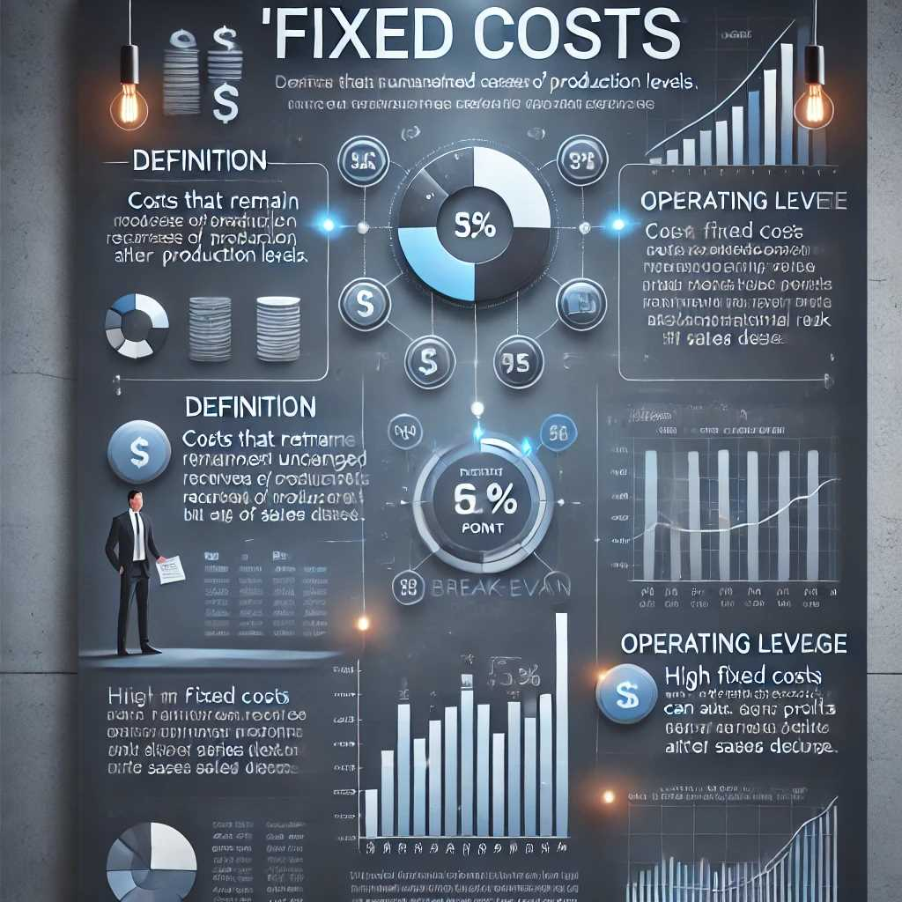
Chapter
Estimating Cash Flows
07
Fixed Costs
  Definition: Costs that do not change with production levels within a relevant range (e.g., rent, certain salaries, insurance).
  Operating Leverage: High fixed costs mean a company benefits more from volume increases (after breaking even) but also faces higher risk if sales drop.
  Example: Monthly rent of $5,000 is paid regardless of whether the company produces 1 or 1,000 units.

Slide 38
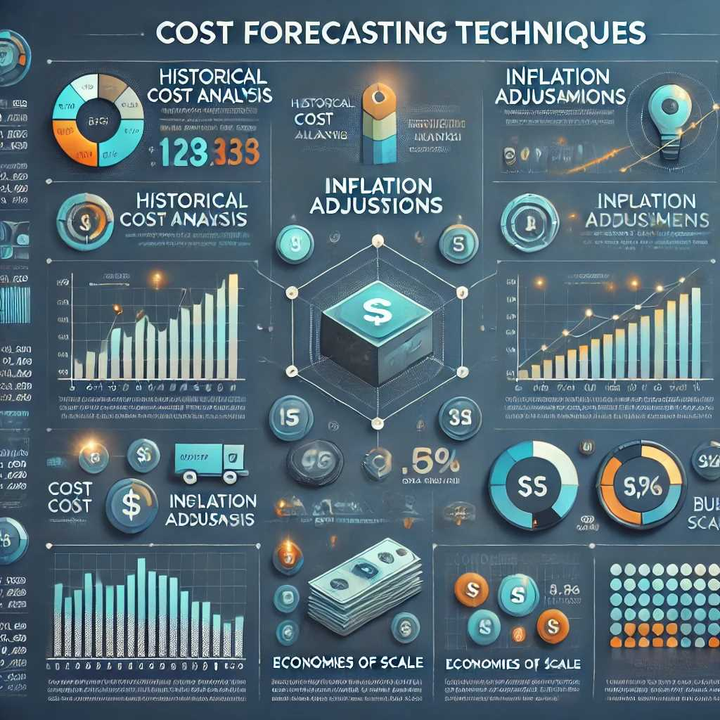
Chapter
Estimating Cash Flows
07
Cost Forecasting Techniques
  Historical Cost Analysis: Examine past trends in expenses to predict future behavior.
  Inflation Adjustments: Account for rising input prices over time.
  Economies of Scale: Determine if bulk purchasing or efficiency improvements will reduce unit costs as volume grows.

Slide 39
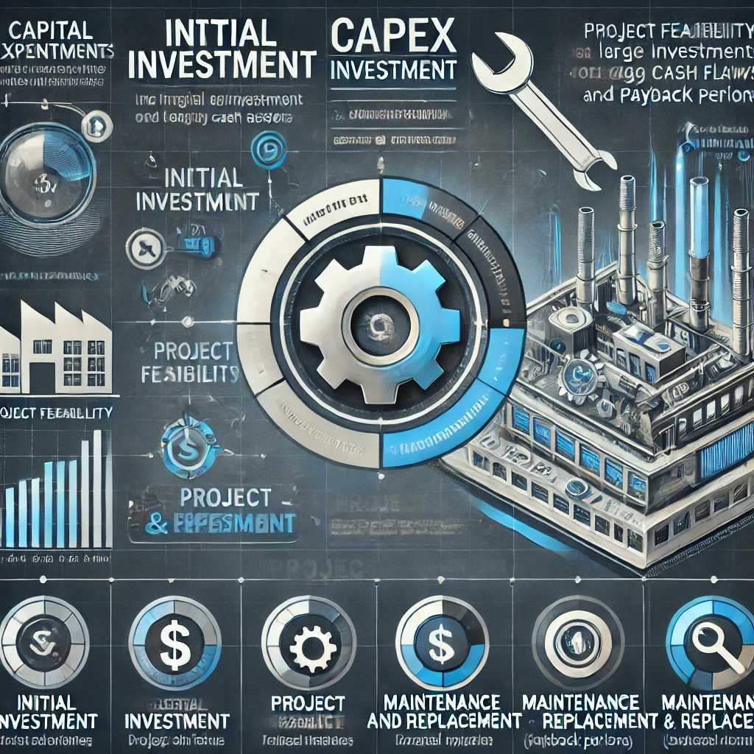
Chapter
Estimating Cash Flows
07
3. Capital Expenditures (CapEx)
Initial Investment
  Definition: The upfront cost of acquiring long-term assets such as machinery, equipment, or technology for a new project or expansion.
  Project Feasibility: Large initial outlays can significantly affect early cash flows and the project’s payback period.
Maintenance and Replacement
  Ongoing Costs: Even after the initial purchase, assets may require periodic upgrades, repairs, or replacements.

Slide 40

Chapter
Estimating Cash Flows
07
  Lifecycle Approach: Forecast these future expenditures to ensure the project’s total cost is accurately estimated.
Impact on Cash Flow Analysis
  Depreciation Tax Shield: Although depreciation is a non-cash expense, it affects taxable income and thus influences after-tax cash flow.
  Residual or Salvage Value: At the project’s end, the asset may have a resale value, which should be considered as a future cash inflow.

Slide 41

Chapter
Estimating Cash Flows
07
4.Working Capital Requirements
Definition
  Working Capital (WC) = Current Assets (e.g., cash, inventory, receivables) – Current Liabilities (e.g., payables, short-term debt).
  Operational Buffer: Adequate working capital ensures smooth day-to-day operations.
Key Components
  Accounts Receivable: Sales on credit can create a lag between the sale and actual cash collection.
  Inventory: Purchasing raw materials or finished goods ties up cash until products are sold.

Slide 42

Chapter
Estimating Cash Flows
07
  Accounts Payable: Delaying payment to suppliers can temporarily free up cash, but may involve discounts lost or strained relationships if prolonged.
Cash Flow Impact
  Investment in WC: Any increase in receivables or inventory represents a cash outflow, while an increase in payables is a cash inflow (in the short term).
  Project Initiation and Completion: Often, a project requires a one-time increase in working capital at the start, which is partially or fully recovered at the project’s end.

Slide 43

Chapter
Estimating Cash Flows
07
5.Taxation and Depreciation
Taxation
  Income Taxes: Profits are subject to corporate tax rates, which reduce net cash flows. Accurately projecting pre-tax earnings is crucial.
  Tax Credits and Incentives: Governments may offer deductions or credits for certain activities (e.g., R&D, green initiatives), impacting net cash flows.
Depreciation
  Non-Cash Expense: Depreciation spreads the cost of a long-term asset over its useful life, reducing taxable income but not the firm’s actual cash balance.

Slide 44

Chapter
Estimating Cash Flows
07
Depreciation
  Tax Shield: By reducing taxable income, depreciation lowers tax liability, effectively increasing after-tax cash flow.
  Depreciation Methods:
    Straight-Line: Spreads cost evenly over the asset’s life.
    Accelerated: Allows higher depreciation expenses in earlier years, potentially boosting early cash flows.

Slide 45

Chapter
Estimating Cash Flows
07
6.Time Value of Money
Discounted Cash Flows (DCF)
  Concept: A dollar today is worth more than a dollar tomorrow due to its potential earning capacity.
  Discount Rate Selection: Firms often use their Weighted Average Cost of Capital (WACC) or a required rate of return to discount future cash flows back to the present.
Capital Budgeting Metrics
  Net Present Value (NPV): Sum of discounted cash inflows minus discounted cash outflows. A positive NPV suggests the project is likely to add value.

Slide 46

Chapter
Estimating Cash Flows
07
Capital Budgeting Metrics
  Internal Rate of Return (IRR): The discount rate at which the NPV equals zero. Projects with an IRR exceeding the firm’s hurdle rate are generally considered desirable.
  Payback Period: The time it takes to recover the initial investment. Useful for measuring liquidity risk, though it ignores cash flows beyond the payback point and time value of money (unless adjusted payback is used).

Slide 47
Chapter
Estimating Cash Flows
07
Putting It All Together
Sales and Cost Forecasting form the revenue and expense backbone of your cash flow projections.
CapEx and Working Capital considerations ensure you capture the lump-sum and ongoing costs of operating a project, as well as the cash tied up in day-to-day processes.
Tax and Depreciation Calculations refine the post-tax cash flows, giving a realistic picture of available funds.
Discounting Future Cash Flows accounts for the time value of money, allowing you to compare a project’s net benefits in present-value terms.
By methodically incorporating each of these elements, you can generate a robust cash flow forecast. This, in turn, forms the basis for reliable capital budgeting decisions—empowering firms to allocate resources effectively and maximize shareholder value.

Slide 48

Chapter
Risk Analysis
07
Risk is an inherent part of any financial or investment decision. Effectively identifying, measuring, and managing this uncertainty helps organizations make better-informed choices, protect their capital, and maintain financial stability. Below is an in-depth look at risk analysis, covering common risk factors, key analytical tools, and mitigation strategies.
1. Definition of Risk
Possibility of Deviation
  Risk is the chance that actual outcomes will deviate—positively or negatively—from those originally expected or planned.

Slide 49

Chapter
Risk Analysis
07
Possibility of Deviation
  This deviation can affect the timing and magnitude of cash flows, ultimately influencing project profitability and overall financial returns.
Types of Outcomes
  Financial Return: Often measured in terms of net present value (NPV) or internal rate of return (IRR).
  Operational Goals: Production schedules, quality targets, or customer satisfaction metrics can also be at risk if underlying assumptions prove incorrect.

Slide 50

Chapter
Risk Analysis
07
2. Risk Factors
Market Risk
  Definition: Risk arising from external market conditions such as economic recessions, changes in consumer preferences, or new competitive threats.
  Examples: A downturn in the economy reduces demand for luxury goods; a new competitor enters with lower-priced alternatives.

Slide 51

Chapter
Risk Analysis
07
2. Risk Factors
Operational Risk
  Definition: Risk stemming from internal processes, systems, or human errors that disrupt operations.
  Examples: Machinery breakdowns, supply chain bottlenecks, or cybersecurity breaches.

Slide 52
Chapter
Risk Analysis
07
3. Tools and Techniques for Risk Analysis
Sensitivity Analysis
  What It Is: A method that tests how changes in individual variables (e.g., sales volume, unit price, raw material costs) affect project outcomes like NPV or IRR.
  Purpose: Identifies which variables have the greatest impact on profitability. If a small change in one variable greatly alters the NPV, that variable carries higher risk.
Scenario Analysis
  What It Is: Examines project cash flows under several plausible “scenarios”—often labeled optimistic, most likely, and pessimistic—to gauge outcomes under varying conditions.
  Purpose: Provides a range of possible results, helping decision-makers plan for best-case and worst-case conditions.

Slide 53
Chapter
Risk Analysis
07
3. Tools and Techniques for Risk Analysis
Monte Carlo Simulation
  What It Is: A sophisticated technique that uses probability distributions for uncertain variables. The simulation runs thousands (or more) of iterations to generate a distribution of possible outcomes.
  Purpose: Offers a statistical view of risk, highlighting not only the average result but also the variability, worst-case outcomes, and likelihood of exceeding certain return thresholds.
Decision Trees
  What It Is: A graphical tool that outlines decision paths and their potential outcomes, along with associated probabilities and payoffs.
  Purpose: Breaks down complex, multi-stage decisions (e.g., “if we invest in Phase 1, and results are favorable, we proceed to Phase 2”) and evaluates the expected value of different courses of action.

Slide 54

Chapter
Risk Analysis
07
4. Risk Mitigation Strategies
Diversification
  Definition: Spreading investments or projects across different regions, industries, or asset classes to reduce reliance on one source of income.
  Benefit: If one venture performs poorly due to unforeseen circumstances, losses may be offset by better performance in other areas.
  Benefit: Swift, organized responses to adverse conditions minimize disruption and financial losses.

Slide 55
Chapter
Risk Analysis
07
4. Risk Mitigation Strategies
Insurance and Hedging
  Definition: Risk transfer methods that protect against specific uncertainties.
  Insurance: Helps limit losses from events like fire, theft, or liability suits.
  Hedging: Using financial instruments (e.g., futures, swaps) to lock in prices or interest rates, thereby stabilizing costs or returns.
Contingency Planning
  Definition: Developing backup strategies or reserves in case negative events materialize.
  Examples: Establishing an emergency cash reserve, signing alternative supplier contracts, or creating detailed crisis-response plans.
  Benefit: Swift, organized responses to adverse conditions minimize disruption and financial losses.

Slide 56

Chapter
Measuring Stand-Alone Risk
07
A project’s stand-alone risk reflects uncertainty about its cash flows.
The required investment, unit sales, sales prices, and operating costs
Three techniques are used to assess stand-alone risk:
(1) sensitivity analysis.
(2) scenario analysis.
(3) Monte Carlo simulation.
We will discuss them in the
following sections.

Slide 57

Chapter
Measuring Stand-Alone Risk
07
Sensitivity Analysis Percentage change in NPV resulting from a given percentage change in an input variable, other things held constant.
Here’s a list of the key inputs for a Project:
● Equipment cost
● Change in net operating working capital
● Unit sales
● Sales price
● Variable cost per unit
● Fixed operating costs
● Tax rate
● WACC

Slide 58



Thank You

