Slide 1

MASTER THESIS PRESENTATION | MIDOCEAN UNIVERSITY
Early Prediction of Alzheimer’s Disease using Deep Learning and Data Fusion
By: Ahmed Naji Lutfi & Mohamed Amin Miqdad
Supervisor: Dr. Mohamed Essa
Collage of Informatics, Midocean University, Comoros

Slide 2
Section 1
Introduction

Slide 3
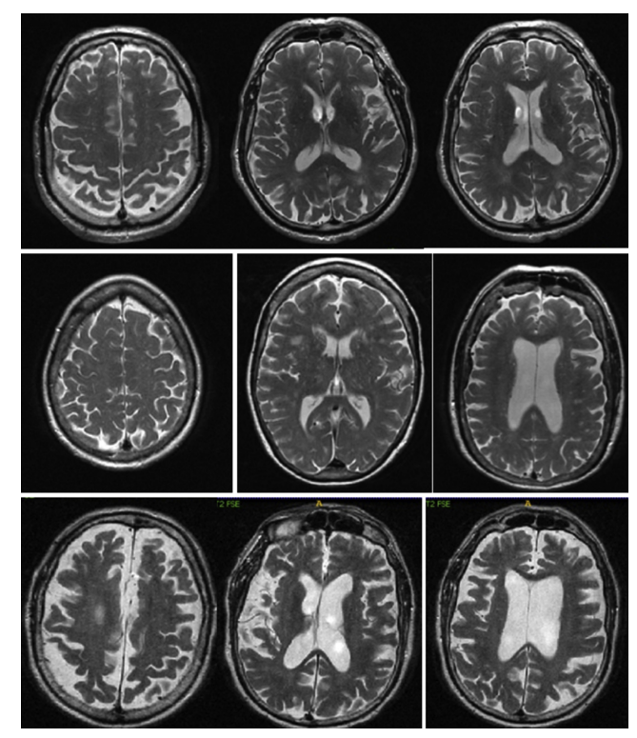
Section 1 : Introduction
Overview
Normal Cognitive (Row 1), Mild Cognitive Impairment (row 2) and last is Alzheimer’s Disease
Alzheimer's disease is considered one of the most devastating diseases of the modern era, as it affects the brain and gradually leads to severe cognitive decline and, eventually, complete memory loss. In the past, dementia was widely believed to affect only older adults. However, growing evidence has shown Normal Cognitive (NC)that cognitive impairment can also occur in younger individuals. The transition start from to Mild Cognitive Impairment (MCI) and end with Alzheimer's Disease (AD).
With the rapid advancement of technology, particularly in the field of artificial intelligence, a growing number of studies have focused on the early detection of Alzheimer's disease. These efforts aim to identify the disease at its earliest stages, enabling more accurate diagnosis and improving the chances of timely intervention, effective disease management, and delaying its progression for as long as possible.
It is hoped that continued advances in medical research and artificial intelligence will may eventually lead to a major breakthrough in the near future, ultimately resulting in an effective treatment—or even a cure—for Alzheimer's disease, thereby improving the quality of life for millions of patients and their families worldwide.
Normal Cognitive (Row 1), Mild Cognitive Impairment (row 2) and last is Alzheimer’s Disease

Slide 4
Section 1: INTRODUCTION
Alzheimer's Disease Transition
STAGE 1
STAGE 2
STAGE 3
Normal Control (NC)
Mild Cognitive Impairment (MCI)
Alzheimer's Disease (AD)

Slide 5
Section 2
Research gaps

Slide 6
Section 2: Research gaps
Main Research Gaps
Gap 1: Single-Modality Bias
• Existing models use MRI-only data without considering use of cognitive MMSE scores, may lead to errors in MCI diagnosis.
Gap 2 : PET Cost & Radiation
• Multimodal models rely on expensive PET scans with radioactive tracers, limiting accessibility.
Gap 3: 2D Slice Information Loss
• Reducing 3D volumes into 2D slices destroys subcortical 3D brain topology and spatial context.
Gap 4: 'Black-Box' Medical Risk
• Deep learning models rarely explain their decisions, creating trust issues for doctors.

Slide 7
Section 3
Objectives

Slide 8
Section 3: Objectives
Main objective
Develop a deep learning model for extracting key features from MRI scans.
Integrate multimodal data (MRI and genetic biomarkers) for improved diagnosis.
Evaluate disease progression and track changes over time.
Compare the proposed framework with single-modality approaches to validate performance.

Slide 9
Section 4
Contribution

Slide 10
Section 4: Contribution
Contribution
1. Multimodal AI-Based Diagnosis
Develop a deep learning framework integrating MRI images and clinical data for improved Alzheimer’s diagnosis.
2. Efficient 3D Spatial Feature Extraction
Implement and compare computer vision models, including CNN,Vgg-16 and 3D ResNet-18, for classification performance.
3. Scalable AI Framework Development
Design a scalable framework for efficient processing of large-scale datasets.
4. Explainable AI (XAI) Integration
•Apply Explainable AI (XAI) techniques to identify and visualize important brain regions, improving model transparency.

Slide 11
Section 5
Methodology & Architecture
ADNI Dataset, 3D Preprocessing Pipeline, Architecture evolution and Multimodal Fusion Framework

Slide 12
Section 5: Methodology
Overview
Develop a multi-class classification framework for Alzheimer’s disease detection.
Classify patients into three categories: NC, MCI, and AD.
Integrate 3D MRI images and clinical data using a dual-stream deep learning model.
Perform data collection, organization, and preprocessing for both modalities.
Extract MRI features using deep learning models (CNN, VGG-16, and ResNet-18).

Slide 13
Section 5: Methodology
Overview
Fuse MRI-based features with clinical information using multimodal fusion.
Apply a Classifier for final diagnosis prediction.
Generate the final classification results through the proposed end-to-end framework.

Slide 14
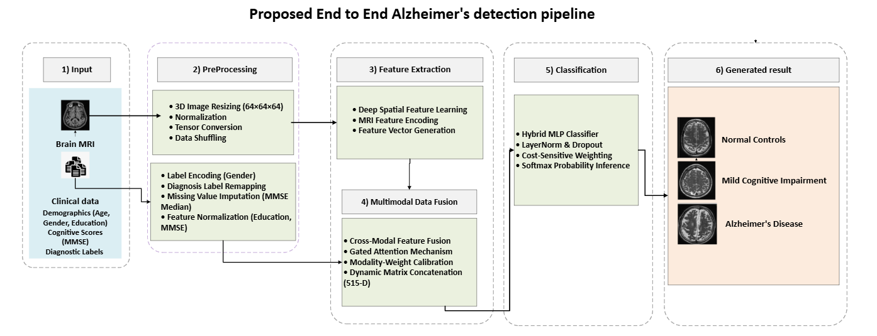
Section 5: Methodology
Overview
Proposed Framework and Dataflow

Slide 15
Section 5: DATASET
Dataset Profile
Alzheimer's Disease Neuroimaging Initiative (ADNI)
Globally recognized benchmark dataset.
Matched 3D sMRI scans and clinical records.
Cohort No (1971)
Class Distribution:
- Normal Control (NC): 479 subjects
- MCI (MCI): 766 subjects
- Alzheimer's Disease (AD): 726 subjects

Slide 16
Section 5: DATASET
Dataset Profile
Medical Group (Diagnosis) | Data Split | Number of Patients (N)
Normal Control (NC) | Training (70%) | 335
Normal Control (NC) | Validation (15%) | 72
Normal Control (NC) | Testing (15%) | 72
Early MCI (EMCI) | Training (70%) | 536
Early MCI (EMCI) | Validation (15%) | 115
Early MCI (EMCI) | Testing (15%) | 115
Alzheimer's (AD) | Training (70%) | 508
Alzheimer's (AD) | Validation (15%) | 109
Alzheimer's (AD) | Testing (15%) | 109
Total Cohort | Cumulative | 1971
ADNI Data set divided to into three subsets
• Training Set (70%): 1,379 subjects.
• Validation Set (15%): 296 subjects.
• Independent Test Set (15%): 296 subjects.

Slide 17
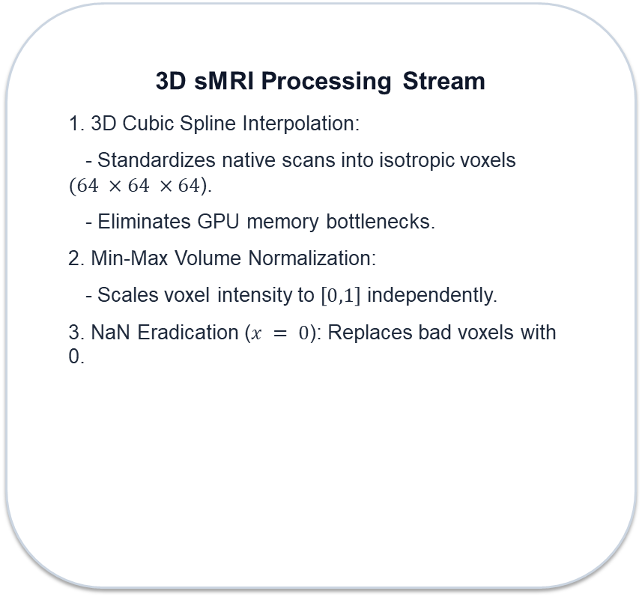
Section 5: PREPROCESSING
Data Preprocessing Pipelines
3D sMRI Processing Stream
1. 3D Cubic Spline Interpolation:
- Standardizes native scans into isotropic voxels $(64 ×64 ×64$).
- Eliminates GPU memory bottlenecks.
2. Min-Max Volume Normalization:
- Scales voxel intensity to $\left[0,1\right]$ independently.
3. NaN Eradication ($x = 0$): Replaces bad voxels with 0.
Clinical Metadata Stream
1. Missing Score Imputation:
- Replaces missing MMSE values using diagnostic group medians.
- Calculated strictly on training set to avoid leakage.
2. Feature Normalization:
- Binary gender encoding (Male=1, Female=0).
- Min-Max scaling for Age, Education, and MMSE scores.

Slide 18
Section 5: ARCHITECTURES
Architectures evaluation progress overview
1. Baseline 3D-CNN
• Standard 3D convolutions.
• Result: 38.85% Accuracy (Biased to MCI majority class).
2. 3D VGG-16 Network
• Deeper network without skip connections.
• Result: 38.85% Accuracy (Stuck in vanishing gradient trap).
3. 3D ResNet-18
• Residual skip connection highways.
• Result: 98.31% Accuracy (Single-modality breakthrough).
4. Proposed Multimodal data Fusion
• Fuses 512-D MRI features with 3-D MMSE vector via Gated Attention.
• Result: 97.30% Accuracy & 100% AD Recall (0 False Negatives).

Slide 19
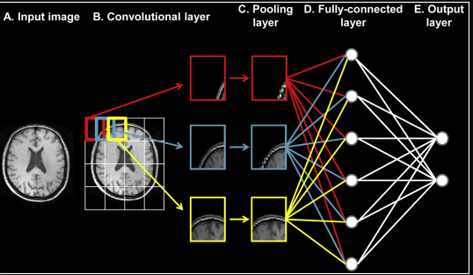
Section 5: ARCHITECTURES
Baseline 3D-CNN
1. Baseline 3D-CNN
Extend traditional CNN models to process 3D volumetric MRI brain scans.
Use 3D convolutional layers to extract spatial features from MRI volumes.
Apply 3D Max-Pooling to reduce spatial dimensions and improve feature representation.
Establish a baseline model for volumetric feature extraction and Alzheimer’s classification.
Limited network depth may reduce the ability to learn high-level features and affect classification performance.

Slide 20
Section 5: ARCHITECTURES
Baseline 3D-CNN Results
1. Baseline 3D-CNN
Achieved an initial testing accuracy of 38.85%.
Extracted basic spatial features from 3D MRI volumes but showed limited learning capability.
Exhibited a strong bias toward the EMCI class, predicting all test samples as EMCI.
Failed to correctly classify NC and AD classes, resulting in zero precision and recall.
Confusion matrix analysis confirmed the model’s inability to distinguish between classes.
Training curves showed minimal improvement, indicating insufficient feature learning from MRI data.
Class | Precision | Recall | F1-Score | Support
Normal Control (NC) | 0.00% | 0.00% | 0.00% | 72
Mild Cognitive Impairment (MCI) | 38.85% | 100.00% | 55.96% | 115
Alzheimer (AD) | 0.00% | 0.00% | 0.00% | 109
Accuracy | — | — | 38.85% | 296
Macro Avg | 12.95% | 33.33% | 18.65% | 296
Weighted Avg | 15.09% | 38.85% | 21.74% | 296

Slide 21
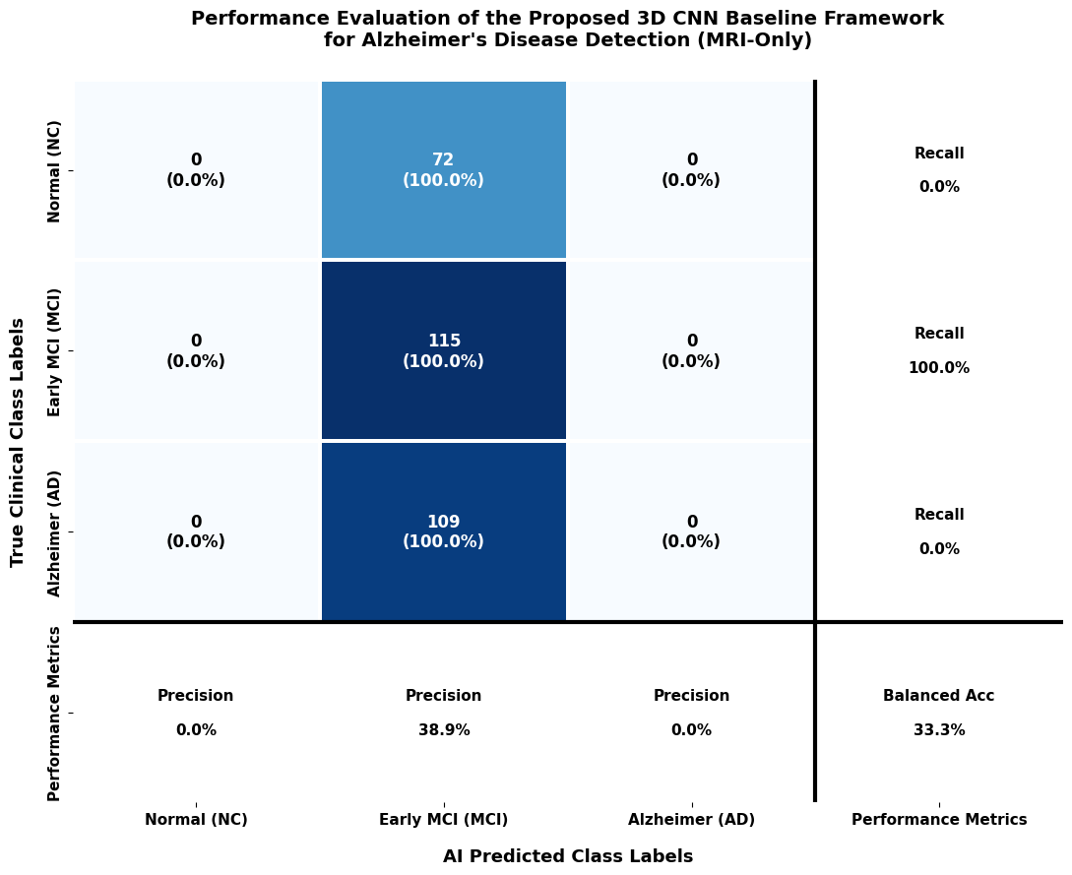
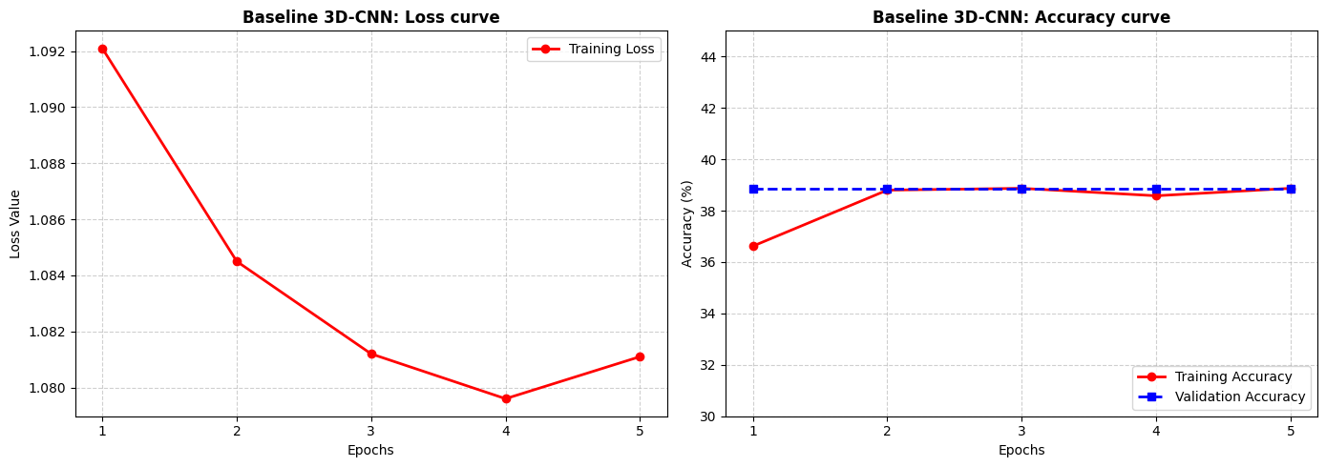
Section 5: ARCHITECTURES
Baseline 3D-CNN Confusion matrix & Training curves
1. Baseline 3D-CNN confusion matrix and training curves
Confusion matrix analysis confirmed the model’s inability to distinguish between classes.
Training curves showed minimal improvement, indicating insufficient feature learning from MRI data.

Slide 22
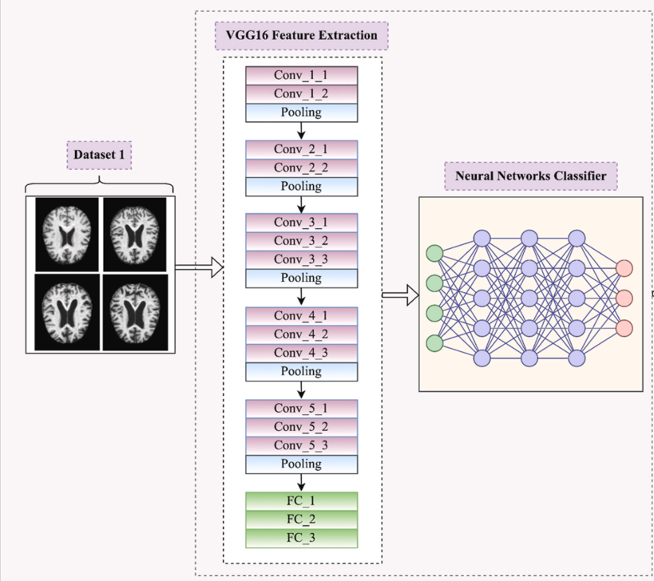
Section 5: ARCHITECTURES
VGG-16
2.VGG-16
Develop a deeper architecture inspired by VGG networks for 3D MRI feature extraction.
Use multiple 3×3×3 convolutional layers to capture complex spatial patterns.
Learn hierarchical representations of structural brain changes from MRI volumes.
Increase network depth to improve feature learning and classification capability.
Face optimization challenges due to the vanishing gradient problem in deeper networks.
Experience difficulty in training and become limited by local optimal solutions during validation.

Slide 23
Section 5: ARCHITECTURES
VGG-16 Results
2.VGG-16 results
Increased network depth to improve feature extraction from 3D MRI volumes.
Learned more complex spatial features using repeated convolutional layers.
Lack of skip connections caused gradient propagation problems during training.
Deeper layers became difficult to optimize, limiting model performance.
Testing accuracy remained unchanged at 38.85%.
The model did not achieve improvement compared with the baseline 3D-CNN.
Class | Precision | Recall | F1-Score | Support
Normal Control (NC) | 0.00% | 0.00% | 0.00% | 72
Mild Cognitive Impairment (MCI) | 38.85% | 100.00% | 55.96% | 115
Alzheimer (AD) | 0.00% | 0.00% | 0.00% | 109
Accuracy | — | — | 38.85% | 296
Macro Avg | 12.95% | 33.33% | 18.65% | 296
Weighted Avg | 15.09% | 38.85% | 21.74% | 296

Slide 24
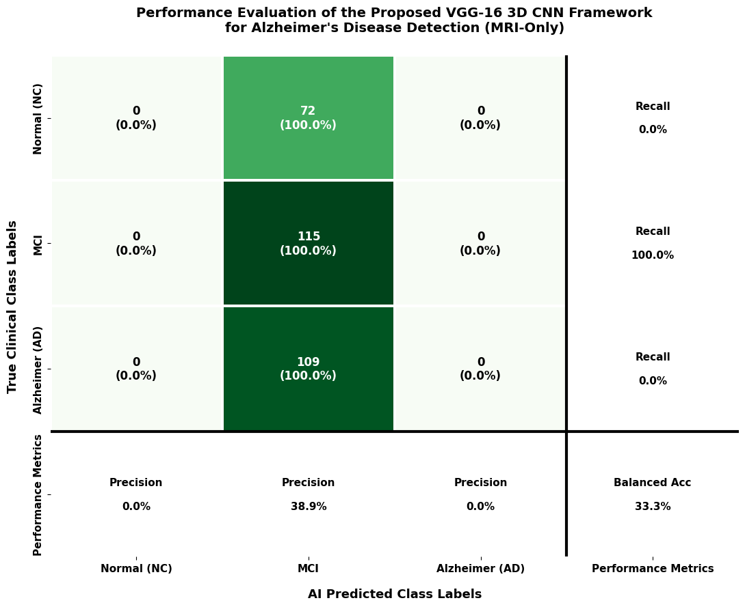
Section 5: ARCHITECTURES
VGG-16 Confusion matrix
2.VGG-16 Confusion matrix
The model predicted all 296 test samples as the EMCI class.
Failed to correctly identify Normal Control (NC) and Alzheimer’s Disease (AD) cases.
Achieved a low precision of 38.9% and balanced accuracy of 33.3%.
Results indicate strong class bias and limited ability to distinguish between different Alzheimer’s stages.

Slide 25
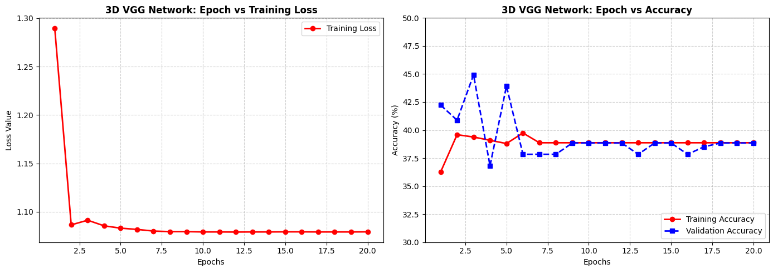
Section 5: ARCHITECTURES
VGG-16 Training curves
2.VGG-16 Training Curve Analysis:
Training loss decreased initially, then remained nearly constant at 1.079 throughout training.
Accuracy improved during the first few epochs and then stabilized at approximately 38.8%.
The model showed limited learning progress and failed to improve further.
Performance limitations were likely caused by optimization issues, such as vanishing gradients.

Slide 26
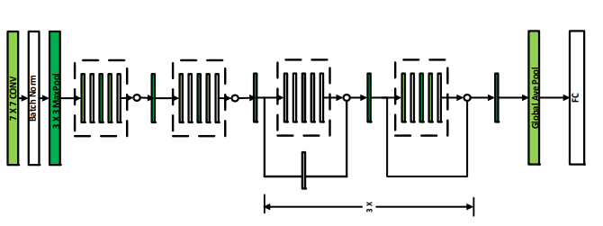
Section 5: ARCHITECTURES
ResNet-18
ResNet-18 Architecture
Adopt a 3D ResNet-18 model to overcome the vanishing gradient problem and improve classification performance.
Use residual skip connections to enhance gradient flow and stabilize deep network training.
Enable deeper feature learning from 3D MRI volumes without significant optimization difficulties.
Extract high-level volumetric features from MRI scans using a pretrained 3D ResNet-18 backbone.
Generate compact MRI feature representations for integration with other data modalities.
Prepare extracted MRI features for the multimodal fusion stage with clinical data.

Slide 27
Section 5: ARCHITECTURES
ResNet-18 Results
ResNet-18 Results
Achieved a significant improvement in testing accuracy, reaching 98.31%.
Residual connections improved training stability and feature learning.
Pretrained convolutional weights enhanced the extraction of informative MRI features.
Generated effective 512-dimensional visual feature representations for classification.
Demonstrated superior performance compared with previous CNN-based architectures.
Class | Precision | Recall | F1-Score | Support
Normal Control (NC) | 98.59% | 97.22% | 97.90% | 72
Mild Cognitive Impairment (MCI) | 99.12% | 97.39% | 98.25% | 115
Alzheimer's Disease (AD) | 97.32% | 100.00% | 98.64% | 109
Accuracy | — | — | 98.31% | 296
Macro Average | 98.34% | 98.20% | 98.26% | 296
Weighted Average | 98.33% | 98.31% | 98.31% | 296

Slide 28
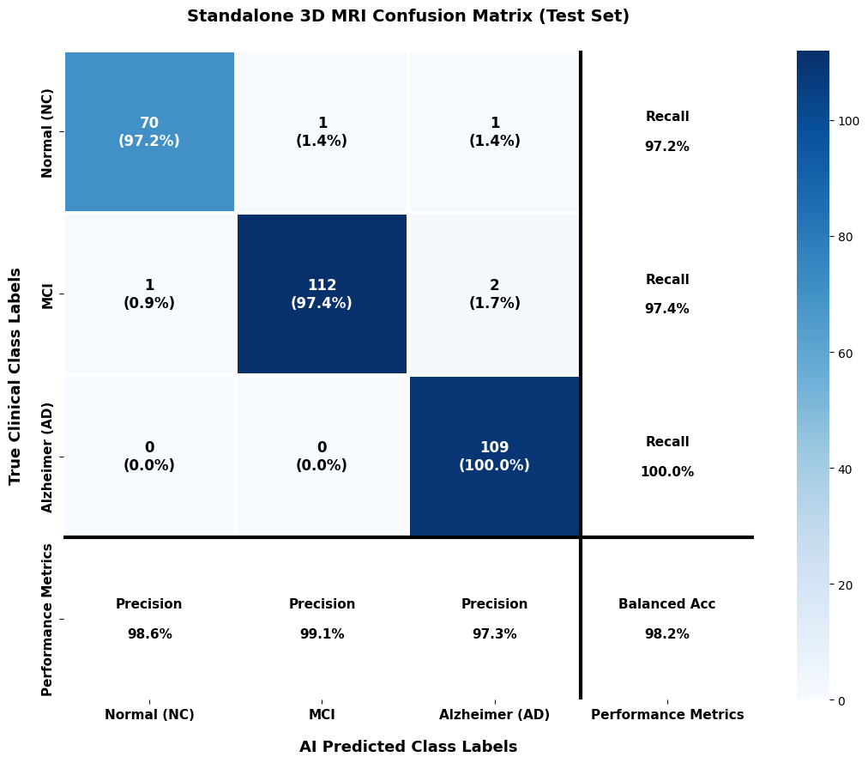
Section 5: ARCHITECTURES
ResNet-18 Confusion matrix
ResNet-18 Confusion Matrix Analysis
Successfully classified the majority of test samples across all three classes.
Correctly identified 70 NC, 112 MCI, and 109 AD cases.
Only 4 out of 292 test samples were misclassified.
Demonstrated strong classification capability and improved class discrimination.
Confirmed the effectiveness of the 3D ResNet-18 model for Alzheimer’s disease classification.

Slide 29
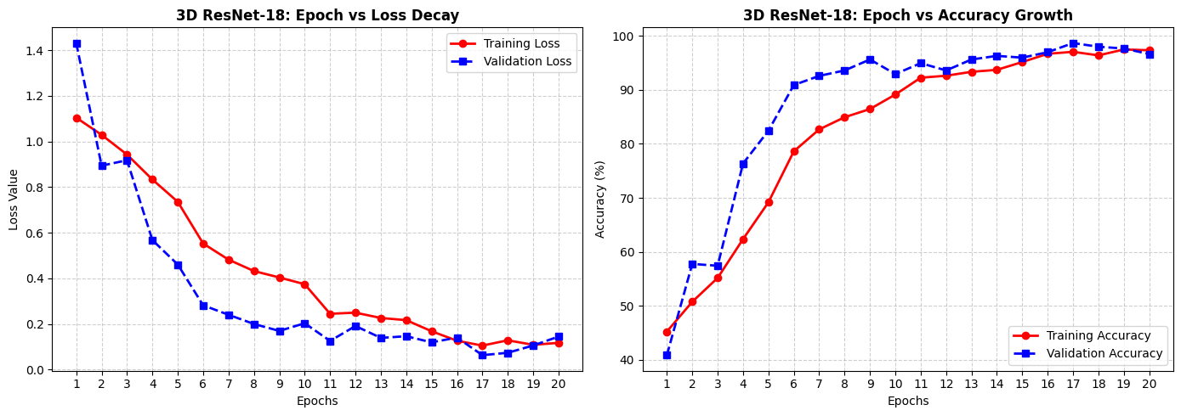
Section 5: ARCHITECTURES
ResNet-18 Training curves
ResNet-18 Training Curve Analysis
Training and validation loss decreased consistently toward zero.
The model achieved stable learning without signs of overfitting.
Residual connections improved gradient flow and training stability.
The network learned robust and meaningful features from MRI data.

Slide 30
Section 5: ARCHITECTURES
Multimodal Data Fusion Model
Develop a multimodal deep learning framework combining MRI and clinical-cognitive information for Alzheimer’s diagnosis.
Overcome limitations of single-modality models by integrating complementary data sources.
Extract high-level MRI features using a pretrained 3D ResNet-18 backbone.
Process clinical features (gender, education level, and MMSE score) to generate clinical representations.
Combine MRI and clinical features using a late fusion strategy.
Use an MLP classifier with class-balanced weighting for final multi-class prediction (NC, MCI, and AD).
Create a unified feature representation that captures both brain structural changes and clinical characteristics.
Improve diagnostic accuracy through comprehensive multimodal learning.

Slide 31
Section 5: ARCHITECTURES
Multimodal Data Fusion model results
Multimodal result
Achieved the high performance with 97.30% testing accuracy.
Combined 3D MRI features with clinical information to improve diagnostic representation.
Integrated clinical features, including normalized MMSE scores, to enhance classification capability.
Improved discrimination between the three diagnostic categories (NC, MCI, and AD).
Demonstrated the effectiveness of multimodal fusion compared with image-only models.
Class | Precision | Recall | F1-Score | Support
Normal Control (NC) | 98.55% | 94.44% | 96.45% | 72
Mild Cognitive Impairment (MCI) | 97.37% | 96.52% | 96.94% | 115
Alzheimer (AD) | 96.46% | 100.00% | 98.20% | 109
Accuracy | — | — | 97.30% | 296
Macro Avg | 97.46% | 96.99% | 97.20% | 296
Weighted Avg | 97.32% | 97.30% | 97.29% | 296

Slide 32
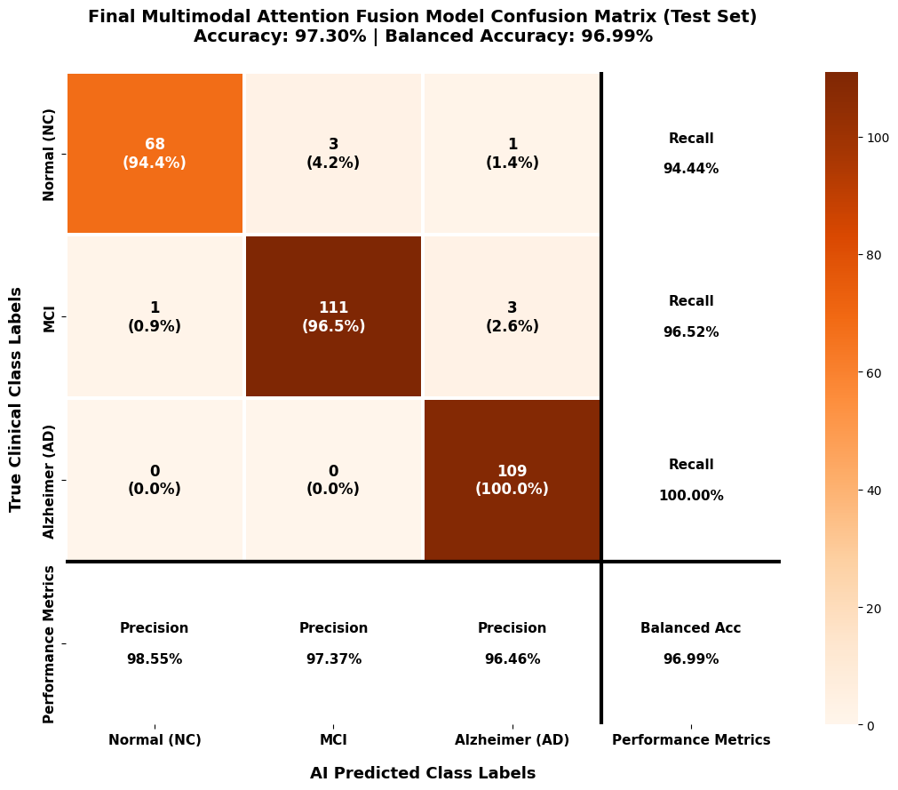
Section 5: ARCHITECTURES
Multimodal Data Fusion model results
Multimodal Confusion Matrix Analysis
Achieved an overall testing accuracy of 97.30%.
Correctly classified 68/72 NC subjects and 111/115 MCI cases.
Successfully identified all 109 AD cases with 100% recall.
Achieved a 0% False Negative Rate (FNR) for Alzheimer’s Disease detection.
Demonstrated high reliability in distinguishing between NC, MCI, and AD categories.
Confirmed the effectiveness of combining MRI and clinical features for accurate diagnosis.

Slide 33
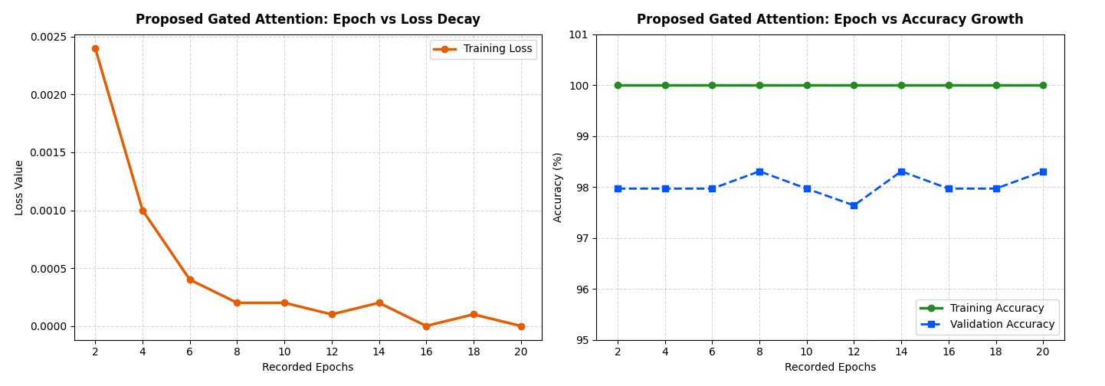
Section 5: ARCHITECTURES
Multimodal Data Fusion model results
Multimodal Training Curve Analysis
Training loss decreased rapidly to nearly zero (0.0000), indicating effective optimization.
Training accuracy reached 100% across the training epochs.
Validation accuracy remained stable between 97.6% and 98.3%.
The model demonstrated strong generalization with no significant overfitting.
Results confirm the stability and effectiveness of the proposed multimodal framework.

Slide 34
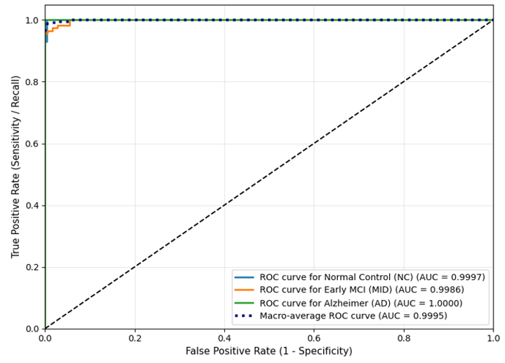
Section 5: ARCHITECTURES
Multimodal Data Fusion Framework AUC
Multimodal Fusion Framework AUC Analysis :
Achieved excellent class separation across all diagnostic categories.
Obtained high AUC scores:
  NC: 0.9997
  MCI: 0.9986
  AD: 1.0000
Achieved a macro-average AUC of 0.9995.
Demonstrated outstanding sensitivity and precision for automated Alzheimer’s disease diagnosis.
Confirmed the robustness of the proposed multimodal fusion model in distinguishing between classes.
100.0%
AD Recall
(Zero False Negatives)
0.9995
Macro AUC
(Class Separation)

Slide 35
Section 5: ARCHITECTURES Comparison results
Performance Comparison Across Architecture Evolution
Architecture Paradigm | Data Modality Input | Global Accuracy | Macro F1-Score | Key Result Note
Baseline 3D-CNN (Scratch) | 3D sMRI Only | 38.85% | 18.65% | Failed; biased to EMCI majority.
3D VGG-16 Inspired Network | 3D sMRI Only | 38.85% | 18.65% | Stuck in vanishing gradient trap.
3D ResNet-18 | 3D sMRI Only | 98.31% | 98.26% | High single-modality accuracy.
Multimodal Data Fusion Framework | 3D sMRI + MMSE Clinical | 97.30% | 97.20% | Optimal clinical balance (0 AD FN).

Slide 36
Section 6
Related works
ALL 15 Prior Studies, Limitations, and analysis

Slide 37
Section 6: RELATED WORK
Complete Related Work Table 2.1 (Part 1: Studies 1 to 5)
Study (Year) | Proposed Method | Dataset | Accuracy | Main Limitations & Analysis
Muksimova et al. (2025) | CNN + LSTM | OASIS | 94.00% | Fuses images only; completely lacks integration of clinical medical records.
Li et al. (2025) | CNN + Transformer | ADNI | 93.04% | Struggles with precise MCI-to-AD intermediate stage prediction.
Bricaud & Masala (2026) | Hybrid ConvNeXtV2-L | ADNI | 91.07% | MRI-only; lacks integration of clinical medical records.
Bekhet et al. (2025) | 1D CNN + Random Forest | OASIS | > 90.0% | No simultaneous fusion; relies on 2D slice images.
Zhang, Y., et al. (2023) | GNN framework | ADNI | 92.00% | High computational cost requiring both MRI + PET scans.

Slide 38
Section 6: RELATED WORK
Complete Related Work Table 2.1 (Part 2: Studies 6 to 10)
Study (Year) | Proposed Method | Dataset | Accuracy | Main Limitations & Analysis
Helaly et al. (2021) | E2AD2C (CNN & VGG19) | ADNI | 97.00% | High power requirement for 3D scans; images-only modality.
Warren & Moustafa (2026) | 3D CNN with XAI | ADNI | 90.00% | Very small sample size; lacks global validation.
Wang, J., et al. (2024) | ResNet + Attention Conv | ADNI | 93.44% | High computational cost requiring both MRI + PET scans.
Alsubaie et al. (2026) | BiFPN3DViT (3D CNN+ViT) | ADNI | 92.10% | MRI-only; lacks integration of clinical medical records.
Ahmed et al. (2023) | Deep CNN | OASIS | 93.86% | MRI-only; lacks Explainable AI (XAI) tools.

Slide 39
Section 6: RELATED WORK
Complete Related Work Table 2.1 (Part 3: Studies 11 to 15 & Proposed)
Study (Year) | Proposed Method | Dataset | Accuracy | Main Limitations & Analysis
Lu et al. (2022) | Transfer (Inception-ResNet) | ADNI | 94.50% | MRI-only; data mostly from Western populations.
Khalid et al. (2026) | CNN & Random Forest | ADNI | 94.00% | Processes images and clinical data separately; lacks unified fusion.
Sheikh et al. (2025) | EfficientNetV2B0 & XAI | Kaggle AD | 88.00% | 2D images only; lacks integration of clinical medical records.
Ghosh et al. (2023) | Federated & MobileNet | Kaggle AD | 95.24% | 2D images only; lacks integration of clinical medical records.
Abbasian & Hammond (2024) | 3D CNN | ADNI | 81.80% | MRI-only; lacks clinical data integration.
Our Proposed Model | Multimodal Data Fusion Model | ADNI | 97.30% | Native 3D sMRI + MMSE fusion, 100% AD Recall (FN=0), 3D Grad-CAM XAI.

Slide 40
Section 7
Conclusions & Future Work
Summary of Scientific Achievements, Impact, and Future Research Directions

Slide 41
Section 7: CONCLUSION
Main Conclusions
Evaluated all models under identical experimental settings using the ADNI testing dataset.
Baseline 3D-CNN: Achieved 38.85% accuracy with limited feature learning.
3D VGG: Increased network depth but showed no performance improvement due to optimization challenges.
3D ResNet-18: Significantly improved classification performance, reaching 98.31% accuracy.
Proposed Multimodal Fusion Framework: Combined MRI and clinical data, achieving 97.30% accuracy and a 0.9995 macro-average AUC.
Correctly identified all Alzheimer's Disease (AD) cases (0 False Negatives).
3D Grad-CAM provided visual explanations by highlighting important brain regions.
Results demonstrate the effectiveness of multimodal learning for Alzheimer's disease diagnosis.
Limitation: Evaluation was conducted on the ADNI dataset only; larger external datasets are needed for further validation.

Slide 42
Section 7: FUTURE WORK
Future Research Directions
1. Multi-Cohort Validation
Test framework on external datasets (OASIS, AIBL) for cross-population robustness.
2. 3D Tissue Segmentation
Integrate Swin UNETR or nnU-Net models for exact hippocampal volume loss calculation.
3. Longitudinal Forecasting
Model temporal patient MRI scans taken over years to predict MCI conversion to full AD.
4. Federated Learning
Implement multi-hospital collaborative model training without sharing private patient data.

Slide 43
THANK YOU!
Questions & Academic Discussion
By: Ahmed Naji Lutfi & Mohamed Amin Miqdad
Supervisor: Dr. Mohamed Essa
Collage of Informatics, Midocean University, Comoros

