Slide 1


Principle of Management
Prepared by
Dr. Bothaina Mahmoud Fouad
Orientation Lec.

Slide 2



Week-1
Orientation Lecture
MGM111
Principle of Management
Prepared by
Dr. Bothaina Mahmoud Fouad
www.midocean.ae
www.midocean.ae

Slide 3
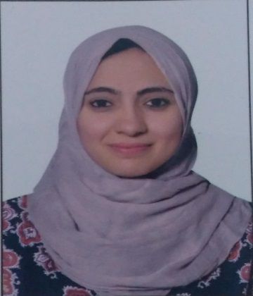
Bothaina Mahmoud Fouad
Lecturer of Entrepreneurship , Innovation and Management
EDUCATION
SKILL HIGHLIGHTS
Bachelor’s degree of Commerce | 2006 , Ain Shams University
Master Degree in Economics | 2013 , Ain Shams University
PH.D Degree in Economics | 2021 , Ain Shams University
Project management and excellent time management.
flexible , responsible , ambitious.
Decision maker and adopting easily to changing situations.
teaching others, helpful, cooperative & have the team spirit
Job Experience
public speaker about Entrepreneurship, Innovation, Management and Economics.
Entrepreneurship and Managing Projects Lecturer
Coordinator of International Affairs
Head of NCTU- Eclub
Executive Manager of NCTU Incubation Program
Team member of TARIEIC Incubator
Team member of STPERI (1st Science park specialized in Electronics Industry)
Administrator and Financial Reviewer
01110624464 /
01097380359
Bothaina.Mahmoud@midoean.edu.km
Bothaina.hussien@nctu.edu.eg
Notes:
Copyright © www.BestFreeCV.com/en

Slide 4
This course aims to:
Provide students with concepts of
the foundations and the concepts of business administration through the presentation of an integrated framework of business management.
It will focus on improving the student understanding of the administrative process: planning, decision- making, organization, coordination, motivation and incentives, administrative communications, control and Its various functions
www.midocean.ae

Slide 5
Learning Outcomes
  The course will help students to gauge understanding in principle of management
Recognize the concepts of the administration, the manager and the organization.
Recognize the administrative functions (planning, organization…)
Understand the concept of administration and its role in the development of organizations and communities
Understand functions of management as they relate to environmental professions.
Understand the principles of effective leadership.
Learn how to systematically approach problem solving.
Understand how environmental management systems influence the managerial environment.
www.midocean.ae

Slide 6

Essential References:
The main material and reference for each course will be:
the textbook mentioned in the course specifications.
Principles of Management by David S. Bright, Anastasia H. Cortes, et al.
Lectures, case studies prepared by the lecturer
Credit Hours: 3 credit hours.
www.midocean.ae

Slide 7
Table of Content
No.of. Weeks | Course Unit
1 | Lecture 1: Overview of management -1
2 | Lecture 2: Overview of management -2
3 | Lecture 3: Leadership
4 | Lecture 4: Planning
5 | Lecture 5: Time Management
6 | Lecture 6: Making decisions Organizational Structure
7 | Lecture 7: Organizational Structure and Design
8 | Lecture 8: Organizing and Managerial Communication
9 | Lecture 9: Human Resource Management
10 | Lecture 10: Controlling as a Management Function
www.midocean.ae

Slide 8

13 Weeks
12 Quizzes
Our roadmap
12 Live Sessions
www.midocean.ae

Slide 9
Intro lec.
10 Lectures
Lectures
Revision lec. +
Final exam lec
www.midocean.ae

Slide 10

Method of teaching the course
practical part
Theoretical
Part
www.midocean.ae

Slide 11

  Assessment Method
Short Exam
  80% marks
    Count of short 10 Exams (Weekly)
    8 Marks for each of short Exam.
  20% Final Examination ( 20 Marks )
www.midocean.ae

Slide 12
  Assessment Method
Multiple Choice
TRUE or FALSE
VOICE Questions
www.midocean.ae

Slide 13
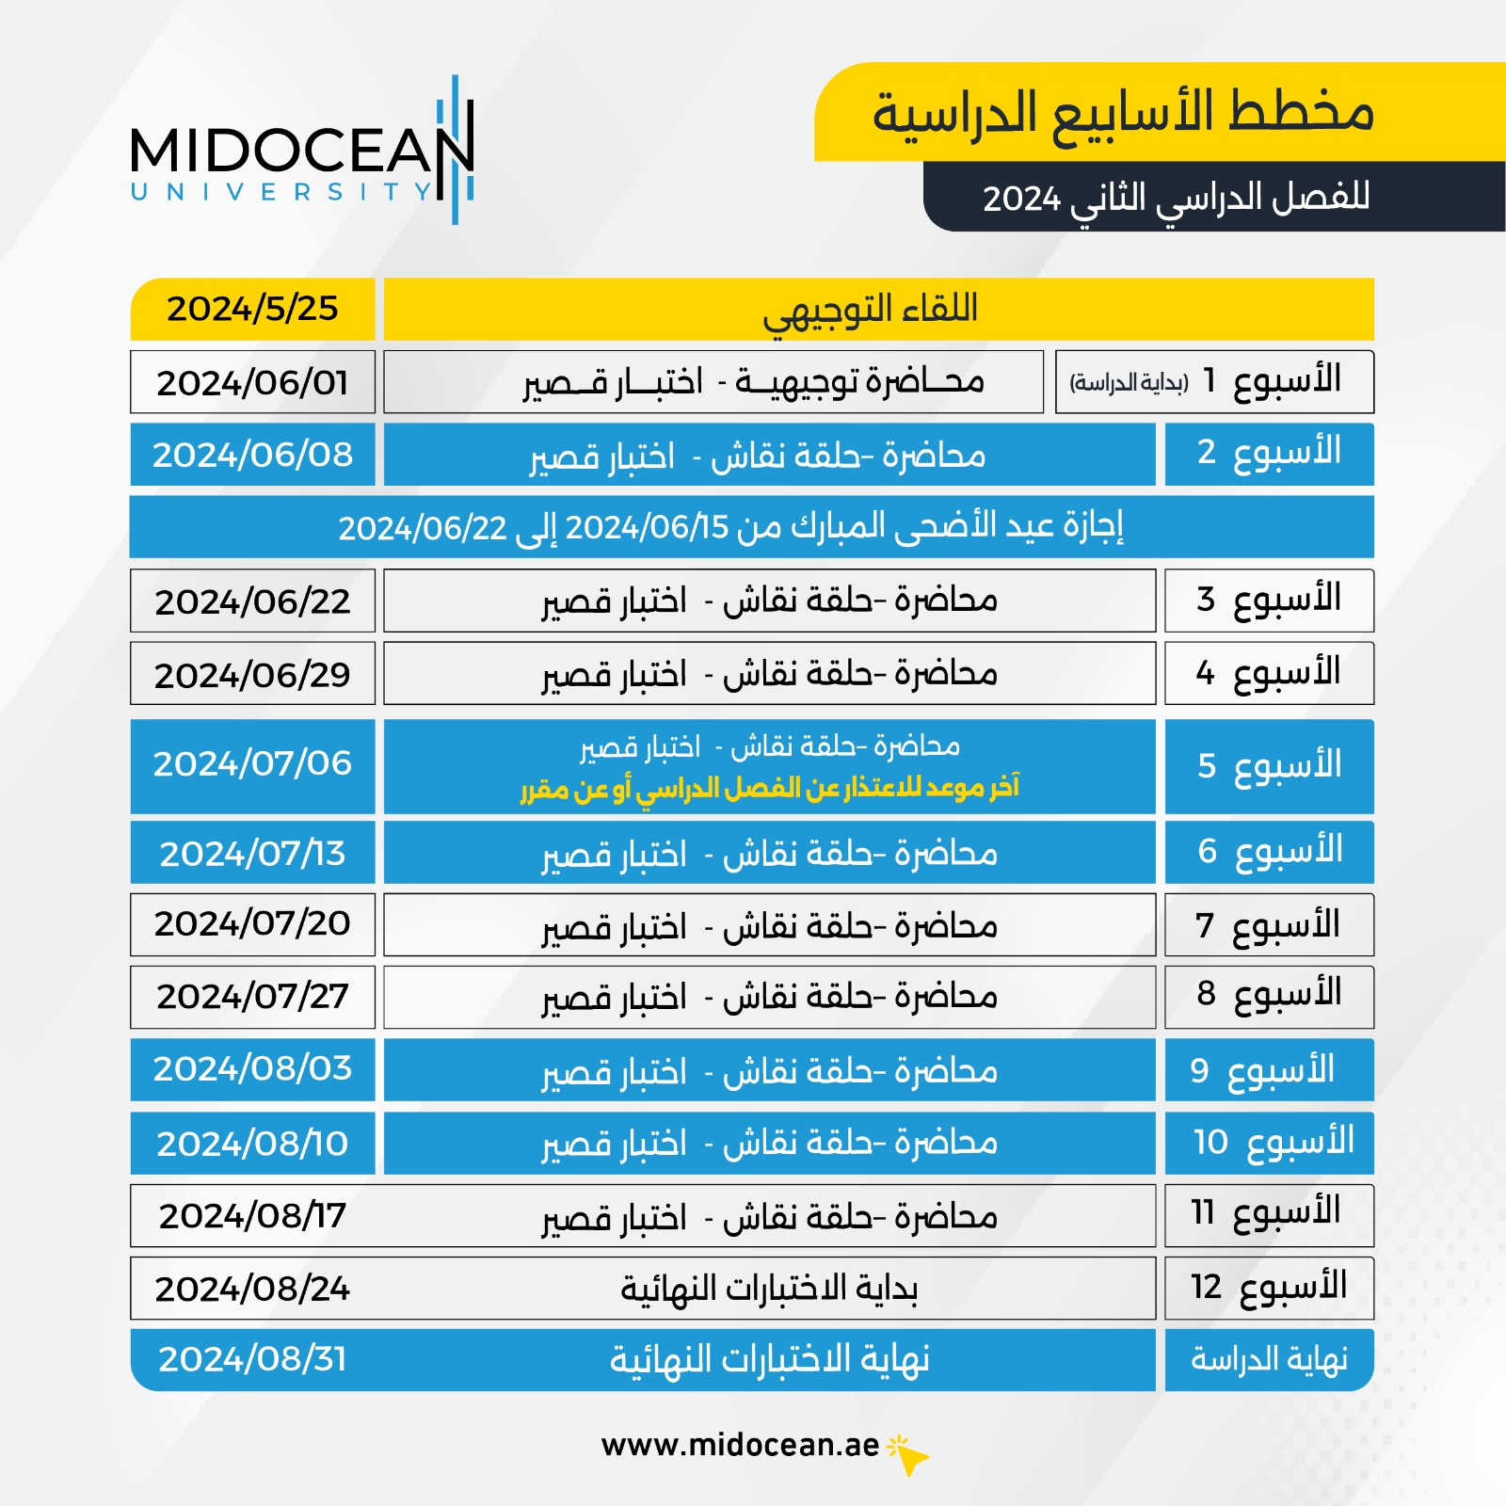
  Educational Weekly Plan

Slide 14


Slide 15

www.midocean.ae
    وسيلة التواصل الأساسية مع الطلاب هو عن طريق المنصة الأكاديمية Sis
  Microsoft Teams
  Discussion Time Every week
  KSA Time
How we can Reach each other

Slide 16
Our lec. time
Lectures
Live session
( office hours )
40 -50 slides
90 Minutes
Weekly
www.midocean.ae

Slide 17



Thank You

