Slide 1


Prepared by Dr. Rana Maya
REA621
Real Estate market analysis
Introduction

Slide 2



Real Estate market analysis
Introduction Lecture
REA621
Real Estate market analysis
Prepared by
Dr. Rana Maya

Slide 3

lecture
Abstract
0
This lecture introduces course description, objectives, contents, and learning outcomes with some case studies.

Slide 4

lecture
0
Contents
1.Course Description
2. Course Objectives
3. Textbook
4. Topics to be covered
5. Learning Outcomes

Slide 5
lecture
0
  Learning outcomes
By the end of the lecture, you will be able to:
1. Understand market analysis and its role
2.Know about objective of market analysis course
3. Learn about course text book and contents
4.Recognize the course learning outcomes

Slide 6

1.Course Description?
This course provides a comprehensive overview of real estate market analysis, exploring the key methods and tools used to evaluate the viability, risks, and opportunities of real estate investments and developments.
Students will learn how market forces, economic trends, location factors, and demographic shifts influence property values and investment decisions.
Emphasis is placed on the practical application of data-driven analysis to guide real estate development, acquisition, and policy-making decisions.

Slide 7

1.Course description - Real Estate Market Analysis?
Given that all 8 billion people on the planet must live somewhere, how do we organize ourselves?
Real estate market analysis is : the identification and study of demand and supply.
-On the demand side are the end users— the buyers or renters of real estate (homebuyers, apartment tenants, retail stores, businesses seeking office or warehouse space, visitors needing hotel accommodations).
-On the supply side are competitors—both existing properties and those at various stages in the development pipeline.
Market analysis identifies prospective users of real estate—both buyers and renters—and their characteristics

Slide 8

1.Course description What Is Real Estate Market Analysis?
Most real estate market analyses examine both the
Market potential
Marketability, or competitiveness, of the proposed project.
The analysis of market potential examines aggregate data about demand and supply.
Demand is, by far, the more difficult half of the equation.
Projecting the strength of demand requires a mix of research, experience ,and intuition.

Slide 9
1. Course description- Example— Jeddah Residential Real Estate Market
Location & Overview:
Jeddah is Saudi Arabia’s second-largest city on the Red Sea coast, serving as a key economic and residential hub in the Makkah Region. It forms one of the main urban centers driving population growth and housing demand in the Kingdom.
Population & Demographics:
The city’s metropolitan area includes over 3.7 million residents, and housing demand remains strong as domestic migration and urbanization continue to expand residential needs.
Median Household Income:
In Saudi Arabia, median household disposable income is around SAR 7,362 per month, with Saudi households typically earning higher at SAR 13,655 monthly, reflecting consumer capacity relevant for housing affordability analysis in urban areas like Jeddah.

Slide 10
Project Example – Mid-Rise Residential Development
Site Advantages
Strategic Location:
  Located within an established residential neighborhood with proven housing demand
  Direct access to main arterial roads and public transportation routes
Proximity to Services:
  Walking distance to schools, supermarkets, healthcare facilities, and local retail
  Short commuting time to major employment centers
Physical Characteristics:
  Flat topography reduces earthwork and foundation costs
  Regular site shape allows efficient building layout and optimal unit planning
Infrastructure Availability:
  Existing connections to water, electricity, sewage, and telecommunications
  No requirement for major off-site infrastructure investment

Slide 11
Demand Analysis - example
Residential Apartment Development – Mid-Income Segment
Proposed project: 120 units
Product Price (Subject Property)
Average unit price: USD 130,000
Average price per m²: USD 1,200
Positioned within prevailing mid-market price range
· Consumer Income
Median household income: USD 24,000/year
Affordable housing expenditure: 30–35% of income
Income levels support mortgage and rental affordability
· Price of Related Products (Substitutes)
Competing apartment prices: USD 1,150–1,300 per m²
Rental substitutes (2 BR): USD 600–700/month
Subject project is competitively priced within market range

Slide 12

2. Course Objectives:
By the end of this course, you will be able to:
1. Understand the fundamental principles of real estate market dynamics.
2. Analyze local and regional real estate markets using both qualitative and quantitative data.
3. Apply analytical techniques to evaluate market demand, supply, and absorption rates.
4. Interpret economic indicators and demographic trends relevant to property markets.
5. Develop professional market analysis reports for different property types.

Slide 13

3.Textbook
•Credit Hours: 3 credit hours
-The main material and reference for each course will be the textbook mentioned in the course specifications. Lecture notes and slides are additional resources that are prepared by the professor.
•Required Textbook:
'Real Estate Market Analysis' by Deborah L. Brett ,2019.

Slide 14


1
4. Topics to be covered
Introduction to real estate markets analysis
This lecture defines market analysis and discusses its uses and users. It shows how market analysis fits into the development process as a way to improve decision-making at each stage.
The Topic highlights Market analysis role as a basis for decisions regarding location and site, project size, design and quality, features and amenities, target audience, pricing, and phasing.
.

Slide 15

2
4. Topics to be covered:
Basics of Real estate market analysis
This lecture outlines in general terms how to approach a real estate market analysis. It describes the basic tasks to be done, discusses the importance of field observations, and identifies the types of information needed to reach supportable conclusions.
A market study should cover key observations regarding the site and its surroundings, advantages and disadvantages of the location, demand indicators, and characteristics of the competition.
The question is : whether the development project should proceed as planned?

Slide 16
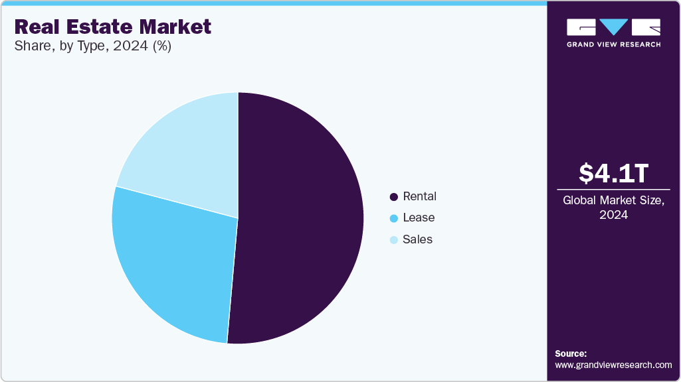
3
4. Topics to be covered
Market conditions: indicators and demographics
National, and local economic conditions affect property demand.
key real estate market indicators and economic indicators with consumer Demographics shape consumer confidence and business investment activity.
Thorough market analysis requires some consideration of the national economic climate.
synthesize the findings and reach conclusions about a proposed project’s marketability or the future performance of an existing property

Slide 17
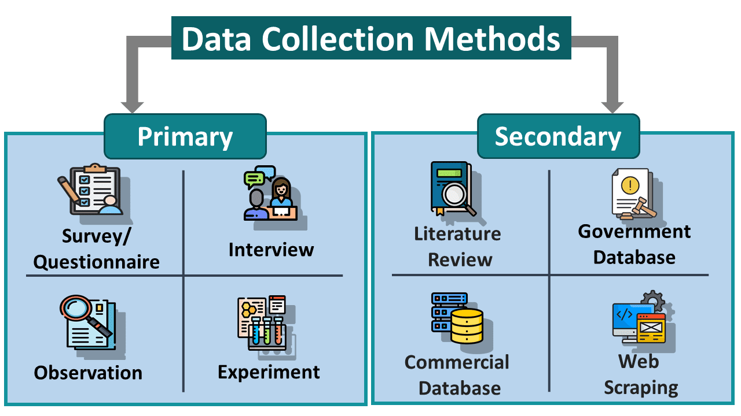
4
4. Topics to be covered
Data Sources and Collection Methods, Site and Location Analysis
The topic present data sources and collection methods, emphasizing the importance of accurate, reliable, and relevant data in real estate analysis.
Primary data such as site visits, surveys, and stakeholder interviews were combined with secondary data from government statistics, market reports, and transaction databases.
This foundation was reinforced through site and location analysis, highlighting how location-specific factors—such as accessibility, zoning, infrastructure, environmental conditions, and surrounding land uses—significantly influence property value and market performance.

Slide 18

5
4. Topics to be covered
Market Segmentation and Target Market Analysis
The topic examine market segmentation and target market analysis, demonstrating how real estate demand varies across income groups, household types, business sectors, and investor profiles.
By identifying target market segments, analysts can better match property type, scale, pricing, and design to market needs, thereby improving absorption rates and project viability.

Slide 19

6
4. Topics to be covered
Financial Feasibility and Risk Assessment
The analysis then progressed to financial feasibility and risk assessment, where market findings were translated into financial projections and investment indicators.
Key measures such as net present value, internal rate of return, and cash flow analysis were used to evaluate project feasibility.
The Topic also address real estate–specific risks, including market cycles, financing constraints, construction costs, regulatory uncertainty, and occupancy risk, emphasizing the need for sensitivity and scenario analysis.

Slide 20
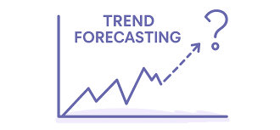
7
4. Topics to be covered
Forecasting Market Trends
Recognizing the dynamic nature of real estate markets, the topic explore forecasting market trends as a critical component of forward-looking analysis.
Techniques such as trend analysis, econometric indicators, and scenario planning were introduced to assess future demand, price movements, and supply responses.
These tools enable developers, investors, and policymakers to anticipate market shifts and make more resilient decisions.

Slide 21

8
4. Topics to be covered
Case Studies in Market Analysis
To connect theory with practice, case studies in real estate market analysis were presented, illustrating how analytical frameworks are applied in different market contexts and property types.
The case studies highlight common challenges, data limitations, and decision trade-offs, while demonstrating best practices and practical solutions.

Slide 22
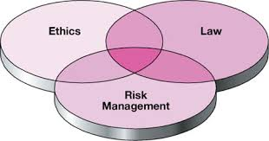
9
4. Topics to be covered
Ethical Considerations and Market Manipulation Risks
The topic also address ethical considerations and market manipulation risks, underscoring the responsibility of real estate analysts to maintain objectivity, transparency, and professional integrity.
Ethical market analysis was presented as essential for protecting investors, supporting fair markets, and maintaining public trust, particularly in environments where information asymmetry and speculative behavior are prevalent.

Slide 23

10
4. Topics to be covered
Preparing and Presenting Market Analysis Reports
Finally, the course concluded with guidance on preparing and presenting real estate market analysis reports, emphasizing clarity, logical structure, and effective communication.
Well-prepared reports were shown to be essential tools for translating complex market data into actionable insights for investors, lenders, developers, and public authorities.

Slide 24
5. Learning Outcomes:
Upon successful completion of this course, students will be able to:
•Explain the structure and function of real estate markets.
•Gather and interpret data relevant to real estate market analysis.
•Conduct basic and advanced analyses to assess market conditions and project feasibility.
•Apply statistical and economic principles to identify real estate investment opportunities.
•Prepare and communicate market analysis findings in a professional format.
•Evaluate the impact of economic cycles and policy changes on real estate markets.

Slide 25
5. Learning Outcomes: case study
📍 Case Study: Residential Real Estate Market Analysis for a Mid-Income Housing Project
1. Background and Objective
A private real estate developer is considering the development of a mid-income residential apartment project in a growing metropolitan area (City A).
The objective of the market analysis is to assess market demand, financial feasibility, risks, and pricing strategy before proceeding with land acquisition and project design.

Slide 26

5. Learning Outcomes: case study
2. Site and Location Analysis
The proposed site is a 25,000 m² parcel located within a secondary urban district approximately 8 km from the central business district (CBD).
Key Location Characteristics:
Direct access to two arterial roads
Public transportation within 500 meters
Proximity to schools, healthcare facilities, and retail centers
Zoning permits residential development up to 8 floors
Conclusion:
The site demonstrates strong locational suitability for mid-income residential housing due to accessibility and availability of urban services.

Slide 27
5. Learning Outcomes: case study
3. Market Segmentation and Target Market
The residential market in City A was segmented based on income levels and household characteristics.
Target Market Segment:
Middle-income households earning USD 2,000–3,500 per month
Young families and professionals aged 30–45
Preference for 2–3 bedroom apartments (90–130 m²)
Demand Indicators:
Population growth rate: 2.8% annually
Household formation growth: 3.1% annually
Mortgage availability improving through local banks

Slide 28

Conclusion
By combining rigorous data collection, market and financial analysis, forecasting, ethical practice, and professional reporting, market analysts are equipped to conduct credible and practical real estate market analyses that support sustainable and informed decision-making in diverse market conditions.
lecture
0
Real estate market analysis is not a single technique but an integrated decision-support process.

Slide 29



Thank You

