Slide 1



Ethics of Digital Law
Lecture 06
LAW 614
English Language for Digital Law
Prepared by
Samara Jasim
www.midocean.ae

Slide 2
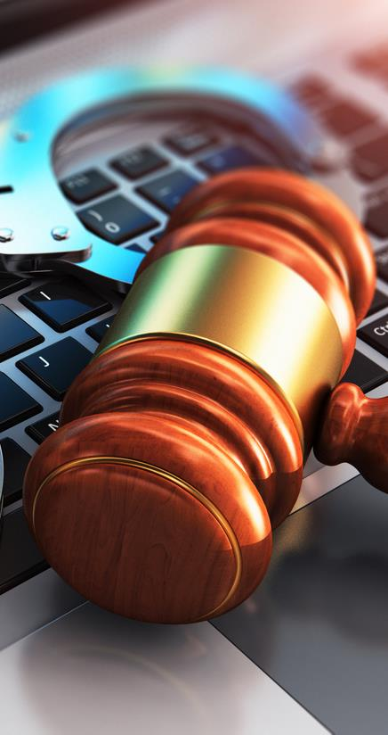

Lecture
06
INTRODUCTION
A. DEFINITION OF DIGITAL LAW
Digital law, also known as cyber law or internet law, refers to the legal framework that governs the use of digital technologies, internet activities, and the interaction of individuals, businesses, and governments in the digital field. It encompasses a wide range of issues, such as data privacy, cybersecurity, intellectual property, online transactions, digital content, social media regulations, and much more.
www.midocean.ae

Slide 3

Lecture
06
INTRODUCTION
B. ROLE OF ETHICS IN DIGITAL LAW
Ethics plays a crucial role in shaping the practice of digital law. While laws and regulations provide the framework for governing digital interactions, ethics serve as the moral compass that guides individuals and organizations in making responsible and just decisions within the digital landscape.
www.midocean.ae

Slide 4
Lecture
06
INTRODUCTION
B. ROLE OF ETHICS IN DIGITAL LAW
The primary role of ethics in digital law is to ensure that the use of technology and digital platforms is aligned with principles that promote fairness, respect for human rights, privacy, and the welfare of society at large. Ethical considerations help legal professionals navigate the complexities of digital environments, allowing them to identify and address potential challenges and dilemmas that arise as technology evolves.
www.midocean.ae

Slide 5

Lecture
06
INTRODUCTION
C. ROLE OF ETHICAL CONSIDERATIONS IN DIGITAL ENVIRONMENT
1. Safeguarding Privacy and Data Protection:
Ethical considerations are crucial in safeguarding individuals' privacy and protecting their personal data. As technology advances, the risk of data breaches and unauthorized access to sensitive information increases. Ethical practices ensure that digital interactions respect users' privacy rights and handle their data responsibly.
www.midocean.ae

Slide 6
Lecture
06
INTRODUCTION
C. ROLE OF ETHICAL CONSIDERATIONS IN DIGITAL ENVIRONMENT
2. Ensuring Transparency and Accountability:
Digital law often deals with complicated algorithms, automated decision-making systems, and AI-driven technologies. Ethical considerations demand transparency in these systems to understand how they function and make decisions. Additionally, holding individuals and organizations accountable for their digital actions ensures a fair and just digital society.
www.midocean.ae

Slide 7
Lecture
06
INTRODUCTION
C. ROLE OF ETHICAL CONSIDERATIONS IN DIGITAL ENVIRONMENT
3. Preserving Cybersecurity and Safety:
The digital landscape is riddled with cyber threats and malicious activities. Ethical considerations in digital law necessitate robust cybersecurity measures to protect individuals and organizations from cyber-attacks. Ethical practices also discourage the use of technology for harmful purposes and advocate for the safety of digital environments.
www.midocean.ae

Slide 8
Lecture
06
INTRODUCTION
C. ROLE OF ETHICAL CONSIDERATIONS IN DIGITAL ENVIRONMENT
4. Promoting Equitable Access and Digital Inclusion:
Ethical digital law addresses the digital divide and advocates for equal access to digital resources and opportunities. It strives to bridge the gap between the digitally privileged and the underserved communities, ensuring that technology is used to empower all members of society.
www.midocean.ae

Slide 9
Lecture
06
INTRODUCTION
C. ROLE OF ETHICAL CONSIDERATIONS IN DIGITAL ENVIRONMENT
5. Addressing Emerging Ethical Challenges:
As technology evolves, new ethical challenges emerge. Ethical considerations in digital law prompt legal professionals to stay proactive in identifying and addressing these challenges, such as the ethical implications of AI, biotechnology, or quantum computing.
www.midocean.ae

Slide 10
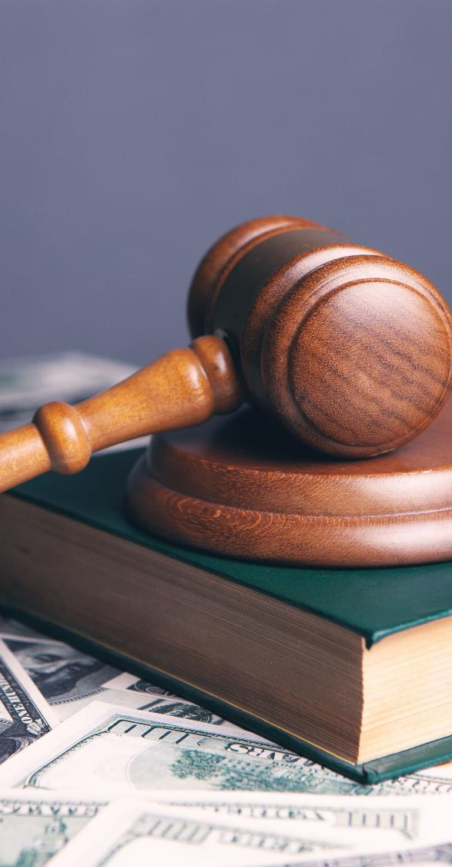
Lecture
06
UNDERSTANDING DIGITAL ETHICS
A. OVERVIEW OF ETHICS AND ITS APPLICATION IN LAW
Ethics, in a broad sense, refers to the moral principles and values that guide human behavior, decision-making, and interactions. In the context of law, ethics plays a vital role in ensuring that legal practices are grounded in principles that uphold justice, fairness, and the well-being of society.
www.midocean.ae

Slide 11
Lecture
06
UNDERSTANDING DIGITAL ETHICS
A. OVERVIEW OF ETHICS AND ITS APPLICATION IN LAW
In the digital era, where technology permeates every aspect of our lives, digital ethics becomes increasingly critical. Digital ethics seeks to apply ethical principles to the use of technology, digital platforms, and internet activities. It encompasses various areas, including data privacy, cybersecurity, intellectual property, artificial intelligence, and social media, to name a few.
www.midocean.ae

Slide 12

Lecture
06
UNDERSTANDING DIGITAL ETHICS
B. KEY ETHICAL PRINCIPLES IN DIGITAL LAW
1. Privacy and Data Protection
Respecting individuals' privacy is a basic human right, and preserving it is vital in the digital world. In digital law, ethical concerns focus on safeguarding personal information from unauthorized access, use, and sharing. As legal professions, it is essential to handle data protection laws and ensure transparent and respectful dealing of individuals' privacy rights.
www.midocean.ae

Slide 13
Lecture
06
UNDERSTANDING DIGITAL ETHICS
B. KEY ETHICAL PRINCIPLES IN DIGITAL LAW
2. Transparency and Accountability
Transparency is a key ethical principle in the digital age. Users have the right to know how their data is being collected, used, and shared. Transparent practices foster trust between individuals and organizations, promoting responsible digital interactions. Accountability holds entities responsible for their actions, making sure they are answerable for any adverse consequences of their digital activities.
www.midocean.ae

Slide 14
Lecture
06
UNDERSTANDING DIGITAL ETHICS
B. KEY ETHICAL PRINCIPLES IN DIGITAL LAW
3. Fairness and Equality
Ethical digital law emphasizes fairness and equality in the treatment of individuals and groups. This principle applies to various areas, including algorithmic decision-making, access to digital resources, and digital content regulation. Legal professionals must be vigilant in identifying and addressing biases and discrimination that might arise from digital technologies and platforms.
www.midocean.ae

Slide 15
Lecture
06
UNDERSTANDING DIGITAL ETHICS
B. KEY ETHICAL PRINCIPLES IN DIGITAL LAW
4. Cybersecurity and Safety
Ensuring the safety and security of digital environments is an ethical imperative. Cybersecurity measures protect individuals and organizations from cyber threats, data breaches, and cyber-attacks. Ethical practices in digital law emphasize the responsible use of technology to prevent harm to individuals and society.
www.midocean.ae

Slide 16
Lecture
06
UNDERSTANDING DIGITAL ETHICS
C. ETHICAL DILEMMAS IN DIGITAL LAW CASES
As legal professionals dealing with digital law, you will inevitably encounter complex ethical dilemmas. Let's explore some common scenarios that pose ethical challenges:
www.midocean.ae

Slide 17
Lecture
06
UNDERSTANDING DIGITAL ETHICS
C. ETHICAL DILEMMAS IN DIGITAL LAW CASES
1. Balancing Privacy and Security:
In cases involving national security or criminal investigations, the balance between privacy and security becomes delicate. Legal professionals must navigate the ethical implications of surveillance and data collection to protect public safety without compromising individual rights.
www.midocean.ae

Slide 18
Lecture
06
UNDERSTANDING DIGITAL ETHICS
C. ETHICAL DILEMMAS IN DIGITAL LAW CASES
2. AI and Decision-Making:
AI-driven decision-making raises questions of transparency and accountability. Ethical considerations demand that the decision-making process is understandable and fair, especially when AI influences significant aspects of individuals' lives.
www.midocean.ae

Slide 19
Lecture
06
UNDERSTANDING DIGITAL ETHICS
C. ETHICAL DILEMMAS IN DIGITAL LAW CASES
3. Social Media and Freedom of Speech:
Social media platforms present challenges concerning freedom of speech and content moderation. Ethical dilemmas arise when determining the line between freedom of expression and preventing harmful or false information from spreading.
www.midocean.ae

Slide 20
Lecture
06
UNDERSTANDING DIGITAL ETHICS
C. ETHICAL DILEMMAS IN DIGITAL LAW CASES
4. Access to Digital Resources:
Making sure that everyone has fair access to digital resources is essential to bridge the digital divide. Ethical questions arise when we try to address the gap between those who have easy access to technology and those who don't.
www.midocean.ae

Slide 21

Lecture
06
TECHNOLOGY AND ETHICS
A. TECHNOLOGY IN LEGAL CONTEXTS
Over the past few decades, digital technologies have become an integral part of legal contexts, streamlining processes, improving access to information, and enhancing the efficiency of legal services. From legal research and case management to dispute resolution and communication, technology has revolutionized the way legal services are delivered.
www.midocean.ae

Slide 22

Lecture
06
TECHNOLOGY AND ETHICS
B. CHALLENGES POSED BY TECHNOLOGICAL ADVANCEMENTS
As technology advances, it also brings along its unique set of challenges that demand careful consideration from legal professionals. Let's explore some of the key challenges posed by technological advancements:
www.midocean.ae

Slide 23

Lecture
06
TECHNOLOGY AND ETHICS
B. CHALLENGES POSED BY TECHNOLOGICAL ADVANCEMENTS
1. AI and Automated Decision-Making
The rise of artificial intelligence (AI) and automated decision-making systems has transformed various legal processes. AI-powered tools can assist legal research, predict case outcomes, and streamline contract review. However, ethical concerns arise regarding the transparency and accountability of AI algorithms, potential biases, and the implications of delegating decisions to machines.
www.midocean.ae

Slide 24
Lecture
06
TECHNOLOGY AND ETHICS
B. CHALLENGES POSED BY TECHNOLOGICAL ADVANCEMENTS
2. Internet of Things (IoT) and Privacy Concerns
The Internet of Things (IoT) connects everyday devices to the internet, creating vast networks of interconnected data. While IoT offers numerous benefits, it also raises significant privacy concerns. Legal professionals must address issues related to data collection, consent, and the potential misuse of personal information collected by IoT devices.
www.midocean.ae

Slide 25
Lecture
06
TECHNOLOGY AND ETHICS
B. CHALLENGES POSED BY TECHNOLOGICAL ADVANCEMENTS
3. Blockchain and Data Integrity
Blockchain technology offers secure and transparent record-keeping systems. Its application in legal contexts can enhance the integrity of contracts, transactions, and intellectual property rights. However, legal professionals must navigate the ethical implications of using blockchain in terms of data privacy, public accessibility, and regulatory compliance.
www.midocean.ae

Slide 26
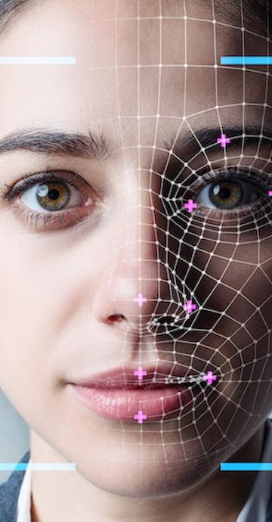
Lecture
06
TECHNOLOGY AND ETHICS
C. ETHICAL IMPLICATIONS OF TECHNOLOGICAL ADOPTION IN LEGAL PRACTICES
The adoption of technology in legal practices presents ethical implications that require careful consideration and responsible decision-making. Let's explore some of these ethical implications:
www.midocean.ae

Slide 27
Lecture
06
TECHNOLOGY AND ETHICS
C. ETHICAL IMPLICATIONS OF TECHNOLOGICAL ADOPTION IN LEGAL PRACTICES
1. Client Confidentiality and Data Security:
The use of digital platforms and cloud-based services raises concerns about client confidentiality and data security. Legal professionals must ensure strong cybersecurity measures are in place to protect sensitive client information.
www.midocean.ae

Slide 28
Lecture
06
TECHNOLOGY AND ETHICS
C. ETHICAL IMPLICATIONS OF TECHNOLOGICAL ADOPTION IN LEGAL PRACTICES
2. Bias and Fairness in AI:
When employing AI tools, legal professionals must assess and mitigate potential biases that may affect the accuracy and fairness of AI-driven outcomes. Ethical considerations demand transparency in the use of AI systems and accountability for the decisions they make.
www.midocean.ae

Slide 29
Lecture
06
TECHNOLOGY AND ETHICS
C. ETHICAL IMPLICATIONS OF TECHNOLOGICAL ADOPTION IN LEGAL PRACTICES
3. Privacy and Consent in IoT:
IoT devices often collect vast amounts of personal data. Legal professionals must ensure that users' privacy is respected, and clear consent is obtained for the collection and use of their data.
www.midocean.ae

Slide 30
Lecture
06
TECHNOLOGY AND ETHICS
C. ETHICAL IMPLICATIONS OF TECHNOLOGICAL ADOPTION IN LEGAL PRACTICES
4. Smart Contracts and Legal Enforcement:
With the adoption of blockchain-based smart contracts, legal professionals must address the enforceability of such contracts and navigate the complexities of cross-border legal implications.
www.midocean.ae

Slide 31

Lecture
06
ETHICS AND CYBERSECURITY
A. ETHICAL PRACTICES IN CYBERSECURITY
Cybersecurity is vital in safeguarding digital systems and data from unauthorized access, cyber-attacks, and potential harm. However, it is equally important to ensure that cybersecurity practices themselves are conducted ethically.
www.midocean.ae

Slide 32
Lecture
06
ETHICS AND CYBERSECURITY
A. ETHICAL PRACTICES IN CYBERSECURITY
Ethical cybersecurity practices involve the responsible use of defensive measures while respecting the rights and privacy of individuals and organizations. It demands transparency in cybersecurity policies and practices to build trust between users and security professionals. Ensuring ethical cybersecurity also means upholding the values of fairness, equality, and accountability in the deployment of security measures.
www.midocean.ae

Slide 33

Lecture
06
ETHICS AND CYBERSECURITY
B. ETHICAL HACKING
Ethical hacking, also known as white-hat hacking, refers to the practice of authorized individuals probing computer systems and networks to identify vulnerabilities before malicious hackers can exploit them. Ethical hackers play a crucial role in improving cybersecurity by identifying weaknesses and helping organizations strengthen their defenses.
www.midocean.ae

Slide 34
Lecture
06
ETHICS AND CYBERSECURITY
B. ETHICAL HACKING
Responsible disclosure is a fundamental aspect of ethical hacking. When ethical hackers discover vulnerabilities, they have an ethical obligation to disclose these findings to the affected organization promptly and discreetly. This allows the organization to patch the vulnerability and protect its users from potential cyber threats.
www.midocean.ae

Slide 35
Lecture
06
ETHICS AND CYBERSECURITY
B. ETHICAL HACKING
Ethical hackers must follow a strict code of conduct, respecting the privacy and confidentiality of the organization's data while conducting their assessments. The goal is to use their skills for the greater good, enhancing cybersecurity for the benefit of all stakeholders.
www.midocean.ae

Slide 36
Lecture
06
ETHICS AND CYBERSECURITY
C. ETHICAL IMPLECATIONS OF CYBERCRIME PROSECUTION
As we combat cybercrime, ethical considerations play a crucial role in the prosecution of offenders. Legal professionals must navigate various ethical dilemmas when dealing with cybercriminals.
www.midocean.ae

Slide 37
Lecture
06
ETHICS AND CYBERSECURITY
C. ETHICAL IMPLECATIONS OF CYBERCRIME PROSECUTION
1. Presumption of Innocence:
Ethical principles demand that all individuals, including cybercriminals, are presumed innocent until proven guilty. Legal professionals must ensure that due process is followed, and the accused have the right to a fair trial.
www.midocean.ae

Slide 38
Lecture
06
ETHICS AND CYBERSECURITY
C. ETHICAL IMPLECATIONS OF CYBERCRIME PROSECUTION
2. Balancing Punishment and Rehabilitation:
While punishing cybercriminals is essential for justice, ethical considerations encourage efforts to rehabilitate offenders when possible. Addressing the root causes of cybercriminal behavior can contribute to reducing recidivism.
www.midocean.ae

Slide 39
Lecture
06
ETHICS AND CYBERSECURITY
C. ETHICAL IMPLECATIONS OF CYBERCRIME PROSECUTION
3. Privacy and Digital Evidence:
Collecting digital evidence in cybercrime cases raises privacy concerns. Legal professionals must strike a balance between the need for evidence and respecting individuals' rights to privacy.
www.midocean.ae

Slide 40
Lecture
06
ETHICS AND CYBERSECURITY
C. ETHICAL IMPLECATIONS OF CYBERCRIME PROSECUTION
4. Avoiding Vigilantism:
Ethical cybercrime prosecution discourages vigilantism or encouraging retaliatory actions against cybercriminals. Instead, it promotes lawful trial through proper legal channels.
www.midocean.ae

Slide 41

Lecture
06
THE ROLE OF LEGAL PROFESSIONALS IN PROMOTING ETHICAL PRACTICES
The pivotal role that legal professionals play in promoting ethical practices, both within the legal field and the broader digital landscape consists of covering the following:
www.midocean.ae

Slide 42
Lecture
06
THE ROLE OF LEGAL PROFESSIONALS IN PROMOTING ETHICAL PRACTICES
1. Upholding Ethical Standards:
As legal professionals, you are the guardians of justice and fairness. By upholding the highest ethical standards in your practice, you set an example for others to follow. Demonstrating integrity, honesty, and respect for all parties involved in legal matters fosters trust and confidence in the legal system.
www.midocean.ae

Slide 43
Lecture
06
THE ROLE OF LEGAL PROFESSIONALS IN PROMOTING ETHICAL PRACTICES
2. Advocating for Ethical Considerations:
Legal professionals have a duty to advocate for ethical considerations in legal decisions and policies. Emphasizing the importance of fairness, privacy, and transparency ensures that ethical principles remain at the forefront of legal practice.
www.midocean.ae

Slide 44
Lecture
06
THE ROLE OF LEGAL PROFESSIONALS IN PROMOTING ETHICAL PRACTICES
3. Educating Clients and Stakeholders:
Educating clients and stakeholders about the ethical implications of legal matters is essential. Providing clear explanations of potential consequences and ethical dilemmas empowers individuals to make informed decisions aligned with ethical values.
www.midocean.ae

Slide 45
Lecture
06
THE ROLE OF LEGAL PROFESSIONALS IN PROMOTING ETHICAL PRACTICES
4. Embracing Technology Ethically:
As technology increasingly shapes legal practices, legal professionals must embrace technology ethically. Adopting secure and responsible technological solutions ensures the protection of clients' data and privacy.
www.midocean.ae

Slide 46
Lecture
06
THE ROLE OF LEGAL PROFESSIONALS IN PROMOTING ETHICAL PRACTICES
5. Addressing Ethical Dilemmas:
Ethical dilemmas are inevitable in the legal profession. Legal professionals must confront these challenges with careful consideration and ethical reasoning, ensuring that decisions align with moral principles.
www.midocean.ae

Slide 47
Lecture
06
THE ROLE OF LEGAL PROFESSIONALS IN PROMOTING ETHICAL PRACTICES
6. Promoting Equal Access to Justice:
Advocating for equal access to justice is a fundamental ethical responsibility. Legal professionals must work towards bridging the gap between privileged and underserved communities, ensuring that everyone has equal opportunities for legal representation.
www.midocean.ae

Slide 48
Lecture
06
THE ROLE OF LEGAL PROFESSIONALS IN PROMOTING ETHICAL PRACTICES
7. Engaging in Continuous Ethical Reflection:
Ethical practice requires ongoing self-reflection and professional development. Legal professionals should stay informed about evolving ethical standards, technological advancements, and legal changes to adapt their practices responsibly.
www.midocean.ae

Slide 49
Lecture
06
THE ROLE OF LEGAL PROFESSIONALS IN PROMOTING ETHICAL PRACTICES
8. Contributing to Ethical Policy Development:
Legal professionals can actively contribute to the development of ethical policies and guidelines. By participating in discussions and debates surrounding ethical issues, they influence legal frameworks to align with the best interests of society.
www.midocean.ae

Slide 50

Lecture
06
Conclusion
In conclusion, ethics play a vital role in digital law, guiding responsible practices and ensuring fairness and privacy. Embracing ethical considerations in cybersecurity and technology adoption is crucial for creating a just and secure digital future. As future legal professionals, upholding ethical principles will drive positive change in the digital world.
www.midocean.ae

Slide 51



Thank You

