Slide 1



Firewall Security Policies and Application
Lecture 6
HCIA-Security
Prepared by
Dr. Abdelrhman Ahmed

Slide 2
Chapter
Security Policy Matching Process
06

Slide 3
Chapter
Application of Security Policies
06

Slide 4
Chapter
Application of Security Policies
06
• Compared with conventional security policies, the security policies on NGFWs can:
□ Distinguish between employees from different departments based on "users“ , making network management more flexible and visualized.
□ Distinguish between applications (such as web IM and web game) using the same protocol (such as HTTP), achieving refined network management.
□ Inspect content security and block viruses and hacker intrusions to better protect internal networks.

Slide 5
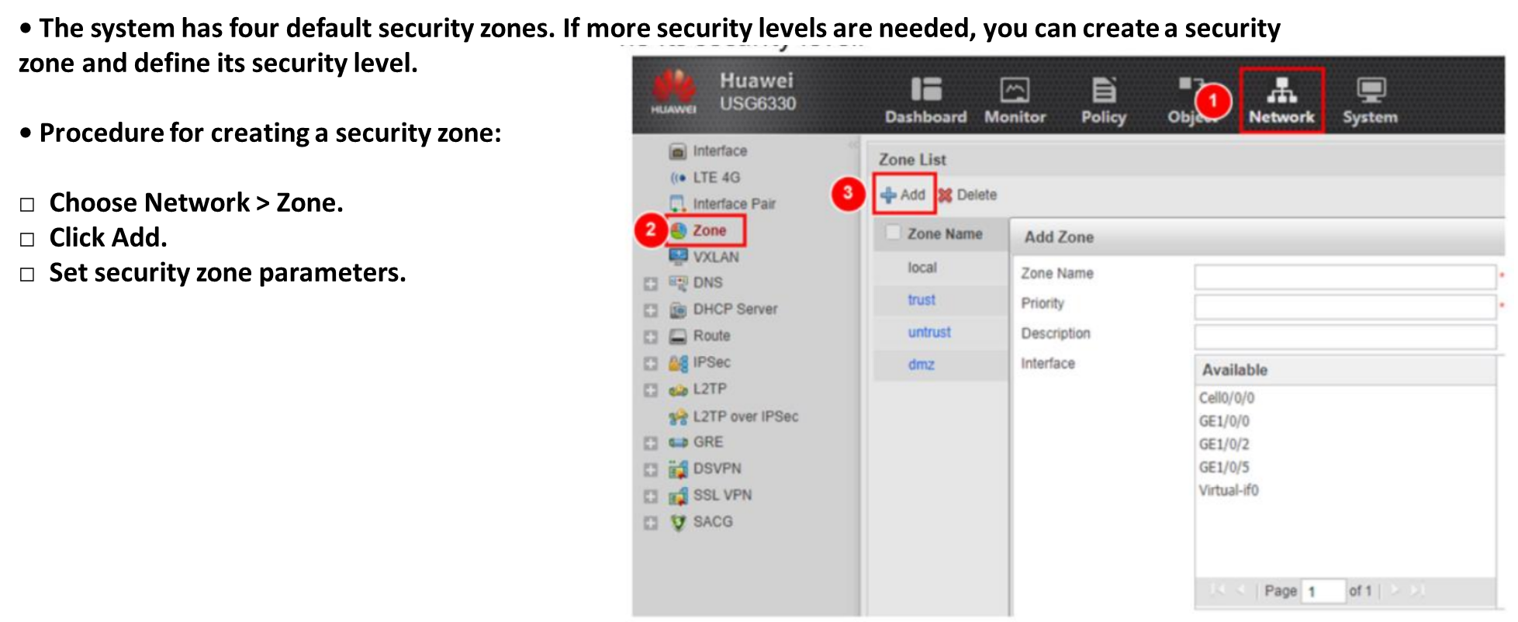
Chapter
Configuring a Security Zone on the Web Ul
06

Slide 6
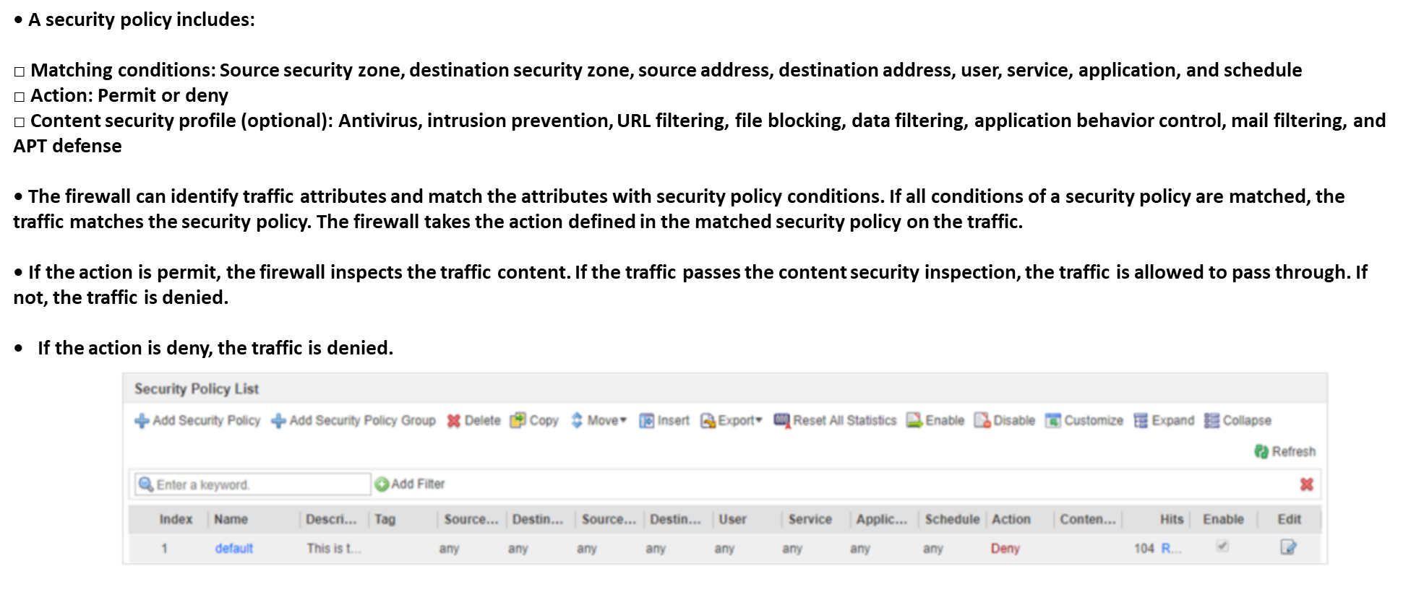
Chapter
Configuring a Security Policy on the Web Ul
06

Slide 7
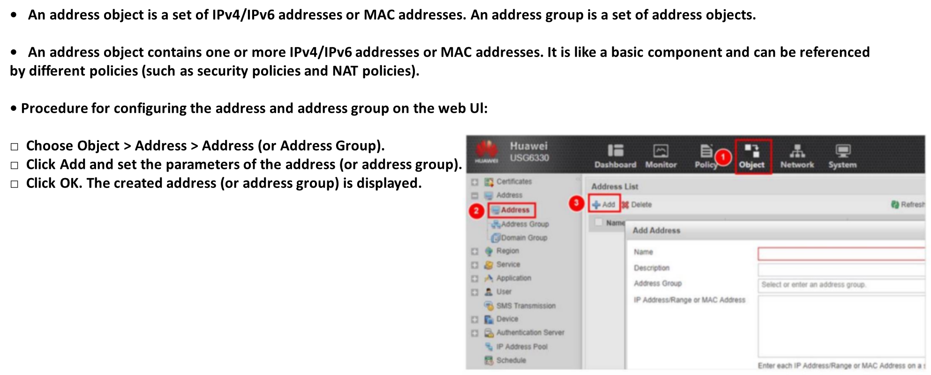
Chapter
06
Configuring Addresses and Address Groups on the Web Ul

Slide 8
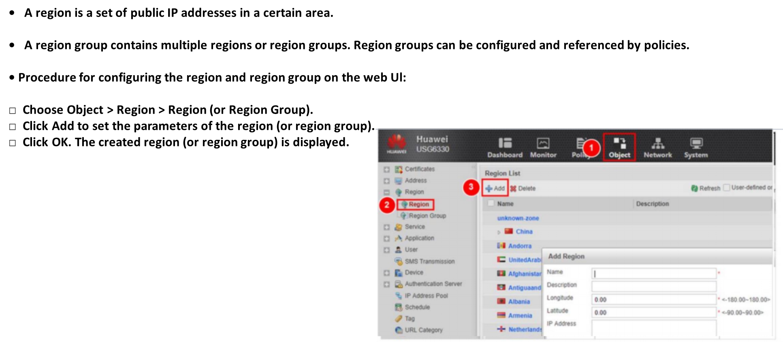
Chapter
06
Configuring Regions and Region Groups on the Web Ul

Slide 9
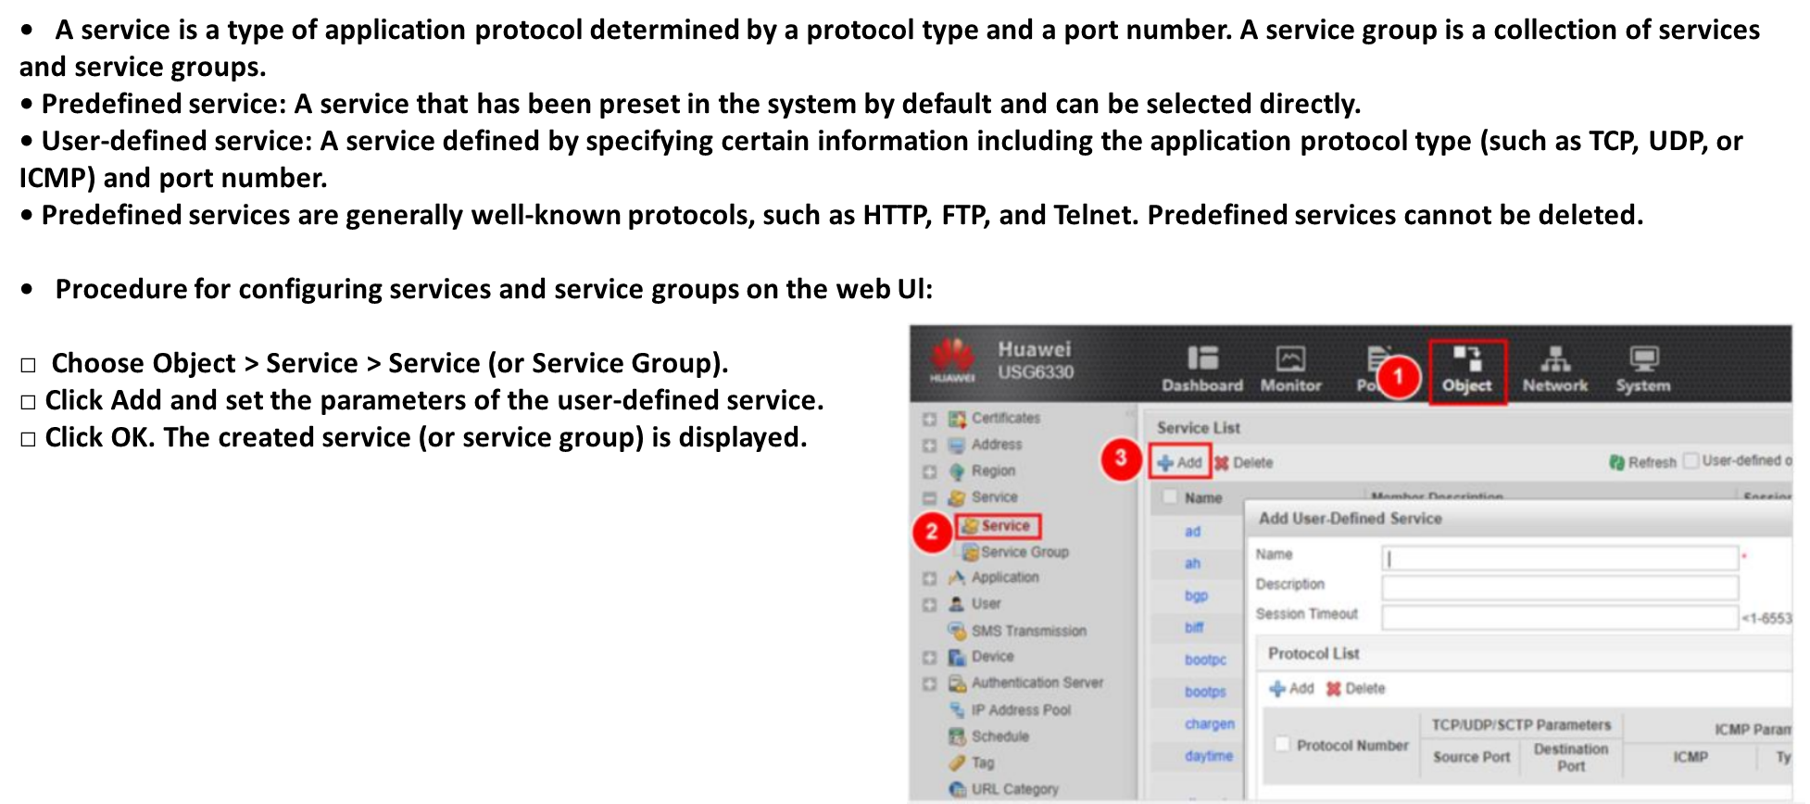
Chapter
Configuring Services and Service Groups
06

Slide 10
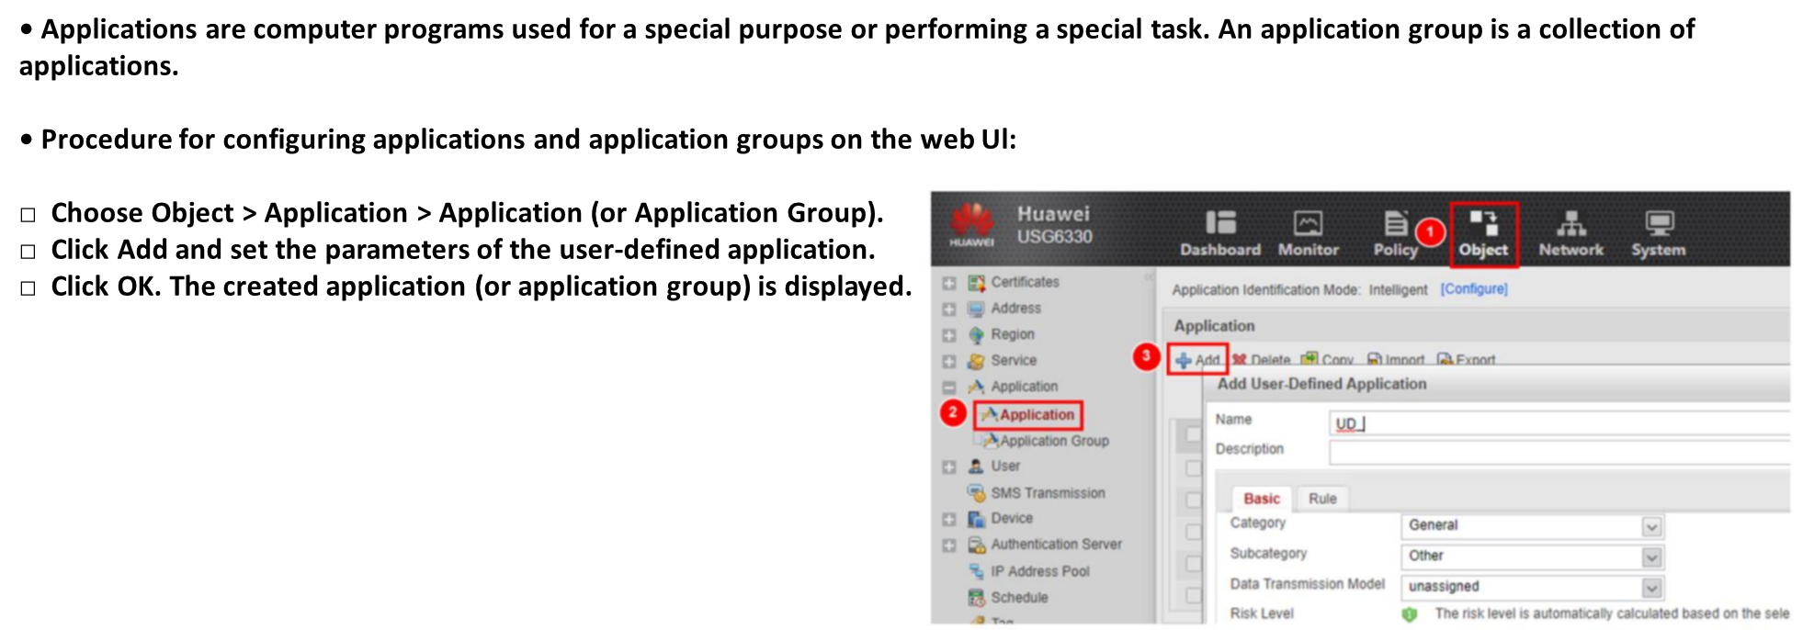
Chapter
06
Configuring Applications and Application Groups on the Web Ul

Slide 11
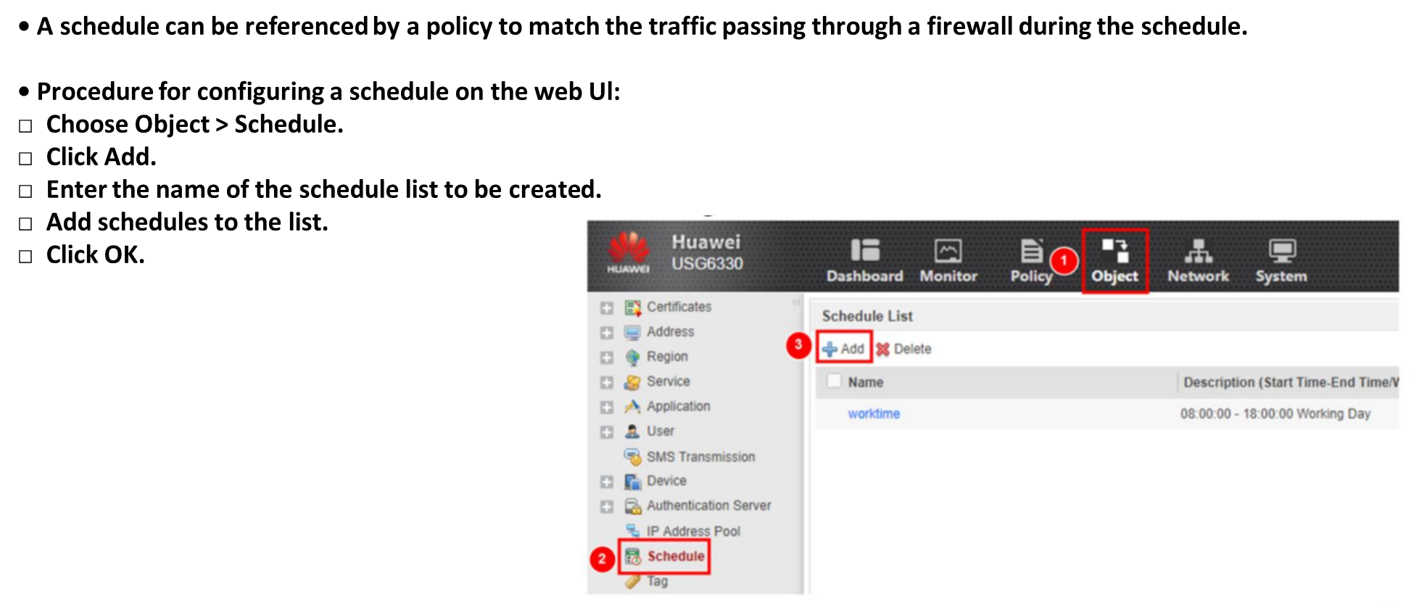
Chapter
Configuring a Schedule on the Web Ul
06

Slide 12
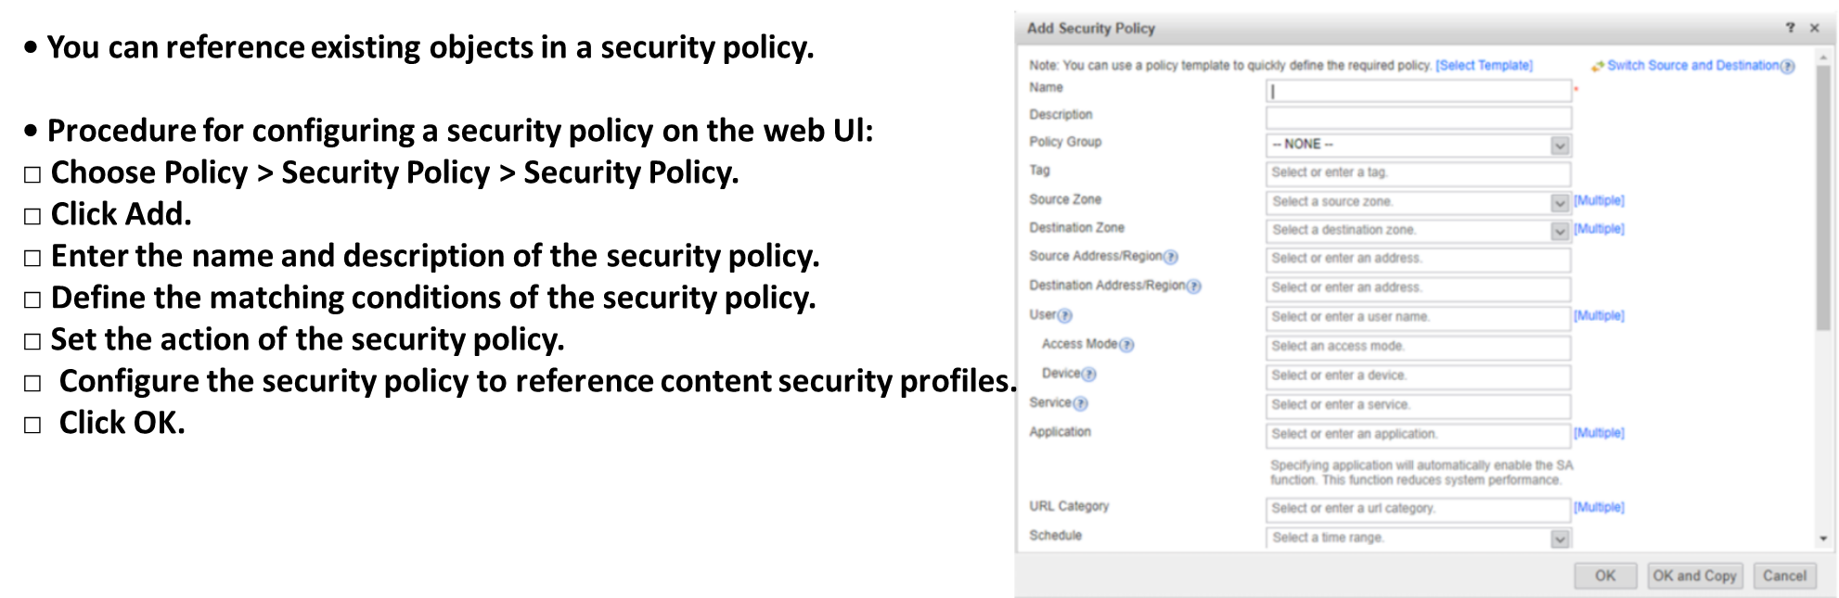
Chapter
Configuring a Security Policy on the Web Ul
06

Slide 13
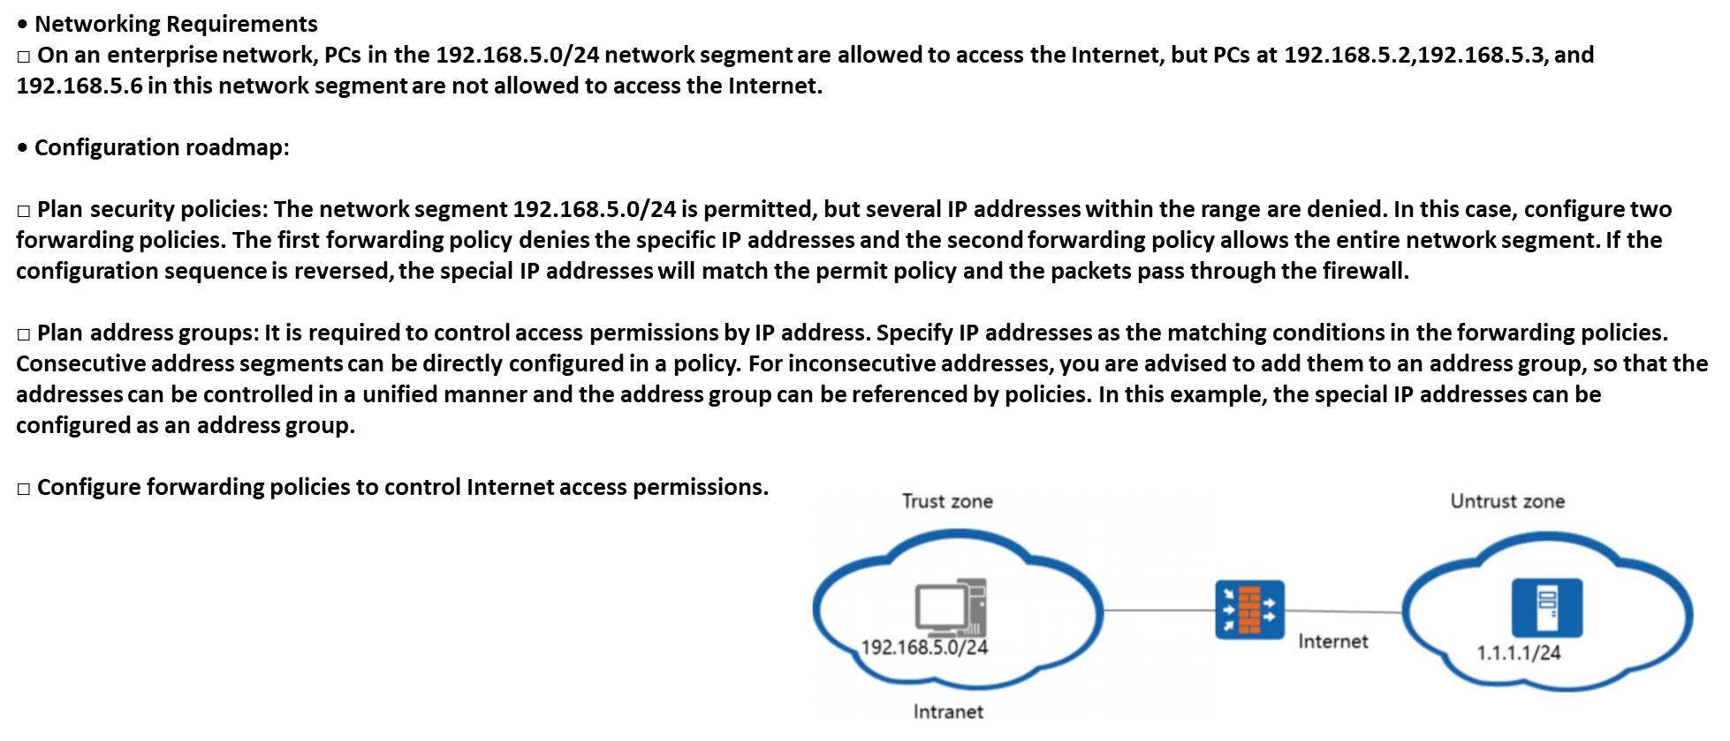
Chapter
Example for Configuring Security Policies
06

Slide 14
Chapter
Security Policy Configuration Process
06

Slide 15
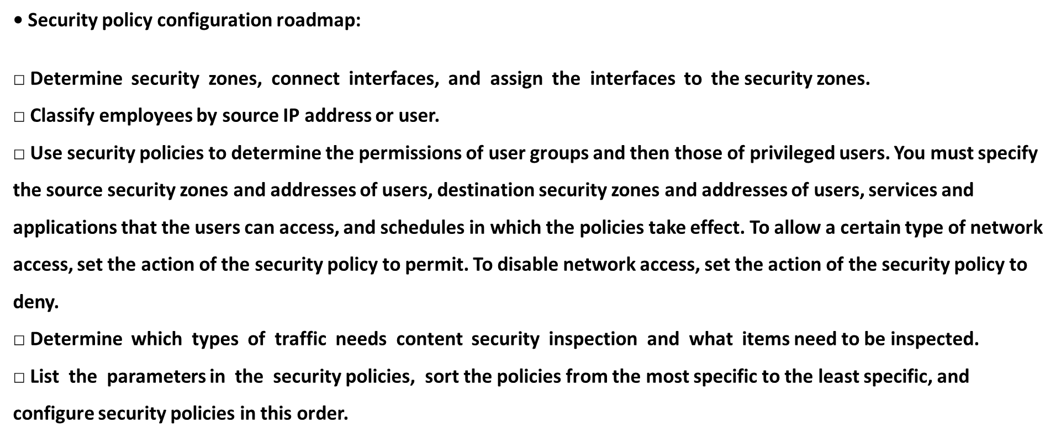
Chapter
Security Policy Configuration Process
06

Slide 16
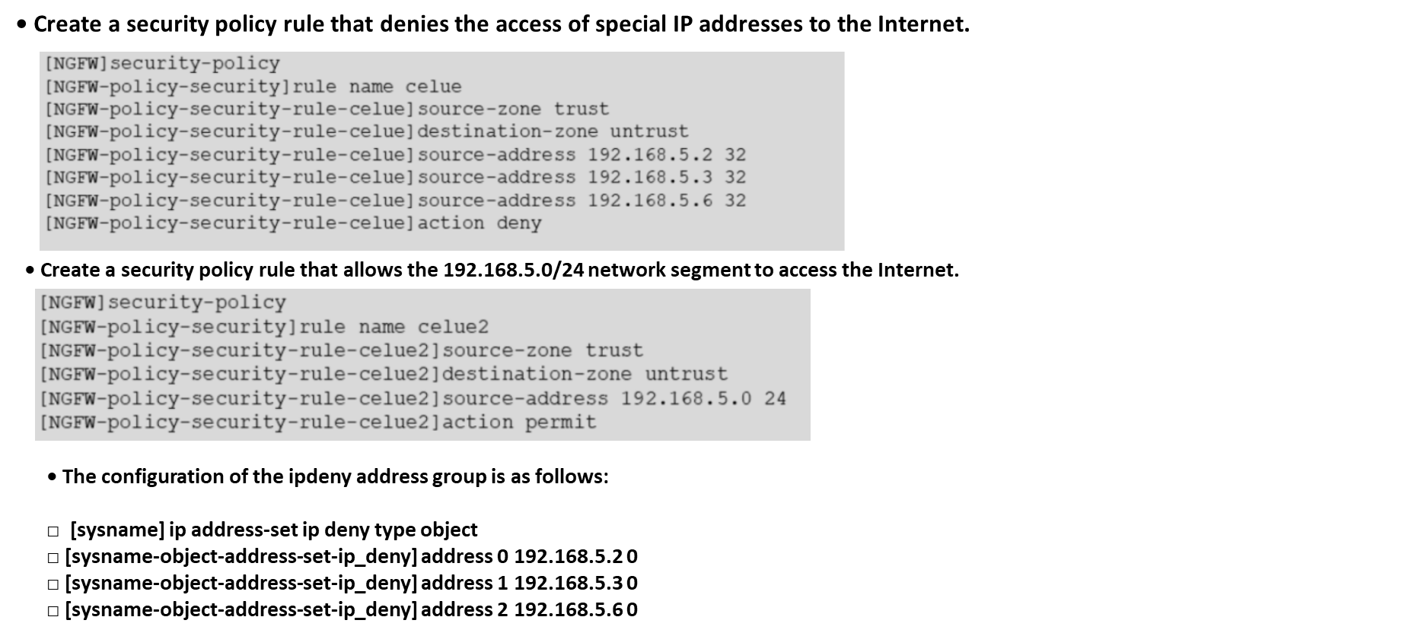
Chapter
Key Configuration (Commands)
06

Slide 17
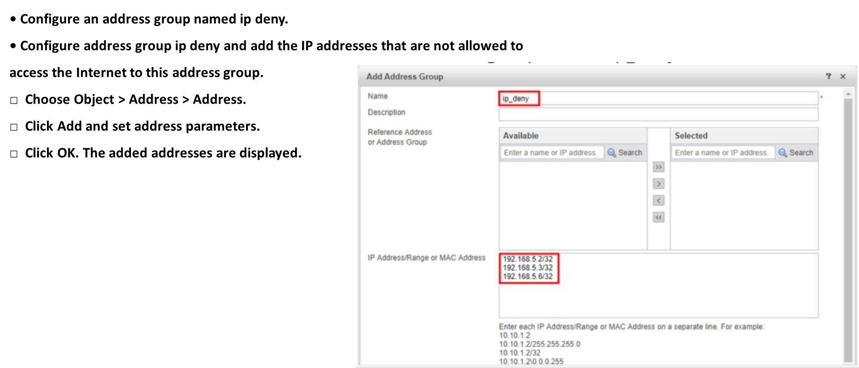
Chapter
Key Configuration on the Web Ul (1)
06

Slide 18
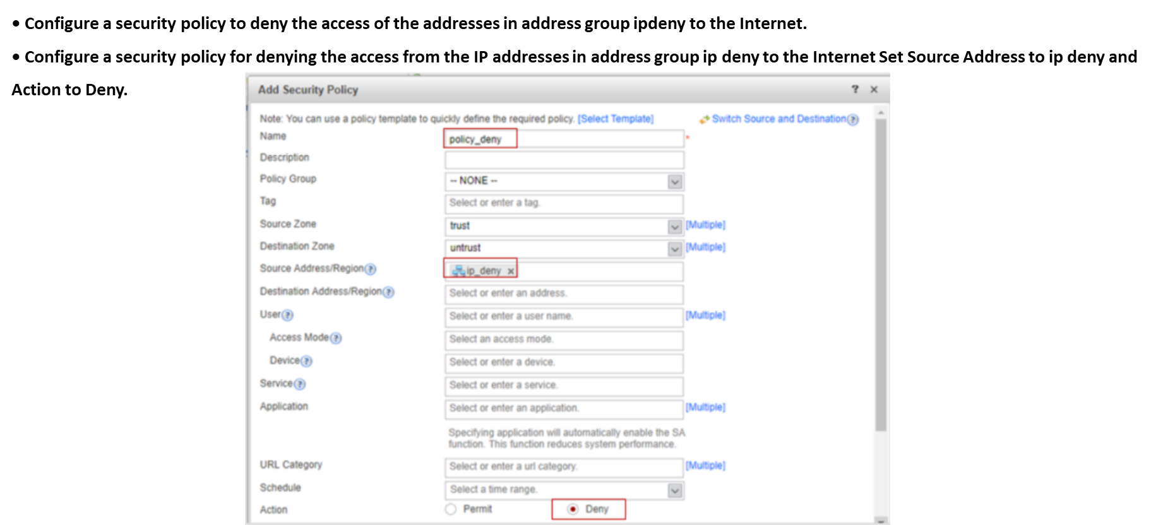
Chapter
Key Configuration on the Web Ul (2)
06

Slide 19
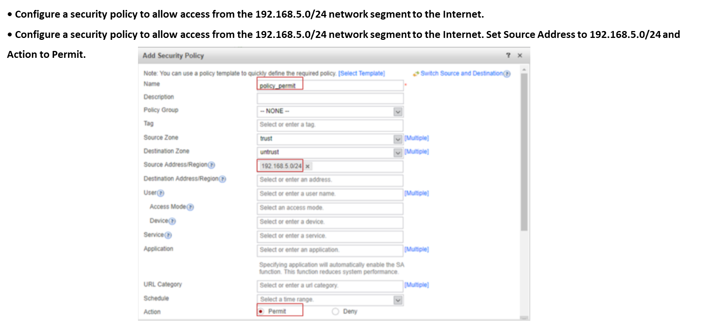
Chapter
Key Configuration on the Web Ul (3)
06

Slide 20
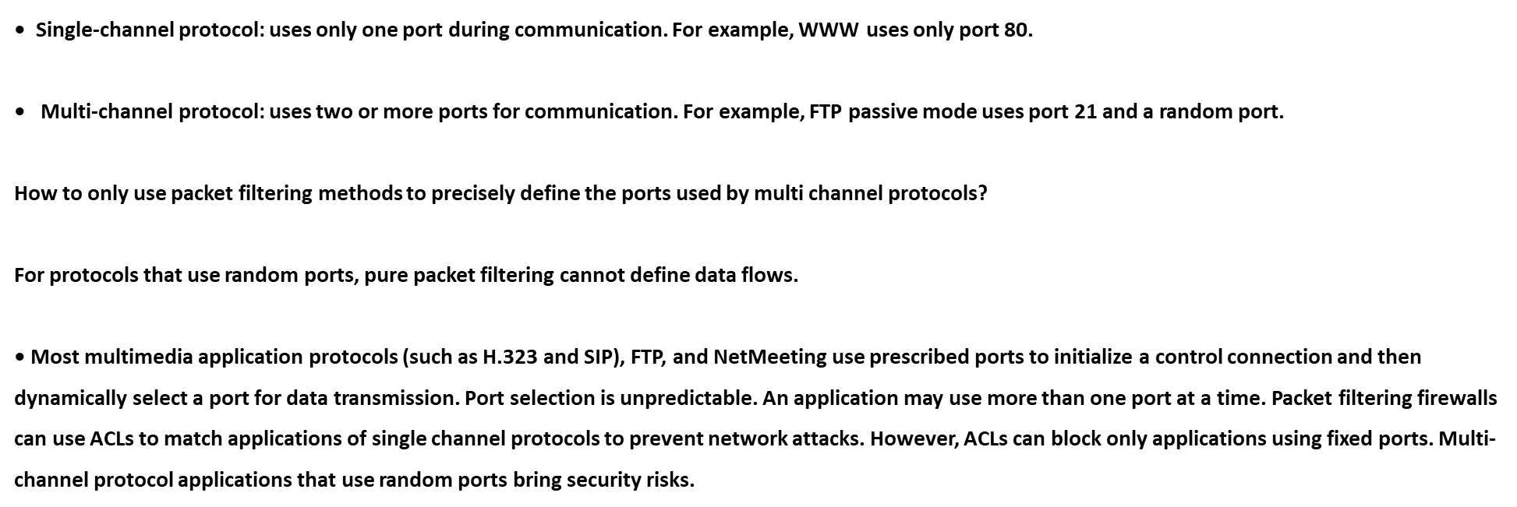
Chapter
Multi-channel Protocol Technology
06

Slide 21
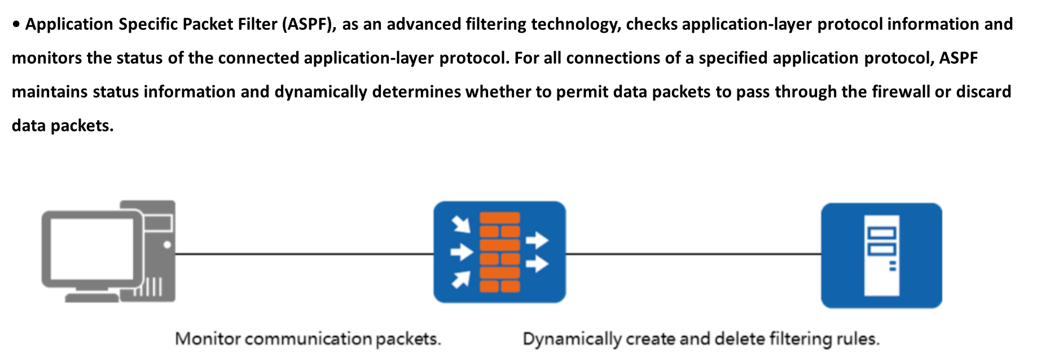
Chapter
ASPF Overview
06

Slide 22
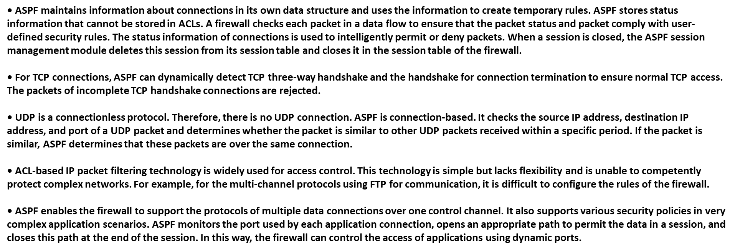
Chapter
Firewall Interzone Forwarding
06

Slide 23
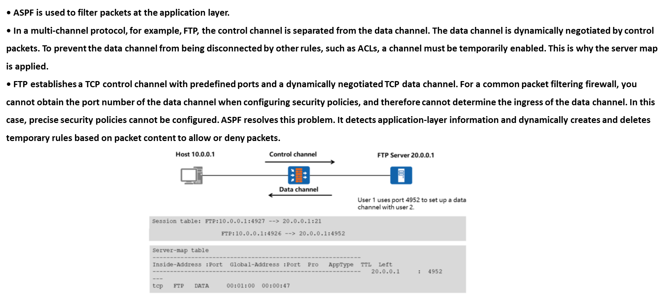
Chapter
ASPF Supports Multi-channel Protocols
06

Slide 24
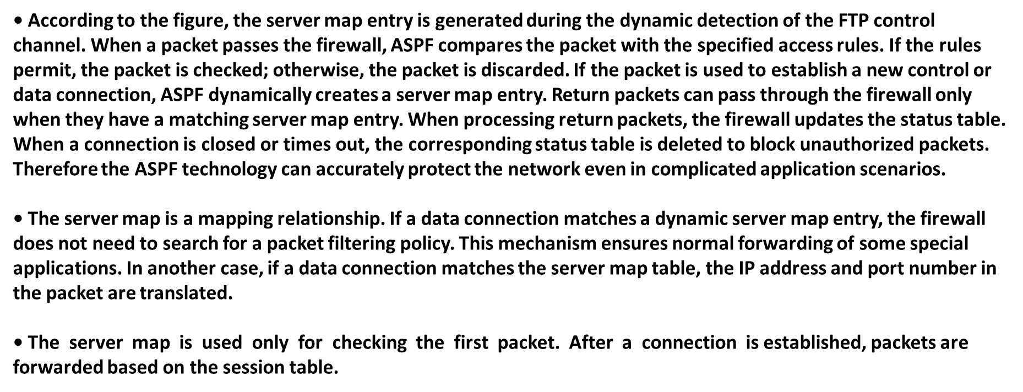
Chapter
ASPF Supports Multi-channel Protocols
06

Slide 25
Chapter
Generation of Server Map
06

Slide 26
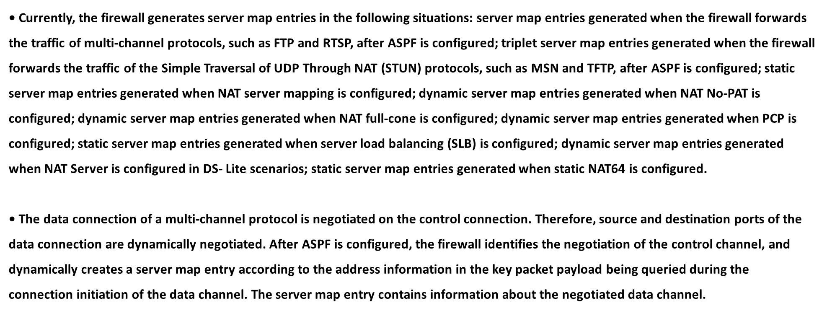
Chapter
Generation of Server Map
06

Slide 27
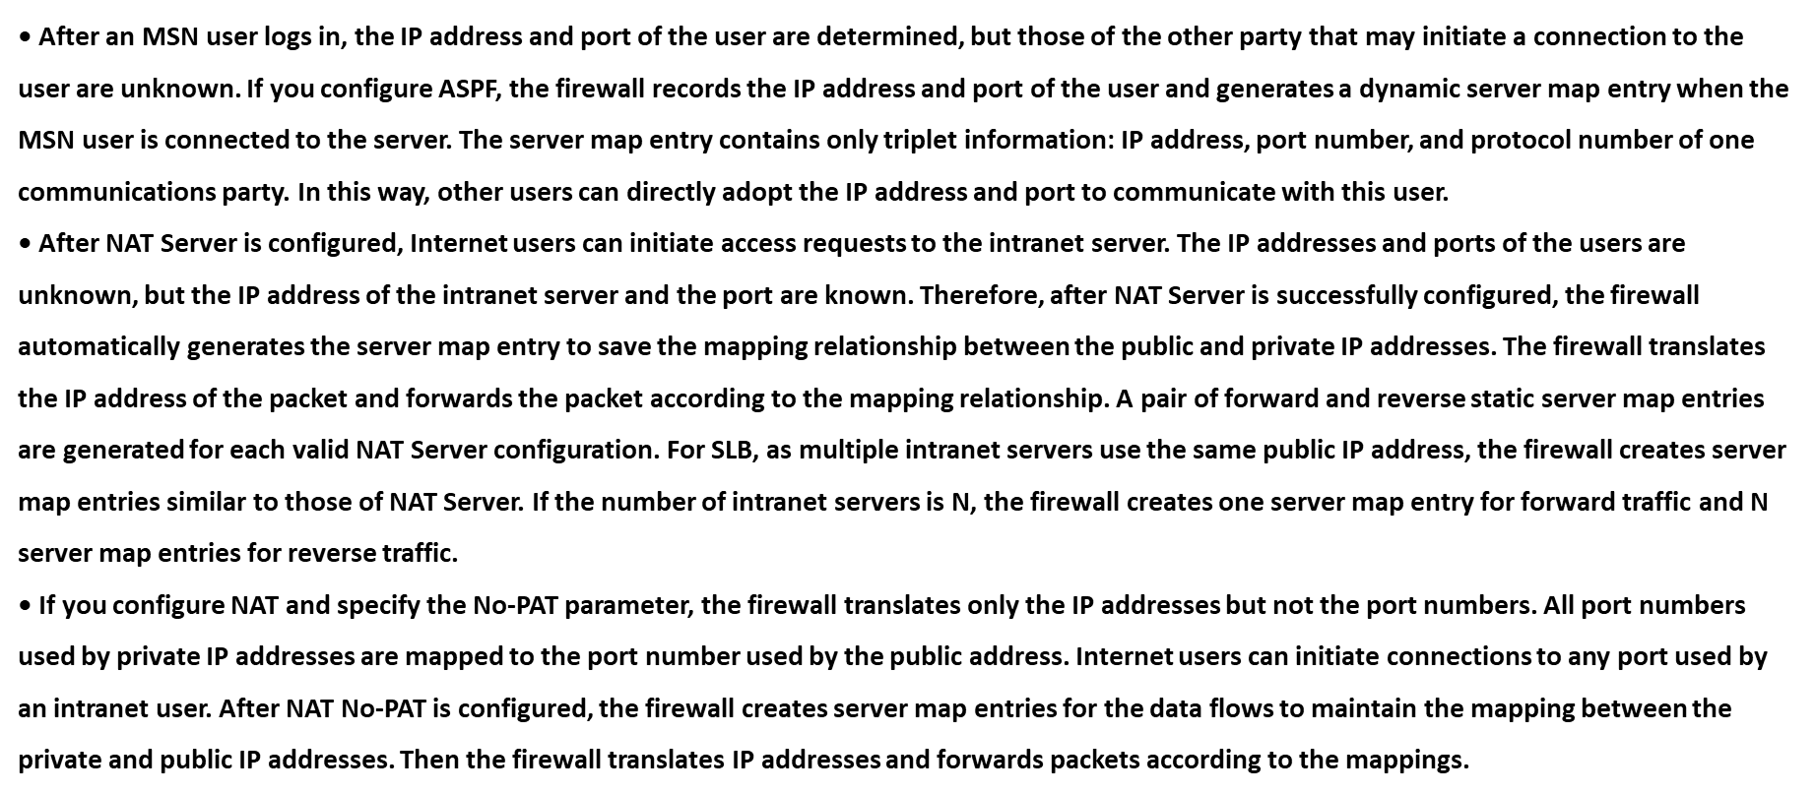
Chapter
Generation of Server Map
06

Slide 28
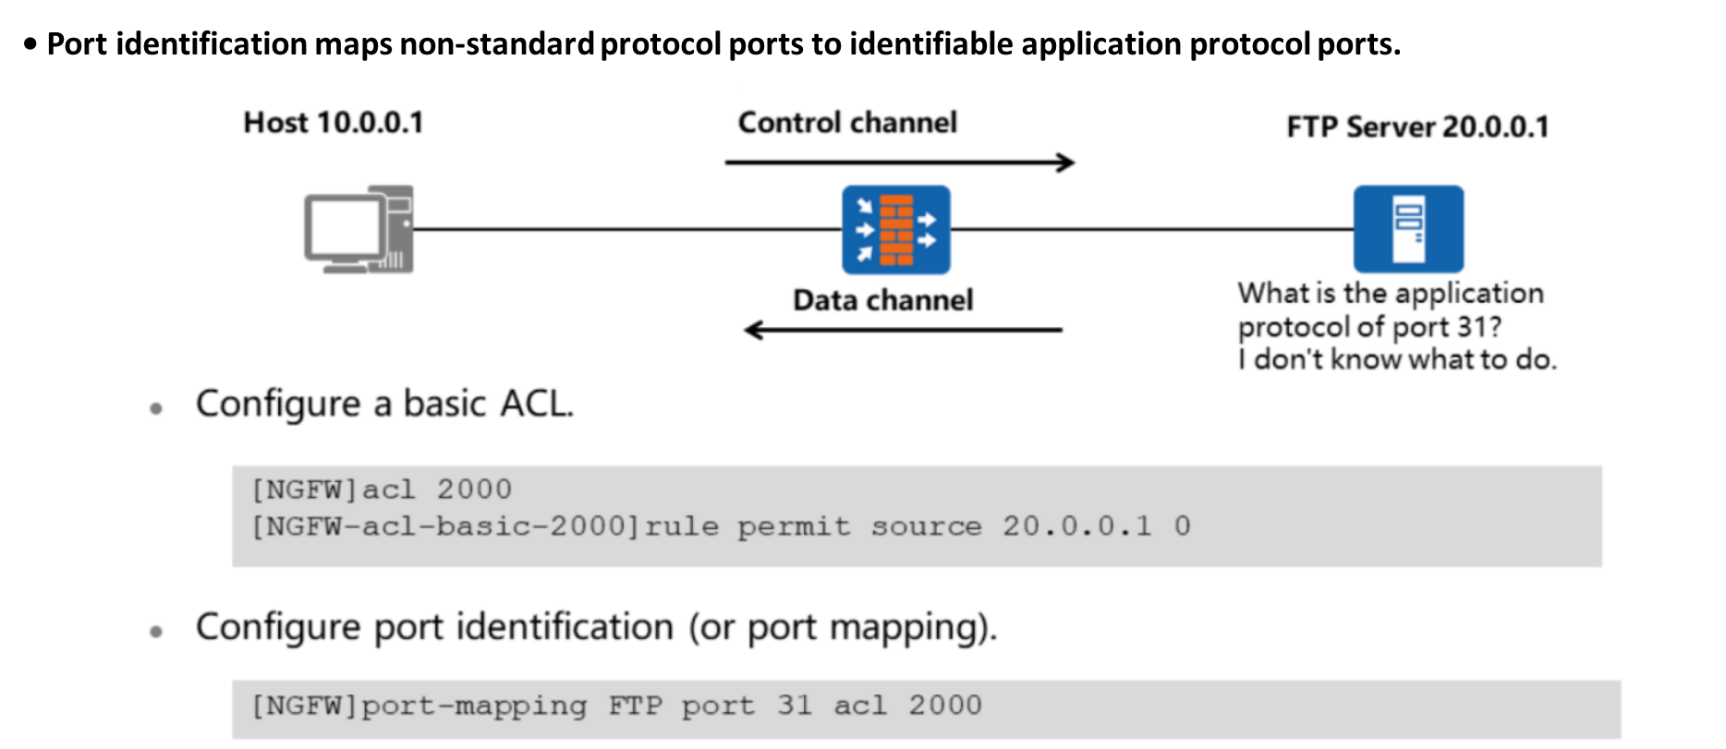
Chapter
06
Support for Multi-channel Protocols by Port Identification

Slide 29
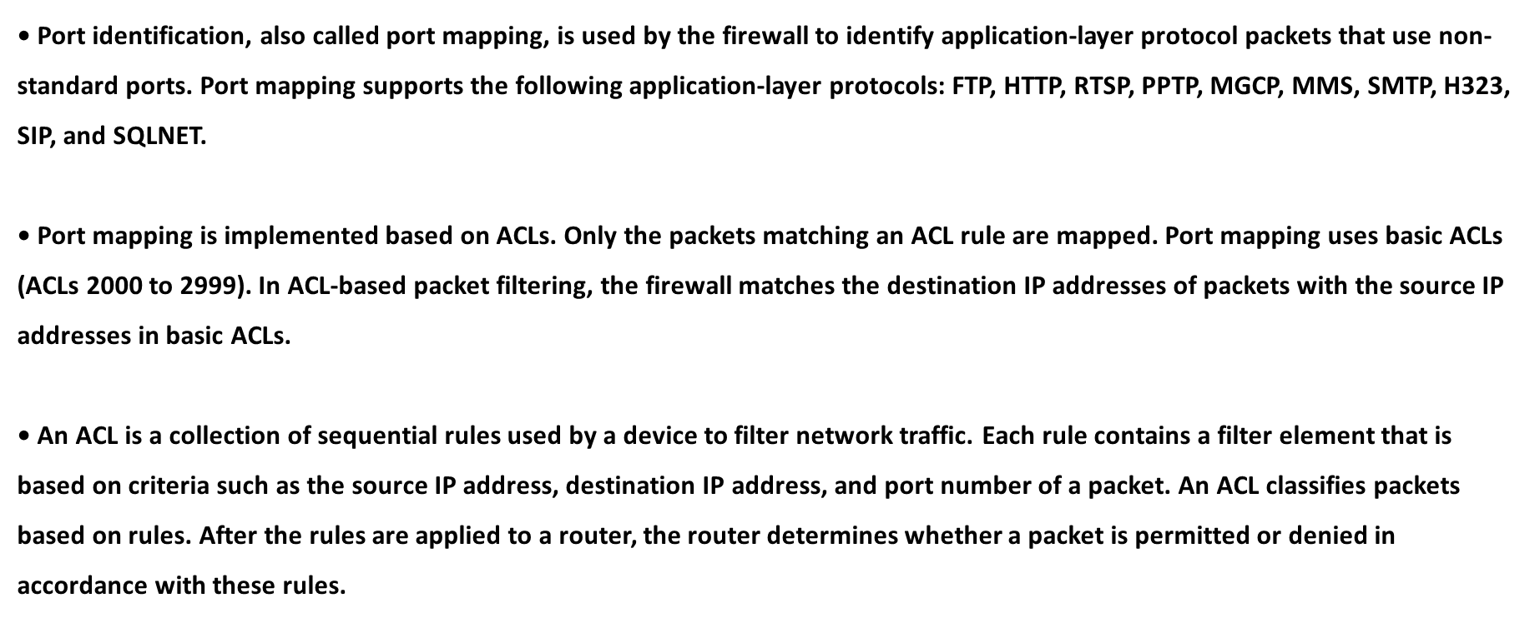
Chapter
06
Support for Multi-channel Protocols by Port Identification

Slide 30
Chapter
06
Support for Multi-channel Protocols by Port Identification
• ACLs are classified into the following types:
□ Basic ACLs (2000 to 2999): A basic ACL matches traffic only by source IP address and schedule. It applies to simple matching scenarios.
□ Advanced ACLs (3000 to 3999): Traffic is matched by source IP address, destination IP address, ToS, schedule, protocol type, priority, ICMP packet type, and ICMP packet code. In most functions, advanced ACLs can be used for accurate traffic matching.
□ MAC address-based ACLs (4000 to 4999): Traffic is matched by source MAC address, destination MAC address, CoS, and protocol code.

Slide 31
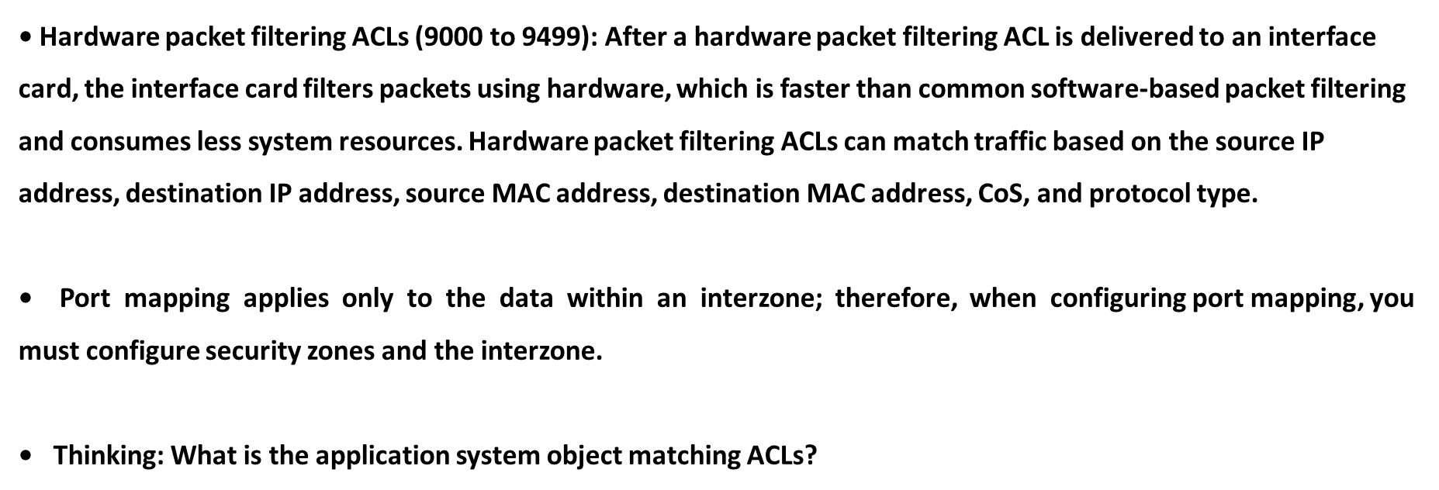
Chapter
06
Support for Multi-channel Protocols by Port Identification

Slide 32
Chapter
Fragment cache
06

Slide 33
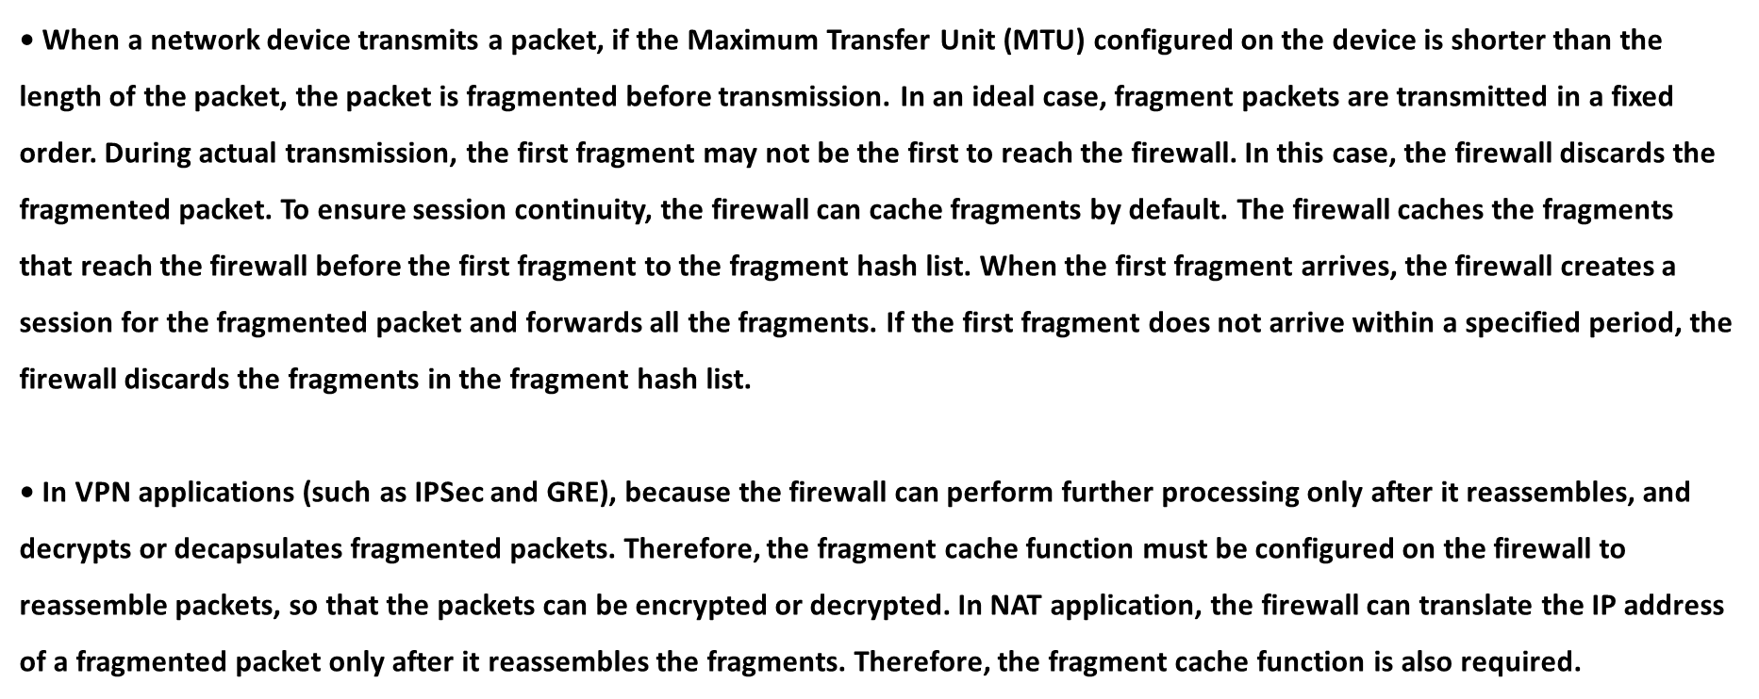
Chapter
Fragment cache
06

Slide 34
Chapter
Fragment cache
06
• The function of directly forwarding fragments applies when NAT is not performed. After this function is enabled, the firewall directly forwards received fragments without creating any session.
• Set the aging time for fragment cache.
□ Firewall session aging-time fragment interval (1-40000)
• Enable or disable the function of directly forwarding fragments.
□ Firewall fragment-forward enable/disable

Slide 35
Chapter
Persistent Connection
06
• Why are persistent connections required?
□ Aging mechanism of the firewall session table
□ Problems caused by the session aging mechanism to special services

Slide 36
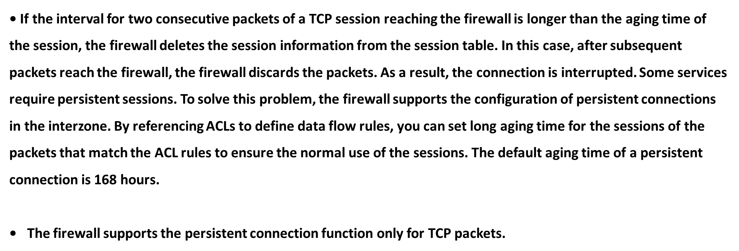
Chapter
Persistent Connection
06

Slide 37
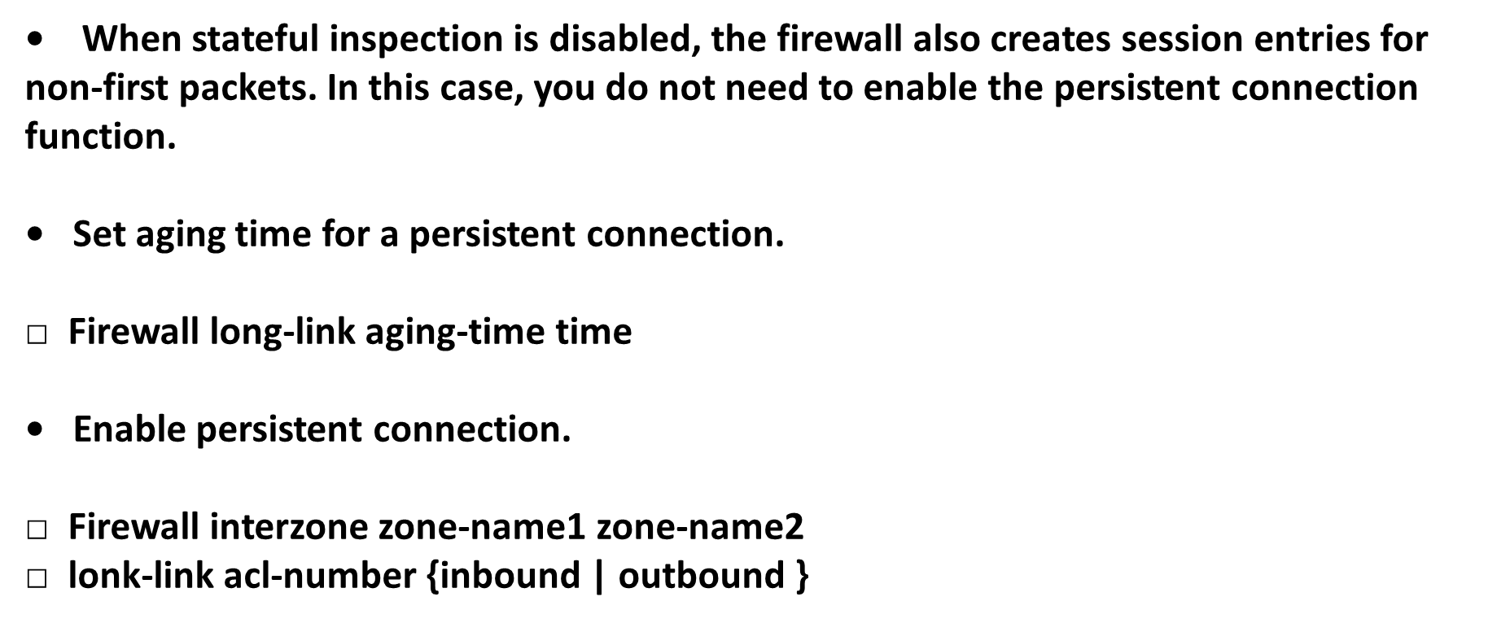
Chapter
Persistent Connection
06

Slide 38



Thank You

