Slide 1



Principles of Management Information Systems
MGM331
Lecture 1
An Introduction to Information Systems
Prepared by
Dr. Eng. Youssef Ntefeh
www.midocean.ae

Slide 2
Chapter 1
This chapter presents an overview of the material covered in the course. The chapter is divided into three major sections corresponding to the three sections of the course. The chapters included in each section of the text are highlighted as a subsection and briefly summarized. The essential material will receive fuller treatment in subsequent chapters.

Slide 3
Principles of Management Information Systems
PART 1 Information Systems in Perspective
PART 2 Information Technology Concepts
PART 3 Business Information Systems
Chapter 1 An Introduction to Information Systems
Chapter 2 Information Systems in Organizations
Chapter 3 Hardware and Mobile Devices
Chapter 4 Software and Mobile Applications
Chapter 5 Database Systems and Big Data
Chapter 6 Networks and Cloud Computing
Chapter 7 Electronic and Mobile Commerce
Chapter 8 Enterprise Systems
Chapter 9 Business Intelligence and Analytics
Chapter 10 Knowledge Management and Specialized Information System

Slide 4
Principles
  The value of information is directly linked to how it helps decision makers achieve the organization’s goals.
  Information systems are composed of fundamental components that must be carefully assembled and integrated to work well together.
  Managers have an essential role to play in the successful implementation and use of information systems that role changes depending on which type of IS system is being implemented.

Slide 5
Principles
  An organization’s infrastructure technology forms the foundation upon which its systems and applications are built.
  Organizations employ a variety of information systems to improve the way they conduct business and make fact-based decisions.
  Strategic planning and project management are keys to ensuring that the organization is working effectively.

Slide 6
Learning Objectives
Distinguish data from information and knowledge, and describe the characteristics of quality data.
Identify the fundamental components of an information system and describe their function.
Identify the three fundamental information system types and explain what organizational complements must be in place to ensure successful implementation and use of the system.

Slide 7
Learning Objectives
Identify and briefly describe the role of each component of an organization’s technology infrastructure.
Identify the basic types of business information systems, including who uses them, how they are used, and what kinds of benefits they deliver.
Describe how organizations are using business intelligence and business analytics to capitalize on the vast amount of data becoming available.

Slide 8
Part 1: Information Systems in Perspective
An Introduction to Information Systems
Information is a central concept of this course. To be an effective manager in any area of business, you need to understand that information is one of an organization’s most valuable resources. Information is not the same thing as data, and knowledge is different from both data and information. These concepts will now be explained.

Slide 9
Data, Information, and Knowledge
Data consists of raw facts, such as an employee number, total hours worked in a week, an inventory part number, or the number of units produced on a production line.
Information is a collection of data organized and processed so that it has additional value beyond the value of the individual facts.
Providing information to customers can also help companies increase revenues and profits.

Slide 10
Data, Information, and Knowledge
Turning data into information is a process, or a set of logically related tasks performed to achieve a defined outcome.
The process of defining relationships among data to create useful information requires knowledge, which is the awareness and understanding of a set of information and the ways in which that information can be made useful to support a specific task or reach a decision.
The value of information is directly linked to how it helps decision makers achieve their organization’s goals. Valuable information can help people perform tasks more efficiently and effectively.

Slide 11
What Is an Information System?
An information system (IS) is a set of interrelated components that collect, process, store, and disseminate data and information
An information system provides a feedback mechanism to monitor and control its operation to make sure it continues to meet its goals and objectives.
The feedback mechanism is critical to helping organizations achieve their goals, such as increasing profits or improving customer service.

Slide 12
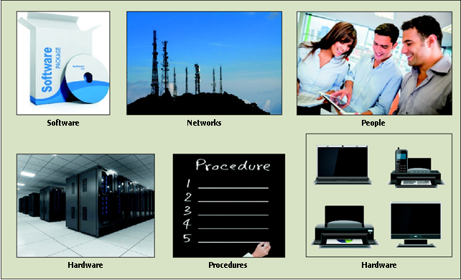
What Is an Information System?
Computer-based information system (CBIS)
is a single set of hardware, software, databases, networks, people, and procedures that are configured to collect, manipulate, store, and process data into information

Slide 13
Part 1: Information Systems in Perspective
Information Systems in Organizations
Organizations have three types of information systems.
Personal IS includes information systems that improve the productivity of individual users in performing stand-alone tasks.
Examples include personal productivity software, such as word-processing, presentation, and spreadsheet software.

Slide 14
Information Systems in Organizations
In today’s fast-moving, global work environment, success depends on our ability to communicate and collaborate with others, including colleagues, clients, and customers. Group IS includes information systems that improve communications and support collaboration among members of a workgroup. Examples include Web conferencing software, wikis, and electronic corporate directories.

Slide 15
Information Systems in Organizations
Enterprise IS includes information systems that organizations use to define structured interactions among their own employees and/or with external customers, suppliers, government agencies, and other business partners.
Successful implementation of these systems often requires the radical redesign of fundamental work processes and the automation of new processes. Target processes may include purely internal activities within the organization (such as payroll) or those that support activities with external customers and suppliers (order processing and purchasing).

Slide 16
Information Systems in Organizations
For each type of IS, certain key organizational complements must be in place to ensure successful implementation and use of the system. These complements include:
Well-trained workers: Employees must be well trained and understand the need for the new system, what their role is in using or operating the system, and how to get the results they need from the system.
System support: Trained and experienced users who can show others how to gain value from the system and overcome start-up problems.

Slide 17
Information Systems in Organizations
Better teamwork: Employees must understand and be motivated to work together to achieve the anticipated benefits of the system.
Redesigned processes: New systems often require radical redesign of existing work processes as well as the automation of new processes.
New decision rights: Employees must understand and accept their new roles and responsibilities including who is responsible for making what decisions. Roles and responsibilities often change with introduction of a new system.

Slide 18
Example
Kroger has annual sales in excess of $100 billion and operates stores across the United States. In surveys, Kroger’s customers have consistently rated waiting at the checkout lane as the worst part of the grocery shopping experience. In response, Kroger developed its QueVision computer-based information system, which relies on real-time data feeds from point-of-sale systems as well as infrared sensors over store doors and cash registers to count customers entering the store and standing at checkout lanes. The system also uses historical point-of-sale records to forecast the number of shoppers that can be expected and, therefore, the number of cashiers that will be needed. All this was done to achieve the goal of ensuring that customers never have more than one person ahead of them in the checkout lane.

Slide 19
Example
The system provides feedback by displaying customer checkout time on a screen that both employees and customers can see delivering a visible measure of how well the whole system is working. The system is now deployed at over 2,300 stores in 31 states and has cut the average time a customer must wait to begin checkout from four minutes to 30 seconds.

Slide 20
Part 2: Information Technology Concepts
Hardware and Mobile Devices
Hardware consists of computer equipment used to perform input, processing, storage, and output activities.
The trend in the computer industry is to produce smaller, faster, and more mobile hardware, such as smartphones, laptops, and tablet computers.
In addition, hardware manufacturers are hard at work developing innovative new hardware devices, such as the following:

Slide 21
Hardware and Mobile Devices
Advanced keyboards that turn individual keys on a keyboard into trackpad-covered buttons where certain dual-purpose keys could be depressed to multiple levels to complete different tasks;
Laptops and displays that connect wirelessly, thus eliminating the need for expensive HDMI or DisplayPort cables

Slide 22
Hardware and Mobile Devices
Computing devices with embedded 3D cameras, which will be able to recognize objects and even measure distances between things.
Keyboards that enable users to log in to Web sites via fingerprint authentication so they won’t have to remember dozens of passwords for different sites
Very high resolution display devices that will show content in incredible detail and dramatically improve the viewing experience (think clarity and resolution way beyond 4K)

Slide 23
Hardware and Mobile Devices
While desktop, laptop, and tablet computers continue to be used in a variety of settings, smartphones have become the primary device used by people around the world to communicate, go online, and access and share information.
In 2013, the number of smartphone users first exceeded the number of personal computer users, and the gap keeps growing, with the number of smartphones sold worldwide far exceeding the combined sale of desktops, laptops, and tablets.
This rapid growth has been spurred by the improving affordability and capability of smartphones, the increasing speed and coverage of wireless networks, longer battery life, and the availability of hundreds of thousands of smartphone applications and games.

Slide 24
Part 2: Information Technology Concepts
Software and Mobile Applications
Software consists of the computer programs that govern the operation of a particular computing device, be it desktop computer, laptop, tablet, smartphone, or some other device. There are two types of software: system software and application software. System software such as Google’s Android or Apple’s iOS oversees basic computer operations such as start-up, controls access to system resources, and manages memory and files.
Application software, such as Microsoft Office, allows you to accomplish specific tasks, including editing text documents, creating graphs, and playing games. Both system software and application software are needed for all types of computers, from small handheld devices to large supercomputers. In choosing application software, you must choose software that will work with the operating system installed on your computing device.

Slide 25
Part 2: Information Technology Concepts
Database Systems and Big Data
A database is an organized collection of facts and information, typically consisting of two or more related data files. An organization’s database can contain facts and information on customers, employees, inventory, sales, online purchases, and much more. A database is essential to the operation of a computer-based information system.
As anyone who works in marketing or sales knows, one of the biggest challenges that any business faces is the ability to generate new leads in an effort to locate customers.

Slide 26
Database Systems and Big Data
A data warehouse is a database that stores large amounts of historical data in a form that readily supports analysis and management decision making.
In a process called the extract-transform-load (ETL) process, raw data is extracted from various sources, transformed into a format that will support the analysis to be performed, and then loaded into the data warehouse.
Data warehouses frequently hold a huge amount of data; they often contain five years or more of data. Many organizations employ data warehouses to hold the data they need to make key business decisions.

Slide 27
Database Systems and Big Data
The digital universe (the collection of all data that exists) is doubling in size every two years
Organizations are challenged by this rapid growth and at the same time scrambling to take advantage of the opportunities provided by this data.
Big data is a term used to describe data collections that are so enormous (think petabytes or larger) and complex (from sensor data to social media data) that traditional data management software, hardware, and analysis processes are incapable of dealing with them.
To gain a perspective on the quantity of data some organizations are struggling to manage, consider that the amount of data traveling over mobile networks alone exceeded 10 exabytes per month in 2016.

Slide 28
Database Systems and Big Data
Unit of Measure | Size | Equivalent To
Byte | 1 byte | One alphanumeric character
Kilobyte | 1,000 bytes | The text of a joke or very short story
Megabyte | 1,000 kilobytes | 800 pages of text
Gigabyte | 1,000 megabytes | 12 minutes of 4K (UHD)
Terabyte | 1,000 gigabytes | The Hubble Space Telescope collected more than 45 terabytes of data in its first 20 years of observations
Petabyte | 1,000 terabytes | 50 years’ worth of DVD-quality video
Exabyte | 1,000 petabytes | 44 billion 25 gigabytes Blu-ray discs
Zettabyte | 1,000 exabytes | The amount of text created by every man, woman, and child on earth tweeting continuously for 100 years
Yottabyte | 1,000 zettabytes | One thousand times the grains of sand on all of Earth’s beaches

Slide 29
Database Systems and Big Data
To avoid being paralyzed by information overload, organizations and indeed society itself must find a way to deal with this oncoming tsunami of data.
This challenge has several aspects, including how to choose which subset of data to keep, where and how to store the data, how to find the useful data that are relevant to the decision making at hand, and how to derive real value from the relevant data.

Slide 30
Part 2: Information Technology Concepts
Networks and Cloud Computing
Networks connect computers and equipment in a room, building, campus, city, across the country, or around the world to enable electronic communication.
Wireless transmission networks enable the use of mobile devices, such as smartphones and tablets.
The Internet is the world’s largest computer network, consisting of thousands of interconnected networks, all freely exchanging information.

Slide 31
Networks and Cloud Computing
People use the Internet to research information, buy and sell products and services, email and instant message one another, participate in social networks (e.g., Facebook and LinkedIn), make travel arrangements, complete banking transactions, make investments, download music and videos, read books, and watch movies among other activities.

Slide 32
Networks and Cloud Computing
The World Wide Web (WWW), better known simply as “the Web,” is a network of links on the Internet to files containing text, graphics, video, and sound.
Information about the documents and access to them are controlled and provided by tens of thousands of specialized computers called Web servers.
The Web is one of many services available over the Internet, and it provides access to millions of files.

Slide 33
Networks and Cloud Computing
The technology used to create the Internet is also being applied within organizations to create intranets, which enable communication, collaboration, search functions, and information sharing between the members of an organization’s team using a Web browser.
An extranet is a network based on Web technologies that allows selected outsiders, such as business partners and customers, to access authorized resources of a company’s intranet.

Slide 34
Networks and Cloud Computing
Many people use extranets every day without realizing it to order products from their suppliers, track shipped goods, or access customer assistance from other companies. Federal Express (FedEx) was one of the first large companies to empower customers to serve themselves at their convenience through the use of a corporate extranet.

Slide 35
Networks and Cloud Computing
The Internet of Things (IoT) is a network of physical objects or “things” embedded with sensors, processors, software, and network connectivity capability to enable them to exchange data with the manufacturer of the device, device operators, and other connected devices.
In theory, the IoT would enable us to connect almost any device with an on/off switch to a network automobiles, appliances, components of an aircraft engine, heart monitor implants, packing labels, ingestible pills, wearable devices, and even highway sensors that can warn of traffic and hazardous road conditions.

Slide 36
Networks and Cloud Computing
Each thing is uniquely identifiable and capable of interoperating with other “things” within the existing IoT infrastructure, often by connecting to a central hub.
The IoT also includes cloud services, which enable the collection and analysis of data so people can process the data and take appropriate action via mobile apps.

Slide 37
Part 3: Business Information Systems
Information systems are used in all functional areas of business organizations, as summarized here:
  Accounting and finance: Information systems are used to forecast revenues and expenses, determine the best sources and uses of funds, manage cash and other financial resources, analyze investments, and perform audits to make sure that the organization is financially sound and that all financial reports and documents are accurate.
  Customer service: Information systems are used to capture data about customers and their interactions with the company to better understand their needs and issues and enable superior customer service.

Slide 38
Part 3: Business Information Systems
Human resources: Information systems help human resource staff screen job applicants, administer performance tests to employees, monitor employee productivity, and generate required government reports.
Manufacturing: Information systems are used to process customer orders, develop production schedules, control inventory levels, and monitor product quality.

Slide 39
Part 3: Business Information Systems
Research and development: Information systems help R&D staff design products, gather input from customers that leads to new ideas and improvements, and enable the sharing of information with a worldwide community of researchers.
Sales and marketing: Information systems help sales and marketing personnel develop new goods and services (product analysis), determine the best advertising and sales approaches (promotion analysis), and set optimal product prices to get the highest total revenues (price analysis).

Slide 40
Part 3: Business Information Systems
Information systems are also used in nearly every industry, as the following examples show:
Agriculture: Farmers attach a yield monitor and a global positioning unit to their combines to determine how much grain should be harvested in each field. This data is entered in a system that produces a color-coded map that predicts the expected yield. From this, farmers can determine where they should add soil additives or fertilizer, for example, to increase the yield.

Slide 41
Part 3: Business Information Systems
Finance: Banks use information systems to help make sound decisions regarding loans, invest wisely, and provide online services, such as bill payment and account transfers for account holders.
Health care: Healthcare organizations use information systems to diagnose illnesses, plan medical treatment, track patient records, and bill patients. Health insurance companies and health maintenance organizations (HMOs) use Web technology to access patients’ insurance eligibility information, pay medical claims, and analyze data to manage costs.

Slide 42
Part 3: Business Information Systems
Mining: Companies use global positioning systems to identify and evaluate promising areas for mineral exploration, model mine construction, and display geochemical and hydrological data. Mining companies also use information systems to gather the necessary data when applying for mining permits, to assess the environmental impacts of a proposed mine, and to design mine closure and reclamation plans.

Slide 43
Part 3: Business Information Systems
Electronic and Mobile Commerce
E-commerce involves the exchange of money for goods and services over electronic networks, and it encompasses many of an organization’s outward-facing processes such as sales, marketing, order taking, delivery and customer service that touch customers, suppliers, and other business partners

Slide 44
Electronic and Mobile Commerce
Benefits of E-commerce
Benefit | How Achieved
Build new revenue streams | Reach a broader geographic dispersion of consumers
Create and enhance relationships with customers and business partners | Increase customer engagement Improve loyalty of customers who initially buy offline Increase opportunity to build loyalty through multiple channels
Improve operating efficiencies | Lower customer acquisition cost Lower operating costs per sale Reduce the expense of supporting and servicing existing customers

Slide 45
Electronic and Mobile Commerce
Mobile commerce (m-commerce) is the buying and selling of goods and/or services using a mobile device, such as a tablet, smartphone, or other portable device.
Electronic business (e-business) goes beyond e-commerce by using information systems and networks to perform business-related tasks and functions, such as:

Slide 46
Electronic and Mobile Commerce
Gathering product demand forecasts directly from the distributors of your product in order to aggregate them and develop a master production schedule
Sharing product data (e.g., design specifications and bills of material) electronically with suppliers and contract manufacturers as your products evolve through research and development, product design, prototyping, process design, and manufacturing

Slide 47
Part 3: Business Information Systems
Enterprise Systems
Computers have been used to perform common business applications since the 1950s. These early systems were designed to reduce costs by automating routine.
One of the first business systems to be computerized was the payroll system.
The primary inputs are the number of employee hours worked during the week and the pay rate.
The primary output consists of paychecks.
Other high-volume, repetitive processes, such as order processing, customer billing, and inventory control, were soon computerized as well.

Slide 48
Part 3: Business Information Systems
Business Intelligence and Analytics
Business intelligence (BI) includes a wide range of applications, practices, and technologies for the extraction, transformation, integration, visualization, analysis, interpretation, and presentation of data to support improved decision making.
Business analytics can be simply defined as the extensive use of data and quantitative analysis to support fact-based decision making within organizations. It can be used to gain a better understanding of current business performance, reveal new business patterns and relationships, explain why certain results occurred, optimize current operations, and forecast future business results.

Slide 49
Part 3: Business Information Systems
Knowledge Management and Specialized Information Systems
A knowledge management system (KMS) is an organized collection of people, procedures, software, databases, and devices that stores and retrieves knowledge, improves collaboration, locates knowledge sources, captures and uses knowledge, or in some other way enhances the knowledge management process.
The workforce at NASA is aging, and it is essential for the organization’s future success that critical knowledge not be lost as workers retire. Rather, their specialized knowledge must be captured and retained for future use.

Slide 50
Part 3: Business Information Systems
NASA employs knowledge management to document and integrate lessons learned from decades of missions to effectively manage the risk involved in future space exploration and human space flight.
Specialized information systems include a wide range of artificial intelligence systems (robotics, vision systems, natural language processing and voice recognition systems, learning systems, and expert systems) that can simulate human intelligence processes. Multimedia systems, virtual reality systems, assistive technology systems, and systems based on game theory are additional types of specialized information systems.

Slide 51
Summary
The value of information is directly linked to how it helps decision makers achieve the organization’s goals.
Data consists of raw facts; information is a collection of data organized and processed so that it has additional value beyond the value of the individual facts.
The value of information created depends on the relationships defined among existing data. Turning data into information is a process performed to achieve a defined outcome.
This process requires knowledge, which is the awareness and understanding of a set of information and the ways in which that information can be made useful to support a specific task or reach a decision.

Slide 52
Summary
Information systems are composed of fundamental components that must be carefully assembled and integrated to work well together.
An information system (IS) is a set of interrelated components that collect, process, store, and disseminate data and information; an information system provides a feedback mechanism to monitor and control its operation to make sure it continues to meet its goals and objectives.
A computer-based information system (CBIS) is a single set of hardware, software, databases, networks, people, and procedures that are configured to collect, manipulate, store, and process data into information.
An organization’s technology infrastructure includes all the hardware, software, databases, networks, people, and procedures that are configured to collect, manipulate, store, and process data into information.

Slide 53
Summary
Managers have an essential role to play in the successful implementation and use of information systems that role changes depending on which type of IS system is being implemented.
When considering the role of business managers in working with IS, it is useful to divide information systems into three types: personal IS, group IS, and enterprise IS.
For each type of IS, certain key organizational complements must be in place to ensure successful implementation and use of the system. These complements include well-trained workers, better teamwork, redesigned processes, and new decision rights.

Slide 54
Summary
An organization’s infrastructure technology forms the foundation upon which its systems and applications are built.
Hardware consists of computer equipment used to perform input, processing, storage, and output activities.
Smartphones have become the primary device used by people around the world to communicate, go online, and access and share information.

Slide 55
Summary
Software consists of computer programs that govern the operation of a particular computing device, be it desktop, laptop, tablet, smartphone, or some other device.
The trend of consumer technology practices influencing the way business software is designed and delivered is called the consumerization of IT.
A database is an organized collection of facts and information, typically consisting of two or more related files.
A data warehouse is a database that stores large amounts of historical data in a form that readily supports analysis and decision making. An extract-transform-load process is used to prepare the data for the data warehouse.

Slide 56
Summary
Big data is a term used to describe collections of data that are so large and complex that traditional database management software, hardware, and analysis processes are incapable of dealing with them.
Networks connect computers and equipment in a room, building, campus, city, across the country, or around the world to enable electronic communications.
The Internet of Things (IoT) is a network of physical objects or things embedded with sensors, processors, software, and network connectivity capability to enable them to exchange data with the manufacturer of the device, device operators, and other connected devices.

Slide 57
Summary
Organizations employ a variety of information systems to improve the way they conduct business and make fact-based decisions.
E-commerce involves the exchange of money for goods and services over electronic networks, and it encompasses many of an organization’s outward facing processes. Electronic business goes beyond e-commerce by using information systems and networks to perform business-related tasks and functions.

Slide 58

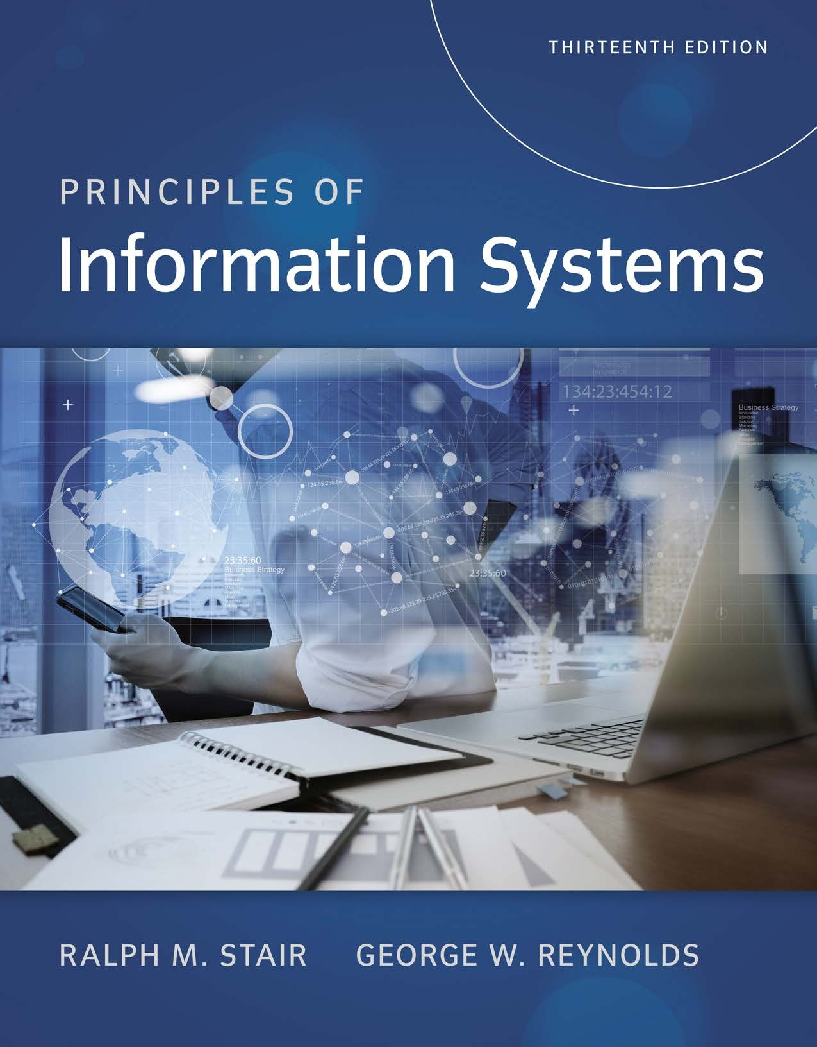
Reference

