Slide 1





Accounting Principles
Prepared by Dr. Hoda Metwally
Lecture 5
Accounting for Receivables

Slide 2

Accounting Principles
Prepared by Dr. Hoda Metwally
Lecture 5

Slide 3
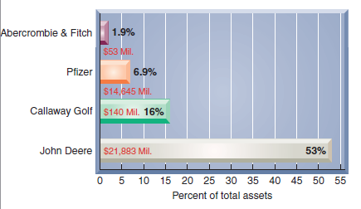
Accounts Receivable
C1
A receivable is an amount due from another party.
This graph shows recent dollar amounts of receivables and their percent of total assets for four well-known companies.
A company must also maintain a separate account for each customer that tracks how much that customer purchases, has already paid, and still owes.
Notes:
A receivable is an amount due from another party. The two most common receivables are accounts receivable and notes receivable. Other receivables include interest receivable, rent receivable, tax refund receivable, and receivables from employees. Accounts receivable are amounts due from customers for credit sales. The graph on this slide shows recent dollar amounts of receivables and their percent of total assets for four well-known companies.
Credit sales are recorded by increasing (debiting) Accounts Receivable. A company must also maintain a separate account for each customer that tracks how much that customer purchases, has already paid, and still owes. This information provides the basis for sending bills to customers and for other business analyses. The general ledger continues to have a single Accounts Receivable account along with the other financial statement accounts, but a supplementary record is created to maintain a separate account for each customer. This supplementary record is called the accounts receivable ledger.

Slide 4

Sales on Credit
C1
On July 1, TechCom had a credit sale of $950 to CompStore and a collection of $720 from RDA Electronics from a prior credit sale.
Notes:
To see how accounts receivable from credit sales are recognized in the accounting records, we look at two transactions on July 1 between TechCom and its credit customers. The first is a credit sale of $950 to CompStore that is recorded with a debit to Accounts Receivable--CompStore and a credit to Sales. The second transaction is a collection of $720 from RDA Electronics from a prior credit sale. The cash receipt from a RDA Electronics is recorded with a debit to Cash and a credit to Accounts Receivable—RDA Electronics.

Slide 5
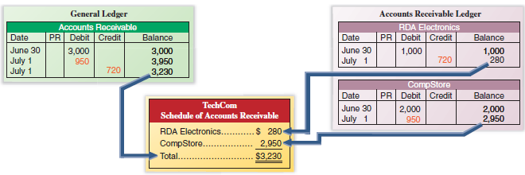
Sales on Credit
C1
Notes:
The credit sale is posted with both a debit to the Accounts Receivable account in the general ledger and a debit to Accounts Receivable—CompStore customer account in the accounts receivable ledger.
The cash receipt from RDA Electronics is posted as a credit to the Accounts Receivable account in the general ledger and to the Accounts Receivable—RDA Electronics customer account in the accounts receivable ledger.
Posting debits or credits to Accounts Receivable in two separate ledgers does not violate the requirement that debits equal credits. The equality of debits and credits is maintained in the general ledger. The accounts receivable ledger is a supplementary record providing information on each customer. The $3,230 sum of the individual accounts equals the debit balance of the Accounts Receivable account in the general ledger.

Slide 6

Credit Card Sales
C1
Advantages of allowing customers to use credit cards:
Customers’ credit is evaluated by the credit card issuer.
Sales increase by providing purchase options to the customer.
The risks of extending credit are transferred to the credit card issuer.
Cash collections are quicker.
Notes:
Many companies allow their customers to pay for products and services using third-party credit cards such as Visa, MasterCard, or American Express, and debit cards (also called ATM or bank cards). The seller pays a fee for services provided by the card company, often ranging from 1% to 5% of card sales. This charge is deducted from the credit to the seller’s account or the cash payment to the seller.
There are several reasons why sellers allow customers to use third-party credit cards and debit cards instead of granting credit directly to customers. First, the seller does not have to evaluate each customer’s credit standing or make decisions about who gets credit and how much. Second, the seller avoids the risk of extending credit to customers who cannot or do not pay. This risk is transferred to the card company. Third, the seller typically receives cash from the card company sooner than had it granted credit directly to customers. Fourth, a variety of credit options for customers offers a potential increase in sales volume.

Slide 7


Credit Card Sales
C1
On July 15th, TechCom has $100 of credit card sales with a 4% fee, and its $96 cash is received immediately on deposit.
Notes:
Let’s see how to record a credit card sale for TechCom. On July 15, TechCom has $100 of credit card sales with a 4% fee, and its $96 cash is received immediately on deposit. TechCom will credit Sales for the entire amount of the sale of $100. However, TechCom will debit Cash for $96, which represents how much cash they will collect from the bank. The difference of $4 is the 4% fee that TechCom must pay for allowing customers to use the third-party credit card. The $4 will be debited to Credit Card Expense.

Slide 8


Credit Card Sales
C1
If instead TechCom must remit electronically the credit card sales receipts to the credit card company and wait for the $96 cash payment, we will make the first entry on July 15, and the second entry on July 20, when the cash is received.
Notes:
If instead TechCom must remit electronically the credit card sales receipts to the credit card company and wait for the $96 cash payment, we will make the first entry on July 15, and the second entry on July 20, when the cash is received. On the date of the sale, TechCom would credit Sales for the entire amount of the sale of $100 and will debit Accounts Receivable for $96, which represents how much cash it will ultimately collect from the credit card company, and will debit $4 to Credit Card Expense. The $4 fee is what TechCom must pay for allowing customers to use the third-party credit card. On July 20, the collection date, TechCom would debit Cash and credit Accounts Receivable for $96.

Slide 9

Installment Accounts Receivable
C1
Amounts owed by customers from credit sales for which payment is required in periodic amounts over an extended time period. The customer is usually charged interest.
Ford Motor Company reports more than $75 billion in installment receivables.
Notes:
Many companies allow their credit customers to make periodic payments over several months. For example, Ford Motor Company reports more than $75 billion in installment receivables. The seller refers to such assets as installment (or finance) accounts receivable, which are amounts owed by customers from credit sales for which payment is required in periodic amounts over an extended time period. Source documents for installment accounts receivable include sales slips or invoices describing the sales transactions. The customer is usually charged interest. Although installment accounts receivable can have credit periods of more than one year, they are classified as current assets if the seller regularly offers customers such terms.

Slide 10

Valuing Accounts Receivable
P1
Some customers may not pay their account. Uncollectible amounts are referred to as bad debts.
There are two methods of accounting for bad debts:
  Direct Write-Off Method
  Allowance Method
Notes:
When a company directly grants credit to its customers, it expects that some customers will not pay what they promised. The accounts of these customers are uncollectible accounts, commonly called bad debts. The total amount of uncollectible accounts is an expense of selling on credit. Why do companies sell on credit if they expect some accounts to be uncollectible? The answer is that companies believe that granting credit will increase total sales and net income enough to offset bad debts. Companies use two methods to account for uncollectible accounts:
direct write-off method and
allowance method.

Slide 11

Direct Write-Off Method
P1
TechCom determines on January 23 that it cannot collect $520 owed to it by its customer J. Kent.
Notice that the specific customer is noted in the transaction so we can make the proper entry in the customer’s Accounts Receivable subsidiary ledger.
Notes:
When using the direct write-off method, customers’ accounts receivable are written off to Bad Debts Expense at the time the company becomes aware that the customer will not be able to pay the amounts owed. TechCom determines on January 23 that it cannot collect $520 owed to it by its customer J. Kent. We must recognize the loss. Using the direct write-off method, TechCom would debit Bad Debts Expense and credit Accounts Receivable—J. Kent for $520. Notice that the specific customer is noted in the transaction so we can make the proper entry in the customer’s Accounts Receivable subsidiary ledger.

Slide 12

Direct Write-Off Method –
Recovering a Bad Debt
P1
On March 11, J. Kent was able to make full payment to TechCom for the amount previously written-off.
Notes:
Now assume that on March 11, J. Kent sends TechCom full payment of $520 after TechCom made the write-off entry. Should TechCom return the $520 since it has written off Kent’s account receivable? Of course not. Since TechCom had written off Kent’s account receivable, the first required entry reverses the write-off and re-establishes part of Kent’s account receivable. This entry includes a debit to Accounts Receivable and a credit to Bad Debts Expense. The second entry is a debit to Cash and a credit to Accounts Receivable for the amount of cash received.

Slide 13

Matching vs. Materiality
P1
The matching (expense recognition) principle requires expenses to be reported in the same accounting period as the sales they helped produce.
Materiality states that an amount can be ignored if its effect on the financial statements is unimportant to users’ business decisions.
The direct write-off method usually does not best match sales and expenses.
Notes:
The matching (expense recognition) principle requires expenses to be reported in the same accounting period as the sales they helped produce. This means that if extending credit to customers helped produce sales, the bad debts expense linked to those sales is matched and reported in the same period. The direct write-off method usually does not best match sales and expenses because bad debts expense is not recorded until an account becomes uncollectible, which often occurs in a period after that of the credit sale. To match bad debts expense with the sales it produces therefore requires a company to estimate future uncollectibles.
The materiality constraint states that an amount can be ignored if its effect on the financial statements is unimportant to users’ business decisions. The materiality constraint permits the use of the direct write-off method when bad debts expenses are very small in relation to a company’s other financial statement items such as sales and net income.

Slide 14

Allowance Method
P1
At the end of each period, estimate total bad debts expected to be realized from that period’s sales.
Two advantages to the allowance method:
It records estimated bad debts expense in the period when the related sales are recorded.
It reports accounts receivable on the balance sheet at the estimated amount of cash to be collected.
Notes:
The allowance method of accounting for bad debts matches the estimated loss from uncollectible accounts receivable against the sales they helped produce. We must use estimated losses because when sales occur, management does not know which customers will not pay their bills. This means that at the end of each period, the allowance method requires an estimate of the total bad debts expected to result from that period’s sales. This method has two advantages over the direct write-off method:
it records estimated bad debts expense in the period when the related sales are recorded and
it reports accounts receivable on the balance sheet at the estimated amount of cash to be collected.

Slide 15

Recording Bad Debts Expense
P1
TechCom had credit sales of $300,000 during its first year of operations. At the end of the first year, $20,000 of credit sales remained uncollected. Based on the experience of similar businesses, TechCom estimated that $1,500 of its accounts receivable would be uncollectible.
Notes:
At the end of the period, a company estimates how much of its accounts receivable will not be collected. This estimate is based on past collection history and current economic information. Remember that when we make this estimate, we do not know specifically WHO will not pay us. If we knew WHO would not pay us, we would never have sold to them on credit in the first place—right?
TechCom had credit sales of $300,000 during its first year of operations. At the end of the first year, $20,000 of credit sales remained uncollected. Based on the experience of similar businesses, TechCom estimated that $1,500 of its accounts receivable would be uncollectible. This estimated expense is recorded with a debit to Bad Debts Expense and a credit to Allowance for Doubtful Accounts, a contra-asset account. A contra account is used instead of reducing accounts receivable directly because at the time of the adjusting entry, the company does not know which customers will not pay.
After posting this entry, the Allowance for Doubtful Accounts credit balance of $1,500 has the effect of reducing accounts receivable to its estimated realizable value. The next slide illustrates how the Accounts Receivable account and the Allowance for Doubtful Accounts are shown in the balance sheet.

Slide 16

Balance Sheet Presentation
P1
TechCom had credit sales of $300,000 during its first year of operations. At the end of the first year, $20,000 of credit sales remained uncollected. Based on the experience of similar businesses, TechCom estimated that $1,500 of its accounts receivable would be uncollectible.
Notes:
On the balance sheet, the Allowance for Doubtful Accounts is subtracted from the Accounts Receivable balance. Realizable value refers to the expected proceeds from converting an asset into cash. Although credit customers owe $20,000 to TechCom, only $18,500 is expected to be realized in cash collections from these customers.

Slide 17


Writing Off a Bad Debt
P1
TechCom decides that J. Kent’s $520 account is uncollectible.
Notes:
When specific accounts are identified as uncollectible, they are written off against the Allowance for Doubtful Accounts. To illustrate, TechCom decides that J. Kent’s $520 account is uncollectible. The entry to record the write-off is a debit to Allowance for Doubtful Accounts and a credit to Accounts Receivable—J. Kent for $520.
Posting this write-off entry to the Accounts Receivable account removes the amount of the bad debt from the general ledger (it is also posted to the accounts receivable subsidiary ledger). After posting, the general ledger accounts for both Accounts Receivable and Allowance for Doubtful Accounts reflect the $520 write off.

Slide 18

Writing Off a Bad Debt
P1
The write-off does not affect the realizable value of accounts receivable.
Notes:
The write-off does not affect the realizable value of accounts receivable as shown on this slide. Neither total assets nor net income is affected by the write-off of a specific account. Instead, both assets and net income are affected in the period when bad debts expense is predicted and recorded with an adjusting entry.

Slide 19

Recovering a Bad Debt
P1
To help restore credit standing, a customer sometimes volunteers to pay all or part of the amount owed on an account even after it has been written off.
On March 11, Kent pays in full his $520 account previously written off.
Notes:
When a customer fails to pay and the account is written off as uncollectible, his or her credit standing is jeopardized. To help restore credit standing, a customer sometimes volunteers to pay all or part of the amount owed. A company makes two entries when collecting an account previously written off by the allowance method. The first is to reverse the write-off and reinstate the customer’s account. The second entry records the collection of the reinstated account. To illustrate, if on March 11 Kent pays in full his account previously written off, the first entry is a debit to Accounts Receivable—J. Kent and a credit to Allowance for Doubtful Accounts for $520 to reinstate the account. The second entry is a debit to Cash and a credit to Accounts Receivable for $520 to record the receipt of the cash.

Slide 20

Estimating Bad Debts Expense
P2
Two Methods
Percent of Sales Method
Accounts Receivable Methods
  Percent of Accounts Receivable
  Aging of Accounts Receivable
Notes:
The allowance method requires an estimate of bad debts expense to prepare an adjusting entry at the end of each accounting period. There are two common methods. The Percent of Sales Method is based on the income statement relation between bad debts expense and sales. The Accounts Receivable Methods are based on the balance sheet relation between accounts receivable and the allowance for doubtful accounts.

Slide 21
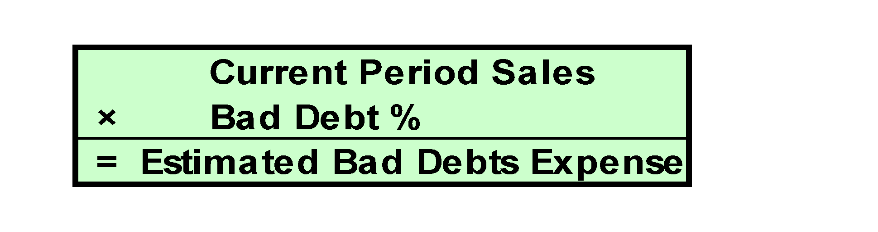

Percent of Sales Method
P2
Bad debts expense is computed as follows:
Notes:
When using the Percent of Sales Method, the estimate at the end of the period is determined by taking current period sales and multiplying by an established bad debt percentage. The bad debt percentage is determined based on past history of the company and current economic trends. Also, the sales transactions included in this computation are typically only the credit sales. There are not any collection issues to consider for cash sales transactions.

Slide 22
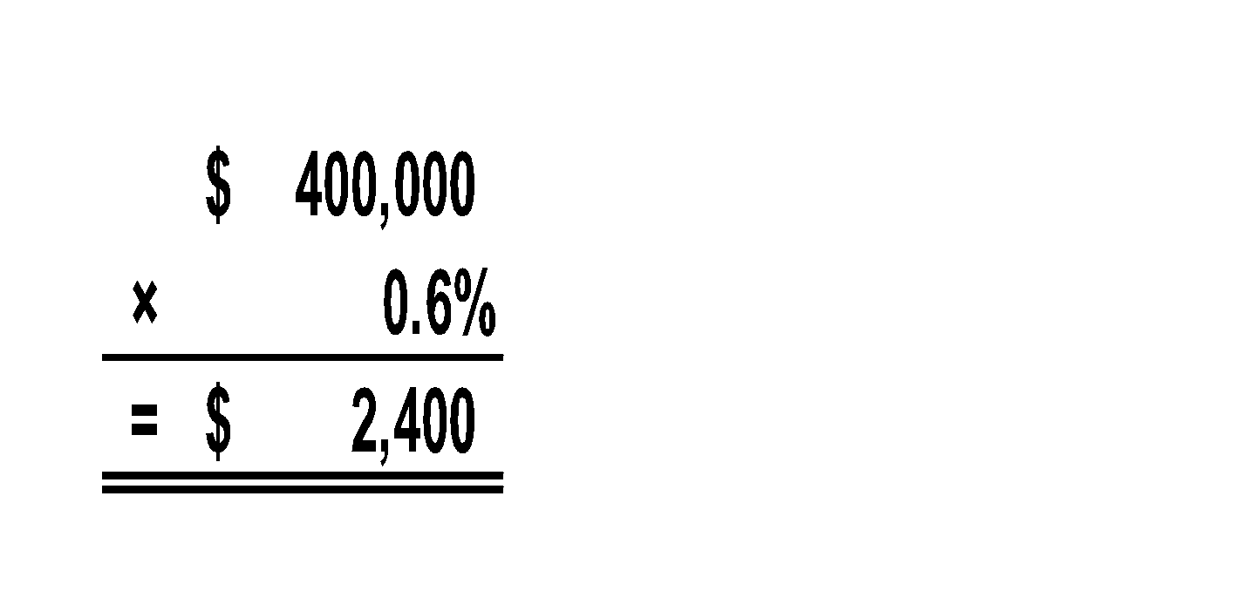

Percent of Sales Method
P2
Musicland has credit sales of $400,000 in 2011. It is estimated that 0.6% of credit sales will eventually prove uncollectible.
Let’s look at recording Bad Debts Expense for 2011.
Musicland’s accountant computes estimated Bad Debts Expense of $2,400.
Notes:
Musicland has credit sales of $400,000 in the year 2011. Management estimates that 0.6% of credit sales will eventually prove to be uncollectible. Let’s look at recording Bad Debts Expense for 2011 using the percentage of sales method of estimating bad debts expense.
Musicland’s Bad Debt Expense would be $2,400. This is determined by multiplying the credit sales of $400,000 by 0.6 %. Musicland will debit Bad Debts Expense and credit Allowance for Doubtful Accounts for $2,400.
The allowance account ending balance on the balance sheet for this method would rarely equal the bad debts expense on the income statement. This is so because unless a company is in its first period of operations, its allowance account has a zero balance only if the prior amounts written off as uncollectible exactly equal the prior estimated bad debts expenses.

Slide 23

Percent of Receivables Method
P2
Compute the estimate of the Allowance for Doubtful Accounts.
Bad Debts Expense is computed as:
Total Estimated Bad Debts Expense
– Previous Balance in Allowance Account
= Current Bad Debts Expense
Notes:
When using the Percent of Accounts Receivable Method, the estimate at the end of the period is determined by taking the Accounts Receivable balance and multiplying by an established bad debt percentage. The bad debt percentage is determined based on past history of the company and current economic trends. This computation provides the company with the balance desired in the Allowance for Doubtful Accounts.
Because the Allowance for Doubtful Accounts is a permanent account, it will always have a balance in it. As a result, when we determine the desired balance in step one, we have to then look and see what balance is already in the Allowance for Doubtful Accounts and make the entry for the amount needed to arrive at the desired balance.

Slide 24
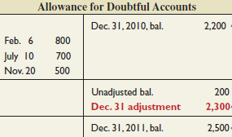


Percent of Receivables Method
P2
Musicland has $50,000 in accounts receivable and a $200 credit balance in Allowance for Doubtful Accounts on December 31, 2011. Past experience suggests that 5% of receivables are uncollectible.
Desired balance in Allowance for Doubtful Accounts.
Notes:
Musicland has $50,000 in Accounts Receivable and a $200 credit balance in Allowance for Doubtful Accounts on December 31, 2011. Past experience suggests that 5% of receivables are uncollectible. Let’s record Musicland’s Bad Debts Expense for 2011.
First, Musicland multiplies the Accounts Receivable balance of $50,000 by the five percent that is expected to be uncollectible. The result of $2,500 represents the desired balance in Allowance for Doubtful Accounts. Remember that Allowance for Doubtful Accounts is a permanent account and already has a $200 credit balance. So, if we want the balance to be $2,500, we only need to credit this account for $2,300.
The entry would be to debit Bad Debts Expense and credit Allowance for Doubtful Accounts for $2,300. This adjustment assumes there were no accounts written off during the year.

Slide 25

Aging of Receivables Method
P2
Classify each receivable by how
long it is past due.
Each age group is multiplied by its estimated bad debts percentage.
Estimated bad debts for each group are totaled.
Notes:
A second method used to determine the amount of Bad Debt Expense is the Aging of Receivables Method. This method uses both past and current receivables information to estimate the allowance amount. Specifically, each receivable is classified by how long it is past its due date. Then estimates of uncollectible amounts are made assuming that the longer an amount is past due, the more likely it is to be uncollectible. Classifications are often based on 30-day periods. After the amounts are classified (or aged), experience is used to estimate the percent of each uncollectible class. These percents are applied to the amounts in each class and then totaled to get the estimated balance of the Allowance for Doubtful Accounts.

Slide 26
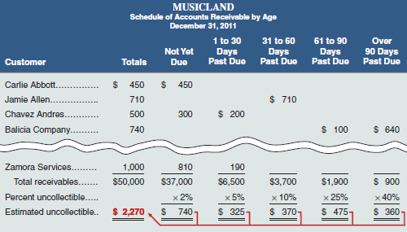
Aging of Accounts Receivable
P2
Notes:
This aging of accounts lists each customer’s individual balances assigned to one of five classes based on its days past due. The amounts in each class are totaled and multiplied by the estimated percent of uncollectible accounts for each class. The percents used are regularly reviewed to reflect changes in the company and economy. The total of $2,270 is the balance we desire in the Allowance for Doubtful Accounts.

Slide 27
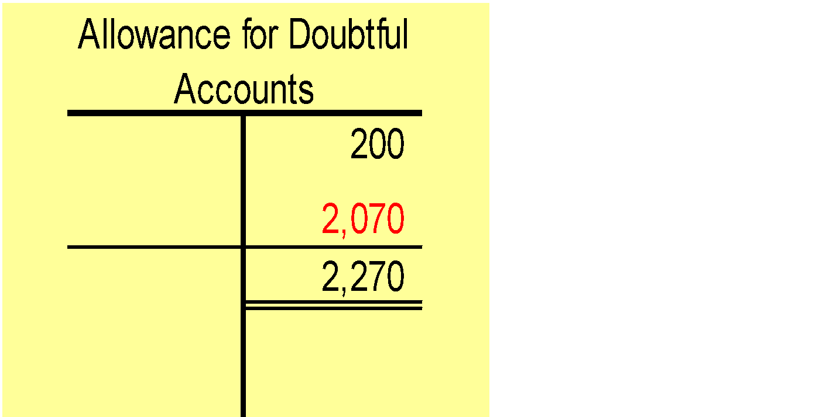

Aging of Accounts Receivable
P2
Musicland has an unadjusted credit balance in the allowance account is $200.
We estimated the proper balance to be $2,270.
Notes:
Notice that Musicland already has an unadjusted credit balance in the Allowance for Doubtful Accounts of $200.
So, if we want the balance to be $2,270, we only need to credit this account for $2,070. The entry would be debit Bad Debts Expense and credit Allowance for Doubtful Accounts for $2,070.

Slide 28
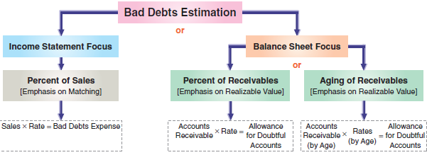
Summary of Methods
P2
Notes:
Here is a summary of the allowance methods we just discussed. The focus of the Percent of Sales Method is on matching Bad Debts Expense with the related revenues. The focus of the two Percent of Accounts Receivable Methods is on valuing Accounts Receivable at net realizable value on the balance sheet. These methods do a better job than the Direct Method of matching and reporting Accounts Receivable at net realizable value in the balance sheet.

Slide 29
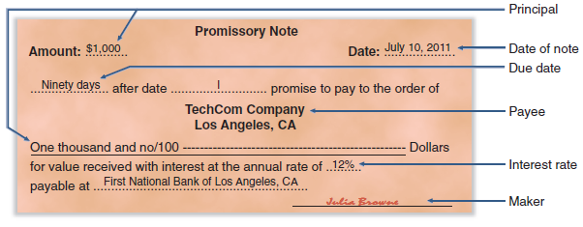
Notes Receivable
C2
A promissory note is a written promise to pay a specified amount of money, usually with interest, either on demand or at a definite future date.
Notes:
A promissory note is a written promise to pay a specified amount of money, usually with interest, either on demand or at a definite future date. Promissory notes are used in many transactions, including paying for products and services, and lending and borrowing money. Sellers sometimes ask for a note to replace an account receivable when a customer requests additional time to pay a past-due account. For legal reasons, sellers generally prefer to receive notes when the credit period is long and when the receivable is for a large amount. If a lawsuit is needed to collect from a customer, a note is the buyer’s written acknowledgment of the debt, its amount, and its terms.
For the note illustrated on this slide, Julia Browne promises to pay TechCom or to its order (according to TechCom’s instructions) a specified amount of money ($1,000), called the principal of a note, at a definite future date (October 8, 2011). As the one who signed the note and promised to pay it at maturity, Browne is the maker of the note. As the person to whom the note is payable, TechCom is the payee of the note. To Browne, the note is a liability called a note payable. To TechCom, the same note is an asset called a note receivable. This note bears interest at 12%, as written on the note. Interest is the charge for using the money until its due date. To a borrower, interest is an expense. To a lender, it is revenue.

Slide 30
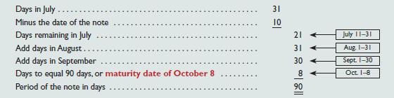
Computing Maturity and Interest
C2
The maturity date of a note is the day the note
(principal and interest) must be repaid.
On July 10, 2011, TechCom received a $1,000, 90-day, 12% promissory note as a result of a sale to Julia Browne.
The note is due and payable on October 8, 2011.
Notes:
The maturity date of a note is the day the note (principal and interest) must be repaid. The period of a note is the time from the note’s (contract) date to its maturity date. Many notes mature in less than a full year, and the period they cover is often expressed in days. When the time of a note is expressed in days, its maturity date is the specified number of days after the note’s date.
Julia Browne’s 90-day note dated July 10 matures on October 8. This October 8 due date is computed as shown on this slide. Start with the number of days in the month the note originated and subtract the date of the note. This gives the number of days in the originating month to count toward the maturity date. In this example, it was 21. Then, we add the days from the next three months until they add up to the note term. In this example, we would add 31 days in August, 30 days in September, and 8 days in October to add up to the note term of 90 days.

Slide 31

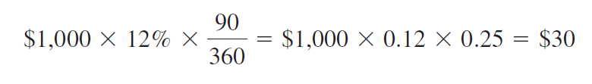
Interest Computation
C2
Even for maturities less than one year, the rate is annualized.
If the note is expressed in days, base a year on 360 days.
Notes:
Interest is the cost of borrowing. It is calculated as Principal times Rate times Time. Remember that interest rates are reported for a year. So, if we just took Principal times Rate, we would get the interest for an entire year. We need to continue to multiply by Time to get the interest for the portion of the year the note was outstanding. Remember that accountants use a year based on 360 days rather than 365 days.
The interest for a 90-day, 12%, $1,000 note would be $30.

Slide 32

Recognizing Notes Receivable
C2
Notes receivable are usually recorded in a single Notes Receivable account to simplify recordkeeping. The original notes are kept on file, including information on the maker, rate of interest, and due date.
To illustrate the recording for the receipt of a note, we use the $1,000, 90-day, 12% promissory note from Julia Browne to TechCom. TechCom received this note at the time of a product sale to Julia Browne.
Notes:
Notes receivable are usually recorded in a single Notes Receivable account to simplify recordkeeping. The original notes are kept on file, including information on the maker, rate of interest, and due date. (When a company holds a large number of notes, it sometimes sets up a controlling account and a subsidiary ledger for notes. This is similar to the handling of Accounts Receivable.)
To illustrate the recording for the receipt of a note, we use the $1,000, 90-day, 12% promissory note from Julia Browne to TechCom. TechCom received this note at the time of a product sale to Julia Browne. This transaction is recorded as a debit to Notes Receivable and a credit to Sales for $1,000.

Slide 33


Recording an Honored Note
P3
The principal and interest of a note are due on its maturity date.
J. Cook has a $600, 15%, 60-day note receivable due to TechCom on December 4.
Notes:
The principal and interest of a note are due on its maturity date. The maker of the note usually honors the note and pays it in full. To illustrate, J. Cook has a $600, 15%, 60-day note receivable due to TechCom on December 4. J. Cook pays TechCom $615, $600 for a Note Receivable and $15 for interest accrued on the note. The entry to record the payment on December 4 is a debit to Cash for $615, a credit to Interest Revenue for $15, and a credit to Notes Receivable for $600.

Slide 34

Recording a Dishonored Note
P3
The act of dishonoring a note does not relieve the maker of the obligation to repay the principal and interest due.
TechCom holds an $800, 12%, 60-day note of Greg Hart. At maturity, October 14, Hart dishonors the note.
Notes:
When a note’s maker is unable or refuses to pay at maturity, the note is dishonored. The act of dishonoring a note does not relieve the maker of the obligation to repay the principal and interest due. TechCom holds an $800, 12%, 60-day note of Greg Hart. At maturity, October 14, Hart dishonors the note.
On October 14, TechCom would debit Accounts Receivable for $816. That is the original note amount of $800 plus the interest of $16 that Greg Hart owes. TechCom would credit Interest Revenue for $16 and Notes Receivable for $800 because the note is no longer valid.

Slide 35

Recording End-of-Period
Interest Adjustments
P3
On December 16, TechCom accepts a $3,000, 60-day, 12% note from a customer in granting an extension on a past-due account. When TechCom’s accounting period ends on December 31, $15 of interest has accrued on the note.
$3,000 x 12% x 15/360 = $15
Notes:
On December 16, TechCom accepts a $3,000, 60-day, 12% note from a customer in granting an extension on a past-due account. When TechCom’s accounting period ends on December 31, $15 of interest has accrued on the note. Using the formula Principal times Rate times Time, we determine that $15 of interest has accrued on this note by December 31.
The adjusting entry includes a debit to Interest Receivable and a credit to Interest Revenue for $15.

Slide 36

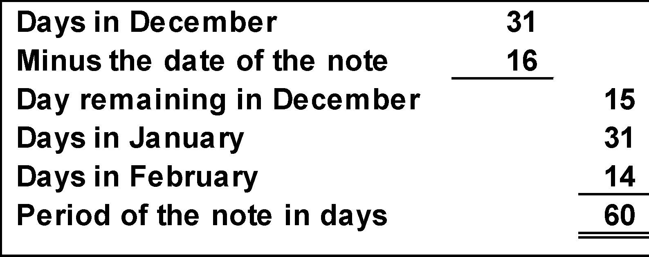

Recording End-of-Period
Interest Adjustments
P3
Recording collection on note at maturity.
$3,000 x 12% x 60/360 = $60
Notes:
The maturity date of the note is February 14, 2009, as shown in the textbox at the top of your screen. Total interest on the note is $60 ($3,000 times 12% times 60 divided by 360).
On February 14, TechCom will debit Cash for $3,060. That is the original note amount of $3,000 plus the interest of $60. Notes Receivable is credited for $3,000. The total interest is divided between two accounts. Interest Receivable is credited for $15. Remember this is removing the Interest Receivable we created in the previous adjusting entry. Interest Revenue is credited for $45. This is the interest revenue TechCom earned in the current year.

Slide 37
Disposal of Receivables
C3
Companies can convert receivables to cash before they are due.
Selling Receivables
Pledging Receivables
Notes:
Companies can convert receivables to cash before they are due. Reasons for this include the need for cash or the desire not to be involved in collection activities. Converting receivables is usually done either by (1) selling them or (2) using them as security for a loan. A recent survey shows that about 20% of companies obtain cash from either selling receivables or pledging them as security. In some industries such as textiles, apparel and furniture, this is common practice.
A company can sell all or a portion of its receivables to a finance company or bank. The buyer, called a factor, charges the seller a factoring fee and then the buyer takes ownership of the receivables and receives cash when they come due. By incurring a factoring fee, the seller receives cash earlier and can pass the risk of bad debts to the factor.
A company can raise cash by borrowing money and pledging its receivables as security for the loan. Pledging receivables does not transfer the risk of bad debts to the lender because the borrower retains ownership of the receivables. If the borrower defaults on the loan, the lender has a right to be paid from the cash receipts of the receivable when collected.

Slide 38
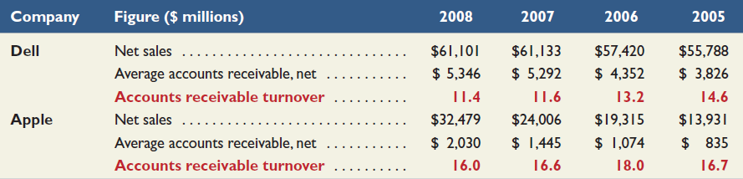
Accounts Receivable Turnover
A1
This ratio provides useful information for evaluating how efficient management has been in granting credit to produce revenue.
Net sales
Average accounts receivable, net
Notes:
The Accounts Receivable Turnover ratio provides useful information for evaluating how efficient management has been in granting credit to produce revenue. It is calculated as Net Sales divided by Average Accounts Receivable. Average Accounts Receivable is determined by adding together the beginning Accounts Receivable balance and the ending Accounts Receivable balance and dividing this total by two.
This ratio measures how often, on average, receivables are received and collected during the period. If a company offers terms of net 30 on its sales, then one would expect the turnover to be approximately twelve times per year. This ratio should be monitored closely from period to period and should also be used to compare collection trends with that of competitors. Here is a look at the accounts receivable at Dell Computers and Apple for the period 2005 through 2008. Dell’s 2008 turnover is 11.4, computed as $61,101/$5,346 ($ millions). This means that Dell’s average accounts receivable balance was converted into cash 11.4 times in 2008. Its turnover declined in 2008, as it has for each of the past 3 years. Apple’s turnover exceeds that for Dell in each of the past 4 years. Both Dell and Apple seem to be doing well managing their receivables.

Slide 39

Global View
Recognition of Receivables
Both U.S. GAAP and IFRS have similar asset criteria that apply to recognition of receivables. Further, receivables that arise from revenue-generating activities are subject to broadly similar criteria for U.S. GAAP and IFRS.
Valuing of Receivables
Both U.S. GAAP and IFRS require that receivables be reported net of estimated uncollectibles. Further, both systems require that the expense for estimated uncollectibles be recorded in the same period when any revenues from those receivables are recorded.
Disposition of Receivables
Both U.S. GAAP and IFRS apply broadly similar rules in recording dispositions of receivables.
Notes:
This slide presents similarities and differences between U.S. GAAP and IFRS regarding the recognition, measurement, and disposition of receivables.
Recognition of Receivables: Both U.S. GAAP and IFRS have similar asset criteria that apply to recognition of receivables. Further, receivables that arise from revenue-generating activities are subject to broadly similar criteria for U.S. GAAP and IFRS. Specifically, both refer to the realization principle and an earnings process. The realization principle under U.S. GAAP implies an arm’s-length transaction occurs, whereas under IFRS this notion is applied in terms of reliable measurement and likelihood of economic benefits. Regarding U.S. GAAP’s reference to an earnings process, IFRS instead refers to risk transfer and ownership reward. However, while these criteria are broadly similar, differences do exist, and they arise mainly from industry-specific guidance under U.S. GAAP, which is very limited under IFRS.
Valuing of Receivables: Both U.S. GAAP and IFRS require that receivables be reported net of estimated uncollectibles. Further, both systems require that the expense for estimated uncollectibles be recorded in the same period when any revenues from those receivables are recorded.
Disposition of Receivables: Both U.S. GAAP and IFRS apply broadly similar rules in recording dispositions of receivables. Those rules are discussed in this chapter. We should be aware of an important difference in terminology. Companies reporting under U.S. GAAP disclose Bad Debts Expense, which is also referred to as Provision for Bad Debts or the Provision for Uncollectible Accounts. For U.S. GAAP, provision here refers to expense. However, under IFRS, the term provision usually refers to a liability whose amount or timing (or both) is uncertain.

Slide 40

End of Chapter
Notes:
End of Chapter 9.

