Slide 1



Enterprise Risk Management
PMG 611
Lecture 10
Cyber security and Information Technology and ERM
Prepared by
Dr. Eng. Abdullah Jameel Halawany

Slide 2

Lecture
Session Outline
09
IT And The ERM Framework
IT Application Systems Risks
Effective IT Continuity Planning
Worms, Viruses, And System Network Risks
10–2

Slide 3
Lecture
Introduction
10
Cyber security and Information Technology and ERM
PMG 611
Enterprise Risk Management
10–3

Slide 4
Lecture
Introduction
10
IT is so pervasive in all business and operations processes.
IT is also a challenging area for understanding risks and developing appropriate risk responses.
As has been the pattern over the years, no matter how strong are the designed and implemented internal controls—particularly those that are software based—someone will find a way to violate and get around them.
10–4

Slide 5
Lecture
Introduction
10
Because of the complexity in building and maintaining Information Technology (IT) systems, their network interconnections, and all types of applications, Risk Management has been a very important consideration in all aspects of IT processes.
One does not have to have been a participant or observer of IT hardware and software projects for that many years to have observed many IT projects that were launched with high expectations but subsequently failed for any of a variety of reasons.
10–5

Slide 6
Lecture
Introduction
10
Just as people involved in marketing often have overly high expectations that some new initiative will succeed, IT processes often have high, positive expectations but ignore the many business and technology risks associated with IT systems.
Digital transformation era.
10–6

Slide 7
Lecture
Introduction
10
90% of organizations in North American that are engaged in Digital Transformation acknowledge their risk profiles have expanded due to their digital initiatives.
Managing Cybersecurity Risks is the top risk management objective for decision makers at organizations engaged in Digital Transformation.
10–7

Slide 8
Lecture
Introduction
10
On any given day, there are numerous media reports about signiﬁcant cyber incidents.
Organizations of all types and sizes are susceptible to cyber attacks.
Which data, systems, and assets are of value at any particular point in time depends on the cyber attacker’s motives.
10–8

Slide 9
Lecture
Introduction
10
As long as cyber incidents continue to have a negative impact on the reputation and ﬁnancial well-being of victim companies and continue to draw additional regulatory and legal scrutiny, cyber breaches will continue to be high proﬁle events that draw a substantial amount of negative press.
10–9

Slide 10
Lecture
Introduction
10
Digital incidents are now costing small businesses $200,000 on average, according to insurance carrier Hiscox, and 60% going out of business within six months of being victimized.
The frequency with which these attacks are happening is also increasing, with more than half of all small businesses having suffered a breach and 4 in 10 having experienced multiple incidents.
10–10

Slide 11
Lecture
IT And The COSO ERM Framework
10
Cyber security and Information Technology and ERM
PMG 611
Enterprise Risk Management
10–11

Slide 12
Lecture
IT And The COSO ERM Framework
10
Information systems general controls include hardware, software, and administrative control procedures that apply to all systems and applications, including:
  Reliability of information systems processing
  Integrity of programs, including configuration management
  Controls of the proper development and implementation of systems.
  Continuity of processing
  Controls of Application Inputs
  Self-balancing and other financial and data controls
  Application output components
10–12

Slide 13
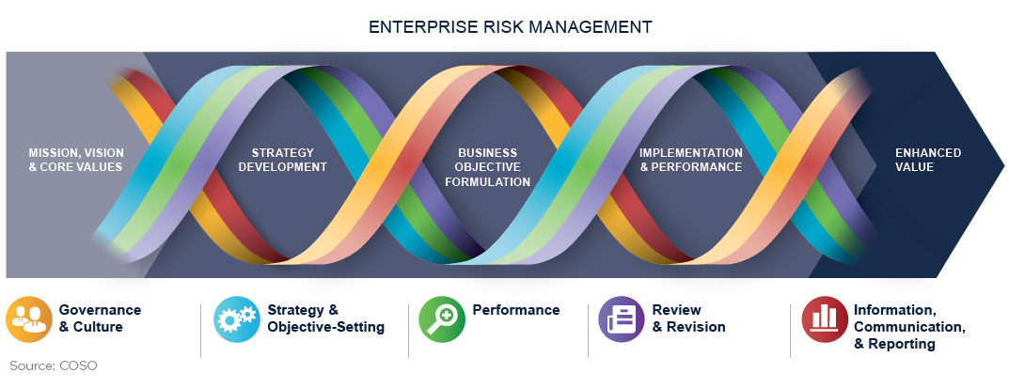
Lecture
IT And The COSO ERM Framework
10
10–13

Slide 14
Lecture
IT And The COSO ERM Framework
10
Governance and Culture (sets the entity’s tone, reinforcing the importance of cyber vigilance and establishing oversight responsibilities for the entity)
Strategy and Objective-Setting (Cyber risk management should integrated)
Performance (identifies and assesses cyber risks that may affect the achievement of that strategy and business objectives)
Review and Revision (reviewing cyber risk management capabilities and practices, and the entity’s performance relative to its targets)
Information, Communication, and Reporting
10–14

Slide 15
Lecture
IT Application Systems Risks
10
Cyber security and Information Technology and ERM
PMG 611
Enterprise Risk Management
10–15

Slide 16
Lecture
IT Application Systems Risks
10
IT applications are pervasive and can contain many risks.
They may represent software routines that have been custom developed by an enterprise, purchased software products, or software that is embedded in many other tools and products.
Some of the areas where an enterprise faces risks with its application systems include situations when a project is poorly planned and misses schedule or budget targets.
Other risk areas are when there are integrity and performance problems, or when there are just ‘‘bugs’’ in the application.
10–16

Slide 17
Lecture
IT Application Systems Risks
10
Failures here can cause problems or even embarrassments for an enterprise.
A new application may be launched where only a limited set of conditions may have been tested.
Increased variation of transactions or volume of transactions.
Whether it is a space launch rocket or a customer billing application, the causes for many if not most IT applications failures can be traced to poor design and testing processes.
Adequate procedures and other good processes in place can limit those risks.
10–17

Slide 18
Lecture
Application Development and Acquisition Risks
10
Enterprise management would decide they needed some type of specific application and would proceed to use their own in-house programming resources to build it.
While some standard applications such as payroll and fixed asset applications have been offered by outside vendors and installed as purchased software for many years, many others have been built in-house by enterprise IT development resources.
10–18

Slide 19
Lecture
Application Development and Acquisition Risks
10
There are risks associated with any new application development effort along with a somewhat different set of risks, depending whether the application is based on essentially purchased software or built by in-house enterprise resources.
Purchased applications typically take a large amount of tailoring work to install, and most in-house developed applications always use purchased software building blocks.
With the possible exception of some desktop system applications, most require some degree of application development work.
10–19

Slide 20
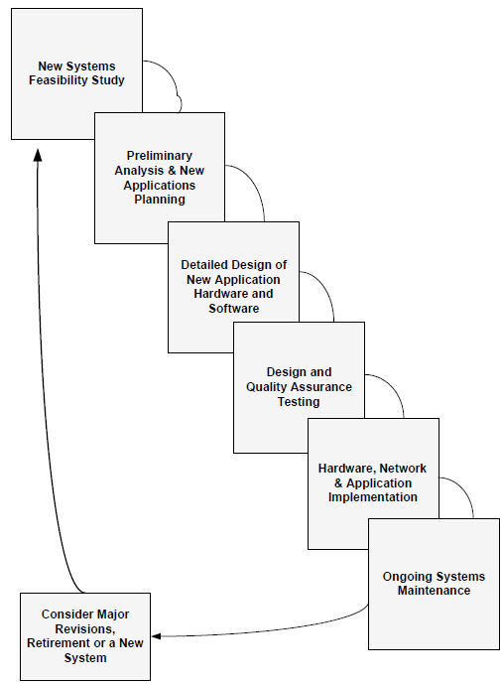

System Development Life Cycle Waterfall Development Processes
10–20

Slide 21
Lecture
Purchased Software Application Risks
10
All-function applications called Enterprise Resource Planning (ERP) applications.
The concept behind these applications is that a change to one module, such as an inventory adjustment, will be reflected in related applications such as the general ledger and the bill of material.
These kinds of purchased ERP applications are not easy to install.
They typically require massive changes to existing processes to better match business operations to the ERP software application as well as some parameter-driven changes to the ERP to make it a better business fit.
10–21

Slide 22
Lecture
Purchased Software Application Risks
10
An ERP system typically requires a long time period for its implementation with a need for specialized staff training and outside consultants.
Failure to select the appropriate software vendors can present major risks to any contracted software product.
10–22

Slide 23
Lecture
10
Purchased Software Contract Guidelines to Reduce Risks
Software Product Feasibility/Compatibility
Product History
Vendor Background
Customer & Trade References
Revision Practices
Product Documentation & Training
Product Customer Support
10–23

Slide 24
Lecture
In-House Developed Software Application Risks
10
Enterprises often decided they had to develop applications because of what they argued were their unique needs.
There is not a strict dividing line between applications purchased from software vendors and those developed in-house.
The reality is that the software development process does not fit totally on one side of this divide or the other.
Risks can be limited through good SDLC procedures supported by strong project management practices.
10–24

Slide 25
Lecture
Software and Application Systems Testing
10
It is necessary to test all new applications before placing them into production.
An enterprise can face a major risk to the quality and integrity of its IT applications if new applications are not fully tested.
This testing process should take place at an application level and for overall systems.
IT testing required strong procedures in place for developing testing plans and for reviewing the results of those testing activities, including specified pass/fail criteria over the results of this testing.
10–25

Slide 26
Lecture
Software and Application Systems Testing
10
The type of testing performed will vary depending on the features, objectives, and controls of the application being reviewed.
This testing should be performed by the application developers, or IT audit.
In order to provide sufficient testing activities to minimize risks, the results of the testing should be well documented so that any outside reviewers could assess the adequacy of this testing activity.
10–26

Slide 27
Lecture
Effective IT Continuity Planning
10
Cyber security and Information Technology and ERM
PMG 611
Enterprise Risk Management
10–27

Slide 28
Lecture
Effective IT Continuity Planning
10
Just as we rely on electrical power and clean water resources to be in operation, an enterprise today depends on its IT systems to operate continuously and effectively.
Enterprise is largely responsible for the operation of its own IT resources.
An enterprise faces numerous risks around its IT assets.
10–28

Slide 29
Lecture
Effective IT Continuity Planning
10
There typically is not one major or central computer facility for handling major automated applications but a wide range of desktop devices, servers, and other computer systems connected through often very complex wireless communications, storage management networks, and links to the Internet.
10–29

Slide 30
Lecture
Effective IT Continuity Planning
10
An enterprise can face a major risk if they lose the ability to access and use their key IT systems for even a relatively short period of time.
To limit those risks, there is a need to have procedures in place to promptly restore their operations.
Systems today support many enterprise operations, and the concept of having tools and procedures in place to rapidly restore overall business operations is called Continuity Planning.
10–30

Slide 31
Lecture
Effective IT Continuity Planning
10
In the event of an unexpected outage, the IT systems should be restored and operating as quickly and efficiently as possible in order to support and restore the business processes.
Enterprise should also be concerned about the continued and high availability of its IT resources.
Any form of computer systems downtime can be very costly to an enterprise.
10–31

Slide 32
Lecture
Effective IT Continuity Planning
10
For example, the Disaster Recovery Institute estimated some years ago that the average hourly impact of an hour of systems downtime is $89,500 for an airline reservations system or $2.6 million for a credit card authorization provider, among others.
Beyond just estimates, eBay’s Internet auction site went down for 22 hours in August 1999.
This caused $4 million in lost fees and a $5 billion drop in eBay’s stock market value.
10–32

Slide 33
Lecture
Effective IT Continuity Planning
10
To minimize risks, enterprises need to think through these various possible situations in advance.
Two types of emergency incidents are significant.
The first is the risk of a fire-in-the-building type of emergency incident.
The supporting emergency response plan here would include posted fire exits and past experience with frequent fire drills.
This type of emergency response plan should cover all enterprise operations, not just IT systems, and should be regularly tested.
10–33

Slide 34
Lecture
Effective IT Continuity Planning
10
The second level of emergency response plan covers specific individual incidents that may or may not turn out to be significant but must be corrected at once followed by an investigation and a plan of corrective action to prevent further incidents.
These are called emergency incidents
  Security Breaches or
  Theft of hardware or software
10–34

Slide 35
Lecture
Effective IT Continuity Planning
10
A good emergency incident response plan should be acted on quickly to minimize the effects of any further breaches.
It should also be formulated to reduce any negative publicity and to focus attention on quick reaction time.
Rather than just an IT-related plan, all appropriate levels of enterprise operations should be covered.
10–35

Slide 36
Lecture
Effective IT Continuity Planning
10
An enterprise’s risk management function should work with their IT operations to develop appropriate emergency response plans that will exist at a total facility level, such as a fire escape plan, and at an individual level, such as a plan to respond to a security breach.
To reduce risks, these plans should be regularly updated and tested.
10–36

Slide 37
Lecture
Effective IT Continuity Planning
10
Beyond an emergency response plan, an enterprise needs to develop a set of IT continuity plans.
This type of plan is an outline of the steps necessary to help an enterprise recover from major service disruptions, whether a fire type of emergency, a computer or network equipment failure, or any other form of major disruption.
The goal of such a plan is to help an enterprise reduce the risk of a disaster outage or extended service interruption to an acceptable level and to bring business operations back.
10–37

Slide 38
Lecture
Effective IT Continuity Planning
10
This type of continuity plan represents a change in emphasis from what IT professionals once called disaster recovery plans.
That older emphasis was to get data processing operations working while the continuity plan emphasizes needs of the business unit.
Today, these plans have been redesigned to broaden them and to reduce risks.
They are frequently called Business Continuity Plans (BCPs).
10–38

Slide 39
Lecture
Worms, Viruses, And System Network Risks
10
Cyber security and Information Technology and ERM
PMG 611
Enterprise Risk Management
10–39

Slide 40
Lecture
Worms, Viruses, And System Network Risks
10
An enterprise’s IT operation today consists of much more than just its IT equipment and resources within offices and plants.
It also includes a wide variety of other facilities connected through the Internet and other often-wireless networked resources.
Even if an enterprise effectively prohibits the regular use of the Internet during regular working sessions, we are all effectively connected to these networks today.
10–40

Slide 41
Lecture
Worms, Viruses, And System Network Risks
10
Communications with many banks, access to government reports, and even ordering certain parts and supplies requires Internet access.
These interconnections contain many risks in terms of exposures to what have become known as worms, viruses, and other types of malignant software code threats that can cause peril for all types of programs and networked computer systems, ranging from a home office desktop to a large central system.
10–41

Slide 42
Lecture
Worms, Viruses, And System Network Risks
10
An enterprise needs to recognize the threat of what is often called cybercrime and needs to take steps to protect from these threats.
Establishing effective controls is a challenge.
Enterprise can reduce its risks and the threat of cybercrime by:
10–42

Slide 43
Lecture
Worms, Viruses, And System Network Risks
10
Following ‘‘Best Practices’’ in Establishing and Maintaining an Effective IT Security System.
Regular systems of security maintenance should be established, including the regular updating of operating systems and software
Enforcement of password policies, disabling unnecessary services, installation and updating of antivirus software on a very frequent basis, and the use of intrusion detection systems and firewalls.
Prevention is always the best cure.
10–43

Slide 44
Lecture
Worms, Viruses, And System Network Risks
10
Remaining on High Alert.
Frequent scanning of Internet logs and incoming and outgoing e-mail should be performed regularly, and any suspicious activity should be looked into and reported to the local authorities, if necessary.
An emergency incident plan could be established as well, in case any system is temporarily or permanently disabled by a virus.
10–44

Slide 45
Lecture
Enterprise Risk Management Developments
10
Cyber security and Information Technology and ERM
PMG 611
Enterprise Risk Management
10–45

Slide 46
Lecture
Enterprise Risk Management Developments
10
Staying ahead in ERM means moving faster, connecting risks across silos, and embedding AI and automation responsibly.
The biggest shifts are about tightening governance for AI, unifying fragmented data, and elevating risk ownership so decisions happen at the speed of emerging threats
10–46

Slide 47
Lecture
Ai-driven Risk And Resilience
10
AI expands both attack surfaces (e.g., model misuse, data leakage) and defensive capabilities (e.g., automated detection).
Integrating AI governance and cybersecurity is now foundational to ERM strategy
10–47

Slide 48
Lecture
Advanced Strategies ERM
10
Integrated risk ownership and faster action:
  What it is: Clarify risk owners, decision rights, and escalation paths; push decisions closer to where risks surface.
  Outcome: Shorter risk-to-impact windows require decentralized, accountable action, not central bottlenecks
10–48

Slide 49
Lecture
Smart tools and technologies
10
Tool category | Primary use | 2025 shift | Example outcome
GRC platforms | Control, issue, policy, audit workflows | Integrations with data lakes and APIs | Single source of truth for KRIs and findings
Continuous control monitoring | Automate evidence/testing | Close coverage gaps via automation | Detect control drift within hours, not quarters
Risk data fabric/lakehouse | Unify siloed data for analytics | Kill blind spots; enable AI models | End‑to‑end lineage, faster risk insights
10–49

Slide 50
Lecture
Summary
10
Cyber security and Information Technology and ERM
PMG 611
Enterprise Risk Management
10–50

Slide 51
Lecture
IT And Effective ERM Processes
10
IT processes play a significant role in the operations of any enterprise and certainly are a major factor when assessing and understanding relative risks.
This chapter has highlighted only three broad IT areas — the application development process, IT continuity plans, and malicious network programs —where an enterprise can face some significant IT risks.
10–51

Slide 52
References
COSO Enterprise Risk Management: Establishing Effective Governance, Risk, and Compliance Processes. Robert R. Moeller.
9-48

Slide 53



Thank You

