Slide 1

Project Financial Management
Dr. Walaa Mohamed
Lecture 1
Everyone’s Smart
University
PMG 615
Introduction to project finance

Slide 2


Introduction
Money makes the world go round! Project management is certainly not an exception. Projects are initiated because an individual or an organization wants a certain type of work done. In turn, they’re willing to pay people to perform the work. Simple, right? At it’s core, that is the essence of finance in project management – one party wants the work done and pays for it; other parties want to do the work and get paid for it. While this is project finance in a nutshell, there are many fine details to be aware of.

Slide 3

Project Financial Management
Project Financial Management determines how the project will be financed, including the processes to acquire and manage the financial resources for the project. It is more concerned with revenue sources and monitoring net cash-flows for the construction project than with managing day-to-day costs. (PMBOK® Guide, Construction Extension 2016 Edition)
Therefore, to continuously monitor the project finances and to ensure the company's financial capacity to complete the project are the most critical finance manager jobs. This also includes the assessment and monitoring of financial risks and the implementation of suitable financial risk management strategies.

Slide 4

Learning Objectives
Defining project and its attributes.
Difference between Routine work (regular operations) and Project.
Defining of project management.
Project Life Cycle.
Definitions of Project finance.
Principles of Project finance.
Difference between project finance and corporate finance.
Elements of a Project-Finance Structure.
Why do investors use project finance?

Slide 5
What is a project?
A project is a group of unique, interrelated activities that are planned and executed in certain sequence to create a unique product or service, within a specific time frame, budget and the client’s specifications.
A project is a temporary endeavor undertaken to create a unique product, service or result.
Temporary means: A Project is a one-off event and not an ongoing operation It has a definite beginning and a definite end.
The end is reached when:
The project’s objectives have been achieved.
When it becomes clear that the project objectives will not or cannot be met.
The need for the project no longer exists and the project is terminated.

Slide 6
Attributes of a Project
A Project is a planned set of activities.
A Project has a specific scope.
A Project has time, cost, quality and resource constraints.
Has a well-defined objective.
Has a defined life span with a beginning and an end.
Involves doing something unique.
Has a customer.
Involves a degree of uncertainty.

Slide 7

Examples of Projects
Construction of a hospital.
Writing a book.
Designing and implementing a computer system.
Introducing a new product in the market.
Construction of a new bridge over a river.
Designing and producing a brochure.
A Politician contesting an election.
Building a dam.
Organizing a seminar.

Slide 8
Difference between project and routine work
Project
One time
Use of wide variety of skills
Use of special purpose equipment for short duration
No revenue during
Project stages
Routine work
Repetitive
Limited Skills
Equipments are in continuous use
Revenues are there

Slide 9
Comparison of Routine Work with Projects
Routine, Repetitive Work
Taking class notes.
Responding to a supply-chain request.
Day to day process of painting cars in an assembly plant.
Routine manufacture of an Apple iPod.
Projects
Writing a term paper.
Developing a supply-chain information system.
Installing robots to paint cars in an assembly plant.
Designing an iPod that is approximately 2 X 4 inches, interfaces with PC, and
stores 10,000 sound records.

Slide 10
Definition of Project Management
Project management is the discipline of organizing and managing resources (money, people, time, space, etc.) in such a way that these resources deliver all the work required to complete a project within defined scope, time, and cost constraints.
It is the application of knowledge, skills, tools and techniques to a broad range of activities in order to meet the requirements of the particular project.
The planning, control and coordination of all aspects of a project, and the motivation of all those involved in it, in order to achieve the project objectives.

Slide 11

Project Life Cycle
Like organic entities, projects have life cycles. From a slow beginning they progress to a buildup of size, then peak, begin a decline, and finally must be terminated. Some projects end by being phased into the normal, ongoing operations of the parent organization.
A standard project typically has the following four major phases (each with its own agenda of tasks and issues): initiation, planning, implementation, and closure. Taken together, these phases represent the path a project takes from the beginning to its end and are generally referred to as the project “life cycle.”

Slide 12



Slide 13

Definitions of Project finance
Project finance is a method of raising long-term debt financing for major projects based on lending against the cash flow generated by the project alone; it depends on a detailed evaluation of a project’s construction, operating and revenue risks, and their allocation between investors, lenders, and other parties through contractual and other arrangements.
This type of financing is usually for large, complex and expensive installations that might include, for example, power plants, chemical processing plants, mines, transportation infrastructure, environment, and telecommunications infrastructure.

Slide 14
Definitions of Project finance
Project finance is non-recourse financing of a single asset or portfolio of assets where the lenders can look only to those specific assets to generate the flow needed to service its fixed obligations, chief of which are interest payments and repayments of principal. Lenders’ security and collateral is usually solely the project’s contracts and physical assets.
Project-finance structures differ between various industry sectors and from deal to deal, since each project has its own unique characteristics. But there are common principles underlying the project-finance approach.

Slide 15

Principles of project finance
1. The project usually relates to major infrastructure with a long construction period and long operating life.
- So, the financing must also be for a long term (typically 15–25 years).
2. Lenders rely on the future cash flow projected to be generated by the project to pay their interest and fees, and repay their debt.
Therefore, the project must be ‘ring-fenced’ (i.e. legally and economically self-contained).
- So, the project is usually carried out through a special-purpose legal entity (usually a limited company) whose only business is the project (the ‘Project Company’).

Slide 16
Principles of project finance
3. There is a high ratio of debt to equity (‘leverage’ or ‘gearing’)—roughly speaking, project finance debt may cover 70–90% of the capital cost of a project.
- The effect of this high leverage is to reduce the blended cost of debt and equity, and hence the overall financing cost of the project.

Slide 17
Principles of project finance
4. The Project Company’s physical assets are likely to be worth much less than the debt if they are sold off after a default on the financing—and in projects involving public infrastructure they cannot be sold anyway.
- So, the main security for lenders is the Project Company’s contracts, licenses, or other rights, which are the source of its cash flow.
- Therefore, lenders carry out a detailed analysis of the project’s risks, and how these are allocated between the various parties through these contracts.

Slide 18
Principles of project finance
5. The project has a finite life, based on such factors as the length of the contracts or licenses, or reserves of natural resources.
So, the project-finance debt must be fully repaid by the end of the project’s life.
6. There are no guarantees from the investors in the Project Company for the project-finance debt. So, this is ‘non-recourse’ finance.

Slide 19
Difference between project finance and corporate finance
1. In corporate finance, loans are primarily lent against a company’s balance sheet and financial projections extrapolated from its past cash flow and profit record.
2. In corporate finance, loans have access to the whole cash flow from the spread of the borrower’s business as security, instead of the limited cash flow from a specific project thus even if an individual project fails, corporate lenders can still reasonably expect to be repaid;

Slide 20
Difference between project finance and corporate finance
3. In corporate finance, loans assume that the company will remain in business for an indefinite period and so can keep renewing (rolling over) its loans, which therefore do not need to be lent on a long-term basis; and
4. In corporate finance, loans may also be secured on the company’s physical assets—its offices, factories, etc., so that if the debt is not repaid these assets can be sold off to help recover the debt.

Slide 21
Elements of a Project-Finance Structure
To look in more detail at the structure of a project financing, this usually has two elements:
● equity, provided by investors in the project.
● project finance-based debt, provided by one or more groups of lenders.
The project-finance debt has first call on the project’s net operating cash flow; the investors’ return is thus more dependent on the success of the project. So as the investors are taking a higher risk, they expect a higher return on their investment, and the reverse is true for lenders.

Slide 22
Elements of a Project-Finance Structure
A nexus of contracts signed by the Project Company provide support for the finance. A ‘Project Agreement’ is often at the centre of this contractual structure.
A project agreement may take 2 main forms:
1- An offtake agreement is an agreement that a producer makes with a purchaser. They agree to sell or buy a specific amount of future production. An offtake agreement typically occurs before the construction of a production facility. For the producer, the offtake agreement is a guarantee for the project’s economic future.
Offtake agreements also improve the chances of obtaining a loan to complete the project. If the lender knows that you already have firm orders, it is more likely to approve your loan application.
This type of agreement is common in natural resource development projects. The capital cost to extract the resource is considerable. Therefore, the company needs firm orders to make sure that the investment is worth it.

Slide 23
Elements of a Project-Finance Structure
Offtake agreement (continued)
In a business with few buyers, the producer needs to be sure that the product will sell. The lender, before approving a loan, also needs to be sure.
We call the party who is purchasing the product or service the offtaker.
The offtaker can usually back out of an agreement. However, it will probably have to pay a fee.
2- or a contract with a central government department, regional or state government, county or municipality, or another public agency (‘Contracting Authority will be used to cover all of these) which gives the Project Company the right to construct the project and earn revenues from it.

Slide 24
Elements of a Project-Finance Structure
Alternatively, the Project Company may sell its production in commodity markets (which may apply, for example, to power or natural-resources projects) or have a license to operate under the terms of general legislation for the industry sector (e.g. a privatized port or airport, or a mobile-phone network), in both cases without an Offtake Contract or Project Agreement, as discussed further below.
The Project Company usually enters into ‘Sub-Contracts’, which provide support for the project finance, particularly by transferring risks from the Project Company to other parties, and which also form part of the lenders’ security package. The Project Agreement and Sub-Contracts are known collectively as the ‘Project Contracts’.

Slide 25
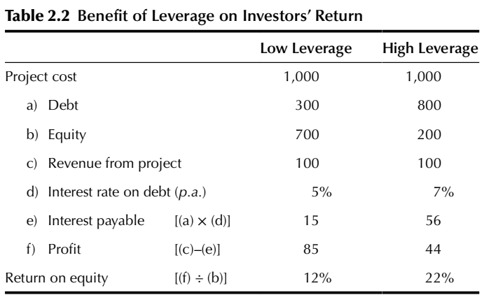
Why Investors Use Project Finance?
1- High Leverage: One major reason for using project finance is that investments in ventures such as power generation or road building have to be long term but do not offer an inherently high return: high leverage improves the return for an investor.

Slide 26
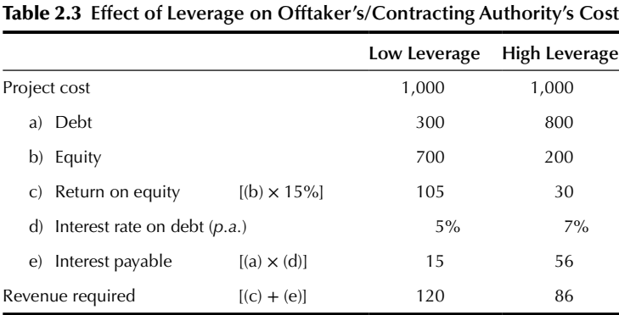
Why Investors Use Project Finance?
2- Lower Cost: If the Project Company is selling a commodity such as electricity into a market, the lower the financing costs the more competitive its pricing can be, and hence the higher leverage may be beneficial if the weighted cost of an investor’s capital (i.e. equity and debt on its own balance sheet) is higher.

Slide 27
Why Investors Use Project Finance?
3- Borrowing Capacity: Project finance increases the level of debt that can be borrowed against a project; moreover, non-recourse finance raised by the Project Company is not normally counted against corporate credit lines (therefore in this sense it may be off-balance sheet). It may thus increase an investor’s overall borrowing capacity, and hence the ability to undertake several major projects simultaneously.
4- Risk Limitation: An investor in a project raising funds through project finance does not normally guarantee the repayment of the debt. The risk is therefore limited to the amount of the equity investment. If the project goes well, the investor will get a good return on the investment, but if it goes badly the investor can simply walk away and hence limit the loss to the amount of the equity investment.

Slide 28
Why Investors Use Project Finance?
5- Risk Spreading/Joint Ventures: A project may be too large for one investor to undertake, so others may be brought in to share the risk in a joint-venture Project Company. This both enables the risk to be spread between investors and limits the amount of each investor’s risk because of the non-recourse nature of the Project Company’s debt financing.
6-Developer Leverage: Projects are often put together by a developer with an idea but little money, who then has to find investors. A project-finance structure, which requires less equity, makes it easier for the weaker developer to maintain an equal partnership, because if the absolute level of the equity in the project is low, the required investment from the weaker partner is also low.

Slide 29
Why Investors Use Project Finance?
7- Unequal Partnerships: Thanks to high leverage, the relatively small amount of equity required for a major project where project finance is used enables parties with different financial strengths to work together. It would be quite normal for example, for the investors to consist of a financial investor (say an infrastructure fund), a construction company, and a maintenance company, whose balance-sheet strengths would probably be very different, but with each bringing particular skills to this partnership.
8- Long-Term Finance: Project-finance loans typically have a longer term than corporate finance. Long-term financing is necessary if the assets financed normally have a high capital cost that cannot be recovered over a short term without pushing up the cost that must be charged for the project’s end product. So, loans for power projects may run for nearly 20 years, and for infrastructure projects even longer.

Slide 30
Why Investors Use Project Finance?
9- Enhanced Credit: A company’s credit rating is less likely to be downgraded if its risks on project investments are limited through a project-finance structure. Also, if the Offtaker has a better credit standing than the investor, this may enable debt to be raised for the project on better terms than the investor would be able to obtain from a corporate loan.
10- Reduces Need for Outside Investors: Another important factor encouraging a high level of debt in Project Companies is the more equity that is required, the more complex the project becomes to manage (especially during the bidding and development phases), if the result of having to raise more equity is that more investors have to be brought in. Moreover, if more investors have to be brought in, this means that the original developers may lose control of the project.

Slide 31
Why Investors Use Project Finance?
11- Tax Benefits: A further factor that may make high leverage more attractive is that interest is tax deductible الفائدة قابلة للخصم الضريبي in many countries, whereas dividends الأرباح الموزعة للمساهمين to shareholders are not, which makes debt even cheaper than equity, and hence encourages high leverage.
12- Off-Balance-Sheet Financing: If the investor has to raise the debt and then inject it into the project, this will clearly appear on the investor’s balance sheet. A project-finance structure may allow the investor to keep the debt off its consolidated balance sheet, but usually only if the investor is a minority shareholder in the project—which may be achieved if the project is owned through a joint venture.

Slide 32
Why Investors Use Project Finance?
13- Transparency. The Offtaker/Contracting Authority may benefit , as a project financing is self-contained (i.e. it deals only with the assets and liabilities, costs, and revenues of the particular project), the true costs of the product or service can more easily be measured and monitored.
14- Third-Party Due Diligence. The Offtaker/Contracting Authority may benefit from the independent due diligence and control of the project exercised by the lenders, who will want to ensure that all obligations under the Project Agreement are clearly fulfilled and that other Project Contracts adequately deal with risk issues.
Due diligence is an audit or investigation, which a company of the potential product or investment conducts. It reviews all financial records. It is a final precaution measure one undertakes, before entering into an agreement with another party.

Slide 33
Resources:
Principles of Project Finance
By:E.R. Yescombe
Second edition
© YCL Consulting Ltd. 2014
www.yescombe.com
This lecture is taken from chapter one & two

Slide 34


حساب اللينك ان الخاص بي
https://www.linkedin.com/in/walaa-mohamed-95a402122/

Slide 35


Thank you for your attention!

