Slide 1



Principles of
Accounting
Lecture 5
MGM 227
Prepared by
Dr. Hoda Metwally
www.midocean.ae

Slide 2
Accounting for Receivables
www.midocean.ae

Slide 3
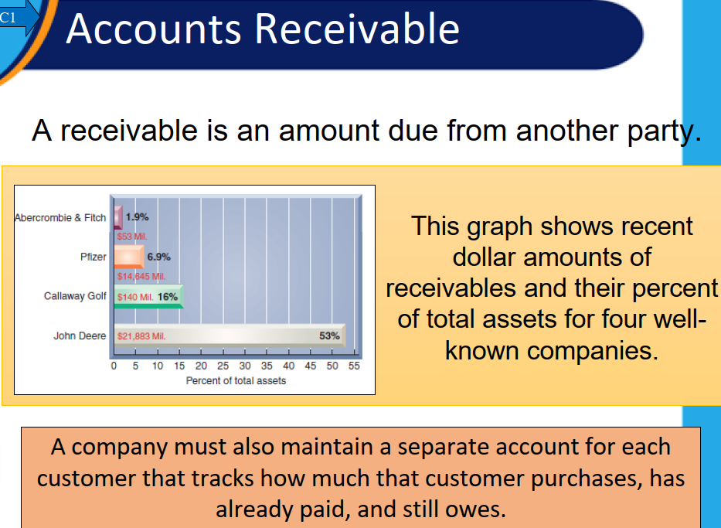
www.midocean.ae

Slide 4
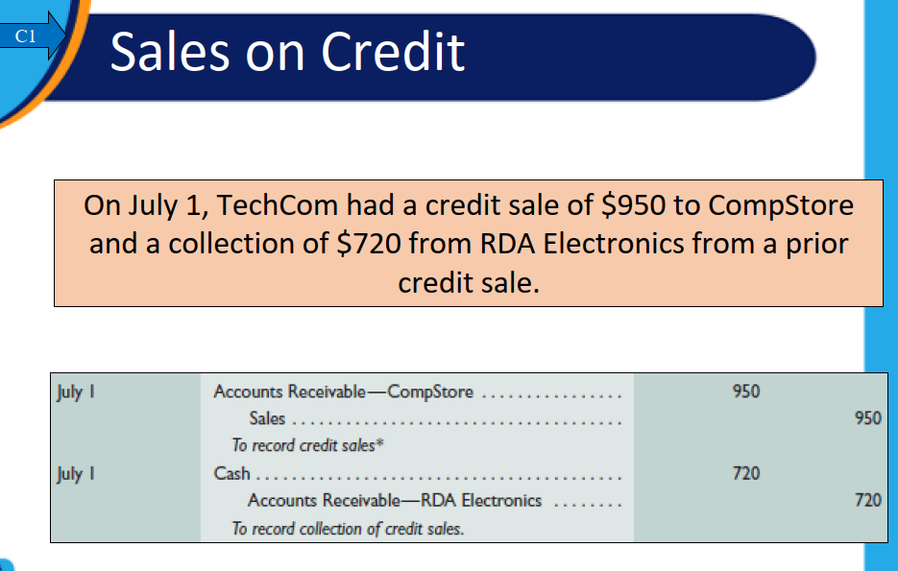
www.midocean.ae

Slide 5
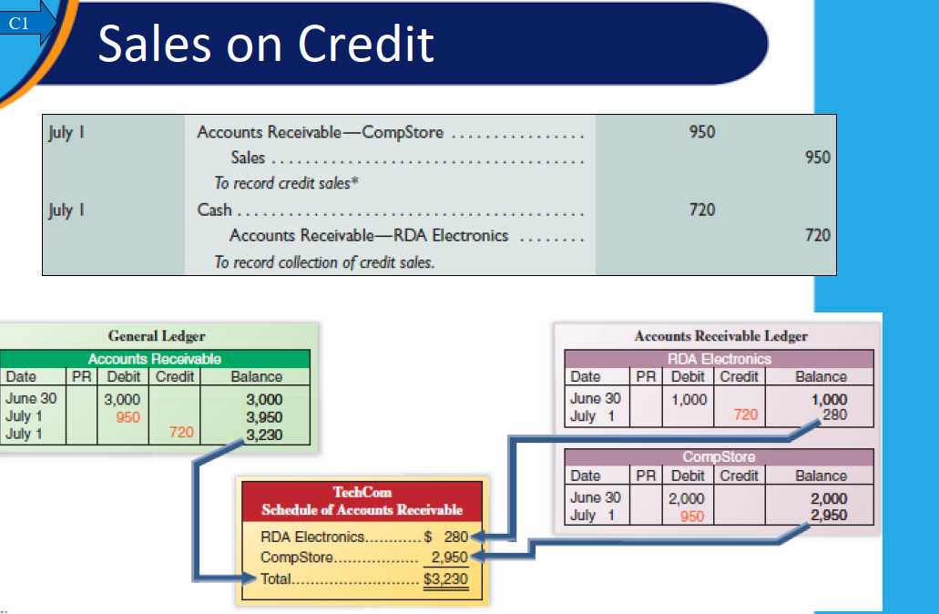
www.midocean.ae

Slide 6
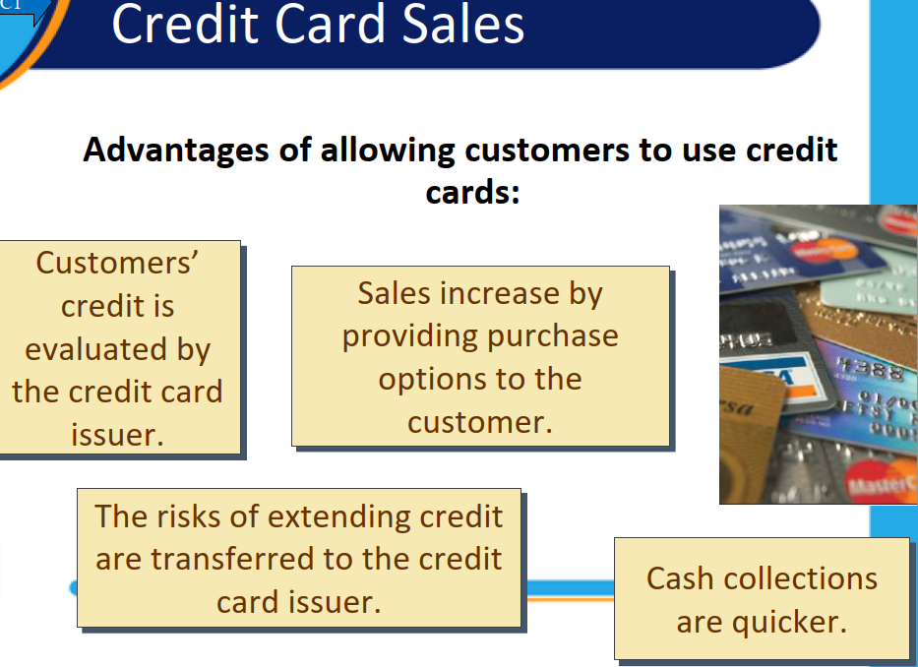
www.midocean.ae

Slide 7
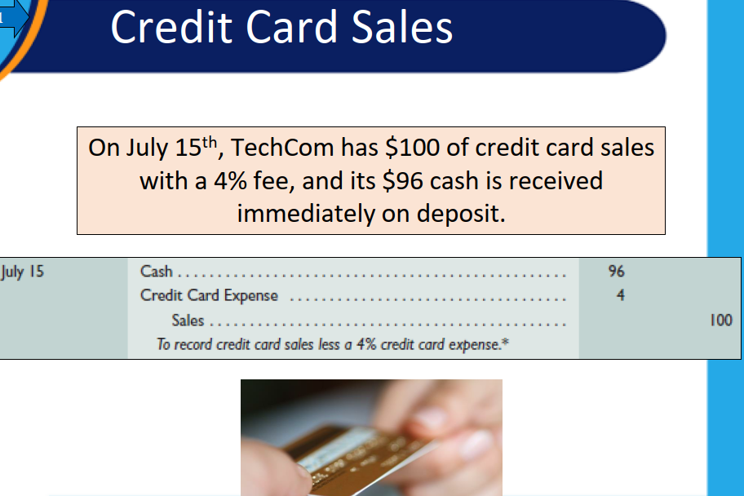
www.midocean.ae

Slide 8
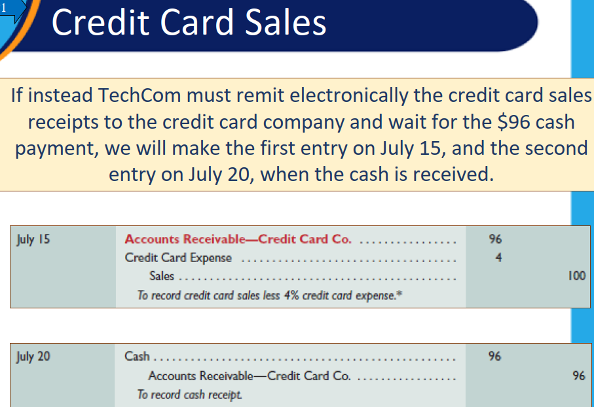
www.midocean.ae

Slide 9
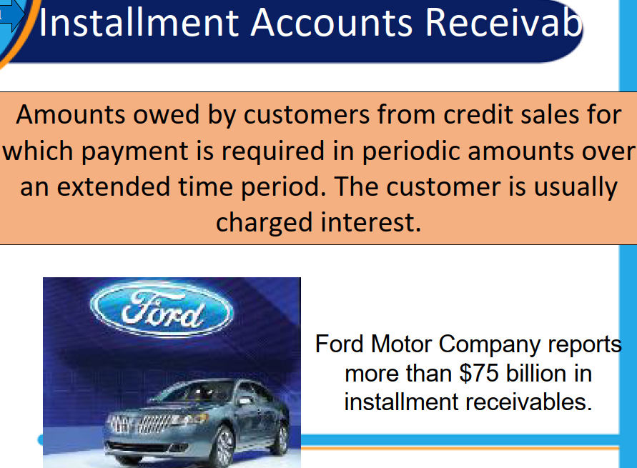
www.midocean.ae

Slide 10
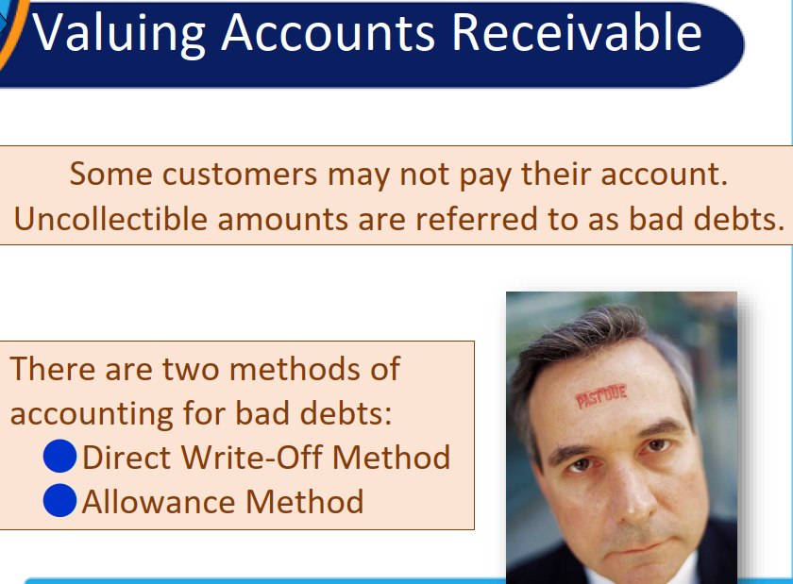
www.midocean.ae

Slide 11
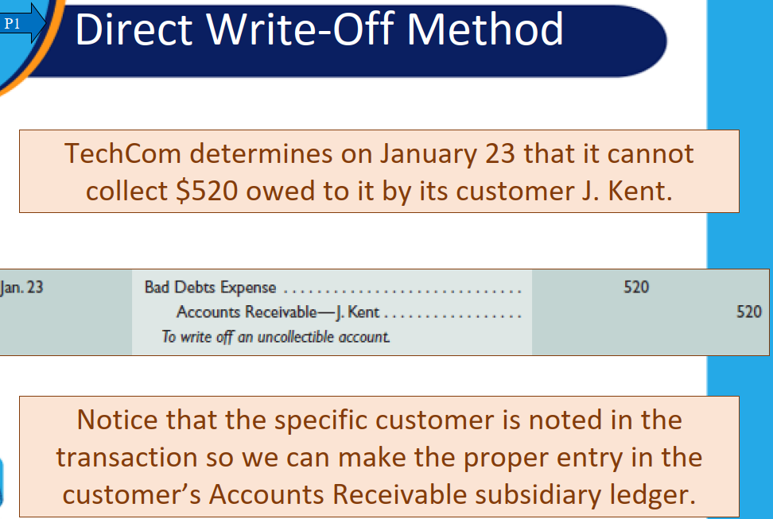
www.midocean.ae

Slide 12
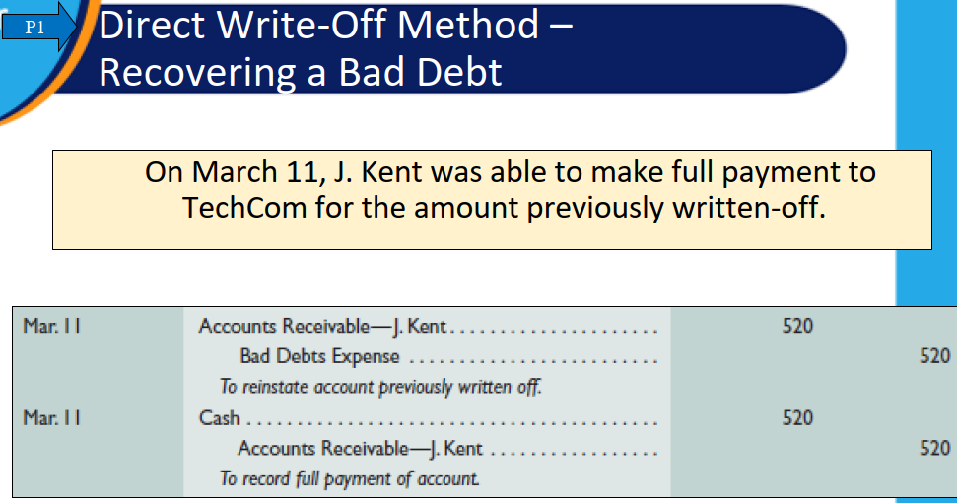
www.midocean.ae

Slide 13
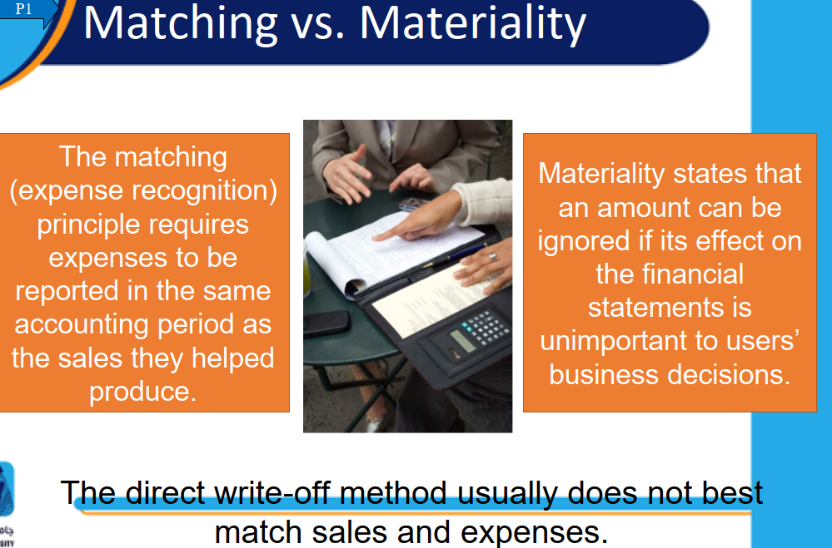
www.midocean.ae

Slide 14
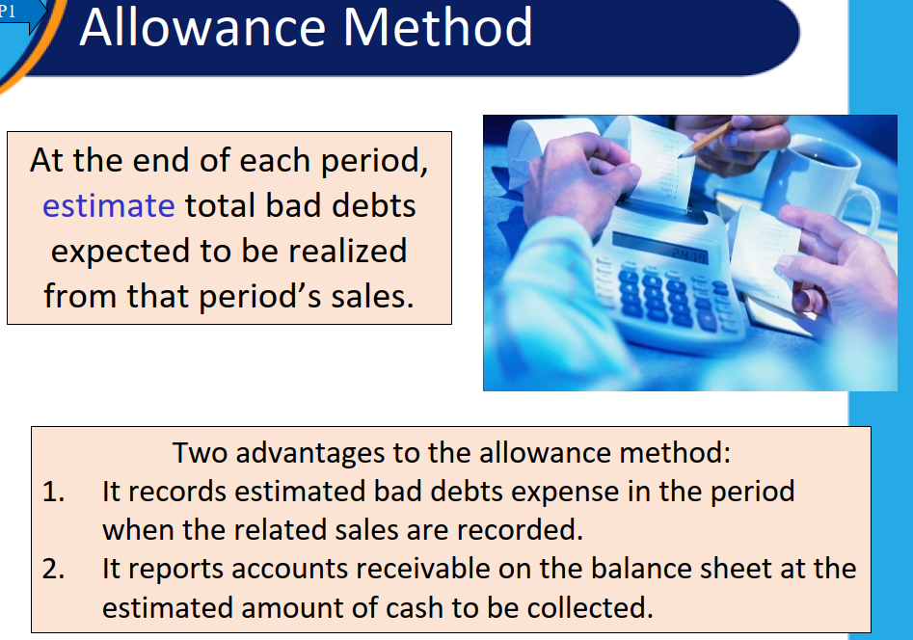
www.midocean.ae

Slide 15
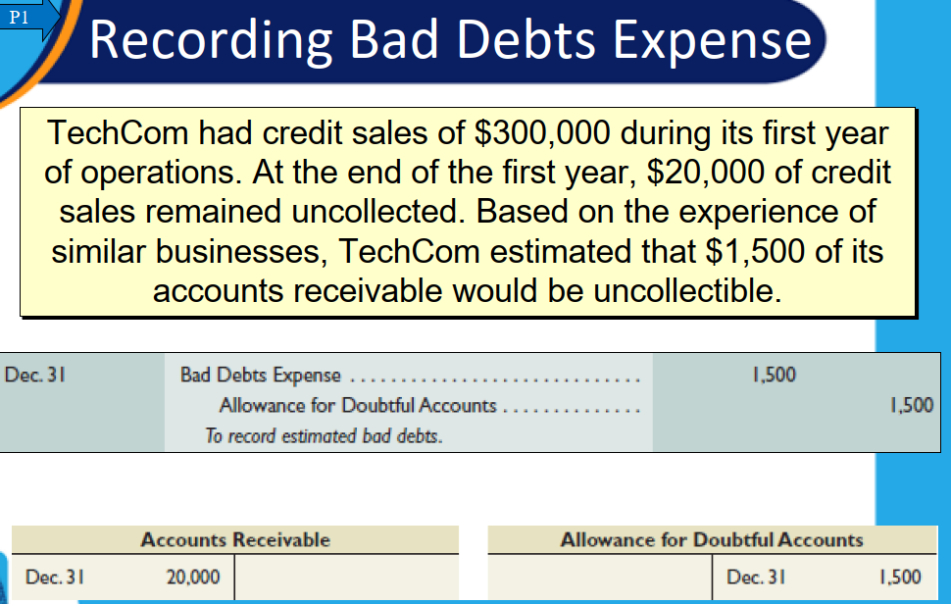
www.midocean.ae

Slide 16
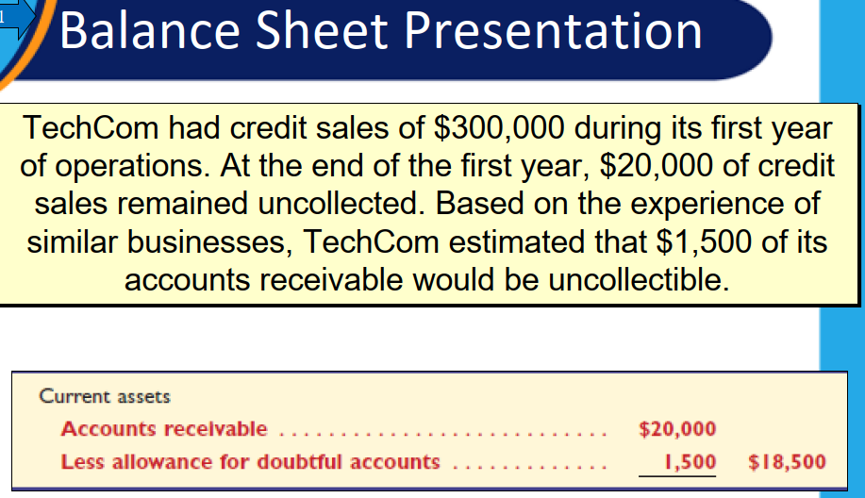
www.midocean.ae

Slide 17
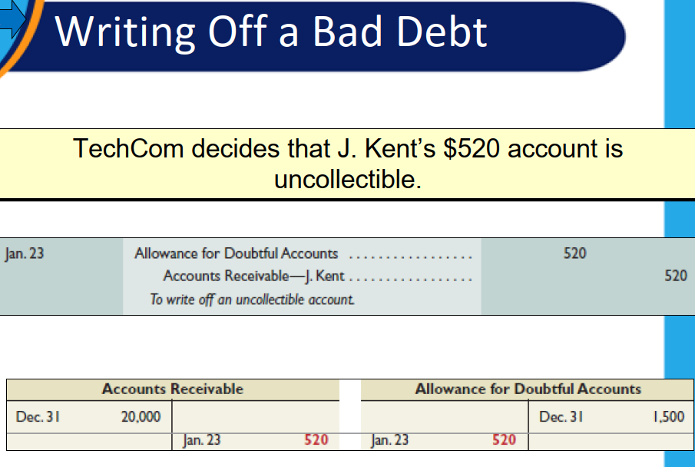
www.midocean.ae

Slide 18
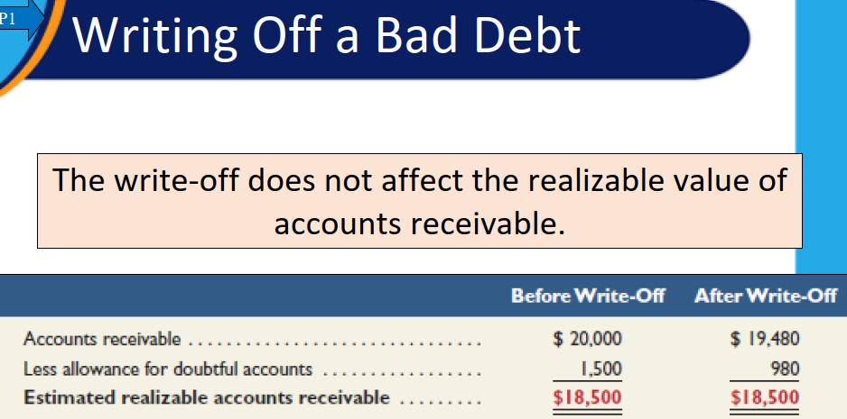
www.midocean.ae

Slide 19
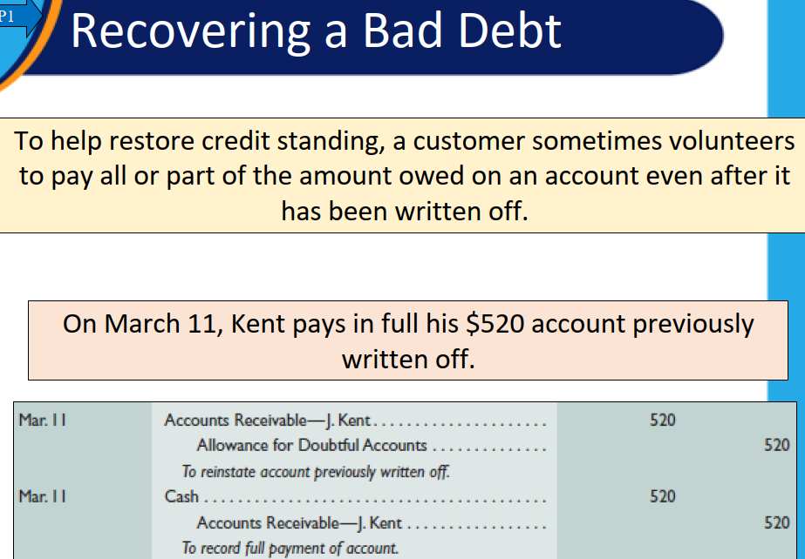
www.midocean.ae

Slide 20
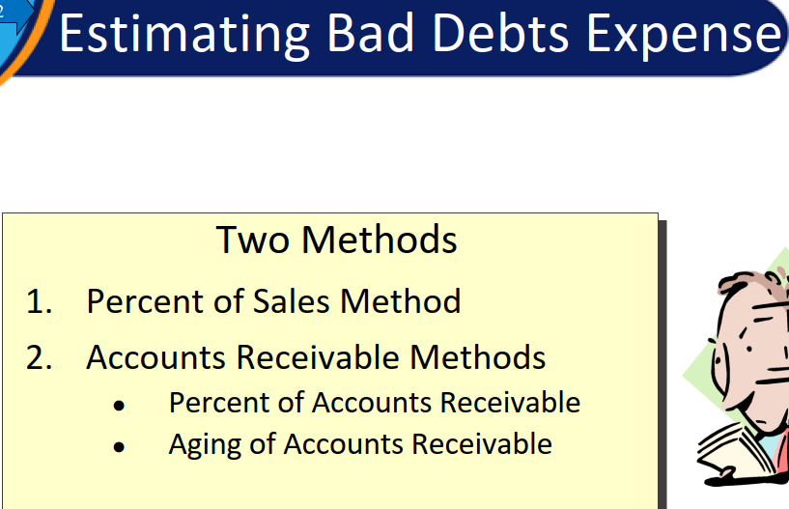
www.midocean.ae

Slide 21
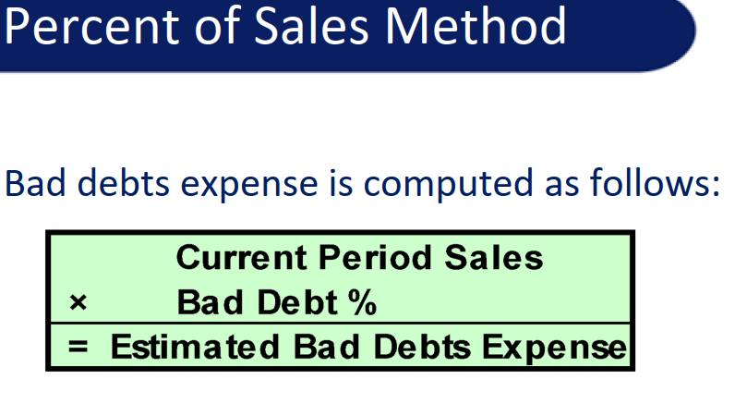
www.midocean.ae

Slide 22
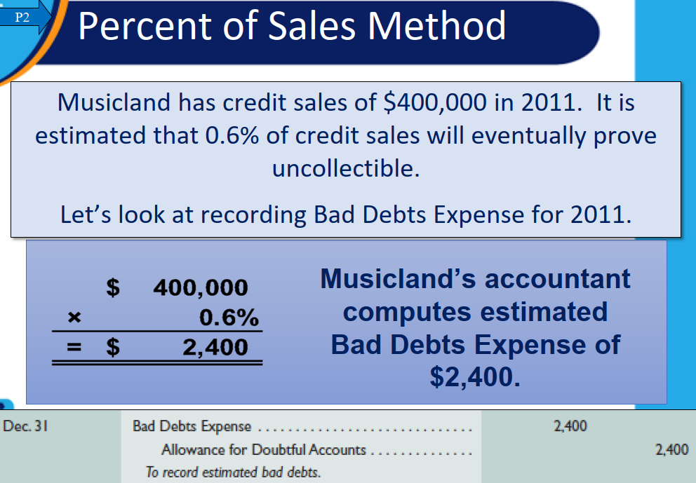
www.midocean.ae

Slide 23
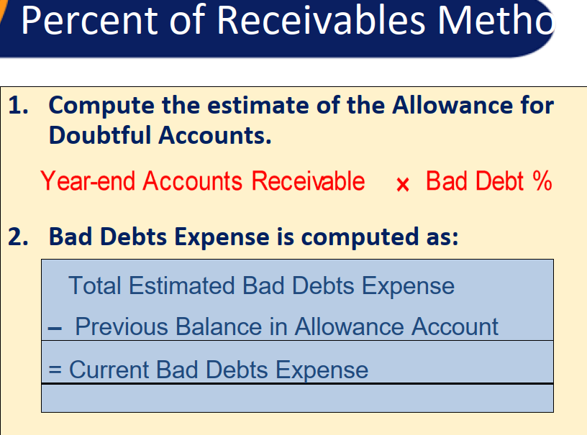
www.midocean.ae

Slide 24
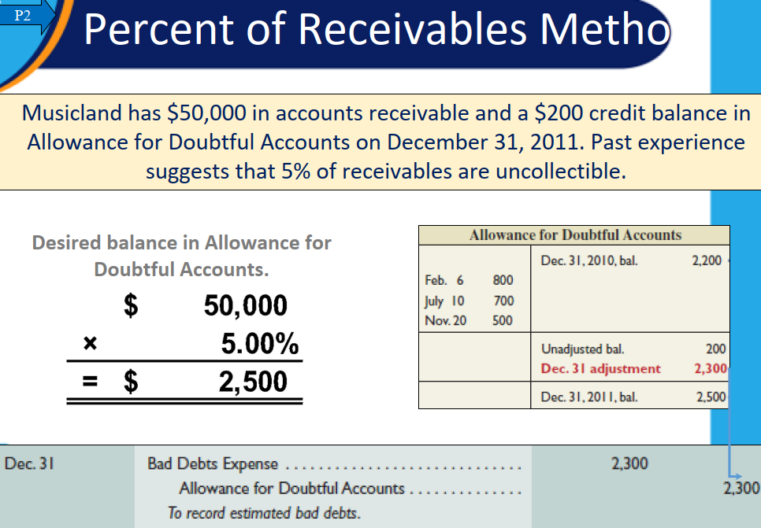
www.midocean.ae

Slide 25
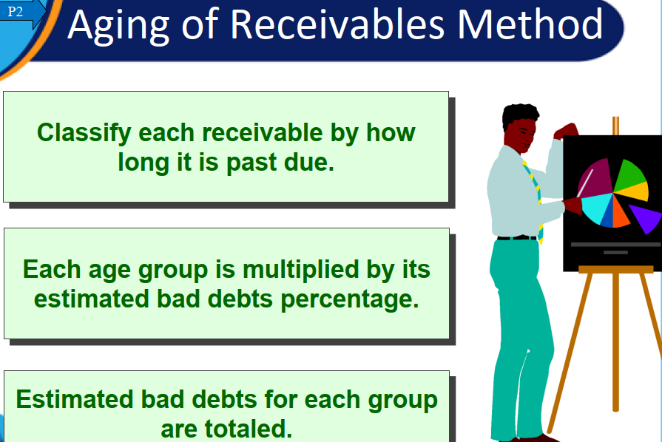
www.midocean.ae

Slide 26
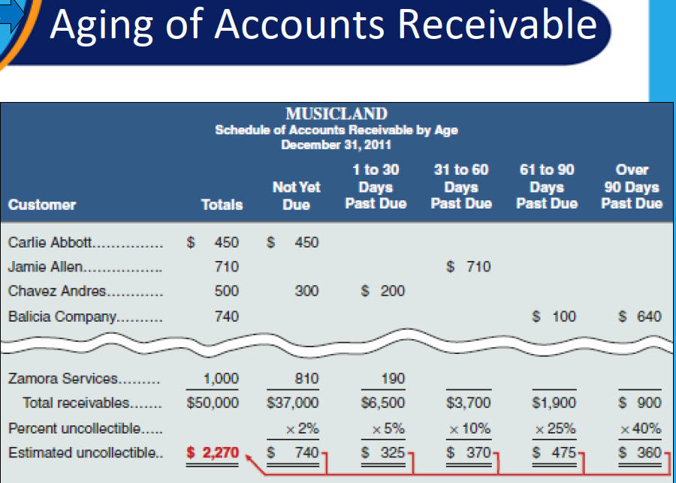
www.midocean.ae

Slide 27
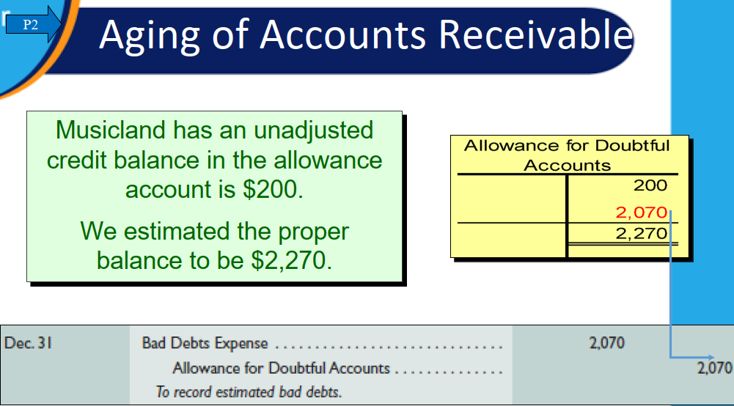
www.midocean.ae

Slide 28
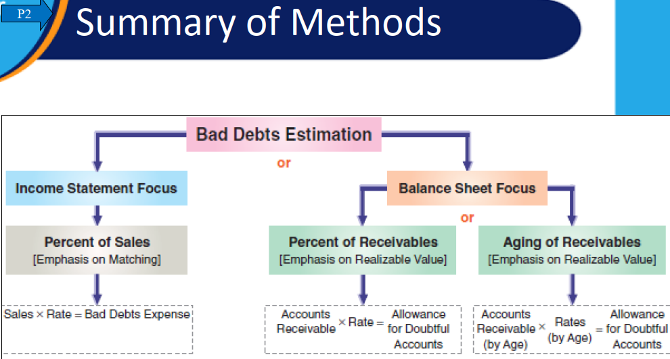
www.midocean.ae

Slide 29
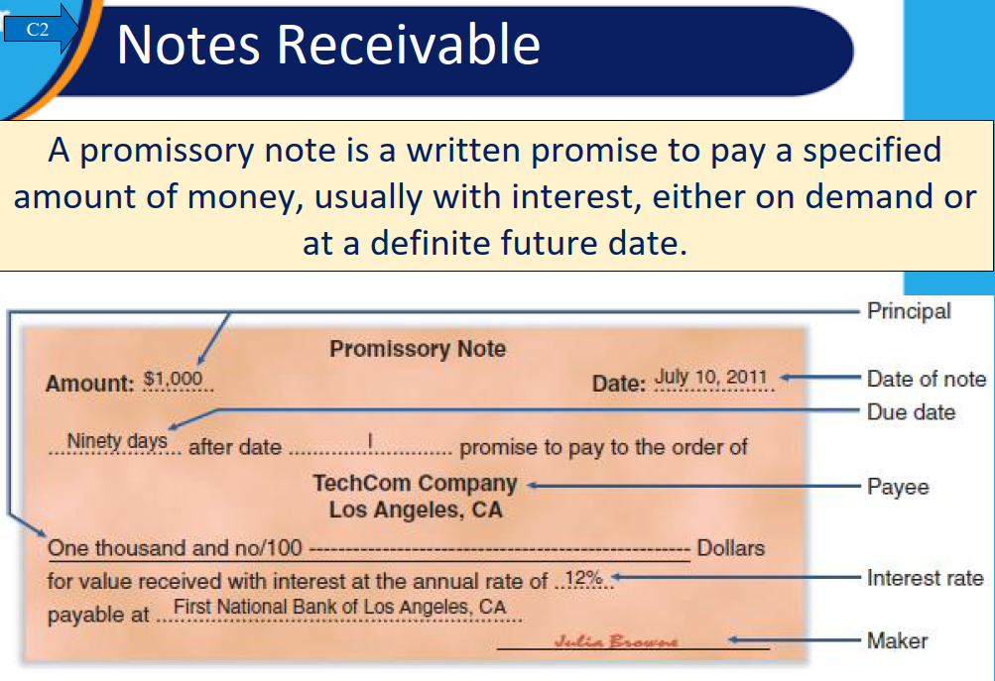
www.midocean.ae

Slide 30
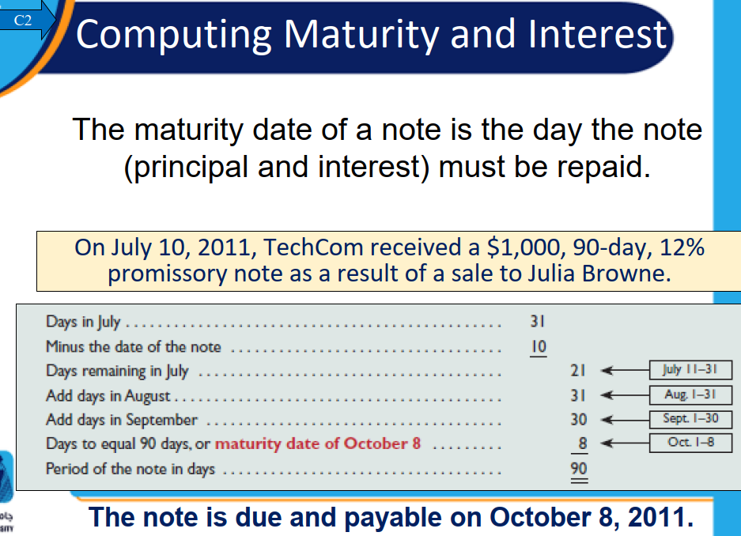
www.midocean.ae

Slide 31
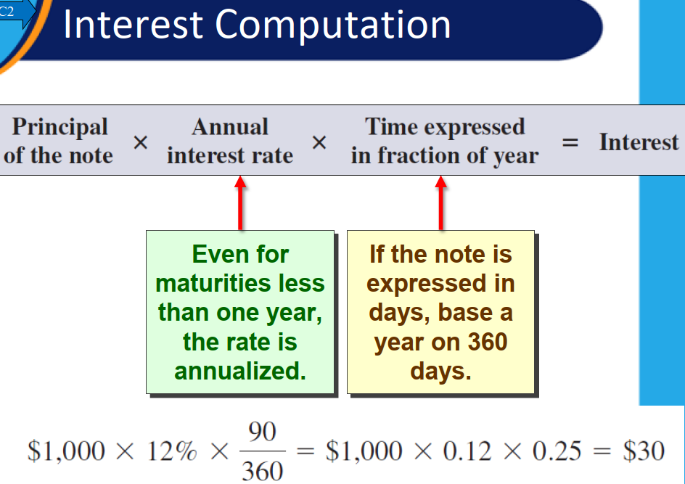
www.midocean.ae

Slide 32
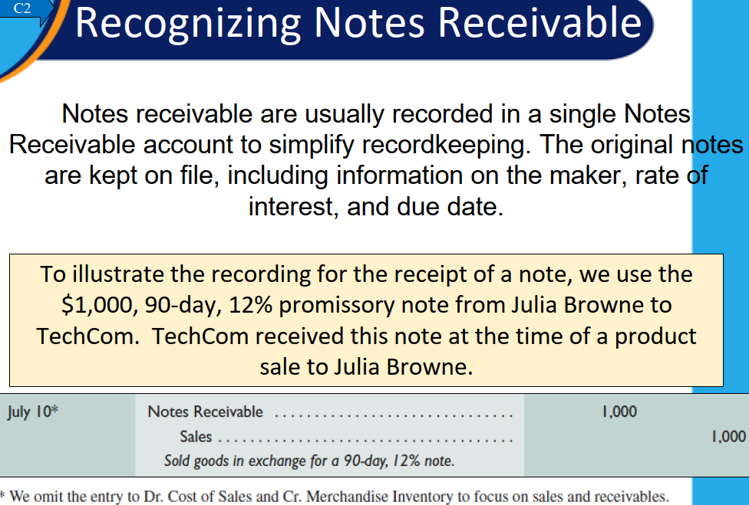
www.midocean.ae

Slide 33
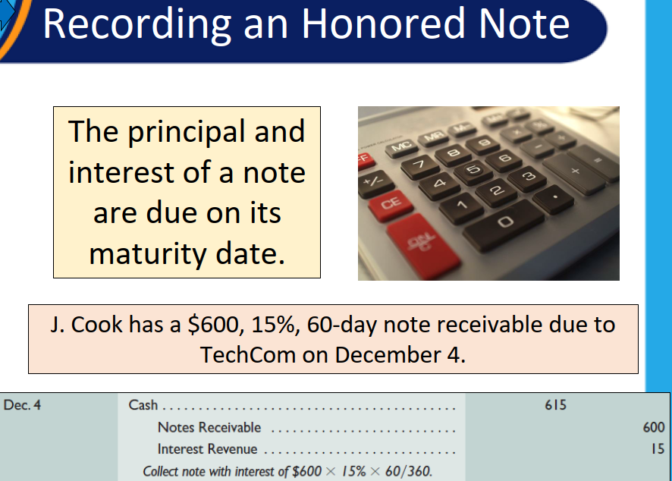
www.midocean.ae

Slide 34
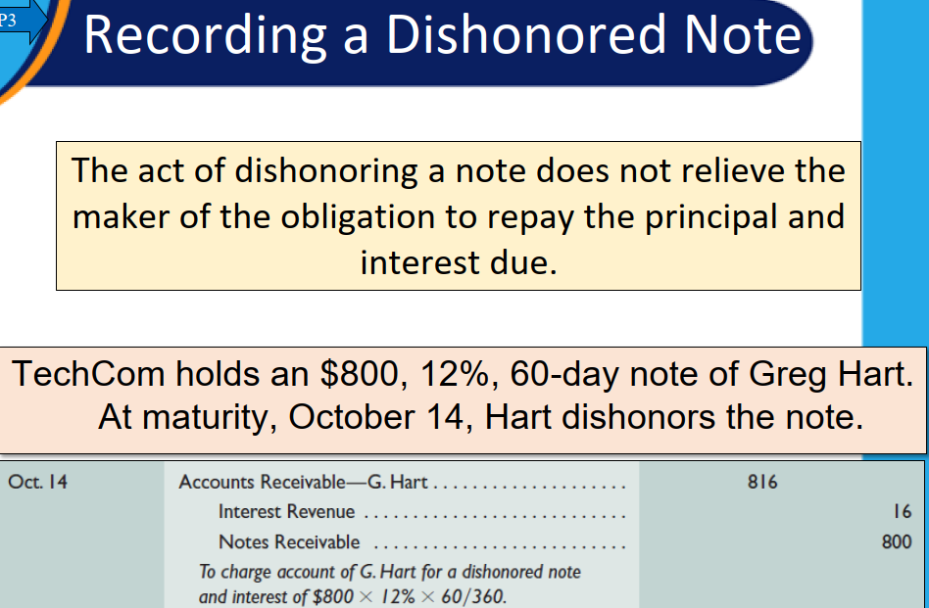
www.midocean.ae

Slide 35
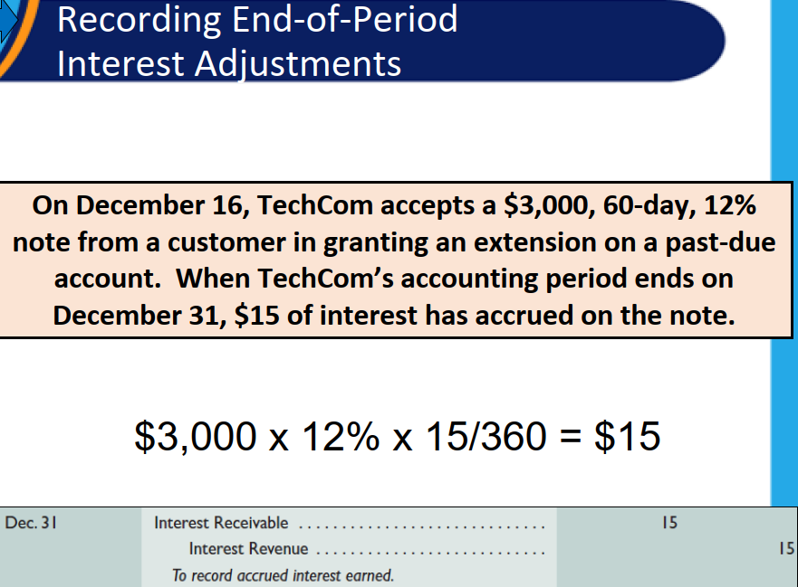
www.midocean.ae

Slide 36
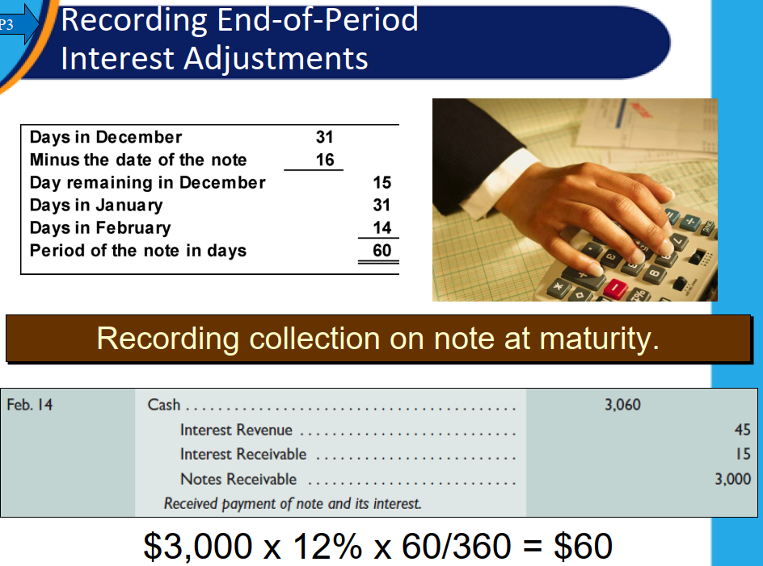
www.midocean.ae

Slide 37
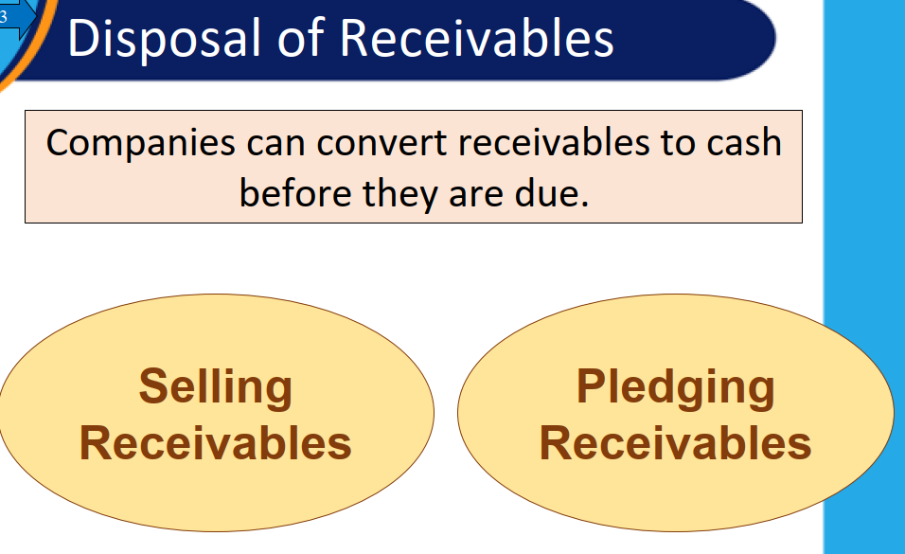
www.midocean.ae

Slide 38
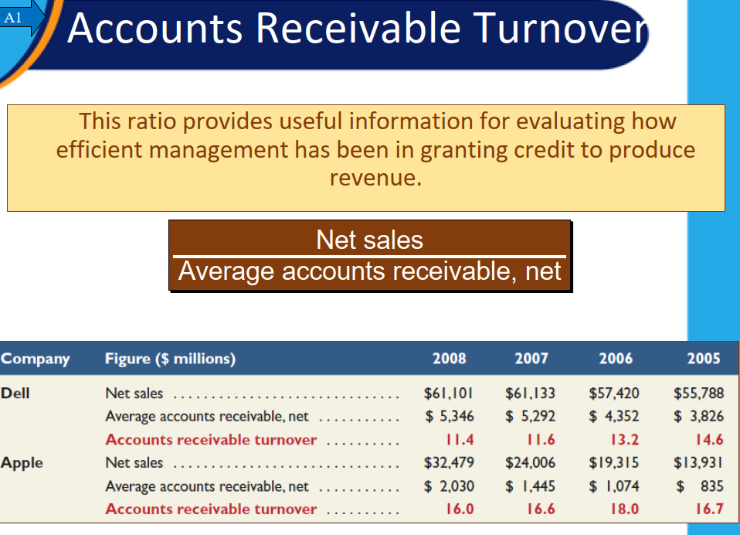
www.midocean.ae

Slide 39
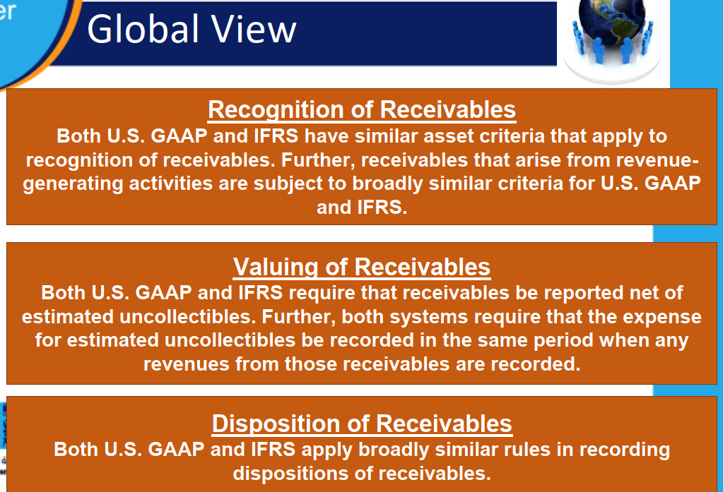
www.midocean.ae

Slide 40
Thank You
www.midocean.ae

