Slide 1



The Negotiation and Influencing Skills
Leadership & Teamwork Skills
Lec.5
ENT623
College of Entrepreneurship and Innovation
Prepared by
Dr. Bothaina Mahmoud Fouad

Slide 2

Understand the importance of leadership and teamwork during the negotiation process.
Case studies
Our Learning Outcomes

Slide 3


Leadership
Teamwork

Slide 4



Best Quotes about Leadership
"A leader is a dealer in hope."
Napoleon Bonaparte
"A spirited horse, which will try to win the race of his accord, will run even faster if encouraged."
Ovid, about 9 A.D.
is the ability to influence others, with or without authority.
Peter DeLisle

Slide 5

“Great leaders are the ones who let others shine”
Manfred Kets de Vries

Slide 6
All successful endeavors are the result of human effort; thus, the ability to influence others is a derivation of
Interpersonal Communications
Conflict Management
Problem solving

Slide 7
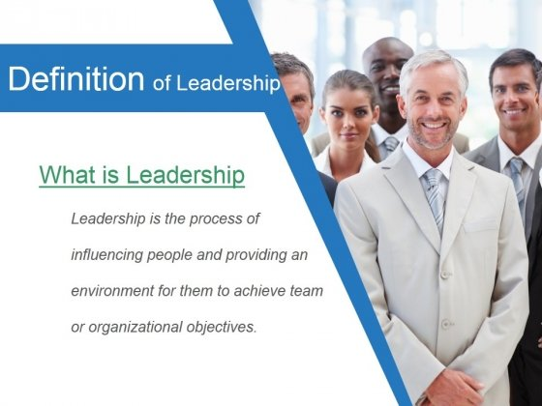
Leadership is the ability to develop a vision that motivates others to move with a passion toward a common goal
Leadership Definition

Slide 8

Leadership Vs. Management
Leadership
Management
is the process of influencing people and providing an environment for them to achieve team or organizational objectives
is the ability to organize resources and coordinate the execution of tasks necessary to reach a goal in a timely and cost-effective manner

Slide 9
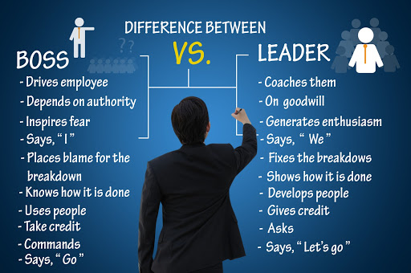
Leadership Vs. Management

Slide 10
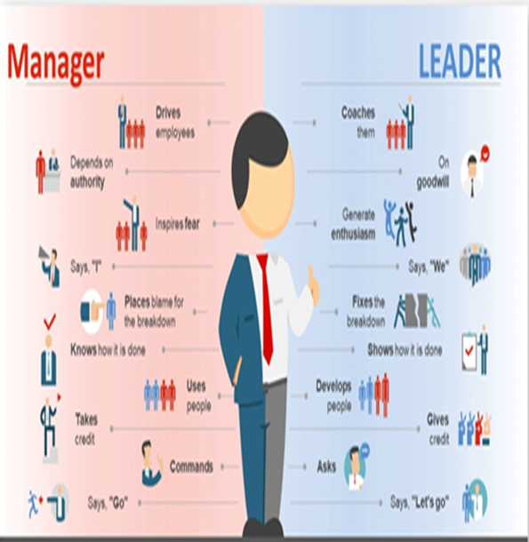
Leader is
a person who is followed by others.
Manager is
a person controlling or administering a business or a part of a business.
A person regarded in
terms of skill in household or financial or other management.
Leadership Vs. Management

Slide 11
Leaders Vs. Managers attributes
Manager | leader
Administrator | innovator
represents control and authority | ensures trust and results
asks questions in how and when | asks questions about what and why
create strategies | give solutions
look for subordinates | make followers
Do things right | Do the right thing

Slide 12
Leadership & Management Skills
Leadership - soft skills
Communications
Motivation
Stress Management
Team Building
Change Management
Management - hard skills
Scheduling
Staffing
Activity Analysis
Project Controls

Slide 13
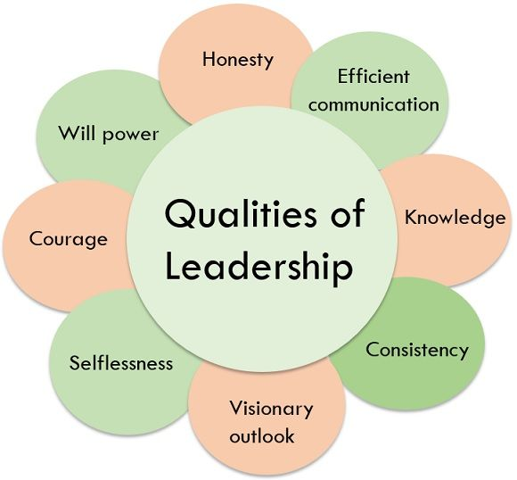
Qualities of Leadership

Slide 14
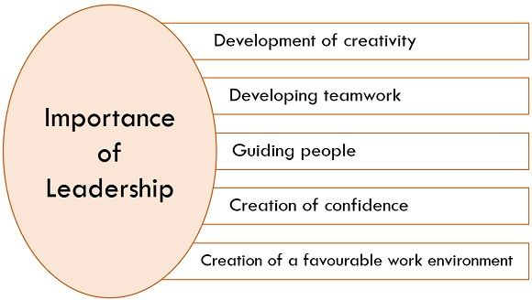
Importance of Leadership

Slide 15
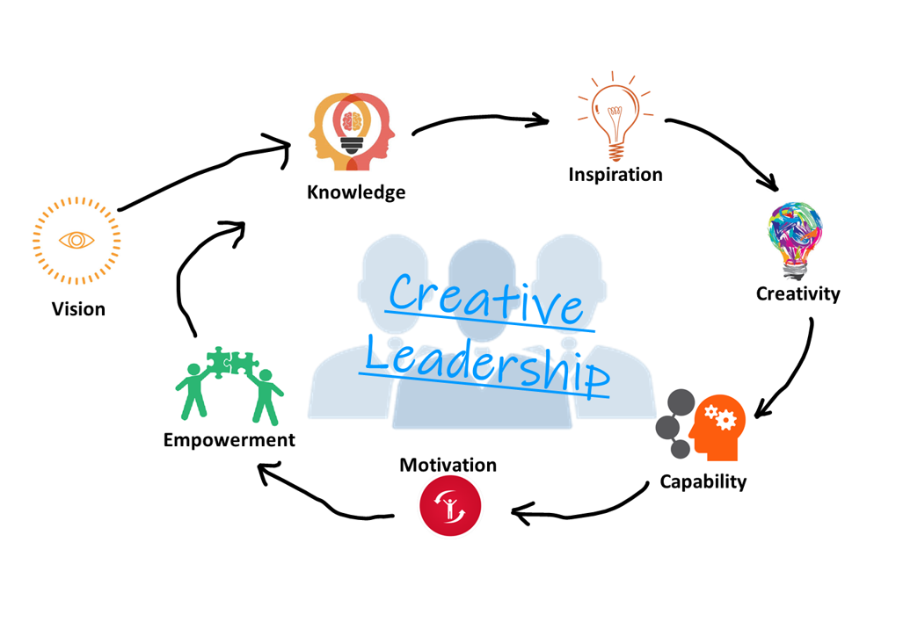
Creative leadership is
The combination of creativity ( the ability to generates ideas ) with leadership ( the ability to execute them through actions of others).
the ability to create and realize innovative solutions especially in the face of structurally complex or changing situations. It refers to those people who, when all is shifting and new approaches are yet unknown, can still create clarity of purpose for their teams.

Slide 16
Recipe for Being a Leader
Listen effectively
Encourage teamwork and participation
Empower team members
Communicate effectively
Emphasize long-term productivity
Make sound and timely decisions
Treat each person as an individual
Protect your team
Have vision, courage and commitment

Slide 17

What Makes an Effective Leader?
Effective leaders have:
the ability to communicate well,
motivate their team,
handle and delegate responsibilities,
listen to feedback,
have the flexibility to solve problems in an ever-changing workplace.

Slide 18
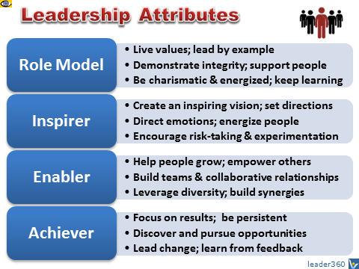
The Leader must be
LEADERSHIP attributes are the inner or personal qualities that constitute effective leadership. These attributes include a large array of Are-Know-Do characteristics such as vision, values, character, motives, habits, traits, competencies, style, behaviors, and SKILLS.

Slide 19
Leadership skills in negotiation situations
Leadership skills in negotiation are used to understand the interests of those you're leading and to find ways of satisfying those interests. In negotiation, effective leaders seek to understand the interests of those they lead and find ways of satisfying those interests in order to achieve organizational goals.

Slide 20
Leadership skills in negotiation situations
leadership skills are critical in negotiation situations, as they can help a leader to build trust, navigate complex interpersonal dynamics, and achieve their goals while preserving the relationship with the other party.

Slide 21
Leadership skills in negotiation situations
Effective negotiation requires strong leadership skills. Some key leadership skills that are particularly important in negotiation situations include:
Communication
Strong communication skills are essential in negotiation, as they allow a leader to clearly convey their message and listen to the other party's perspective. Effective communication involves active listening, asking clarifying questions, and using language that is clear and concise.
Creativity
Negotiation often requires creative problem-solving, as parties may have different goals and priorities. A leader who is able to think outside of the box and generate novel solutions can often find a mutually beneficial outcome for both parties.

Slide 22
Leadership skills in negotiation situations
Emotional Intelligence
Is the ability to understand and manage one's own emotions, as well as read and respond to the emotions of others. In negotiation, emotional intelligence can help a leader navigate complex interpersonal dynamics, build rapport with the other party, and defuse tense situations.
Strategic Thinking
A leader who is able to think strategically can anticipate the other party's moves, identify potential roadblocks, and develop a long-term plan for achieving their goals. This involves considering the broader context of the negotiation, such as market conditions, political factors, and cultural differences.
Confidence
A leader who exudes confidence can inspire trust and respect from the other party, which can be essential in negotiation. Confidence allows a leader to assert their position without being aggressive or confrontational, and can help to build a sense of momentum in the negotiation.

Slide 23
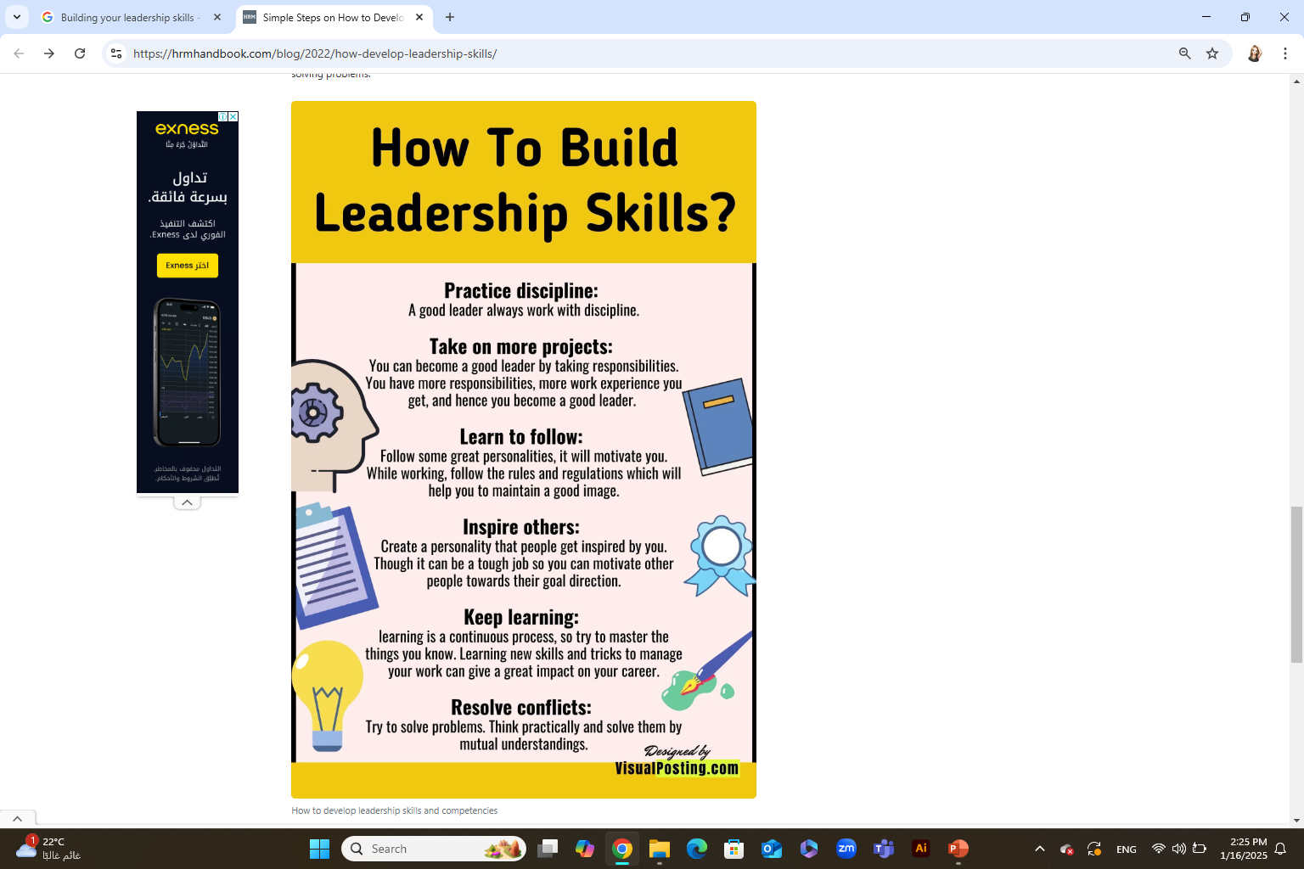
Building your leadership skills need
Take initiative
Look beyond the tasks in your job description.
Request more responsibility
Target specific skills
If you have a specific skill that you want to develop, create a plan to improve your abilities in this area.
you can share with your manager that you're eager to grow your leadership abilities
Think long-term about what would be beneficial for your department and the company.
Try to brainstorm ideas and commit to doing work that goes beyond the daily routine.
This could mean taking a class, finding a mentor to help, reading books, or setting a small goal that forces you to develop this skill.

Slide 24
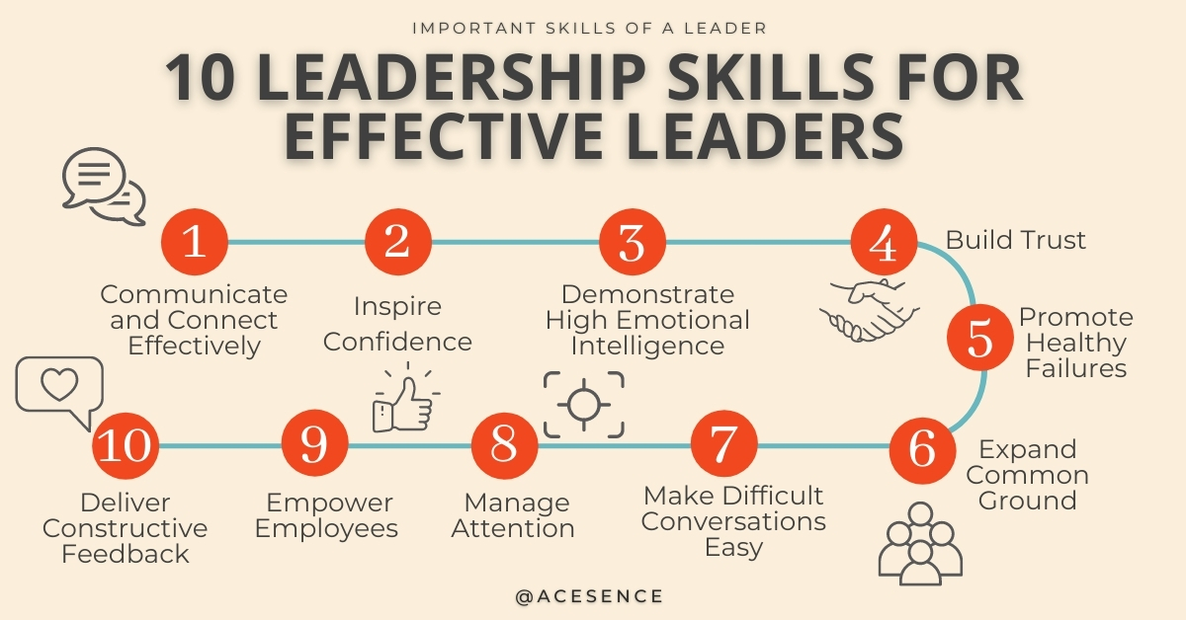
How to Develop your Leadership Skills
According to the World Economic Forum, leadership skills are some of the most in-demand soft skills in today’s complex workplaces.
Strong leadership skills are not good-to-have – they are an absolute necessity. As workplaces continue to be disrupted, the need for effective leaders increases.

Slide 25
Top Skills for Effective Leaders
1. Connect and Communicate Effectively
John Maxwell said a good leader communicates; a great leader connects. An effective leader often has a knack for working with people.
Ultimately, communicating effectively with diverse team members and senior leaders is not easy. However, once leaders master this, the impact on their executive presence and influence is astounding.
2. Inspire Confidence
In a leadership role, a successful leader helps employees and team members sail through crises. One of the most important leadership skills great leaders need to develop is the ability to inspire confidence.
To do so, followers need to first trust the leader. That often means followers believe the leader is guided by values. For example, when the team faces challenges or takes risks, they feel confident and safe because the leader role models a learning focus instead of blaming others.
https://blog.acesence.com/10-important-leadership-skills-for-effective-leaders/

Slide 26
Top Skills for Effective Leaders
3. Demonstrate Emotional Intelligence
Emotional intelligence is the ability to understand your emotions and the emotions of others. It is also the ability to manage those emotions within yourself and others.
4. Build Trust to Empower Members
A study by Marcus Buckingham has recently found that leaders need to build more trust in the workplace. In his study, he found that employees do not fear change. On the contrary, what makes change management difficult for them is being kept in the dark.
5. Promote Healthy Failures for Disruptive Innovation
Successful companies are innovative. At the same time, the world’s largest companies are facing the threat of an increasing rate of constructive destruction. This means, that only the businesses that can learn fast, fail fast, and innovate will survive the constant waves of disruption. How you respond then, as a leader, in the face of ‘failures’ makes or breaks the innovative culture.
https://blog.acesence.com/10-important-leadership-skills-for-effective-leaders/

Slide 27
Top Skills for Effective Leaders
6. Expand Common Ground and Facilitate Conversations
A good leader understands the need to bring workplaces suitable for a diverse workforce.
In today’s business landscape, fostering common ground among stakeholders and leveraging their strengths and weaknesses are necessary for business leaders.
7. Make Difficult Conversations Easy
Managing conflicts in the office and difficult conversations is vital for leaders. That is why many leadership training programs include conflict management.
Leaders may be reluctant to confront deep-seated biases that are part of their organizational culture, but working on yourself first increases your courage to resolve such issues in the workplace.
8. Manage Attention (not Time)
Prioritizing and focusing your attention on what’s most important to your strategy will give you a long-term strategic advantage. When I’m coaching clients, I always see positive change when they manage their attention better.
https://blog.acesence.com/10-important-leadership-skills-for-effective-leaders/

Slide 28
Top Skills for Effective Leaders
9. Empower Employees to Aim for Success
Delegation and empowerment might look like the same skill, but they are not identical.
Delegating and empowering are both important when in a business environment, but have different functions. When delegating tasks, it’s obligatory to assign people what they need to do. When you empower someone, they become more motivated and creative
10. Deliver Constructive Feedback
Constructive feedback should be specific and timely. It is important to acknowledge the good work that was done. When you are specific, you show that you are paying attention.
constructive feedback works best for employees when you give them in a timely manner. That means, do not wait till the annual performance review to do that because that tends to feel more judgmental instead of being developmental.
https://blog.acesence.com/10-important-leadership-skills-for-effective-leaders/

Slide 29
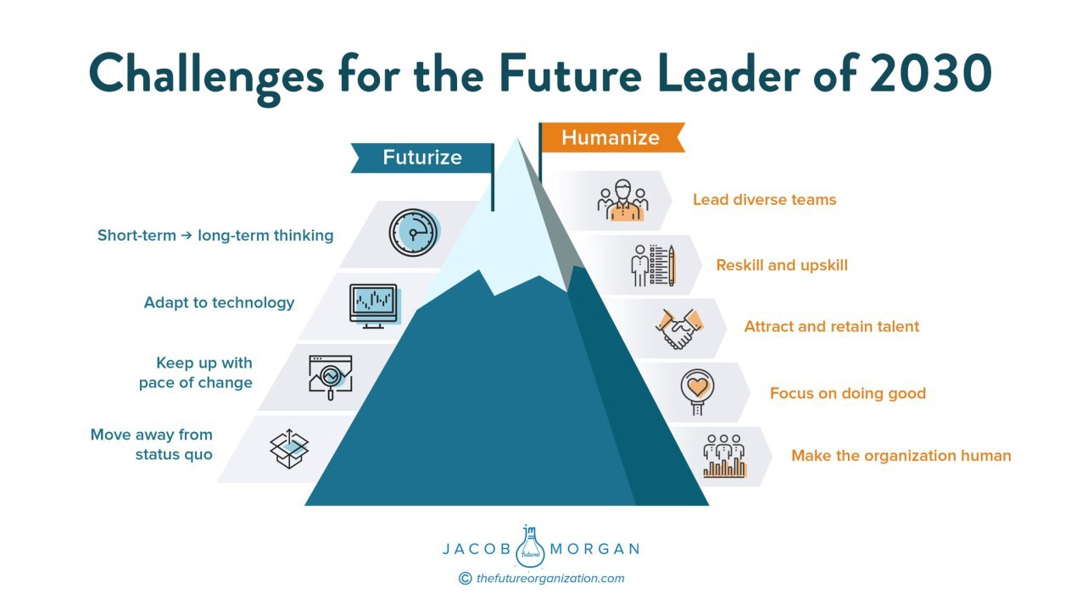

Slide 30
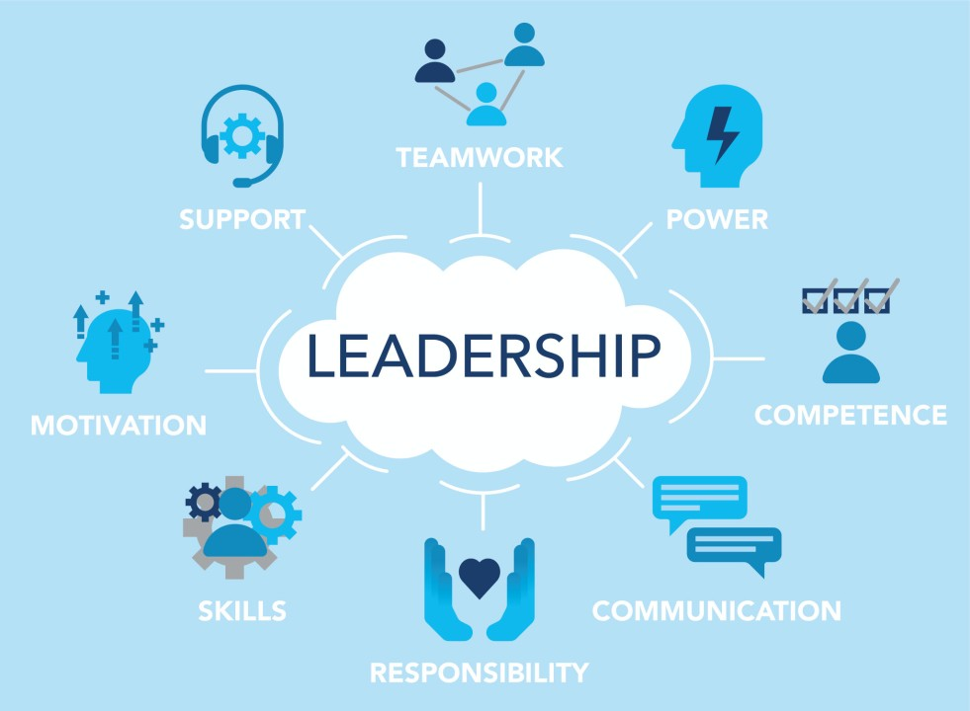
Top common leadership challenges

Slide 31

01
Amazon's Negotiation with Publishers

Slide 32
Amazon, the world's largest online retailer, has been involved in a number of high-profile negotiations with publishers over the years. These negotiations have centered around a range of issues, including pricing, distribution, and control over content. Amazon's leadership team, led by CEO Jeff Bezos, has been praised for its negotiation skills in these situations.
One notable negotiation occurred in 2014, when Amazon was in a dispute with Hachette, one of the world's largest publishers. Amazon was seeking lower prices for e-books, while Hachette was concerned about maintaining its profits and control over its content.

Slide 33
Amazon's negotiation team employed a number of key strategies to achieve a favorable outcome, including:
Building leverage: Amazon built leverage by using its dominant market position to put pressure on Hachette. Amazon stopped taking pre-orders for Hachette's books, reduced discounts, and delayed shipments, which hurt Hachette's sales and put the company under financial pressure.
Communicating clearly: Amazon's leadership team communicated their position clearly and publicly, using social media and other channels to explain their perspective to customers, authors, and the media. This helped to build support for Amazon's position and put pressure on Hachette to come to the negotiating table.
3. Being creative: Amazon's negotiation team was creative in finding solutions that would benefit both parties. They proposed a revenue-sharing model that would allow Hachette to maintain its profits while also reducing prices for customers. This proposal eventually formed the basis of a new agreement between Amazon and Hachette.
4. Being willing to walk away: Amazon's leadership team was willing to walk away from the negotiation if they couldn't achieve their desired outcome. This demonstrated to Hachette that Amazon was serious about its position and willing to take action to achieve its goals.

Slide 34
Ultimately, Amazon's negotiation with Hachette was successful, and the two companies reached a new agreement that satisfied both parties. Amazon's leadership in negotiation has helped the company to achieve its goals while maintaining positive relationships with its partners and customers.

Slide 35
2. Team Work

Slide 36
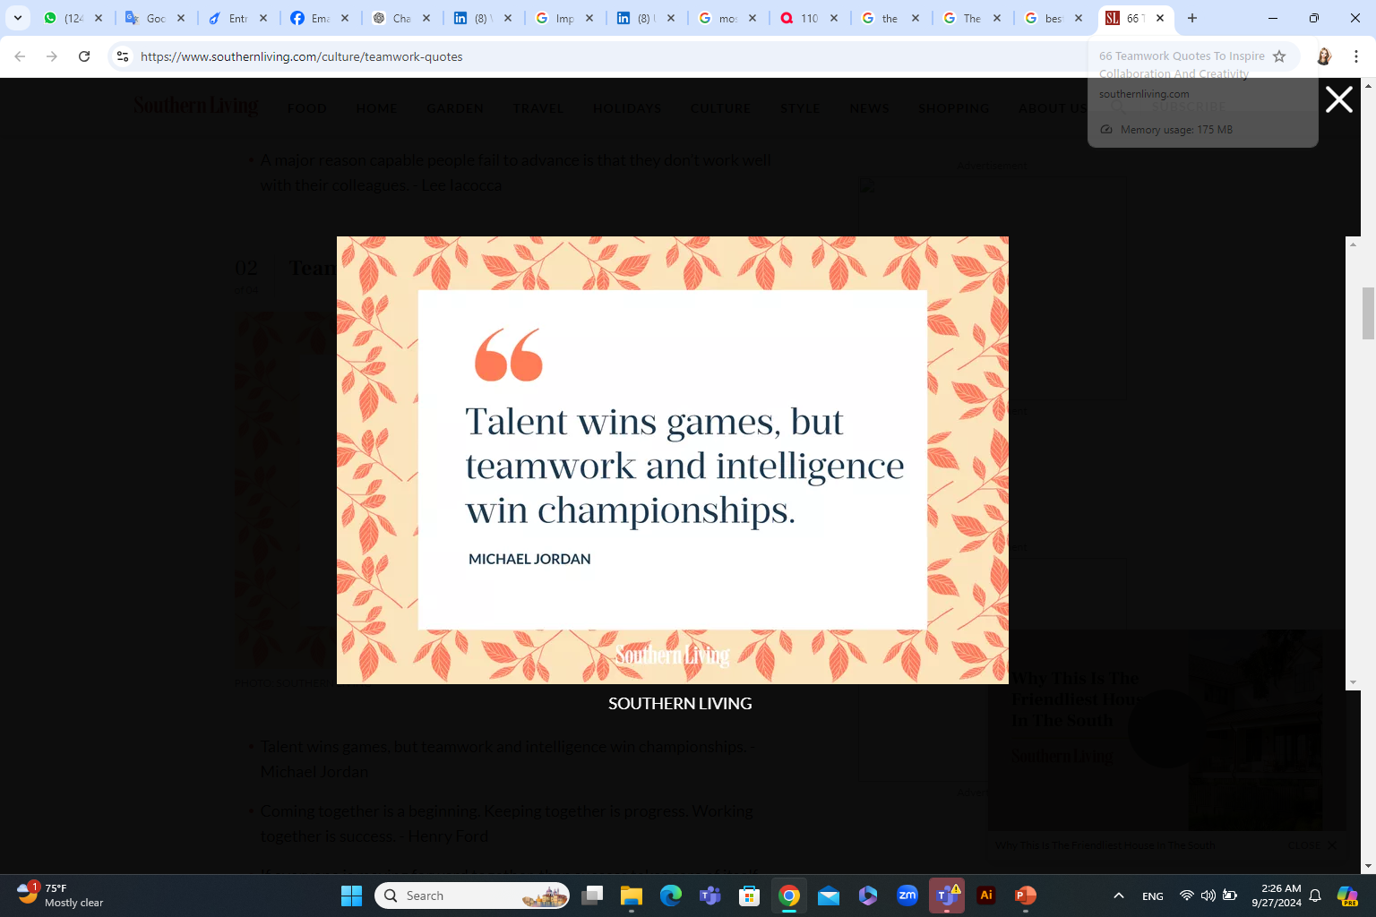
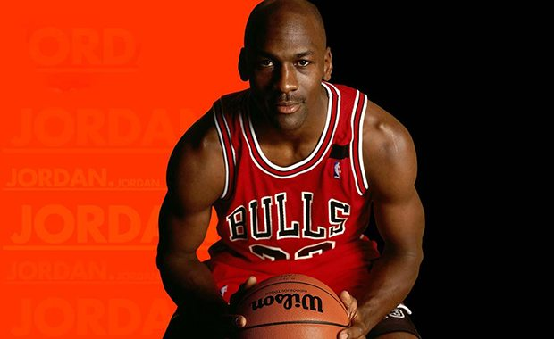
الموهبة قد تكسبك مباراة لكن العمل الجماعى قد يكسبك البطولة

Slide 37
What is the meaning of TEAM??
Total
Effort from
All
Members
TOGETHER EVERYONE ACHIEVES MORE

Slide 38
What is a team?
A team is a group of people with a commitment to one another, to the team, to a high level of achievement, to a common goal, and to a common vision.

Slide 39
Why Use Teams?
Benefits to the business, organization or system
Benefits to the team member
Enhanced creative thinking needed for innovation
Promote employee involvement and buy-in (commitment) to the company’s success
A team generates results that are greater than those that could be produced by its individual members
Improved professional and personal skills
Better understanding of the whole company/system and how it works
Preparation for upward professional growth (promotion

Slide 40
The advantages of teams
A team broadens what individuals can do.
Several heads mean a wider range of ideas.
Teams have a great array of talents and skills.
Team members learn new skills from their colleagues.
Teamwork is more efficient than a number of individuals working singly.
Teamwork provides relief when someone's having a problem.
Team workers are more effective.
A team member has more ownership of what she's doing.
Good teams can build leaders.
A shared vision keeps everyone moving forward.

Slide 41
The Disadvantages of teams
Team decision-making takes longer
Team effort can be wasted effort.
The team's success may hang on the work of the least effective team member.
A team might gain momentum in the wrong direction.
Team members may be reluctant to tell other about their unsatisfactory work.
Lost motivation for lack of individual recognition

Slide 42
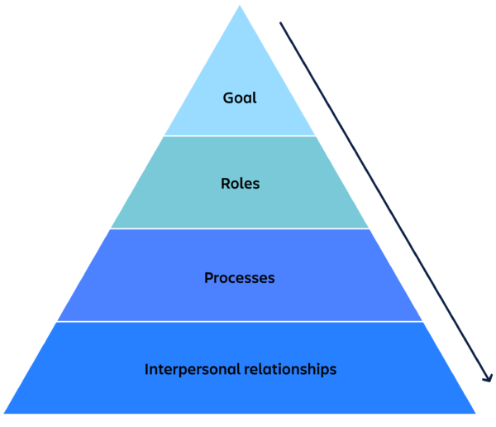
When should you build teams?
Goals: teams need a solid and shared understanding of what they’re working toward together.
Roles: teams need to know who’s doing what, without ambiguity or a lot of overlap between responsibilities.
Processes: teams need to understand how decisions are made and how work gets accomplished.
Interpersonal relationships: teams need to understand and respect each other’s communication styles and work approaches
https://www.atlassian.com/blog/teamwork/what-strong-teamwork-looks-like#:~:text=The%20forming%2Dstorming%2Dnorming%2D,forming%20a%20brand%20new%20team.

Slide 43
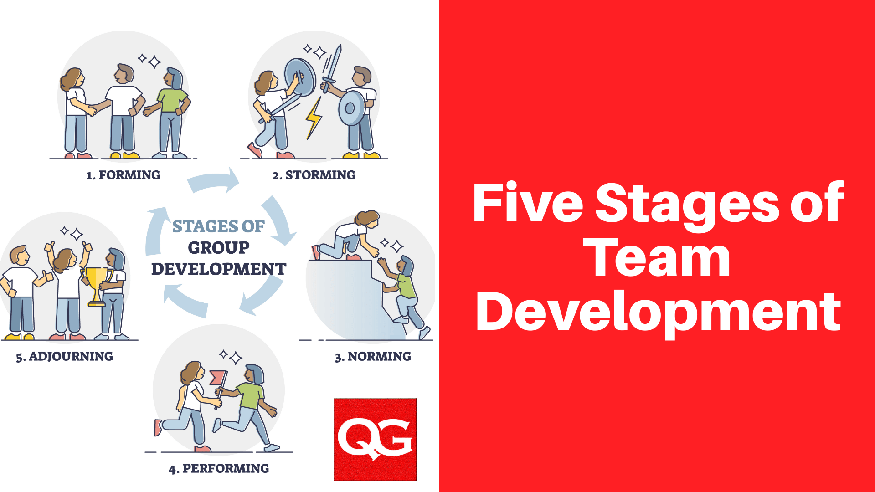
Stages of Team Development and building
Forming
Storming
Norming
Performing
Transforming/Adjourning

Slide 44

Forming
Team members meet and introduce themselves.
A facilitator or leader is assigned or selected.
The team may set ground rules for the process
Discussions about the project scope, goals, and timeframe begin.
The Forming stage includes polite but not deep conversation.

Slide 45

Storming
Members may compete for leadership of the group.
Conflicting ideas are expressed.
Some members speak little; others dominate the discussion.
Members argue about how to accomplish project goals and how to measure success.
  The Storming stage is uncomfortable, but entirely normal.

Slide 46

Norming
Members reconcile differences.
Members now feel part of a productive group.
The team reaches agreement on goals and how to achieve them.
Information is freely shared.
  During the Norming stage, teams begin to make significant progress.

Slide 47

Performing
Members understand their roles and trust one another to complete tasks.
Obstacles are easily overcome.
Productivity is high; each member contributes his/her skills and knowledge.
  In the Performing stage, decision-making becomes easier because the group is truly functioning as a team.

Slide 48
Transforming/ Adjourning
التحويل/التأجيل
After goals are met, results evaluated and accomplishments acknowledged:
The team may be dismissed
The team may be assigned a new project, or
Some members may leave the team and new members join for a new project.

Slide 49
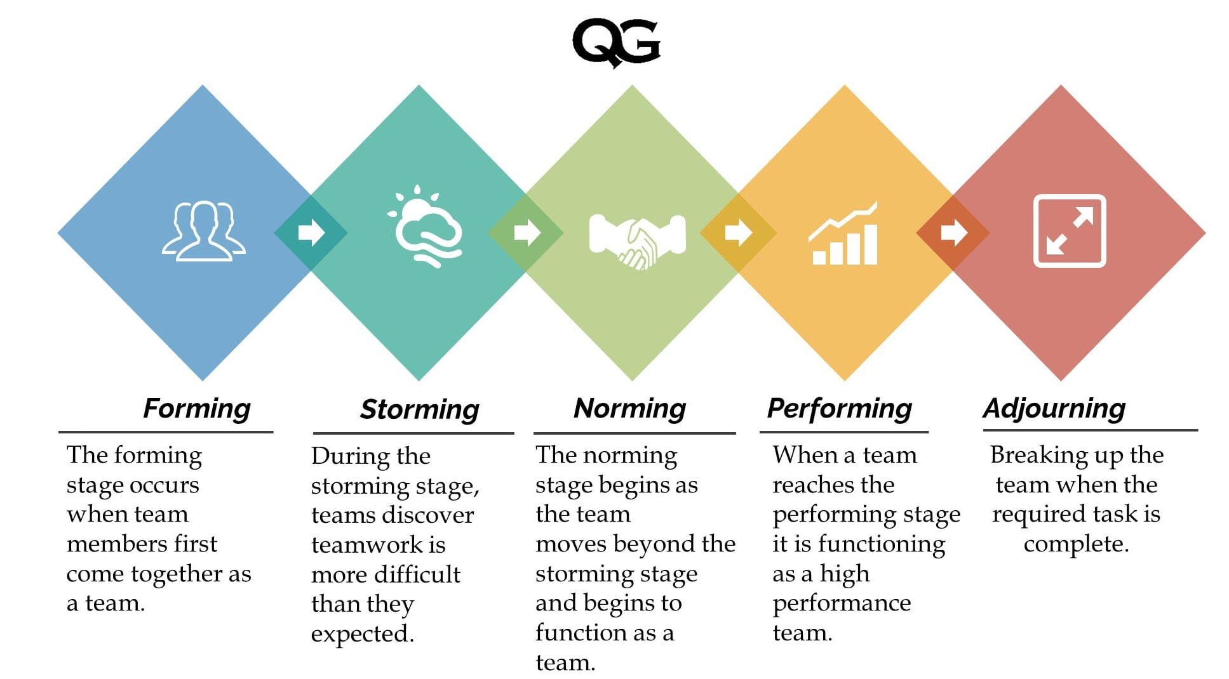

Slide 50
Barriers to Team Performance
Diffusion of responsibility
“not my job”
Conformity
Obedience to authority vs. empowered creativity
Lack of management support or resources
Groupthink

Slide 51
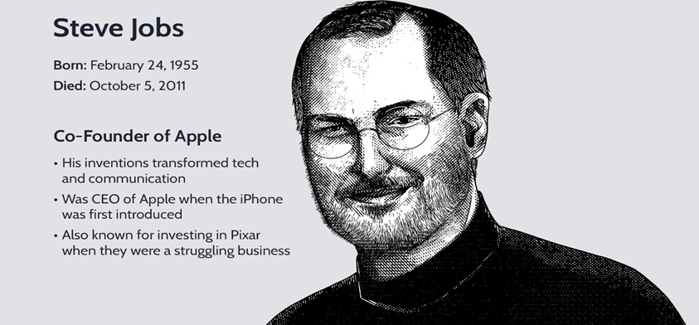
Steve Jobs
“Technology alone is not enough.”

Slide 52
TITLE OF SLIDE
Steve Jobs, the co-founder and former CEO of Apple, was known for his strong leadership skills, including his ability to build and lead effective teams.
While Jobs was often the public face of Apple, he relied on the work of a talented team of designers, engineers, and marketers to create some of the company's most successful products.

Slide 53
Clear Communication: Jobs was an excellent storyteller and was able to paint a picture of what he wanted to achieve, which helped his team to understand the direction he wanted to take.
Attention to Detail: Jobs expected his team members to share his attention to detail and work tirelessly to create products that were not only functional but also aesthetically pleasing.
Collaboration: Jobs was willing to work closely with his team members and was open to their ideas and feedback.
Passion: Jobs was able to inspire his team members to share his passion and work tirelessly to achieve their goals.
Innovation: Jobs was always encouraged his team members to think outside the box, take risks, and create products that were truly groundbreaking.

Slide 54
Jobs' ability to build and lead effective teams was a key factor in Apple's success. He recognized the importance of clear communication, attention to detail, collaboration, passion, and innovation, and was able to inspire his team members to work together towards a common goal.

Slide 55
In 2000, he relocated the company to an abandoned Del Monte canning factory. The original plan called for three buildings, with separate offices for computer scientists, animators, and the Pixar executives.
Instead of three buildings, there was going to be a single vast space, with an atrium at its center.
But for Jobs, it was not just about creating a space: he needed to make people go there. The primary challenge for Pixar, as he saw it, was getting its different cultures to work together and collaborate.
Jobs saw separated offices as a design problem.
Steve realized that when people run into each other when they make eye contact, things happen.”

Slide 56
Some lessons about Great Groups:
Greatness starts with superb people.
Great Groups and great leaders create each other.
Every Great Group has a strong leader
Great Groups are full of talented people who can work together.
Leaders of Great Groups love talent and know where to find it.

Slide 57



Thank You

