Slide 1


Data Structures and Algorithms
Prepared by Prof. Shereen Taie
IT251
Information Technology Department
Lecture 8

Slide 2




Data Structures and
Algorithms
Lecture 8
IT251
Information Technology Department
Prepared by
Prof. Shereen Taie
www.midocean.ae

Slide 3
Learning Objectives:
Graphs & Terminology
WHAT ARE GRAPHS?
GRAPH EXAMPLES
KINDS OF GRAPHS
GRAPH REPRESENTATIONS
Sparse vs. Dense Graphs
BFS (Breadth-first search)
Chapter
04
www.midocean.ae

Slide 4
Graphs Terminology
Chapter
04
www.midocean.ae

Slide 5
WHAT ARE GRAPHS?
Chapter
04
www.midocean.ae

Slide 6
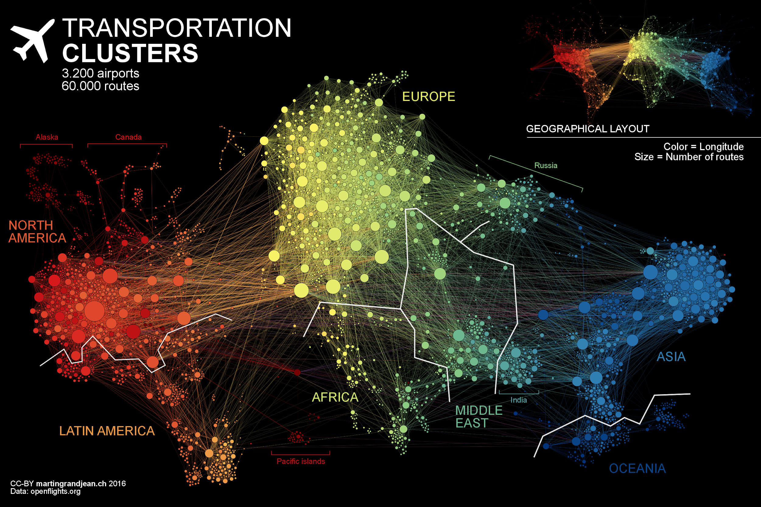
GRAPH EXAMPLES
Each “node” is an airport, and flight routes are represented by the “edge” in between them
Chapter
04
www.midocean.ae

Slide 7
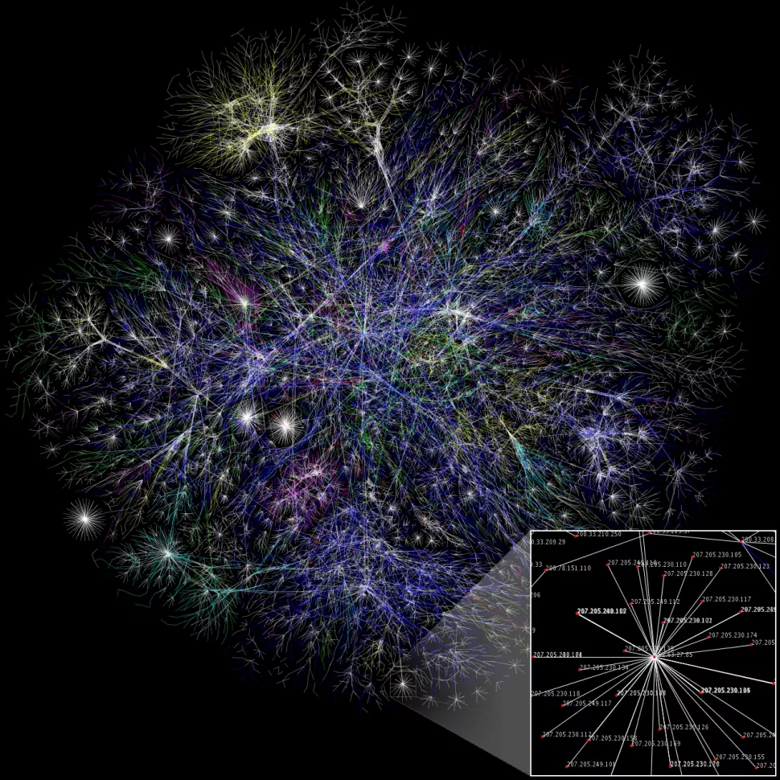
GRAPH EXAMPLES
Partial graph of the Internet (in 2005), where each “node” is an IP address, and the “edges” between them reveal connectivity delays (shorter lines = closer IP addresses)
Chapter
04
www.midocean.ae

Slide 8
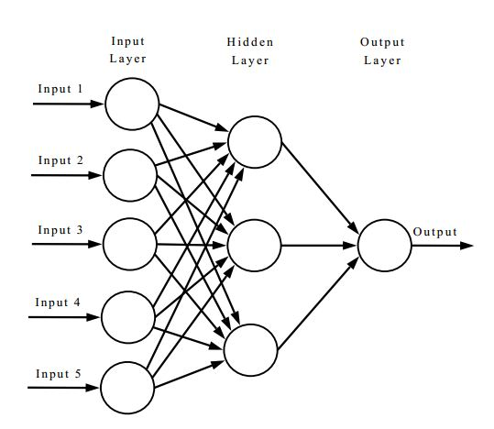
GRAPH EXAMPLES
Neural networks! Each “node” represents a module of the neural network, and “edge” represent output/input relationships
Chapter
04
www.midocean.ae

Slide 9
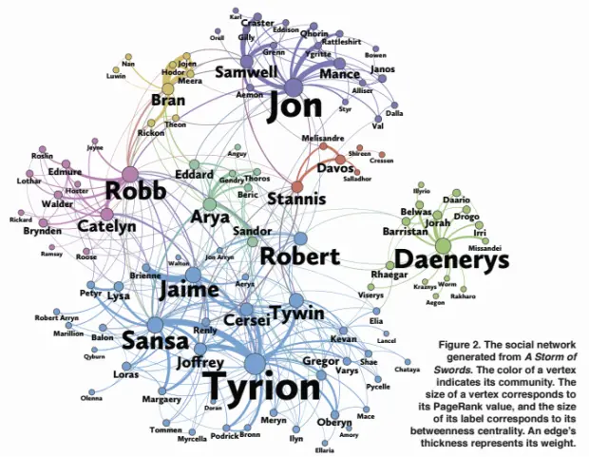
GRAPH EXAMPLES
Graph of characters in the third book of Game of Thrones, where each “node” is a character, and “edge” reveal frequency of interaction (i.e. 2 names appearing within 15 words of one another).
Chapter
04
www.midocean.ae

Slide 10
GRAPH EXAMPLES
CS 109
CS prerequisites!
“nodes” are classes and an “edge” from class A to class B means “class B depends on class A”
CS 161
CS 103
CS 166
CS 106B
CS 107
CS 106A
CS 110
CS 140
Chapter
04
www.midocean.ae

Slide 11
GRAPH EXAMPLES
To an algorithms person, a graph means a representation of the relationships between pairs of Objects.
Road networks. When your smartphone’s software computes driving directions, it searches through a graph that represents the road network, with vertices corresponding to intersections and edges corresponding to individual road segments.
Chapter
04
www.midocean.ae

Slide 12
GRAPH EXAMPLES
The World Wide Web. The Web can be modeled as a directed graph, with the vertices corresponding to individual Web pages, and the edges corresponding to hyperlinks, directed from the page containing the hyperlink to the destination page.
Precedence constraints. Graphs are also useful in problems that lack an obvious network stucture. For example, imagine that you a first-year university student, planning which courses to take and in which order.
Chapter
04
www.midocean.ae

Slide 13
GRAPH EXAMPLES
Social networks. A social network can be represented as a graph whose vertices correspond to individuals and edges to some type of relationship. For example, an edge could indicate a friendship between its endpoints, or that one of its endpoints is a follower of the other. Among the currently popular social networks, which ones are most naturally modeled as an undirected graph, and which ones as a directed graph?
Chapter
04
www.midocean.ae
Notes:
Facebook (undirected), Twitter or Google+ (directed).

Slide 14
WHAT ARE GRAPHS USED FOR?
There are a lot of diverse problems that can be represented as graphs, and we want to answer questions about them
For example:
  How do we most efficiently route packets across the internet?
  Are there natural “clusters” or “communities” in a graph?
  Which character(s) are least related with _____?
  How should I sign up for classes without violating pre-req constraints?
But first off, some terminology!
Chapter
04
www.midocean.ae

Slide 15

Chapter
04
KINDS OF GRAPHS
www.midocean.ae

Slide 16
TWO KINDS OF GRAPHS:
Undirected Graph
2. Directed Graph
Chapter
04
www.midocean.ae

Slide 17
Two KINDS OF GRAPHS:
In an undirected graph, each edge corresponds to an unordered pair {v,w} of vertices, which are called the endpoints of the edge. In an undirected graph, there is no difference between an edge (v,w) and an edge (w, v).
UNDIRECTED GRAPHS
An undirected graph has
a set of vertices (V) & a set of edges (E)
A
Formally,
G = (V, E)
B
C
D
Chapter
04
V = {A, B, C, D}
E = { {A, B}, {A, C}, {A, D}, {B, D}, {C, D}}
www.midocean.ae
17

Slide 18
Two KINDS OF GRAPHS:
In a directed graph, each edge (v,w) is an ordered pair, with the edge traveling from the first vertex v (called the tail) to the second w (the head);
DIRECTED GRAPHS
A directed graph has
a set of vertices (V) & a set of DIRECTED edges (E)
Formally,
G = (V, E)
A
B
C
D
Chapter
04
The in-degree of vertex D is 2. The out-degree of vertex D is 1.
Vertex D’s incoming neighbors are A, B, & C
Vertex D’s outgoing neighbor is B
www.midocean.ae

Slide 19
Chapter
04
GRAPH REPRESENTATIONS OPTIONS
www.midocean.ae

Slide 20
GRAPH REPRESENTATIONS OPTIONS:
OPTION 1: ADJACENCY MATRIX
OPTION 2: ADJACENCY LIST
Chapter
04
www.midocean.ae

Slide 21

GRAPH REPRESENTATIONS
OPTION 1: ADJACENCY MATRIX
The adjacency matrix representation of G is a square n x n matrix A equivalently, a two-dimensional array—with only zeroes and ones as entries. Each entry A_{ij} is defined as:
Chapter
04
www.midocean.ae

Slide 22
GRAPH REPRESENTATIONS
OPTION 2: ADJACENCY LIST
Ingredients for Adjacency Lists
1. An array containing the graph’s vertices.
2. An array containing the graph’s edges.
3. For each edge, a pointer to each of its two endpoints.
4. For each vertex, a pointer to each of the incident edges.
Chapter
04
www.midocean.ae

Slide 23
GRAPH REPRESENTATIONS
OPTION 1: ADJACENCY MATRIX
(destination)
A
 | A | B | C | D
A | 0 | 1 | 1 | 1
B | 1 | 0 | 0 | 1
C | 1 | 0 | 1 | 1
D | 1 | 1 | 1 | 0
B
C
D
(source)
(An undirected graph)
Chapter
04
www.midocean.ae

Slide 24
GRAPH REPRESENTATIONS
OPTION 1: ADJACENCY MATRIX
(destination)
A
 | A | B | C | D
A | 0 | 1 | 1 | 1
B | 0 | 0 | 0 | 1
C | 0 | 0 | 1 | 1
D | 0 | 1 | 0 | 0
B
C
D
(source)
(A directed graph)
Chapter
04
www.midocean.ae

Slide 25
GRAPH REPRESENTATIONS
OPTION 2: ADJACENCY LISTS
A B C D
A
Each list stores a node’s neighbors
B
C
B
A
A
A
D
C
D
C
B
(An undirected graph)
D
D
C
Chapter
04
www.midocean.ae

Slide 26
GRAPH REPRESENTATIONS
OPTION 2: ADJACENCY LISTS
A B C D
A
B
C
Tracks outgoing neighbors.
(You could also do the same for incoming neighbors as well)
B
D
C
B
D
C
D
(A directed graph)
D
Chapter
04
www.midocean.ae

Slide 27
GRAPH REPRESENTATIONS
ADJACENCY LISTS | ADJACENCY MATRIX | GRAPH REPRESENTATIONS TECKNIQUES
For a graph G = (V, E) where |V| = n, and |E| = m
SPACE REQUIREMENTS | O(n²) | O(n + m)
Generally, better for sparse graphs (where m << n²).
We’ll assume this representation, unless otherwise stated.
0 | 1 | 1 | 1
1 | 0 | 0 | 1
1 | 0 | 1 | 1
1 | 1 | 1 | 0
Chapter
04
www.midocean.ae

Slide 28
GRAPH REPRESENTATIONS
Generally Adjacency Lists representation, better than Adjacency Matrix representation for sparse graphs (where m < n²).
We’ll assume Adjacency Lists representation, unless otherwise stated.
Chapter
04
www.midocean.ae

Slide 29
Chapter
04
Sparse Graphs vs. Dense Graphs
www.midocean.ae

Slide 30
Sparse Graphs vs. Dense Graphs
A graph is sparse if the number of edges is relatively close to linear in the number of vertices.
A graph is dense if the number of edges is closer to quadratic in the number of vertices.
Chapter
04
www.midocean.ae

Slide 31
BREADTH-FIRST SEARCH
(BFS)
One way to explore a graph!
Chapter
04
www.midocean.ae

Slide 32

BREADTH-FIRST SEARCH
Breadth-first search explores the vertices of a graph in layers, in order of increasing distance from the starting vertex.
An analogy:
A bird is exploring a maze from above (with a bird’s eye view)
S
Chapter
04
www.midocean.ae

Slide 33
BREADTH-FIRST SEARCH
An analogy:
A bird is exploring a labyrinth from above (with a bird’s eye view)
unvisited
S
Layer 0: reachable in 0 steps
Layer 1: reachable in 1 step
Layer 2: reachable in 2 steps
Layer 3: reachable in 3 steps
Chapter
04
www.midocean.ae

Slide 34
BREADTH-FIRST SEARCH
An analogy:
A bird is exploring a labyrinth from above (with a bird’s eye view)
unvisited
S
Layer 0: reachable in 0 steps
Layer 1: reachable in 1 step
Layer 2: reachable in 2 steps
Layer 3: reachable in 3 steps
Chapter
04
www.midocean.ae

Slide 35
BREADTH-FIRST SEARCH
An analogy:
A bird is exploring a labyrinth from above (with a bird’s eye view)
unvisited
S
Layer 0: reachable in 0 steps
Layer 1: reachable in 1 step
Layer 2: reachable in 2 steps
Layer 3: reachable in 3 steps
Chapter
04
www.midocean.ae

Slide 36
BREADTH-FIRST SEARCH
An analogy:
A bird is exploring a labyrinth from above (with a bird’s eye view)
unvisited
S
Layer 0: reachable in 0 steps
Layer 1: reachable in 1 step
Layer 2: reachable in 2 steps
Layer 3: reachable in 3 steps
Chapter
04
www.midocean.ae

Slide 37
BREADTH-FIRST SEARCH
An analogy:
A bird is exploring a labyrinth from above (with a bird’s eye view)
unvisited
S
Layer 0: reachable in 0 steps
Layer 1: reachable in 1 step
Layer 2: reachable in 2 steps
Layer 3: reachable in 3 steps
Chapter
04
www.midocean.ae

Slide 38
BREADTH-FIRST SEARCH
L₀
L₁
L₂
BFS(s):
Set L_{i} = [] for i = 0, ..., n-1
L₀ = s
for i = 0, ..., n-1:
for u in L_{i}:
for v in u.neighbors:
if v not yet visited:
mark v as visited
add v to L_{i+1}
s
L₃
L_{i} = The set of nodes we can reach in i steps from s
Chapter
04
www.midocean.ae

Slide 39
BREADTH-FIRST SEARCH
L₀
L₁
L₂
BFS(s):
Set L_{i} = [] for i = 0, ..., n-1
L₀ = s
for i = 0, ..., n-1:
for u in L_{i}:
for v in u.neighbors:
if v not yet visited:
mark v as visited
add v to L_{i+1}
s
L₃
L_{i} = The set of nodes we can reach in i steps from s
Go through all nodes in L_{i} and add their unvisited neighbors to L_{i+1}
Chapter
04
www.midocean.ae

Slide 40




Thank You

