Slide 1
Name: Sultan Ali Alwassam Aldwsari
ID No. 252000203
Student Email: 252000203@st.midocean.edu.km
Supervisor Name: Dr Khaled Eskaf
Email: Khaledeskaf@midocean.edu.km

Slide 2
"Hello everyone, Today I'll present my research: Enhancing Identity and Access Management Systems with AI. The goal of this research is to improve cybersecurity by integrating AI technologies

Slide 3
Abstract
This research explores the application of artificial intelligence in enhancing Identity and Access Management (IAM) systems. AI facilitates automation, intelligent decision-making, and anomaly detection ,improving the protection of sensitive data.

Slide 4
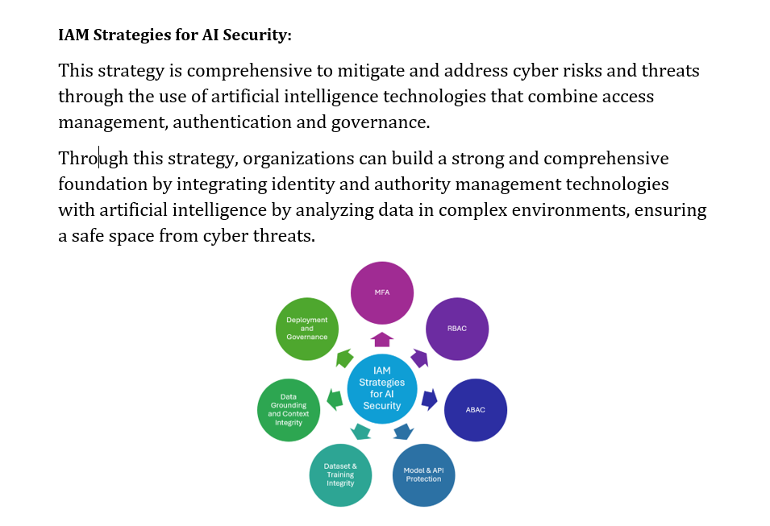

Slide 5
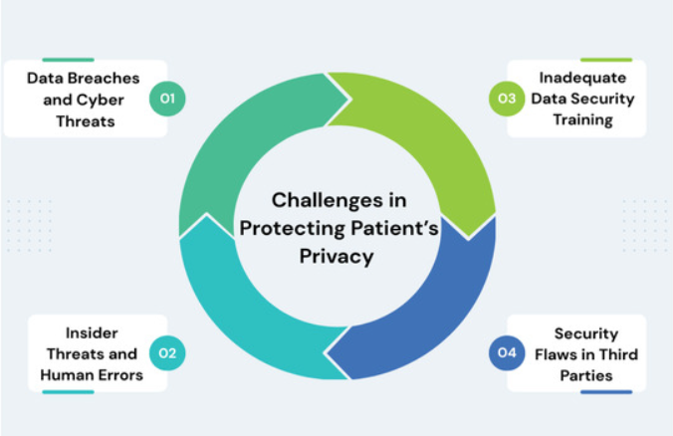
Problem Statement
Conventional Identity and Access Management systems encounter multiple challenges, including difficulties in detecting insider threats, limited adaptability to cloud and Internet of Things (IoT) environments, and inadequate real-time response to cyberattacks. These limitations result in significant security vulnerabilities

Slide 6
Literature Review

Slide 7
Research Problem
Study | Main Contribution | Key Findings | Challenges / Limitations /
Muhammad, 2021 | Use of AI in IAM | Automation and improved data protection | Lack of validation
Adenola, 2023 | Enhancing IAM with AI | Improved efficiency / | Limited privacy focus
Sarker et al., 2024 | Smart IAM systems | Anomaly detection | Needs real-world applications /
Souaddah & Mezrioui, 2024 | AI challenges | Privacy & explainability / الخصوصية وقابلية التفسير | Weak solutions /
Mandru, 2022 | Legacy integration | System improvement / تحسين الأنظمة | Integration difficulty
Zhang et al., 2020 | IoT security | Access risks | Traditional limits
Comparison Table of IAM Studies (English & Arabic)

Slide 8
This Study Enhancing Identity and Access Management Systems (IAM) Using Artificial Intelligence | Used AI? / yes | Main Contribution AI IAM model | key Findings Dual verification + Risk Scoring | Challenges / Limitations / Needs to implemented in real Enivr / anaconda IAM

Slide 9
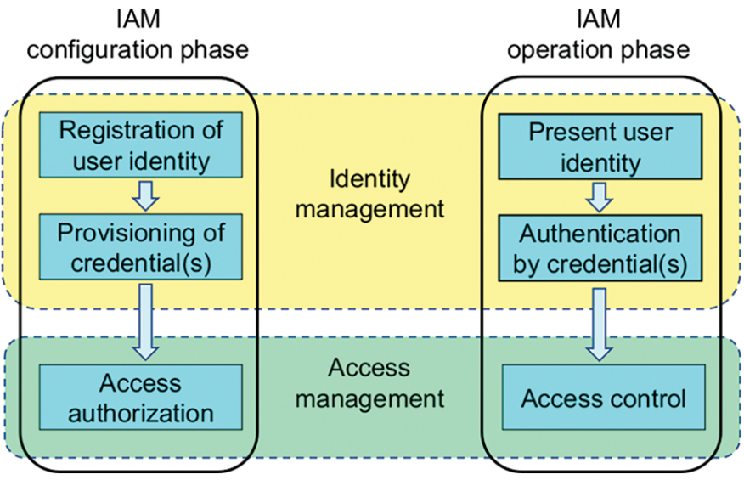
Research Objectives
"This research aims to improve Identity and Access Management systems through the application of artificial intelligence, focusing on advancing anomaly detection, automating access control, and enabling immediate security response

Slide 10
Research Contributions
"This study proposes a risk assessment model that leverages user behavior analysis through artificial intelligence techniques, thereby enhancing detection accuracy and minimizing false positive rates."

Slide 11
Methodology
A dataset was created to simulate user behavior, and machine learning models such as Random Forest and Isolation Forest were used to detect anomalous behavior and classify users. The data was further enhanced through: Using SMOTE to increase samples for the minority class and achieve data balance. Applying Over-sampling to increase the number of rare samples. Handling missing values by imputing them with the mean or appropriate values. Using Hyperparameter Tuning to optimize model performance.

Slide 12
Risk Assessment model
The system calculates a risk score based on several factors, such as the number of login attempts, access time, and usage frequency. Based on the result, an appropriate decision is made, such as granting access, requesting additional verification, or blocking the account.

Slide 13
(Evaluation)
The model was evaluated using several key metrics: Recall: Measures the model's ability to correctly detect positive cases. The higher the value, the better the model is at detecting threats. F1-Score:Combines precision and recall, and is especially important when dealing with imbalanced data.

Slide 14
results
The results showed exceptionally high accuracy in detecting threats. Additionally, data balancing techniques such as SMOTE enhanced performance and minimized false positive rates.

Slide 15
Future Work
• Include Deep Learning ( LSTM Long Short-Term Memory for behavioral series) and AI techniques. "LSTM is a type of RNN neural network used in artificial intelligence, designed to handle sequential data such as text, audio, and time series
• Real-world implementation in live environments.
• Combined learning for privacy- protecting multi-organization IAM.
• Addition to agentic AI identities in zero-trust structures.

Slide 16
Conclusion
In conclusion, the integration of AI into Identity and Access Management systems reinforces security levels, thereby enabling cybersecurity monitoring systems to become more intelligent and adaptive to emerging originations.

Slide 17
Thank you for your kind listening

