Slide 1



Master of Science in Artificial intelligent
Lecture 4
AI511
Foundations of Artificial Intelligence
Prepared by
Prof. Lamiaa Fattouh Ibrahim
www.midocean.ae

Slide 2
Outline
Search: Basic idea
  Search tree
    Tree Search Algorithm Outline
    Handling repeated states
  Backtracking Search
    Backtracking Algorithm Data Structure
    Backtracking Algorithm

Slide 3

Outline
Blind vs. Heuristic Strategies
  Blind Strategies
  Depth-First Strategy
  Breadth- First Strategy
www.midocean.ae

Slide 4
Search
Given:
Initial state Actions Transition model Goal state
Path cost
How do we find the optimal solution?

Slide 5
Search: Basic Idea
Let’s begin at the start state and expand it by making a
list of all possible successor states.
successor states→ frontier
Maintain a frontier (or fringe) or a list of unexpanded states.
At each step, pick a state from the frontier to expand.
Keep going until you reach a goal state.
Try to expand as few states as possible.

Slide 6


Search: Basic Idea
Start state

Slide 7








Search: Basic Idea

Slide 8


Search: Basic Idea

Slide 9






Search: Basic Idea

Slide 10
Search: Basic Idea

Slide 11





Search: Basic Idea

Slide 12
Search: Basic Idea

Slide 13


Search: Basic Idea

Slide 14
Search: Basic idea

Slide 15


Search: Basic Idea

Slide 16
Search: Basic Idea

Slide 17


Search: Basic Idea

Slide 18

Search Tree
Starting state
“What if” tree of sequences of actions and outcomes
When we are searching, we are not acting in the
world, merely “thinking” about the possibilities
The root node corresponds to the starting state
The children of a node correspond to the successor
states of that node’s state
A path through the tree corresponds to a sequence of actions
A solution is a path ending in the goal state
Nodes vs. states
A state is a representation of the world, while a node is a data structure that is part of the search tree Node has to keep pointer to parent, path cost, possibly other info
Action
Successor state
…
Frontier
Goal state

Slide 19
Tree Search Algorithm Outline
Initialize the frontier using the starting state.
While the frontier is not empty:
Choose a frontier node according to search strategy.
If the node contains the goal state, return solution.
Else expand the node and add its children to the frontier.

Slide 20
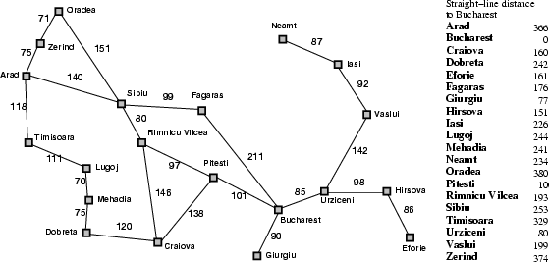
Tree Search Example
Start: Arad
Goal: Bucharest

Slide 21

Tree Search Example
Start: Arad
Goal: Bucharest

Slide 22
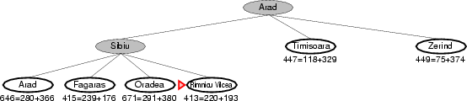
Tree Search Example
Start: Arad
Goal: Bucharest

Slide 23
Handling Repeated States
Initialize the frontier using the starting state
While the frontier is not empty
Choose a frontier node according to search strategy
and take it off the frontier.
If the node contains the goal state, return solution
Else expand the node and add its children to the
frontier.
To handle repeated states:
Every time you expand a node, add that state to the Explored set (Close Or Deadend list); do not put explored states on the frontier again.
Every time you add a node to the frontier, check whether it already exists with a higher path cost, and if yes, replace the path with the new one with low cost.

Slide 24
Backtracking Search
“Backtracking is a technique for systematically trying all
paths through a state space”
It begins at the start state and pursues a path until:
Finding a goal, then quit and return the solution path.
Finding a dead end, then backtrack to the most recent unexamined node and continue down one of its
branches.
Search method
Exhaustive
Uninformed
Brute force
What if graph
Heuristic
Informed
Rule thumb

Slide 25
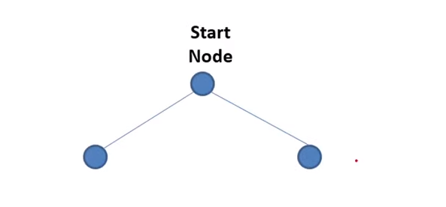
Backtracking Search

Slide 26
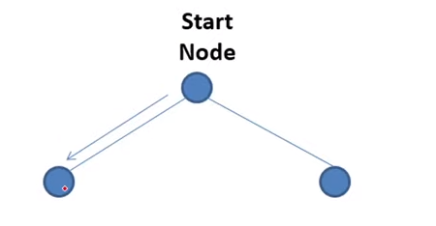
Backtracking Search

Slide 27
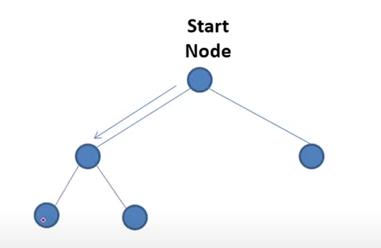
Backtracking Search

Slide 28
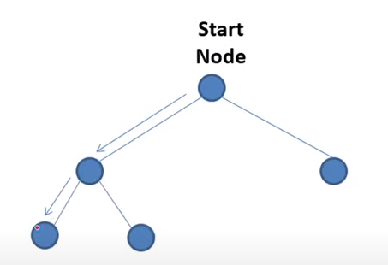
Backtracking Search

Slide 29
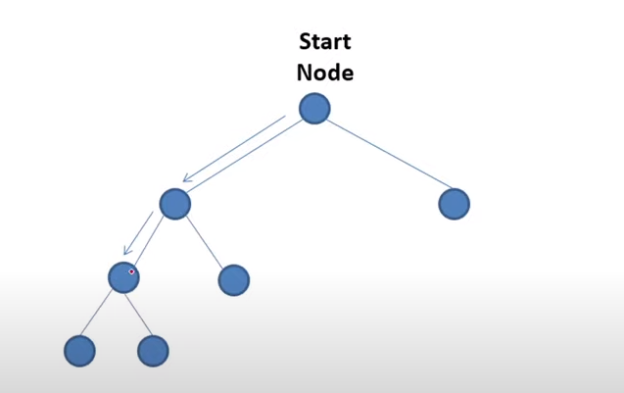
Backtracking Search

Slide 30
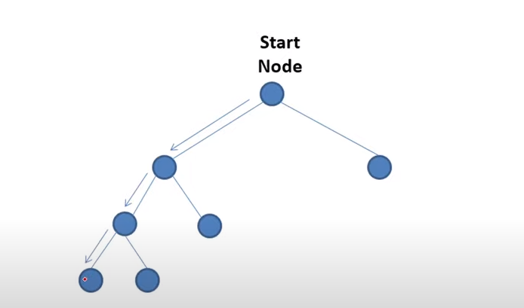
Backtracking Search

Slide 31
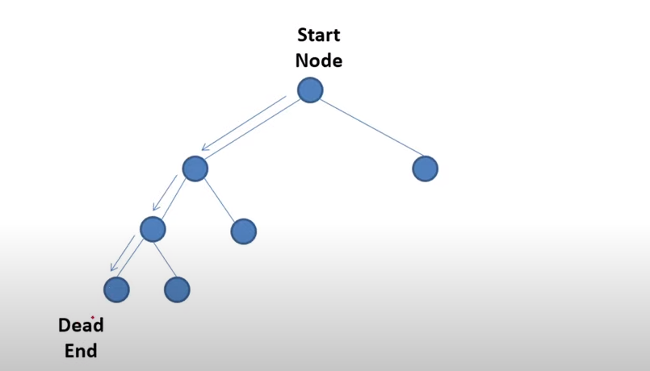
Backtracking Search

Slide 32
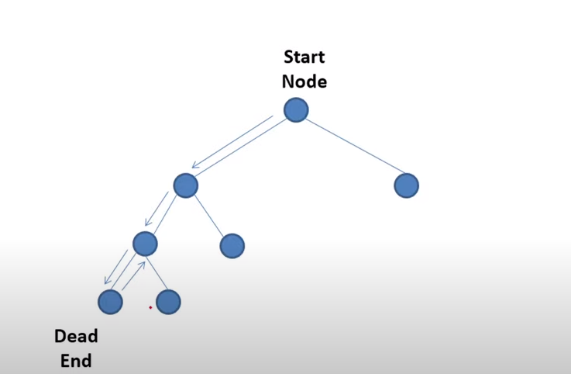
Backtracking Search

Slide 33
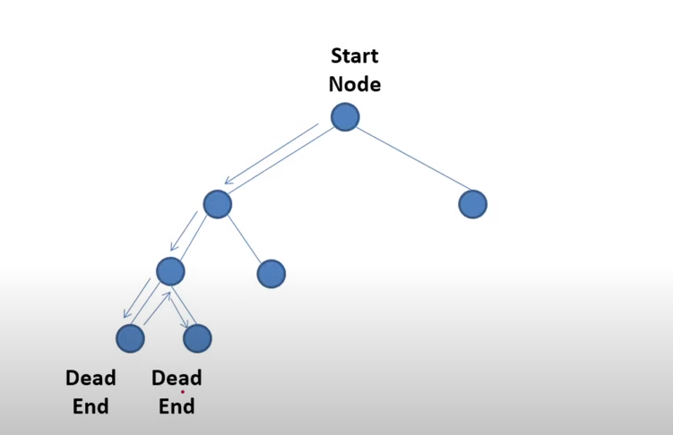
Backtracking Search

Slide 34
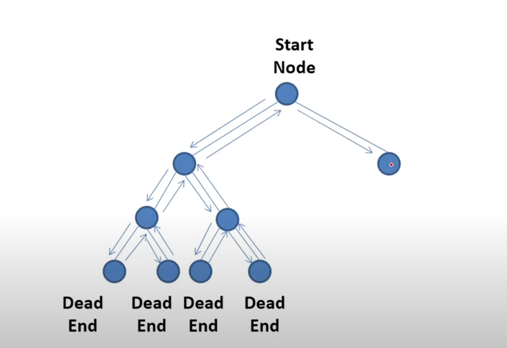
Backtracking Search
Goal

Slide 35
Backtracking Algorithm Data Structure
State List (SL): lists the states in the current path being tried. If the goal is found, then it contains the solution path.
New State List (NSL): contains nodes a waiting evaluation (frontier or open).
Dead Ends (DE): lists states whose descendants have
failed to contain a goal node.
Current State (CS): a state currently under consideration pointer.

Slide 36
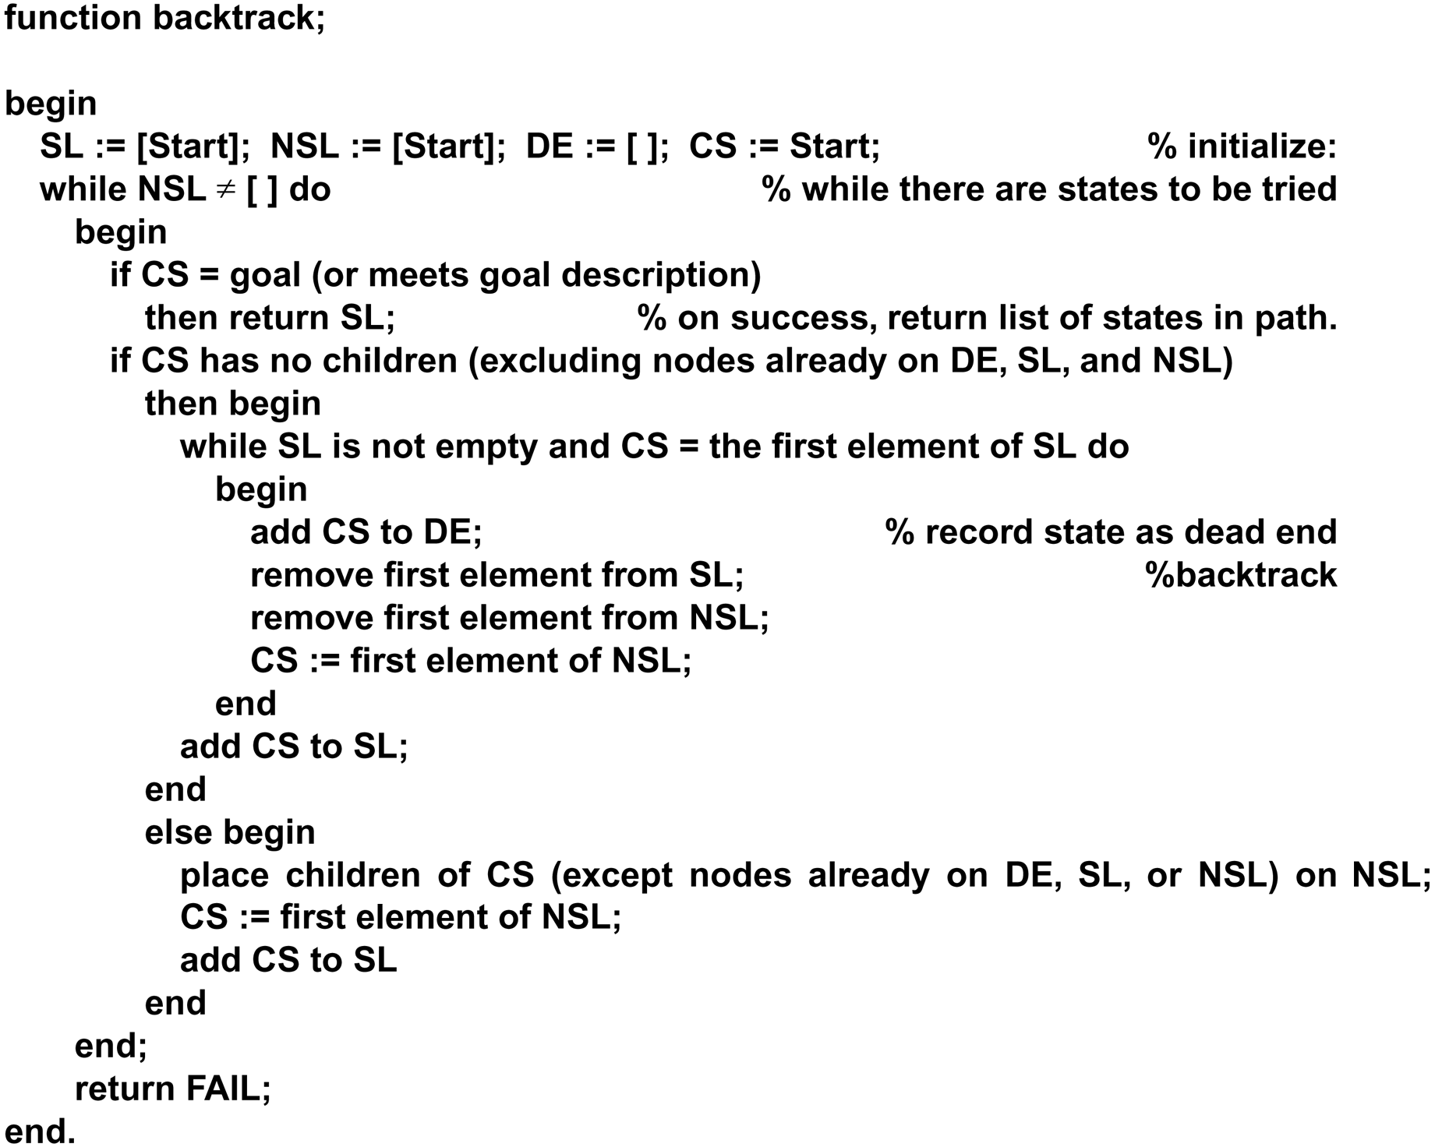
The Backtracking Algorithm

Slide 37
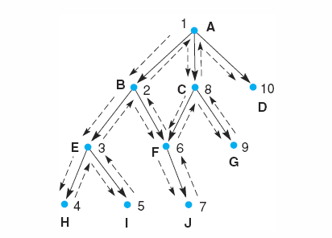
Example

Slide 38


Slide 39
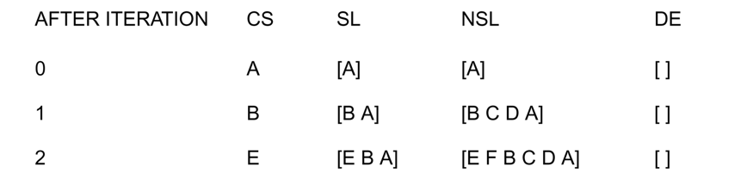

Slide 40
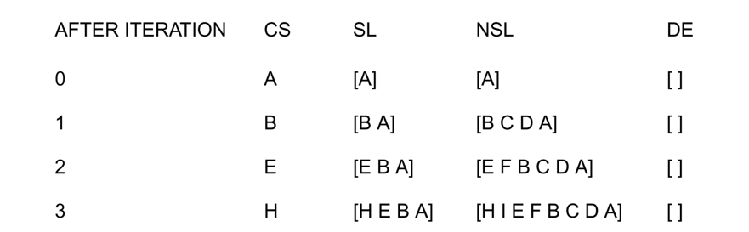

Slide 41
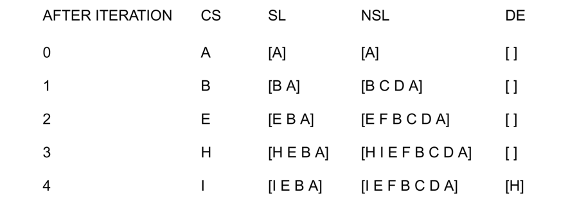

Slide 42
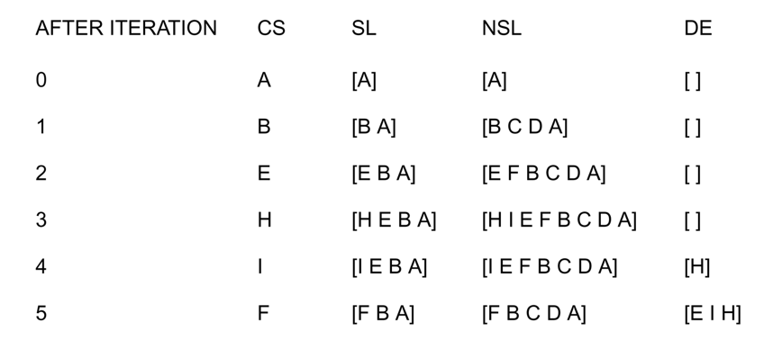

Slide 43
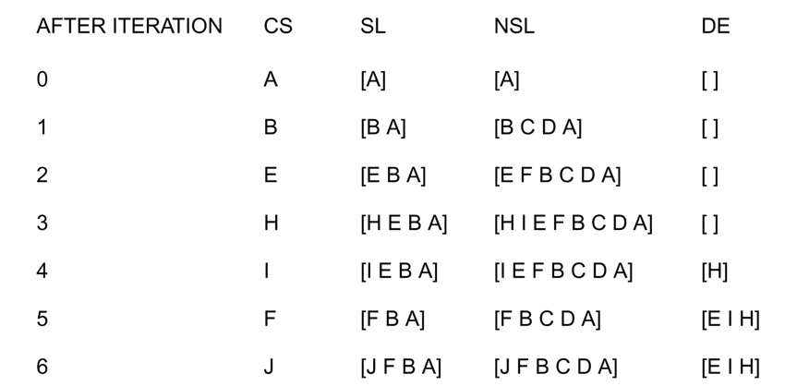

Slide 44
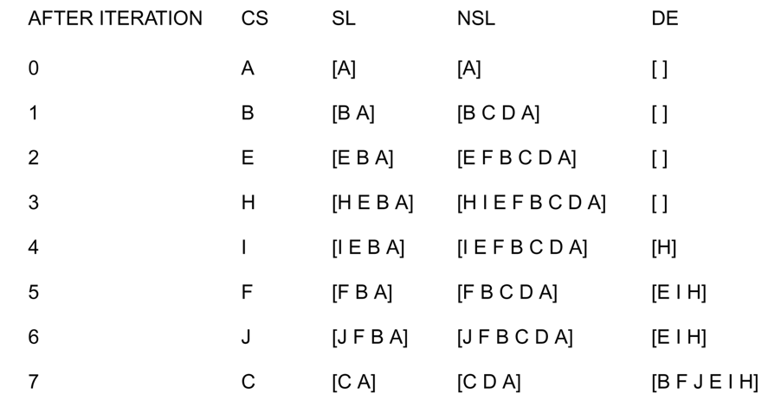

Slide 45
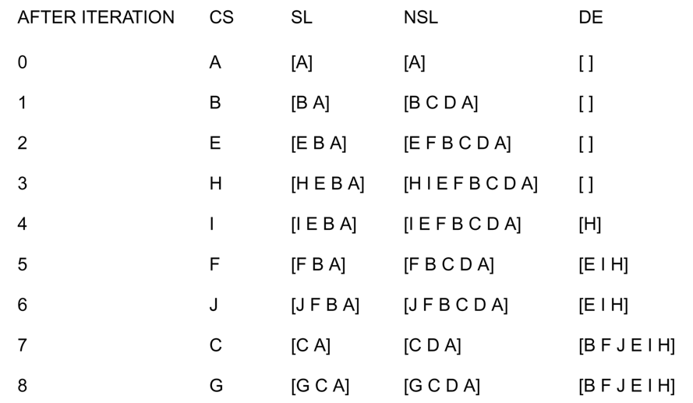

Slide 46
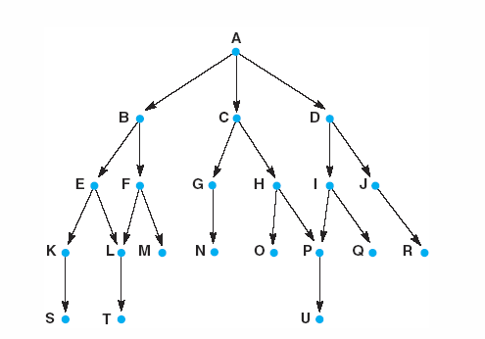
Example 2

Slide 47
Blind (or un-informed or exhaustive or brute-force ) strategies do not exploit any of the information contained in a state.
Heuristic (or informed) strategies exploits such information
to assess that one node is “more promising” than another.

Slide 48
Breadth-first Bidirectional
Blind Strategies
Step cost = 1
Depth-first Depth-limited
Iterative deepening
Uniform-Cost
Step cost = c(action) ≥ ε > 0

Slide 49






Depth-First Strategy
New nodes are inserted at the front of FRINGE
 | 1
2 | 3 FRINGE = (1)
4 | 5
Goal

Slide 50


Depth-First Strategy
New nodes are inserted at the front of FRINGE
 | 1
2 | 3 FRINGE = (2, 3)
4 | 5

Slide 51
Depth-First Strategy
New nodes are inserted at the front of FRINGE
 | 1
2 | 3 FRINGE = (4, 5, 3)
4 | 5

Slide 52


Depth-First Strategy
New nodes are inserted at the front of FRINGE
1
2
3
4
5

Slide 53

Depth-First Strategy
New nodes are inserted at the front of FRINGE
1
2
3
4
5

Slide 54

Depth-First Strategy
New nodes are inserted at the front of FRINGE
1
2
3
4
5

Slide 55
Depth-First Strategy
New nodes are inserted at the front of FRINGE
1
2
3
4
5

Slide 56
Depth-First Strategy
New nodes are inserted at the front of FRINGE
1
2
3
4
5

Slide 57

Depth-First Strategy
New nodes are inserted at the front of FRINGE
1
2
3
4
5

Slide 58
Depth-First Strategy
New nodes are inserted at the front of FRINGE
1
2
3
4
5

Slide 59

Depth-First Strategy
New nodes are inserted at the front of FRINGE
1
2
3
4
5

Slide 60
Graph for depth first search examples.
A Depth first search of the graph considers the states in the order: A,B,E,K,S,L,T,F,M,C,G,N,H,O,P,U,D,I,Q,J,R

Slide 61
Graph for Breadth first search examples.
A breadth first search of the graph considers the states in the order:
A, B, C, D, E, F, G, H, I, J, K, L, M, N, O, P, Q, R, S, T, U.
Luger: Artificial Intelligence, 5th edition. © Pearson Education Limited, 2005
19

Slide 62
Example
Consider a state space where the start state is number 1 and each state k has two successors: numbers 2k and 2k + 1.
- Draw the portion of the state space for states 1 to 15.

Slide 63
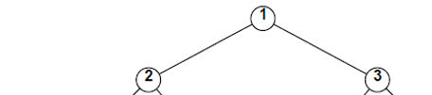
Consider a state space where the start state is number 1 and each state k has two successors: numbers 2k and 2k + 1.
- Draw the portion of the state space for states 1 to 15.

Slide 64
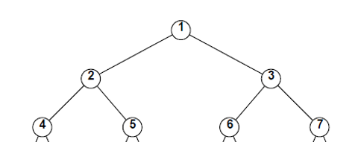

Slide 65
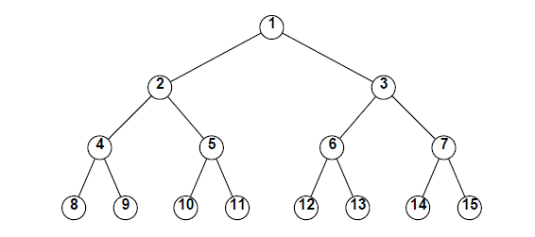

Slide 66
Summary
  Search tree
    Tree Search Algorithm Outline
    Handling repeated states
  Backtracking Search
    Backtracking Algorithm Data Structure
    Backtracking Algorithm
  Blind Strategy
    Depth-First Strategy
    Breadth- First Strategy

Slide 67


Thank You

