Slide 1


Pricing
Prepared by Dr. Thana Ahmed
Lecture 6
MGM204
PRINCIPLE OF MARKETING

Slide 2

1. Defining Pricing
2. Price Model
3. New Product Pricing strategies
4. Product Mix Pricing strategies
5. Price adjustment strategies

Slide 3

1. WHAT IS A PRICE?
PRICE = “The amount charged for a product or service, or the sum of the values that customers exchange for the benefits of having or using the product or service”
Price = CAPTURING VALUE FROM THE CUSTOMERS.
Price is the only element in the marketing mix that produces revenue; all other elements represent costs.

Slide 4
“ No matter what the state of the economy, companies should sell value, not price”
Armstrong et al. 2017

Slide 5
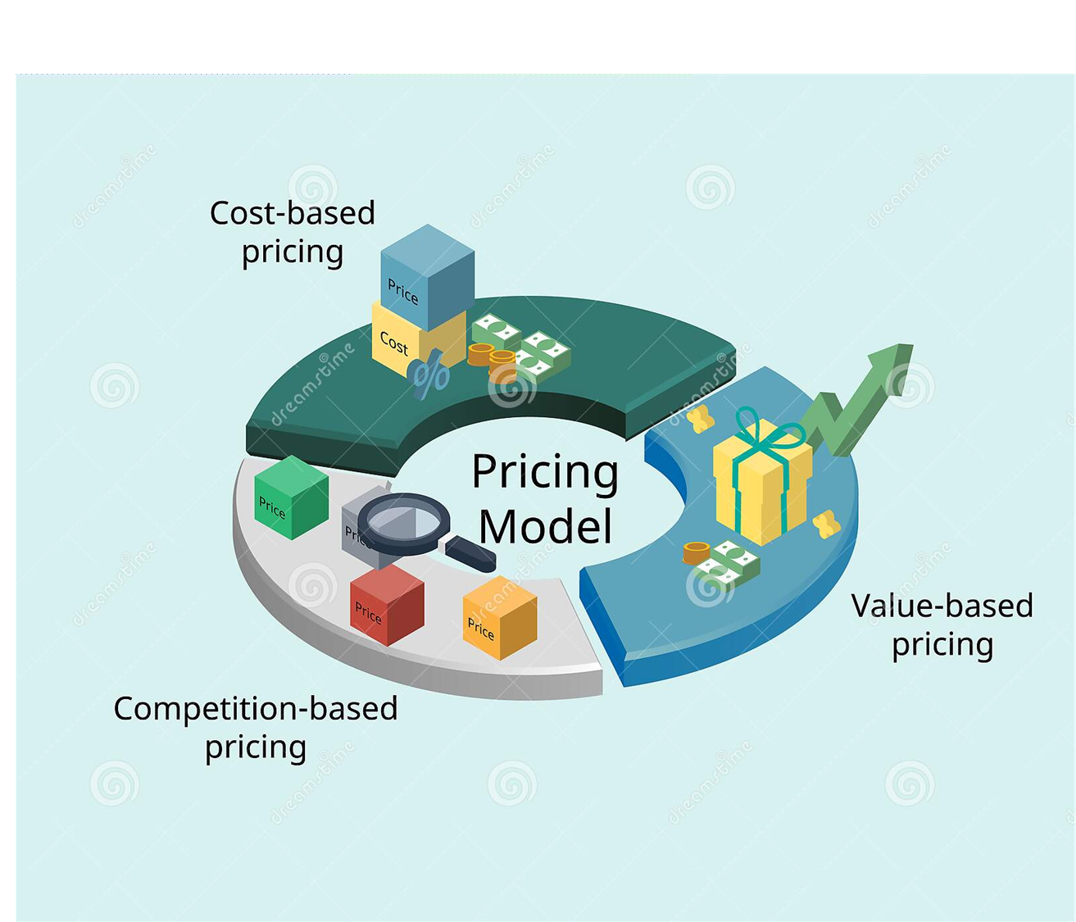
2. Price Model

Slide 6
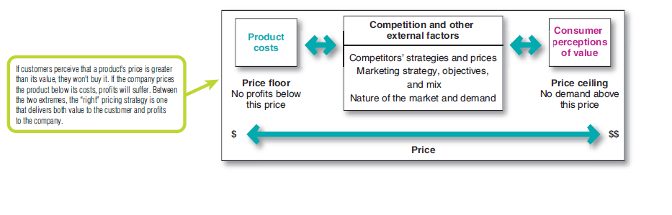
Major considerations in setting prices
Considerations in setting prices
There are three major pricing strategies: customer value-based pricing, cost-based pricing, and competition-based pricing

Slide 7
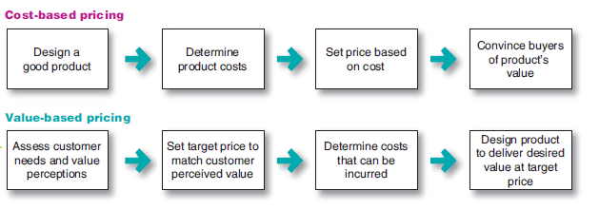
2.1. Customer Value-based Pricing
Customer Value-based Pricing = Setting price based on buyers’ perceptions of value rather than on the seller’s cost.
Value-based pricing means that the marketer cannot design a product and marketing program and then set the price. Price is considered along with all other marketing mix variables before the marketing program is set.
Value-based Pricing versus cost-based Pricing

Slide 8

Types of value-based pricing
Good-value pricing
Offering the right combination of quality and good service at a fair price.
It may involve introducing less expensive versions of established brand name products or new lower-price lines.
Or it may involve redesigning existing brands to offer more quality for a given price or the same quality for less
Value-added pricing
Attaching value-added features and services to differentiate a company’s offers and charging higher prices

Slide 9
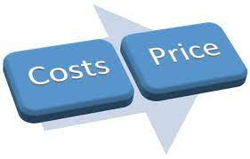
2.2. Cost-based pricing
Cost-based pricing = Setting prices based on the costs of producing, distributing, and selling the product plus a fair rate of return for effort and risk.
Companies with lower costs can set lower prices that result in smaller margins but greater sales and profits.
However, other companies—such as Apple and BMW,- intentionally pay higher costs so that they can add value and claim higher prices and margins.

Slide 10
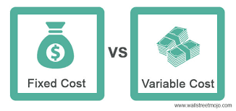
2.2. Cost-based pricing
Types of costs:
  Fixed costs: Costs that do not vary with production or sales level.
  Variable costs: Costs that vary directly with the level of production.
  Total Costs: The sum of the fixed and variable costs for any given level of production.
  Total Costs= Fixed costs + Variable costs

Slide 11
2.2. Cost-based pricing
Cost-Plus Pricing
The simplest pricing method is cost-plus pricing (or markup pricing)—adding a standard markup to the cost of the product.
Example: an electronics retailer might pay a manufacturer $20 for a flash drive and mark it up to sell at $30
20 (cost) + 10 (margin) = 30 (selling price)
Markup = 50% of cost (20*50/100=10)
Markup % =
    =
selling price – cost
X 100
Cost
30-20
X 100
=50
20

Slide 12
2.2. Cost-based pricing
Generally NO
Does using standard markups to set prices make sense?
Any pricing method that ignores consumer demand and competitor prices is not likely to lead to the best price.
Markup pricing remains popular for many reasons.
  Sellers are more certain about costs than about demand. By tying the price to cost, sellers simplify pricing.
  When all firms in the industry use this pricing method, prices tend to be similar and price competition is minimized.

Slide 13
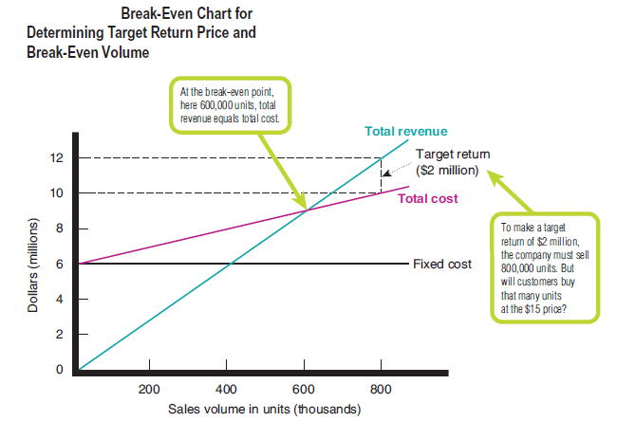
2.2. Cost-based pricing
Break-even pricing (target return pricing)
Setting price to break even on the costs of making and marketing a product or setting price to make a target return.
Break-even point is reached when total costs = total revenues
Break-even volume = fixed costs ÷ [price – variable costs]

Slide 14
2.2. Cost-based pricing
Example
Fixed costs = $6 million
Variable costs = $5 per unit.
the price = $15
At the $15 price, the manufacturer must sell at least 600,000 units to break even
Break-even volume = fixed costs ÷ [price – variable costs]
= $6,000,000 ÷ [$15 – $5]
=600,000.

Slide 15
2.2. Cost-based pricing
Break-even pricing:
The major problem with this analysis is that it fails to consider customer value and the relationship between price and demand.
As the price increases, demand decreases, and the market may not buy even the lower volume needed to break even at the higher price.
Although break-even analysis and target return pricing can help the company to determine the minimum prices needed to cover expected costs and profits, they do not take the price–demand relationship into account.

Slide 16
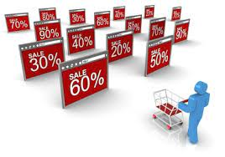
2.3. Competition- based pricing
Competition- based pricing= Setting prices based on competitors’ strategies, prices, costs, and market offerings.
In assessing competitors’ pricing strategies, the company should ask several questions.
  how does the company’s market offering compare with competitors’ offerings in terms of customer value?
  how strong are current competitors, and what are their current pricing strategies?
the goal is not to match or beat competitors’ prices. Rather, the goal is to set prices according to the relative value created versus competitors. If a company creates greater value for customers, higher prices are justified.

Slide 17
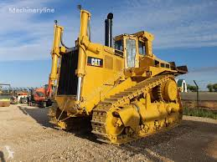
CATERPILLAR EXAMPLE
Caterpillar makes high-quality, heavy-duty construction and mining equipment. It dominates its industry despite charging higher prices than competitors such as Komatsu. When a commercial customer once asked a Caterpillar dealer why it should pay $500,000 for a big Caterpillar bulldozer when it could get an “equivalent” Komatsu dozer for $420,000, the Caterpillar dealer famously provided an analysis like the following:

Slide 18
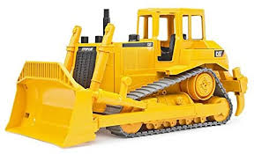
CATERPILLAR EXAMPLE
$420,000 the Caterpillar’s price if equivalent to the competitor’s bulldozer
$50,000 the value added by Caterpillar’s superior reliability and durability
$40,000 the value added by Caterpillar’s lower lifetime operating costs
$40,000 the value added by Caterpillar’s superior service
$20,000 the value added by Caterpillar’s longer parts warranty
$570,000 the total value-added price for Caterpillar’s bulldozer
−$70,000 discount
$500,000 final price
Thus, although the customer pays an $80,000 price premium for the Caterpillar bulldozer, it’s actually getting $150,000 in added value over the product’s lifetime. The customer chose the Caterpillar bulldozer.

Slide 19
2.4. Other internal and external considerations affecting Price Decisions
Overall Marketing strategy, objectives, and Mix
Organizational considerations
The Market and Demand
The economy
Other external factors

Slide 20
Overall Marketing strategy, objectives, and Mix
Before setting price, the company must decide on its overall marketing strategy for the product or service.
For some companies, the overall strategy is built around its price and value story (Example Walmart)
For others, pricing strategy support the overall brand positioning (Example Kindle- positioning: offering the same (or even more, for less)
Pricing may play an important role in helping to accomplish company objectives at many levels.
  A firm can set prices to attract new customers or profitably retain existing ones.
  It can set prices low to prevent competition from entering the market or set prices at competitors’ levels to stabilize the market.
  It can price to keep the loyalty and support of resellers or avoid government intervention.
  Prices can be reduced temporarily to create excitement for a brand.
  Or one product may be priced to help the sales of other products in the company’s line.

Slide 21
Overall Marketing strategy, objectives, and Mix
Target costing: Pricing that starts with an ideal selling price, then targets costs that will ensure that the price is met.
Target costing reverses the usual process of first designing a new product, determining its cost, and then asking, “Can we sell it for that?” Instead, it starts with an ideal selling price based on customer value considerations and then targets costs that will ensure that the price is met.
For example, when Honda initially designed the Honda Fit, it began with a $13,950 starting price point and highway mileage of 33 miles per gallon firmly in mind. It then designed a stylish, peppy little car with costs that allowed it to give target customers those values.

Slide 22

Organizational considerations
Management must decide who within the organization should set prices.
In small companies, prices are often set by top management rather than by the marketing or sales departments.
In large companies, pricing is typically handled by divisional or product managers.
In industrial markets, salespeople may be allowed to negotiate with customers within certain price ranges.

Slide 23
The Market and Demand
Pricing in Different types of Markets
Type of Markets | Definition of market type | Pricing
Pure competition | The market consists of many buyers and sellers trading in a uniform commodity, such as wheat or copper. | Sellers in these markets do not spend much time on marketing strategy. The price is the one set by the market.
Monopolistic competition | The market consists of many buyers and sellers trading over a range of prices rather than a single market price. A range of prices occurs because sellers can differentiate their offers to buyers | Sellers try to develop differentiated offers for different customer segments and, in addition to price, freely use branding, advertising, and personal selling to set their offers apart.
Oligopolistic competition | The market consists of only a few large sellers such as mobile service providers. | Each seller is alert and responsive to competitors’ pricing strategies and marketing moves. price becomes a major competitive tool.
Pure monopoly | The market is dominated by one seller. | Pricing is handled differently depending on the seller.

Slide 24
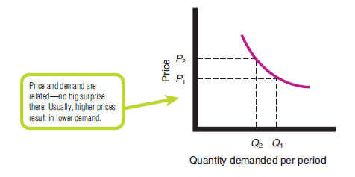
The Market and Demand
Analyzing the Price–Demand relationship
Each price the company might charge will lead to a different level of demand. The relationship between the price charged and the resulting demand level is shown in the demand curve
Demand curve: A curve that shows the number of units the market will buy in a given time period at different prices that might b In the normal case, demand and price are inversely related—that is, the higher the price, the lower the demand charged.

Slide 25

The Market and Demand
Price elasticity of Demand
Price elasticity: A measure of the sensitivity of demand to changes in price
If demand hardly changes with a small change in price, we say demand is inelastic. If demand changes greatly, we say the demand is elastic.
If demand is elastic rather than inelastic, sellers will consider lowering their prices

Slide 26

Economy
Economic conditions can have a strong impact on the firm’s pricing strategies.
Economic factors such as a boom or recession, inflation, and interest rates affect pricing decisions because they affect consumer spending, consumer perceptions of the product’s price and value, and the company’s costs of producing and selling a product..

Slide 27

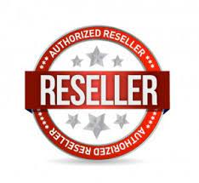

Other external factors
Resellers: The company should set prices that give resellers a fair profit, encourage their support, and help them to sell the product effectively.
The government
Social concerns may need to be considered. In setting prices, a company’s short-term sales, market share, and profit goals may need to be tempered by broader societal considerations.

Slide 28
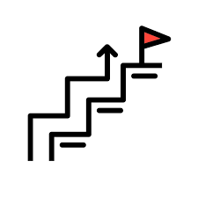
3. New Product Pricing strategies
3.1. Market-skimming Pricing:
Market-skimming pricing (price skimming) Setting a high price for a new product to skim maximum revenues layer by layer from the segments willing to pay the high price; the company makes fewer but more profitable sales (Example: Apple)
Market skimming makes sense only under certain conditions.
  The product’s quality and image must support its higher price, and enough buyers must want the product at that price.
  The costs of producing a smaller volume cannot be so high that it cancels the advantage of charging more.
  Competitors should not be able to enter the market easily and undercut the high price

Slide 29
3. New Product Pricing strategies
3.2. Market-Penetration Pricing
Market- Penetration pricing: Setting a low price for a new product in order to attract a large number of buyers and a large market share (Samsung)
Companies set a low initial price to penetrate the market quickly and deeply—to attract a large number of buyers quickly and win a large market share. The high-sales volume results in falling costs, allowing companies to cut their prices even further
Several conditions must be met for this low-price strategy to work.
  The market must be highly price sensitive so that a low price produces more market growth.
  Production and distribution costs must decrease as sales volume increases.
  The low price must help keep out the competition, and the penetration price must maintain its low-price position. Otherwise, the price advantage may be only temporary

Slide 30
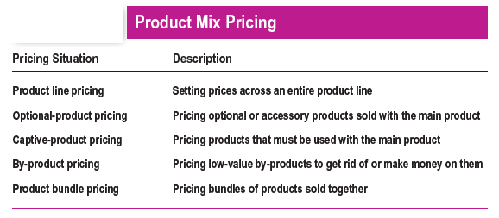
4. Product Mix Pricing strategies

Slide 31
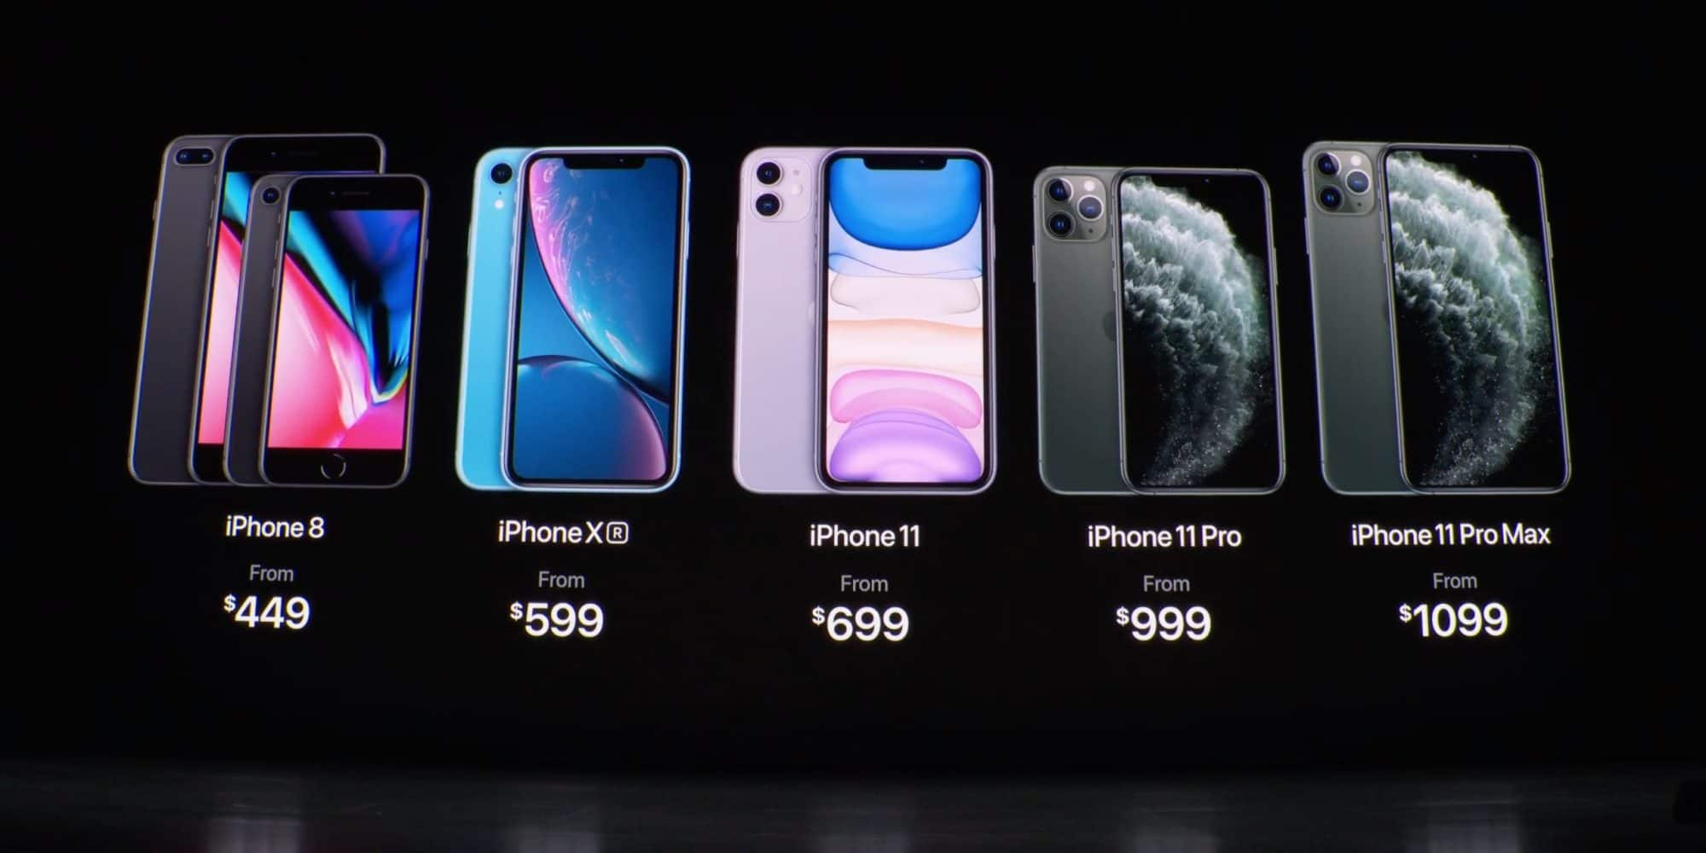
4.1. Product line Pricing:
Setting the price steps between various products in a product line based on cost differences between the products, customer evaluations of different features, and competitors’ prices.

Slide 32
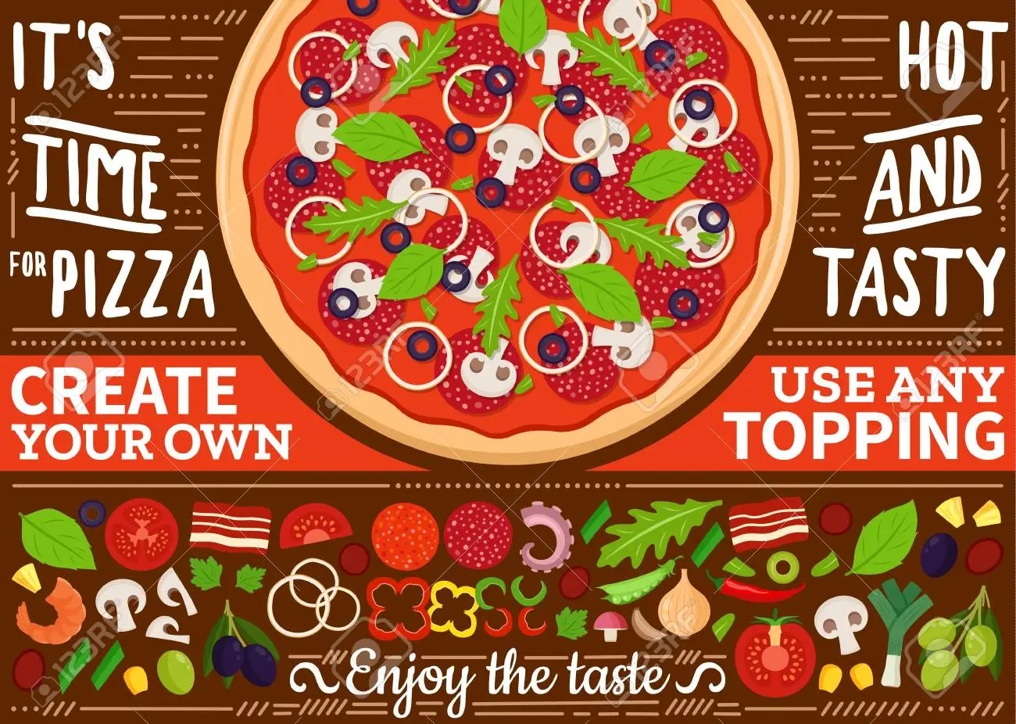
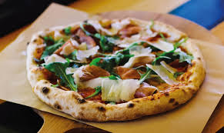
4.2. Optional-Product Pricing:
The pricing of optional or accessory products along with a main product.

Slide 33
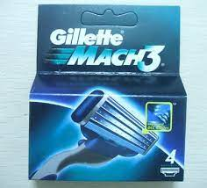

4.3. Captive-Product Pricing:
Setting a price for products that must be used along with a main product.

Slide 34
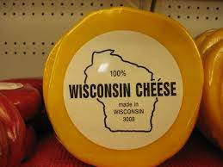

4.4. By-Product Pricing:
Setting a price for by-products in order to make the main product’s price mor competitive.
Using by-product pricing, the company seeks a market for these by-products to help offset the costs of disposing of them and help make the price of the main product more competitive

Slide 35
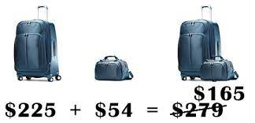
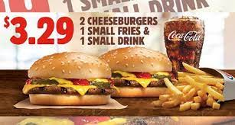
4.5. Product bundle Pricing
Combining several products and offering the bundle at a reduced price.
Price bundling can promote the sales of products consumers might not otherwise buy, but the combined price must be low enough to get them to buy the bundle.

Slide 36
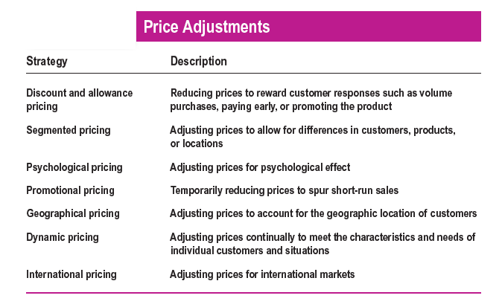
5. Price adjustment strategies

Slide 37
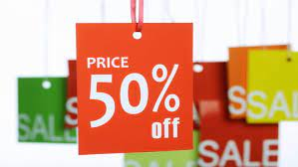
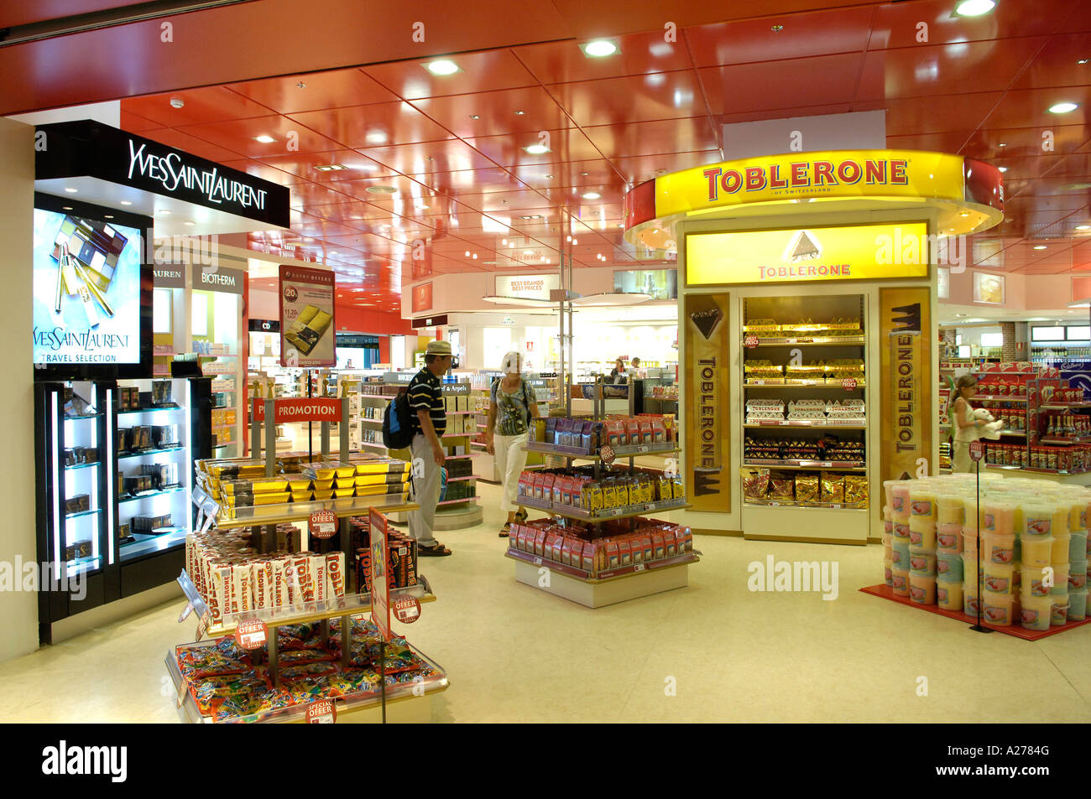
5.1. Discount and allowance Pricing
Discount: A straight reduction in price on purchases during a stated period of time or of larger quantities.
Allowance: Promotional money paid by manufacturers to retailers in return for an agreement to feature the manufacturer’s products in some way.

Slide 38

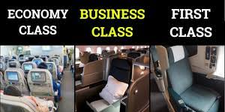
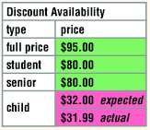
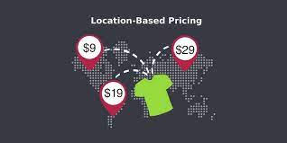
5.2. Segmented Pricing
Time-based pricing
Product form pricing
Selling a product or service at two or more prices, where the difference in prices is not based on differences in costs.
Customer-segment pricing, different customer pay different prices for the same product or service.
Product form pricing, different versions of the product are priced differently but not according to differences in their costs.
Location-based pricing, a company charges different prices for different locations, even though the cost of offering each location is the same.
Time-based pricing, a firm varies its price by the season, the month, the day, and even the hour.
Customer-segment pricing
Location-based pricing

Slide 39
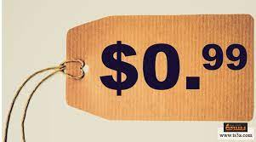
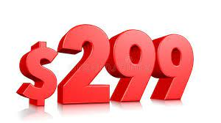
5.3. Psychological Pricing
Pricing that considers the psychology of prices and not simply the economics; the price is used to say something about the product.
Consumers usually perceive higher-priced products as having higher quality specially when they cannot judge quality because they lack the information or the necessary skills.
Reference prices: Prices that buyers carry in their minds and refer to when they look at a given product. The reference price might be formed by noting current prices, remembering past prices, or assessing the buying situation.

Slide 40
5.4. Promotional Pricing
Promotional pricing: Temporarily pricing products below the list price, and sometimes even below cost, to increase short-run sales.
Forms of promotional pricing:
  Discounts
  Special-event pricing
  Limited-time offers
  Flash sales
  Cash rebates
  Low-interest financing, longer warranties, or free maintenance.
Promotional pricing can have adverse effects as consumers may delay buying a product until it gets promoted + if used too frequently it can erode a brand’s value in the eyes of customers.

Slide 41

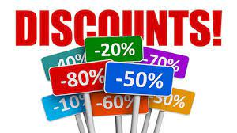
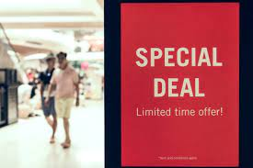
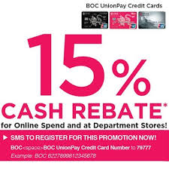

Example forms of promotional pricing
  Special-event pricing
  Discounts
  Limited-time offers
  Cash rebates
  Flash sales

Slide 42
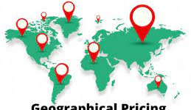
5.5. Geographical Pricing
A company also must decide how to price its products for customers located in different parts of the country or the world.

Slide 43

5.5. Dynamic and online Pricing
Dynamic Pricing: Adjusting prices continually to meet the characteristics and needs of individual customers and situations.
Dynamic pricing is especially prevalent online.
Done well, dynamic pricing can help sellers to optimize sales and serve customers better.
However, done poorly, it can trigger margin-eroding price wars and damage customer relationships and trust.

Slide 44

5.6. International Pricing
Companies that market their products internationally must decide what prices to charge in different countries.
In some cases, a company can set a uniform worldwide price
However, most companies adjust their prices to reflect local market conditions and cost considerations.
The price that a company should charge in a specific country depends on many factors, including economic conditions, competitive situations, laws and regulations, and the nature of the wholesaling and retailing system. Consumer perceptions and preferences also may vary from country to country, calling for different prices

Slide 45


