Slide 1
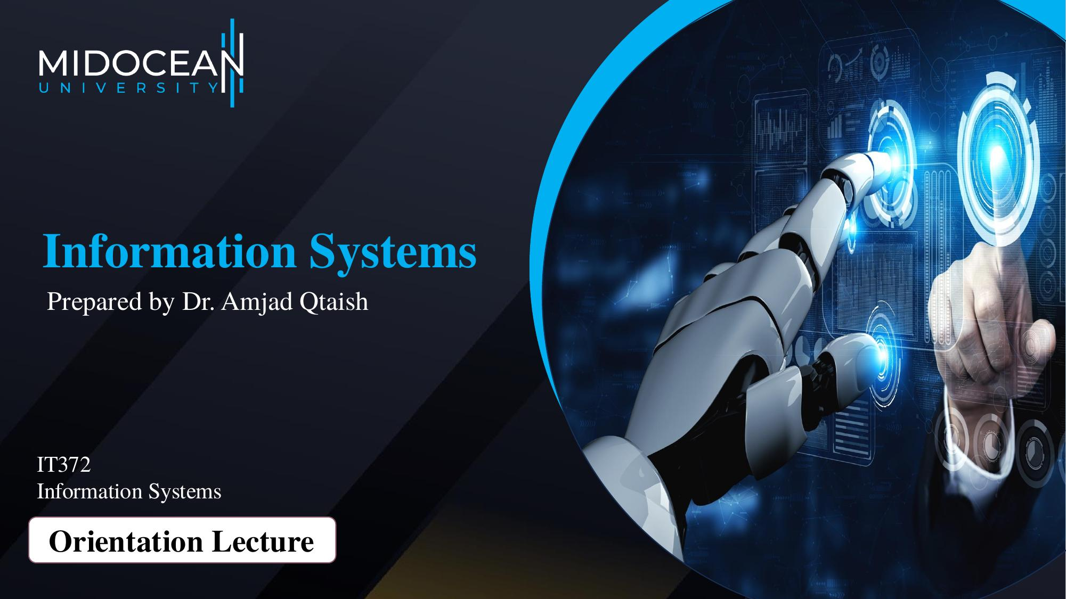

Slide 2
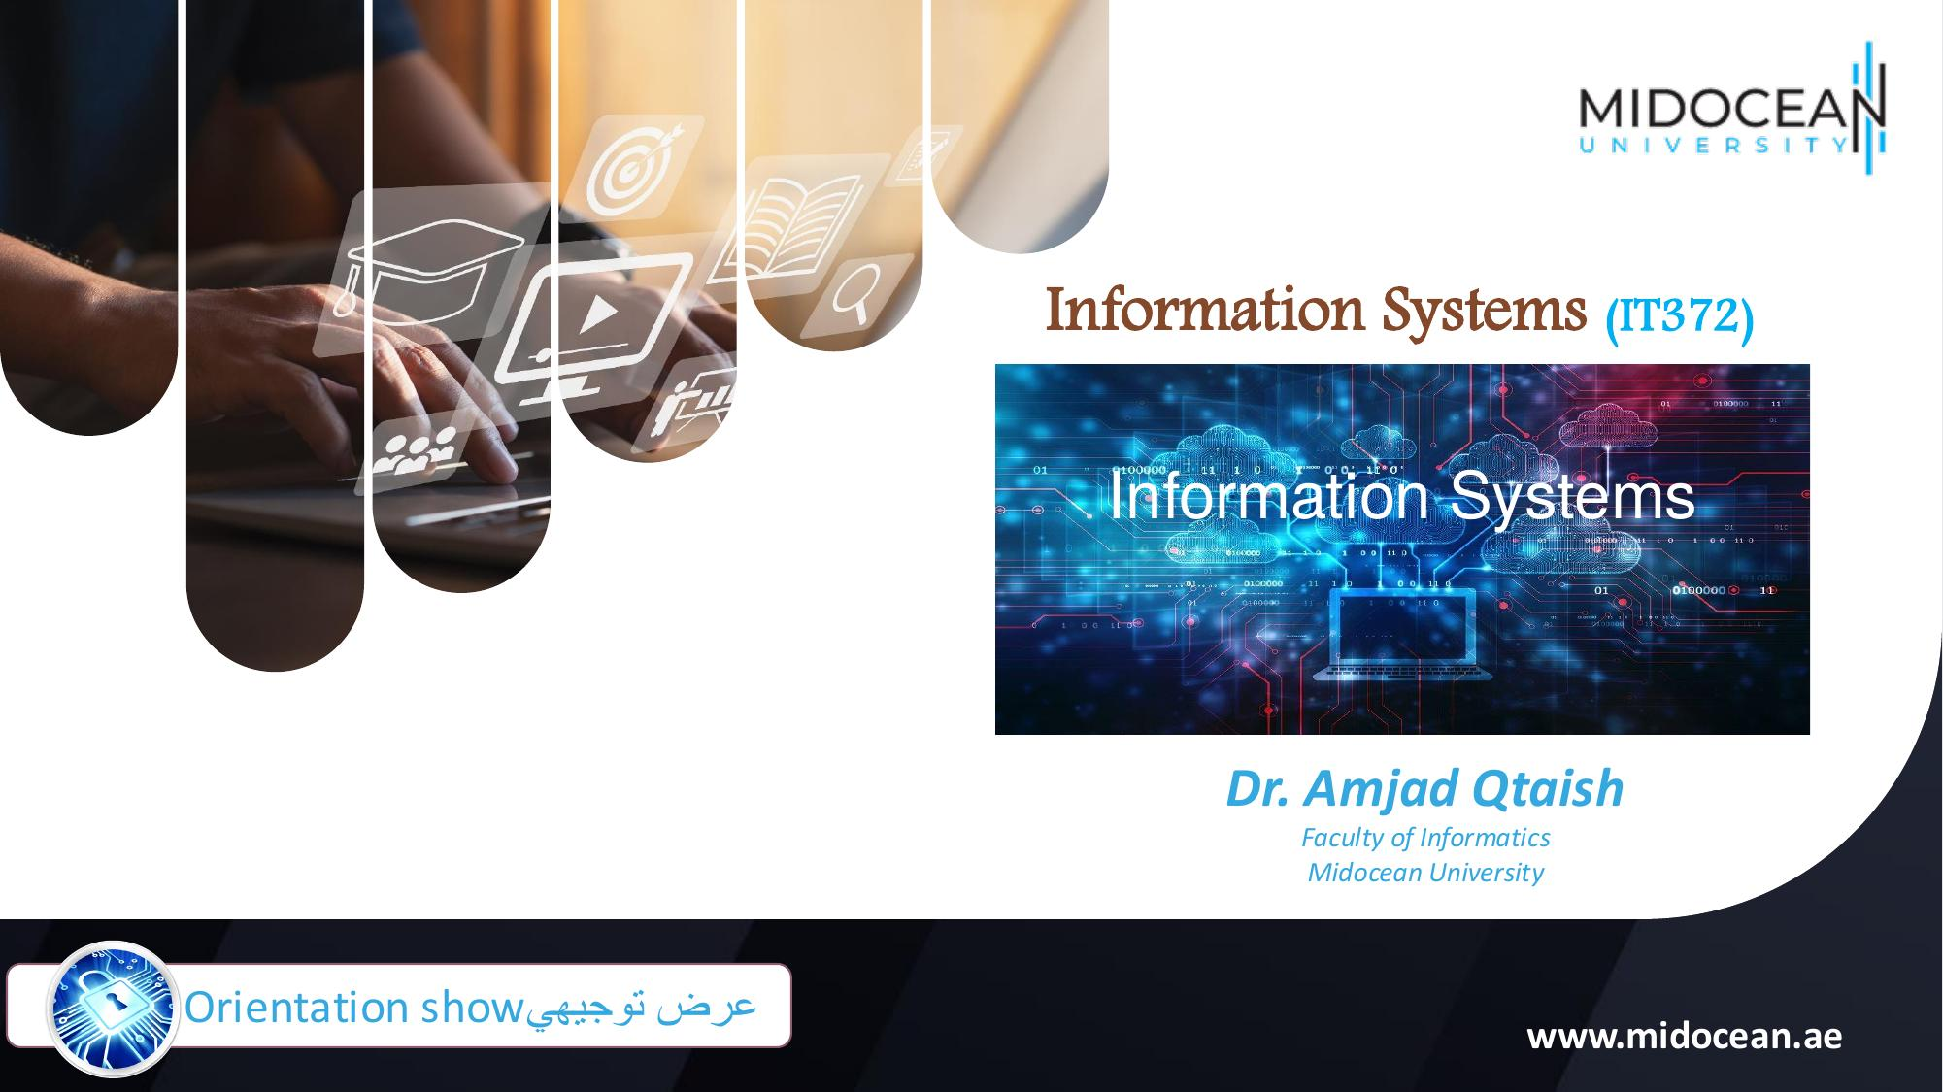

Slide 3
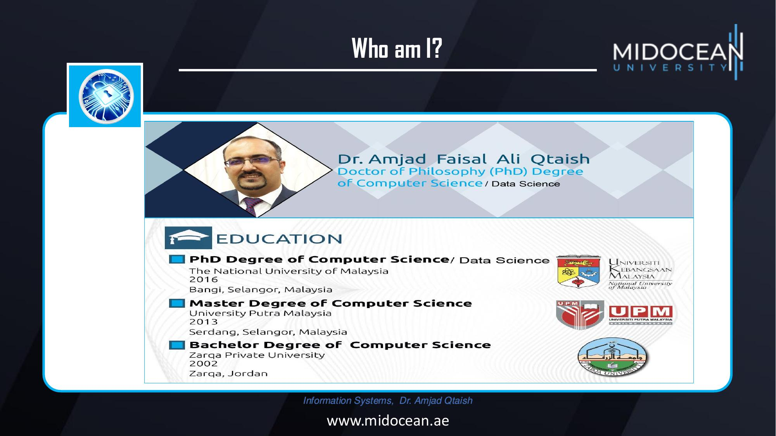

Slide 4
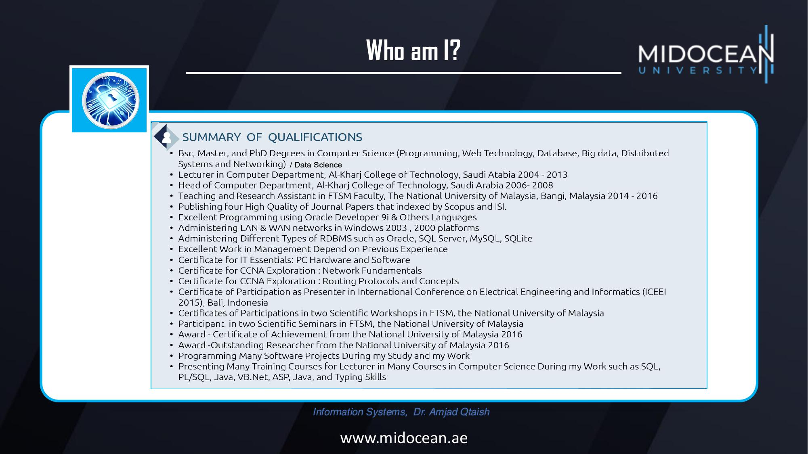

Slide 5
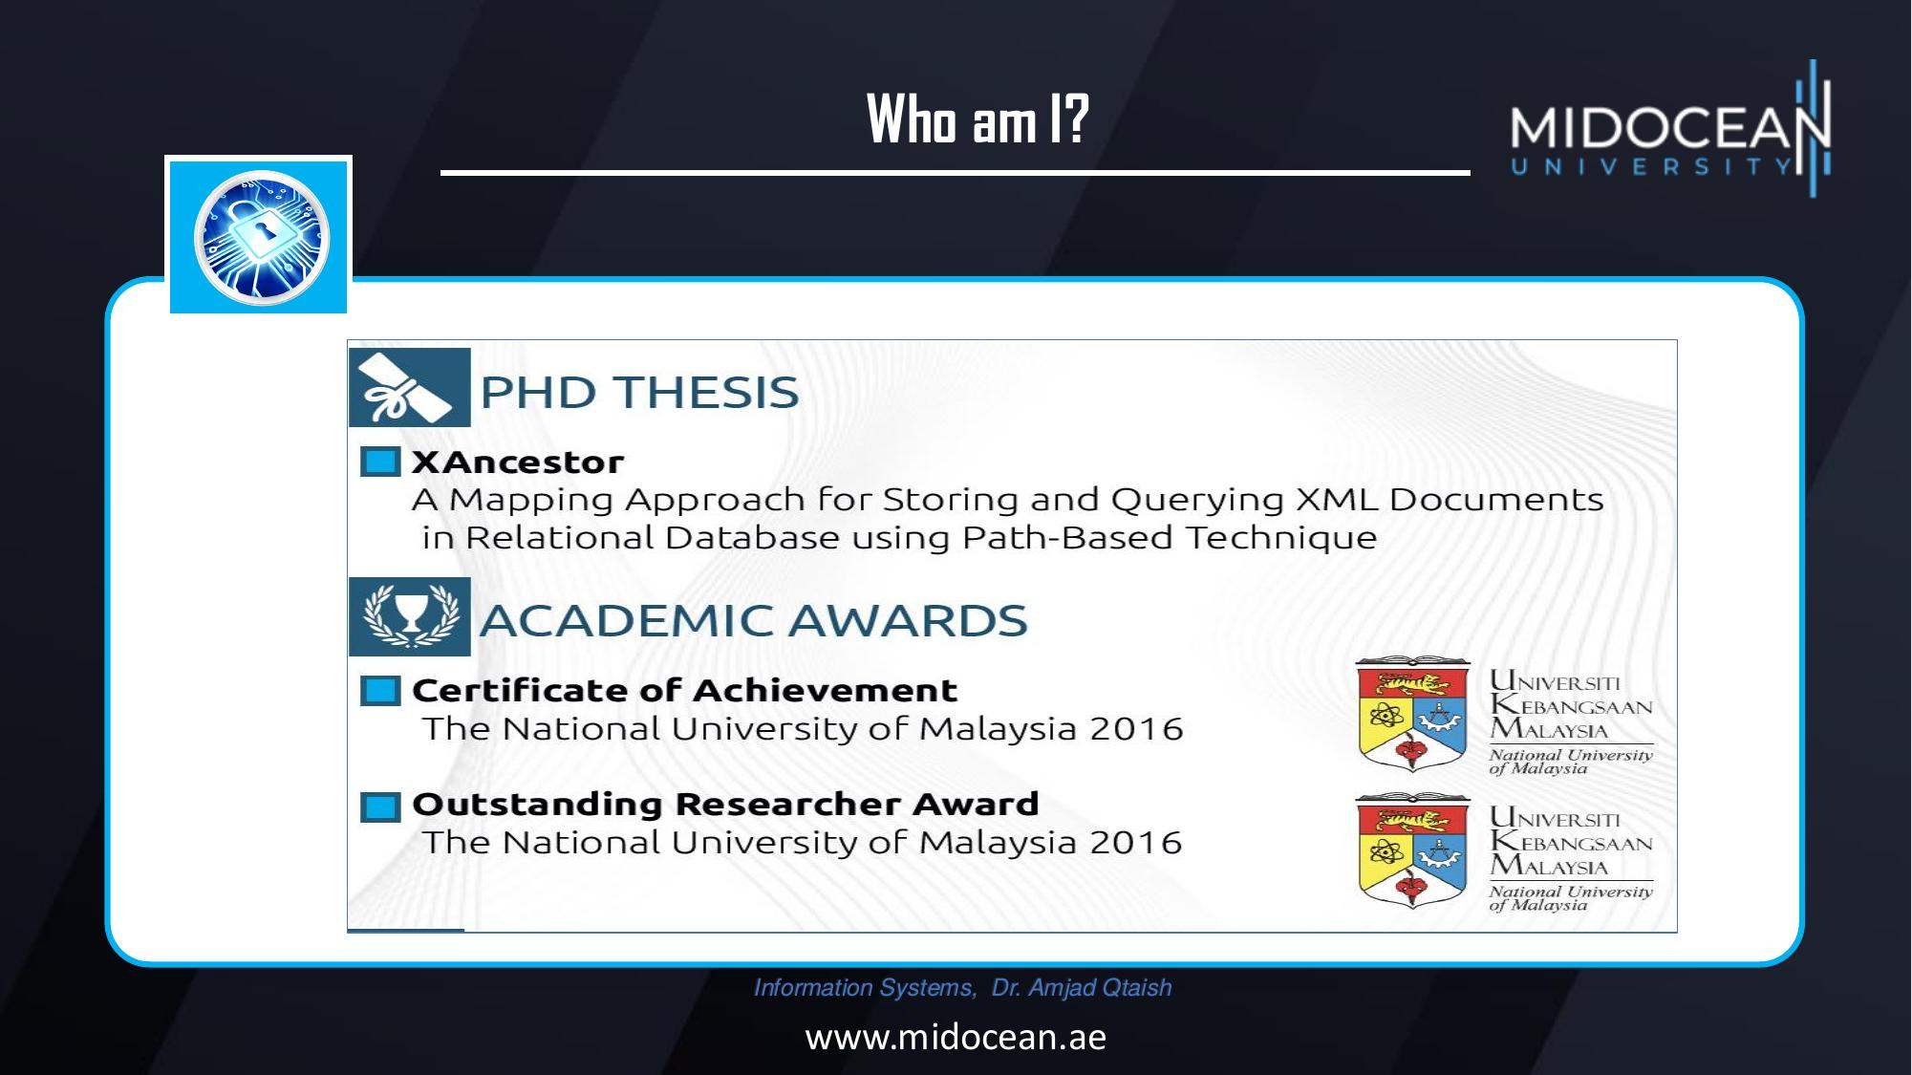

Slide 6
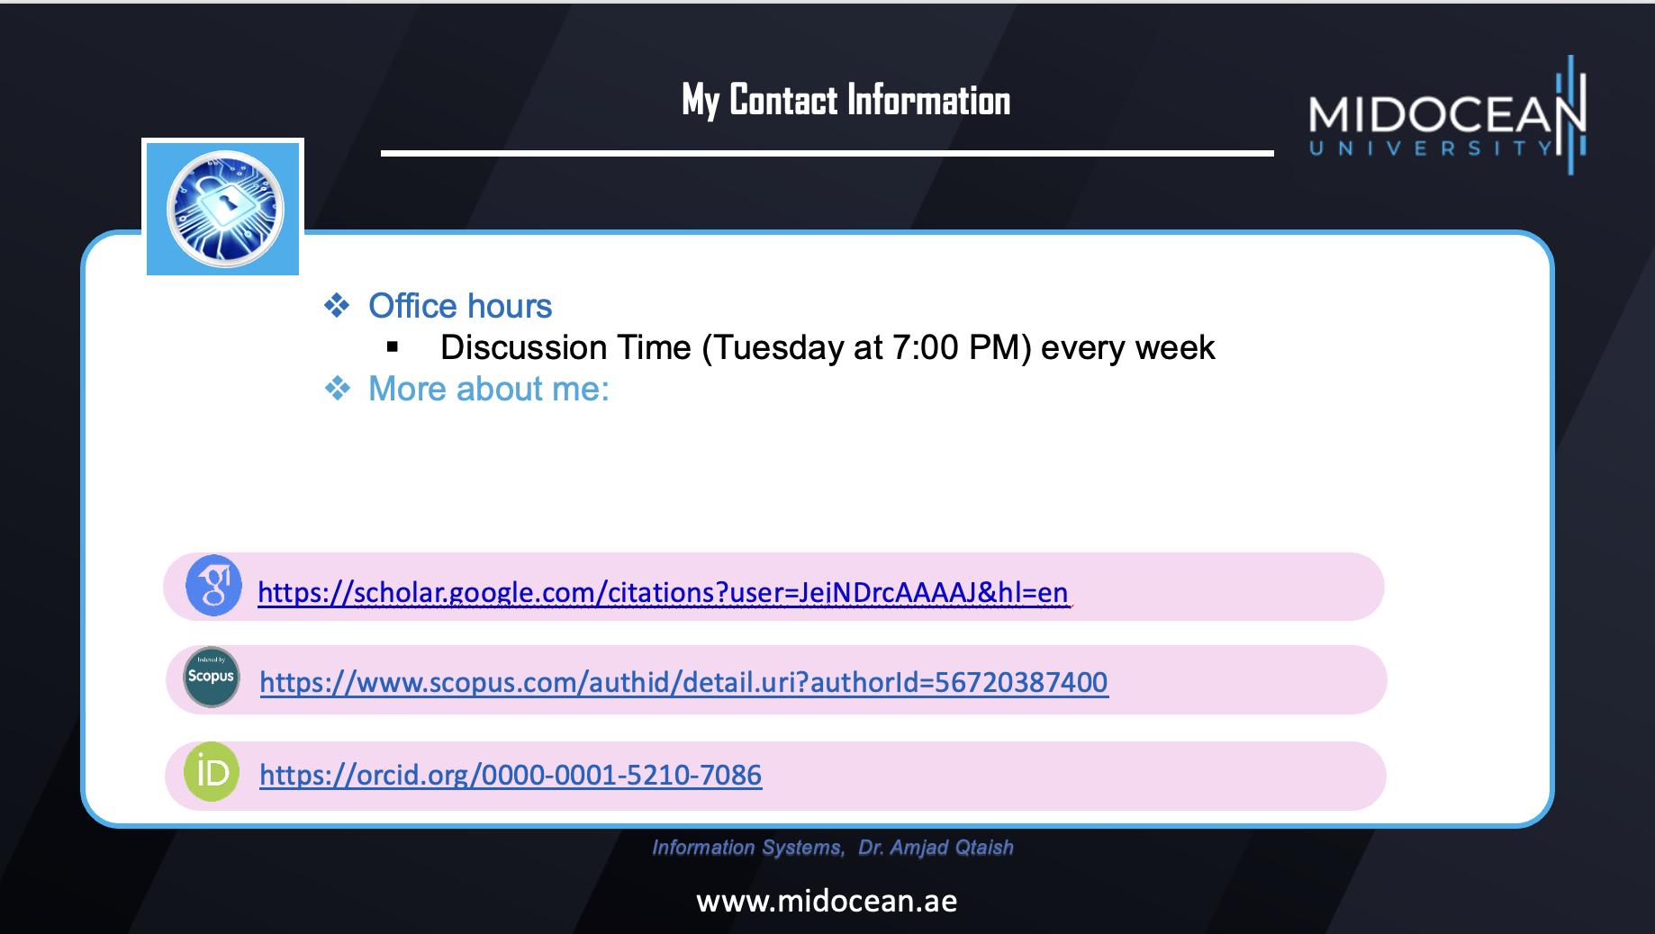

Slide 7
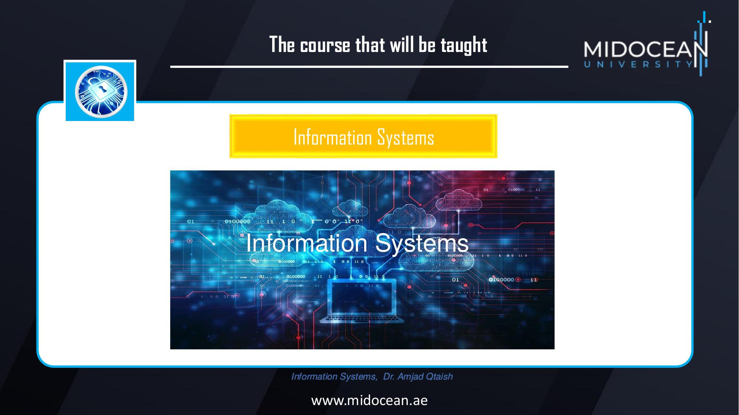

Slide 8
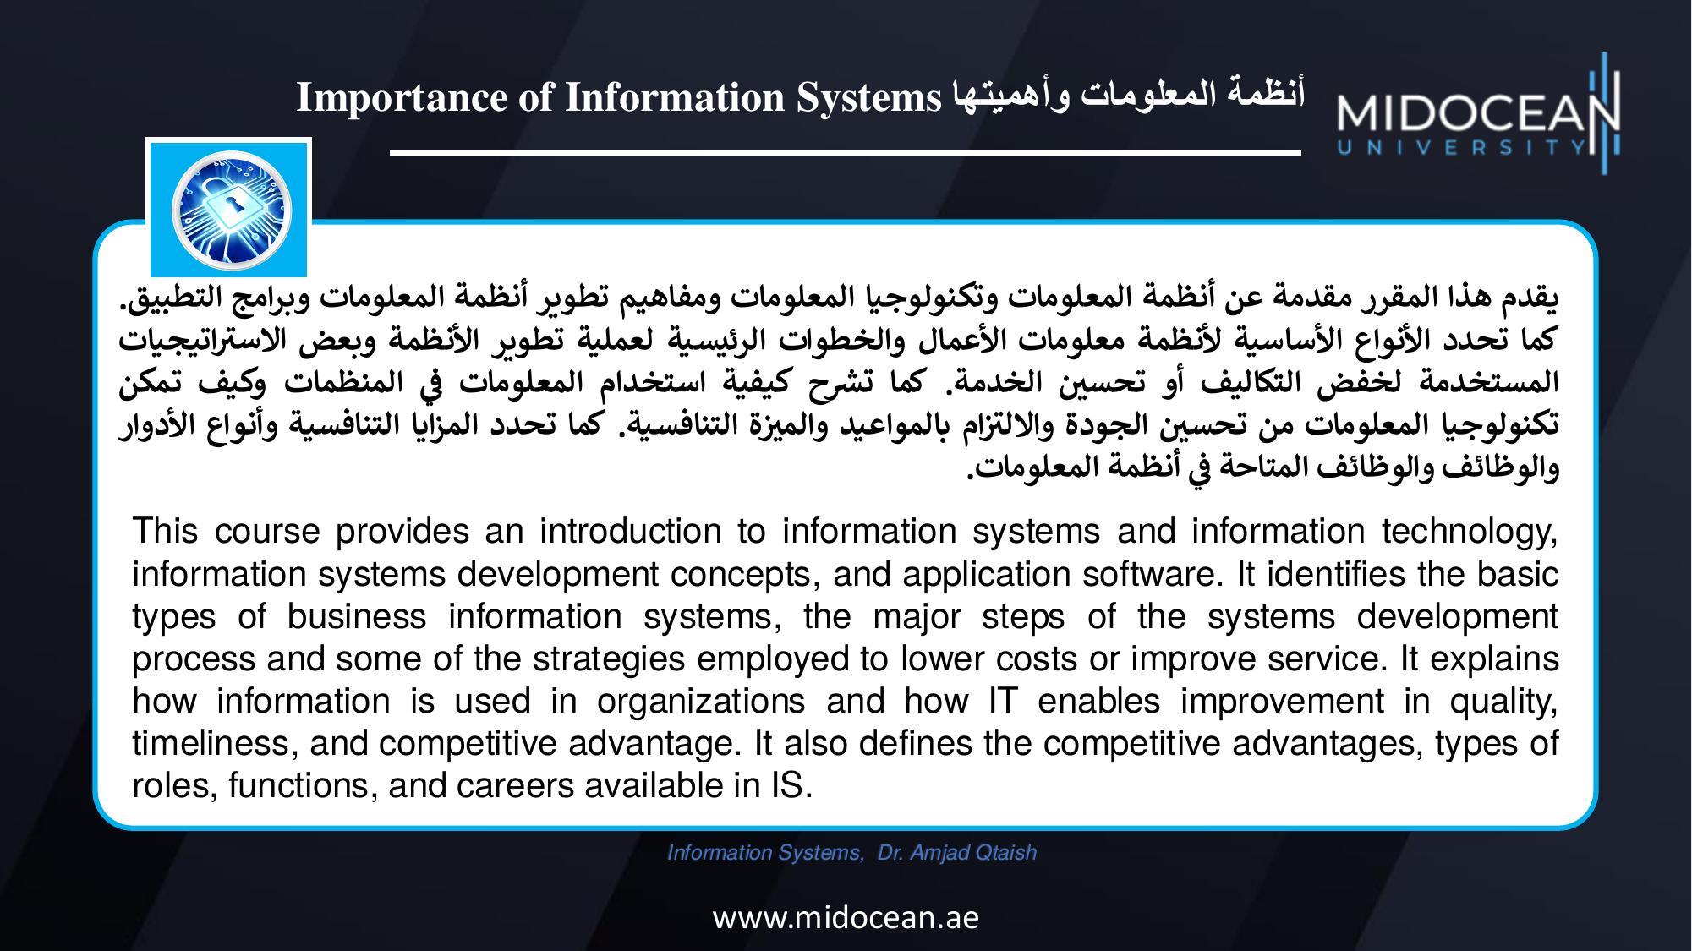

Slide 9
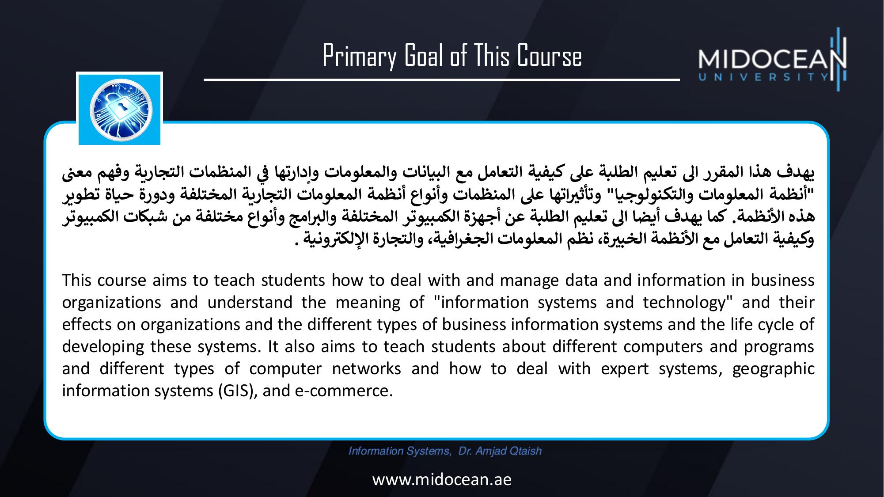

Slide 10
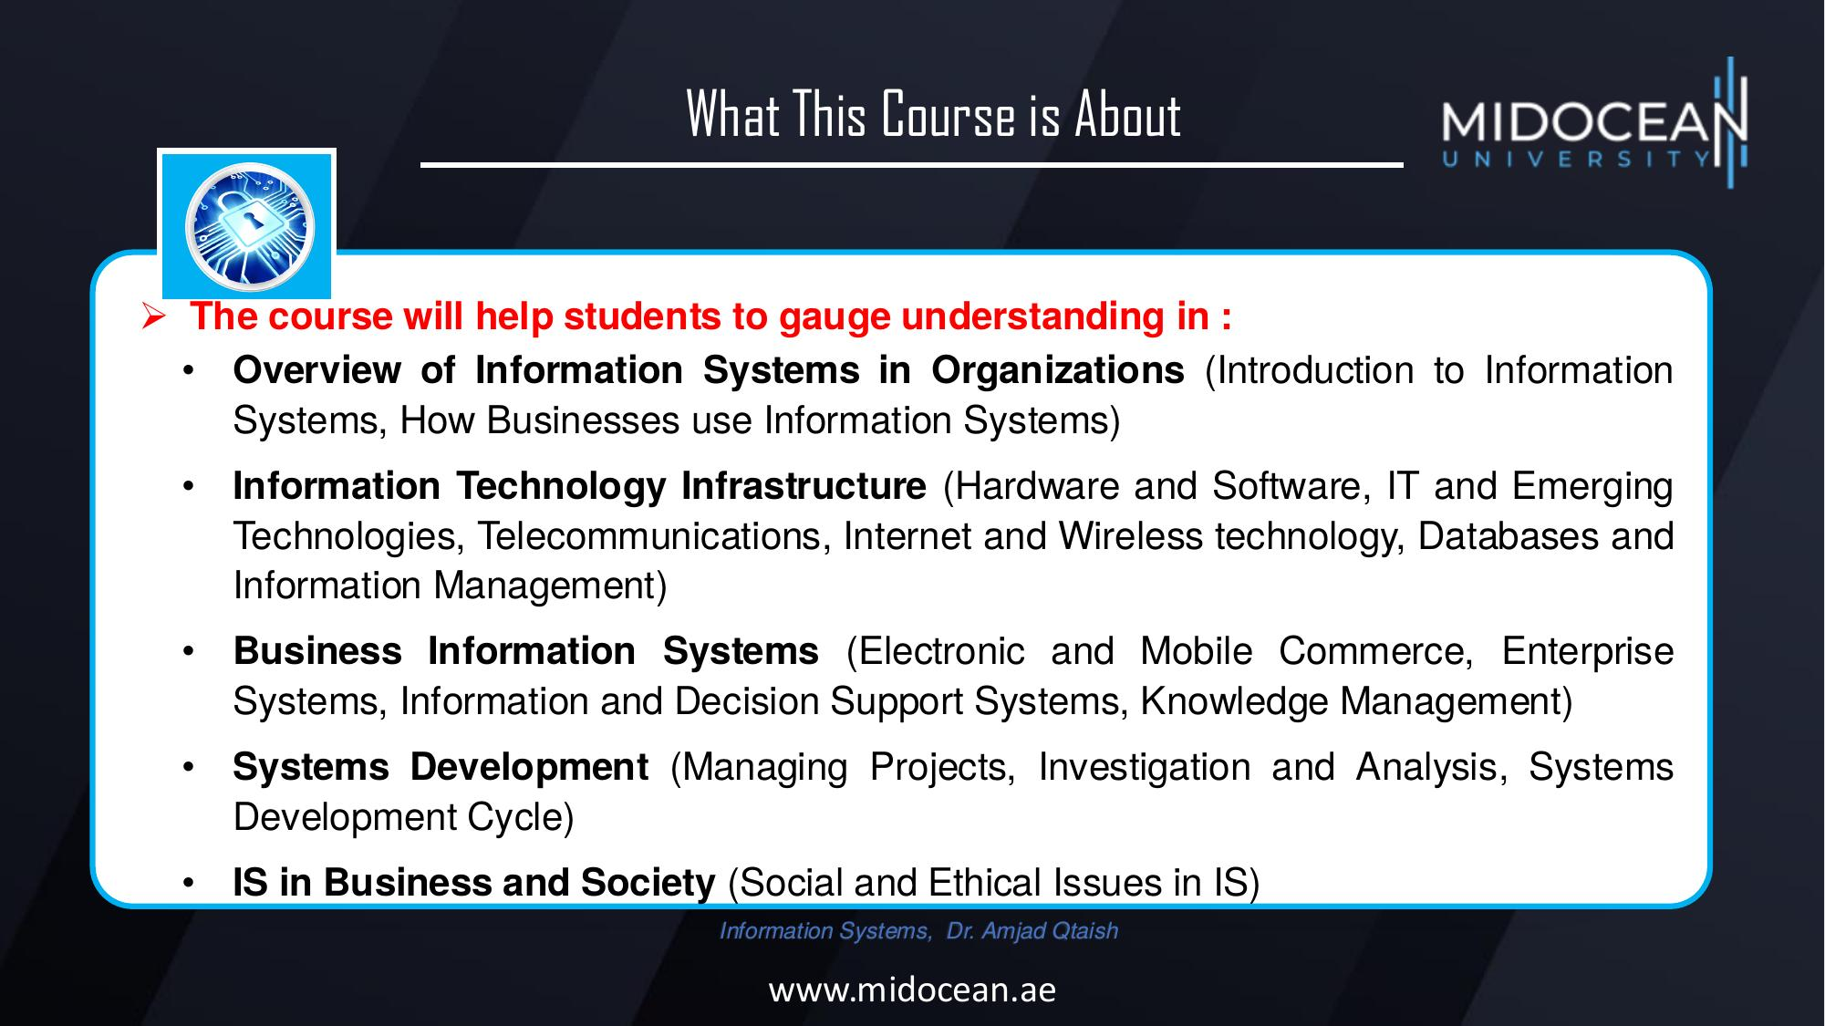

Slide 11


Units of Course Contents
Module | Course Unit | No.of. Weeks | Contact Hours
1 | Lecture 1: Introduction to Information Systems | 1st | 3
2 | Lecture 2: Hardware, Software, and Emerging Technologies | 2nd | 3
3 | Lecture 3: Databases and Information Management | 3rd | 3
4 | Lecture 4: Telecommunications, Internet and Wireless Technology | 4th | 3
5 | Lecture 5: Electronic and Mobile Commerce, Enterprise Systems | 5th | 3
6 | Lecture 6: Information and Decision Support Systems | 6th | 3
7 | Lecture 7: Investigation and Analysis | 7th | 3
8 | Lecture 8: Knowledge Management, Information System Project Management | 8th | 3
9 | Lecture 9: Design And Implementation, Social and Ethical Issues in IS | 9th | 3
10 | Lecture 10: expert ‎systems (ES), Geographic information system (GIS) | 10th | 3
Information Systems, Dr. Amjad Qtaish
www.midocean.ae

Slide 12
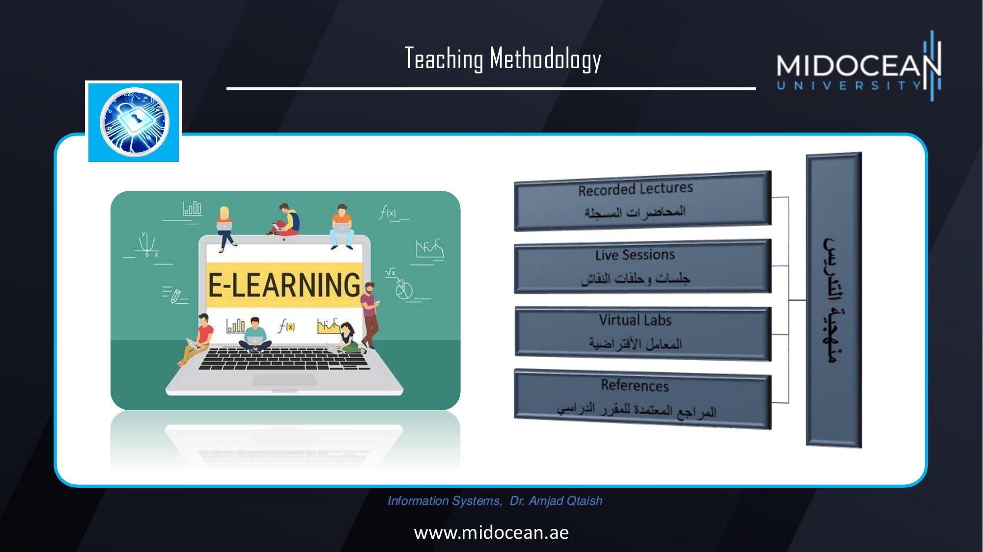

Slide 13
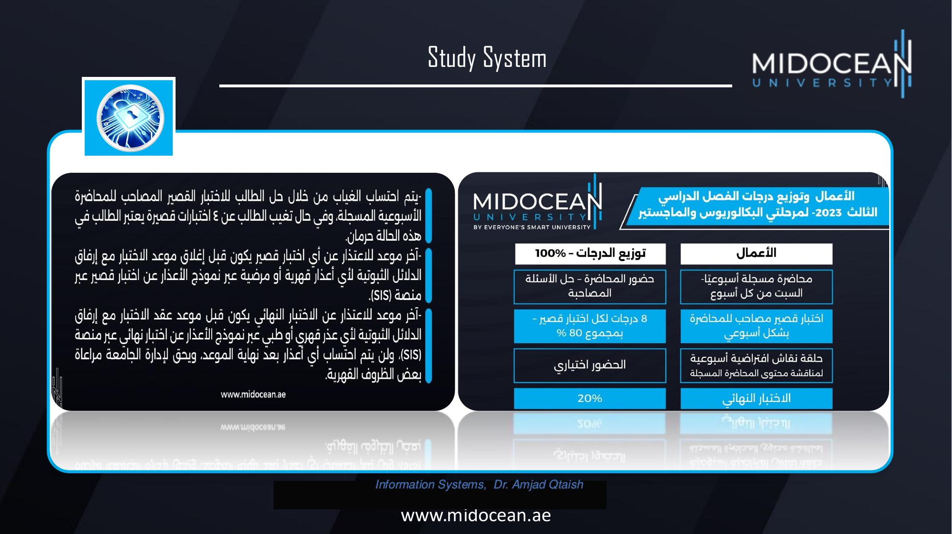

Slide 14
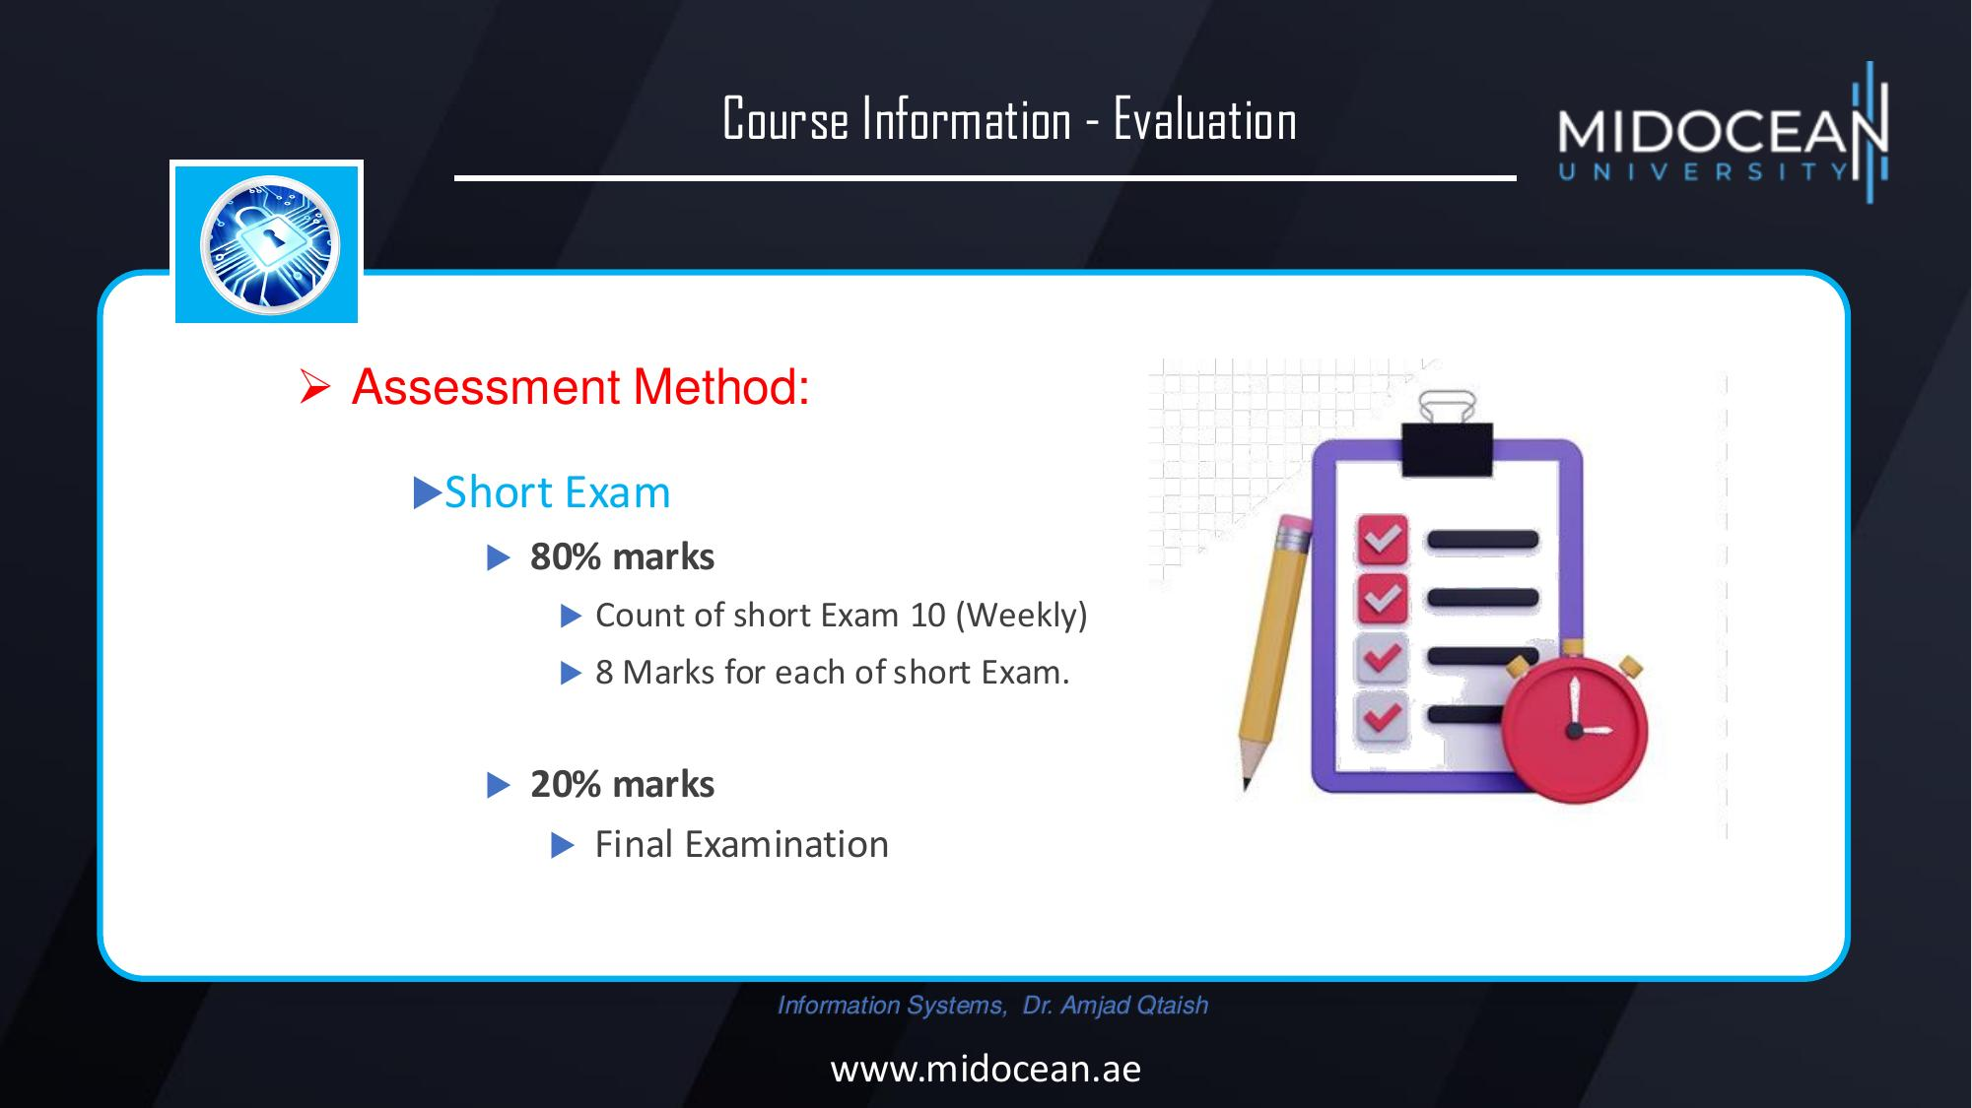

Slide 15
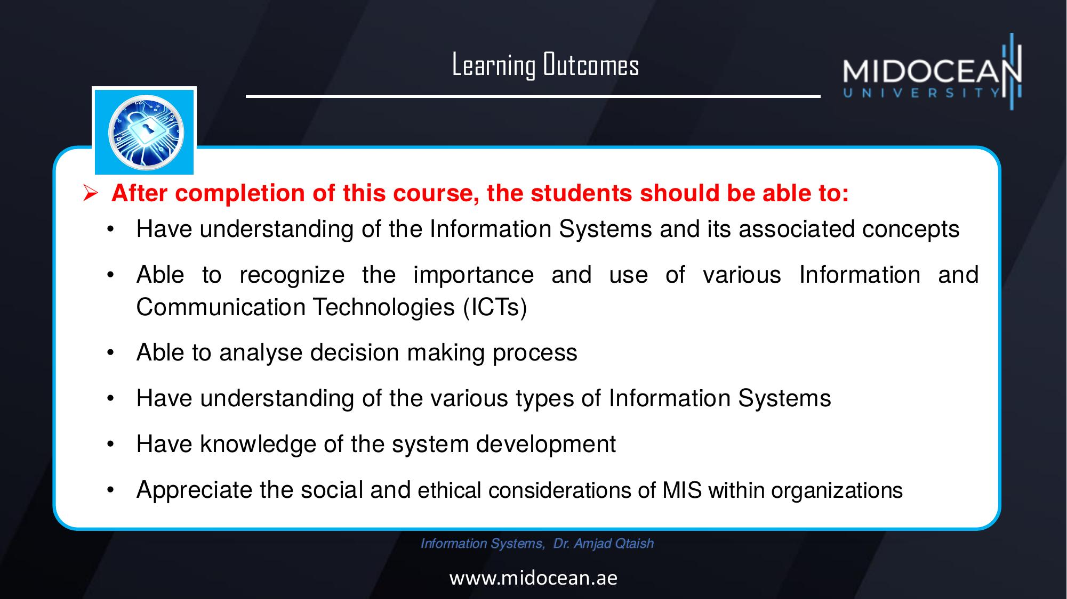

Slide 16
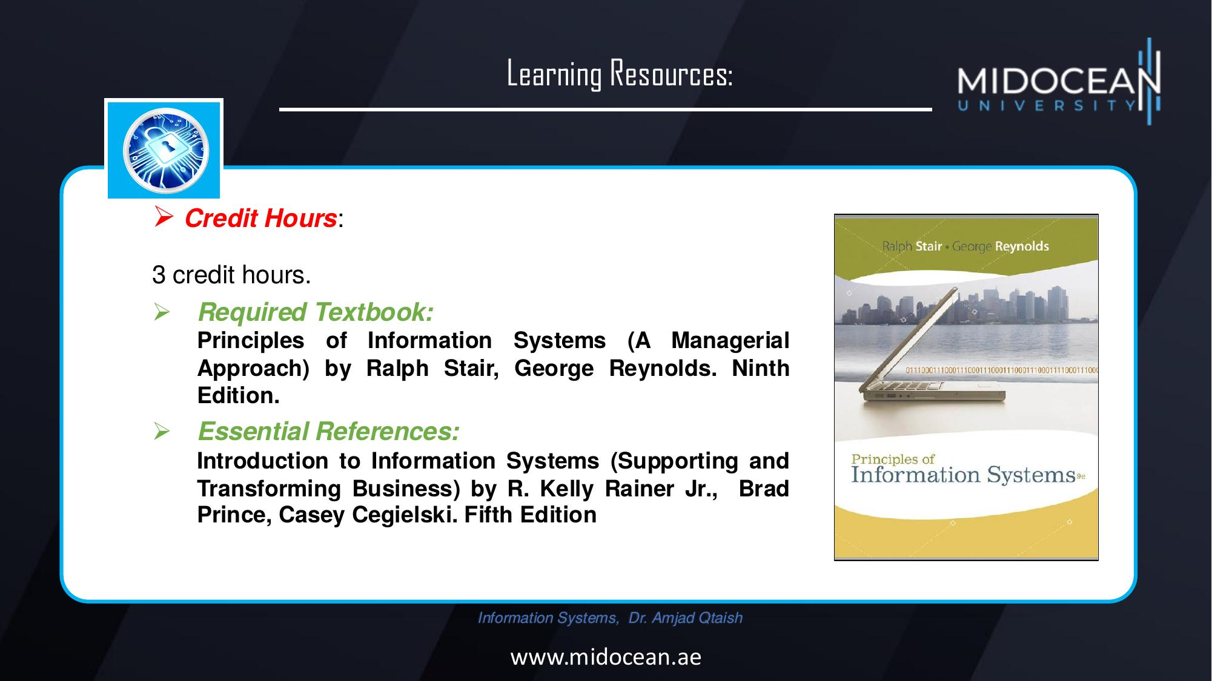

Slide 17


