Slide 1

Risk Registers
Lecture 10
Everyone’s Smart
University
PMG510
Risk Management

Slide 2

Common Risk Register attributes
Risk Identification
1. Risk ID – This is a unique identification number used to identify and track the risk in the risk register. If Resources is Category 8, then the first risk identified in this category has a unique ID of 8.1.
2. Risk Category – This is where you categorize your risk. Does it fall under the category of scope, time, cost, resources, environmental, or another key category? Using these categories helps tease out likely risks and groups them into relevant categories for future reference.
3. Risk Description – A brief description of the potential risk
Risk Analysis data
4. Project Impact – A description of the potential impact on the project as a result of the risk.
5. Likelihood – The estimated likelihood or probability that the risk will occur at some point and become a project issue. This can be qualitative: high, medium, or low; but it can also be quantitative if enough information is available.
6. Consequence – The potential consequence or impact of the risk if it did become a project issue. For our project, time is a fixed constraint, and so any risk that has the potential to significantly delay the project schedule has a “High” consequence.

Slide 3
Common Risk Register attributes
Risk Evaluation
7. Risk Rank – This is the magnitude or the level of the risk. It is a combination of likelihood and consequence. As they are both “High” in our example, then the risk rank is also “High.”
8. Risk Trigger – What are the triggers that would indicate the need to implement contingency plans? “If resource conflicts have not been resolved three weeks before the scheduled start date, then implement contingency plans.”
Risk Treatment
9. Prevention Plan – This is an action plan to prevent the risk from occurring.
10. Contingency Plan – This is an action plan to address the risk if it does occur.
11. Risk Owner – This is the person responsible for managing the risk and implementing the Prevention or Contingency Plans. 12. Residual Risk – This is the risk that remains after treatment is carried out. After treatment, we assess the residual risk level as “Low.”

Slide 4

Risk Register Tailoring
Risk Identification
1. Risk ID
2. Risk Category
3. Risk Description
Risk Identification
1. Risk ID
2. Risk Category
3. Risk Description
Risk Analysis data
4. Project Impact
5. Likelihood
6. Consequence
Risk Analysis data
4. Project Impact
5. Likelihood
Risk Evaluation
7. Risk Rank
8. Risk Trigger
Risk Evaluation
8. Risk Trigger
Risk Treatment
Risk Treatment
9. Prevention Plan
10. Contingency Plan
11. Risk Owner
12. Residual Risk
10. Contingency Plan
11. Risk Owner

Slide 5
Case Study
Establishment of Community Based Safe Drinking Water Centers” – Tanzania
Project Background:
Access to safe and readily available water for drinking and domestic use is fundamental for a healthy and productive life. The project aims to establish a sustainable model for enhancing access to safe drinking water in Kahama Rural District, Shinayana Region, through a community-based water management system. The proposed project seeks to improve access to safe water in rural Tanzania through the establishment of community based safe drinking water centers. The project will be implemented in Kahama Rural District, Shinayana Region, Tanzania over a period of 2.5 years. The project is based on the principles of Participatory Development and will involve the communities’ right from the initial stages so as to develop a strong foundation and to inculcate ownership of the project.
Tanzania has more than 37% water resources than Uganda and almost three times more renewable water than Kenya, but despite the availability of water resources in abundance, communities in both rural and urban Tanzania face severe water shortage. The rural communities in Tanzania face water security risks in terms of both the availability and water quality, which further impacts the health and the socio-economic development of the people and the region. Though there have been investments made towards the improvement of water access and technological interventions to improve water quality, the situation has not improved much, which could be attributed to poor management systems and lack of willingness to adapt to new processes both by the local administration and the communities.
Another factor that affects water shortage in Tanzania, is the population explosion that has occurred between 1967 to 2012 (the population has tripled from 12.3 million to 44.9 million). 70% of the increase has happened in rural areas, thereby adding pressure to the local water bodies in the rural region. Furthermore, reports suggest that access to drinking water coverage increased by only 1% between 1990 to 2015. Data from The World Bank also reiterates that population growth has led to water stress in the country and the average volume of renewable fresh water per capita per year in Tanzania has declined by 80% since 1962.

Slide 6
Case Study
Establishment of Community Based Safe Drinking Water Centers” – Tanzania
Project Goal:
The project aims to establish a sustainable model for enhancing access to safe drinking water in Kahama Rural District, Shinayana Region, through a community-based water management system.
Project Objectives
To develop community based safe drinking water plans for the identified project wards in Kahama Rural District, Shinayana Region.
To strengthen the local institutions and to build the capacity of community groups to enhance clean water access in the identified project site.
To establish community owned safe drinking water centers and improve local infrastructure to enhance clean water supply in project wards.
Project Budget
The project is full reserved and fund by everyone’s smart university – ESU , United Emiratis.

Slide 7
Case Study
Establishment of Community Based Safe Drinking Water Centers” – Tanzania
Project Approach:
The project is based on the principles of Participatory Development and will involve the communities right from the initial stages so as to develop a strong foundation and to inculcate ownership of the project. The following stages of participatory development projects will be utilized during project implementation.
Research: During this phase, we shall involve relevant stakeholders to get all the information related to water issues. We will be conducting meetings and interviews of local community members, water associations, local government authorities and others in the sector.
Design: To secure ownership and commitment of the communities, we shall develop safe water plans with the local communities. The suggested interventions for safe water supply will be more effective and will be readily adopted by the community only when the plan takes into consideration the ideas and suggestions of the local community. We have to use international specialists.
Implementation: To ensure sustainability of the project and increase the commitment, relevance and ownership, the project will be implemented in collaboration with the local community. The overseeing will conduct by some Saudis experts.
Evaluation: The local communities will be involved for evaluation of the project as well, and based on the feedback received, necessary changes will be made. The indicators for evaluation of the project will be identified right in the beginning of the project and necessary data will be collected throughout the project duration.
Now..
We assign you as forging consultant to develop the project risk register. Do you job..

Slide 8
Case Study
Establishment of Community Based Safe Drinking Water Centers” – Tanzania
8
Identify Risks
Tools & Techniques
.1 Expert judgment
.2 Data gathering
• Brainstorming
• Checklists
• Interviews
.3 Data analysis
• Root cause analysis
• Assumption and constraint analysis
• SWOT analysis
• Document analysis
.4 Interpersonal and team skills
• Facilitation
.5 Prompt lists
.6 Meetings
Inputs
Outputs

Slide 9
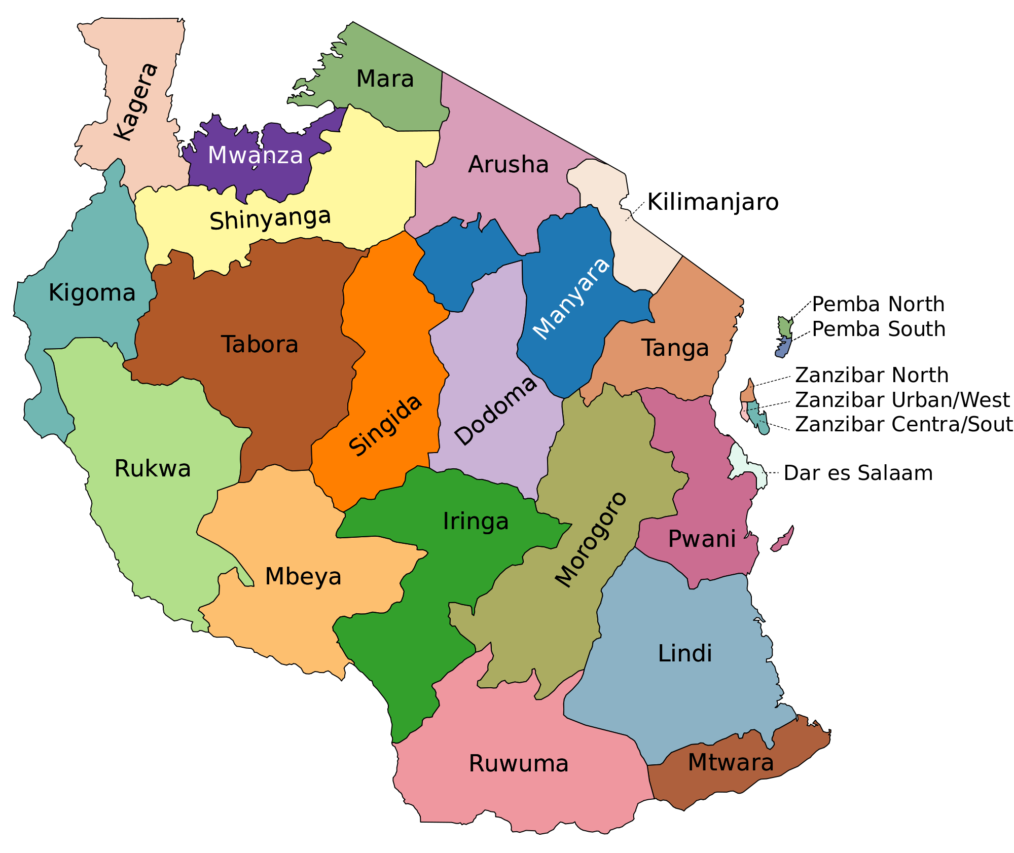

Case Study
Establishment of Community Based Safe Drinking Water Centers” – Tanzania
Data gathering
تقسم تنزانيا إلى 30 إقليم. تقسم الأقاليم إلى 169 ضاحية تمتلك كل منها مجلساً واحداً على الأقل وذلك لزيادة السلطة المحلية؛ تعرف هذه المجالس أيضاً بالسلطات الحكومية المحلية. حالياً يوجد 169 مجلساً، 34 منها في المدن و 92 في المناطق الريفية. يغلب على المجتمعات الطابع العربي والإسلامي في زنجبار بسبب التواجد العماني الممتد لقرون في هذه المناطق التي كانت جزءا من الإمبراطورية العمانية ويشكل العمانيون اليوم نسبة كبيرة من سكان تنزانيا كما يشغلون مناصب سياسية واقتصادية.
الزراعة دعامة الاقتصاد التنزاني وتمثل 85% من قيمة الصادرات، يعمل بها أكثر من 80% من السكان، والحاصلات تتكون من الأرز، والذرة والنباتات الدرنية وتشغل الغلات الزراعية الغذائية 60% من الأراضي الزراعية، ومن الحاصلات القطن، والبن، والقرنفل، والسيسل، والكاسافا، وقصب السكر، ونخيل الزيت.
تمتد أرض تنزانيا من المحيط الهندي شرقا على شكل شواطئ رملية وشعاب مرجانية ومستنقعات تنمو بها غابات المنجروف الساحلية، ثم سهل يمتد بطول سواحلها، ويبلغ أقصى عرض له في المنطقة الوسطى إلى الغرب من مدينة دار السلام، ثم يلي الساحل من الغرب هضبة متوسطة ارتفاعها 1500 متر، تنتشر فوقها الجبال البركانية، مثل كليمنجارو أعلى جبال أفريقيا ويقع قرب منطقة الحدود بينها وبين كينيا، وجبل أوزبارا، وتضم تنزانيا مسطحاً عظيماً من البحيرات العذبة، وتزيد مساحتها على 53000 كيلو متر منها نصف بحيرة فكتوريا ونصف بحيرة تنجانيقا وقسما من بحيرة ملاوي (نياسا سابقاً) وعدداً من البحيرات الصغيرة، وأبرز أنهار تنزانيا روفوما ويشكل الحدود بينها وبين موزمبيق، ونهر روفيجي، ووامي وبنجاني. وتمتاز تنزانيا بعدد جيد من أنواع الحيوانات حيث توجد كثير من أنواع الغزلان والقطط الكبيرة وحمير الوحش والجواميس والأبقار والزراف والفيلة والنعام في سهول السافانا والماعز والغزلان الجبلية على سفوح الجبال مثل:كلمنجارو وأوزبارا وكذلك تعيش كثير من أنواع الطيور في تنزانيا كالببغاوات والنوارس وطيور البفن.
9

Slide 10
Case Study
Establishment of Community Based Safe Drinking Water Centers” – Tanzania
Data gathering
المساحة: 947303 كيلومتر مربع
اللغة الرسمية. السواحلية، والإنجليزية
التعداد السكاني: 57310019 (2017) نسمة
متوسط العمر: 65.675 سنة (2016)
السلطة التنفيذية: مجلس وزراء تنزانيا
تاريخ الاستقلال: 26 أبريل 1964
مؤشر التنمية البشرية: 0.538
معدل البطالة: 3 نسبة مئوية (2014)
معدل الضريبة القيمة المضافة: 18% نسبة مئوية
السن القانونية: 18 سنة
10

Slide 11

Case Study
Establishment of Community Based Safe Drinking Water Centers” – Tanzania
SWOT ANALYSIS
11
STRENGTHS | WEAKNESSES | OPPORTUNITIES | THREATS
Fund availability | Weakness in transportation and logistics services | social and economic needs | Economic inflation
Experts' availability | Understanding the local language. | social solidarity | Agricultural water consumption
Government support |  |  | Political challenges with others.
Water resources |  |  | The large number of local communities
 |  |  | labor availability

Slide 12
Case Study
Establishment of Community Based Safe Drinking Water Centers” – Tanzania
Risk Register
Risk Identification |  |  | Risk Analysis data |  | Risk Evaluation | Risk Treatment
Risk ID | Category | Description | Impact | Likelihood | Trigger | Contingency Plan | Risk Owner
1 | THREATS | Miscommunication and misunderstanding | High | High | Issues, delay, | Using standard official channels. Acquiring translators. Hold awareness sessions. | Project Manger
2 | THREATS | Increase costs, as consequence of Economic inflation | High | Moderate | Global oil price | Long-term contracting. Diversification of supply sources. | Procurements Manager
3 | OPPORTUNITIES | Tax Exemption | High | High | High Society Cooperation | Adopting social community initiatives. Cooperation with humanitarian sector organizations | Public relations manager

