Slide 1


Entrepreneurial
New Ventures
Prepared by Dr. Sarah Chahine
ENT 634
Getting Financing or Funding
Lecture 8

Slide 2


Entrepreneurial
New Ventures
Lecture 8
ENT 634
Getting Financing or Funding
Prepared by
Dr. Sarah Chahine
www.midocean.ae

Slide 3

Chapter
Introduction
10
The need to raise money surprises a number of entrepreneurs, in that many of them launch their firms with the intention of funding all their needs internally.
www.midocean.ae

Slide 4

Chapter
Introduction
10
Commonly, though, entrepreneurs discover that operating without investment capital or borrowed money is more difficult than they anticipated. Because of this, it is important for entrepreneurs to understand the role of investment capital in the survival and subsequent success of a new firm.
www.midocean.ae

Slide 5
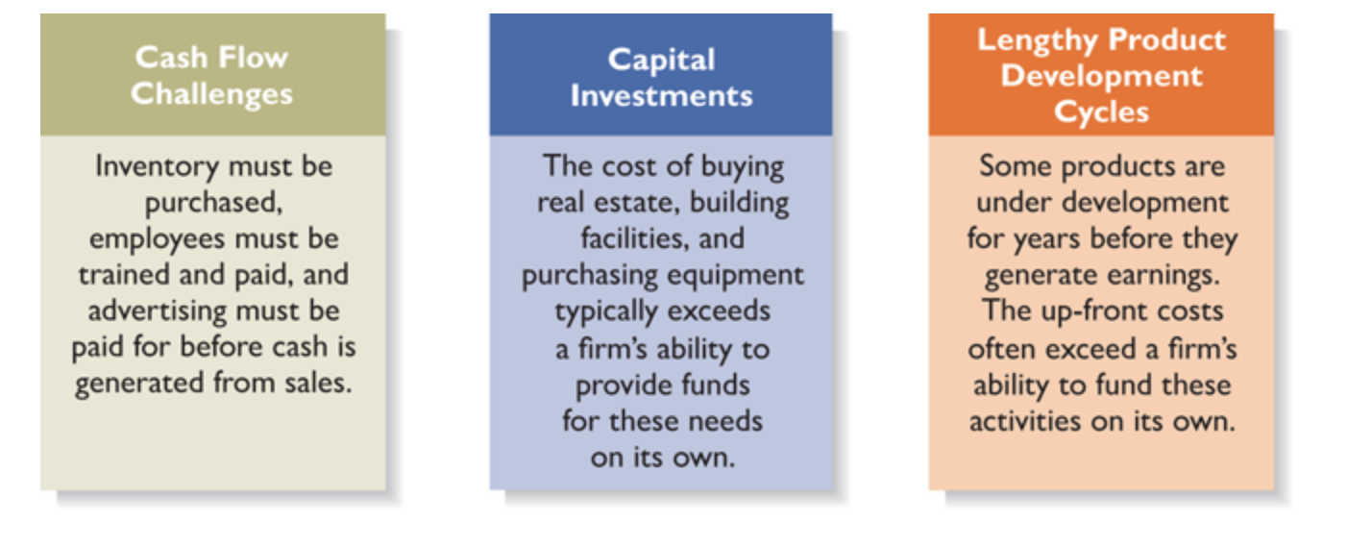
Chapter
Why Most New Ventures Need Funding
10
There are three reasons that most entrepreneurial ventures need to raise money during their early life.
www.midocean.ae

Slide 6
Chapter
Why Most New Ventures Need Funding
10
Cash Flow Challenges:
As a firm grows, it requires an increasing amount of cash to operate as the foundation for serving its customers.
  Often, equipment must be purchased and new employees hired and trained before the increased customer base generates additional income.
The lag between spending to generate revenue and earning income from the firm’s operations creates cash flow challenges, particularly for new, often small, ventures, as well as for ventures which are growing rapidly.
www.midocean.ae

Slide 7
Chapter
Why Most New Ventures Need Funding
10
Cash Flow Challenges:
A company’s burn rate is the rate at which it is spending its capital until it reaches profitability.
A firm usually fails if it burns through all of its capital before it becomes profitable.
To prevent their firms from running out of money, most entrepreneurs need investment capital from a bank to cover cash flow shortfalls until their firms can begin making money.
www.midocean.ae

Slide 8
Chapter
Why Most New Ventures Need Funding
10
Capital Investments:
Firms often need to raise money early on to fund capital investments. Although it may be possible for the venture’s founders to fund its initial activities, it becomes increasingly difficult for them to do so when it comes to buying property, constructing buildings, purchasing equipment, or investing in other capital projects.
www.midocean.ae

Slide 9
Chapter
Why Most New Ventures Need Funding
10
Lengthy Product Development Cycles:
In some industries, firms need to raise money to pay the up-front costs of lengthy product development cycles. For example, in the prescription drug industry, the path from the research lab to the patient takes an average of 10 years. This pace of product development requires substantial up-front investment before the anticipated payoff is realized.
www.midocean.ae

Slide 10
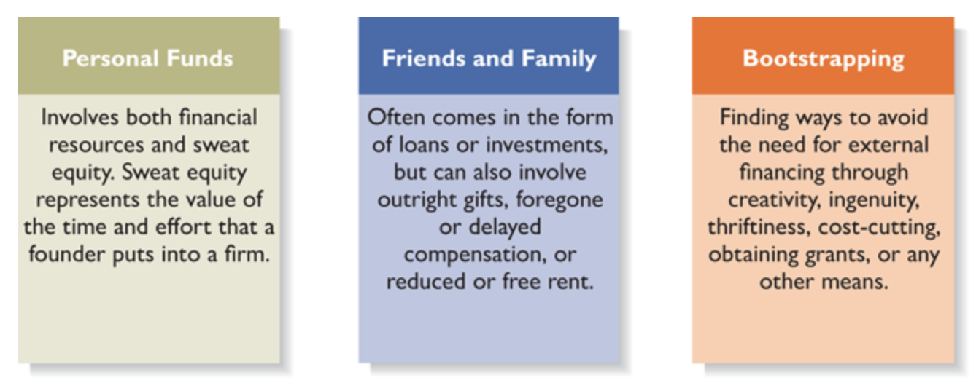
Chapter
Sources of Personal Financing
10
The seed money that gets a company off the ground comes from the founders’ own pockets. There are three categories of sources of money in this area:
www.midocean.ae

Slide 11
Chapter
Sources of Personal Financing
10
Personal Funds
The vast majority of founders contribute personal funds along with sweat equity to their ventures. In fact, according to data compiled by Fundable, 57 percent of start-ups are funded, at least in part, by the entrepreneurs’ personal savings and credit.
Sweat equity, which represents the value of the time and effort that a founder puts into a new venture, is also important. Because many founders do not have a substantial amount of cash to put into their ventures, it is often the sweat equity that makes the most difference.
www.midocean.ae

Slide 12
Chapter
Sources of Personal Financing
10
Friends and Family
This type of contribution often comes in the form of loans or investments, but can also involve outright gifts, foregone or delayed compensation, or reduced or free rent.
There are three rules of thumb that entrepreneurs should follow when asking friends and family members for money. First, the request should be presented in a businesslike manner, just as one would deal with a banker or investor.
Second, if the help the entrepreneur receives is in the form of a loan, a promissory note should be prepared, with a repayment schedule, and the note should be signed by both parties.
www.midocean.ae

Slide 13
Chapter
Sources of Personal Financing
10
Friends and Family
Third, financial help should be requested only from those who are in a legitimate position to offer assistance. It is not a good idea to ask certain friends or family members, regardless of how much they may have expressed a willingness to help, for assistance if losing the money would cripple them financially.
A promissory note details the terms of a loan agreement.
www.midocean.ae

Slide 14
Chapter
Sources of Personal Financing
10
Bootstrapping:
Bootstrapping is a third source of seed money for new ventures. Bootstrapping is finding ways to avoid the need for external financing or funding through creativity, cost-cutting, or any means necessary. It is the term attached to the general philosophy of minimizing start-up expenses by aggressively pursuing cost-cutting techniques and money-saving tactics.
There are many ways entrepreneurs bootstrap to raise money or cut costs. Examples include:
www.midocean.ae

Slide 15
Chapter
Sources of Personal Financing
10
Bootstrapping:
  Buy used instead of new equipment
  Coordinate purchases with other businesses
  Lease equipment instead of buying
  Avoid unnecessary expenses, such as lavish office space or furniture
  Buy items cheaply, but prudently, through discount outlets or online auctions
  Share office space or employees with other businesses
  Hire interns
www.midocean.ae

Slide 16
Chapter
Preparing to Raise Debt or Equity Financing
10
Once a start-up’s financial needs exceed what personal funds, friends and family, and bootstrapping can provide, debt and equity are the two most common sources of funds.
The most important thing an entrepreneur must do at this point is determine precisely what the company needs and the most appropriate source to use to obtain those funds.
A carefully planned approach to raising money increases a firm’s chance of success and can save an entrepreneur considerable time.
www.midocean.ae

Slide 17
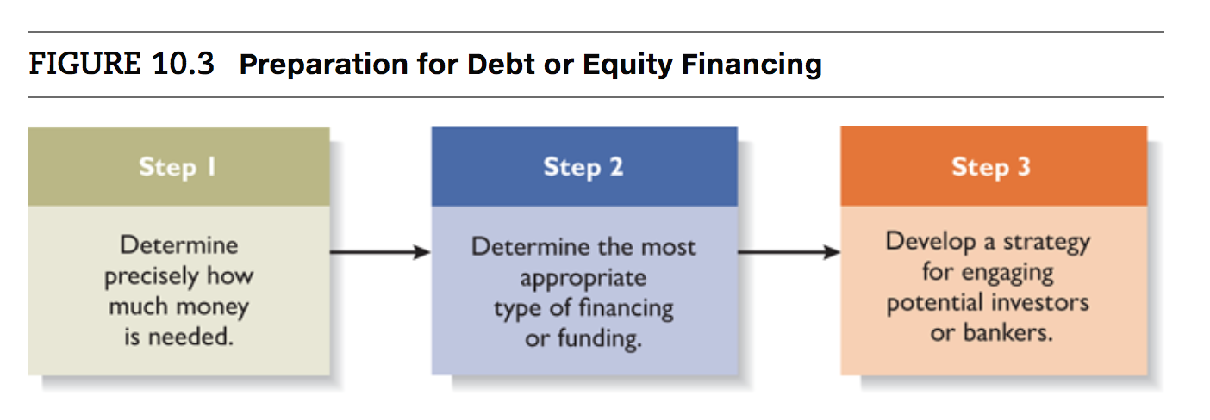
Chapter
Preparing to Raise Debt or Equity Financing
10
www.midocean.ae

Slide 18
Chapter
Preparing to Raise Debt or Equity Financing
10
Step 1: determine precisely how much money the company needs. Constructing and analyzing documented cash flow statements and projections for needed capital expenditures are actions taken to complete this step. This information should already be in the business plan.
Step 2: determine the most appropriate type of financing or funding. Equity and debt financing are the two most common alternatives for raising money. Equity financing means exchanging partial ownership of a firm, usually in the form of stock, in return for funding.
  Equity funding is not a loan—the money that is received is not paid back. Instead, equity investors become partial owners of the firm.
www.midocean.ae

Slide 19
Chapter
Preparing to Raise Debt or Equity Financing
10
  Equity investors have a 3- to 5-year investment horizon and expect to get their money back, along with a substantial capital gain, through the sale of their stock.
  Debt financing is getting a loan. The most common sources of debt financing are commercial banks that lend money that must be repaid with interest. Bankers are interested in minimizing risk, properly collateralizing loans, and repayment. The ideal candidate for a bank loan is a firm with a strong cash flow, audited financial statements, and a healthy balance sheet. Hence, it is difficult for start-ups to receive bank loans. Most start-ups are simply too early in their life cycle to have the set of characteristics bankers want.
www.midocean.ae

Slide 20
Chapter
Preparing to Raise Debt or Equity Financing
10
  Step 3: developing a strategy for engaging potential investors or bankers. There are three steps to developing a strategy for engaging potential investors or bankers. First, the lead entrepreneurs in a new venture should prepare an elevator speech (or pitch)—a brief, carefully constructed statement that outlines the merits of a business opportunity. Most elevator speeches are 45 seconds to 2 minutes long.
  There are many occasions when a carefully constructed elevator speech might come in handy. For example, university-sponsored centers for entrepreneurship hold events that bring investors and entrepreneurs together.
www.midocean.ae

Slide 21
Chapter
Preparing to Raise Debt or Equity Financing
10
  The second step in developing a strategy for engaging potential investors or bankers is more deliberate and requires identifying and contacting the best prospects.
  The third step in engaging potential investors or bankers is to be prepared to provide the investor or banker a completed business plan and make a presentation of the plan if requested.
www.midocean.ae

Slide 22
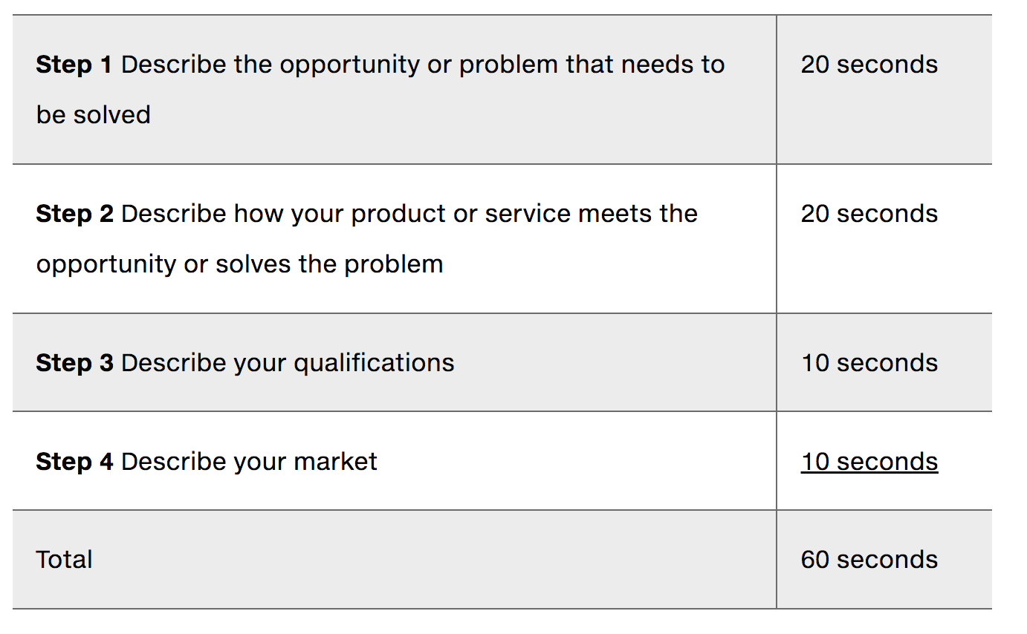
Chapter
Preparing to Raise Debt or Equity Financing
10
Guidelines for Preparing an Elevator Speech
www.midocean.ae

Slide 23
Chapter
Sources of Equity Funding
10
  The primary disadvantage of equity funding is that the firm’s owners relinquish part of their ownership interest and may lose some control.
  The primary advantage is access to capital.
  In addition, because investors become partial owners of the firms in which they invest, they often try to help those firms by offering their expertise and assistance.
  Unlike a loan, the money received from an equity investor doesn’t have to be paid back. The investor receives a return on the investment through dividend payments and by selling the stock.
  Next, we describe the three most common forms of equity funding.
www.midocean.ae

Slide 24
Chapter
Sources of Equity Funding
10
  Business Angels:
  Business angels are individuals who invest their personal capital directly in start-ups. The prototypical business angel, who invests in entrepreneurial start-ups, is about 50 years old, has high income and wealth, is well educated, has succeeded as an entrepreneur, and invests in companies that are in the region where he or she lives.
  These investors generally invest between $10,000 and $500,000 in a single company and are looking for companies that have the potential to grow 30 to 40 percent per year before they are acquired or go public.
www.midocean.ae

Slide 25
Chapter
Sources of Equity Funding
10
  Business Angels:
  Many well-known firms have received their initial funding from one or more business angels. For example, Apple received its initial investment capital from Mike Markkula, who obtained his wealth as an executive with Intel. In 1977, Markkula invested $91,000 in Apple and personally guaranteed another $250,000 in credit lines. When Apple went public in 1980, his stock in the company was worth more than $150 million.
www.midocean.ae

Slide 26
Chapter
Sources of Equity Funding
10
  Business Angels:
  Business angels are valuable because of their willingness to make relatively small investments. This gives access to equity funding to a start-up that needs minimal investments starting $10,000.
  Many angels are also motivated by more than financial returns; they enjoy the process of mentoring a new firm. Most angels remain fairly anonymous and are matched with entrepreneurs through referrals. To find a business angel investor, an entrepreneur should discreetly work a network of acquaintances to see if anyone can make an appropriate introduction.
www.midocean.ae

Slide 27
Chapter
Sources of Equity Funding
10
  Venture Capital:
  Venture capital is money that is invested by venture capital firms in start-ups and small businesses with exceptional growth potential.
  A distinct difference between angel investors and venture capital firms is that angels tend to invest earlier in the life of a company, whereas venture capitalists come in later. The majority of venture capital money goes to follow-on funding for businesses that were originally funded by angel investors.
www.midocean.ae

Slide 28
Chapter
Sources of Equity Funding
10
  Venture Capital:
  Venture capital firms are limited partnerships of money managers who raise money in “funds” to invest in start-ups and growing firms. The funds, or pools of money, are raised from high-net-worth individuals, pension plans, university endowments, foreign investors, and similar sources. In 2015, the average fund size was $135 million.
  Some venture capital firms invest in specific areas. For example, Foundry Group invests in information technology start-ups.
www.midocean.ae

Slide 29
Chapter
Sources of Equity Funding
10
  Venture Capital:
  Because of the venture capital industry’s lucrative nature and because in the past venture capitalists have funded high-profile successes such as Google, and Facebook, the industry receives a great deal of attention. But actually, venture capitalists fund less than 1 percent of new firms.
  Many entrepreneurs become discouraged when they are rejected for venture capital funding, even though they may have an excellent business plan.
  An advantage to obtaining this funding is that venture capitalists are extremely well connected in the business world and can offer a firm considerable assistance beyond funding.
www.midocean.ae

Slide 30
Chapter
Sources of Equity Funding
10
  Initial Public Offering:
  Another source of equity funding is to sell stock to the public by staging an initial public offering (IPO). An IPO is the first sale of stock by a firm to the public.
  When a company goes public, its stock is typically traded on one of the major stock exchanges.
  An IPO is an important milestone for a firm. Typically, a firm is not able to go public until it has demonstrated that it is viable and has a bright future.
www.midocean.ae

Slide 31
Chapter
Sources of Equity Funding
10
  Initial Public Offering:
  Firms decide to go public for several reasons.
    First, it is a way to raise equity capital to fund current and future operations.
    Second, an IPO raises a firm’s public profile, making it easier to attract high-quality customers, alliance partners, and employees.
    Third, an IPO is a liquidity event that provides a mechanism for the company’s stockholders, including its investors, to cash out their investments.
www.midocean.ae

Slide 32
Chapter
Sources of Debt Financing
10
  The main advantage to obtaining a loan as opposed to equity funding is that none of the ownership of the firm is surrendered.
  There are two major disadvantages of getting a loan:
    Loans must be repaid, which may be difficult in a start-up venture.
    Lenders often impose strict conditions on loans and insist on ample collateral to fully protect their investment.
www.midocean.ae

Slide 33
Chapter
Sources of Debt Financing
10
  Commercial Banks:
  Banks are interested in firms that have a strong cash flow, audited financials, good management, and a healthy balance sheet. Although many new ventures have good management, few have the other characteristics initially.
  Two reasons that make banks reluctant to lend money to start-ups:
    Banks are risk averse, have internal controls and regulatory restrictions prohibiting them from making high-risk loans.
    Lending to small firms is not as profitable as lending to large firms, which have been the staple clients of commercial banks.
www.midocean.ae

Slide 34
Chapter
Sources of Debt Financing
10
  Online Lenders: There is a group of online lenders, including OnDeck, Kabbage, and BlueVine that provide loans to businesses. Depending on the company, loans are available from $2,000 to $2 million. Interest rates are normally higher than those charged by a commercial bank.
  Peer-to-peer lenders underwrite borrowers but don’t fund the loans directly. Instead, they act as intermediaries between borrowers and individuals or borrowers and institutional investors. Funding Circle, Lending Club, and StreetShares are examples of peer-to-peer lenders. Similar to online lenders, the thing to watch out for when considering peer-to-peer loans is the annual percentage rate, which in many cases is very high.
www.midocean.ae

Slide 35


Thank You

